Slide 1
C-space and RRTs
Dr. Troi Williams
Slide Credits: Pratap Tokekar

Slide 2
Note
Extra Lab days on Tuesday, March 10th and Thursday, March 12th.

Slide 3
Configuration
A configuration is a complete specification of every point of the robot
C-space is the space of all possible configurations
Some examples:
a point robot that can translate in 2D:
a robot that can rotate and translate:
a two link manipulator:

Slide 4
Solution v2
Randomly pick a sample configuration, x_{i}
Check if q_{i} is collision-free
If q_{i} is in C_{free} then add it to the graph
add edges to existing vertices (more details later)
If q_{i} is not in C_{free}, then discard it
Check if we have found a path, else repeat

Slide 5
Rapidly Exploring Dense Trees (RDTs)
One of the most popular techniques
Introduced by LaValle in ‘98
many, many, many extensions and variants
Ch 5.5, 5.6, 14.4
http://planning.cs.uiuc.edu

Slide 6
RDTs vs RRTs vs PRMs
Many versions of the same idea
with different guarantees
Rapidly exploring Random Trees
randomly sample the C-space
graph built will be a tree
Rapidly exploring Dense Trees
any sequence of samples (not necessarily random)
Probabilistic Roadmaps
build a general graph (roadmap) instead of a tree
useful for multiple queries with diff. start and goals

Slide 7
And many, many variants
articulated robots
kinematics, dynamics, differential constraints
http://msl.cs.uiuc.edu/rrt/gallery.html (circa 2000)

Slide 8
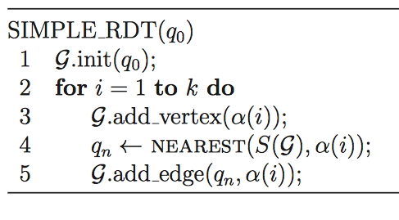
starting configuration
sampled config.
nearest point on the tree

Slide 9
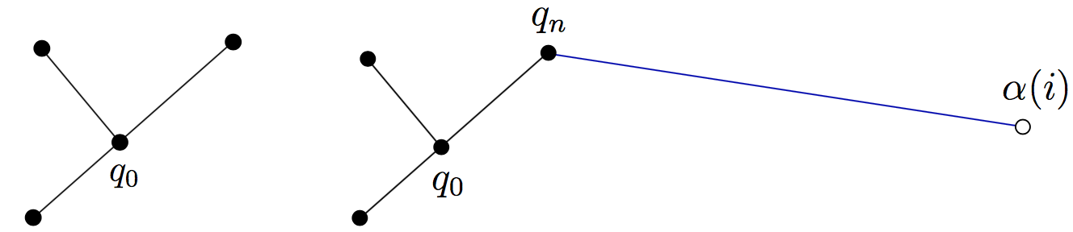
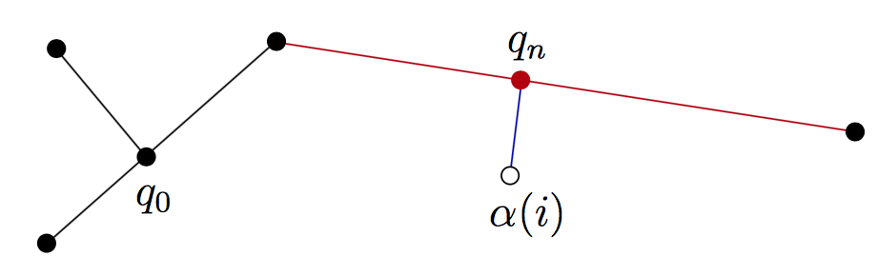
assume no obstacles
if nearest point lies on an existing edge, then split that edge

Slide 10
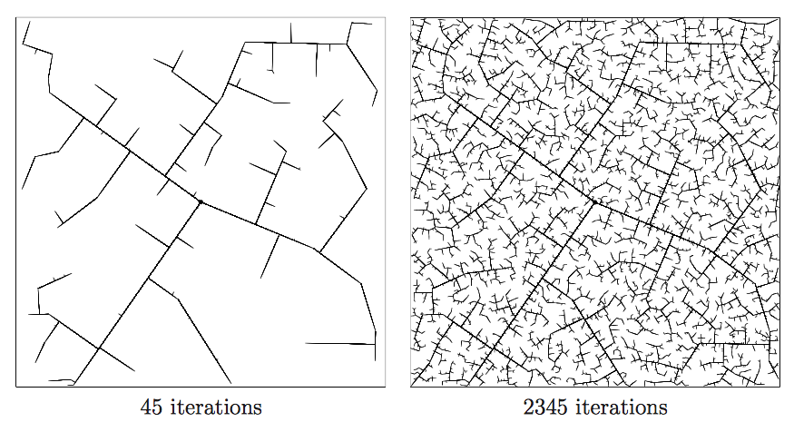
recall that there is no parameter involved

Slide 11
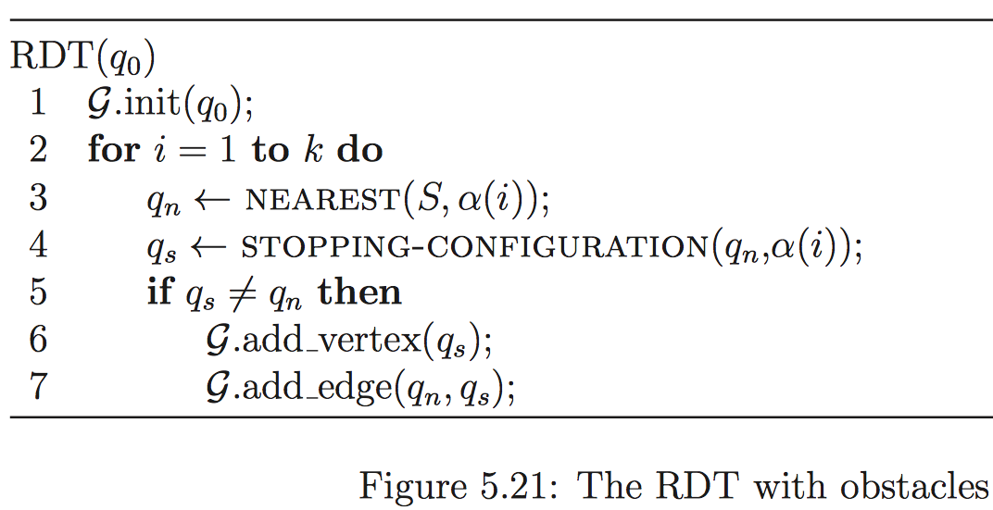
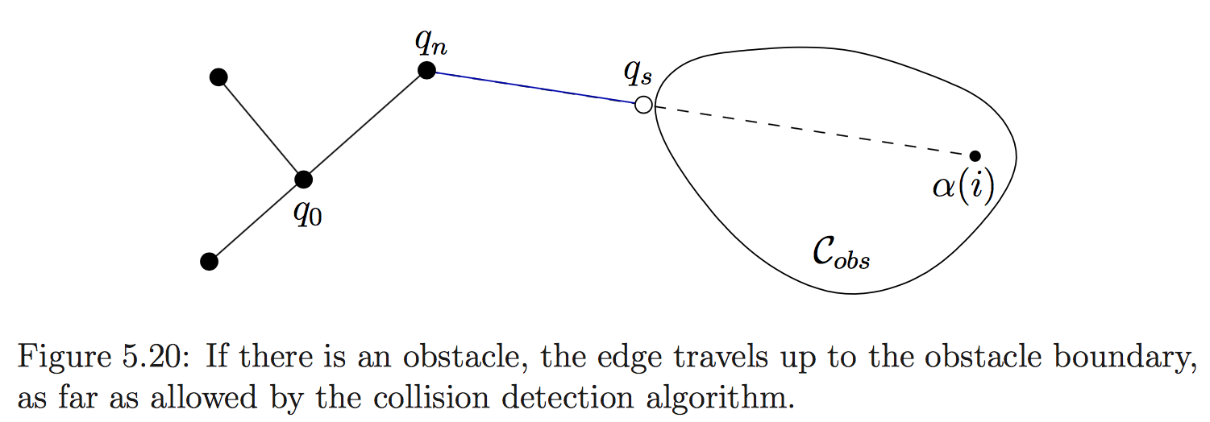

Slide 12
What about the goal?
So far, RDT is only building a tree
Occasionally add the goal configuration and see if it gets connected to the tree
say every 100th iteration

Slide 13
Remember
We are in the C-space
A vertex in the graph is a specific configuration
How to find the nearest configuration?
What is the distance function?

Slide 14
Distances in C-space
The C-space is not necessarily Euclidean space
Need to define appropriate distances
e.g., distance along a circle for 1-link manipulator
e.g., distance along the surface of the torus for a 2-link manipulator

Slide 15
Distances in C-space
The C-space is not necessarily Euclidean space
Need to define appropriate distances
Each edge represents a path in C-space
An edge means that there is a collision-free path between two configurations

Slide 16
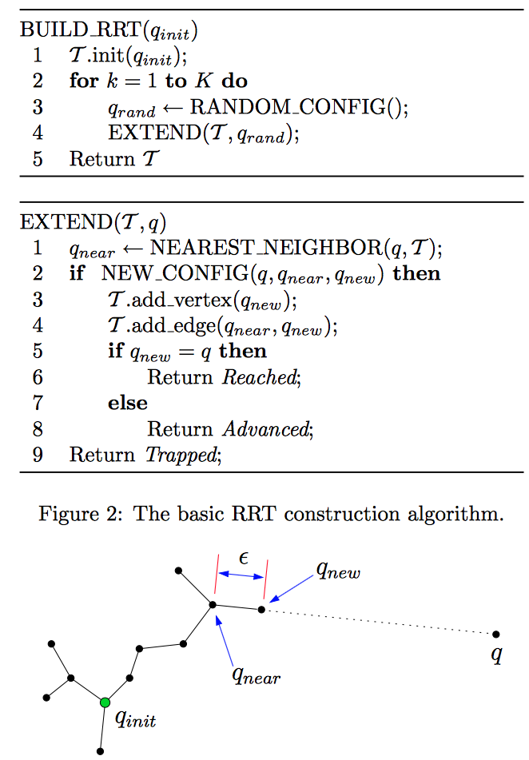
Practical Solutions
Use a step size parameter
Move in steps and check collision of a configuration
Often, a local steering function is used instead*
* more details later
https://personalrobotics.ri.cmu.edu/files/courses/papers/Kuffner00-rrtconnect.pdf

Slide 17
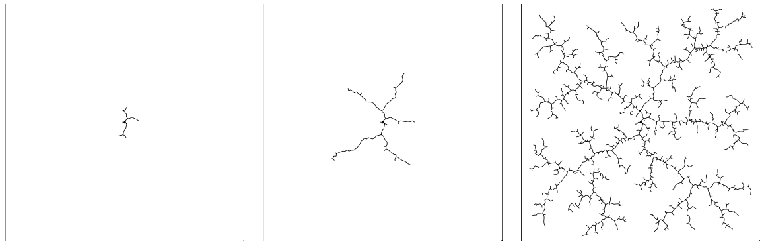
Tree “grows” from the start config. due to step size parameter
without step size
with step size
Notes:
with

Slide 18
Demo
run_rrt.py
Change DELTA and observe the effect on the running time and path length

Slide 19
Guarantees?
Is RRT complete?
No but it is probabilistically complete – if there exists a path, the probability that RRT will not find the path decays to zero as the number of samples approaches infinity.
Is RRT optimal? No
“… the probability that the RRT converges to an optimum solution, as the number of samples approaches infinity, is zero under some reasonable technical assumptions.”
RRT* is optimal

Slide 20
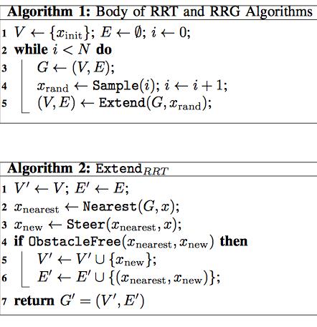
RRT*
TL;DR: Samples a point, try to connect it to the tree via the Extend function, then repeat.
Result: a tree that incrementally approximates the reachable space.
TL;DR: (Vanilla RRT extension–it is not optimal).
Adds a new node to the graph if the node is collision-free.
https://arxiv.org/pdf/1005.0416.pdf

Slide 21
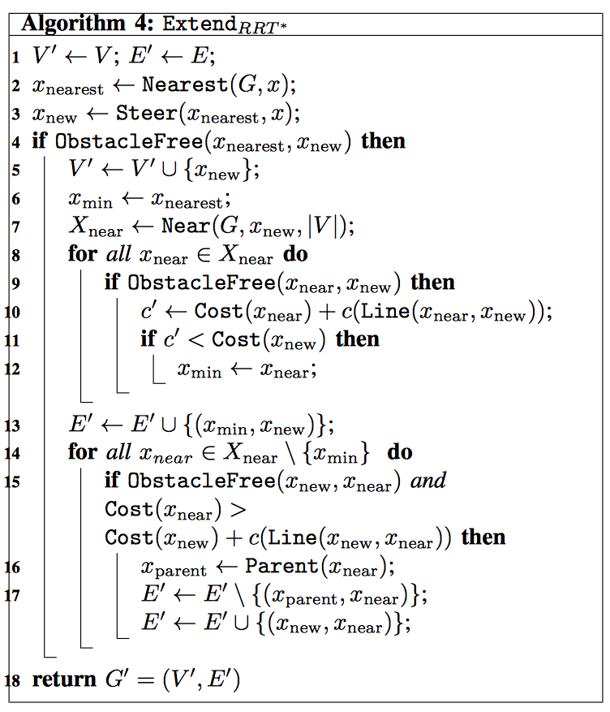




RRT*
Same steps as before.
TL;DR: RRT extension that rewires for optimality.
First Loop: Picks the cheapest way to insert the new node.
Second Loop: See if the new node can make any of its neighbors cheaper and rewire them.
https://arxiv.org/pdf/1005.0416.pdf

Slide 22
RRT*
https://arxiv.org/pdf/1005.0416.pdf

Slide 23
Why are RRTs so popular?
Once you define the C-space and implement following subroutines, the actual algorithm is very simple:
random configuration generator
nearest neighbor
collision checker
In practice, it works rather well.
Can add heuristics on top, e.g., bias the random config. generator towards goal configuration

Slide 24
EXTEND() is the real crux
EXTEND() takes the tree and extends it closer to the given random configuration
We saw the Euclidean case where the extension is a straight line
In general, kinematic (and dynamic) constraints can be handled within EXTEND()

Slide 25
Example: car-like robot
Configuration is ??

Slide 26
Example: car-like robot
Configuration is (x,y,𝜽)
Robot can’t slide sideways
Suppose q = (0,0,90°) and q_{near} = (1,0,90°)
Can we draw an edge?
Solving for a feasible path from q to q_{near} is as hard as the original problem

Slide 27
Example: car-like robot
Solving for a feasible path from q to q_{near} is as hard as the original problem
Does not matter
Just apply a random or best control input for a fixed time to obtain q_{new} in NEW_CONFIG()

Slide 28
Practical Matters
Configuration space
OMPL: ompl.kavrakilab.org/
Nearest neighbor search in high dimensions
FLANN: https://www.cs.ubc.ca/research/flann/
Collision Checking
FCL: https://github.com/flexible-collision-library/fcl
Integration with sensors and ROS
MoveIt! https://moveit.ros.org

Slide 29
Try it out
Install OMPL.app on your machine
https://www.youtube.com/watch?v=EsXM4VLWxkE

Slide 30
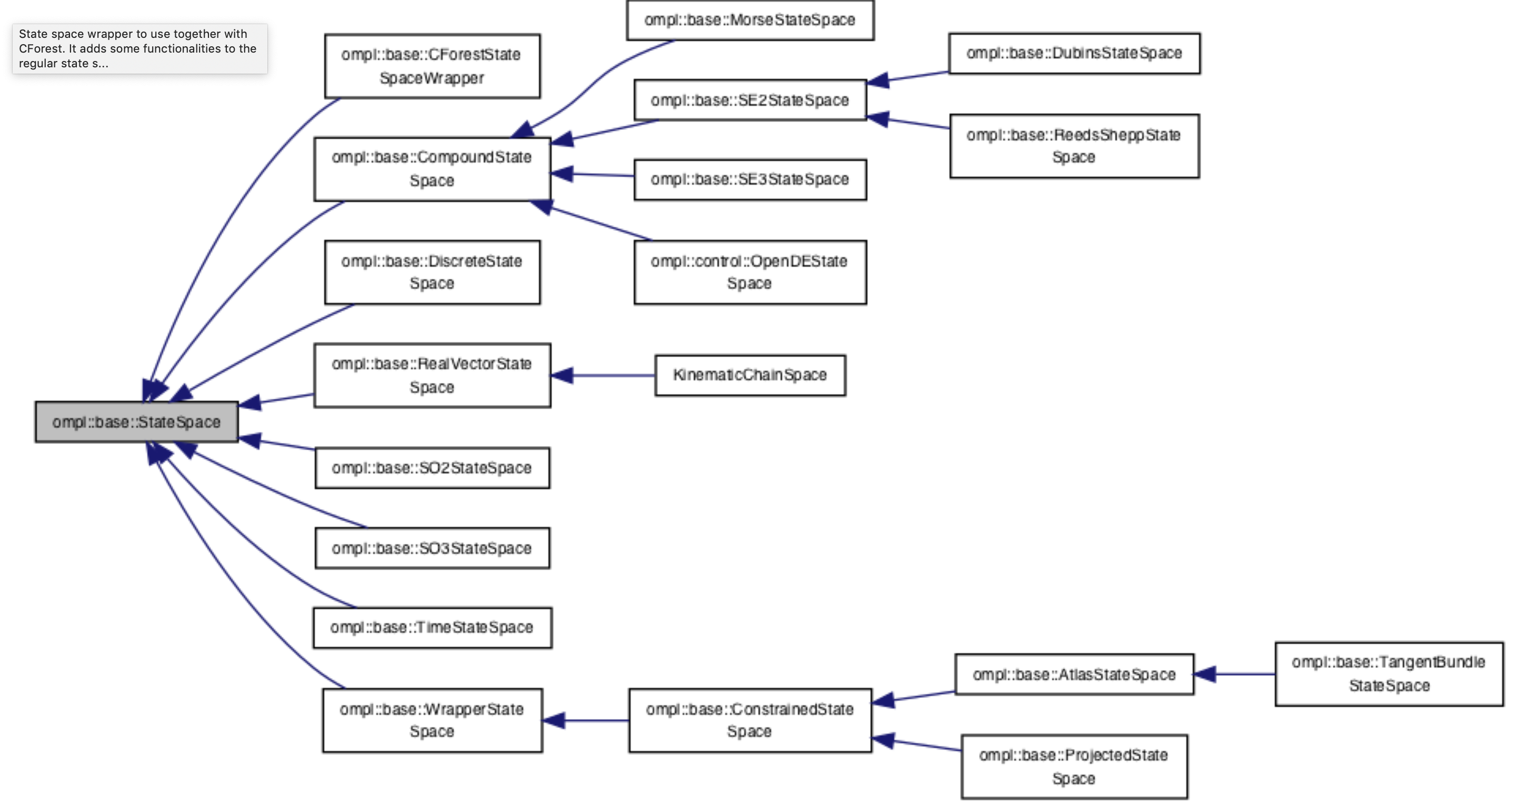
Configuration space (OMPL)
Most commonly used ones are already defined
Car-like robots
2D/3D translation + rotation
2D/3D rotations

Slide 31
Combine spaces
For example, to get the state space of a manipulator arm one could combine R⁵ and SO2 (circle) to represent 5 joints that have bounds and one joint that can rotate continuously
*OMPL calls configuration space as state space

Slide 32
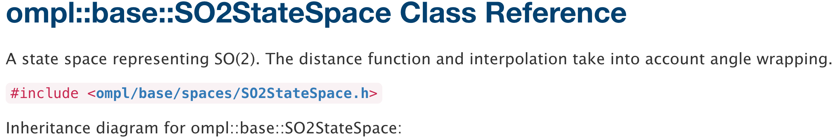
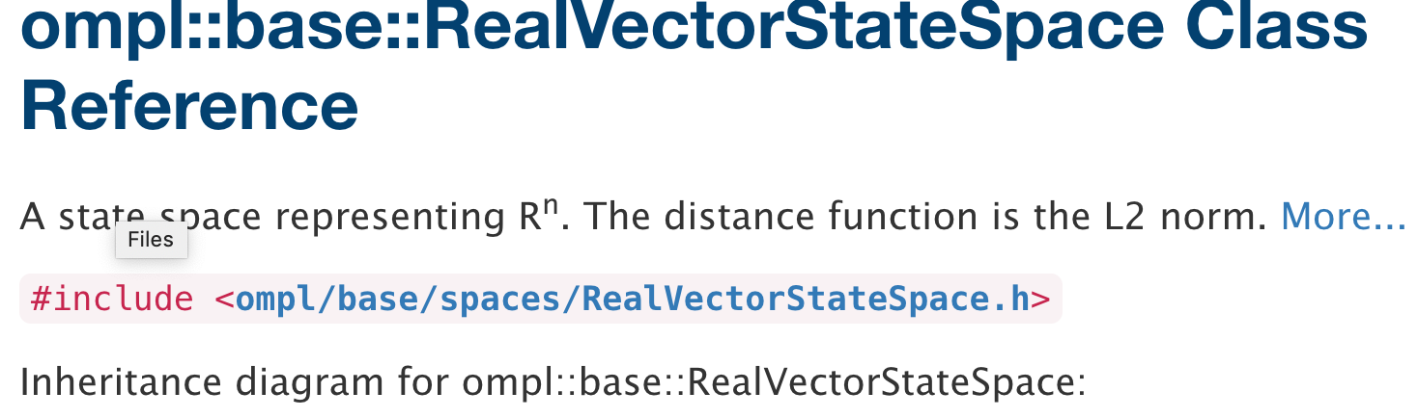
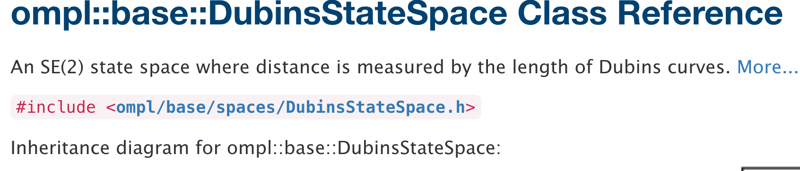
Distance function
To compute nearest neighbors using FLANN
Already implemented for common spaces

Slide 33
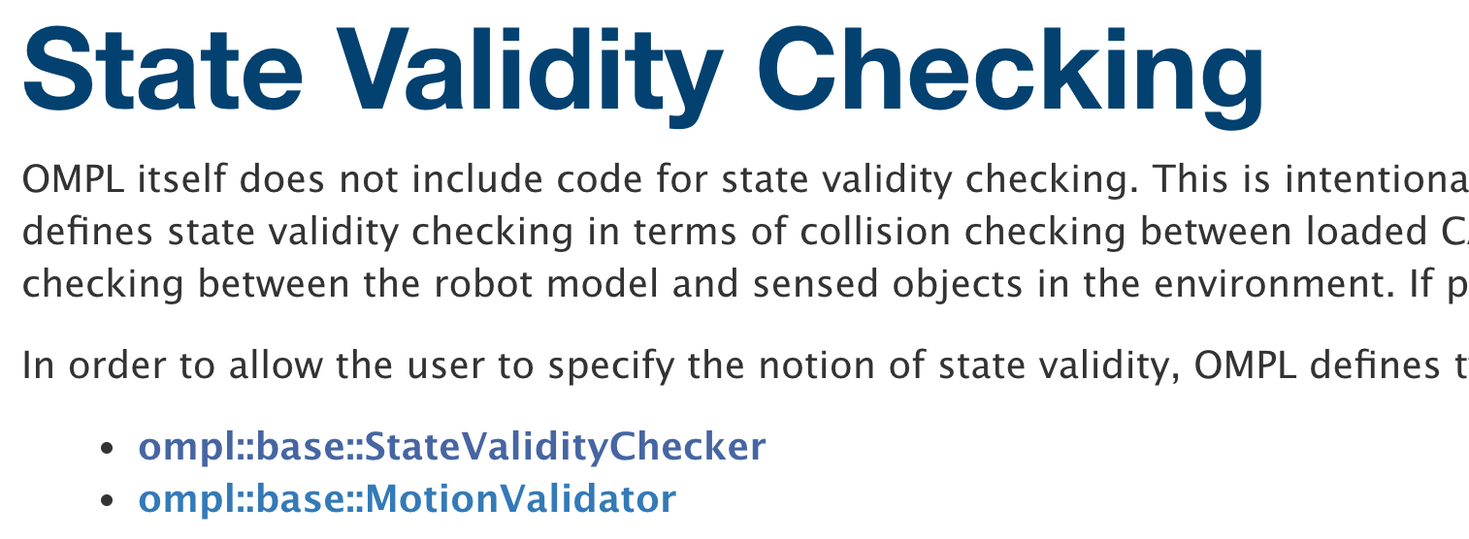
Collision Checking
OMPL doesn’t do collision checking
Instead, you can choose to use any existing collision checker --- commonly used one is FCL

Slide 34
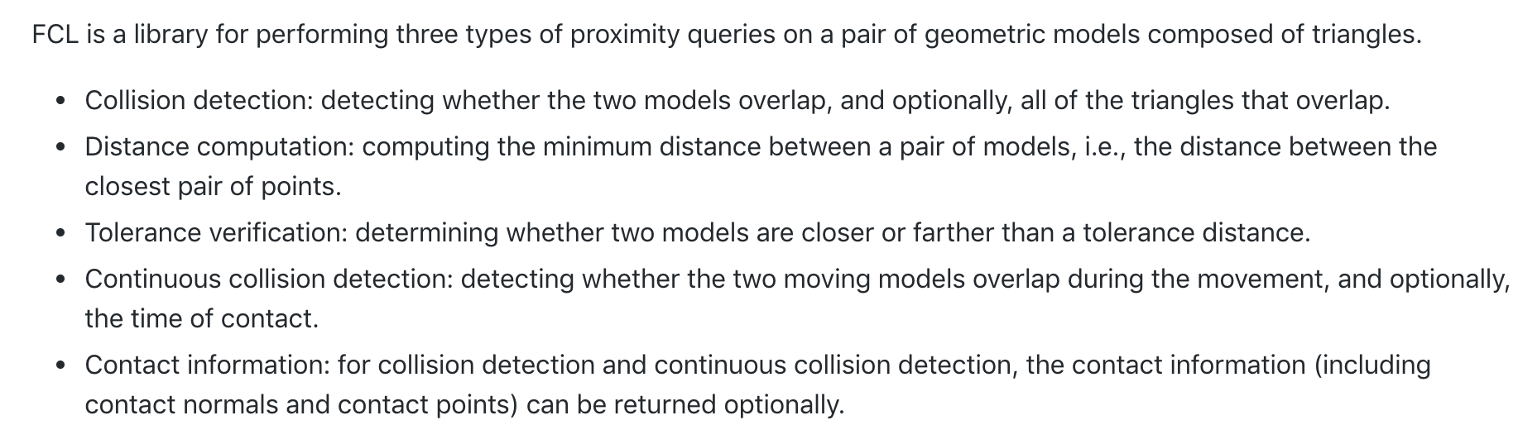
Collision Checking – FCL
Normally, instead of using FCL directly, you should use it through ROS (with the MoveIt! Package)

Slide 35
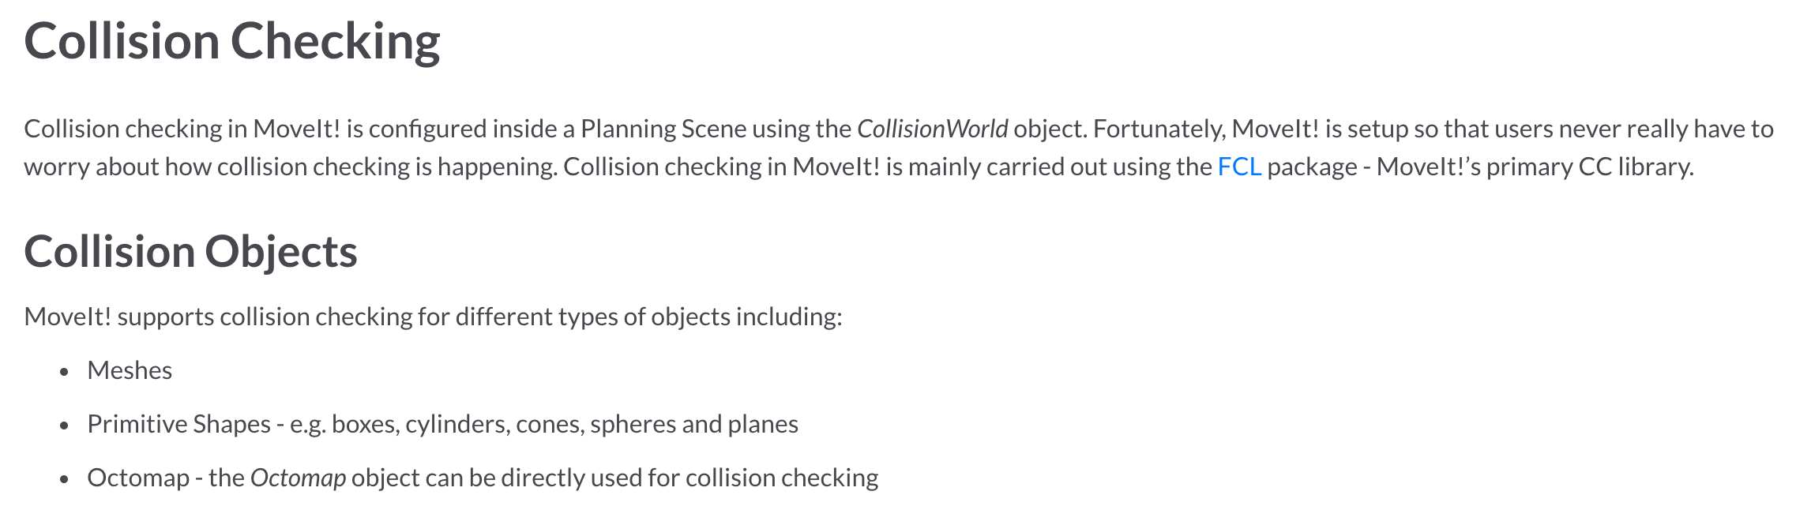
Collision checking – MoveIt!

