Slide 1
C-space and RRTs
Dr. Troi Williams
Slide Credits: Pratap Tokekar

Slide 2
Note
Extra Lab days on Tuesday, March 10th and Thursday, March 12th.

Slide 3
Textbooks
Ch 6.2, 6.3.2-6.3.3, 4.3.2
(with slides and figures from S. Leonard, G. Hager and H. Choset)
http://planning.cs.uiuc.edu

Slide 4
Overview
We’ve seen graph-based planning algorithms
BFS, DFS, Dijkstra/UCS, A*
What (unrealistic) assumptions have we made?

Slide 5
Overview
 | Input | Actions | Observations
BFS/DFS, Dijkstra, A* | graph + costs | no uncertainty | no uncertainty
RRTs | coordinates of obstacles | no uncertainty | no uncertainty
Point robot
Arbitrary shape

Slide 6
Today’s Lecture
It’s easier to plan assuming that the robot is a point
Point robot = robot on a graph vertex
Key idea: how to take an arbitrarily shaped robot and still solve a “point robot on a graph” planning problem

Slide 7
Configuration
A configuration is a complete specification of every point of the robot
C-space is the space of all possible configurations
Some examples:
a point robot that can translate in 2D:

Slide 8
Configuration
A configuration is a complete specification of every point of the robot
C-space is the space of all possible configurations
Some examples:
a point robot that can translate in 2D:
a robot that can rotate and translate: what would this be?
a two-link manipulator: what would this be?

Slide 9
Configuration
A configuration is a complete specification of every point of the robot
C-space is the space of all possible configurations
Some examples:
a point robot that can translate in 2D:
a robot that can rotate and translate:
a two-link manipulator:

Slide 10
Demo
one_link_manipulator.py

Slide 11
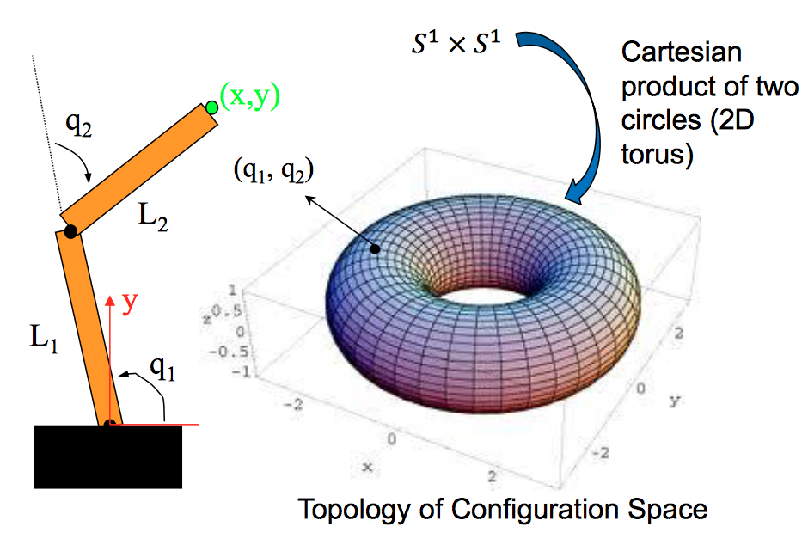
Two Link Manipulator

Slide 12
Two Link Manipulator
Why does the Cartesian product of two circles create a donut?

Slide 13
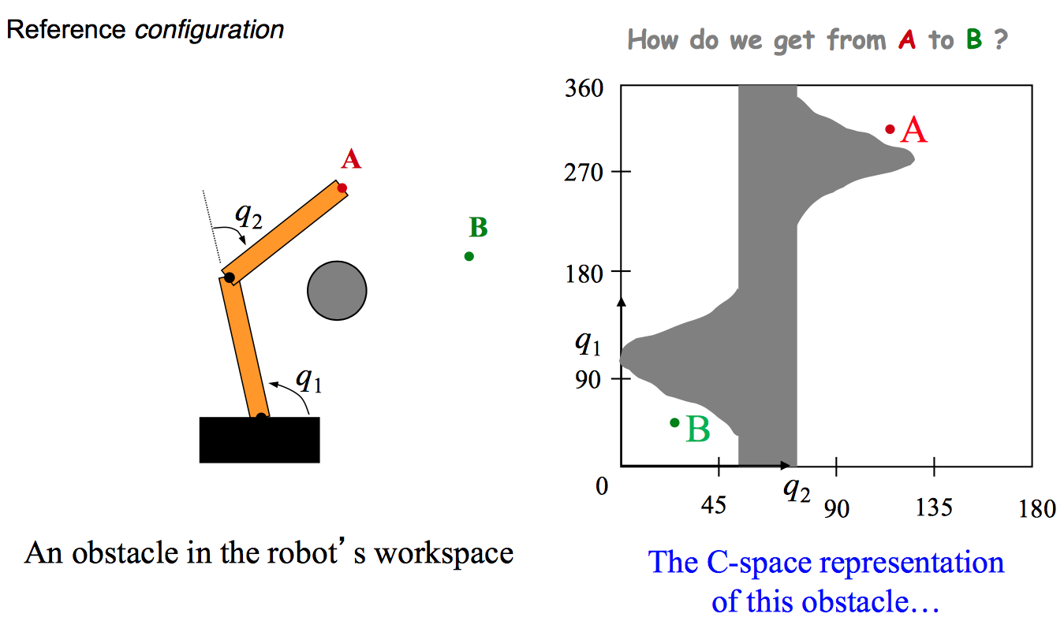
C-space Obstacles

Slide 14
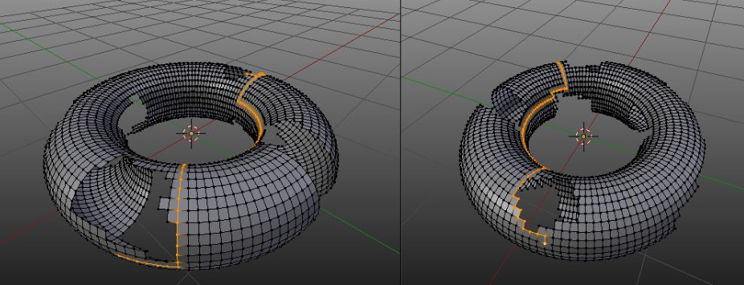
Punching holes in the donut
We plan for shortest paths in the C-space and not in the workspace.
Naïve idea: draw a grid in the C-space
No vertices/edges inside C-space obstacles

Slide 15
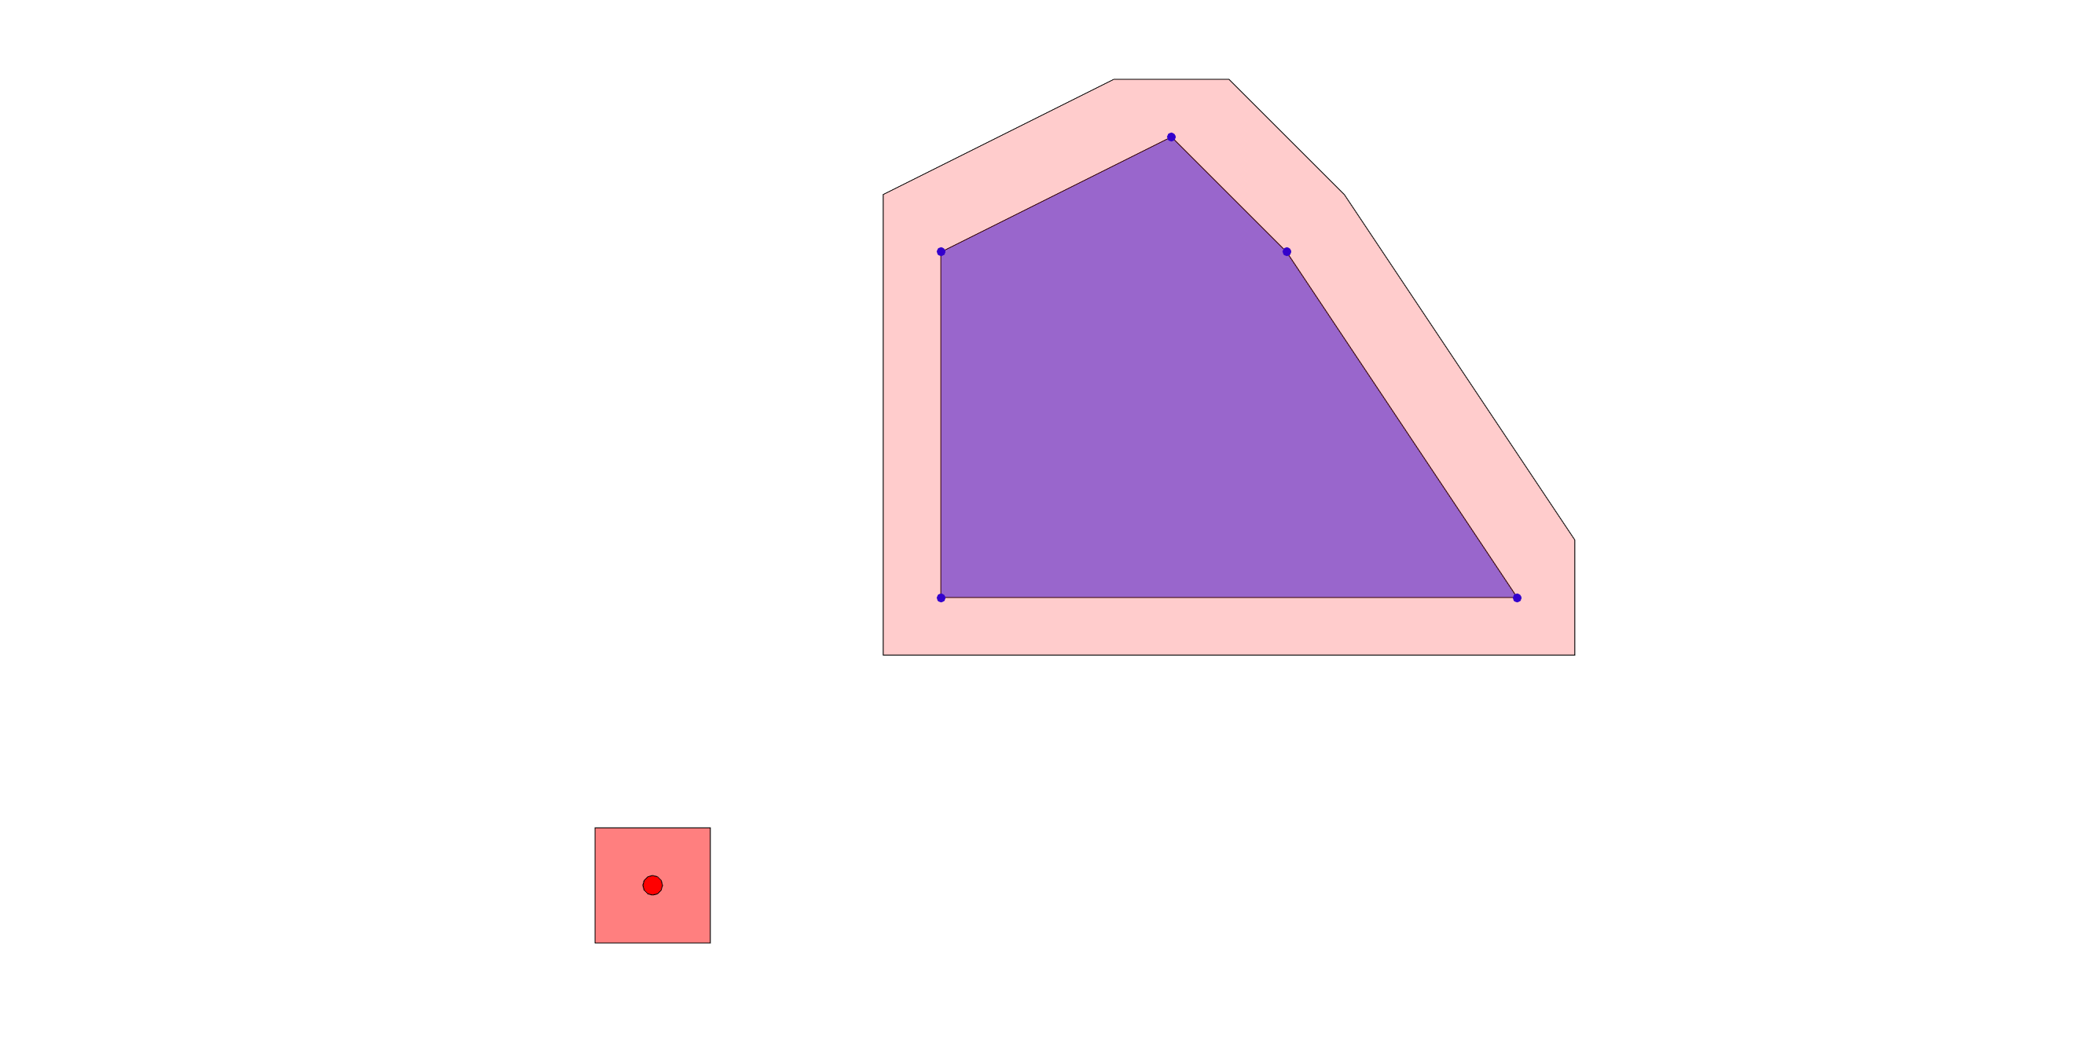
2D robot that can only translate
If robot and obstacles are both polygonal, we can compute C-space obstacles by taking Minkowski difference
C-space obstacle
workspace obstacle
square robot

Slide 16
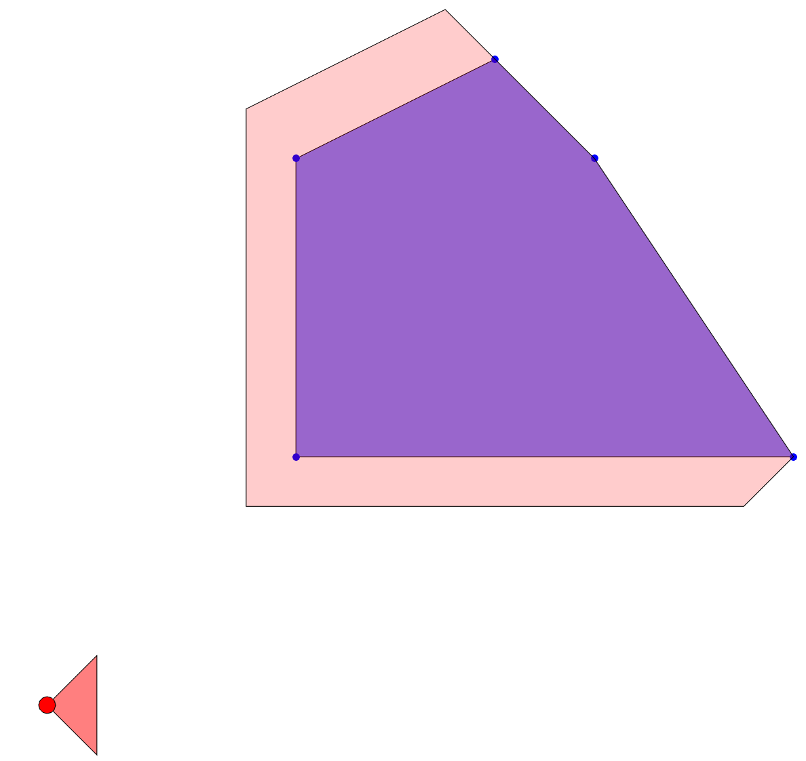
Non-Symmetric Robots
If the robot is not symmetric about the origin, we should take the Minkowski difference and not the sum!
That is “flip” the robot and then take Minkowski sum
=

Slide 17
Demo
minkowski.py
Square robot
Triangular robot

Slide 18
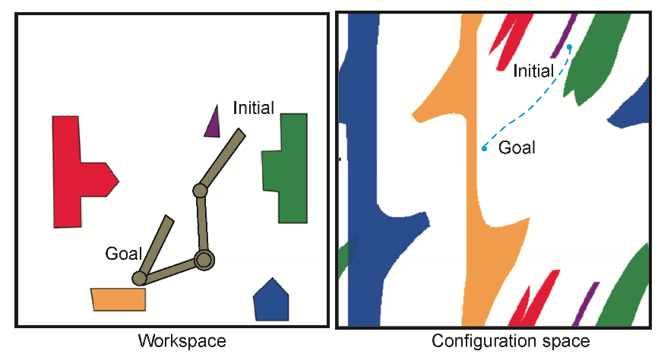
C-space obstacles can become complicated quickly!
[Pan and Manocha, ‘15]
Computing exact C-space obstacles is challenging.

Slide 19
Path Planning in C-space
From now on, we will be planning paths in C-space (not just in the robot workspace)
The challenge is even describing the exact shape of the C-space obstacles is difficult
Any ideas on how to solve the problem?

Slide 20
Solution v1
Idea: checking whether a specific configuration is in collision is easier
Let’s assume we have a fast collision checker
black-box for now
Don’t construct the C-space obstacles
Discretize the C-space
For each vertex, check if it is in collision, else add it to the graph

Slide 21
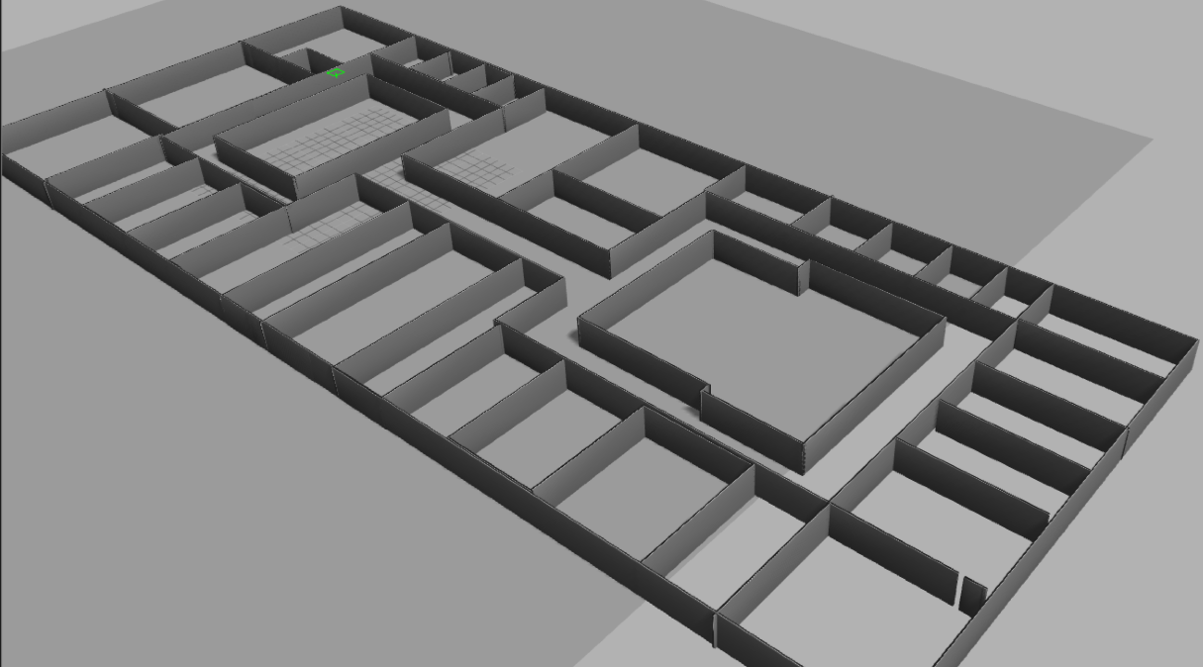
Discretizing the C-space
What is a good grid resolution? Too small and we may miss solutions, too large makes it computationally expensive.
start
goal
goal
start

Slide 22
Discretizing the C-space
What is a good grid size? Too small and we may miss solutions, too large makes it computationally expensive.
start
goal
goal
start

Slide 23
Discretizing the C-space
Recall that we are planning in the C-space and not the workspace
The robot is a point in C-space
C-space can be very complex and have “narrow openings”
Finding one path, let alone, the optimal path is challenging

Slide 24
Solution v2
Idea v1 was to fix a grid graph
Instead, let’s create a (non-grid) graph
Idea v2: Design a scheme that produces sequences of discrete samples, q_{i}, in the C-space
How?
Just random

Slide 25
Solution v2
Randomly pick a sample configuration, x_{i}
Check if q_{i} is collision-free
If q_{i} is in C_{free} then add it to the graph
add edges to existing vertices (more details later)
If q_{i} is not in C_{free}, then discard it
Check if we have found a path, else repeat

Slide 26
Rapidly Exploring Dense Trees (RDTs)
One of the most popular techniques
Introduced by LaValle in ‘98
many, many, many extensions and variants
Ch 5.5, 5.6, 14.4
http://planning.cs.uiuc.edu

Slide 27
RDTs vs RRTs vs PRMs
Many versions of the same idea
with different guarantees
Rapidly exploring Random Trees
randomly sample the C-space
graph built will be a tree
Rapidly exploring Dense Trees
any sequence of samples (not necessarily random)
Probabilistic Roadmaps
build a general graph (roadmap) instead of a tree
useful for multiple queries with diff. start and goals

Slide 28
And many, many variants
articulated robots
kinematics, dynamics, differential constraints
http://msl.cs.uiuc.edu/rrt/gallery.html (circa 2000)

Slide 29
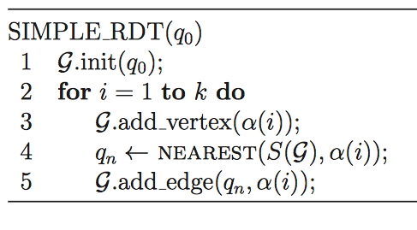
starting configuration
sampled config.
nearest point on the tree

Slide 30
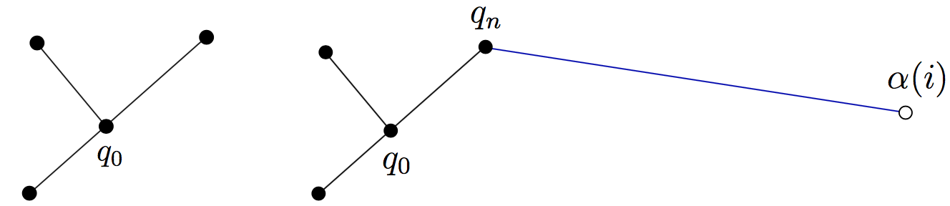
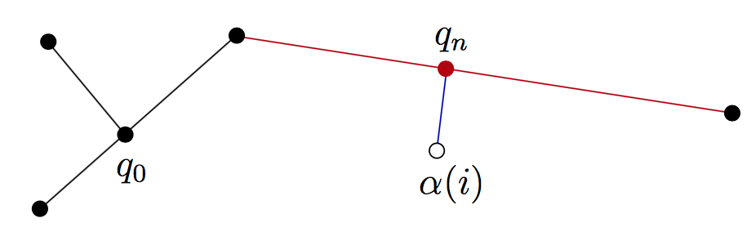
assume no obstacles
if nearest point lies on an existing edge, then split that edge

Slide 31
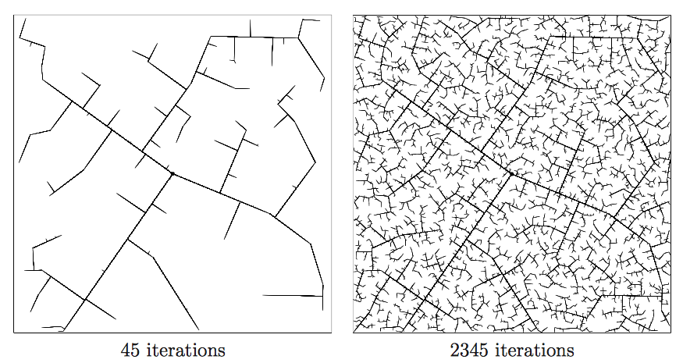
recall that there is no parameter involved

Slide 32
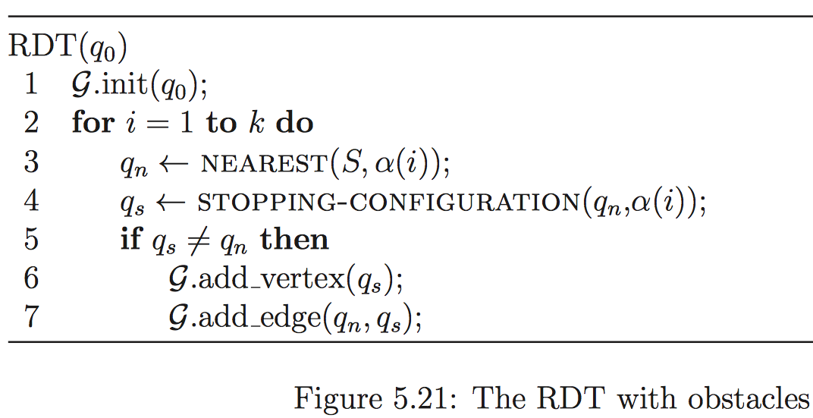
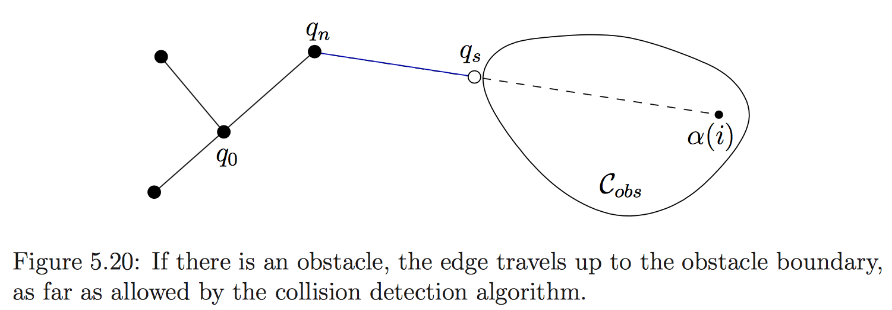

Slide 33
What about the goal?
So far, RDT is only building a tree
Occasionally add the goal configuration and see if it gets connected to the tree
say every 100th iteration

Slide 34
Remember
We are in the C-space
A vertex in the graph is a specific configuration
How to find the nearest configuration?
What is the distance function?

Slide 35
Distances in C-space
The C-space is not necessarily Euclidean space
Need to define appropriate distances
e.g., distance along a circle for 1-link manipulator
e.g., distance along the surface of the torus for a 2-link manipulator

Slide 36
Distances in C-space
The C-space is not necessarily Euclidean space
Need to define appropriate distances
Each edge represents a path in C-space
An edge means that there is a collision-free path between two configurations

Slide 37
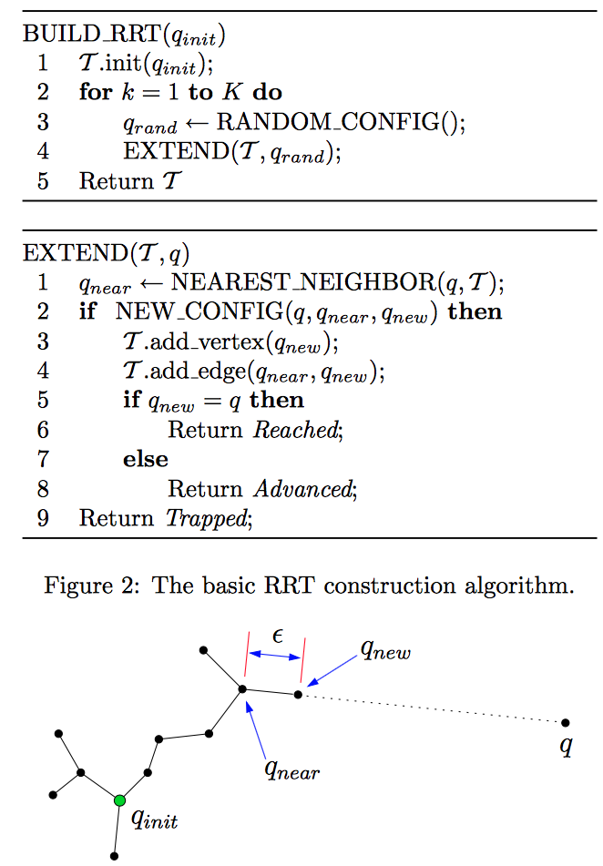
Practical Solutions
Use a step size parameter
Move in steps and check collision of a configuration
Often, a local steering function is used instead*
* more details later
https://personalrobotics.ri.cmu.edu/files/courses/papers/Kuffner00-rrtconnect.pdf

Slide 38
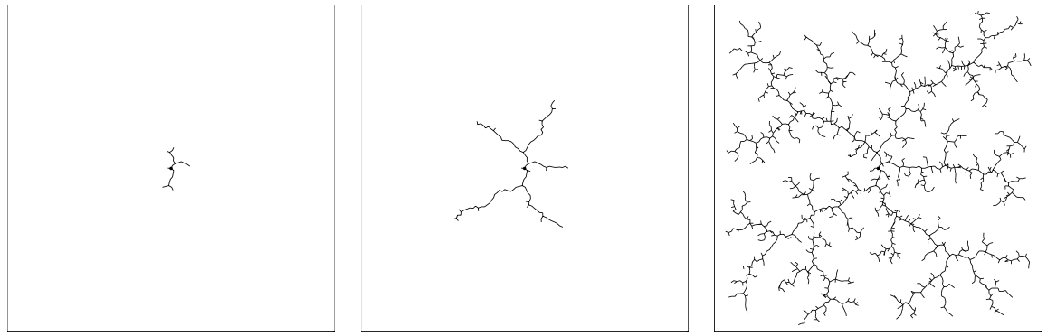
Tree “grows” from the start config. due to step size parameter
without step size
with step size
Notes:
with

Slide 39
Demo
run_rrt.py
Change DELTA and observe the effect on the running time and path length

Slide 40
Why are RRTs so popular?
Once you define the C-space and implement following subroutines, the actual algorithm is very simple:
random configuration generator
nearest neighbor
collision checker
In practice, it works rather well.
Can add heuristics on top, e.g., bias the random config. generator towards goal configuration

