Slide 1
Neural Networks
Troi Williams
(Slide Credits: Prof. Pratap Tokekar)

Slide 2
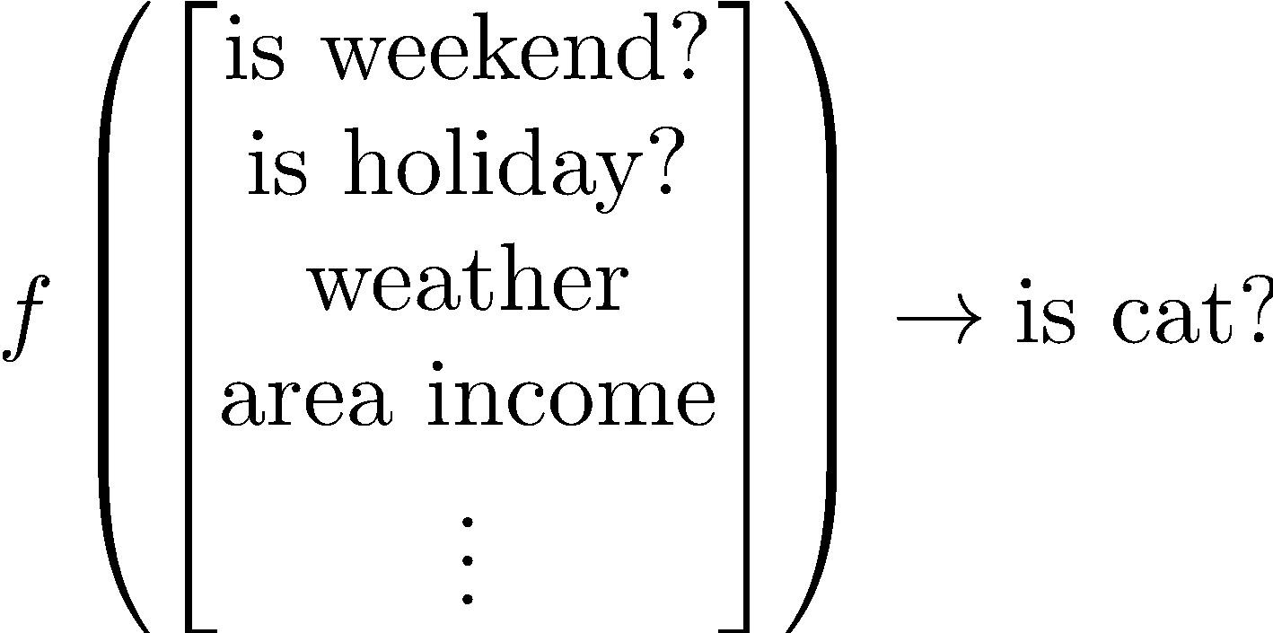
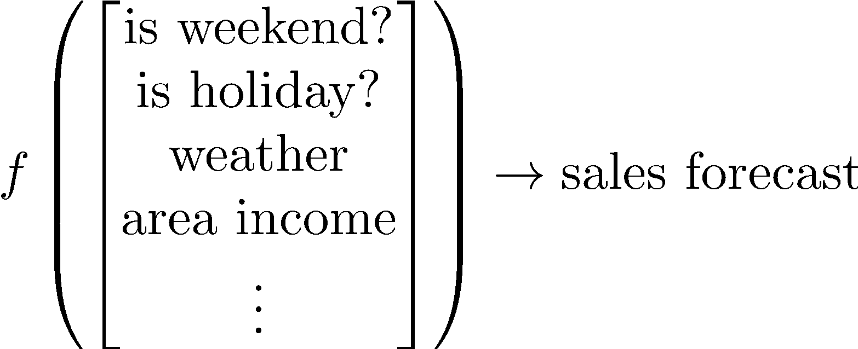

Neural networks are function approximators
Use data to learn f(x)
Prediction/Regression
output is a continuous variable
Classification
output is a discrete label

Slide 3

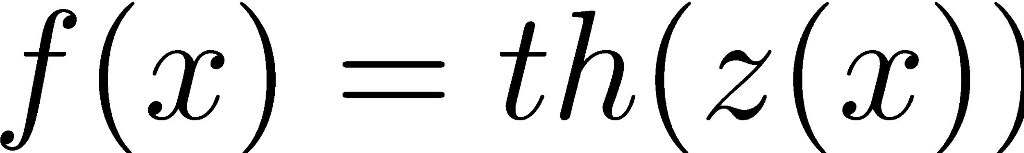
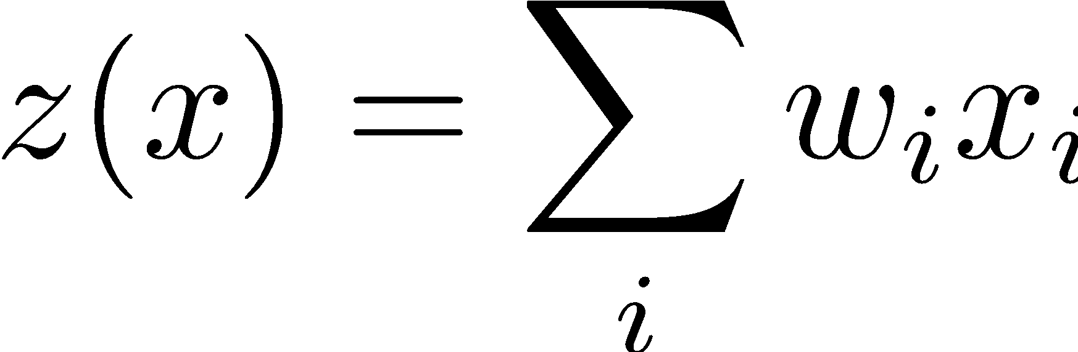
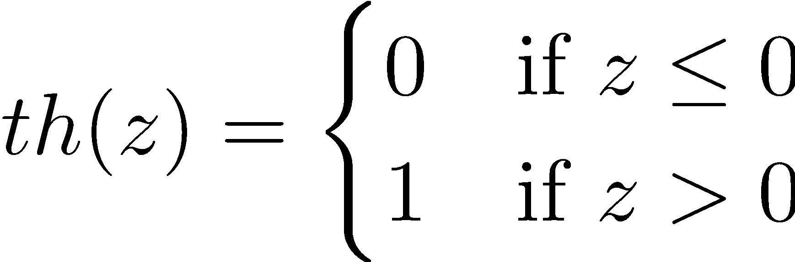
Perceptron
1
w₀
x₁
w₁
f(x) output
w₂
x₂
1. Find weighted sum of inputs
Output is a composition of two functions
2. apply threshold function

Slide 4
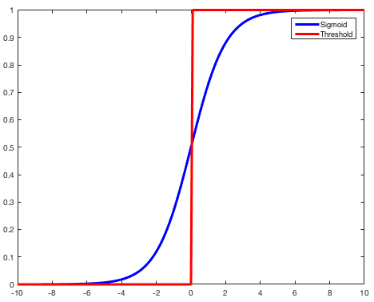
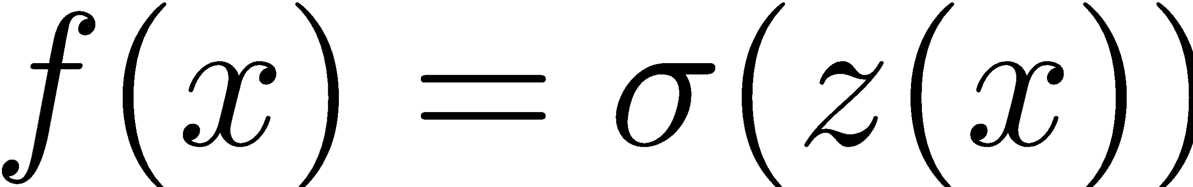
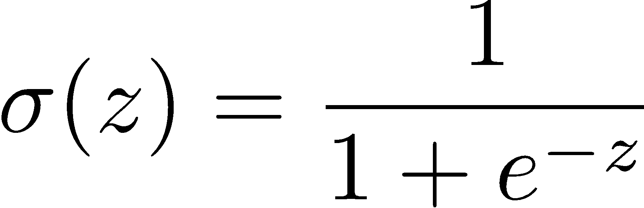
Sigmoid Neuron
1
w₀
x₁
w₁
f(x) output
x₂
w₂
1. Find weighted sum of inputs
Output is a composition of two functions
2. apply sigmoid function

Slide 5
Supervised Learning
w₁
w₁₃
w₂
w₁₄
w₃
output layer (can have multiple outputs)
input layer (activation function = identity)
w₄
one or more hidden layers
Training inputs
Training output
Given training inputs and outputs, find weights so that network output matches training outputs. How?
x₁ | x₂ | x₃ | y
0.6 | 0 | -1 | 10
0.4 | 1.2 | 3.1 | 21
1.7 | 0.6 | -0.3 | 2.1
1 | 1 | 0 | 0.1

Slide 6
General Recipe
Training output
Start with some initial weights
Compute f(x) based on these weights
Check if f(x) matches y
If not, adjust the weights
Rinse and repeat
Training inputs
x₁ | x₂ | x₃ | y
0.6 | 0 | -1 | 10
0.4 | 1.2 | 3.1 | 21
1.7 | 0.6 | -0.3 | 2.1
1 | 1 | 0 | 0.1
w₁
w₁₃
w₂
w₁₄
w₄
w₃

Slide 7
General Recipe
Training output
Start with some initial weights
Compute f(x) based on these weights
Check if f(x) matches y – how?
If not, adjust the weights – how?
Rinse and repeat
Training inputs
x₁ | x₂ | x₃ | y
0.6 | 0 | -1 | 10
0.4 | 1.2 | 3.1 | 21
1.7 | 0.6 | -0.3 | 2.1
1 | 1 | 0 | 0.1
w₁
w₁₃
w₂
w₁₄
w₄
w₃

Slide 8
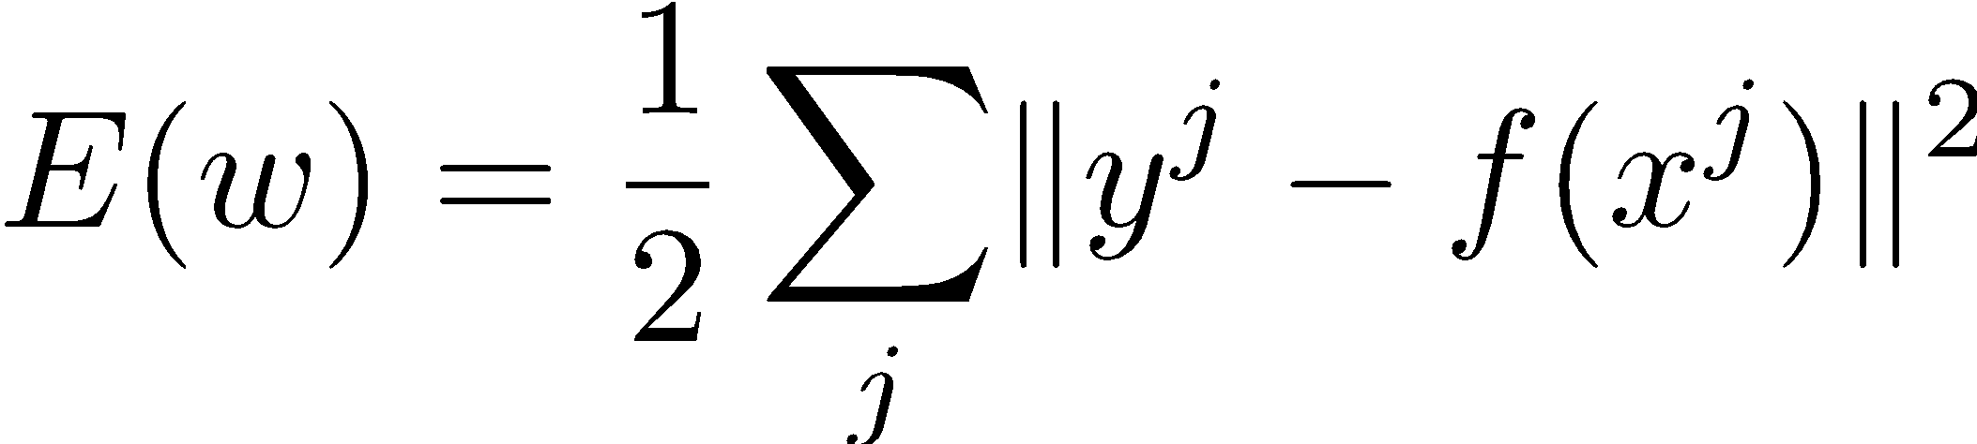
Check if f(x) matches y – how?
Training output
Compute how close f(x) is to y
Training inputs
x₁ | x₂ | x₃ | y
0.6 | 0 | -1 | 10
0.4 | 1.2 | 3.1 | 21
1.7 | 0.6 | -0.3 | 2.1
1 | 1 | 0 | 0.1
x^{j}
y^{j}
j corresponds to the j’th training example. Sum over all j. That is, compute the sum of error over all training examples
w₁
w₁₃
w₂
w₁₄
w₄
w₃

Slide 9
Check if f(x) matches y – how?
Training output
Training inputs
E(w) is called as the loss function
This one is squared error loss.
But there are other types of loss functions that one can use (depends on the problem)
x₁ | x₂ | x₃ | y
0.6 | 0 | -1 | 10
0.4 | 1.2 | 3.1 | 21
1.7 | 0.6 | -0.3 | 2.1
1 | 1 | 0 | 0.1
x^{j}
y^{j}
w₁
w₁₃
w₂
w₁₄
w₄
w₃

Slide 10
Check if f(x) matches y – how?
Training output
Training inputs
E(w) is called as the loss function
Note that E(w) is a function of the weights
If you change w then f(x) will change and thus loss will change
x₁ | x₂ | x₃ | y
0.6 | 0 | -1 | 10
0.4 | 1.2 | 3.1 | 21
1.7 | 0.6 | -0.3 | 2.1
1 | 1 | 0 | 0.1
x^{j}
y^{j}
w₁
w₁₃
w₂
w₁₄
w₄
w₃

Slide 11
General Recipe
Training output
Start with some initial weights
Compute f(x) based on these weights
Check if f(x) matches y – how? Compute E(w)
If E(w) is not zero, adjust the weights – how?
Rinse and repeat
Training inputs
x₁ | x₂ | x₃ | y
0.6 | 0 | -1 | 10
0.4 | 1.2 | 3.1 | 21
1.7 | 0.6 | -0.3 | 2.1
1 | 1 | 0 | 0.1
w₁
w₁₃
w₂
w₁₄
w₄
w₃

Slide 12
If E(w) is not zero, adjust the weights – how?
Training output
For complicated function, E(w) will never be zero (overfitting)
Instead, we want to find weights such that E(w) becomes minimum
How?
Training inputs
x₁ | x₂ | x₃ | y
0.6 | 0 | -1 | 10
0.4 | 1.2 | 3.1 | 21
1.7 | 0.6 | -0.3 | 2.1
1 | 1 | 0 | 0.1
w₁
w₁₃
w₂
w₁₄
w₄
w₃

Slide 13
If E(w) is not zero, adjust the weights – how?
Training output
For complicated function, E(w) will never be zero (overfitting)
Instead, we want to find weights such that E(w) becomes minimum
How? Calculus II(?) to the rescue
Use gradient descent
Training inputs
x₁ | x₂ | x₃ | y
0.6 | 0 | -1 | 10
0.4 | 1.2 | 3.1 | 21
1.7 | 0.6 | -0.3 | 2.1
1 | 1 | 0 | 0.1
w₁
w₁₃
w₂
w₁₄
w₄
w₃

Slide 14
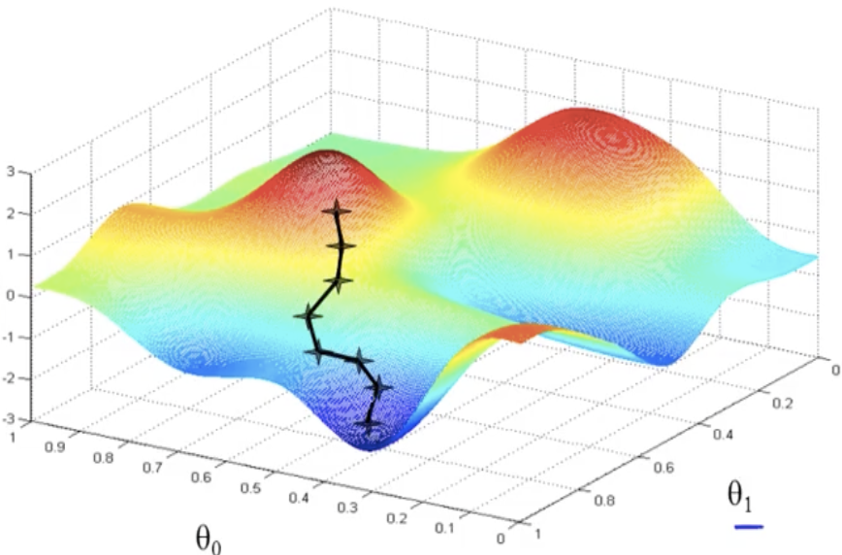
Gradient Descent
E(w)
w₂
w₁
Notes:
E(w) → the loss between the predicted and true values given the current weights. Lower loss, better the weights.
Easier to visualize with weights, not with MANY.
Line denotes the loss decreasing over time using gradient descent.

Slide 15
We can’t usually visualize the entire E(w) function. But we can compute the gradient to E(w) at the current point. Keep following the negative of the gradient (go down the hill) until you reach the minima.
E(w)
w₂
w₁

Slide 16
General Recipe
Training output
Start with some initial weights
Compute f(x) based on these weights
Check if f(x) matches y – how? Compute E(w)
If E(w) is not zero, adjust the weights – how?
Rinse and repeat
Training inputs
x₁ | x₂ | x₃ | y
0.6 | 0 | -1 | 10
0.4 | 1.2 | 3.1 | 21
1.7 | 0.6 | -0.3 | 2.1
1 | 1 | 0 | 0.1
w₁
w₁₃
w₂
w₁₄
w₄
w₃

Slide 17
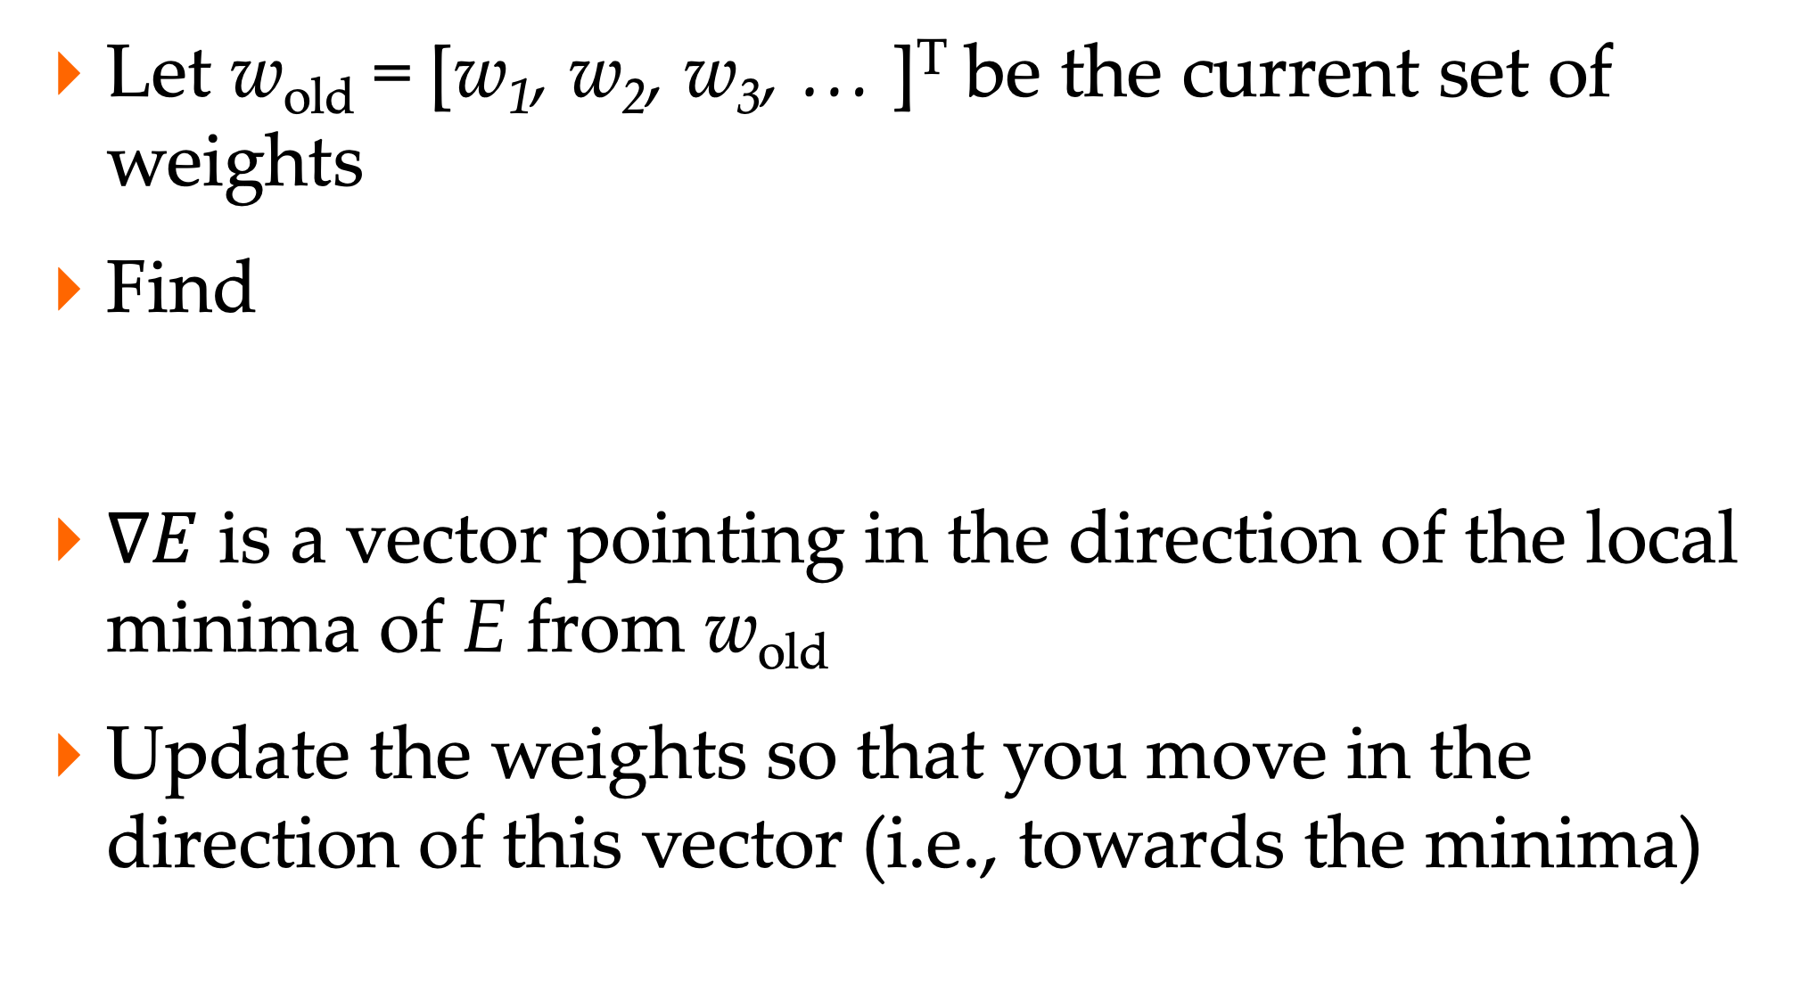
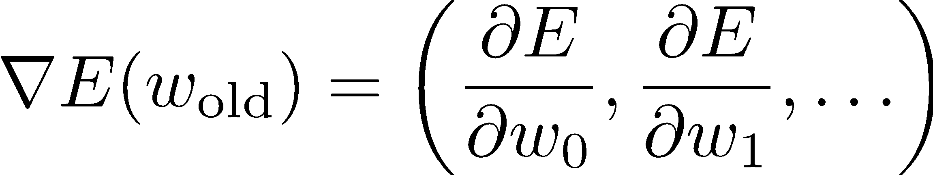
How to adjust weights?
w₂
w₁

Slide 18
Why take the negative of the gradient?
Notes:
E(w) → the loss between the predicted and true values given the current weights. Lower loss, better the weights.
Easier to visualize with weights, not with MANY.
Line denotes the loss decreasing over time using gradient descent.

Slide 19
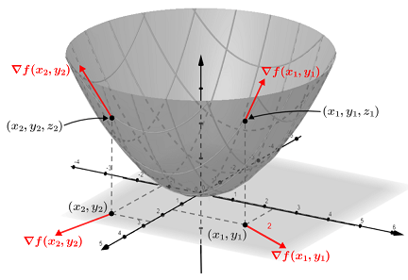
Why take the negative of the gradient?
The gradient points in the direction of the steepest ascent, resulting in the weights causing an increase in error.
We want the opposite! Hence, computing the negative of the gradient.
Notes:
Grad

Slide 20
Gradient Descent
w₂
We still need to compute
I’ll show how to do this for a single sigmoid neuron
Then, we will see how to do this for a neural network – backpropagation
Most libraries implement automatic differentiation
w₁

Slide 21
Sigmoid Neuron
1
w₀
f_{w}(x) output
x₁
w₁
x₂
w₂

Slide 22
Sigmoid Neuron
1
w₀
f_{w}(x) output
x₁
w₁
x₂
w₂
need to compute

Slide 23
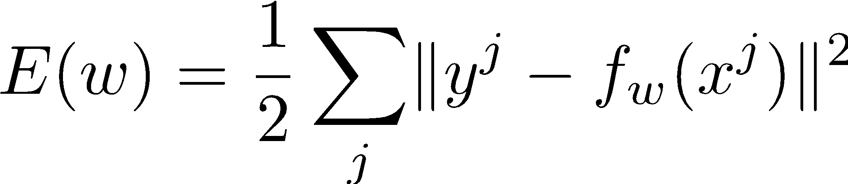
Sigmoid Neuron
1
w₀
f_{w}(x) output
x₁
w₁
x₂
w₂
need to compute

Slide 24
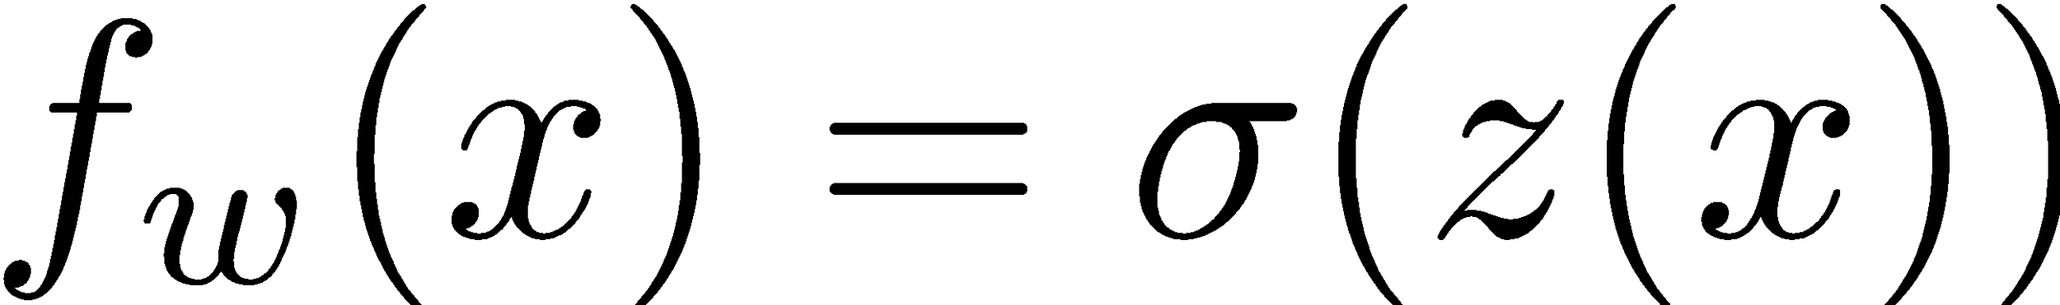



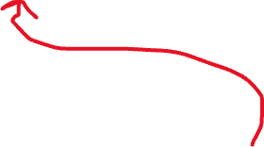
Sigmoid Neuron
1
w₀
f_{w}(x) output
x₁
w₁
x₂
w₂
need to compute

Slide 25
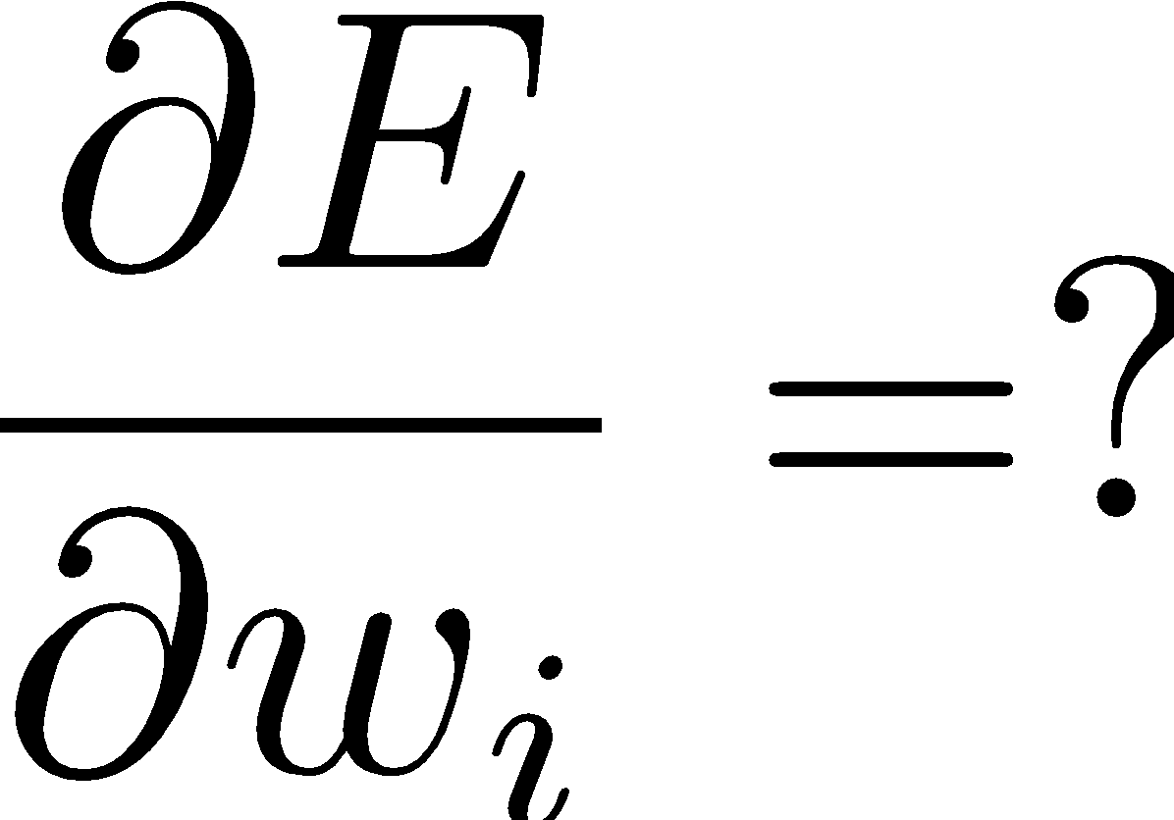
Finding the weights

Slide 26
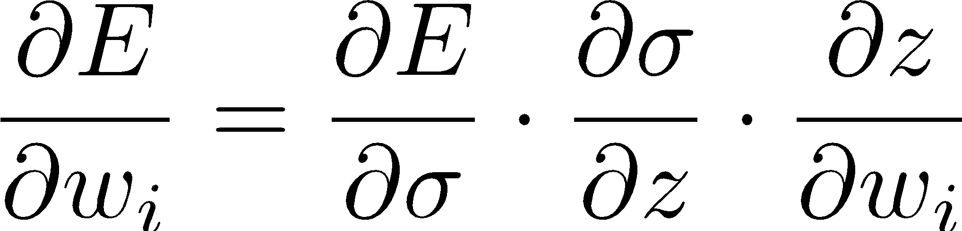
Finding the weights
Use chain rule

Slide 27
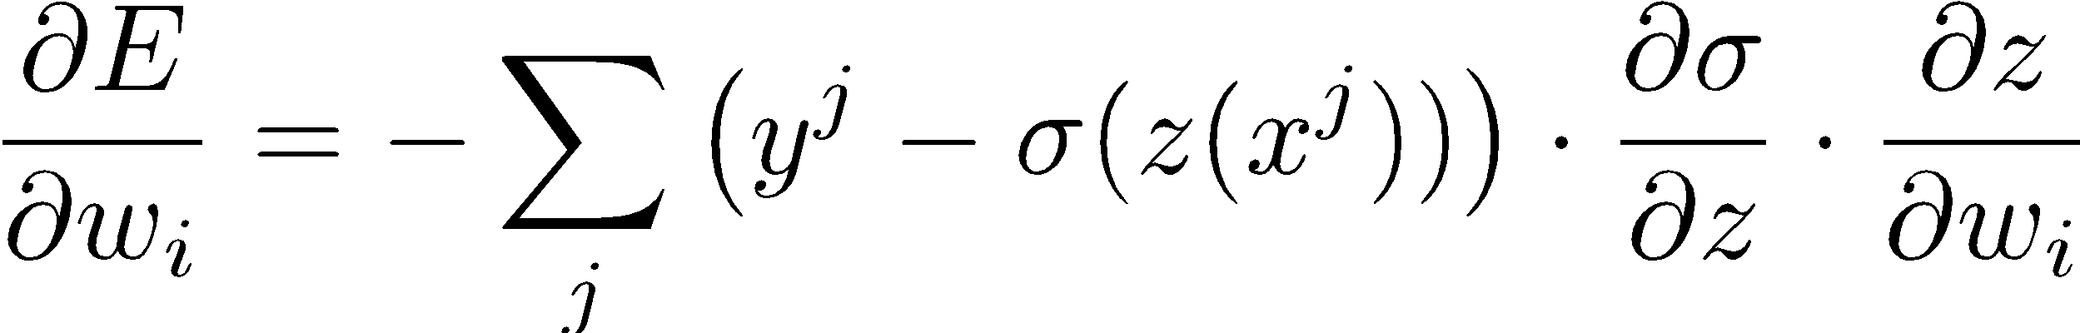
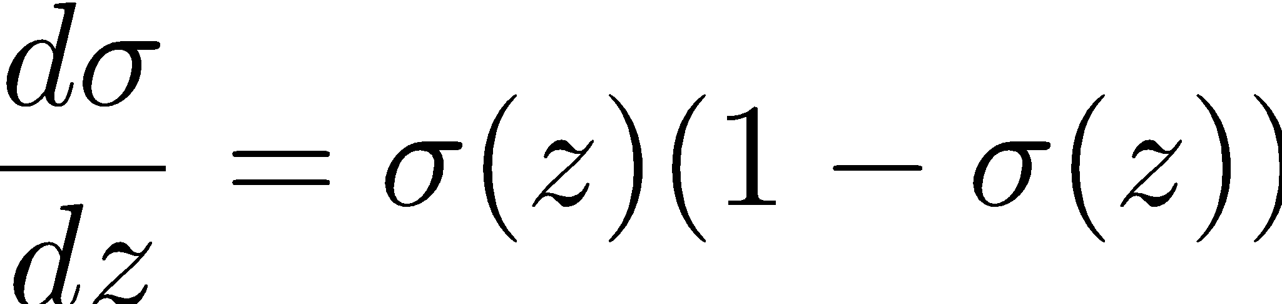
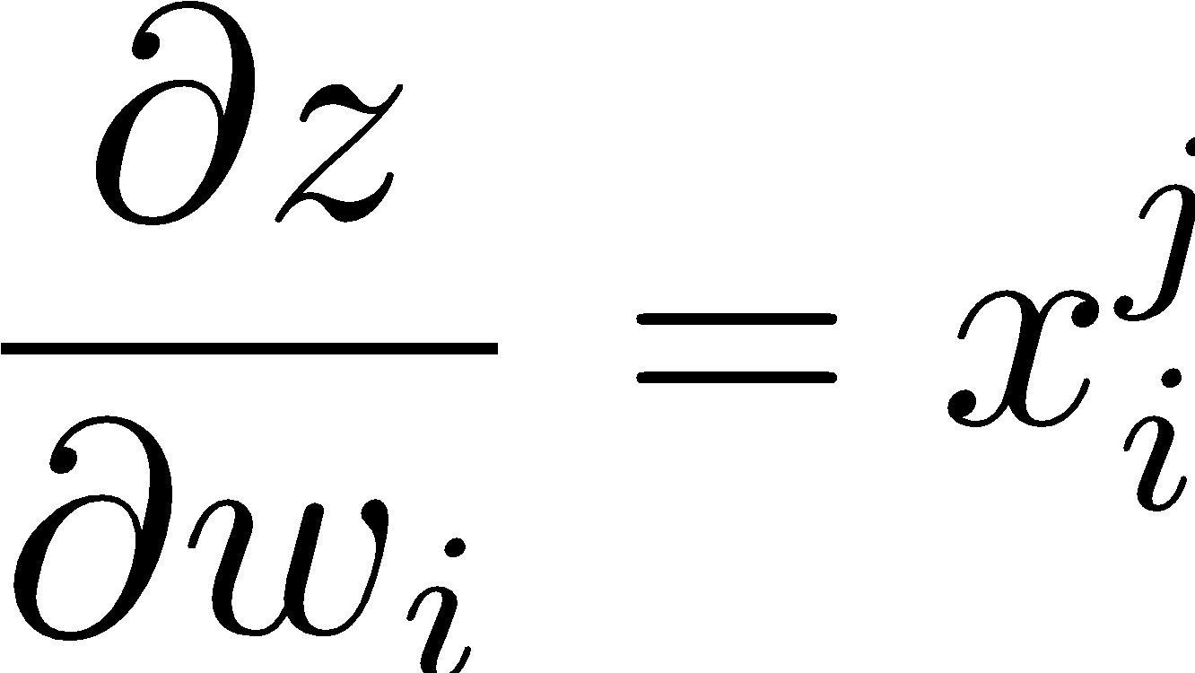


Finding the weights
x^{j}_{i} is the i’th term of vector x^{j}
Use chain rule

Slide 28
Finding the weights
all three terms are the same – output of the neuron f_{w}(x^{j})
x^{j}_{i} is the i’th term of vector x^{j}

Slide 29
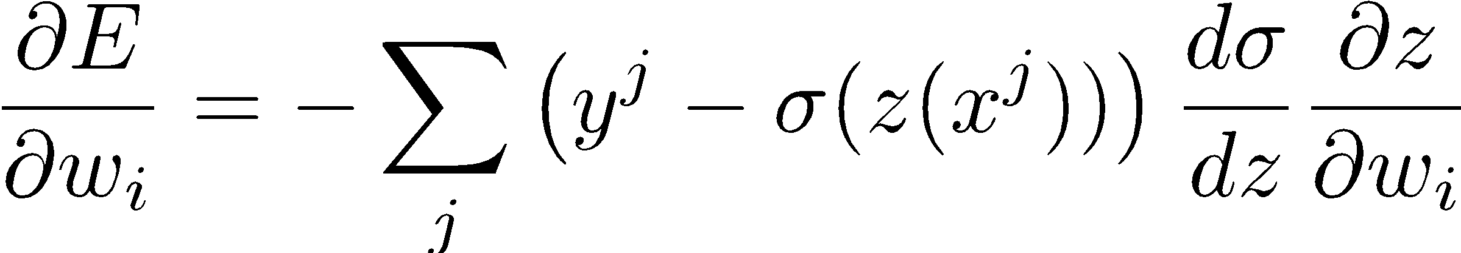
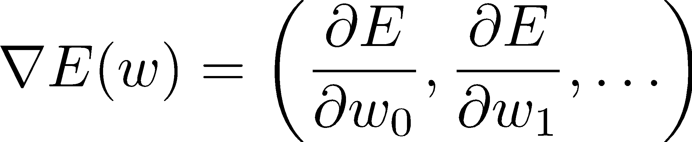
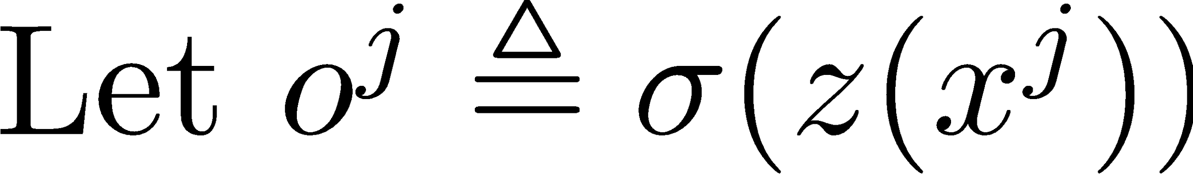
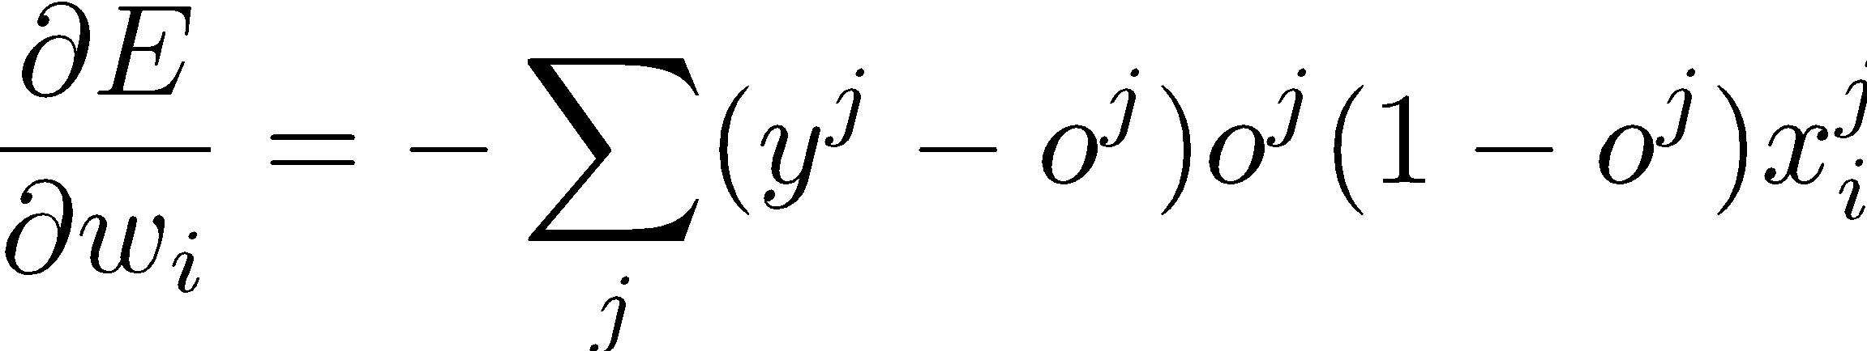
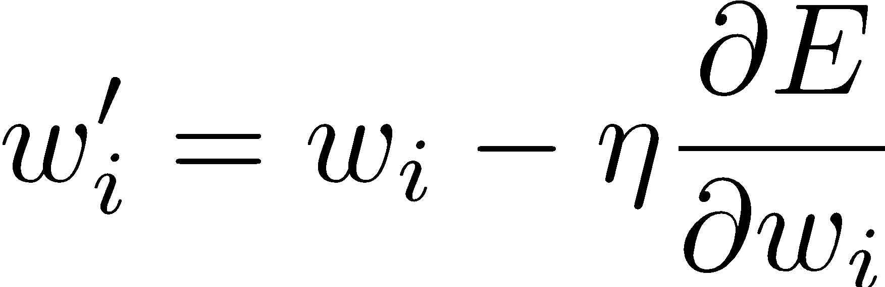
Rewriting the equations
output of the neuron for input x^{j}
Update rule:

Slide 30
Gradient Descent
change in w_{i} is proportional to gradient of loss wrt w_{i}
output of the neuron for input x^{j}
Update rule:

Slide 31
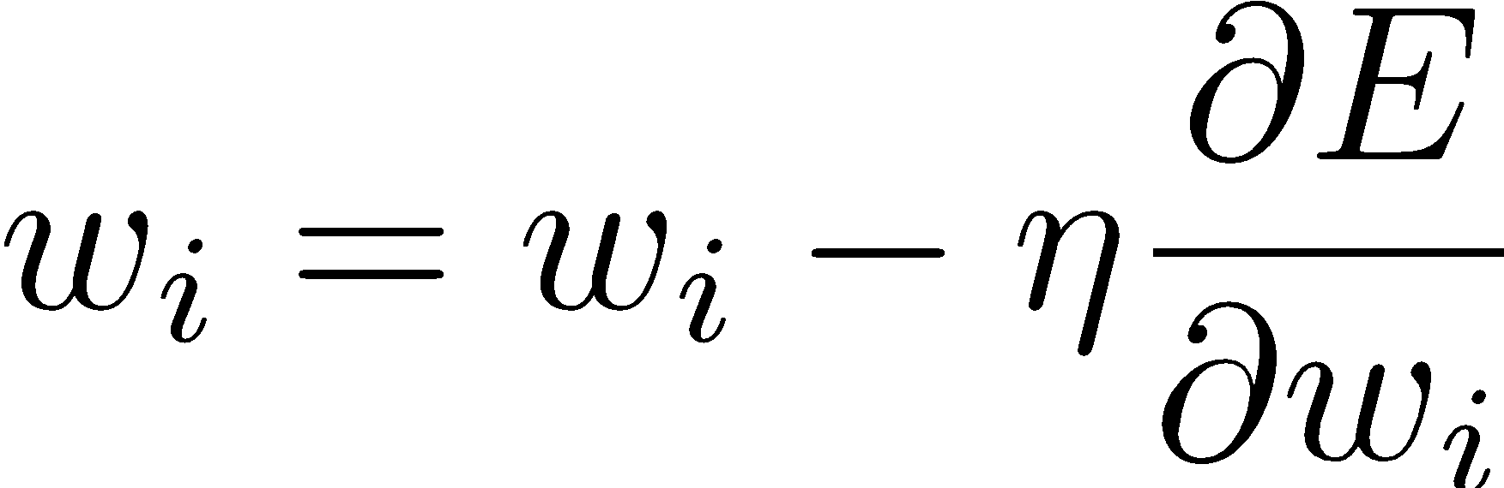
A more specific recipe
Start with some initial weights w = [w₀, w₁, …]
Repeat until convergence
For each input x^{j}, use the current weights w to compute the output of the neuron f_{w}(x^{j}) (call it o^{j})
Compute the loss E(w) between f_{w}(x^{j}) and y^{j}
Compute the gradient of the loss wrt each w_{i}
Update each weight w_{i} based on the gradient

Slide 32
Neural Network
input layer (activation function = identity)
output layer
hidden layer
Directed graph of neurons
Each edge corresponds to a unique weight
We need to learn all the weights

Slide 33
Training one neuron
Start with some initial weights w = [w₀, w₁, …]
Repeat until convergence
For each input x^{j}, use the current weights w to compute the output of the neuron f_{w}(x^{j}) (call it o^{j})
Compute the loss E(w) between f_{w}(x^{j}) and y^{j}
Compute the gradient of the loss wrt each w_{i}
Update each weight w_{i} based on the gradient

Slide 34
Same idea as single neuron
Start with some initial weights w = [w₀, w₁, …]
Repeat until convergence
For each input x^{j}, use the current weights w to compute the output of the network f_{w}(x^{j})
Compute the loss E(w) between f_{w}(x^{j}) and y^{j}
Compute the gradient of the loss wrt each w_{i}
slightly more complicated equation
Update each weight w_{i} based on the gradient

Slide 35
Intuition
The math becomes complicated. I don’t expect you to know the equations off the top of your mind.
But it’s important to understand the intuition.
Lots of resources online: here’s a good one… https://www.youtube.com/watch?v=Ilg3gGewQ5U

Slide 36
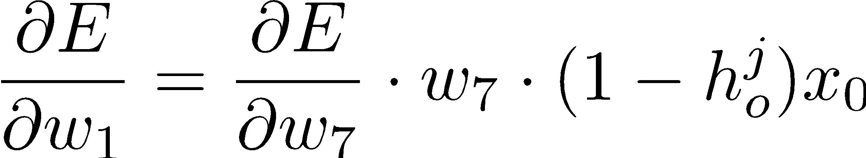
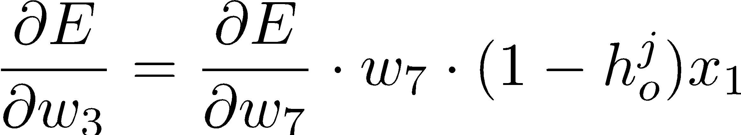
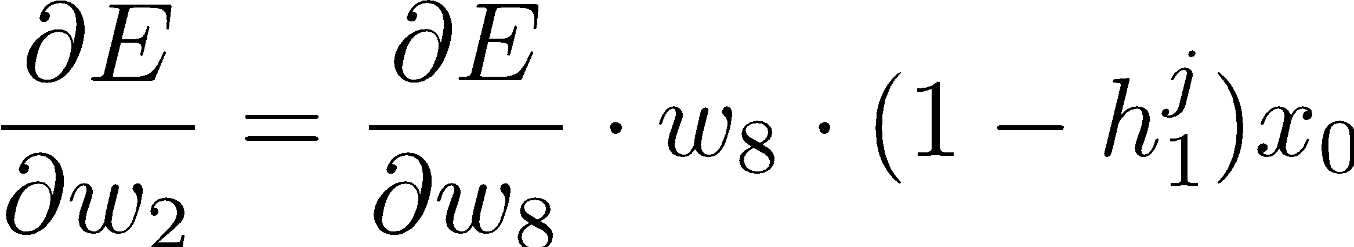
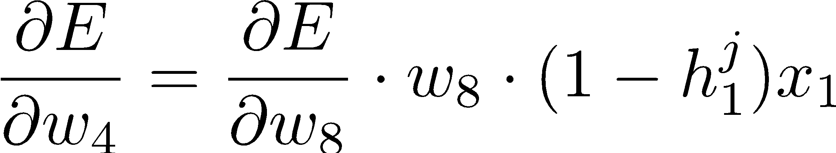
There is a structure here
x₀
w₁
w₂
h₀
w₇
x₁
w₃
o
w₄
w₈
w₅
h₁
x₂
w₆

Slide 37
Structure
more neurons
more neurons
Gradient of a weight w depends only on
output of the neuron it is connected to
gradient from a neuron in the next layer
weight of the edge connected these two neurons

Slide 38
Forward pass: use current weights to compute outputs of all neurons from left to right
more neurons
more neurons
Gradient of a weight w depends only on
output of the neuron it is connected to
gradient from a neuron in the next layer
weight of the edge connected these two neurons

Slide 39
Backward pass: use gradient of the last layer to compute the gradient of the previous layer, repeat right to left
more neurons
more neurons
Gradient of a weight w depends only on
output of the neuron it is connected to
gradient from a neuron in the next layer
weight of the edge connected these two neurons

Slide 40
Backpropagation
x₀
w₁
w₂
h₀
w₇
x₁
w₃
o
w₄
w₈
w₅
h₁
x₂
w₆
Use current weights to do a forward pass. That is, based on the current weights, compute the outputs (h_{i}) of all neurons.
Compute the gradient wrt weights of the last layer.
Use that gradient to compute the gradient wrt weights of the second-last layer.
Use that gradient to compute the gradient wrt to …

Slide 41
Neural Network w/ Backpropagation
Start with some initial weights w = [w₀, w₁, …]
Repeat until convergence
For each input x^{j}, use the current weights w to compute the output of all the neurons and the final output f_{w}(x^{j})
Compute the loss E(w) between f_{w}(x^{j}) and y^{j}
Compute the gradient of the loss at the output layer
Use that to compute the gradient of the loss at the last-but-one layer
…
Update each weight w_{i} based on the gradient

Slide 42
Convergence
Depends on the loss function
Convex loss function 🡪 eventually converges to the optimal weights
Loss function is rarely, if ever, convex
Converges to local minima instead of global one

Slide 43
Demo
https://playground.tensorflow.org
http://www.ccom.ucsd.edu/~cdeotte/programs/neuralnetwork.html

Slide 44
Neural networks are function approximators
Use supervised data to learn f(x)
Prediction/Regression
output is a continuous variable
Classification
output is a discrete label
In RL, we use NN for regression f(x) 🡨 Q( [s,a] )

Slide 45
Training a NN
Gradient descent requires training data
input: x output (aka target values): y
Often need lots of data (if you want to learn a complex function)
Available in many cases
image classification: get training data by human annotation

Slide 46

You have helped train a NN before

Slide 47
You have helped train a NN before
But how???

Slide 48
You have helped train a NN before
Using ground truth and consensus!

Slide 49
You have helped train a NN before
Using ground truth and consensus!
Some data is already annotated, but not all.
Consensus from many, many humans helps add to the training set!

Slide 50
Big Picture
Deep neural networks – learn complex functions
image processing
speech processing
natural language processing
economics/financial
…
Need lots of data for training
Reinforcement learning
interactively collect data
Ethics, fairness, explainability concerns

Slide 51
Designing a NN
There is no canonical architecture
The architecture depends on the specific problem
In practice, don’t start by designing a new architecture for a new problem
Instead, start with one that is known to work
Often, the quality of data impacts the final performance (loss)

Slide 52
Designing a NN
Remember, the only unknowns are the weights
Everything else should be decided by you
How many layers?
How many neurons in each layer?
How to connect the neurons?
What activation function to use?
What loss function to use?
What gradient descent method to use?
What update method to use?
What is your convergence criterion?

Slide 53
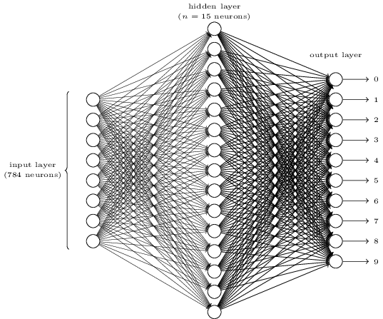
How to connect the neurons?
Fully connected
Convolutional
Pooling
Recurrent/LSTM
Attention
…

Slide 54
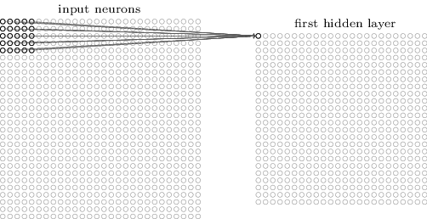
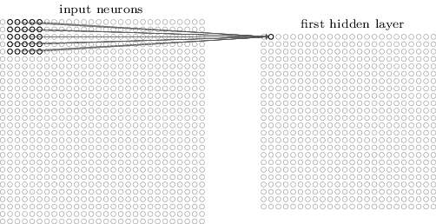
How to connect the neurons?
Fully connected
Convolutional
Pooling
Recurrent/LSTM
Attention
…
useful in image processing

Slide 55
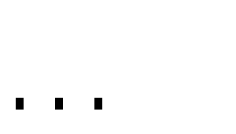

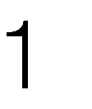
How to connect the neurons?
Fully connected
Convolutional
Pooling
Recurrent/LSTM
Attention
…
x
w
Typically in the later layers
Notes:
Taking the maximum of a window.
Purpose: dimension reduction, spatial invariance, prevent overfitting

Slide 56
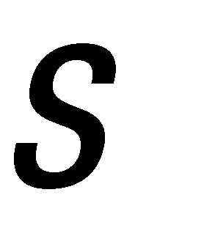



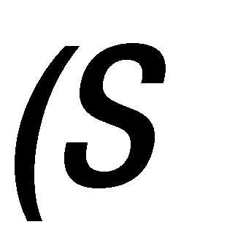

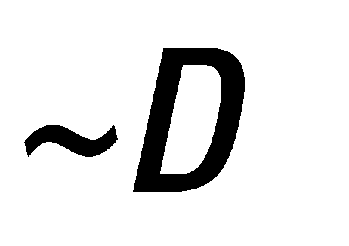

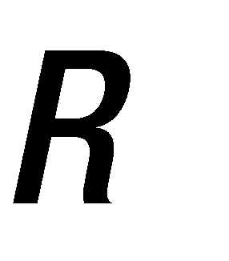
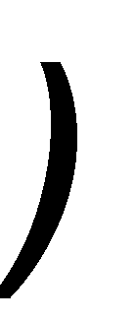

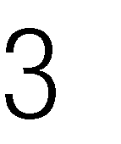
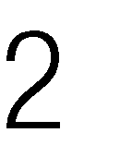
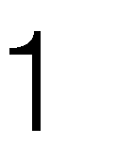
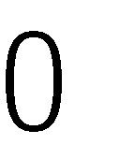
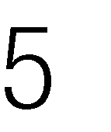
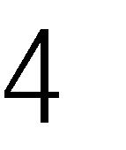
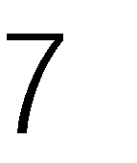
What’s the result???

Slide 57
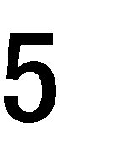
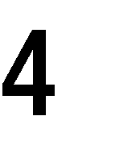





4 x 4
2 x 2

Slide 58
4 x 4
3 x 3

Slide 59
4 x 4
3 x 3

Slide 60
4 x 4
3 x 3

Slide 61


4 x 4
3 x 3

Slide 62






Slide 63







Slide 64






Slide 66
Why do we need tensor flattening between convolutional and dense layers?

Slide 67
Dense layers require a 1D vector, while convolutional layers output 3D matrices.

Slide 68


Take the 3D+ matrices and “flatten” them—lay them sequentially.

Slide 69
But what’s an issue with flattening?

Slide 70
But what’s an issue with flattening?
We lose spatial information from the convolutions, which is why we do flatten at the end!

Slide 71
Designing a NN
Remember, the only unknowns are the weights
Everything else should be decided by you
How many layers?
How many neurons in each layer?
How to connect the neurons?
What activation function to use?
What loss function to use?
What gradient descent method to use?
What update method to use?
What is your convergence criterion?

Slide 72
What activation function to use?
Sigmoid
tanh
ReLU
Softmax
Identity
1
w₀
x₁
w₁
?
f(x)
w₂
x₂

Slide 73

Problems with Sigmoid Activation
Sigmoid function saturates at 0 and 1
This kills the gradient (i.e., gradient goes to 0 near these points)
If the gradient is small, then the updates in the weights are also small, leading to slower convergence.

Slide 74

What activation function to use?
Sigmoid
tanh
Rectified Linear Unit
Softmax
Identity
ReLU is discontinuous. The gradient at z=0 is therefore not defined when z=0 (but is defined everywhere else). This is not a problem, in practice, since z=0 happens very rarely. We can set the gradient arbitrarily when it does happen (this is a hack). There are other continuous versions of ReLU that can be used instead.

Slide 75

What activation function to use?
These two are usually used at the last (output) layer
Sigmoid
tanh
ReLU
Softmax – classification problems
Identity – regression problems

Slide 76
Designing a NN
Remember, the only unknowns are the weights
Everything else should be decided by you
How many layers?
How many neurons in each layer?
How to connect the neurons?
What activation function to use?
What loss function to use?
What gradient descent method to use?
What update method to use?
What is your convergence criterion?

Slide 77
What loss function to use?
Depends on what function you want to approximate with your NN.
Regression problems
Output is continuous*
We want f(x^{j}) to be close to true function output y^{j}
Use mean-squared error (L2)
*piecewise continuous is okay

Slide 78
Classification problems
Output is a discrete class label instead of a continuous function
Digit classification example
We have only two possibilities*
f(x^{j}) = y^{j}
f(x^{j}) != y^{j}
Hinge loss
Cross-entropy loss
KL divergence

Slide 79
Designing a NN
Remember, the only unknowns are the weights
Everything else should be decided by you
How many layers?
How many neurons in each layer?
How to connect the neurons?
What activation function to use?
What loss function to use?
What gradient descent method to use?
What update method to use?
What is your convergence criterion?

Slide 80
Many Alternatives
Batch (what we covered – sum over all training samples)
Stochastic gradient descent (SGD)
Mini-batch gradient descent
Momentum
RMSPropagation, Adam (Adaptive moment estimation), Adagrad (Adaptive gradient)
https://cs.stanford.edu/people/karpathy/convnetjs/demo/trainers.html

Slide 81
Hyperparameter optimization
Lots and lots of hyperparams
Learning rate (alpha)
random seeds
batch size
filter size
…
Performance is very sensitive to hyperparams
How to find the right configuration of hyperparams?

Slide 82
Demo
http://www.ccom.ucsd.edu/~cdeotte/programs/neuralnetwork.html
https://cs.stanford.edu/people/karpathy/convnetjs/demo/regression.html
https://playground.tensorflow.org/

Slide 83
Designing a NN
Remember, the only unknowns are the weights
Everything else should be decided by you
How many layers?
How many neurons in each layer?
How to connect the neurons?
What activation function to use?
What loss function to use?
What gradient descent method to use?

