Slide 1
Path Planning on a Graph
Dr. Troi Williams
Slide credits: Pratap Tokekar, Chahat Deep Singh

Slide 2
Previously, we talked about
Using DFS to find a path on a graph.

Slide 3
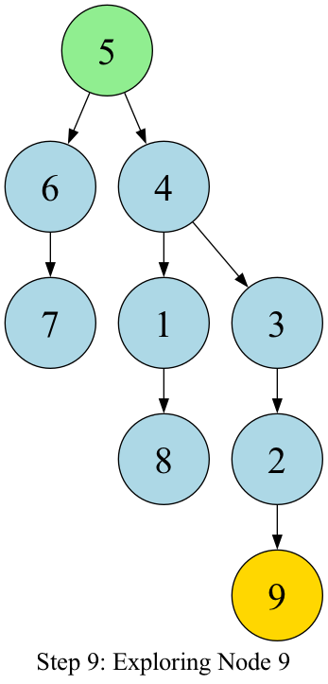
DFS Planning on Simple Graph
Compare the path in the tree to the visited order… they are NOT the same!
Path (according to the tree): 5 → 4 → 3 → 2 → 9
(We get the path via backtracking from 9 to 5).
S: 6, 1, 3, 9, 8
V: 5, 4, 3, 2, 1, 6, 7, 8, 9
7
8
9
6
1
2
5
4
3

Slide 4
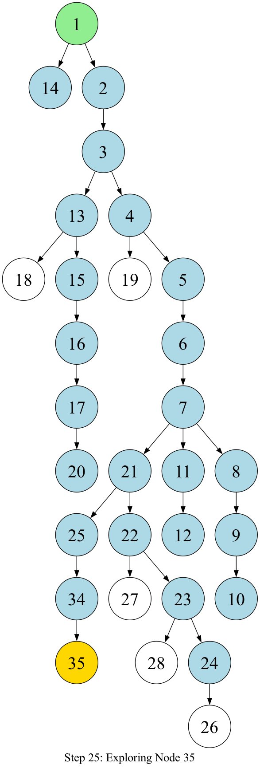
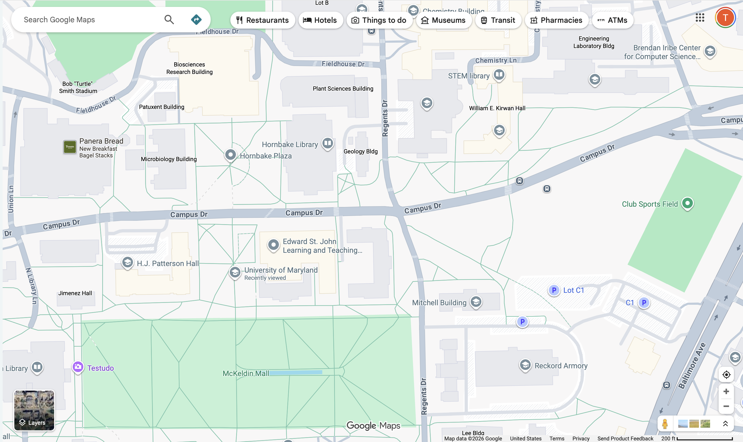
DFS Planning on UMD Graph
S: 14, 13, 19, 21, 18, 19, 25, 27, 28, 26
V: 1, 2, 3, 4, 5, 6, 7, 8, 9, 10, 11, 12, 13, 15, 14, 16, 17, 20, 21, 22, 23, 24, 25, 34, 35
27
29
30
31
28
32
35
26
33
34
22
23
24
25
17
20
21
16
19
15
18
11
9
14
13
12
7
8
10
1
2
3
4
5
6

Slide 5
Previously, we talked about
Using DFS to find a path on a graph.
Using BFS to find a path on a graph.

Slide 6
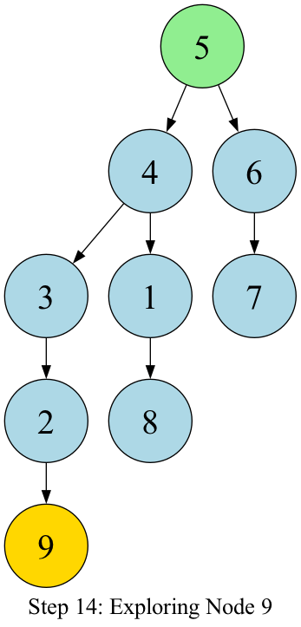
BFS Planning on Simple Graph
Compare the path in the tree to the visited order… they are NOT the same!
Path (according to the tree): 5 → 4 → 3 → 2 → 9
(We get the path via backtracking from 9 to 5).
Q:
V: 5, 4, 6, 3, 1, 7, 2, 8, 9
7
8
9
6
1
2
5
4
3

Slide 7
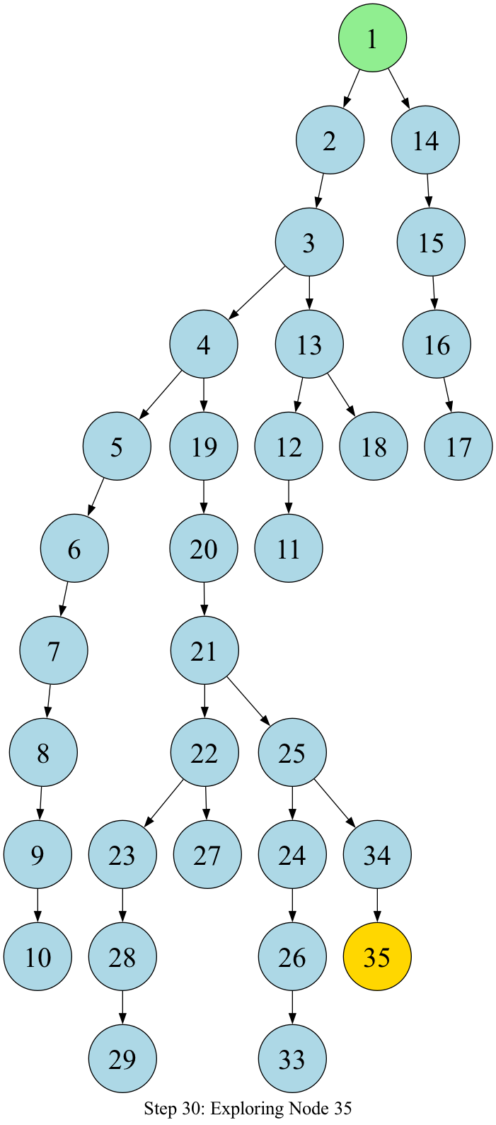
BFS Planning on UMD Graph
Q: 29, 33
V: 1, 2, 14, 3, 15, 4, 13, 16, 5, 19, 12, 18, 17, 6, 20, 11, 7, 21, 8, 22, 25, 9, 23, 27, 24, 34, 10, 28, 26, 35
27
29
30
31
28
32
35
26
33
34
22
23
24
25
17
20
21
16
19
15
18
11
9
14
13
12
7
8
10
1
2
3
4
5
6

Slide 8
BFS vs DFS
BFS
DFS

Slide 9
BFS vs DFS (Group Exercise)
Which one would you choose? Why?
Memory?
Optimal path?
Space Complexity (High or Low)?
Time (Fast or Slow)?
Which is better when the goal is close versus far?

Slide 10
BFS vs DFS
Memory (less or more)?

Slide 11
BFS vs DFS
Requires more memory
Requires less memory

Slide 12
BFS vs DFS
Requires more memory
Which finds the shortest path?
Requires less memory

Slide 13
BFS vs DFS
Requires more memory
Optimal for finding the shortest path*
Requires less memory
NOT Optimal for finding shortest path
*when the cost for all edges = 1, not optimal otherwise

Slide 14
BFS vs DFS
Requires more memory
Optimal for finding the shortest path*
Space complexity (less or more)?
Requires less memory
NOT Optimal for finding shortest path
*when the cost for all edges = 1, not optimal otherwise

Slide 15
BFS vs DFS
Requires more memory
Optimal for finding the shortest path*
Higher Space Complexity
Requires less memory
NOT Optimal for finding shortest path
Lower Space Complexity
*when the cost for all edges = 1, not optimal otherwise

Slide 16
BFS vs DFS
Requires more memory
Optimal for finding the shortest path*
Higher Space Complexity
Time complexity (less or more)?
Requires less memory
NOT Optimal for finding shortest path
Lower Space Complexity
*when the cost for all edges = 1, not optimal otherwise

Slide 17
BFS vs DFS
Requires more memory
Optimal for finding the shortest path*
Higher Space Complexity
Slower
Requires less memory
NOT Optimal for finding shortest path
Lower Space Complexity
Faster
*when the cost for all edges = 1, not optimal otherwise

Slide 18
BFS vs DFS
Requires more memory
Optimal for finding the shortest path*
Higher Space Complexity
Slower
Which is better when the goal is close versus far?
Requires less memory
NOT Optimal for finding shortest path
Lower Space Complexity
Faster
*when the cost for all edges = 1, not optimal otherwise

Slide 19
BFS vs DFS
Requires more memory
Optimal for finding the shortest path*
Higher Space Complexity
Slower
Better when target is close to the source
Requires less memory
NOT Optimal for finding shortest path
Lower Space Complexity
Faster
Better when target is far from the source
*when the cost for all edges = 1, not optimal otherwise

Slide 20
These algorithms can be used in real-world settings…

Slide 21
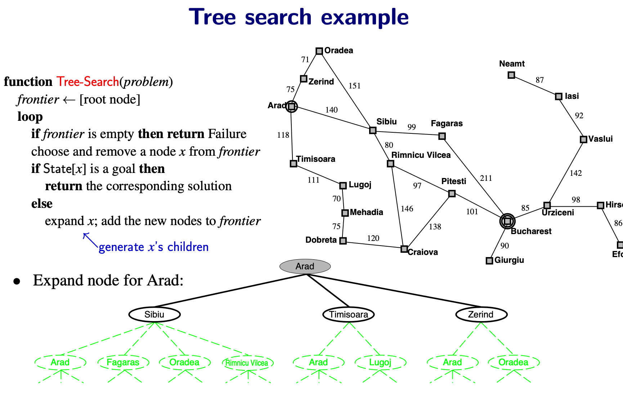
E.g., finding paths to cities…
Arad → Bucharest with varying distances.

Slide 22
E.g., finding paths to cities…
Arad → Bucharest with varying distances.

Slide 23
Let’s see what these algorithms look like in general…

Slide 24
Frontier is the queue. Think of it as the boundary between explored and unexplored.

Slide 25
initial state
Frontier is the queue. Think of it as the boundary between explored and unexplored.

Slide 26
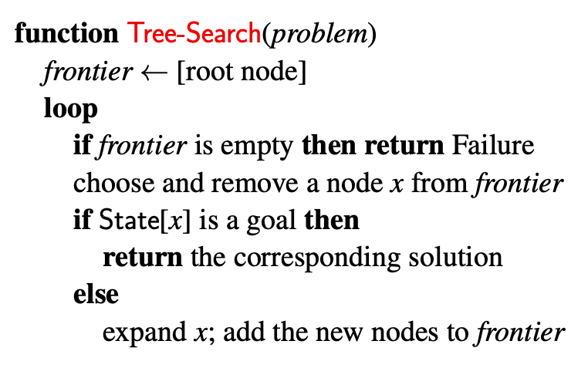
Search Strategies
Which node to choose from the frontier?
Uninformed strategies
BFS: frontier is FIFO queue
DFS: frontier is LIFO queue (pushdown stack)
Uniform-Cost Search (Dijkstra): frontier is priority queue
Iterative Deepening Search
Informed strategies (extra information → heuristic)
A* search

Slide 31

Exhaustive… explores everything/where!

Slide 32
Depth-first search
A
function Tree-Search(problem)
frontier ← [root node]
B
C
loop
if frontier is empty then return Failure choose and remove a node x from frontier if State[x] is a goal then
return the corresponding solution
else
expand x; add the new nodes to frontier
G
D E F
H I J K L M N O
b = maximum branching factor d = depth of shallowest solution m = max. depth of any node
Select deepest node
frontier is a pushdown stack
Like what you’ve seen in previous courses, except expanding a node generates all of its children at once

Slide 33
Depth-first search
A
function Tree-Search(problem)
frontier ← [root node]
B
C
loop
if frontier is empty then return Failure choose and remove a node x from frontier if State[x] is a goal then
return the corresponding solution
else
expand x; add the new nodes to frontier
G
D E F
H I J K L M N O
b = maximum branching factor d = depth of shallowest solution m = max. depth of any node
Select deepest node
frontier is a pushdown stack
Like what you’ve seen in previous courses, except expanding a node generates all of its children at once

Slide 34
Depth-first search
A
function Tree-Search(problem)
frontier ← [root node]
B
C
loop
if frontier is empty then return Failure choose and remove a node x from frontier if State[x] is a goal then
return the corresponding solution
else
expand x; add the new nodes to frontier
G
D E F
H I J K L M N O
b = maximum branching factor d = depth of shallowest solution m = max. depth of any node
Select deepest node
frontier is a pushdown stack
Like what you’ve seen in previous courses, except expanding a node generates all of its children at once

Slide 35
Depth-first search
A
function Tree-Search(problem)
frontier ← [root node]
B
C
loop
if frontier is empty then return Failure choose and remove a node x from frontier if State[x] is a goal then
return the corresponding solution
else
expand x; add the new nodes to frontier
G
D E F
H I J K L M N O
b = maximum branching factor d = depth of shallowest solution m = max. depth of any node
Select deepest node
frontier is a pushdown stack
Like what you’ve seen in previous courses, except expanding a node generates all of its children at once

Slide 36
Depth-first search
A
function Tree-Search(problem)
frontier ← [root node]
B
C
loop
if frontier is empty then return Failure choose and remove a node x from frontier if State[x] is a goal then
return the corresponding solution
else
expand x; add the new nodes to frontier
D
G
E F
I J K L M N O
b = maximum branching factor d = depth of shallowest solution m = max. depth of any node
Select deepest node
frontier is a pushdown stack
Like what you’ve seen in previous courses, except expanding a node generates all of its children at once

Slide 37
Depth-first search
A
function Tree-Search(problem)
frontier ← [root node]
B
C
loop
if frontier is empty then return Failure choose and remove a node x from frontier if State[x] is a goal then
return the corresponding solution
else
expand x; add the new nodes to frontier
G
E F
J K L M N O
b = maximum branching factor d = depth of shallowest solution m = max. depth of any node
Select deepest node
frontier is a pushdown stack
Like what you’ve seen in previous courses, except expanding a node generates all of its children at once

Slide 38
Depth-first search
A
function Tree-Search(problem)
frontier ← [root node]
B
C
loop
if frontier is empty then return Failure choose and remove a node x from frontier if State[x] is a goal then
return the corresponding solution
else
expand x; add the new nodes to frontier
G
E F
J K L M N O
b = maximum branching factor d = depth of shallowest solution m = max. depth of any node
Select deepest node
frontier is a pushdown stack
Like what you’ve seen in previous courses, except expanding a node generates all of its children at once

Slide 39
Depth-first search
A
function Tree-Search(problem)
frontier ← [root node]
B
C
loop
if frontier is empty then return Failure choose and remove a node x from frontier if State[x] is a goal then
return the corresponding solution
else
expand x; add the new nodes to frontier
E
F
G
K L M N O
b = maximum branching factor d = depth of shallowest solution m = max. depth of any node
Select deepest node
frontier is a pushdown stack
Like what you’ve seen in previous courses, except expanding a node generates all of its children at once

Slide 40
Depth-first search
A
function Tree-Search(problem)
frontier ← [root node]
C
loop
if frontier is empty then return Failure choose and remove a node x from frontier if State[x] is a goal then
return the corresponding solution
else
expand x; add the new nodes to frontier
F
G
L M N O
b = maximum branching factor d = depth of shallowest solution m = max. depth of any node
Select deepest node
frontier is a pushdown stack
Like what you’ve seen in previous courses, except expanding a node generates all of its children at once

Slide 41
Depth-first search
A
function Tree-Search(problem)
frontier ← [root node]
C
loop
if frontier is empty then return Failure choose and remove a node x from frontier if State[x] is a goal then
return the corresponding solution
else
expand x; add the new nodes to frontier
F
G
L M N O
b = maximum branching factor d = depth of shallowest solution m = max. depth of any node
Select deepest node
frontier is a pushdown stack
Like what you’ve seen in previous courses, except expanding a node generates all of its children at once
Deep dives along a path…

Slide 42
Question: Is this algorithm guaranteed to terminate?

Slide 43


Depth-first search
function Tree-Search(problem)
Oradea
71
frontier ← [root node]
Neamt
loop
if frontier is empty then return Failure choose and remove a node x from frontier if State[x] is a goal then
return the corresponding solution
else
expand x; add the new nodes to frontier
75
Zerind
151
87
Arad
Iasi
140
92
Sibiu
99
Fagaras
118
80
Rimnicu Vilcea
Vasl
Timisoara
111
Pitesti
211
142
Lugoj
97
70
85
98
Mehadia
146
101
Urziceni
Select deepest node
frontier is a pushdown stack
75
Dobreta
138
Bucharest
120
90
Giurgiu
Craiova
Poll: On the above graph, is this guaranteed to terminate?
Yes
No

Slide 44
Depth-first search
function Tree-Search(problem)
Oradea
71
frontier ← [root node]
Neamt
loop
if frontier is empty then return Failure choose and remove a node x from frontier if State[x] is a goal then
return the corresponding solution
else
expand x; add the new nodes to frontier
75
Zerind
151
87
Arad
Iasi
140
92
Sibiu
99
Fagaras
118
80
Rimnicu Vilcea
Vasl
Timisoara
111
Pitesti
211
142
Lugoj
97
70
85
98
Mehadia
146
101
Urziceni
Select deepest node
frontier is a pushdown stack
75
Dobreta
138
Bucharest
120
90
Giurgiu
Craiova
•
•
In(Arad) → In(Zerind) → In(Oradea) → In(Sibiu) → In(Arad) → In(Zerind) → . . .
In(Arad) → In(Zerind) → In(Arad) → In(Zerind) → In(Arad) → . . .
Cycle detection: modify node expansion
Y ← {all of x’s children}
discard every y ∈ Y for which there’s an ancestor z with State[z] = State[y]
add the remaining nodes to frontier

Slide 45
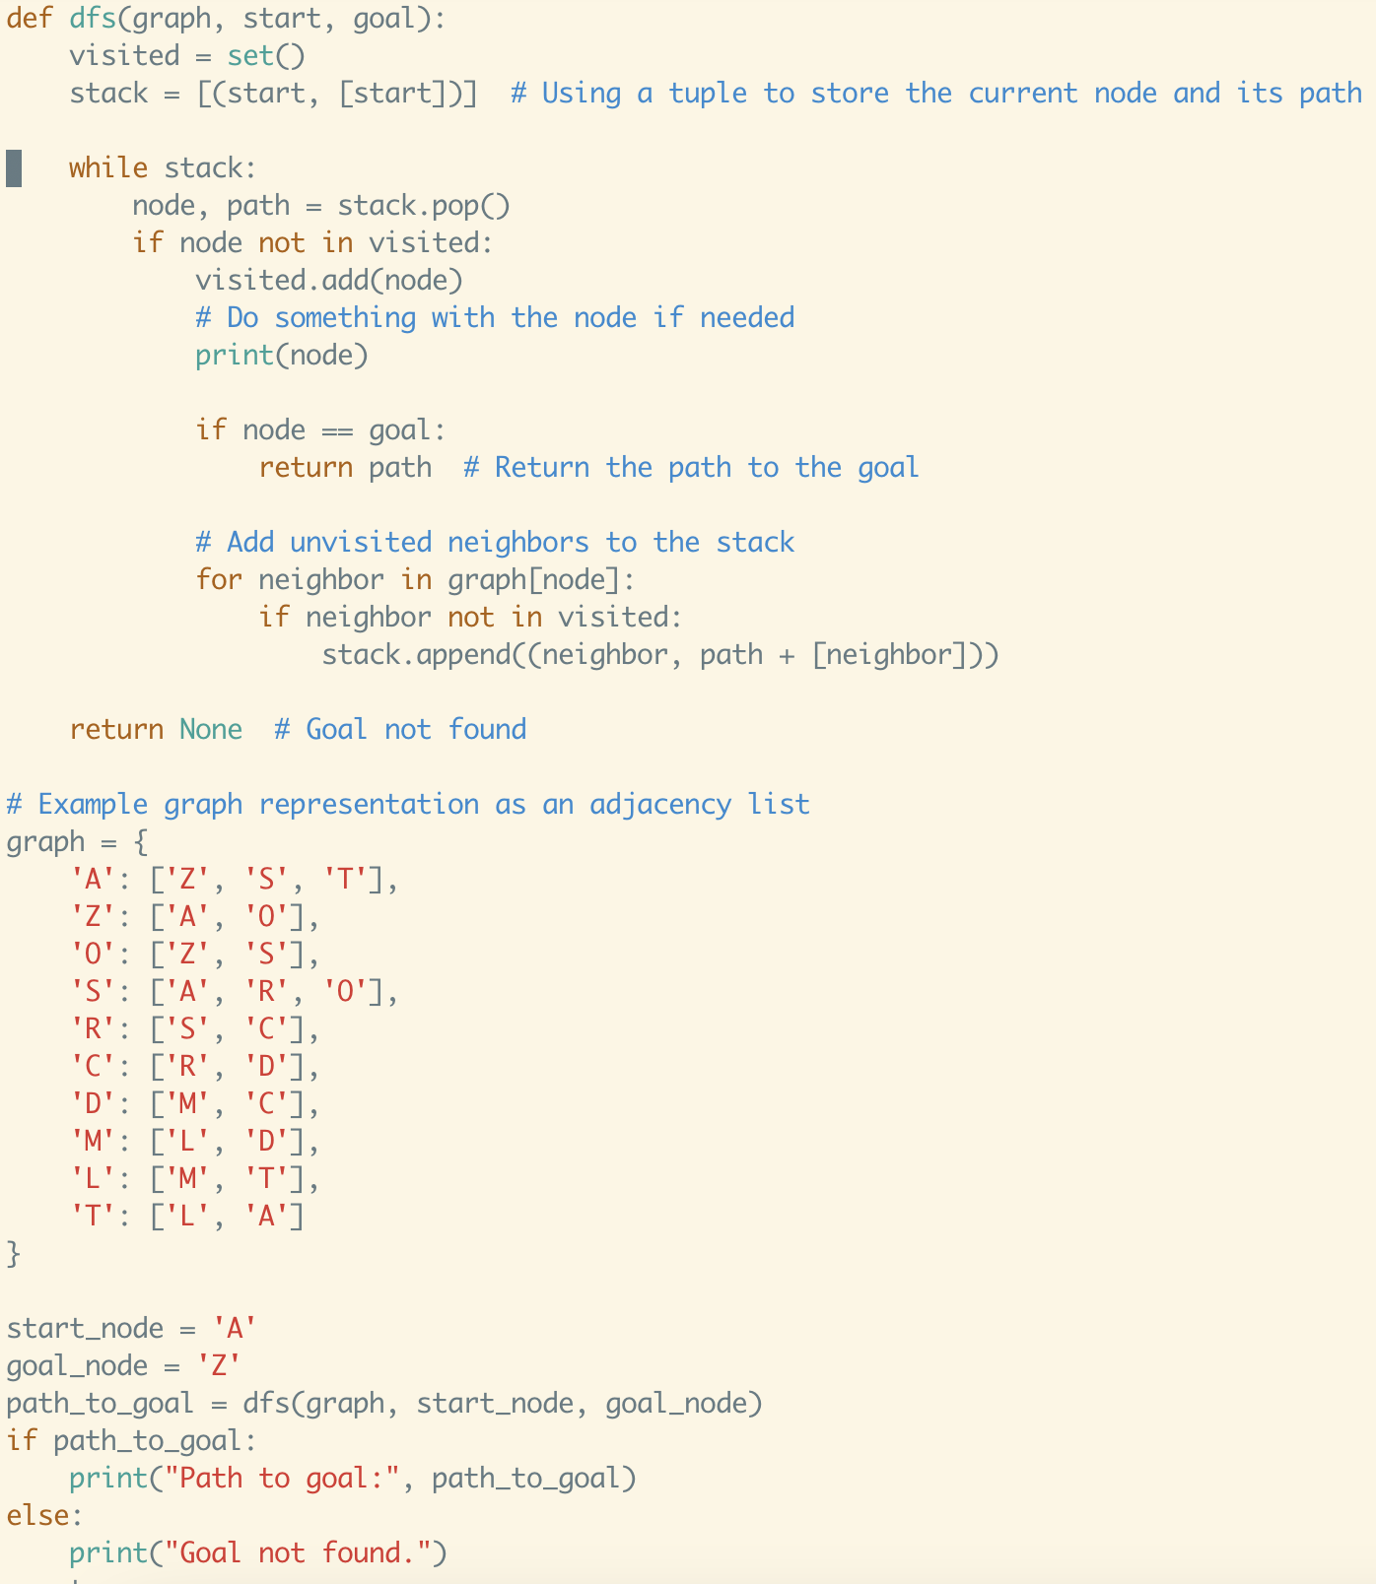
Oradea
71
75
Zerind
151
140
Sibiu
99
118
80
Rimnicu Vilcea
Timisoara
111
Lugoj
97
70
Mehadia
146
75
Dobreta
120
Craiova

Slide 46

Prevents cycles!
Oradea
71
75
Zerind
151
140
Sibiu
99
118
80
Rimnicu Vilcea
Timisoara
111
Lugoj
97
70
Mehadia
146
75
Dobreta
120
Craiova

Slide 47
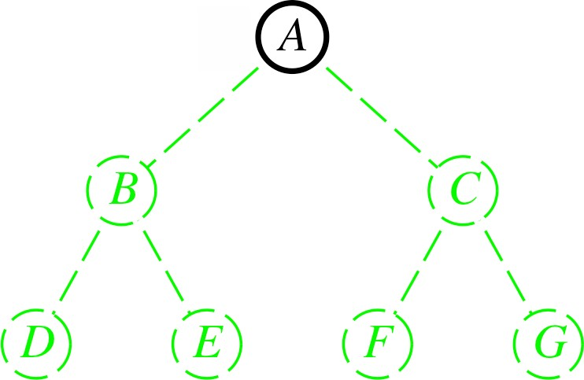
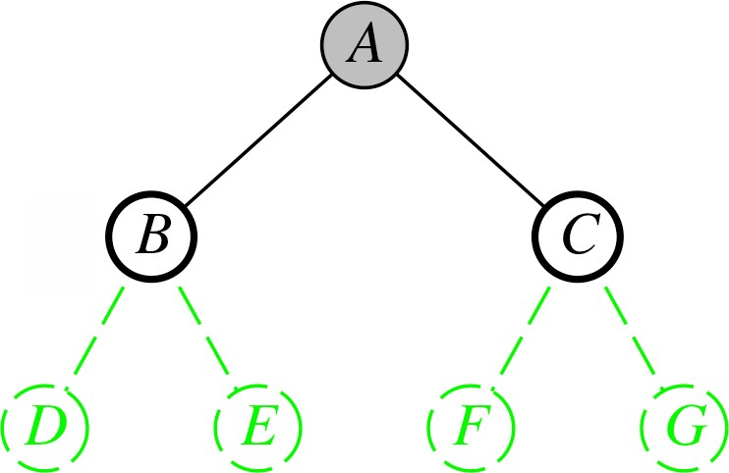
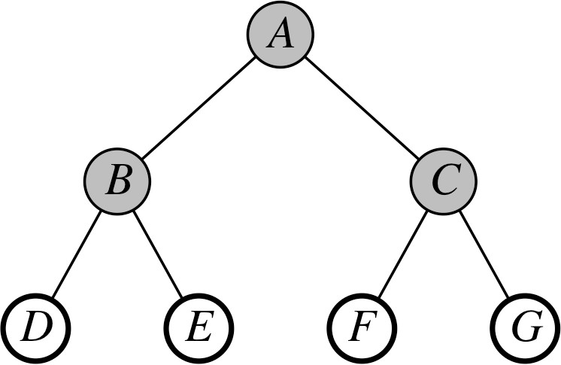
Limited-depth search
limit = 0:
function LD-Tree-Search(node, problem, limit)
if State(node) is a goal state then return the corresponding solution
else if limit = 0 then return Cutoff
else
did cutoff ← False
limit = 1:
for each y in Expand(node) do
result ← LD-Tree-Search(y, problem, limit − 1)
if result is a solution then return result
else if result = Cutoff then did cutoff ← True
if did cutoff then return Cutoff else return Failure
limit = 2:
Depth-first search, backtracks at limit
Returns a solution if it finds one
Else Cutoff if at least one cutoff occurred
Else Failure (all paths are dead ends)

Slide 48
Iterative deepening
function ID-Tree-Search( problem)
limit = 0:
node ← root node
for limit ← 0 to ∞ do
result ← LD-Tree-Search(node, problem, limit)
if result /= Cutoff then return result
function LD-Tree-Search(node, problem, limit)
if State(node) is a goal state then return the corresponding solution
else if limit = 0 then return Cutoff
else
limit = 1:
did cutoff ← False
for each y in Expand(node) do
limit = 2:
result ← LD-Tree-Search(y, problem, limit − 1)
if result is a solution then return result
else if result = Cutoff then did cutoff ← True
if did cutoff then return Cutoff else return Failure
Depth-limited search to deeper and deeper depths
Returns when it generates the goal

Slide 49
Optimality
DFS and its variants: not guaranteed to be optimal
BFS: optimal only if all edges have same costs
In general?

Slide 50
Uniform Cost Search / Dijkstra
UCS and Dijkstra are very similar
UCS finds the shortest path from start to goal
Dijkstra finds the shortest path from start to all other vertices + some other minor differences
Key idea:
BFS: FIFO
DFS: LIFO
UCS: minimum cost is the first out

Slide 51
Uniform-cost search
function Tree-Search(problem)
Oradea
71
frontier ← [root node]
Neamt
loop
if frontier is empty then return Failure choose and remove a node x from frontier if State[x] is a goal then
return the corresponding solution
else
expand x; add the new nodes to frontier
75
Zerind
151
87
Arad
Iasi
140
92
Sibiu
99
Fagaras
118
80
Rimnicu Vilcea
Vasl
Timisoara
111
Pitesti
211
142
Lugoj
97
70
85
98
Mehadia
146
101
Urziceni
Select node with minimum g value
priority queue, ordered by g values
75
Dobreta
138
120
Bucharest
90
Giurgiu
Craiova
Arad (0)
Timisoara (118)
Sibiu (140)
Zerind (75)
When adding a node to the frontier, also store the cost to reach that node from the start

Slide 52
Uniform-cost search
function Tree-Search(problem)
Oradea
71
frontier ← [root node]
Neamt
loop
if frontier is empty then return Failure choose and remove a node x from frontier if State[x] is a goal then
return the corresponding solution
else
expand x; add the new nodes to frontier
75
Zerind
151
87
Arad
Iasi
140
92
Sibiu
99
Fagaras
118
80
Rimnicu Vilcea
Vasl
Timisoara
111
Pitesti
211
142
Lugoj
97
70
85
98
Mehadia
146
101
Urziceni
Select node with minimum g value
priority queue, ordered by g values
75
Dobreta
138
120
Bucharest
90
Giurgiu
Craiova
Arad (0)
Timisoara (118)
Sibiu (140)
Zerind (75)
g(node) = g(parent) + edge cost (parent, node)

Slide 53
Uniform-cost search
function Tree-Search(problem)
Oradea
71
frontier ← [root node]
Neamt
loop
if frontier is empty then return Failure choose and remove a node x from frontier if State[x] is a goal then
return the corresponding solution
else
expand x; add the new nodes to frontier
75
Zerind
151
87
Arad
Iasi
140
92
Sibiu
99
Fagaras
118
80
Rimnicu Vilcea
Vasl
Timisoara
111
Pitesti
211
142
Lugoj
97
70
85
98
Mehadia
146
101
Urziceni
Select node with minimum g value
priority queue, ordered by g values
75
Dobreta
138
120
Bucharest
90
Giurgiu
Craiova
Arad (0)
Timisoara (118)
Sibiu (140)
Zerind (75)
Arad (150)
Oradea (146)

Slide 54
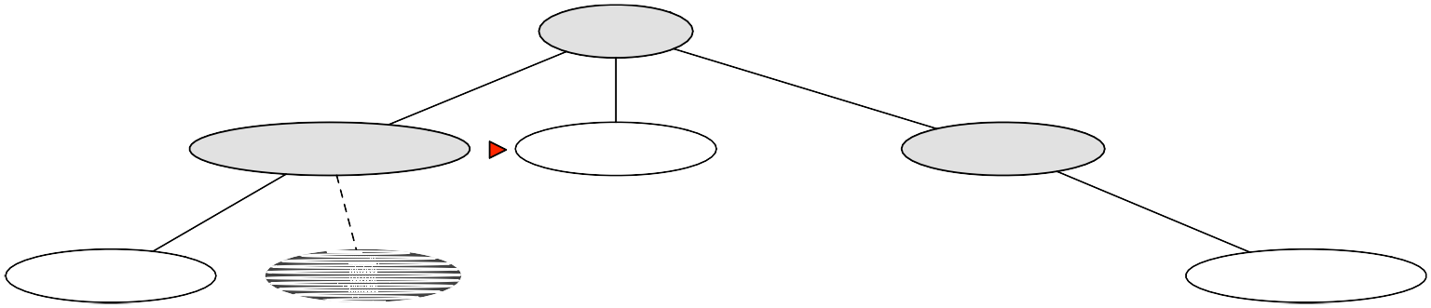
Uniform-cost search
function Tree-Search(problem)
Oradea
71
frontier ← [root node]
Neamt
loop
if frontier is empty then return Failure choose and remove a node x from frontier if State[x] is a goal then
return the corresponding solution
else
expand x; add the new nodes to frontier
75
Zerind
151
87
Arad
Iasi
140
92
Sibiu
99
Fagaras
118
80
Rimnicu Vilcea
Vasl
Timisoara
111
Pitesti
211
142
Lugoj
97
70
85
98
Mehadia
146
101
Urziceni
Select node with minimum g value
priority queue, ordered by g values
75
Dobreta
138
120
Bucharest
90
Giurgiu
Craiova
Arad (0)
Timisoara (118)
Sibiu (140)
Zerind (75)
Lugoj (229)
Arad (236)
Oradea (146)

Slide 55
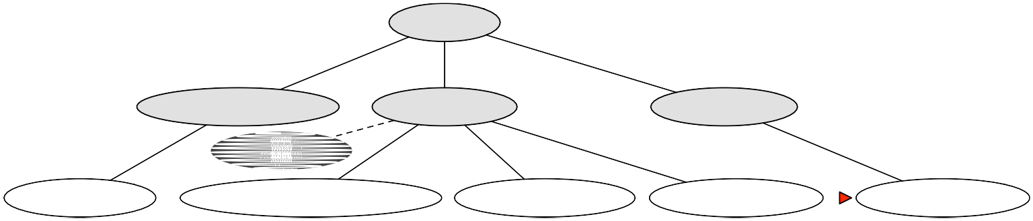
Uniform-cost search
function Tree-Search(problem)
Oradea
71
frontier ← [root node]
Neamt
loop
if frontier is empty then return Failure choose and remove a node x from frontier if State[x] is a goal then
return the corresponding solution
else
expand x; add the new nodes to frontier
75
Zerind
151
87
Arad
Iasi
140
92
Sibiu
99
Fagaras
118
80
Rimnicu Vilcea
Vasl
Timisoara
111
Pitesti
211
142
Lugoj
97
70
85
98
Mehadia
146
101
Urziceni
Select node with minimum g value
priority queue, ordered by g values
75
Dobreta
138
120
Bucharest
90
Giurgiu
Craiova
Arad (0)
Timisoara (118)
Arad (280)
Sibiu (140)
Zerind (75)
Lugoj (229)
Rimnicu Vilcea (220)
Fagaras (239)
Oradea (280)
Oradea (146)

Slide 56
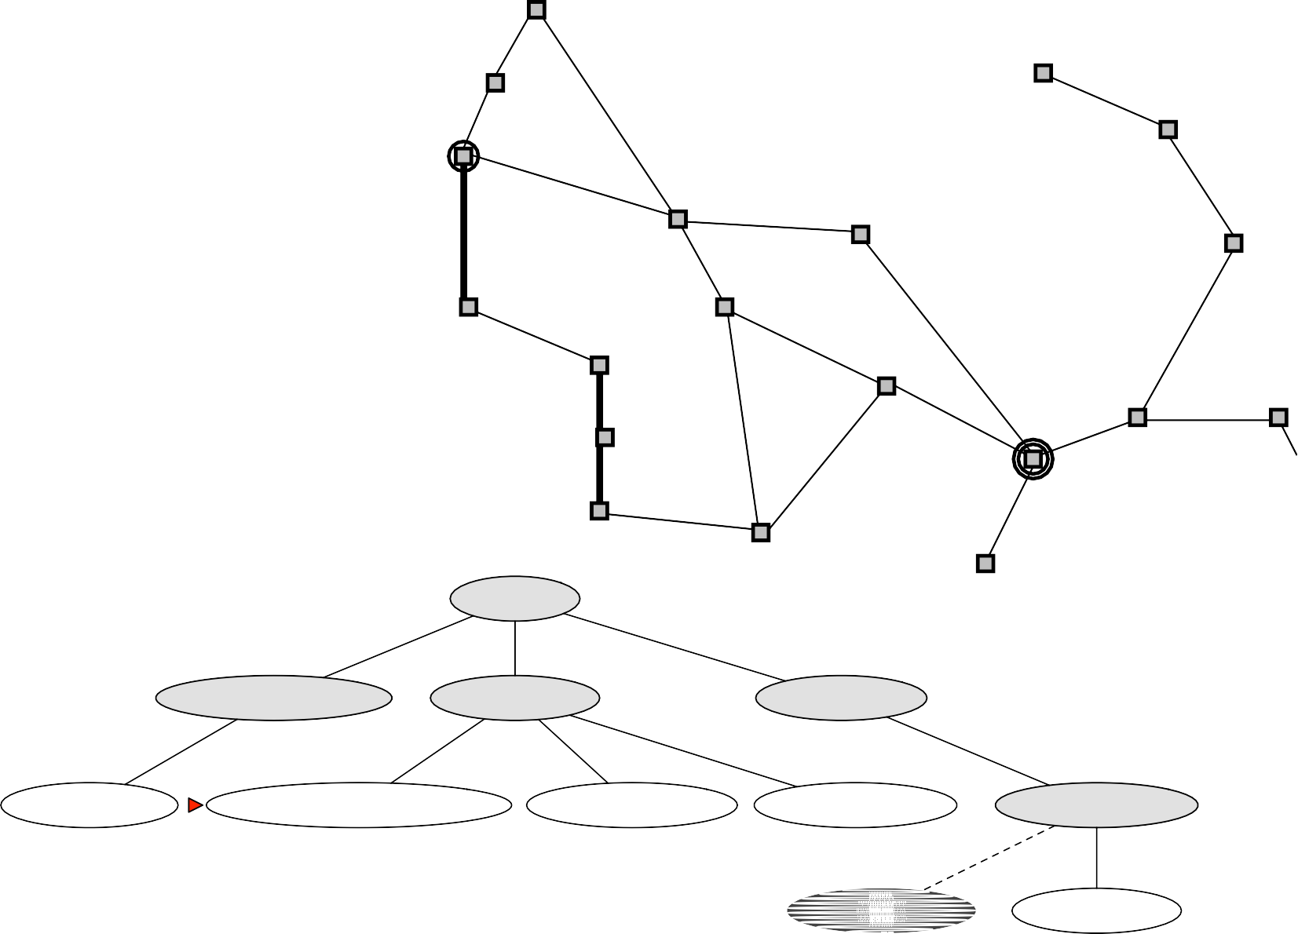
Uniform-cost search
function Tree-Search(problem)
Oradea
71
frontier ← [root node]
Neamt
loop
if frontier is empty then return Failure choose and remove a node x from frontier if State[x] is a goal then
return the corresponding solution
else
expand x; add the new nodes to frontier
75
Arad
Zerind
151
87
Iasi
140
92
Sibiu
99
Fagaras
118
80
Rimnicu Vilcea
Vasl
Timisoara
111
Pitesti
211
142
Lugoj
97
70
98
Urziceni
Mehadia
146
101
85
Select node with minimum g value
priority queue, ordered by g values
On solvable problems, guaranteed
75
Dobreta
138
120
Bucharest
90
Giurgiu
Craiova
Arad (0)
to find optimal solution
Timisoara (118)
Sibiu (140)
Zerind (75)
Lugoj (229)
Rimnicu Vilcea (220)
Fagaras (239)
Oradea (280)
Oradea (146)
Zerind (221)
Sibiu (297)

Slide 57
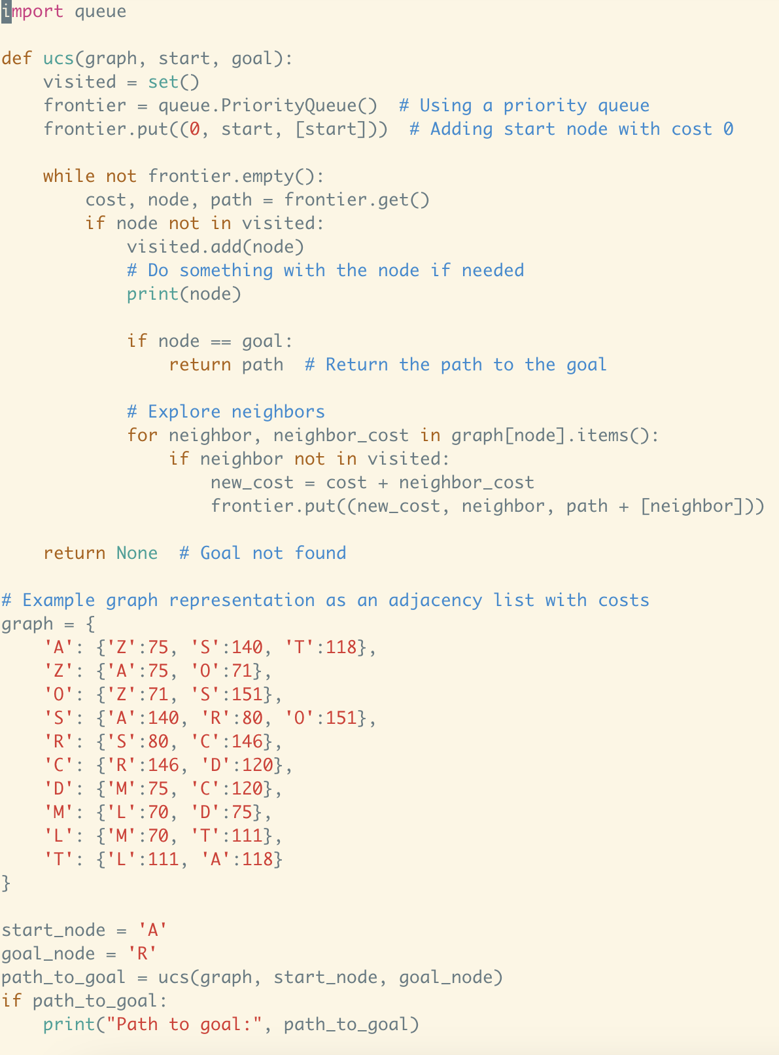

Slide 58
Comparison
Algorithm | Complete? | Optimal? | Running time | Space
BFS | Yes | If all costs are same | Best | Worst
DFS | With cycle detection | No | Worst | Best
Iterative Deepening | Yes | If all costs are same | Best | Better
UCS | If all costs are positive | If all costs are positive | Better | Worse

Slide 59
Heuristic Search
Can sometimes do much better on the average, using heuristics
Heuristic?
59

Slide 60
Heuristic Search
Can sometimes do much better on the average, using heuristics
Heuristic: an educated guess
Heuristic function h(x), where x is a state
estimate of h∗(x) = smallest possible cost of going from x to goal
Use it when choosing which node to expand next
A good heuristic function can reduce the amount of search by leading you toward a goal
A bad one can make you go in the wrong direction
60

Slide 61
Heuristic Search
Is a systematic guess!
g(x): minimum cost to reach x from start state
h(x): heuristic --- guess about the cost to go from x to G
UCS: choose node in frontier with lowest g(x)
A*: choose node in frontier with lowest g(x) + h(x)

Slide 62
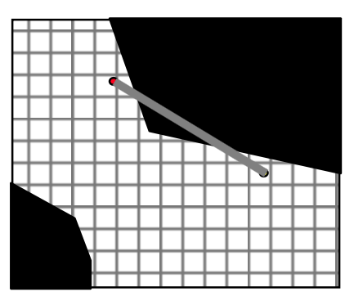
How to come up with a heuristic?
Not always possible -- just use h(x) = 0
Depending on the specific problem, you may have extra information that you can use
h(x_{i}) = 0 (UCS/Dijkstra)
h(x_{i}) = Euclidean distance from x_{i} to x_{G}
http://theory.stanford.edu/~amitp/GameProgramming/Heuristics.html

Slide 63
Straight line distance as h(x)
Recall that we want to get to Bucharest
Let h(x) = straight-line distance from x to Bucharest
Oradea
Straight−line distance to Bucharest
71
Neamt
Arad | 366
Bucharest | 0
Craiova | 160
Dobreta | 242
Eforie | 161
Fagaras | 176
Giurgiu | 77
Hirsova | 151
Iasi | 226
Lugoj | 244
Mehadia | 241
Neamt | 234
Oradea | 380
Pitesti | 100
Rimnicu Vilcea | 193
Sibiu | 253
Timisoara | 329
Urziceni | 80
Vaslui | 199
Zerind | 374
Zerind
151
87
75
Iasi
Arad
140
92
Sibiu
99
Fagaras
178
118
Vaslui
80
Timisoara
Rimnicu Vilcea
111
211
142
Lugoj
97
Pitesti
70
98
98
Mehadia
146
101
85
Urziceni
Hirsova
75
138
Bucharest
90
86
Dobreta
120
Craiova
Giurgiu
Eforie
63

Slide 64
A* tree search
Evaluation function f (x) = g(x)+ h(x)
g(x) = cost of path from root to x
h(x) = estimated cost from x to goal
f (x) = estimated total cost of path from root, through x, to goal
Same tree-search algorithm same as before
A∗ node selection:
argmin_{x∈frontier} f (x)
tie-breaking: oldest
Implementation:
frontier is a priority queue, ordered by f
function Tree-Search(problem)
frontier ← [root node]
loop
if frontier is empty then return Failure choose and remove a node x from frontier if State[x] is a goal then
return the corresponding solution
else
expand x; add the new nodes to frontier

Slide 65
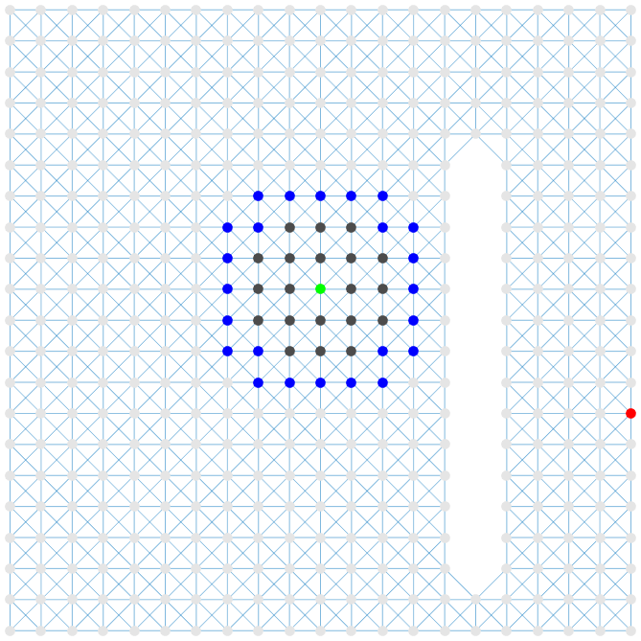
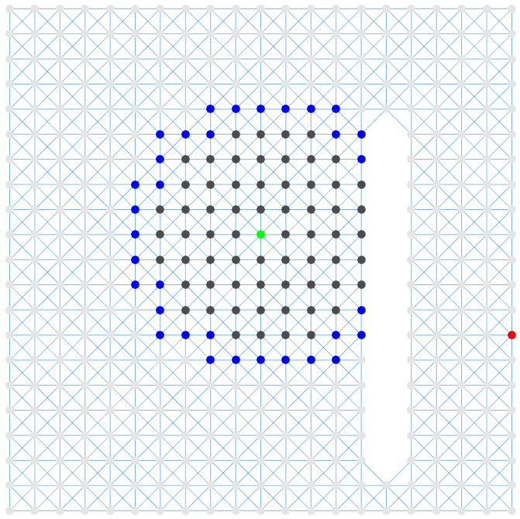
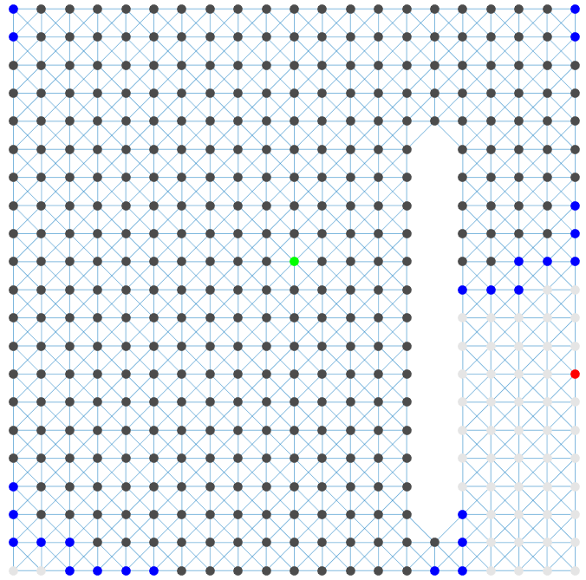
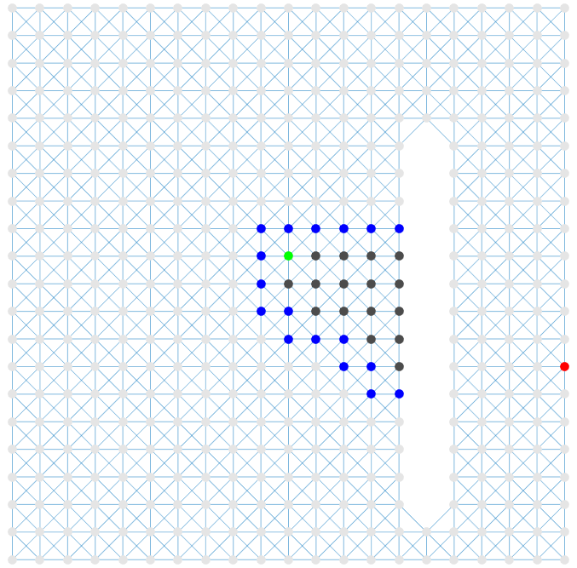
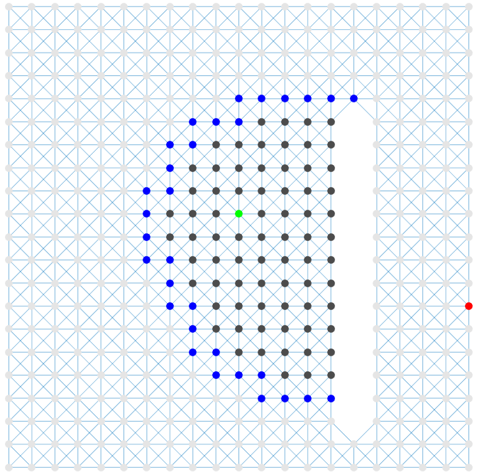
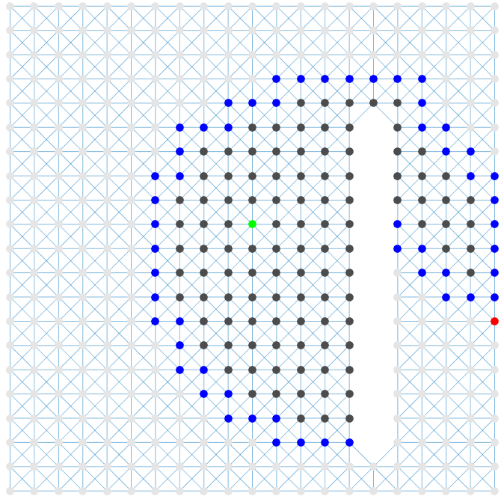
No heuristic
A* with straight-line heuristic.
Blue nodes are frontier.

Slide 66
Oradea
Straight−line distance to Bucharest
71
Neamt
Arad | 366
Bucharest | 0
Craiova | 160
Dobreta | 242
Eforie | 161
Fagaras | 176
Giurgiu | 77
Hirsova | 151
Iasi | 226
Lugoj | 244
Mehadia | 241
Neamt | 234
Oradea | 380
Pitesti | 100
Rimnicu Vilcea | 193
Sibiu | 253
Timisoara | 329
Urziceni | 80
Vaslui | 199
Zerind | 374
Zerind
151
87
75
Iasi
Arad
140
92
Sibiu
99
Fagaras
178
118
Vaslui
80
Timisoara
Rimnicu Vilcea
111
211
142
Lugoj
97
Pitesti
70
98
98
Mehadia
146
101
85
Urziceni
Hirsova
75
138
Bucharest
90
86
Dobreta
120
Craiova
Giurgiu
Arad 366=0+366
Eforie
Search tree:

Slide 67
Oradea
Straight−line distance to Bucharest
71
Neamt
Arad | 366
Bucharest | 0
Craiova | 160
Dobreta | 242
Eforie | 161
Fagaras | 176
Giurgiu | 77
Hirsova | 151
Iasi | 226
Lugoj | 244
Mehadia | 241
Neamt | 234
Oradea | 380
Pitesti | 100
Rimnicu Vilcea | 193
Sibiu | 253
Timisoara | 329
Urziceni | 80
Vaslui | 199
Zerind | 374
Zerind
151
87
75
Iasi
Arad
140
92
Sibiu
99
Fagaras
178
118
Vaslui
80
Timisoara
Rimnicu Vilcea
111
211
142
Lugoj
97
Pitesti
70
98
98
Mehadia
146
101
85
Urziceni
Hirsova
75
138
Bucharest
90
86
Dobreta
120
Craiova
Giurgiu
Eforie
Arad
Search tree:
Sibiu 393=140+253
Timisoara 447=118+329
Zerind 449=75+374

Slide 68
Oradea
Straight−line distance to Bucharest
71
Neamt
Arad | 366
Bucharest | 0
Craiova | 160
Dobreta | 242
Eforie | 161
Fagaras | 176
Giurgiu | 77
Hirsova | 151
Iasi | 226
Lugoj | 244
Mehadia | 241
Neamt | 234
Oradea | 380
Pitesti | 100
Rimnicu Vilcea | 193
Sibiu | 253
Timisoara | 329
Urziceni | 80
Vaslui | 199
Zerind | 374
Zerind
151
87
75
Iasi
Arad
140
92
Sibiu
99
Fagaras
178
118
Vaslui
80
Timisoara
Rimnicu Vilcea
111
211
142
Lugoj
97
Pitesti
70
98
98
Mehadia
146
101
85
Urziceni
Hirsova
75
138
Bucharest
90
86
Dobreta
120
Craiova
Giurgiu
Eforie
Arad
Search tree:
Sibiu
Timisoara 447=118+329
Zerind 449=75+374
Arad
646=280+366 415=239+176 671=291+380 413=220+193
Fagaras Oradea
Rimnicu Vilcea

Slide 69
Oradea
Straight−line distance to Bucharest
71
Neamt
Arad | 366
Bucharest | 0
Craiova | 160
Dobreta | 242
Eforie | 161
Fagaras | 176
Giurgiu | 77
Hirsova | 151
Iasi | 226
Lugoj | 244
Mehadia | 241
Neamt | 234
Oradea | 380
Pitesti | 100
Rimnicu Vilcea | 193
Sibiu | 253
Timisoara | 329
Urziceni | 80
Vaslui | 199
Zerind | 374
Zerind
151
87
75
Iasi
Arad
140
92
Sibiu
99
Fagaras
178
118
Vaslui
80
Timisoara
Rimnicu Vilcea
111
211
142
Lugoj
97
Pitesti
70
98
98
Mehadia
146
101
85
Urziceni
Hirsova
75
138
Bucharest
90
86
Dobreta
120
Craiova
Giurgiu
Eforie
Arad
Search tree:
Sibiu
Timisoara 447=118+329
Zerind 449=75+374
Arad 646=280+366
Fagaras Oradea 415=239+176 671=291+380
Rimnicu Vilcea
Craiova Pitesti Sibiu 526=366+160 417=317+100 553=300+253

Slide 70
Oradea
Straight−line distance to Bucharest
71
Neamt
Arad | 366
Bucharest | 0
Craiova | 160
Dobreta | 242
Eforie | 161
Fagaras | 176
Giurgiu | 77
Hirsova | 151
Iasi | 226
Lugoj | 244
Mehadia | 241
Neamt | 234
Oradea | 380
Pitesti | 100
Rimnicu Vilcea | 193
Sibiu | 253
Timisoara | 329
Urziceni | 80
Vaslui | 199
Zerind | 374
Zerind
151
87
75
Iasi
Arad
140
92
Sibiu
99
Fagaras
178
118
Vaslui
80
Timisoara
Rimnicu Vilcea
111
211
142
Lugoj
97
Pitesti
70
98
98
Mehadia
146
101
85
Urziceni
Hirsova
75
138
Bucharest
90
86
Dobreta
120
Craiova
Giurgiu
Eforie
Arad
Search tree:
Sibiu
Timisoara 447=118+329
Zerind 449=75+374
Arad 646=280+366
Fagaras
Oradea 671=291+380
Rimnicu Vilcea
Sibiu
Bucharest
Craiova
Pitesti
Sibiu
591=338+253
450=450+0
526=366+160 417=317+100
553=300+253

Slide 71
Oradea
Straight−line distance to Bucharest
71
Neamt
Arad | 366
Bucharest | 0
Craiova | 160
Dobreta | 242
Eforie | 161
Fagaras | 176
Giurgiu | 77
Hirsova | 151
Iasi | 226
Lugoj | 244
Mehadia | 241
Neamt | 234
Oradea | 380
Pitesti | 100
Rimnicu Vilcea | 193
Sibiu | 253
Timisoara | 329
Urziceni | 80
Vaslui | 199
Zerind | 374
Zerind
151
87
75
Iasi
Arad
140
92
Sibiu
99
Fagaras
178
118
Vaslui
80
Timisoara
Rimnicu Vilcea
111
211
142
Lugoj
97
Pitesti
70
98
98
Mehadia
146
101
85
Urziceni
Hirsova
75
138
Bucharest
90
86
Dobreta
120
Craiova
Giurgiu
Eforie
Arad
Search tree:
Sibiu
Timisoara 447=118+329
Zerind 449=75+374
Arad 646=280+366
Fagaras
Oradea 671=291+380
Rimnicu Vilcea
Sibiu 591=338+253
Bucharest 450=450+0
Craiova 526=366+160
Pitesti
Sibiu 553=300+253
Bucharest 418=418+0
Craiova 615=455+160
Rimnicu Vilcea
607=414+193
18

Slide 72
What’s a good heuristic?
heuristic gives an overestimate of actual cost
h(x) > minimum cost to reach G from x
heuristic gives an underestimate of actual cost
h(x) <= minimum cost to reach G from x

Slide 73
What’s a good heuristic?
heuristic gives an overestimate of actual cost
h(x) > minimum cost to reach G from x
heuristic gives an underestimate of actual cost
h(x) <= minimum cost to reach G from x
A* tree search will return optimal solution if an admissible heuristic is used. (admissible = underestimate).
YouTube animation showing admissible vs. non-admissible.
YouTube video explaining A* and admissibility.

Slide 74
Comparison
Algorithm | Complete? | Optimal? | Running time | Space
BFS | Yes | If all costs are same | Best | Worst
DFS | With cycle detection | No | Worst | Best
Iterative Deepening | Yes | If all costs are same | Best | Better
UCS | If all costs are positive | If all costs are positive | Better | Worse
A* | If all costs are positive | If heuristic is admissible | Better than or equal to UCS | Better than or equal to UCS

Slide 75
Note
There are graph versions and tree versions of the algorithms we’ve seen
We covered the tree version
The graph version is similar but uses different data structures (open lists/closed lists) than the ones we used (frontier as queue/stack)
Be careful of the version you are using

