Slide 1
Neural Networks
Troi Williams
(Slide credits: Prof. Pratap Tokekar)

Slide 2
Same idea as single neuron
Start with some initial weights w = [w₀, w₁, …]
Repeat until convergence
For each input x^{j}, use the current weights w to compute the output of the network f_{w}(x^{j})
Compute the loss E(w) between f_{w}(x^{j}) and y^{j}
Compute the gradient of the loss wrt each w_{i}
slightly more complicated equation
Update each weight w_{i} based on the gradient

Slide 3
Neural Network w/ Backpropagation
Start with some initial weights w = [w₀, w₁, …]
Repeat until convergence
For each input x^{j}, use the current weights w to compute the output of all the neurons and the final output f_{w}(x^{j})
Compute the loss E(w) between f_{w}(x^{j}) and y^{j}
Compute the gradient of the loss at the output layer
Use that to compute the gradient of the loss at the last-but-one layer
…
Update each weight w_{i} based on the gradient

Slide 4
Convergence
Depends on the loss function
Convex loss function → eventually converges to the optimal weights
Loss function is rarely, if ever, convex
Converges to local minima instead of global one

Slide 5
Demo
https://playground.tensorflow.org
http://www.ccom.ucsd.edu/~cdeotte/programs/neuralnetwork.html

Slide 6
Training a NN
Gradient descent requires training data
input: x output (aka target values): y
Often need lots of data (if you want to learn a complex function)
Available in many cases
image classification: get training data by human annotation

Slide 7
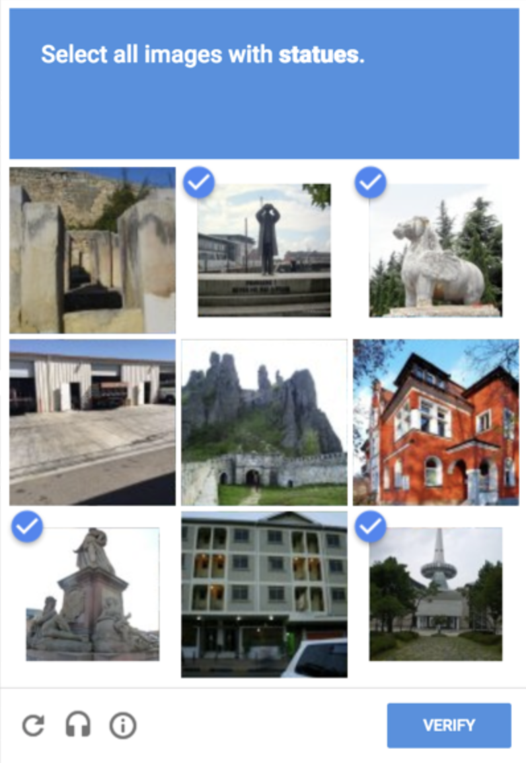
You have helped train a NN before

Slide 8
Designing a NN
There is no canonical architecture
The architecture depends on the specific problem
In practice, don’t start by designing a new architecture for a new problem
Instead, start with one that is known to work
Often, the quality of data impacts the final performance (loss)

Slide 9
Designing a NN
Remember, the only unknowns are the weights
Everything else should be decided by you
How many layers?
How many neurons in each layer?
How to connect the neurons?
What activation function to use?
What loss function to use?
What gradient descent method to use?
What update method to use?
What is your convergence criterion?

Slide 10
How to connect the neurons?
Fully connected
Convolutional
Pooling
Recurrent/LSTM
Attention
…

Slide 11
How to connect the neurons?
Fully connected
Convolutional
Pooling
Recurrent/LSTM
Attention
…
useful in image processing

Slide 12
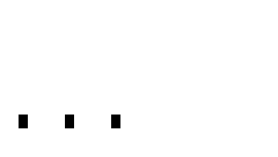

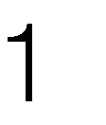
How to connect the neurons?
Fully connected
Convolutional
Pooling
Recurrent/LSTM
Attention
…
x
w
Typically in the later layers

Slide 13
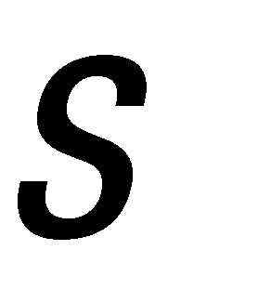


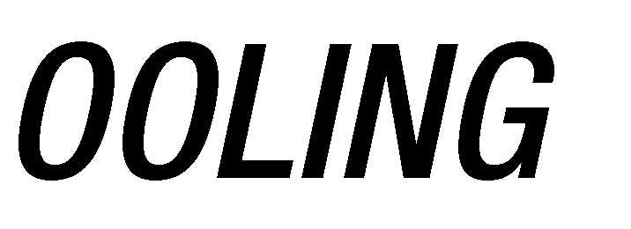
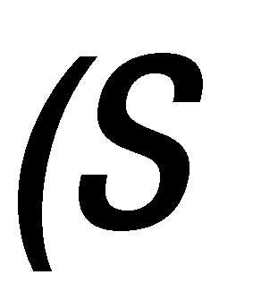

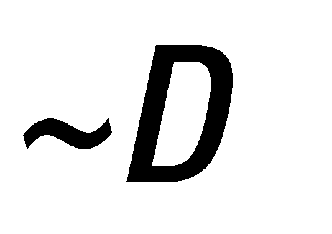

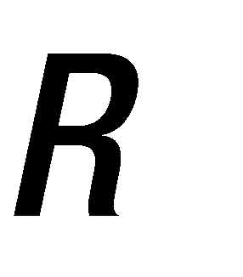
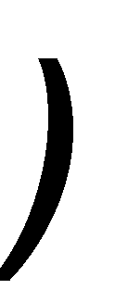

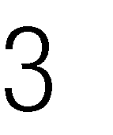
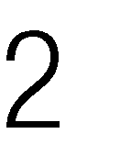
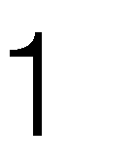
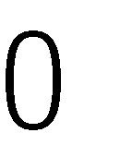
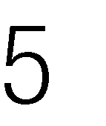
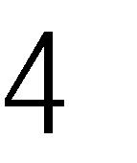
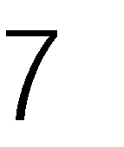

Slide 14
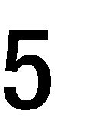
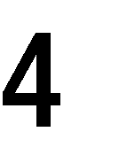
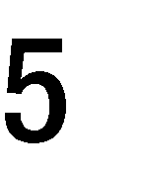
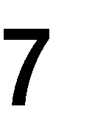
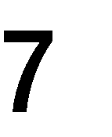

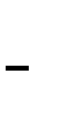
4 x 4
2 x 2

Slide 15
4 x 4
3 x 3

Slide 16
4 x 4
3 x 3

Slide 17
4 x 4
3 x 3

Slide 18
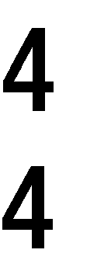
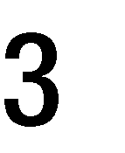
4 x 4
3 x 3

Slide 19
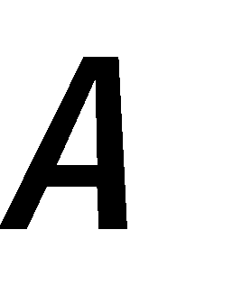

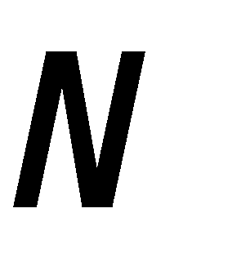

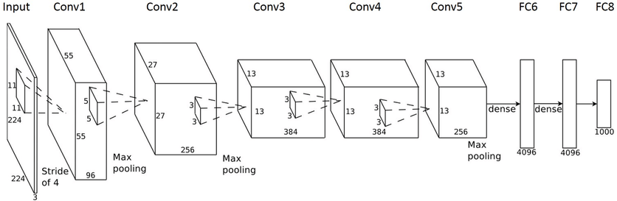

Slide 20


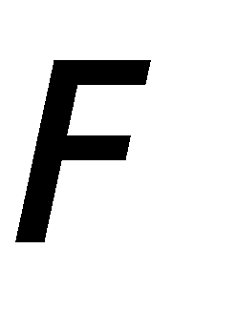

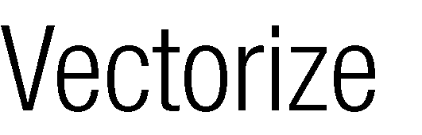

Slide 22
Designing a NN
Remember, the only unknowns are the weights
Everything else should be decided by you
How many layers?
How many neurons in each layer?
How to connect the neurons?
What activation function to use?
What loss function to use?
What gradient descent method to use?
What update method to use?
What is your convergence criterion?

Slide 23
What activation function to use?
Sigmoid
tanh
ReLU
Softmax
Identity
1
w₀
x₁
w₁
?
f(x)
w₂
x₂

Slide 24
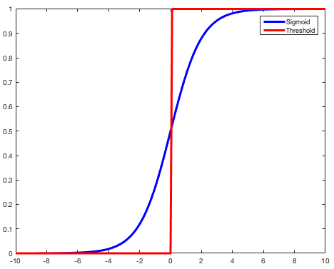
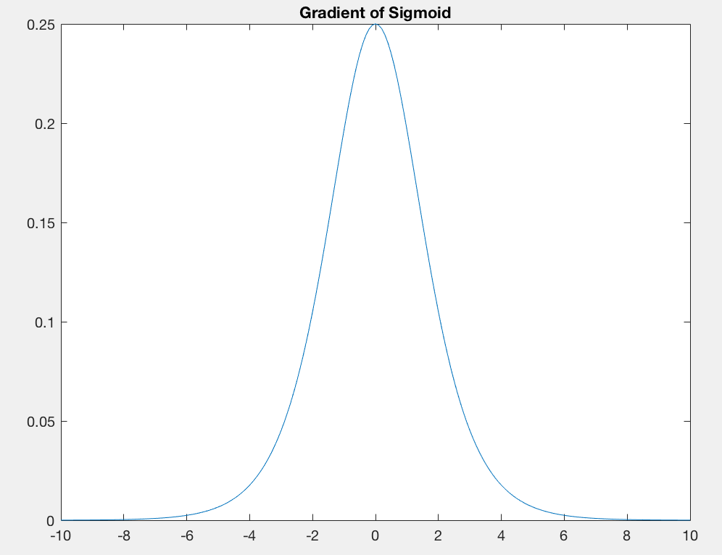
Problems with Sigmoid Activation
Sigmoid function saturates at 0 and 1
This kills the gradient (i.e., gradient goes to 0 near these points)
If the gradient is small, then the updates in the weights are also small, leading to slower convergence.

Slide 25
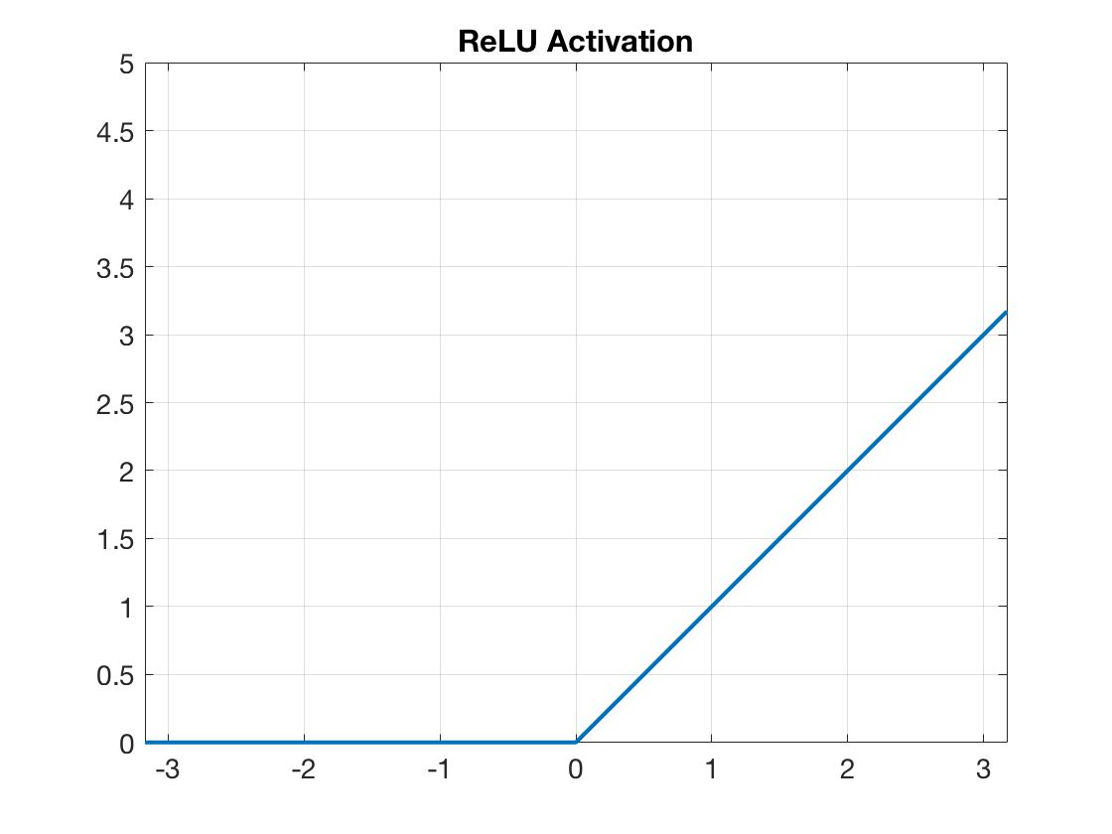
What activation function to use?
Sigmoid
tanh
Rectified Linear Unit
Softmax
Identity
ReLU is discontinuous. The gradient at z=0 is therefore not defined when z=0 (but is defined everywhere else). This is not a problem, in practice, since z=0 happens very rarely. We can set the gradient arbitrarily when it does happen (this is a hack). There are other continuous versions of ReLU that can be used instead.

Slide 26
What activation function to use?
These two are usually used at the last (output) layer
Sigmoid
tanh
ReLU
Softmax – classification problems
Identity – regression problems

Slide 27
Designing a NN
Remember, the only unknowns are the weights
Everything else should be decided by you
How many layers?
How many neurons in each layer?
How to connect the neurons?
What activation function to use?
What loss function to use?
What gradient descent method to use?
What update method to use?
What is your convergence criterion?

Slide 28
What loss function to use?
Depends on what function you want to approximate with your NN.
Regression problems
Output is continuous*
We want f(x^{j}) to be close to true function output y^{j}
Use mean-squared error (L2)
*piecewise continuous is okay

Slide 29
Classification problems
Output is a discrete class label instead of a continuous function
Digit classification example
We have only two possibilities*
f(x^{j}) = y^{j}
f(x^{j}) != y^{j}
Hinge loss
Cross-entropy loss
KL divergence

Slide 30
Designing a NN
Remember, the only unknowns are the weights
Everything else should be decided by you
How many layers?
How many neurons in each layer?
How to connect the neurons?
What activation function to use?
What loss function to use?
What gradient descent method to use?
What update method to use?
What is your convergence criterion?

Slide 31
Many Alternatives
Batch (what we covered – sum over all training samples)
Stochastic gradient descent (SGD)
Mini-batch gradient descent
Momentum
RMSPropagation, Adam (Adaptive moment estimation), Adagrad (Adaptive gradient)
https://cs.stanford.edu/people/karpathy/convnetjs/demo/trainers.html

Slide 32
Hyperparameter optimization
Lots and lots of hyperparams
Learning rate (alpha)
random seeds
batch size
filter size
…
Performance is very sensitive to hyperparams
How to find the right configuration of hyperparams?

Slide 33
Demo
http://www.ccom.ucsd.edu/~cdeotte/programs/neuralnetwork.html
https://cs.stanford.edu/people/karpathy/convnetjs/demo/regression.html
https://playground.tensorflow.org/

Slide 34
Designing a NN
Remember, the only unknowns are the weights
Everything else should be decided by you
How many layers?
How many neurons in each layer?
How to connect the neurons?
What activation function to use?
What loss function to use?
What gradient descent method to use?

Slide 35
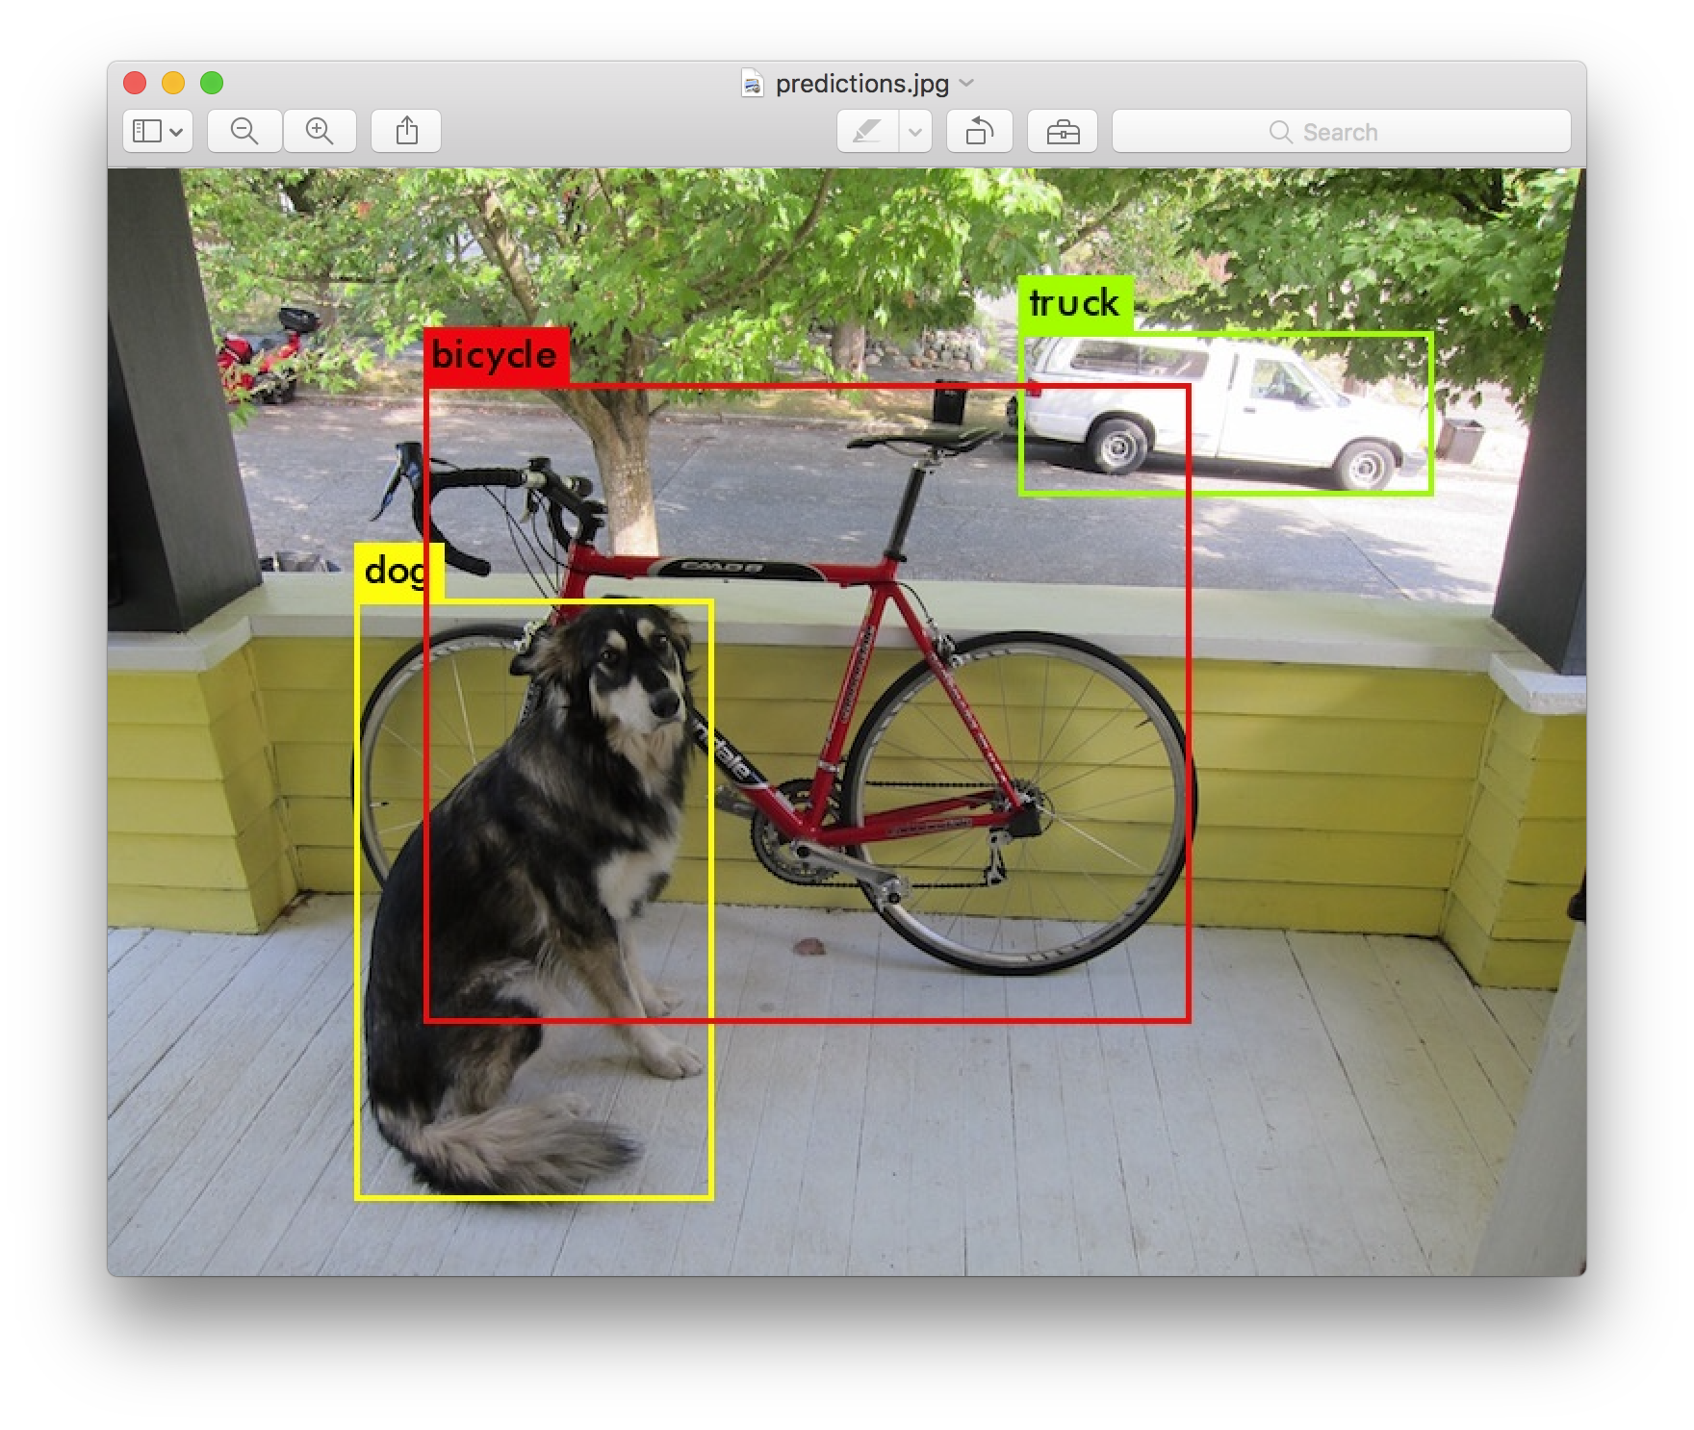
Let’s Talk about YOLO
YOLO Object Detector
https://www.youtube.com/watch?v=MPU2HistivI

Slide 36
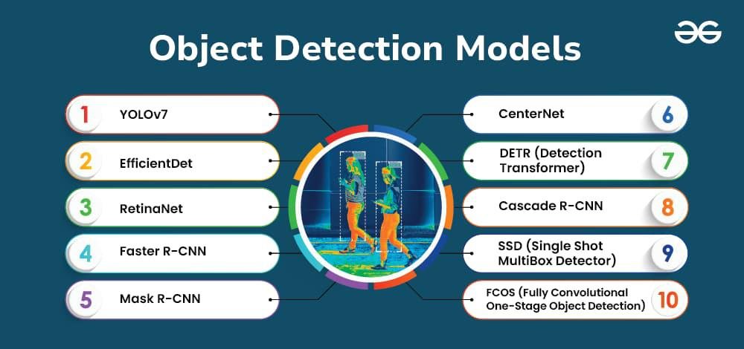
YOLO’s not the first or last!
(from geeksforgeeks.org)

Slide 37
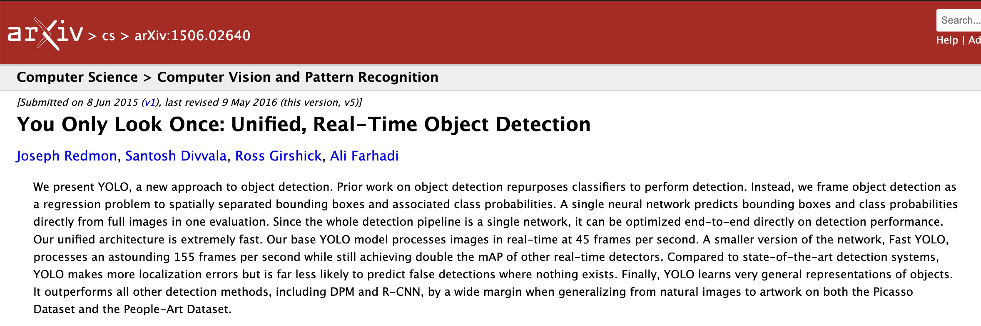
Why was YOLO created?
Created in 2015!!!

Slide 38
Why was YOLO created?
Created in 2015!!!
Why? (Any clues?)

Slide 39
Why was YOLO created?
Created in 2015!!!
Why? (Hint: in CS, we always seek for a method to be better how?)

Slide 40
Why was YOLO created?
Created in 2015!!!
Why? Earlier models were too complex and slow!

Slide 41
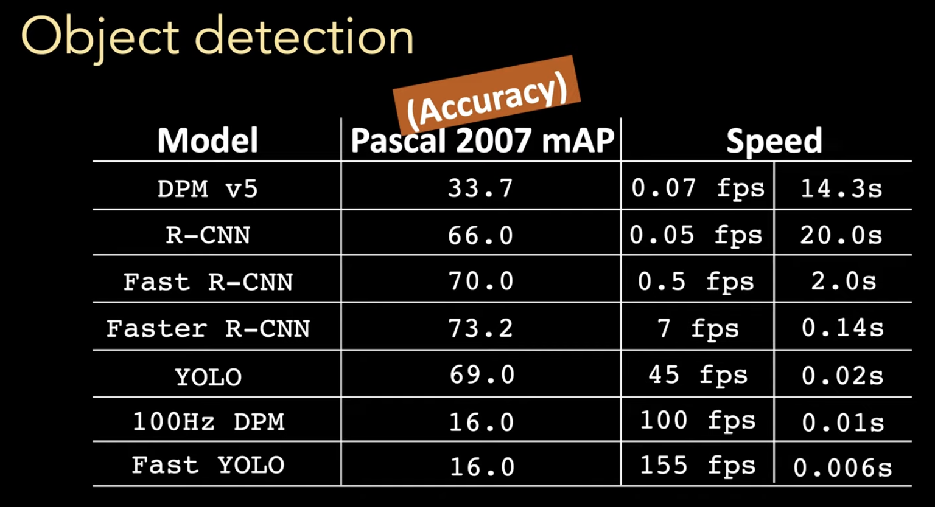
Why was YOLO created?
Notes:
A good balance between speed and accuracy

Slide 42




Why was YOLO created?
Notes:
A good balance between speed and accuracy

Slide 43
Why was YOLO created?
Created in 2015!!!
Why? Earlier models were too complex and slow!
Who was dominate before YOLO? (any clue?)

Slide 44
Why was YOLO created?
Created in 2015!!!
Why? Earlier models were too complex and slow!
Who was dominate before YOLO? The R-CNN family (R-CNN, Fast R-CNN, Faster R-CNN, etc.)

Slide 45
Why was YOLO created?
Created in 2015!!!
Why? Earlier models were too complex and slow!
Who was dominate before YOLO? The R-CNN family (R-CNN, Fast R-CNN, Faster R-CNN, etc.)
What is the R-CNN family?

Slide 46
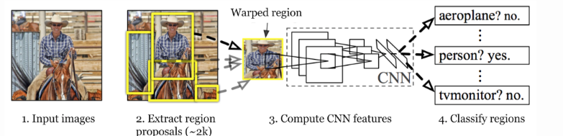
About the R-CNN family
Multiple step network:
Generate region proposals
Extract features
Classify objects and refine their bounding boxes

Slide 47
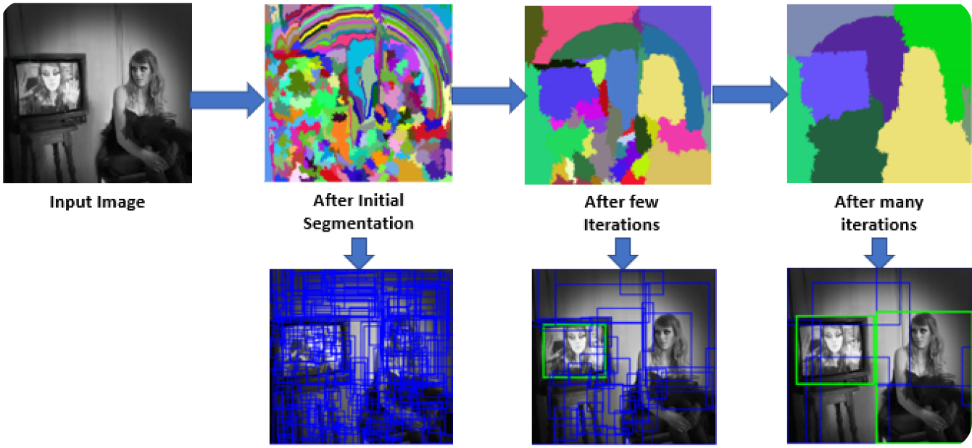
Region Proposals via Selective Search
Notes:
Use color, texture, shape, etc. to find similar regions.
Selective search helps identify where objects MIGHT be.
Proposal regions allow the network to focus on subsets of the image rather than the entire image.

Slide 48
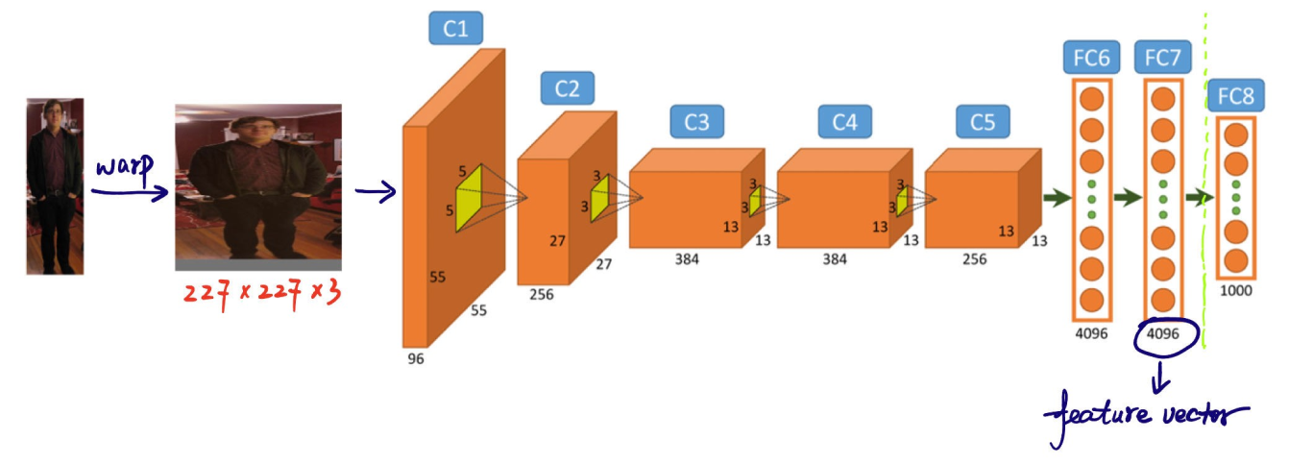
Feature Extraction via CNNs

Slide 49
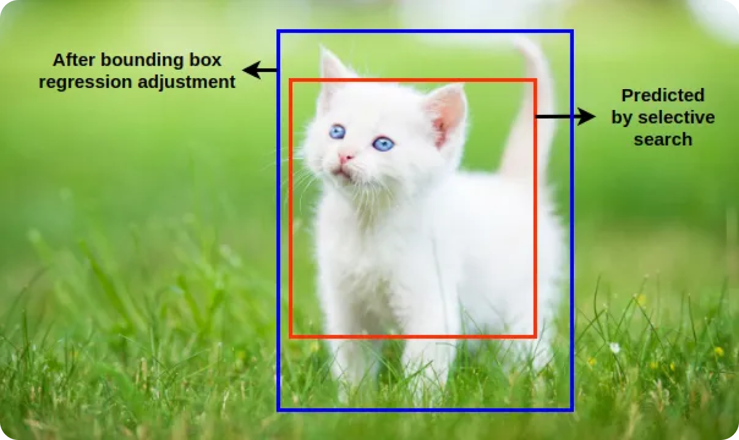
Object Classification
Notes:
Pass the extracted features through an SVM to classify the object.
Bounding box regression refines dimensions of the bounding box to better match the object.

Slide 50
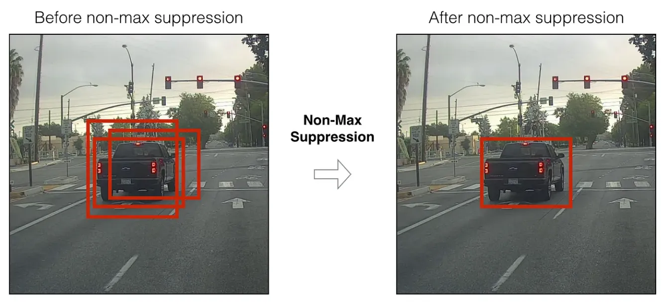
Non-Maximum Suppression
Notes:
Take the bounding box with the highest score and suppress the boxes that overlap with it a lot.

Slide 51
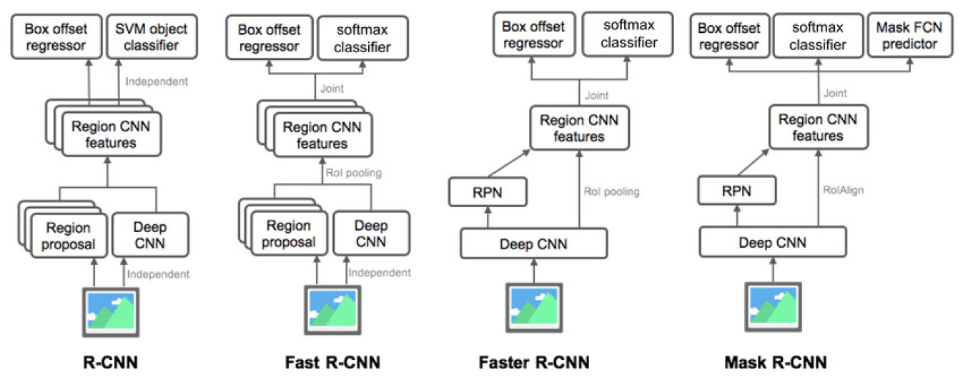
The R-CNN Family

Slide 52
The R-CNN Family Limitations
Slow inference times: 2k proposals that are fed to a CNN
High compute costs: The CNN must process many overlapping regions.

Slide 53
Key Aspect about YOLO
Approach of prior models: Look at the image MANY times to do detection.

Slide 54
Key Aspect about YOLO
Approach of prior models: Look at the image MANY times to do detection.
Approach of YOLO: ???

Slide 55
Key Aspect about YOLO
Approach of prior models: Look at the image MANY times to do detection.
Approach of YOLO: You Only Look Once!

Slide 56
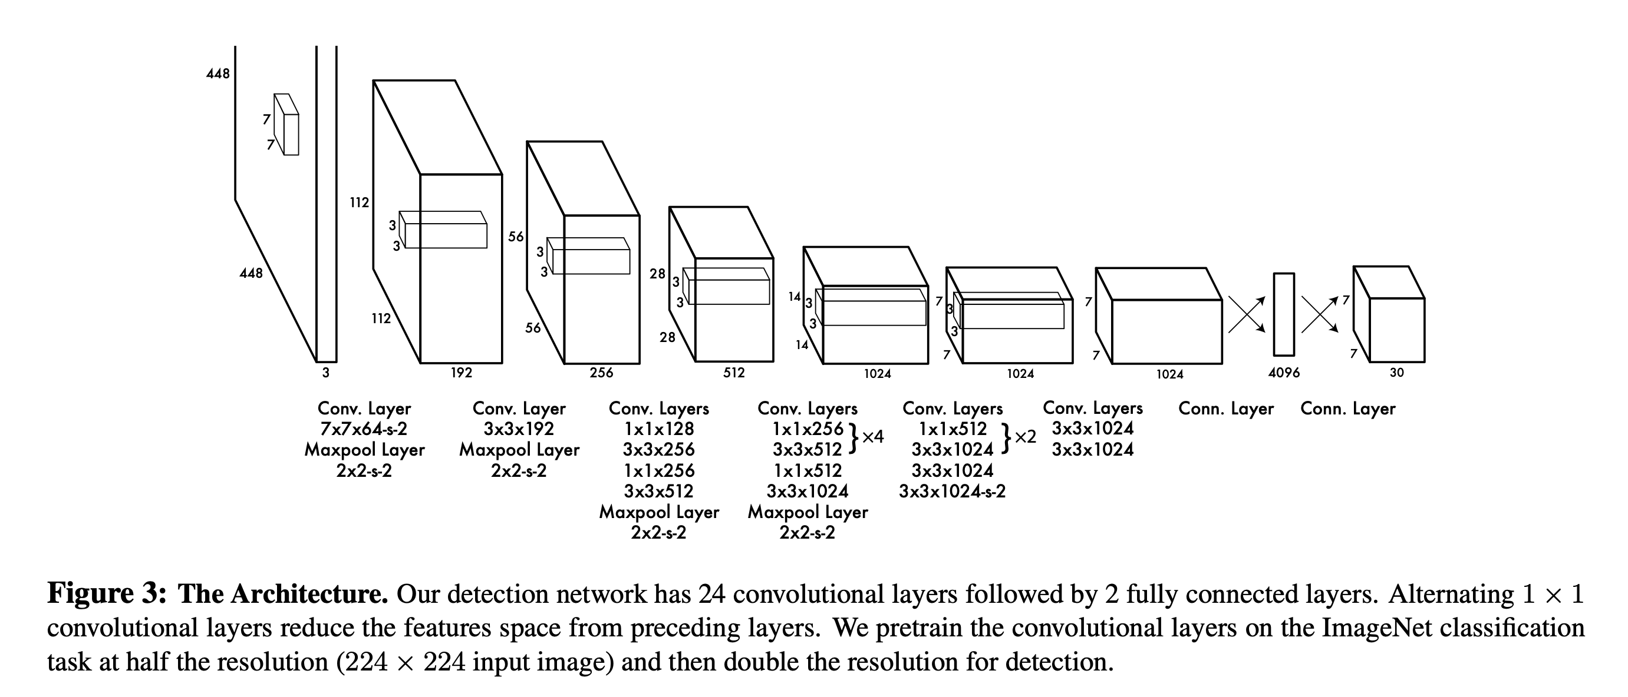
The YOLO Architecture
Input: 448x448x3 (RGB) image
Output: 7x7x30 tensor

Slide 57
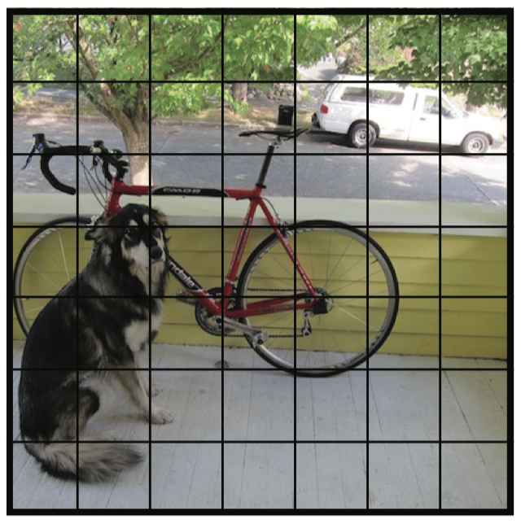
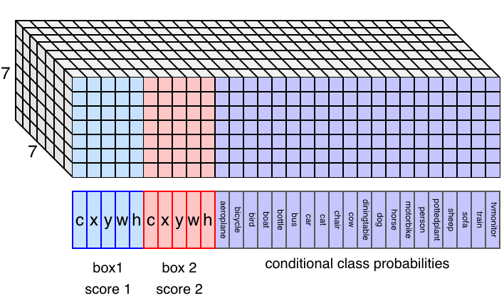
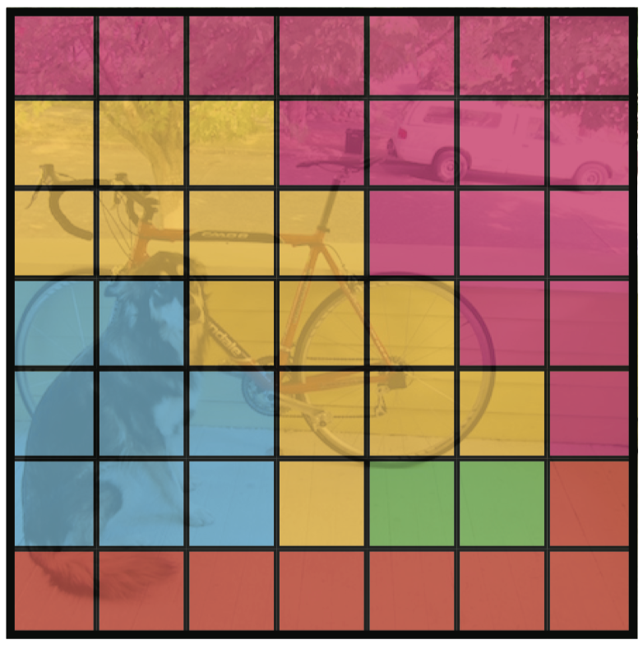
7x7x30 dimensional output
Notes:
Class prob map → What object class is most likely within each cell given that an object exists in the cell at all.

Slide 58
7x7x30 dimensional output
We will output a 30 dimensional vector for each of the 7x7 grid cells

Slide 59
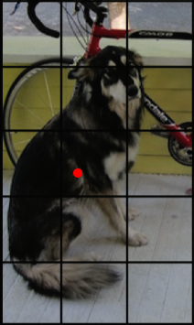
7x7x30 dimensional output
If an object center falls in a grid cell, then that cell is responsible to detect it.
The corresponding 30 dimensional vector should detect the bounding box.

Slide 60
7x7x30 dimensional output
If an object center falls in a grid cell, then that cell is responsible to detect it.

Slide 61
7x7x30 dimensional output
c: confidence score that object lies in that grid cell
x, y: relative position of bbox center within the cell
w, h: width and height of bbox
+ 20 probabilities for which object type it is
Notes:
Conf → the model’s confidence that an object actually exists in the box
Bbox params → x, y center and height and width (each cell will have multiple bounding boxes)
P → For each grid cell, we output a list of class probabilities

Slide 62
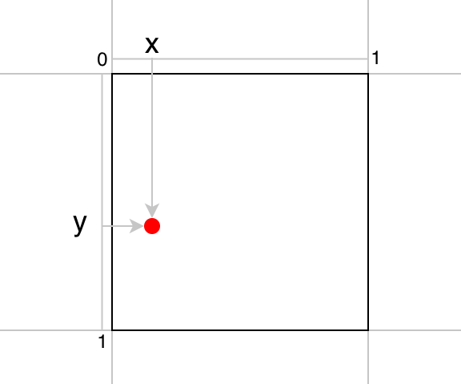
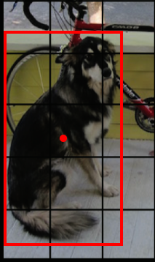
7x7x30 dimensional output

Slide 63
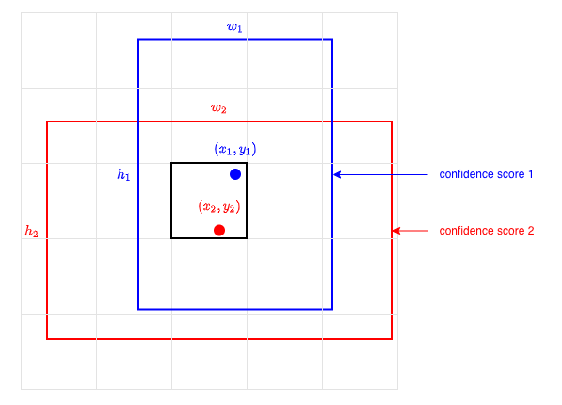
7x7x30 dimensional output

Slide 64

49 x 2 bounding boxes predicted per image
Only keep the ones with the highest confidence scores that don’t overlap

Slide 65

Mean Square Error Loss with weights (lambdas) for different terms in the loss

Slide 66

Want to Learn More?

