Slide 1
Interregional migration in the Dutch Regional Population and Household Projections
Notes:
-The Population Forecast: by PBL and CBS, PRIMOS prognose

Slide 2
The Regional Population and Household Projections
Projections of population, households and demographic events in Dutch municipalities until 2040
Carried out every three years: previous edition was in 2016, next in 2019
Netherlands Environmental Assessment Agency (PBL) and Statistics Netherlands (CBS)
Regional projections (PBL/CBS) are made consistent with the national projections (CBS)
The projections made with the cohort-component model PEARL (Projecting population Events at Regional Level)
Trends in components of population growth and transition rates between household positions are projected separately as inputs to the model

Slide 3
Migration and regional population growth
Internal migration is a key driver of population changes at the regional level
PEARL distinguishes long- and short distance migration (cut-off 35 km)
Trends in short-distance migration are predicted with a spatial interaction (gravity) model
i,j: municipality
M: moves
O: departures
P: population
D: distance
C: centrality
H: net new dwellings
α,β,γ,δ: estimated
parameters
Notes:
- 35 Cut- off: underlying assumption is that short-distance migration is driven by a wish to move to a new apartment. Cut-off is a result of a study examining whether housing was a main motive for moves of different ranges.
Centrality measure: how attractive is i compared to Cij=Σk=1;k≠j;k≠iPk/Djk
Estimated parameters are elasticities of each independent variable
Model is linearised and parameters are estimated

Slide 4
The role of the dwelling stock
Strong relation between population growth and the number of dwellings: effect of new construction is particularly strong in municipalities with a shortage of housing
Short-distance migration in PEARL:
Potential moves estimated with spatial interaction model
Actual migration calculated by taking into account housing availability (potentially moving back to 1…)
Building plans are obtained through a combination of desk research and consultation with municipalities and provinces
http://www.pbl.nl/publicaties/pbl-cbs-regionale-bevolkings-en-huishoudensprognose-2016-2040-woningbouwveronderstellingen

Slide 5
Regional population from the 2016 edition
The population of the Netherlands will grow until 2040
But the growth is unevenly spread: strong growth in the urban agglomerations, population decline in peripheral regions

Slide 6
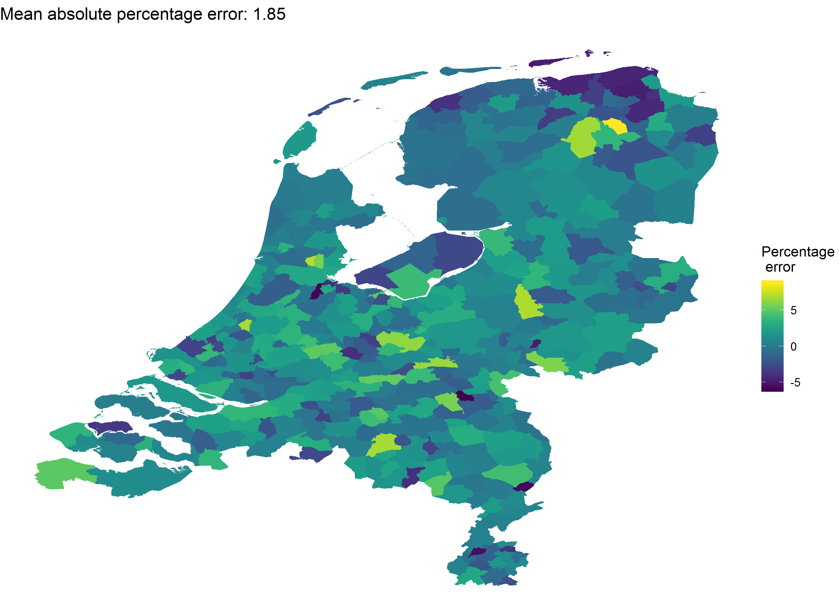
How accurate were the projections?
Population in 2017 according to the 2013 edition, compared with the data
Notes:
Corrected for municipalitiy changes
Between -5 and 5, average absolute error of 1.85

Slide 7
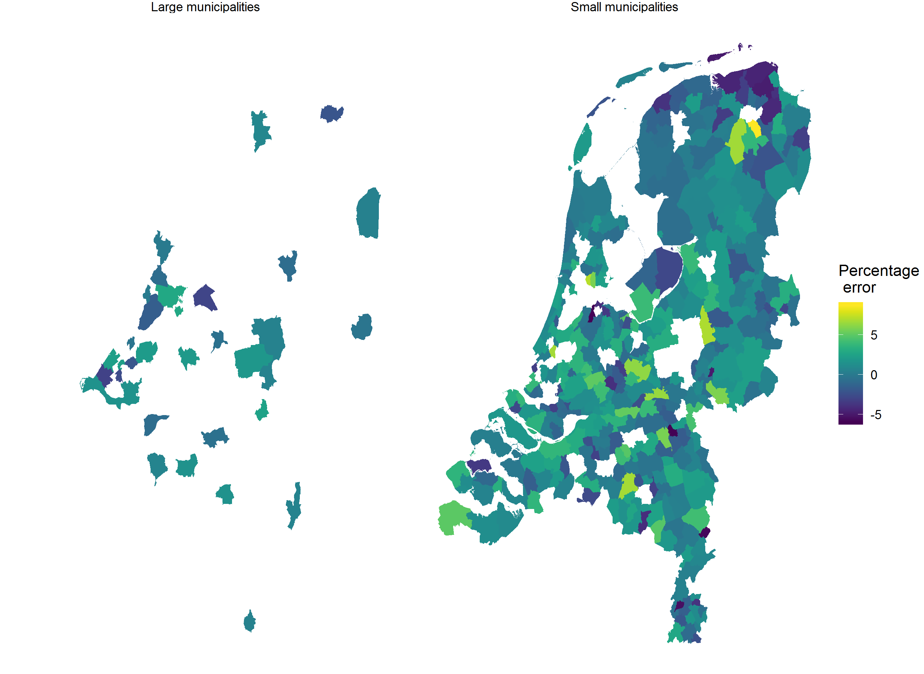
How accurate were the projections?
Large: >100000
inhabitants
Notes:
Forecasting errors are smaller in larger municipalities
Seems that (positive) errors are concentrated in municipalities close to large municipalities
Groningen: city of Groningen is a regional centre, migration to Groningen affects surrounding municipalities
Almere: within commuting distance from Amsterdam, destination for households working in Amsterdam who wish to own a house

Slide 8
Explaining the deviances
2012 was, in terms of the housing market, still very much a crisis year
Plans for future building by municipalities and provinces were likely pessimistic
The sour mood worked through the projections of short-distance migration into the population projections!
The deviations were larger in small municipalities (still PEARL did better than a naive forecast)
http://www.pbl.nl/publicaties/evaluatie-pbl-cbs-regionale-bevolkings-en-huishoudensprognose

Slide 9
Making assumptions on interregional migration for the Projections of 2019
In some municipalities there is an extreme shortage of housing
This has led to an explosive growth in house prices and rent
New construction is the talk of the day, however, this will only solve shortages in the medium- to long run
The number of sales of houses is declining in some cities
Are we near a peak mobility?
Notes:
-We are currently in the stage of collecting and analysing the data. A couple issues we are dealing with

Slide 10
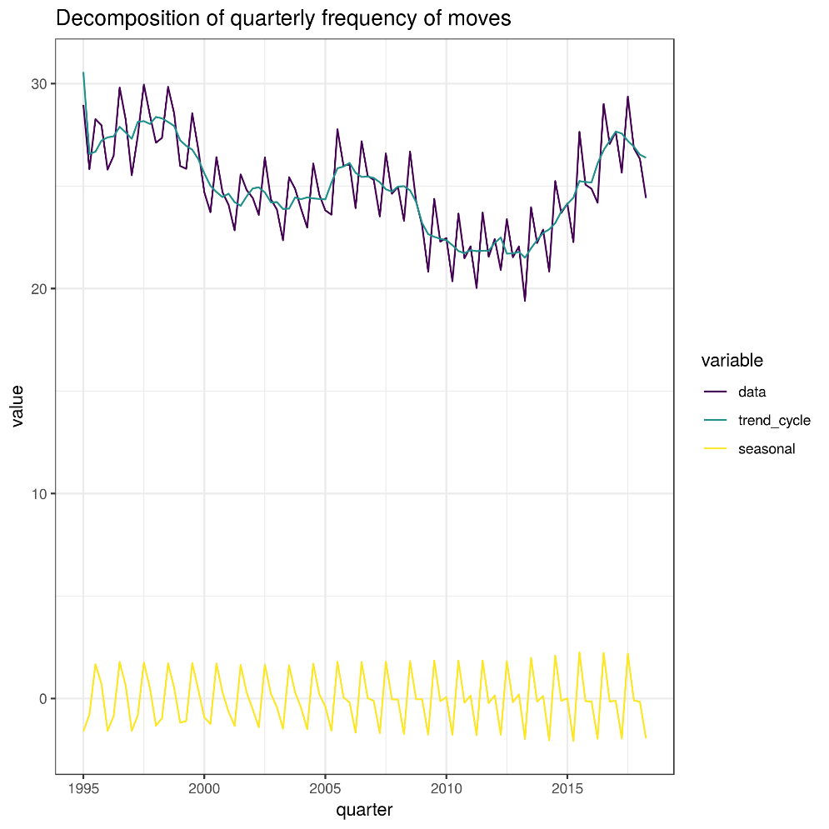
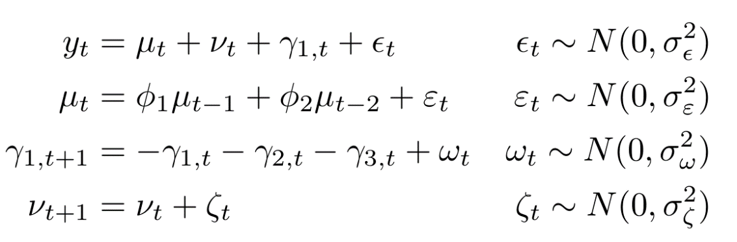
Analysis of the frequency of moves
Goal: decompose the frequency of moves into trend-cycle and seasonal effects
Data: quarterly moves per 100000 inhabitants
Method: state-space model
Notes:
-Frequency of moves, national level: sum of within- and between-municipality moves
- ss: dynamic linear model, general model for non-stationary time-series. Uses the kalman filter for smoothing and forecasting

Slide 11
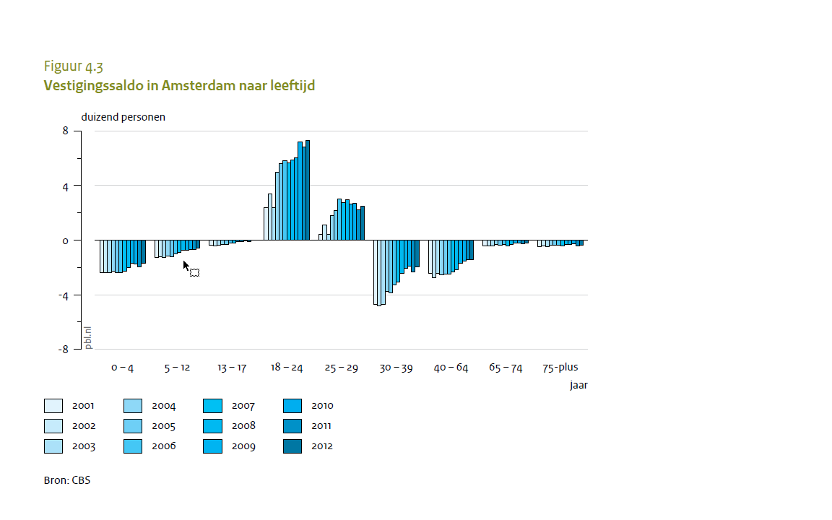
Recent changes to migration in university cities
Recent changes to study financing may have reduced mobility (students continue living at home)
‘The social class escalator’
Consequences for housing market in university cities, and in surrounding municipalities
Notes:
- Figure on the right: arrivals, net of departures in Amsterdam. Positive, and increasing in the age group 18-24. Age group 30-39, negative
- University cities as a social class escalator: students arrive in university cities and move on after ended studies. Theory worked well to predict a type of interregional migration until crisis. After crisis the dynamics seem to have been broken. What now?

Slide 12
Conclusions
The presentation has focused on the role of interregional migration in the Regional Population and Household Projections
Short-distance migration is determined by a spatial interaction model and driven by housing availability
The important role of the housing market in PEARL means that the forecast may be impacted by the business cycle
On the hand the close connection with the housing market is attractive because municipality- provincial officers can better relate to our numbers; on the other hand our results may be vulnerable to the business cycle
Happy to have a discussion on assumptions and specification of the spatial interaction model

