Slide 1
Interregional migration in the Dutch Regional Population Forecast

Slide 2
The Regional Population Forecast
Forecast of population, households and demographic events in Dutch municipalities until 2040
Carried out every three years: previous forecast in 2016, next in 2019
Netherlands Environmental Assessment Agency (PBL) and Statistics Netherlands (CBS)
Regional forecast is made consistent with the national forecast
The forecast is carried out with the cohort-component model PEARL (Projecting population Events at Regional Level)
Trends in individual components are projected separately and are inputs to the model

Slide 3
Migration and regional population growth
Interregional migration is a key driver of population changes in PEARL
PEARL distinguishes long- and short distance migration (cut-off 35 km)
Trends in short-distance migration are predicted with a spatial interaction (gravity) model
i,j: municipality
M: moves
O: departures
P: inhabitants
D: distance
C: centrality
H: net new dwellings
α,β,γ,δ: estimated
parameters
Notes:
Cij=Σk=1;k≠j;k≠iPk/Djk

Slide 4
The role of the dwelling stock
Strong relation between population growth and the number of dwellings: effect of new construction is particularly strong in municipalities with a shortage of housing
Short-distance migration in PEARL:
Potential moves estimated with spatial interaction model
Actual migration calculated by taking into account housing availability (potentially moving back to 1…)
Building plans are obtained through a combination of desk research and consultation with municipalities and provinces
http://www.pbl.nl/publicaties/pbl-cbs-regionale-bevolkings-en-huishoudensprognose-2016-2040-woningbouwveronderstellingen

Slide 5
The Population Forecast in 2016
The population of the Netherlands will grow until 2040
But the growth is unevenly spread: strong growth in the urban agglomerations, population decline in peripheral regions

Slide 6
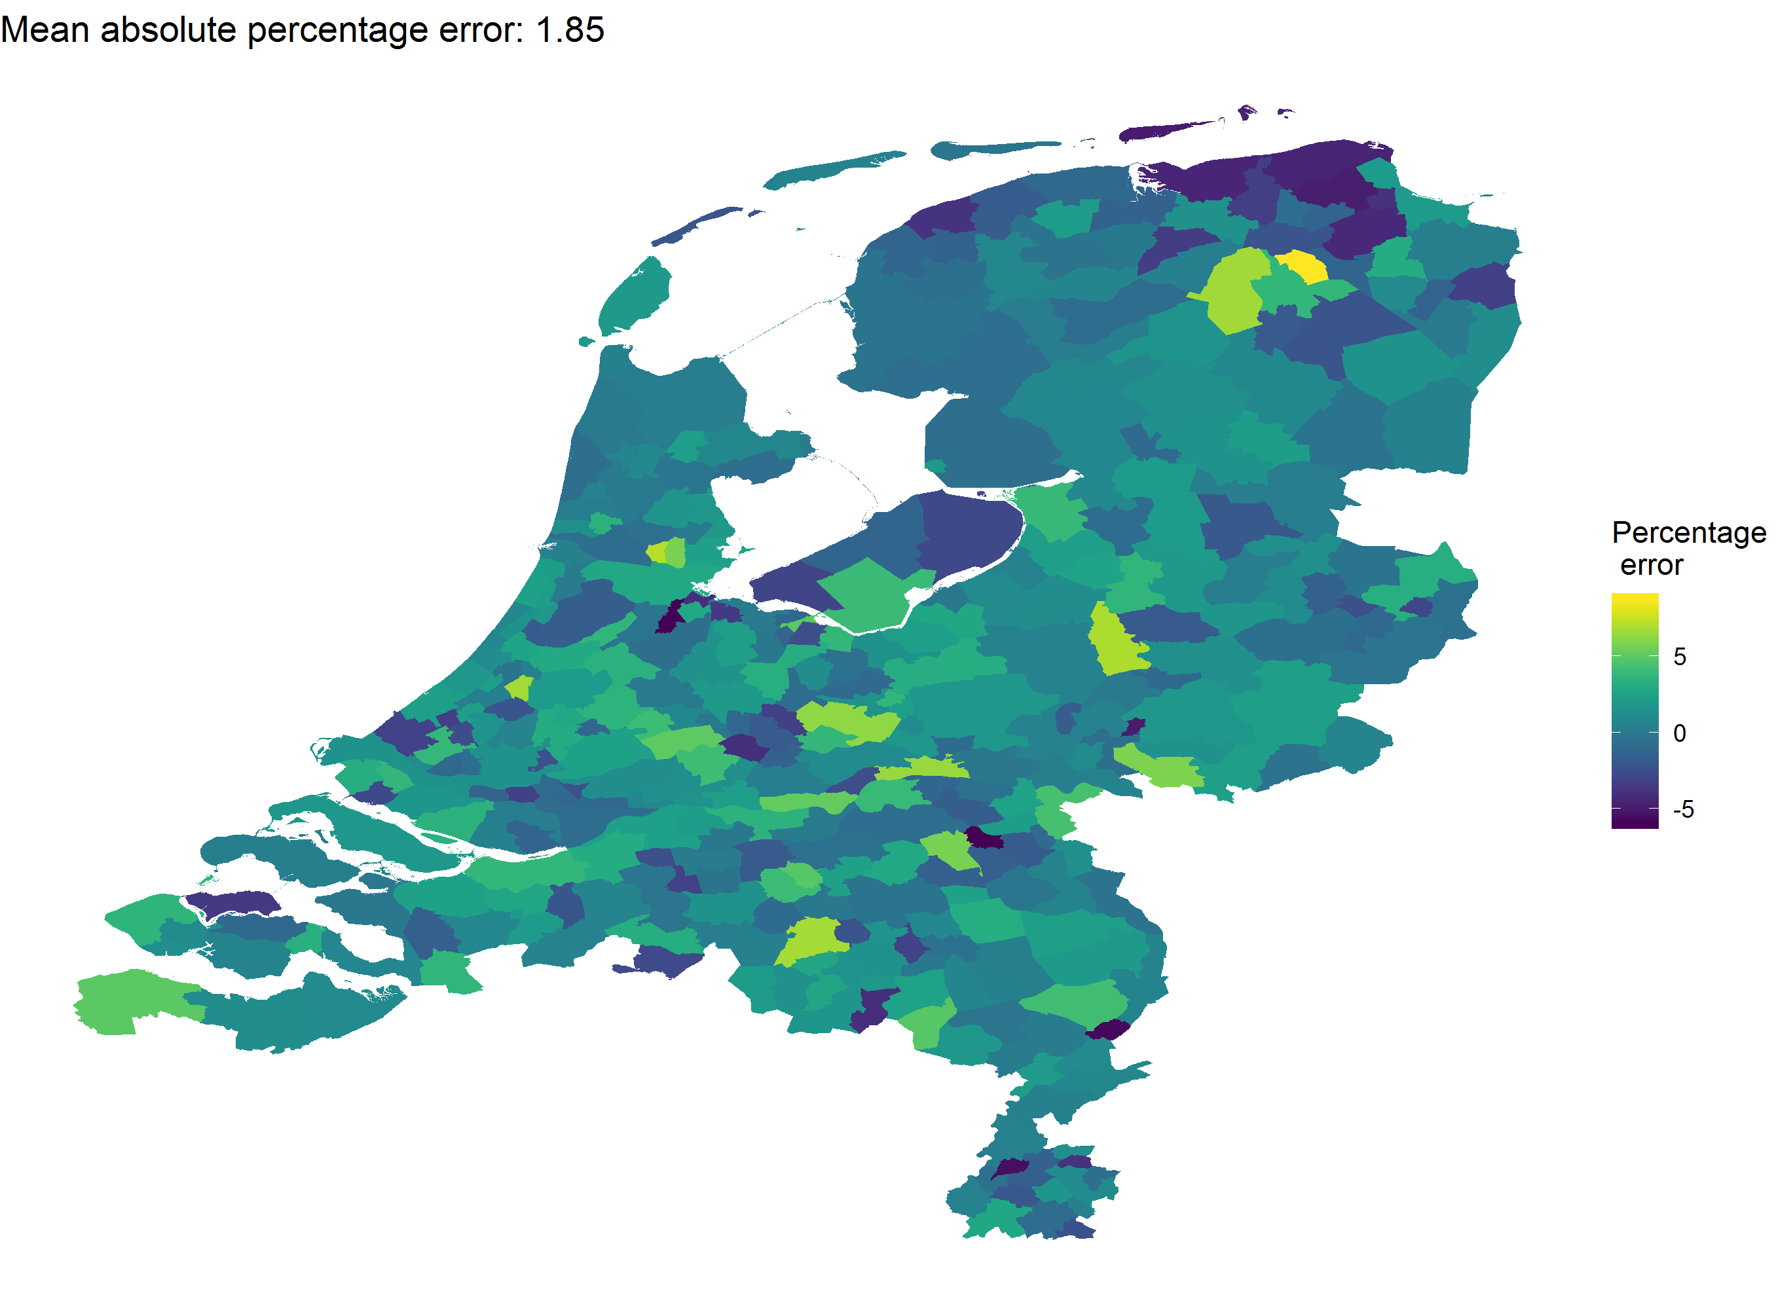
How accurate is the forecast?
Population in 2017 from the 2013 forecast, compared with the data

Slide 7
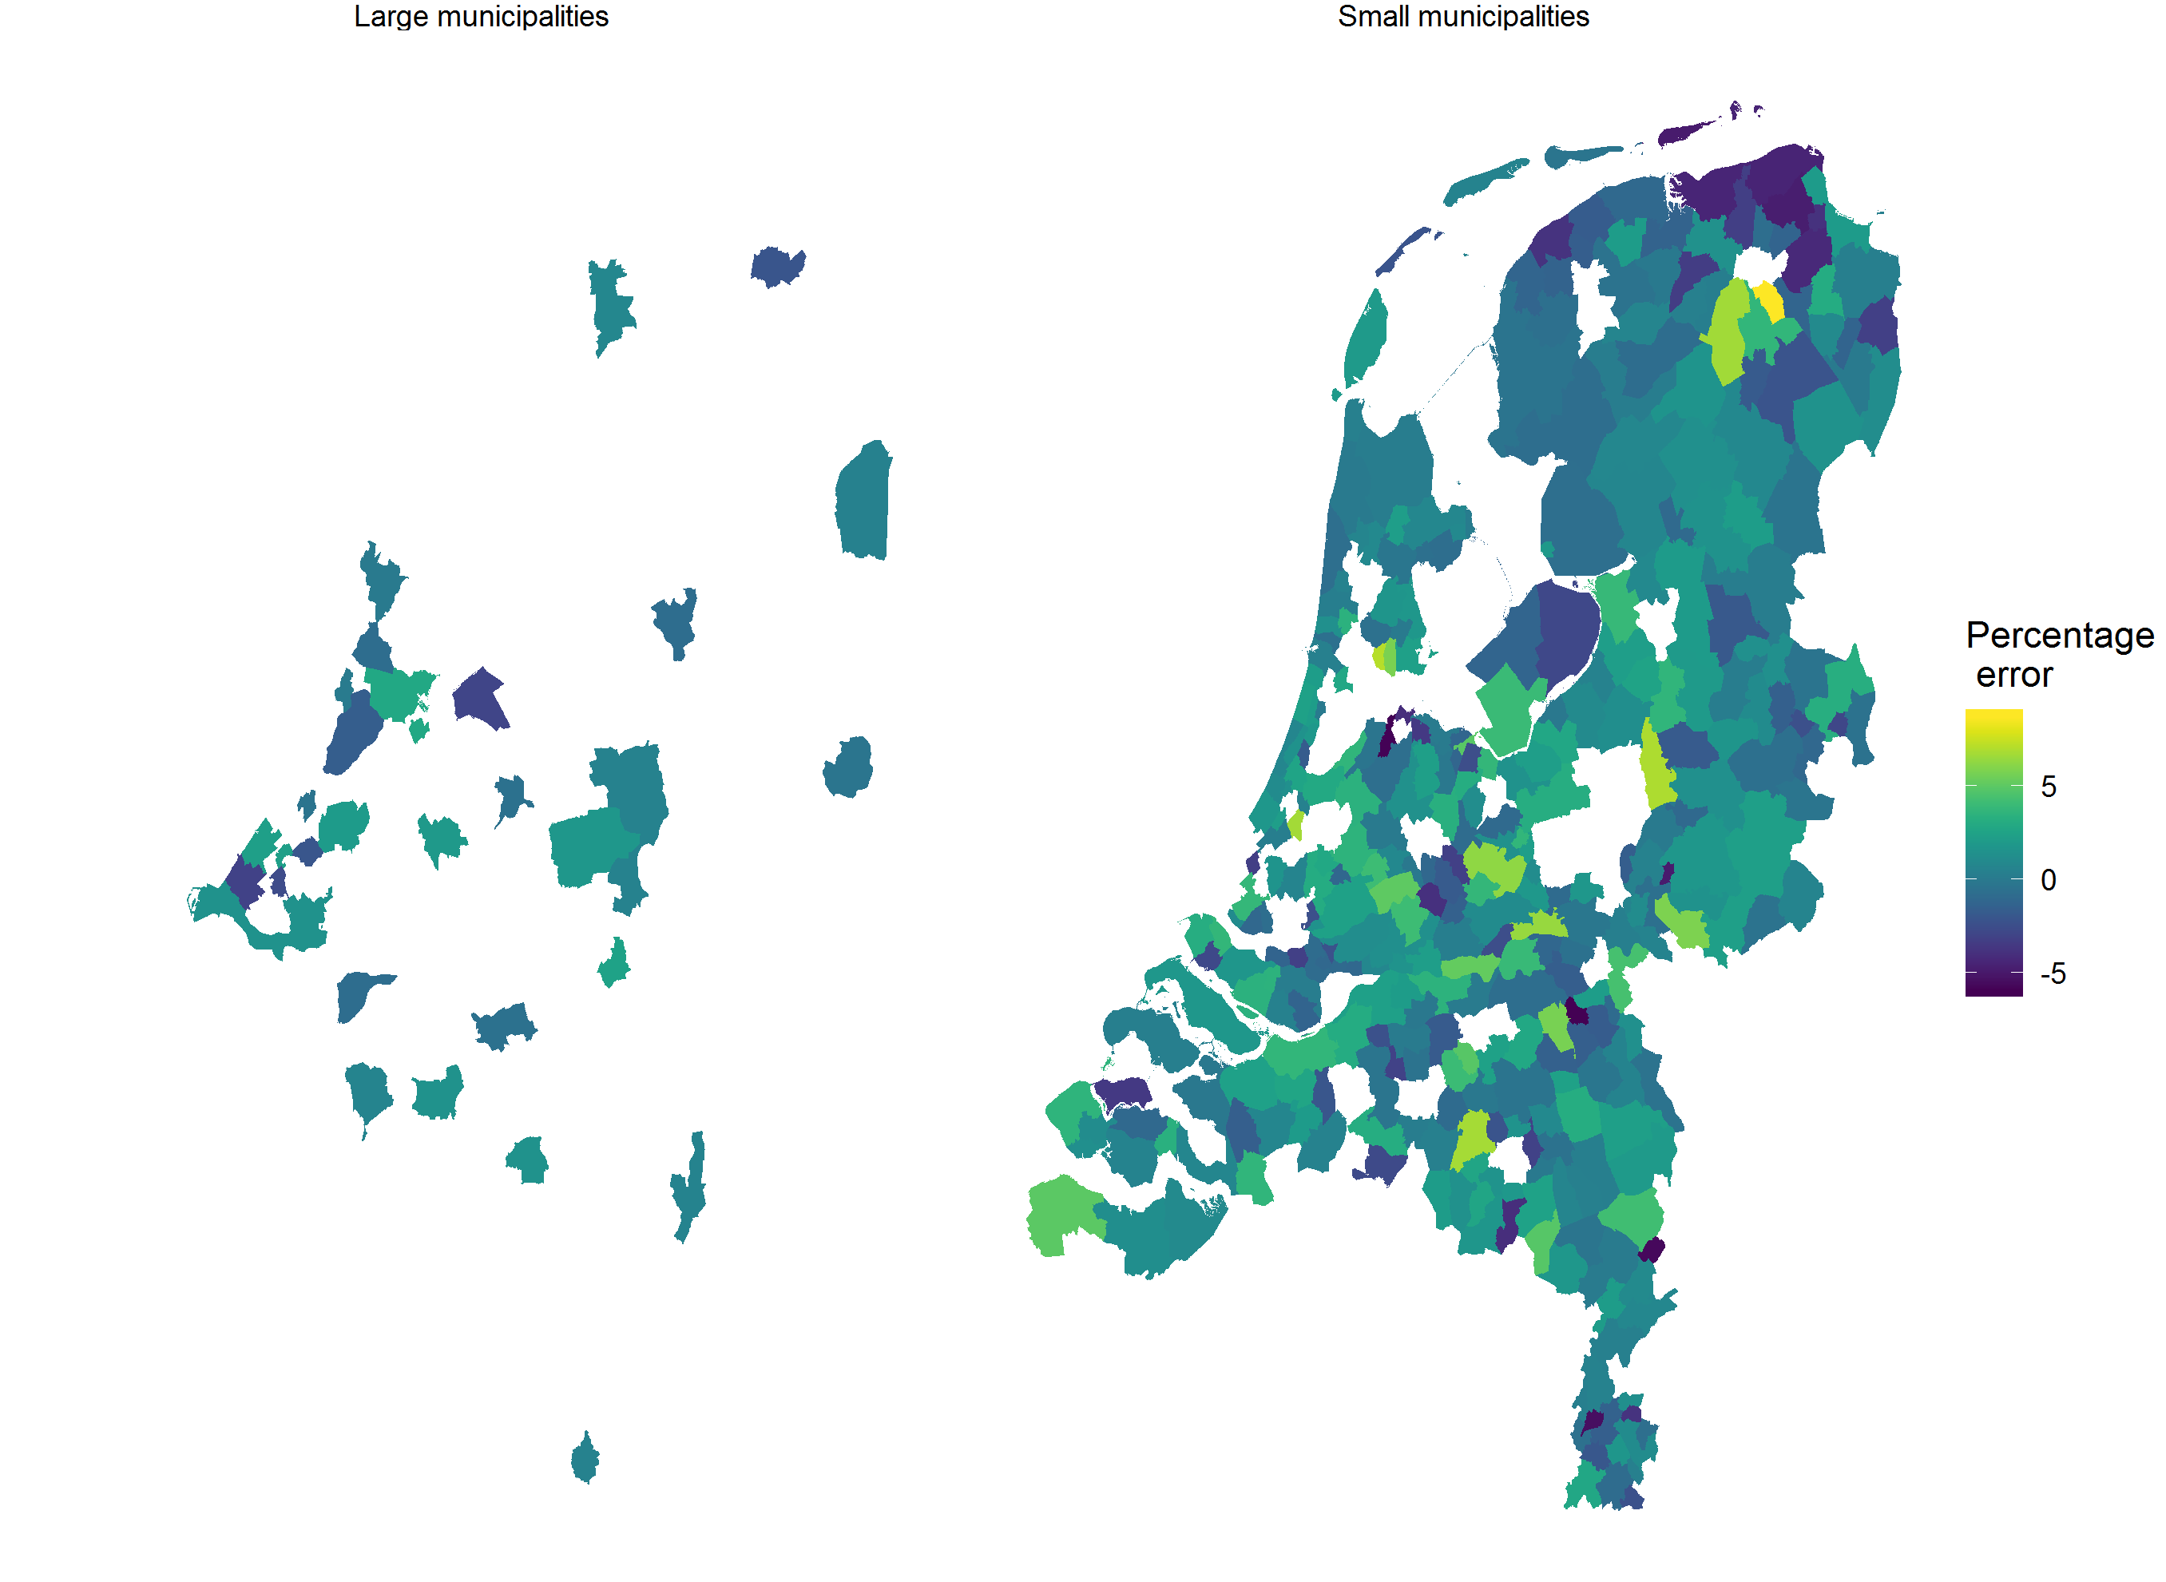
How accurate is the forecast? 2013 edition
Large: >100000
inhabitants

Slide 8
Explaining the deviances
2012 was, in terms of the housing market, still very much a crisis year
Building projections by municipalities and provinces were likely pessimistic
The sour mood worked through the projections of short-distance migration into the population forecast!
The deviations were larger in small municipalities (still PEARL did better than a naive forecast)
http://www.pbl.nl/publicaties/evaluatie-pbl-cbs-regionale-bevolkings-en-huishoudensprognose

Slide 9
Migration in the Forecast of 2019
What now, six years later?
In some municipalities there is an extreme shortage of housing
Explosive growth in house prices and rent
New construction is the talk of the day, however, this will only solve shortages in the medium- to long run
The number of sales of houses is declining in some cities
Are we near a peak mobility?

Slide 10
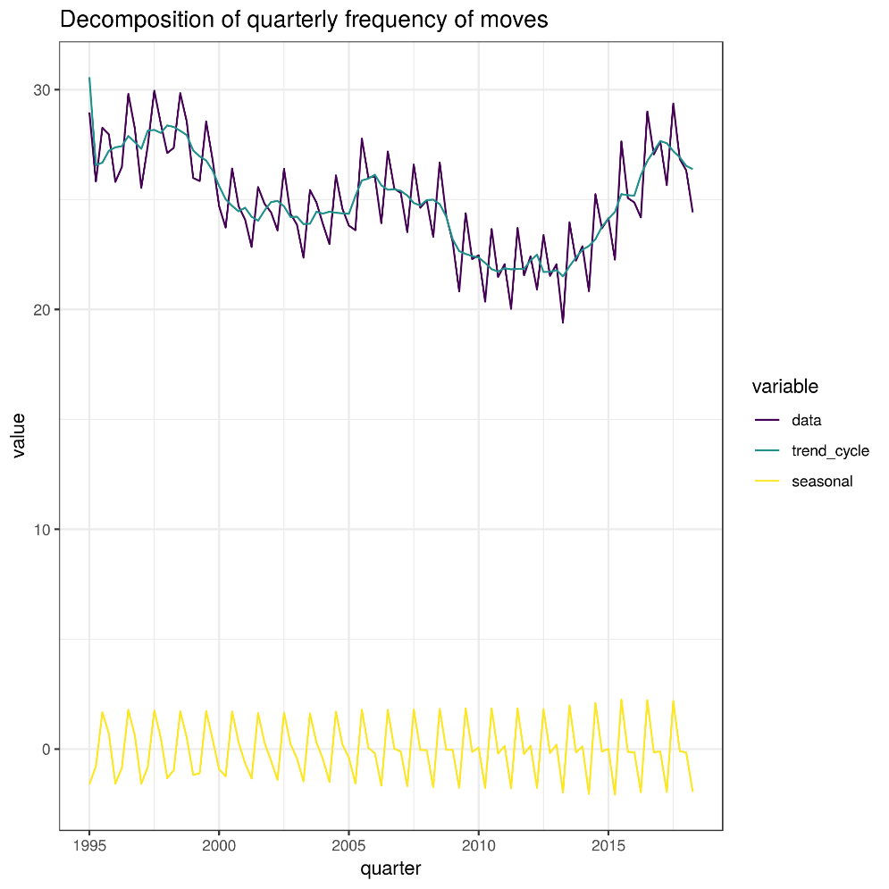
Decomposing the frequency of moves
Goal: decompose (and forecast) frequency of moves into trend-cycle and seasonal effects
Method: state-space model with local trend and AR(2) elements
Data: quarterly moves per 100000 inhabitants

Slide 11
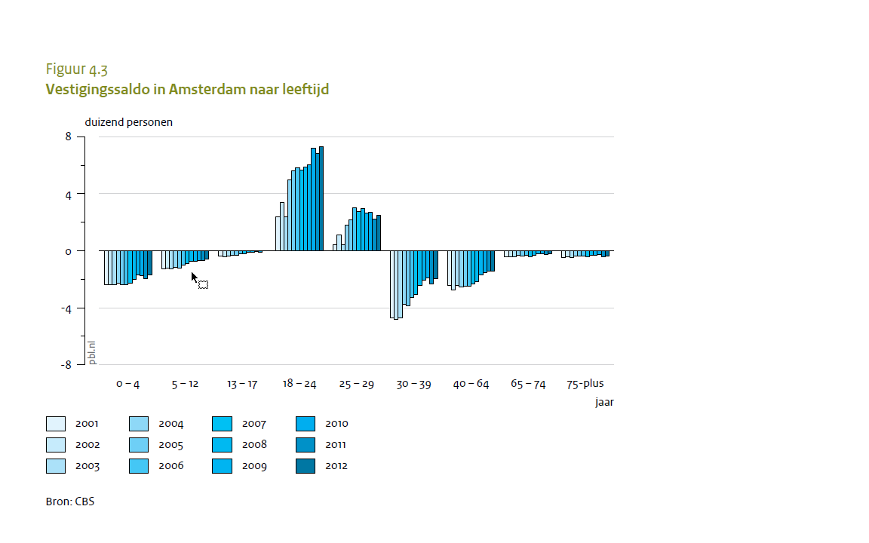
Migration in the Forecast of 2019
Recent changes to study financing may have reduced mobility (students continue living at home)
‘The social class escalator’
Consequences for housing market in university cities, and in surrounding municipalities

Slide 12
Conclusions
The presentation has focused on the role of interregional migration in the Regional Population Forecast
Short-distance migration is determined by a spatial interaction model and driven by housing availability
The important role of the housing market in PEARL means that the forecast is heavily impacted by the business cycle
On the hand the close connection with the housing market is attractive because municipality- provincial officers can better relate to our numbers; on the other hand our results are vulnerable to the business cycle
Happy to have a discussion on assumptions and specification of the spatial interaction model

