Slide 1
layer_analyzer_complex
A toolbox for continuous time series analysis.

Slide 2
Why continuous time?
If you can handle continuous time, you can handle discrete observations also, particularly if they are equidistant in time (but not restricted to that).
Time is continuous... ☺
The program I made (layer_analyzer_complex) is a continuous time analysis toolbox.
A process is a stochastic function of time: X(t) ∀ t.
Typically a process has a starting point in time, which is typically set to t=0.
Stationary processes can however extend infinitely back in time.

Slide 3
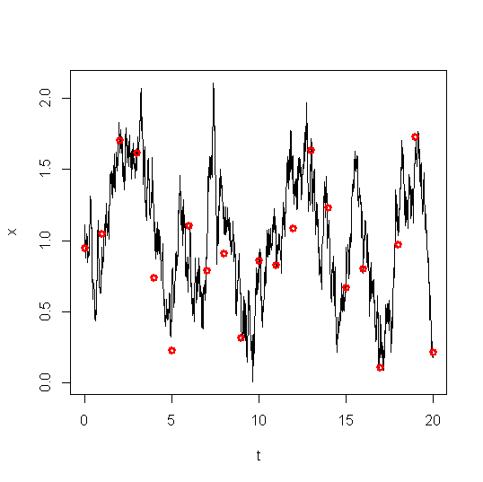
Continuous time series vs discrete measurements
While our state may be continuous in time, we’ll only have a finite set of measurements. These are often (but not always) made equidistantly in time.
Continuous time linear processes sampled equidistanly in time results in discrete time linear processes.
Observations are deemed as flawed and can go missing. Likelihood extracted using the Kalman filter.

Slide 4
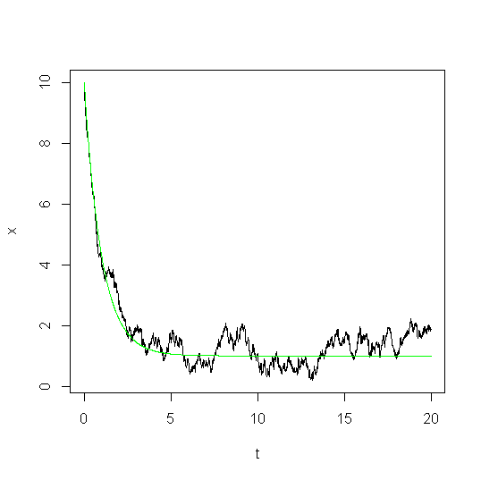
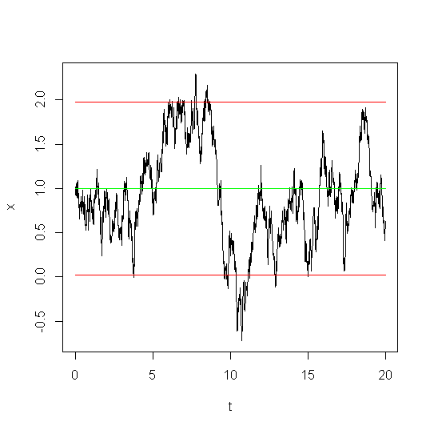
Single state linear processes (Ornstein-Uhlenbeck)
X(0)=10, μ=1, Δt =1
Green line=expectancy (and solution without noise)
A single state linear process represents a process not affected by anything except noise.
It can (and often will) have a dampening factor that makes the process approach a stationary expectancy and stay near that expectancy in a stationary fashion.
If so, it is characterized by three parameters:
μ - the expectation value
σ - the size of the noise contribution
Δt - the characteristic time.
The characteristic time, Δt, is the most important parameter here for describing the dynamics. It tells
How fast the process approaches the expectancy. The distance will be 1/e of it’s original value after a time Δt.
How fast the process forgets previous states, i.e. how fast the auto-correlation is dampened. ρ(t)=e^{-t/Δt}. The time it takes for the auto-correlation to drop with a factor of 1/e is again Δt.
If it is more comfortable to look at halving times, that can be easily derived:
X(0)=1, same process
Green line=stationary expectancy, red line=stationary 95% credibility interval.

Slide 5
Ornstein-Uhlenbeck – Stochastic differential equation representation
Mathematically, the OU process is represented by a linear stochastic differential equations:
where a=1/Δt. The first term represents an ordinary differential equation that pulls X(t) towards μ, reducing the distance by a factor 1/e for each time interval Δt.
The second term represents stochastic contributions, dB_{t}, having a noise size σ.
The size of the noise contribution is a bit complicated, in that it tells how much a process will increase in variance without the dampening. With a dampening it can be related to the stationary standard deviation as:
X(0)=1, μ=1, Δt =1, sd(X(t))=0.5
Green line=stationary expectancy, red line=stationary 95% credibility interval.

Slide 6
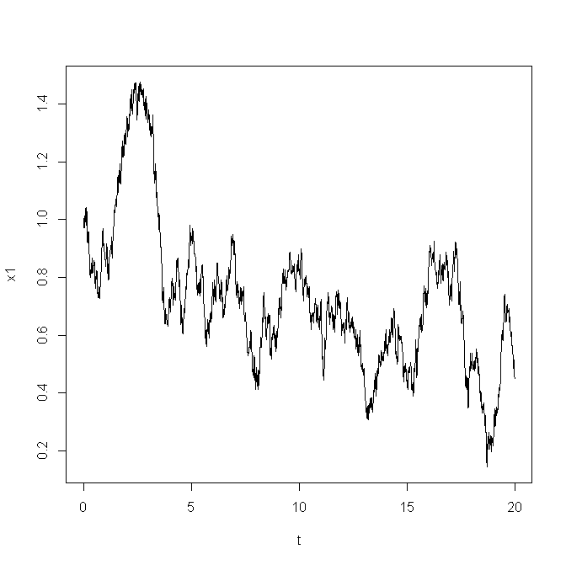
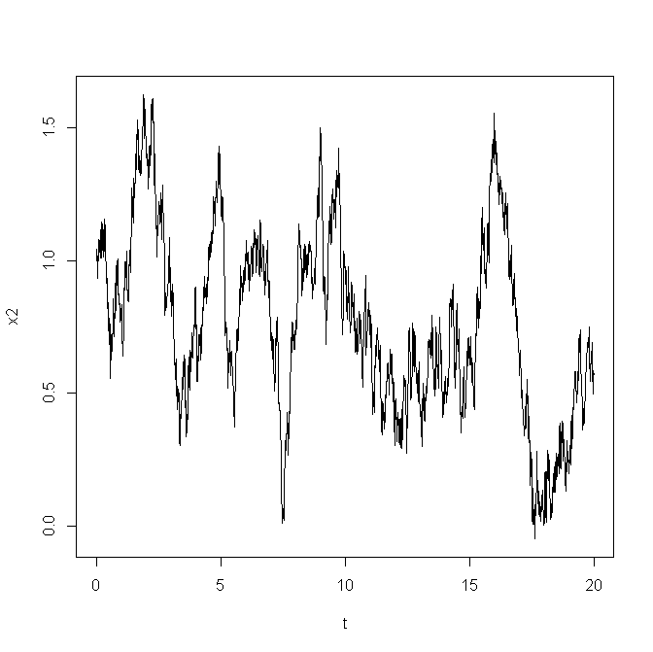
Single measurement time series but multi state processes
Even without having multiple time series, multiple states can be of value. Examples:
The characteristics of an organism in deep time depend both on previous characteristics but also on changes in the optimal characteristics (environment).
Position of a particle (depending both on previous position and velocity).
Discharge (depending on previous discharge and area precipitation).
The top layer process which is associated with the observations is said to track the underlying state.
Each layer comes with a set of dynamical parameters, Δt and σ.
Multiple state processes give rise to different correlation on the observable top process structures than single state. So such hidden layers are detectable!
SDE:
Effects are a bit delayed in time (a factor Δt₁) and the tracking can have a certain dampening effect.

Slide 7
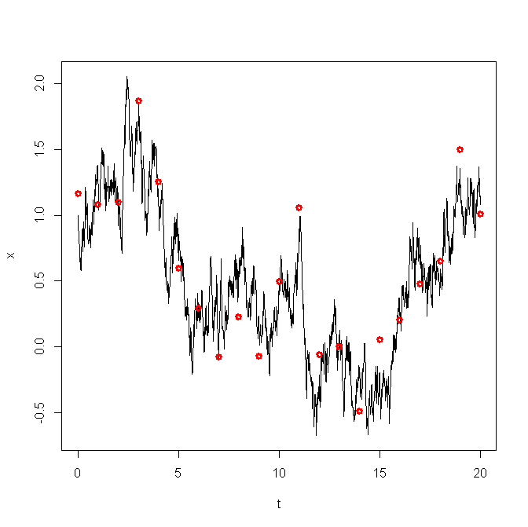
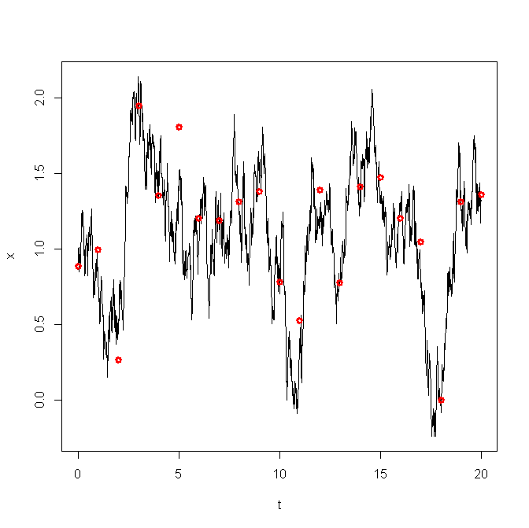
Multiple time series
Multiple time series can be handled simply by expanding the process state space.
A zero-hypothesis can be made by letting the time series behave separately.

Slide 8
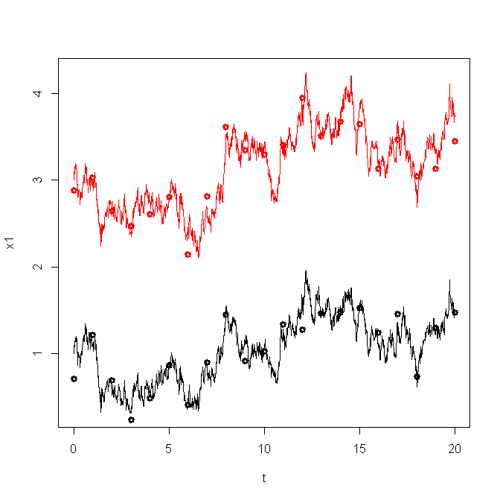
Correlated time series
Correlated time series are time series where the stochastic contributions for process 1 and 2 are correlated.
On average there will be no time delay between process 1 and 2. They represents processes affected by the same randomness (a third and fourth process containing white noise uncorrelated in time but correlated between each other).

Slide 9
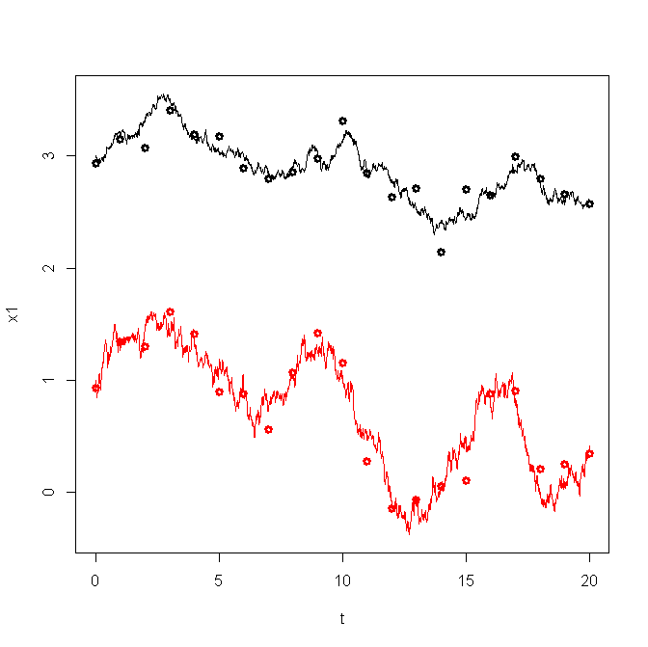
Causal (regressed) time series
One observed time series can respond to another. Ex: discharge vs precipitation, sedimentation vs temperature(?).

Slide 10
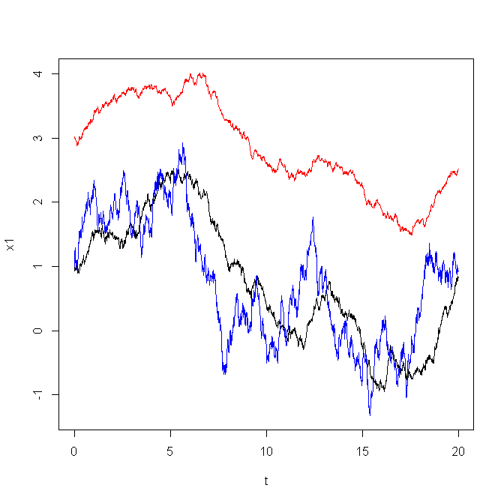
Correlated time series – the advanced version
Time series can be correlated because they respond to some underlying process. This process doesn’t have to be white noise.

Slide 11
Input formats to ’layer_analyzer_complex’
The program takes a couple of text input formats:
Units of years Units of seconds
19550622/1200 20.353693
19550623/1200 20.353693
19550624/1200 20.901571
19550625/1200 24.979340
19550626/1200 24.979340
19550627/1200 37.489353
19550628/1200 35.195778
19550629/1200 31.560976
19550630/1200 30.861866
19550701/1200 30.861866
19550702/1200 31.560976
19550703/1200 35.195778
19550704/1200 47.529839
1956 6.97
1957 8.60
1958 8.83
1959 13.68
1960 6.61
1961 12.25
1962 10.71
1963 11.57
1964 12.77
1981 10.93
1982 9.82
1983 10.34
1984 9.97
1988-01-01 00:00:00;1.68
1988-01-01 01:00:00;1.67
1988-01-01 02:00:00;1.66
1988-01-01 03:00:00;1.66
1988-01-01 04:00:00;1.65
1988-01-01 05:00:00;1.64
1988-01-01 06:00:00;1.63
1988-01-01 07:00:00;1.62
1988-01-01 08:00:00;1.61
1988-01-01 09:00:00;1.59
Units of seconds
Can be made using DAGUT/FINUT in the start system. Some use of ’emacs’ afterwards can be necessary to remove header info and other stuff the program doesn’t understand.

Slide 12
Prior file
The prior distribution is specified in a csv file by a couple of 95% credibility intervals:
is_log;mu1;mu2;dt1;dt2;s1;s2;lin1;lin2;beta1;beta2;init1;init2;obs1;obs2
1;0.01;100;0.01;100.0;0.001;10;-0.01;0.01;-10;10;0.01;100;0.001;1.0
Lower and upper limits for 95% credibility interval for μ.
Same for Δt, σ, β_{t}, β, x₀, τ
Linear time dependency
Initial state
Observational noise
Log indicator. 0=no, 1=yes, 2=yes but the transformation has already been done

Slide 13
Standard one series usage:
Axis label Name of file Prior file
~trr/prog/layer_analyzer_complex -i -l 1 Q oksfjord_year.txt vf_prior.txt 100 1000 10 1
Output:
In addition, plots will appear showing the MCMC samples.
#temp-
ering
Specifies a new input file with associated model structure
#layers other model
options go here
#mcmc
samples
spacing
burnin
5664 w=258351 p=1.44105e+101 lik=1.14361e+66 prior=1.26008e+35 w*p=3.72296e+106 probsum=7.2119e+107
6208 w=308.316 p=1.6414e+104 lik=1.70522e+66 prior=9.62574e+37 w*p=5.06071e+106 probsum=8.48268e+107
probsum_0=1.43248e+104
lprobsum=140.127
probsum=7.18146e+60
-DIC/2 = 391.131
( DIC: -782.262 , mean_D=-303.112 , p_eff=-479.149 , D_mean=176.037 )
Computing time=1.65s
Total time:1.69544a
T0=0.027721 T1=0.14182 T2=0.356696 T3=0.038651 T4=0 T5=0.612491 T6=0.329193
exp(mu_Q): mean=10.338097 median=10.307631 95% cred=(9.869251-10.879960)
dt_Q_1: mean=2.864142 median=0.622801 95% cred=(0.004866-16.669872)
sigma_Q_1: mean=0.174822 median=0.082960 95% cred=(0.001359-0.480256)
obs_sd_Q_origscale: mean=1.011760 median=1.532218 95% cred=(0.002186-1.881838)
exp(mu_Q) - spacing between independent samples:1.14996
Model likelihood:
log(f(D|M))
Parameter inference

Slide 14
Model testing, silent mode
Silent mode. Only show model likelihood and parameter inference
Test 1 layer vs 2 layer:
~trr/prog/layer_analyzer_complex –s -i -l 1 Q oksfjord_year.txt vf_prior.txt 100 1000 10 1
~trr/prog/layer_analyzer_complex –s -i -l 2 Q oksfjord_year.txt vf_prior.txt 100 1000 10 1
Output 1: Output 2:
#layers
lprobsum=139.865
probsum=5.53054e+60
-DIC/2 = 152.272
( DIC: -304.543 , mean_D=-302.654 , p_eff=-1.88963 , D_mean=-300.764 )
Computing time=1.65s
Total time:1.64504a
T0=0.027343 T1=0.13741 T2=0.352572 T3=0.038697 T4=0 T5=0.592385 T6=0.323732
exp(mu_Q): mean=10.364665 median=10.338734 95% cred=(9.84-10.885)
dt_Q_1: mean=0.380993 median=0.357423 95% cred=(0.045396-0.894161)
sigma_Q_1: mean=0.406557 median=0.376359 95% cred=(0.107764-1.001149)
obs_sd_Q_origscale: mean=0.359155 median=0.055519 95% cred=(0.000659-1.769155)
exp(mu_Q) - spacing between independent samples:0.776065
dt_Q_1 - spacing between independent samples:4.37597
sigma_Q_1 - spacing between independent samples:9.79643
obs_sd_Q_origscale - spacing between independent samples:8.67418
lprobsum=139.517
exp(mu_Q): mean=10.428876 median=10.404806 95% cred=(9.720750-11.22)
dt_Q_1: mean=0.173807 median=0.089425 95% cred=(0.009180-0.975355)
sigma_Q_1: mean=0.871136 median=0.728526 95% cred=(0.139335-2.315518)
dt_Q_2: mean=4.362118 median=0.418588 95% cred=(0.002742-31.960495)
sigma_Q_2: mean=0.170937 median=0.048421 95% cred=(0.000848-1.190461)
obs_sd_Q_origscale: mean=0.182744 median=0.0342 95% cred=(0.000423-1.27)
exp(mu_Q) - spacing between independent samples:0.59746
dt_Q_1 - spacing between independent samples:8.82372
sigma_Q_1 - spacing between independent samples:14.8241
dt_Q_2 - spacing between independent samples:1.57009
sigma_Q_2 - spacing between independent samples:2.13165
obs_sd_Q_origscale - spacing between independent samples:4.12879
Conclusion: 1 layer slightly better than 2.

Slide 15
Model testing, silent mode (2)
Silent mode. Only show model likelihood and parameter inference
OU vs random walk:
~trr/prog/layer_analyzer_complex –s -i -l 1 Q oksfjord_year.txt vf_prior.txt 100 1000 10 1
~trr/prog/layer_analyzer_complex –s -i -l 1 -np Q oksfjord_year.txt vf_prior.txt 100 1000 10 1
Output 1: Output 2:
No pull
lprobsum=139.865
probsum=5.53054e+60
-DIC/2 = 152.272
( DIC: -304.543 , mean_D=-302.654 , p_eff=-1.88963 , D_mean=-300.764 )
Computing time=1.65s
Total time:1.64504a
T0=0.027343 T1=0.13741 T2=0.352572 T3=0.038697 T4=0 T5=0.592385 T6=0.323732
exp(mu_Q): mean=10.364665 median=10.338734 95% cred=(9.84-10.885)
dt_Q_1: mean=0.380993 median=0.357423 95% cred=(0.045396-0.894161)
sigma_Q_1: mean=0.406557 median=0.376359 95% cred=(0.107764-1.001149)
obs_sd_Q_origscale: mean=0.359155 median=0.055519 95% cred=(0.000659-1.769155)
exp(mu_Q) - spacing between independent samples:0.776065
dt_Q_1 - spacing between independent samples:4.37597
sigma_Q_1 - spacing between independent samples:9.79643
obs_sd_Q_origscale - spacing between independent samples:8.67418
lprobsum=141.049
probsum=1.80555e+61
-DIC/2 = 145.844
( DIC: -291.687 , mean_D=-293.085 , p_eff=1.39705 , D_mean=-294.482 )
Computing time=1.36s
Total time:1.37014a
T0=0.022751 T1=0.122395 T2=0.309545 T3=0.033328 T4=0 T5=0.452388 T6=0.287972
exp(mu_Q): mean=45060230266049501255393288312903808269074134514794496.000000 median=984407080387292954624.000000 95% cred=(65.153740-nan)
sigma_Q_1: mean=0.020774 median=0.016852 95% cred=(0.006410-0.060541)
obs_sd_Q_origscale: mean=1.728383 median=1.731585 95% cred=(1.423301-2.087830)
exp(mu_Q) - spacing between independent samples:0.979783
sigma_Q_1 - spacing between independent samples:1.4924
obs_sd_Q_origscale - spacing between independent samples:1.26234
Conclusion: No pull better than OU.

Slide 16
Tying several series together
Example: sediment vs temperature
# Only from 1950
../prog/layer_analyzer_complex -i -l 1 sediment NewCore3-sediment-after1950.txt sediment_prior.txt -i -l 1 0 0 temp Year_average_temperature.txt temp_prior.txt 400 1000 10 1
lprobsum=-258.989
../prog/layer_analyzer_complex -i -l 1 sediment NewCore3-sediment-after1950.txt sediment_prior.txt -i -l 1 0 0 temp Year_average_temperature.txt temp_prior.txt -f 2 1 1 1 400 1000 10 1
lprobsum=-254.657
../prog/layer_analyzer_complex -i -l 1 sediment NewCore3-sediment-after1950.txt sediment_prior.txt -i -l 1 0 0 temp Year_average_temperature.txt temp_prior.txt -C 2 1 1 1 400 1000 10 1
lprobsum=-258.556
Conclusion: temperature -> sediment.
Bayes factor of exp(4)

