Slide 1
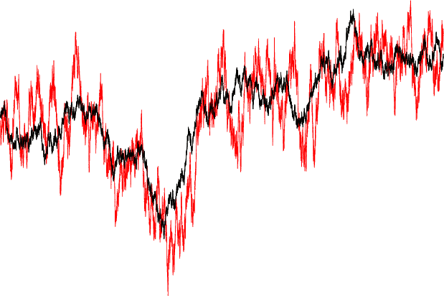
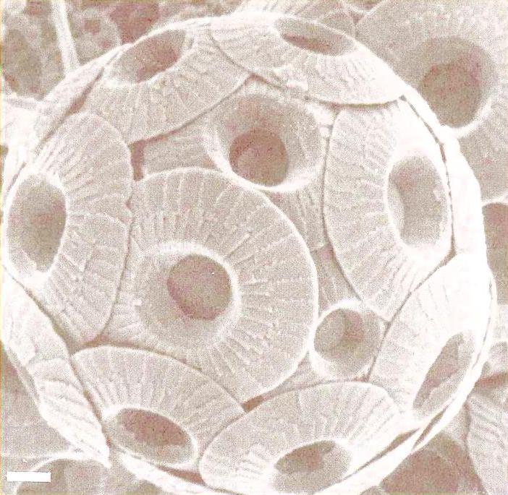
Layered continuous time processes in biology
Tore Schweder and Trond Reitan
CEES, University of Oslo
Jorijntje Henderiks
University of Uppsala
Combining causal statistical time series with fossil measurements.
BISP7, Madrid 2011

Slide 2
Overview
Introduction - Motivating example:
Coccolith data (microfossils)
Phenotypic evolution: irregular time series related by (possibly common) latent processes
Causality in continuous time processes
Stochastic differential equation vector processes
Ito representation and diagonalization
Tracking processes and hidden layers
Kalman filtering
Model variants
Inference and results
Bayesian inference on model properties, models, process parameters and process states
Results for the coccolith data.
Second application: Phenotypic evolution on a phylogenetic tree
Primates - preliminary results
Conclusion

Slide 3
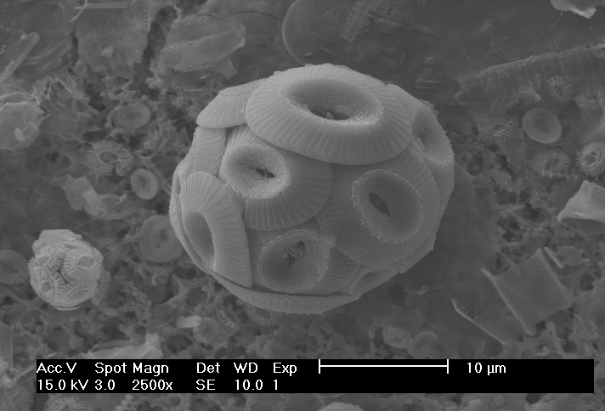
Irregular time series related by latent processes: evolution of body size in Coccolithus Henderiks – Schweder - Reitan
The size of a single cell algae (Coccolithus) is measured by the diameter of its fossilized coccoliths (calcite platelets). Want to model the evolution of a lineage found at six sites.
Phenotype (size) is a process in continuous time and changes continuously.
19,899 coccolith measurements, 205 sediment samples (1< n < 400) of body size by site and time (0 to -60 my).

Slide 4
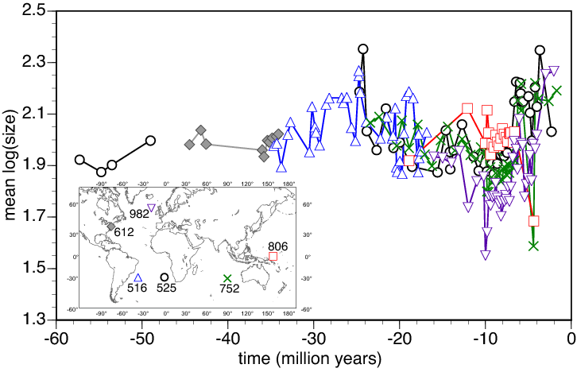
Our data – Coccolith size measurements
205 Sample mean log coccolith size (1 < n < 400) by time and site.

Slide 5
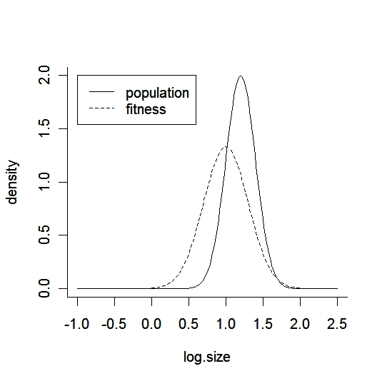
Evolution of size distribution
Fitness = expected number of reproducing offspring.
The population tracks the fitness curve (natural selection)
The fitness curve moves about, the population follow.
With a known fitness, µ, the mean phenotype should be an Ornstein-Uhlenbeck process (Lande 1976).
With fitness as a process, µ(t),, we can make a tracking model:

Slide 6
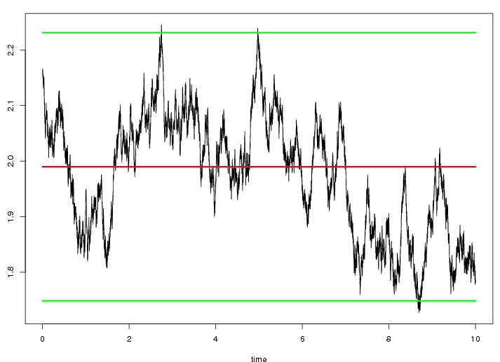
The Ornstein-Uhlenbeck process
Attributes:
Stationary
Normally distributed
long-term level: μ
Standard deviation: s=σ/√2α
Markovian
α: pull
corr(x(0),x(t))=e^{-αt}
Time for the correlation to drop to 1/e: Δt =1/α
μ+1.96 s
μ
Δt
μ-1.96 s
The parameters (μ, Δt, s) can be estimated from the data. In this case: μ≈1.99, Δt=1/α≈0.80Myr, s≈0.12.

Slide 7
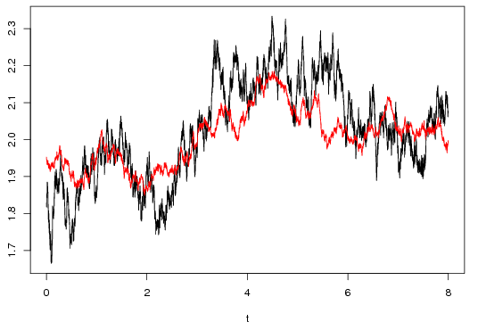
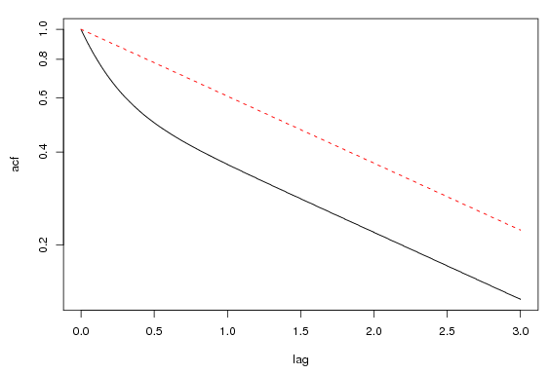
One layer tracking another
Black process (Δt₁=1/α₁=0.2, s₁=2) tracking red process (Δt₂=1/α₂=2, s₂=1)
Auto-correlation of the upper (black) process, compared to a one-layered SDE model.
A slow-tracking-fast can always be re-scaled to a fast-tracking slow process.
Impose identifying restriction: α₁ ≥ α₂

Slide 8
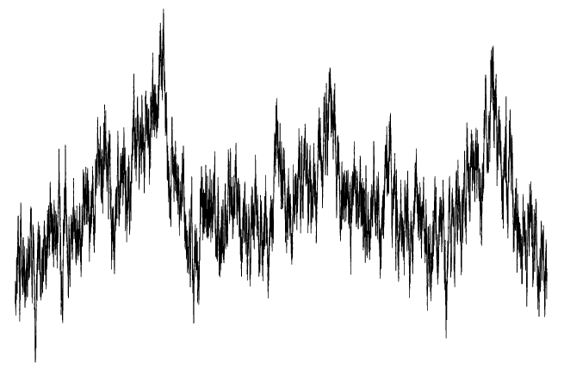
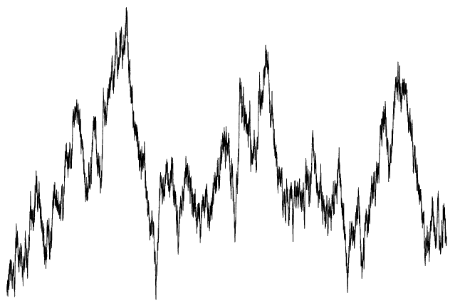
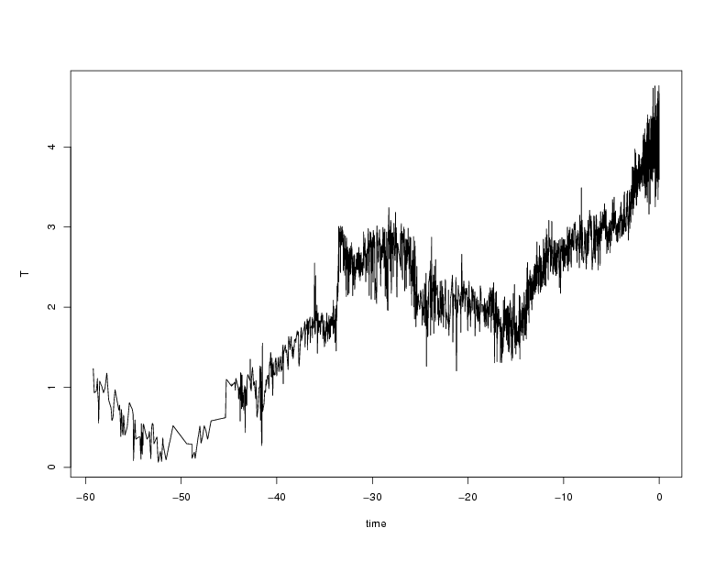
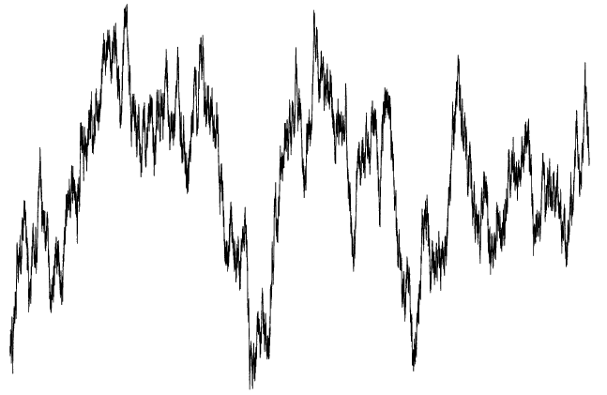
Process layers - illustration
Observations
Layer 1 – local phenotypic expression
Layer 2 – local fitness optimum
T
External
series
Layer 3 – hidden climate variations or primary optimum
Stationary expectancy

Slide 9
Causality in SDE processes
We want to express in process terms the fact that climate affects the phenotypic optimum which again affects the actual phenotype.
Local independence (Schweder 1970):
Context: Composable continuous time processes.
Component A is locally independent of B iff transition prob. of A does not depend on B.
If B is locally dependent on A but not vice versa, we write A→B.
Local dependence can form a notion of causality in cont. time processes the same way Granger causality does for discrete time processes.

Slide 10
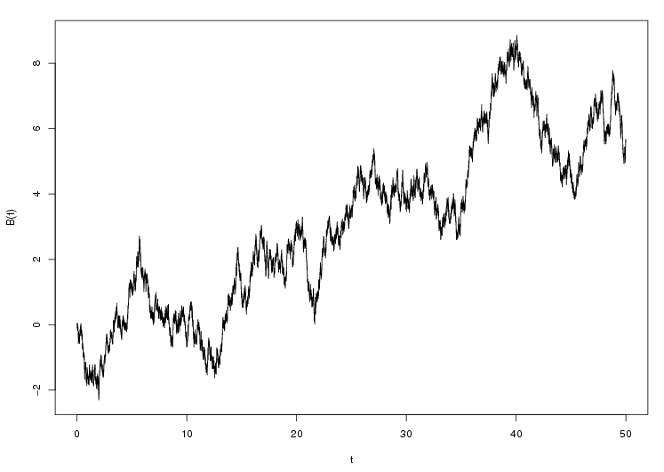
Stochastic differential equation (SDE) vector processes

Slide 11
Stochastic differential equation (SDE) vector processes
The zeros in this matrix determines
the local independencies.

Slide 12
Model variants for Coccolith evolution
Model variations:
1, 2 or 3 layers (possibly more)
Inclusion of external time series or extra internal time series in connection to the one we are modelling
In a single layer:
Local or global parameters
Correlation between sites (inter-regional correlation)
Deterministic response to the lower layer
Random walk (no tracking)

Slide 13
Likelihood: Kalman filter
Need a linear, normal Markov chain with independent normal observations:
Process
Observations
The Ito solution
gives, together with measurement variances, what is needed to calculate the likelihood using the Kalman filter:
and

Slide 14
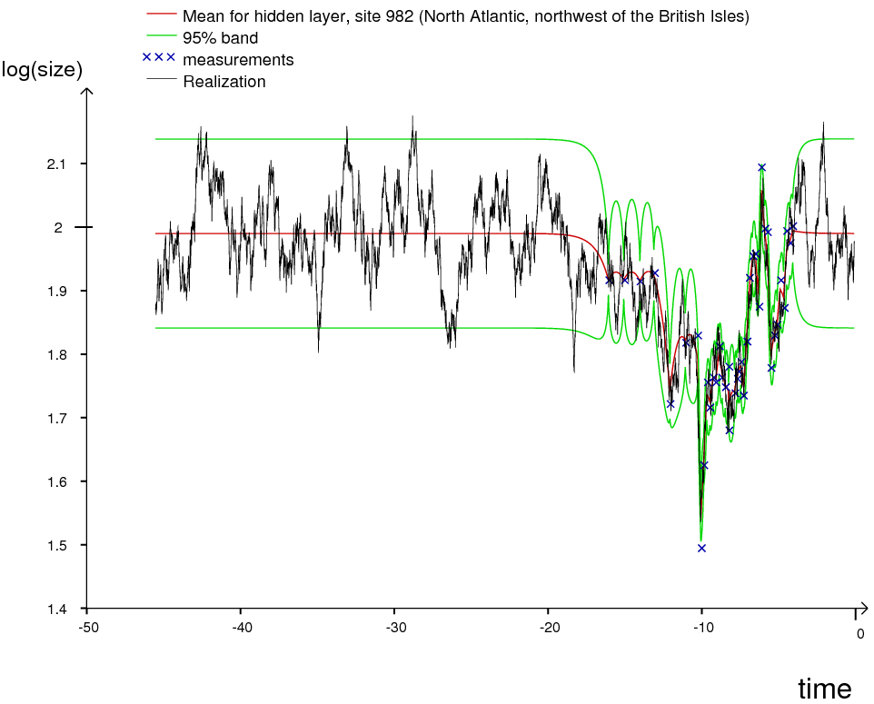
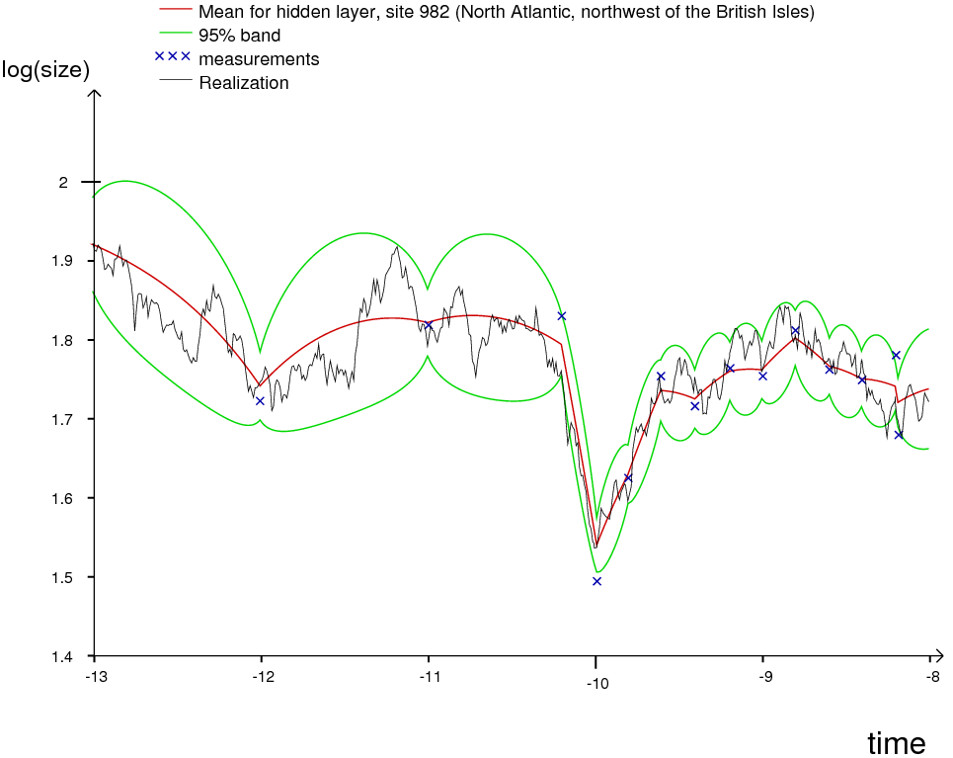
Kalman smoothing (state inference) A tracking model with 3 layers and fixed parameters
North Atlantic
Red curve: expectancy
Black curve: realization
Green curve: uncertainty
Snapshot:

Slide 15
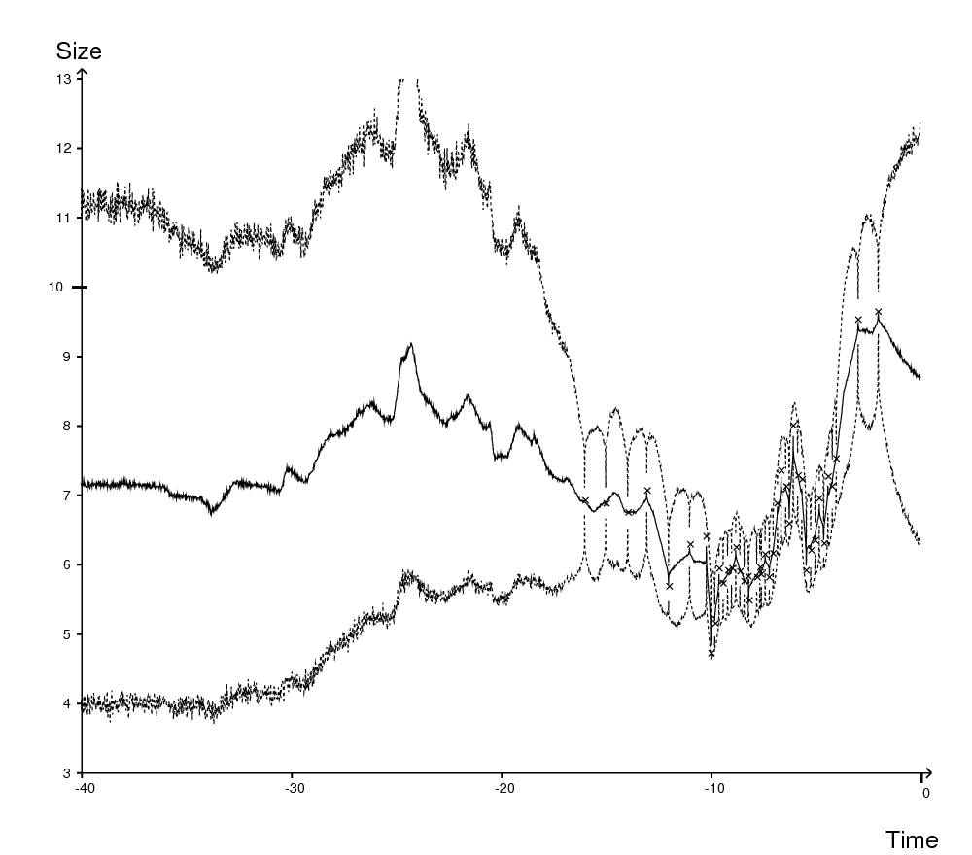
Parameter and model inference
Wide but informative prior distributions respecting identifying restrictions
MCMC for parameter inference on individual models:
MCMC samples+state samples from Kalman smoother -> Possible to do inference on the process state conditioned only on the data.
Model likelihood (using an importance sampler) for model comparison (posterior model probabilities).
Posterior weight of a property C from model likelihoods:

Slide 16
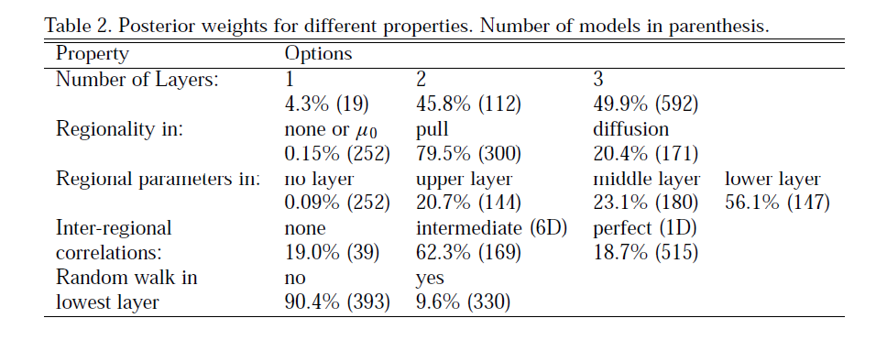
Bayesian inference on the 723 models

Slide 17
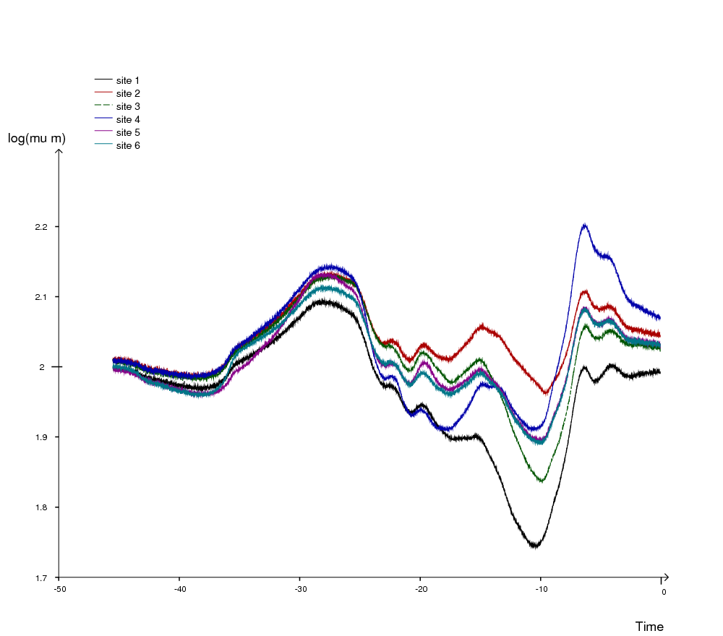
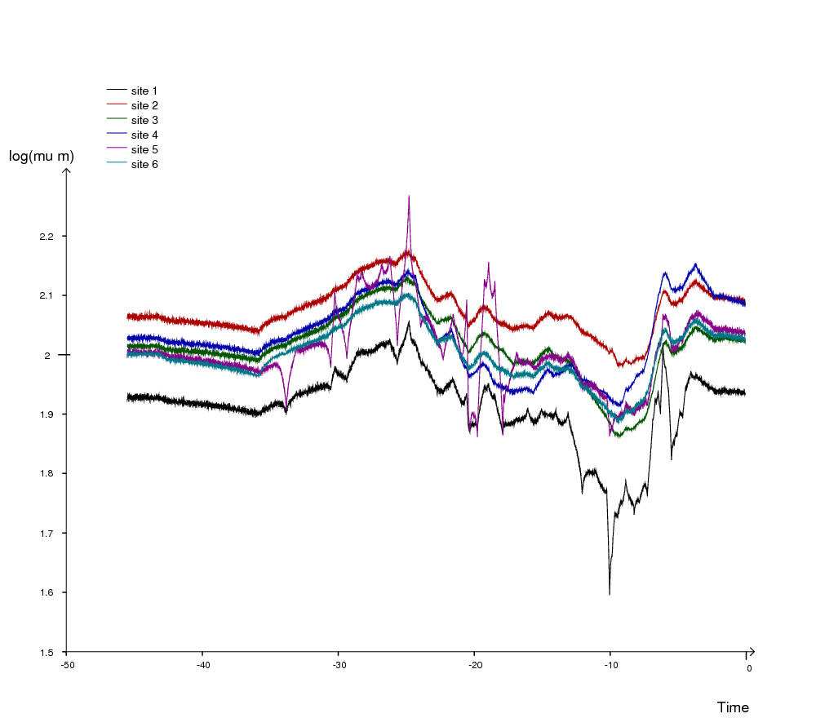
Results
Best 5 models in good agreement. (together, 19.7% of summed integrated likelihood):
Three layers.
Common expectancy in bottom layer .
No impact of exogenous temperature series.
Lowest layer: Inter-regional correlations, ρ ≈ 0.5. Site-specific pull.
Middle layer: Intermediate tracking.
Upper layer: Very fast tracking.
Middle layers: fitness optima
Top layer: population mean log size

Slide 18
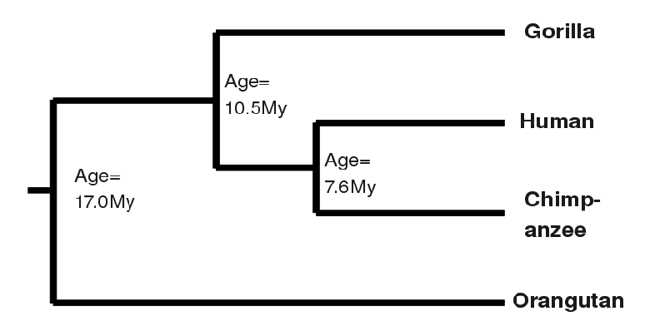
Phenotypic evolution on a phylogenetic tree: Body size of primates

Slide 19
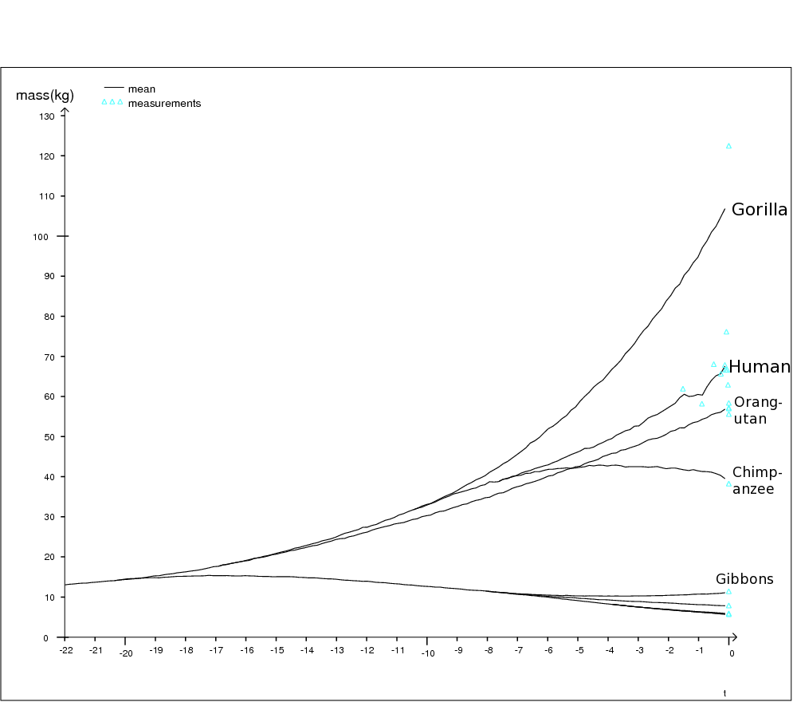
First results for some primates

Slide 20
Why linear SDE processes?
Parsimonious: Simplest way of having a stochastic continuous time process that can track something else.
Tractable: The likelihood, L(θ) ≡ f(Data | θ), can be analytically calculated by the Kalman filter or directly by the parameterized multi-normal model for the observations. (θ = model parameter set)
Can code for causal structure (local dependence/independence).
Some justification in biology, see Lande (1976), Estes and Arnold (2007), Hansen (1997), Hansen et. al (2008).
Great flexibility, widely applicable...
Thinking and modelling might then be more natural in continuous time.
Allows for varying observation frequency, missing data and observations arbitrary spaced in time.
Extensions:
Non-linear SDE models…
Non-Gaussian instantaneous stochasticity (jump processes).

Slide 21
Bibliography
Commenges D and Gégout-Petit A (2009), A general dynamical statistical model with causal interpretation. J.R. Statist. Soc. B, 71, 719-736
Lande R (1976), Natural Selection and Random Genetic Drift in Phenotypic Evolution, Evolution 30, 314-334
Hansen TF (1997), Stabilizing Selection and the Comparative Analysis of Adaptation, Evolution, 51-5, 1341-1351
Estes S, Arnold SJ (2007), Resolving the Paradox of Stasis: Models with Stabilizing Selection Explain Evolutionary Divergence on All Timescales, The American Naturalist, 169-2, 227-244
Hansen TF, Pienaar J, Orzack SH (2008), A Comparative Method for Studying Adaptation to a Randomly Evolving Environment, Evolution 62-8, 1965-1977
Schuss Z (1980). Theory and Applications of Stochastic Differential Equations. John Wiley and Sons, Inc., New York.
Schweder T (1970). Decomposable Markov Processes. J. Applied Prob. 7, 400–410
Source codes, examples files and supplementary information can be found at http://folk.uio.no/trondr/layered/.

