Slide 1
Introducing layeranalyzer, a process-based R package for time series analysis.
Trond Reitan, BLEED project, NHM, University of Oslo

Slide 2
Motivation
Why time series analysis?
Auto-correlation
Causal vs correlative
Why continuous time processes?
Some time series are not organized in equal time bins. Ex: paleodata
Binning removes info
Even if equal time bins, the process being modelled can be continuous in time.
Why linear stochastic differential equations (SDEs)?
Tractable
Allows for causal/correlative distinction
Various tempo/mode models in paleobiology are linear SDEs.
Why the layeranalyzer R package?
Quite general
Freely available!

Slide 3
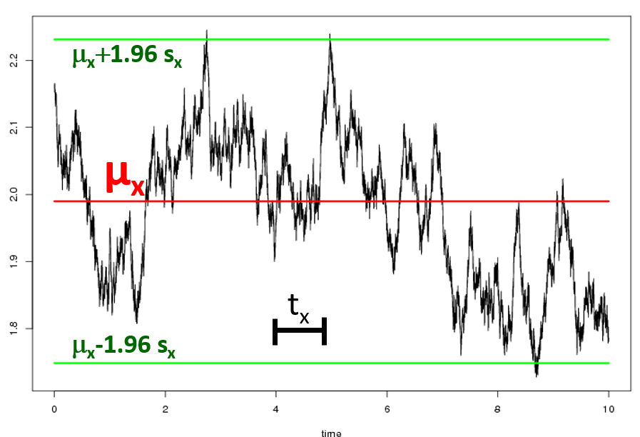
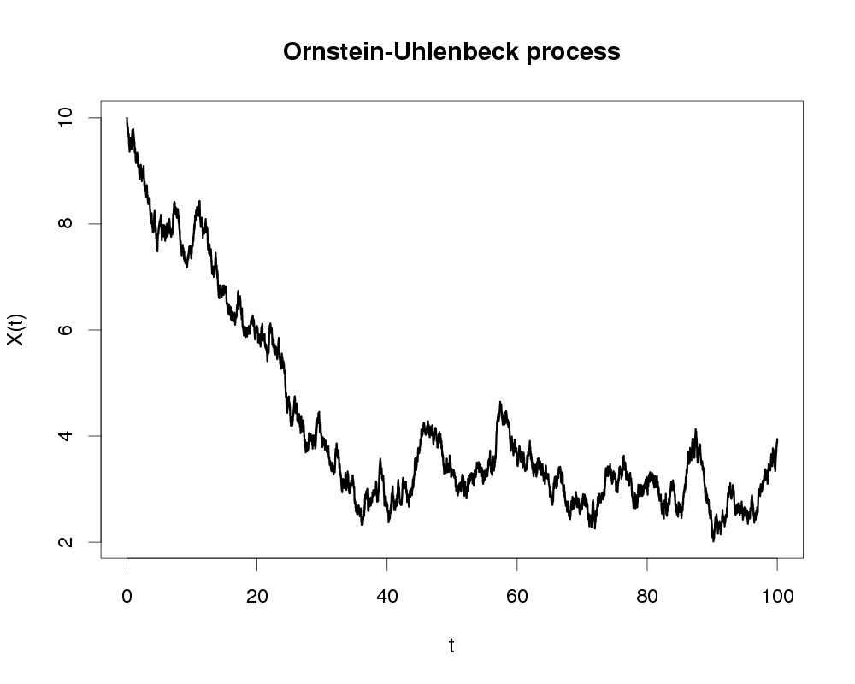


One process linear SDE, the OU process
$$dx\left(t\right)=−a\left(x\left(t\right)−μ_{x}\right)dt+σ_{x}dB_{t}$$
Starting off outside equilibrium
$$t_{x}=1/a,$$
$$s_{x}=σ_{x}/\sqrt{2a}$$
time
time

Slide 4
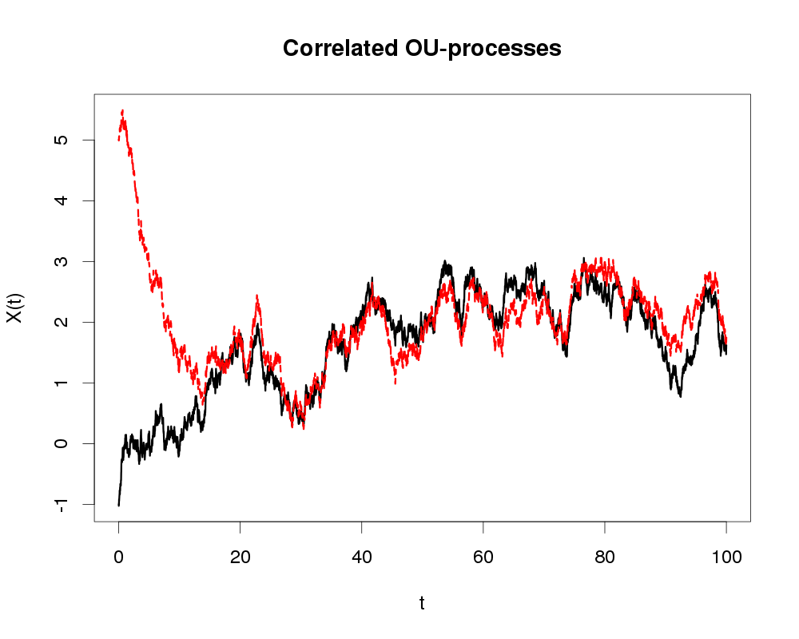
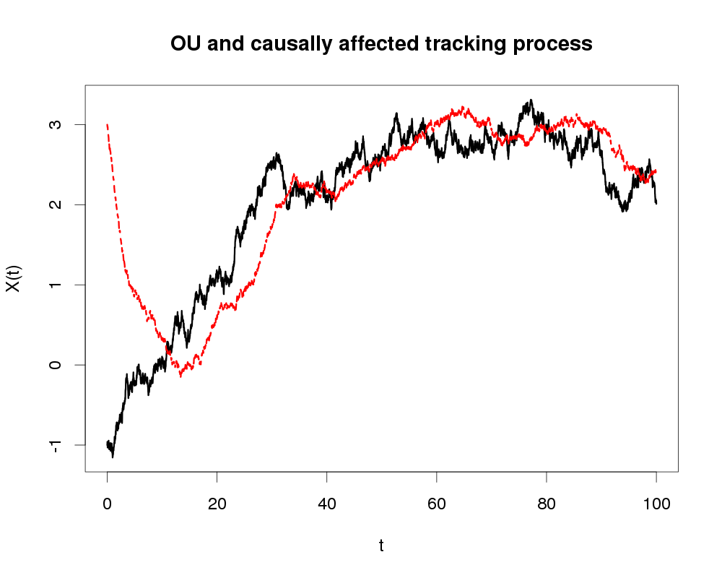



Multiple processes, causal vs correlative
$$d\underline{X}\left(t\right)=\left(A\underline{X}\left(t\right)+\underline{m}\right)dt+Σd{\underline{B}}_{t}$$
Connection in the «$d{\underline{B}}_{t}$» terms ($Σ$).
Connection in the «$dt$» terms ($A$).
time
time

Slide 5
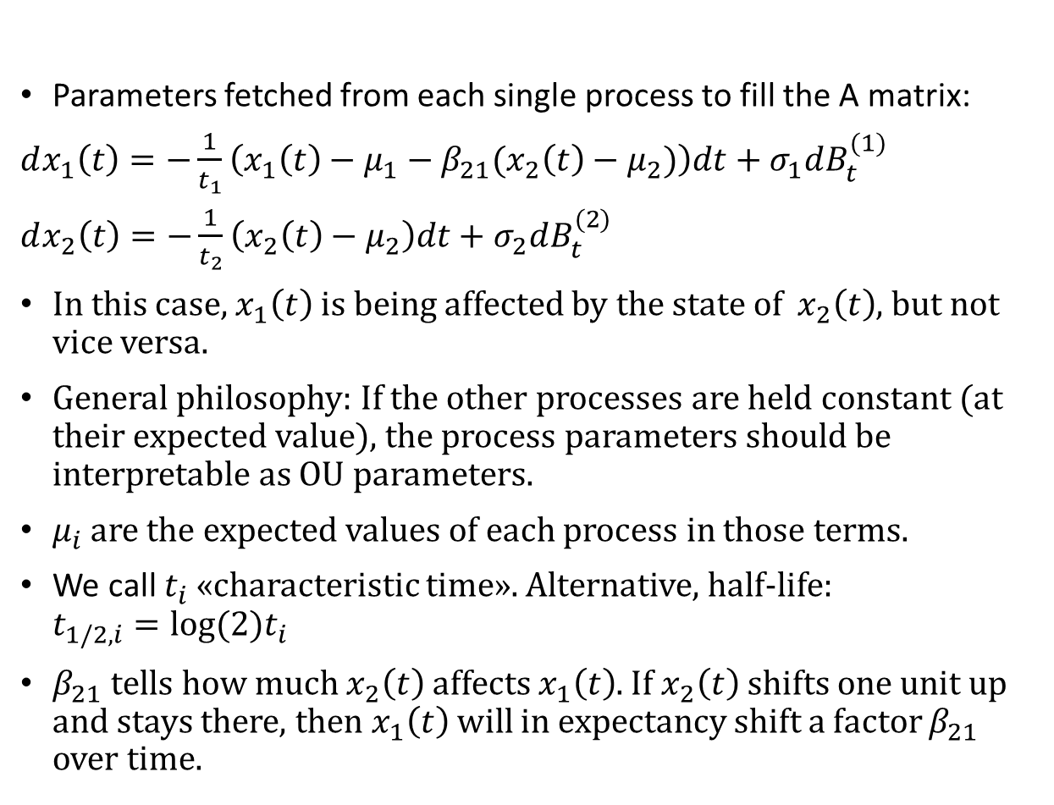
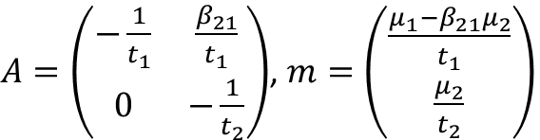

Parametrization – deterministic part (A)
$$d\underline{X}\left(t\right)=\left(A\underline{X}\left(t\right)+\underline{m}\right)dt+Σd{\underline{B}}_{t}$$
Parameters fetched from each single process to fill the A matrix:
$dx_{1}\left(t\right)=−\frac{1}{t_{1}}\left(x_{1}\left(t\right)−μ_{1}−β_{21}(x_{2}\left(t\right)−μ_{2})\right)dt+σ_{1}dB_{t}^{(1)}$
$dx_{2}\left(t\right)=−\frac{1}{t_{2}}\left(x_{2}\left(t\right)−μ_{2}\right)dt+σ_{2}dB_{t}^{(2)}$
In this case, $x_{1}\left(t\right)$ is being affected by the state of $x_{2}\left(t\right)$, but not vice versa.
General philosophy: If the other processes are held constant (at their expected value), the process parameters should be interpretable as OU parameters.
$μ_{i}$ are the expected values of each process in those terms.
We call $t_{i}$ «characteristic time». Alternative, half-life: $t_{1/2,i}=log⁡(2)t_{i}$
$β_{21}$ tells how much $x_{2}\left(t\right)$ affects $x_{1}\left(t\right)$. If $x_{2}\left(t\right)$ shifts one unit up and stays there, then $x_{1}\left(t\right)$ will in expectancy shift a factor $β_{21}$ over time.
$A=\left(\begin{matrix}−\frac{1}{t_{1}} & \frac{β_{21}}{t_{1}} \\ 0 & −\frac{1}{t_{2}}\end{matrix}\right)$, $m=\left(\begin{matrix}\frac{μ_{1}−β_{21}μ_{2}}{t_{1}} \\ \frac{μ_{2}}{t_{2}}\end{matrix}\right)$

Slide 6

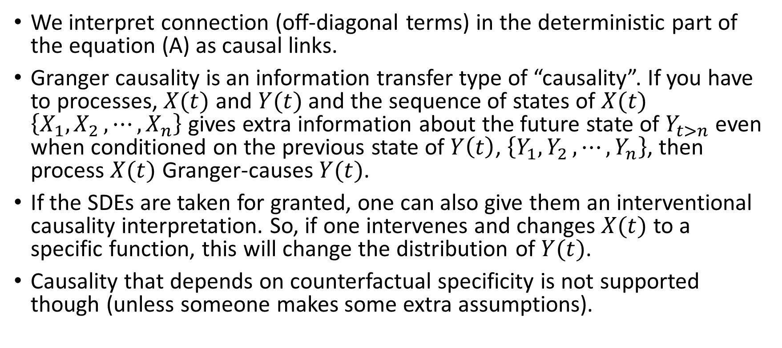
Causality
$$d\underline{X}\left(t\right)=\left(A\underline{X}\left(t\right)+\underline{m}\right)dt+Σd{\underline{B}}_{t}$$
We interpret connection (off-diagonal terms) in the deterministic part of the equation (A) as causal links.
Granger causality is an information transfer type of “causality”. If you have to processes, $X(t)$ and $Y(t)$ and the sequence of states of $X(t)$ $\left\{X_{1},X_{2 },⋯,X_{n}\right\}$ gives extra information about the future state of $Y_{t>n}$ even when conditioned on the previous state of $Y\left(t\right)$, $\left\{Y_{1},Y_{2 },⋯,Y_{n}\right\}$, then process $X(t)$ Granger-causes $Y(t)$.
If the SDEs are taken for granted, one can also give them an interventional causality interpretation. So, if one intervenes and changes $X(t)$ to a specific function, this will change the distribution of $Y(t)$.
Causality that depends on counterfactual specificity is not supported though (unless someone makes some extra assumptions).

Slide 7
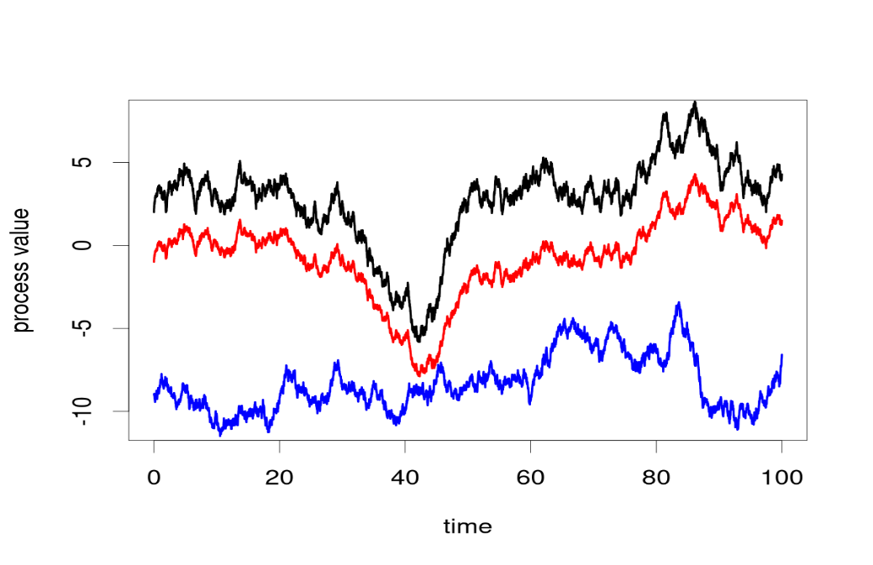
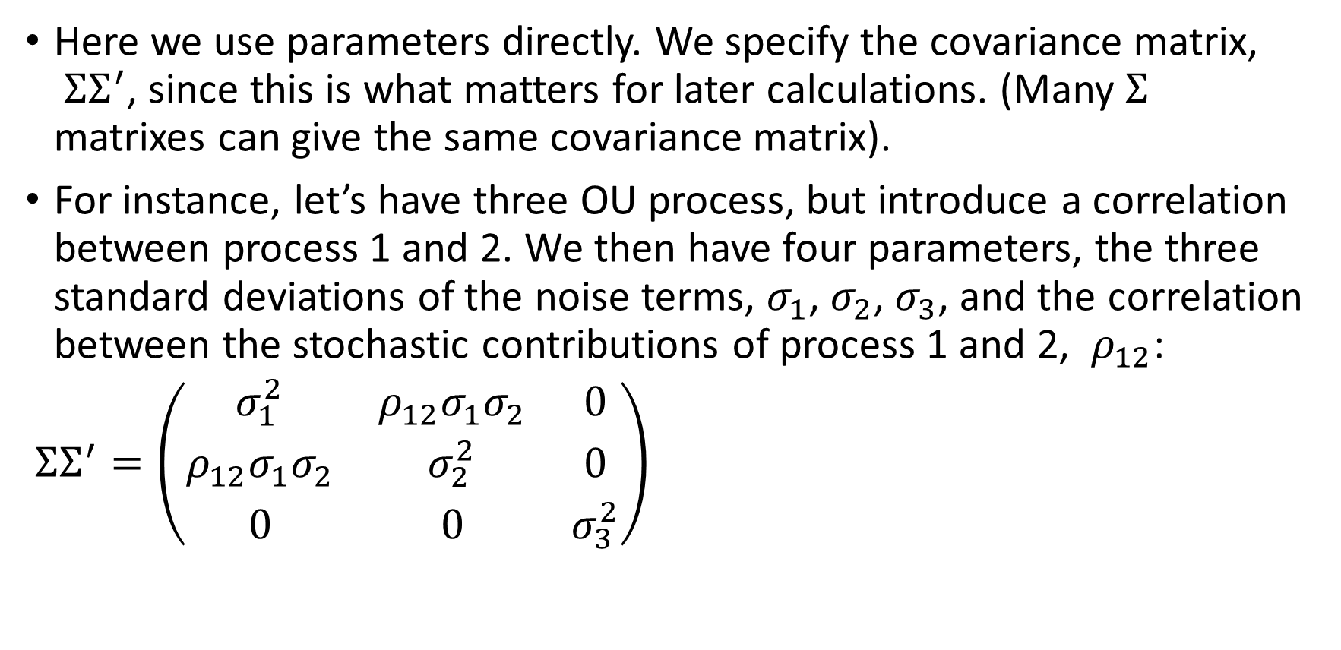

Parametrization – stochastic part ($Σ$)
Here we use parameters directly. We specify the covariance matrix, ${ΣΣ}^{′}$, since this is what matters for later calculations. (Many $Σ$ matrixes can give the same covariance matrix).
For instance, let’s have three OU process, but introduce a correlation between process 1 and 2. We then have four parameters, the three standard deviations of the noise terms, $σ_{1}$, $σ_{2}$, $σ_{3}$, and the correlation between the stochastic contributions of process 1 and 2, $ρ_{12}$:
${ΣΣ}^{′}=\left(\begin{matrix}σ_{1}^{2} & ρ_{12}σ_{1}σ_{2} & 0 \\ ρ_{12}σ_{1}σ_{2} & σ_{2}^{2} & 0 \\ 0 & 0 & σ_{3}^{2}\end{matrix}\right)$
Black = process 1
Red = process 2
Blue = process 3

Slide 8
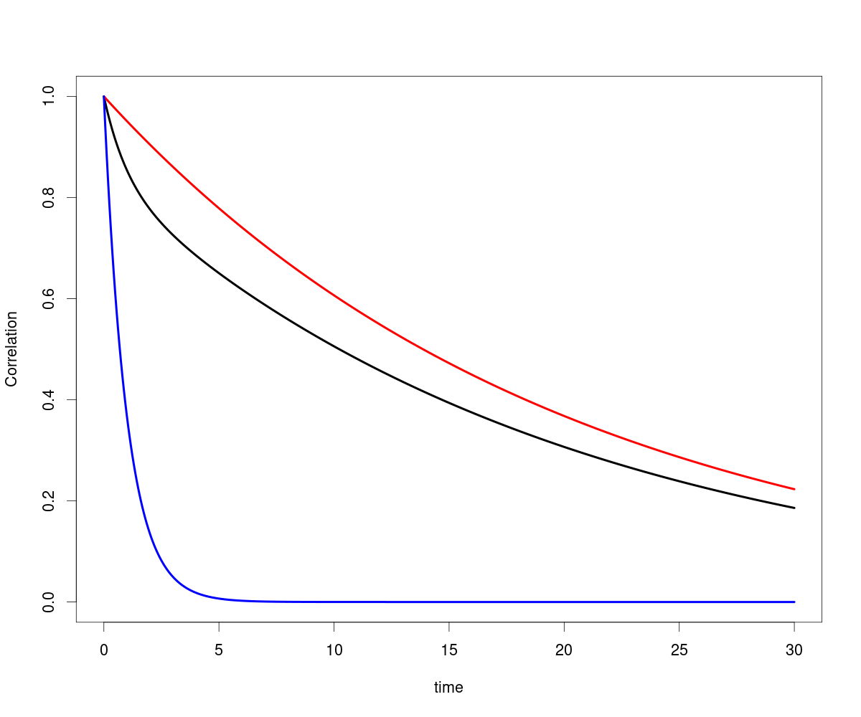
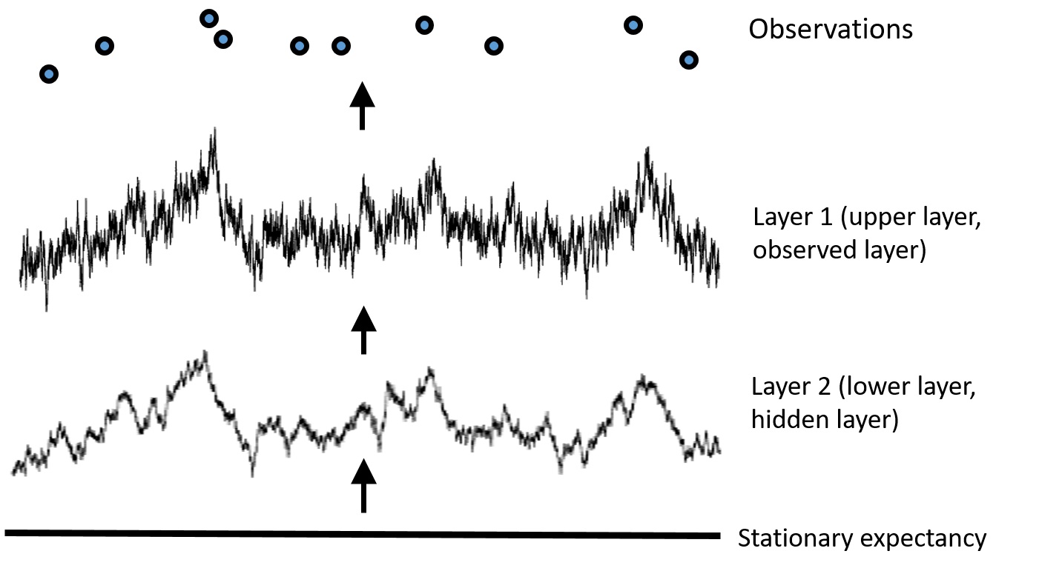
Layers
An two causally linked processes, you might only have measurements for one. Ex: phenotype and optimum.
The hidden layer can be found by its imprint on the observed layer.
Black=top layer of 2-layered system
Blue=top layer by itself
Red=lower layer correlation
(Default, but optional)
time

Slide 9

Identifiability issues in layered models
Let’s start with $x_{2}\left(t\right)$ causing $x_{1}\left(t\right)$
$dx_{1}\left(t\right)=−\frac{1}{t_{1}}\left(x_{1}\left(t\right)−μ_{1}−β_{21}(x_{2}\left(t\right)−μ_{2})\right)dt+σ_{1}dB_{t}^{(1)}$
$dx_{2}\left(t\right)=−\frac{1}{t_{2}}\left(x_{2}\left(t\right)−μ_{2}\right)dt+σ_{2}dB_{t}^{(2)}$
When $x_{2}\left(t\right)$ isn’t measured, we neither know the expected value ($μ_{2}$) nor the scale.
In layeranalyzer, this is solved by letting $x_{1}\left(t\right)$ inherit it’s expected value from $x_{2}\left(t\right)$ and fix the “regression term”, $β_{21}=1$.
$dx_{1}\left(t\right)=−\frac{1}{t_{1}}\left(x_{1}\left(t\right)− x_{2}\left(t\right)\right)dt+σ_{1}dB_{t}^{(1)}$
$dx_{2}\left(t\right)=−\frac{1}{t_{2}}\left(x_{2}\left(t\right)−μ_{2}\right)dt+σ_{2}dB_{t}^{(2)}$
Fast tracking of slow moving process
Even so, the characteristic time of the two layers can be swapped, from slow tracking of fast moving process to vice versa (if the stochastic contributions are scaled accordingly). So, what dynamics belongs to which layer is not identifiable.
Introduce an extra restriction: a lower layer has larger characteristic time than a higher layer (which is closer to the measurements). Reasonable for phenotypic evolution.
Had to introduce some subtle ways of restricting in the Bayesian prior. There’s more than one way implemented though simulation tests showed that the one we default use is the best.
Slow tracking of fast moving process
OU+OU

Slide 10
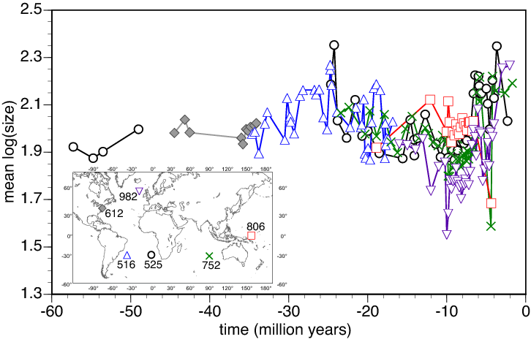

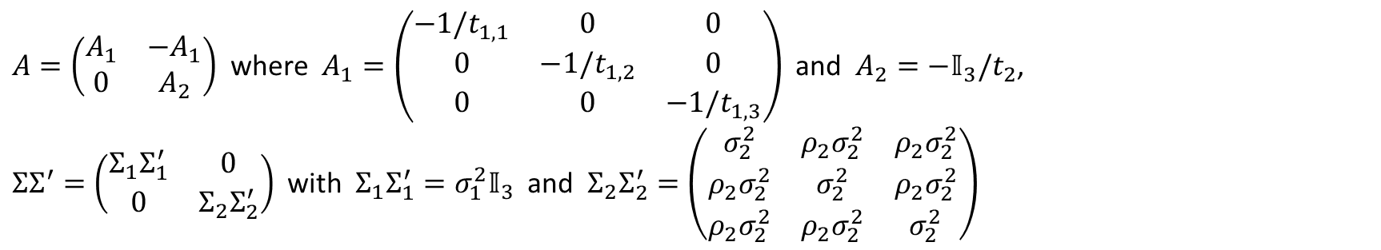
Parallel dataseries (regions)
In the original application, we had 6 different time series from 6 different regions, all measuring the same thing, namely coccolith size. Let’s reduce the number to 3 though…
Each layer is then represented by a vector of 3 parallel processes, and each element in the $A$ and ${ΣΣ}^{′}$ is now a 3x3 matrix. We allow correlations between the regions but no causal connections (as that would single out a region).
Parameters can be global (default) or regional (specific to each region).
For instance, if there are two layers and correlations in the second layer, and regional differences in the characteristic time on layer 1, then
$A=\left(\begin{matrix}A_{1} & −A_{1} \\ 0 & A_{2}\end{matrix}\right)$ where $A_{1}=\left(\begin{matrix}−1/t_{1,1} & 0 & 0 \\ 0 & −1/t_{1,2} & 0 \\ 0 & 0 & −1/t_{1,3}\end{matrix}\right)$ and $A_{2}={−𝕀}_{3}/t_{2}$,
${ΣΣ}^{′}=\left(\begin{matrix}{Σ_{1}Σ}_{1}^{′} & 0 \\ 0 & {Σ_{2}Σ}_{2}^{′}\end{matrix}\right)$ with ${Σ_{1}Σ}_{1}^{′}=σ_{1}^{2}𝕀_{3}$ and ${Σ_{2}Σ}_{2}^{′}=\left(\begin{matrix}σ_{2}^{2} & {ρ_{2}σ}_{2}^{2} & {ρ_{2}σ}_{2}^{2} \\ {ρ_{2}σ}_{2}^{2} & σ_{2}^{2} & ρ_{2}σ_{2}^{2} \\ {ρ_{2}σ}_{2}^{2} & {ρ_{2}σ}_{2}^{2} & σ_{2}^{2}\end{matrix}\right)$

Slide 11
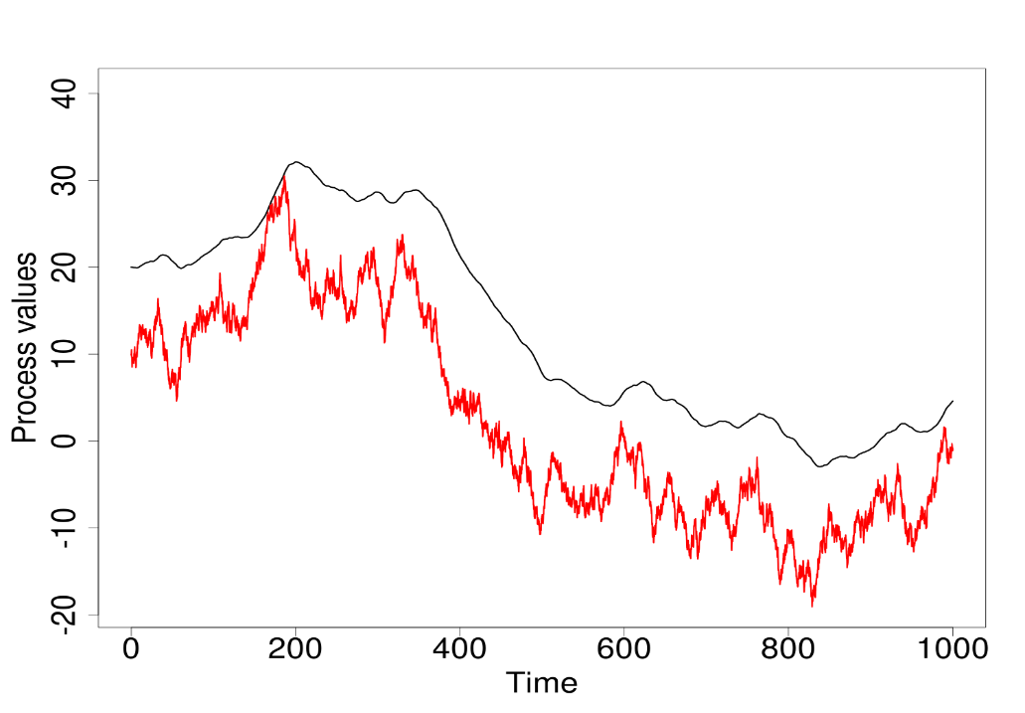
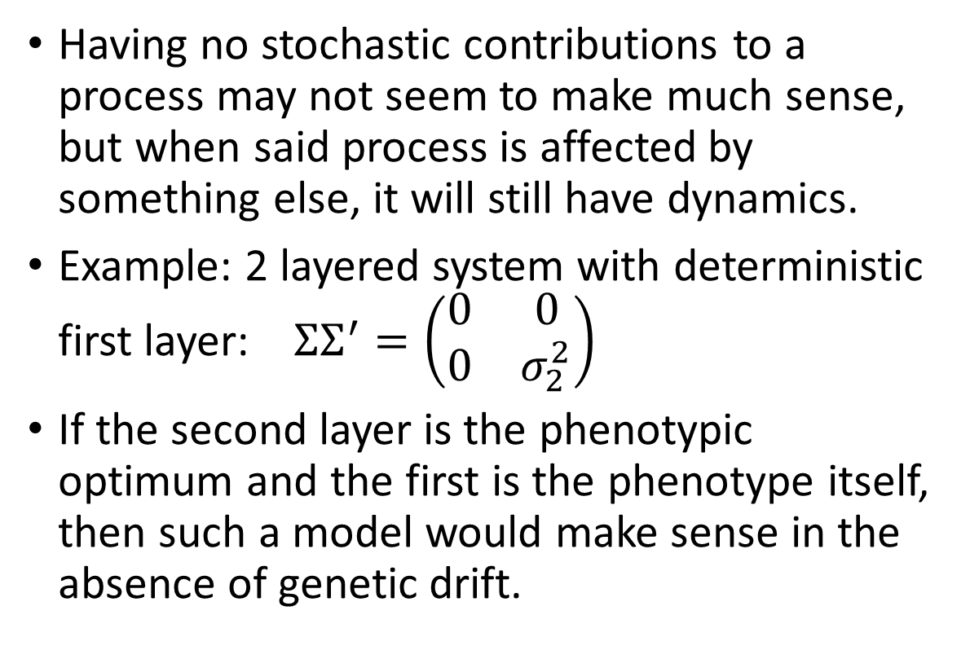
Deterministic layers
Having no stochastic contributions to a process may not seem to make much sense, but when said process is affected by something else, it will still have dynamics.
Example: 2 layered system with deterministic first layer: ${ΣΣ}^{′}=\left(\begin{matrix}0 & 0 \\ 0 & σ_{2}^{2}\end{matrix}\right)$
If the second layer is the phenotypic optimum and the first is the phenotype itself, then such a model would make sense in the absence of genetic drift.

Slide 12
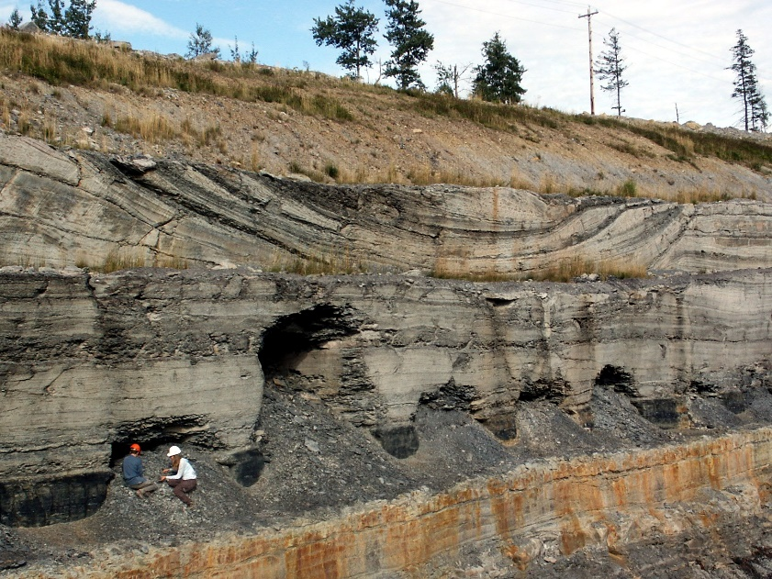
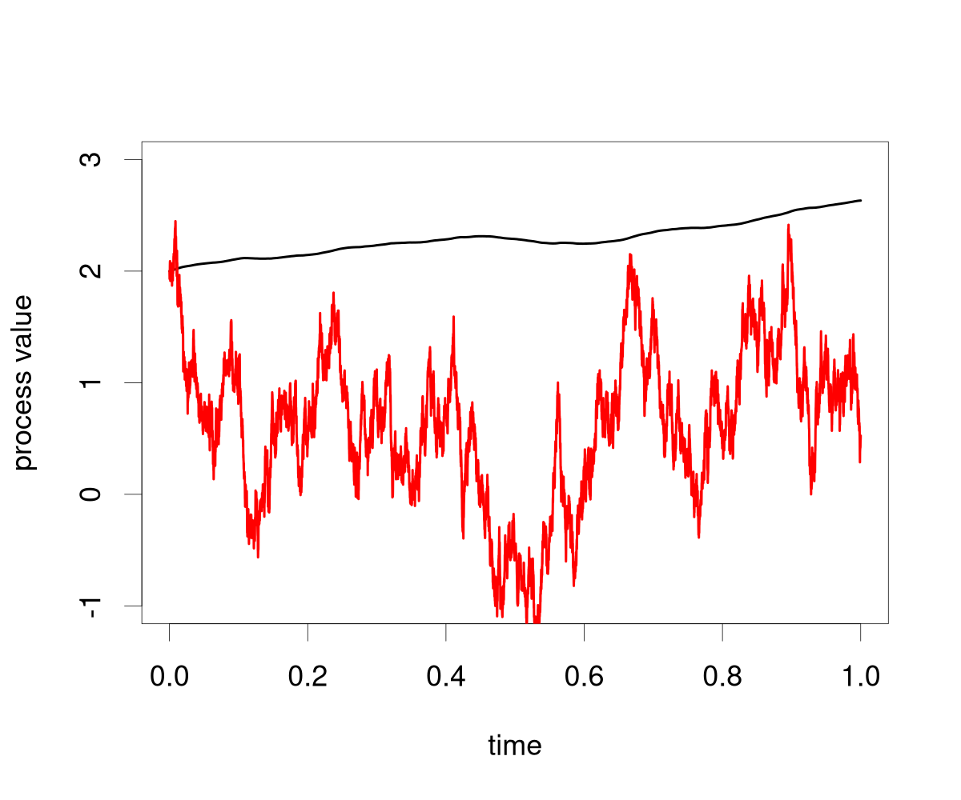
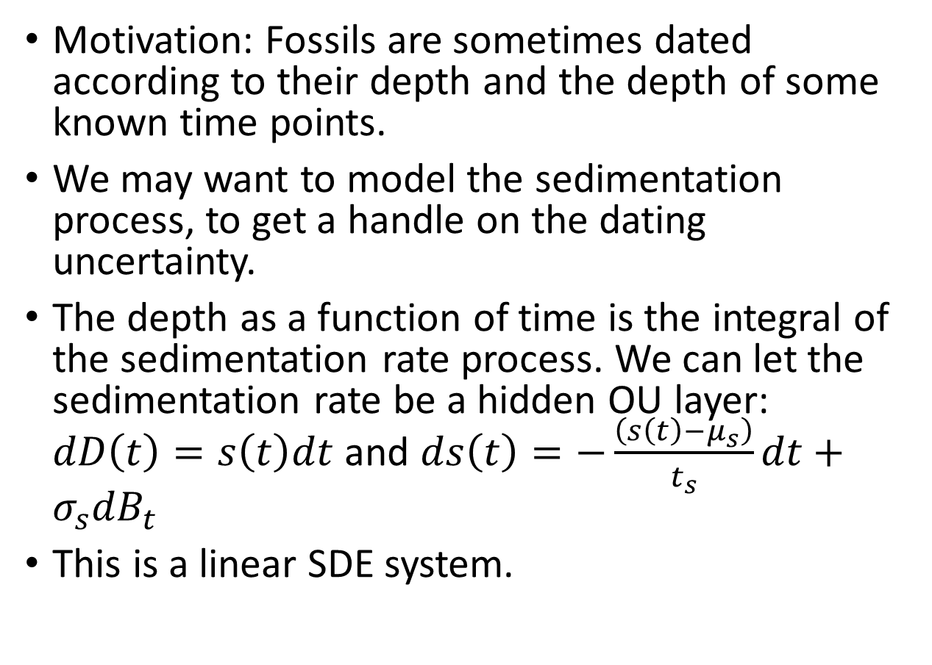
Integration layers
Motivation: Fossils are sometimes dated according to their depth and the depth of some known time points.
We may want to model the sedimentation process, to get a handle on the dating uncertainty.
The depth as a function of time is the integral of the sedimentation rate process. We can let the sedimentation rate be a hidden OU layer: $dD\left(t\right)=s\left(t\right)dt$ and $ds\left(t\right)=−\frac{\left(s\left(t\right)−μ_{s}\right)}{t_{s}}dt+σ_{s}{dB}_{t}$
This is a linear SDE system.

Slide 13
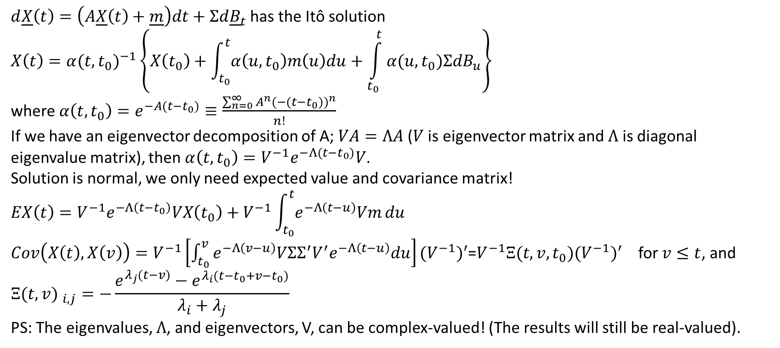
Solving linear SDEs
$d\underline{X}\left(t\right)=\left(A\underline{X}\left(t\right)+\underline{m}\right)dt+Σd{\underline{B}}_{t}$ has the Itô solution
$$X\left(t\right)={α(t,t_{0})}^{−1}\left\{X\left(t_{0}\right)+\int_{t_{0}}^{t}{α\left(u,t_{0}\right)m\left(u\right)du}+\int_{t_{0}}^{t}{α(u,t_{0})ΣdB_{u}}\right\}$$
where $α\left(t,t_{0}\right)=e^{−A(t−t_{0})}≡\frac{\sum_{n=0}^{∞}{A^{n}}(−({t−t_{0}))}^{n}}{n!}$
If we have an eigenvector decomposition of A; $VA=ΛA$ ($V$ is eigenvector matrix and $Λ$ is diagonal eigenvalue matrix), then $α\left(t,t_{0}\right)=V^{−1}e^{−Λ(t−t_{0})}V$.
Solution is normal, we only need expected value and covariance matrix!
$$EX\left(t\right)=V^{−1}e^{−Λ\left(t−t_{0}\right)}VX\left(t_{0}\right)+V^{−1}\int_{t_{0}}^{t}{e^{−Λ\left(t−u\right)}Vm}du$$
$Cov\left(X\left(t\right),X\left(v\right)\right)=V^{−1}\left[\int_{t_{0}}^{v}{e^{−Λ\left(v−u\right)}VΣΣ^{′}V^{′}e^{−Λ\left(t−u\right)}du}\right]{{(V}^{−1})}^{′}$=$V^{−1}Ξ(t,v,t_{0}){{(V}^{−1})}^{′}$ for $v≤t$, and
$${Ξ(t,v) }_{i,j}=−\frac{e^{λ_{j}(t−v)}−e^{λ_{i}(t−t_{0}+v−t_{0})}}{λ_{i}+λ_{j}}$$
PS: The eigenvalues, $Λ$, and eigenvectors, V, can be complex-valued! (The results will still be real-valued).

Slide 14
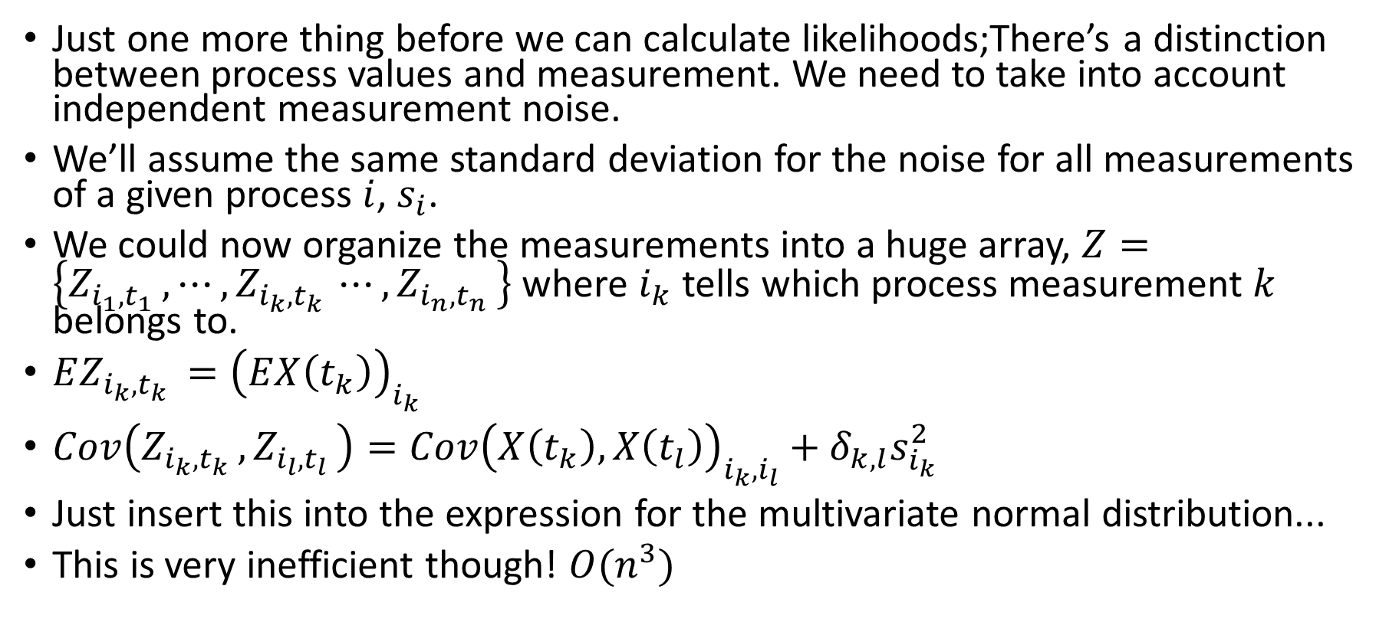
Naïve likelihood calculation
Just one more thing before we can calculate likelihoods;There’s a distinction between process values and measurement. We need to take into account independent measurement noise.
We’ll assume the same standard deviation for the noise for all measurements of a given process $i$, $s_{i}$.
We could now organize the measurements into a huge array, $Z=\left\{Z_{i_{1},t_{1} },⋯,Z_{i_{k},t_{k} }⋯,Z_{i_{n},t_{n} }\right\}$ where $i_{k}$ tells which process measurement $k$ belongs to.
$EZ_{i_{k},t_{k} }={\left(EX\left(t_{k}\right)\right)}_{i_{k}}$
$Cov\left(Z_{i_{k},t_{k} },Z_{i_{l},t_{l} }\right)={Cov\left(X\left(t_{k}\right),X\left(t_{l}\right)\right)}_{i_{k},i_{l}}+δ_{k,l}s_{i_{k}}^{2}$
Just insert this into the expression for the multivariate normal distribution...
This is very inefficient though! $O(n^{3})$

Slide 15
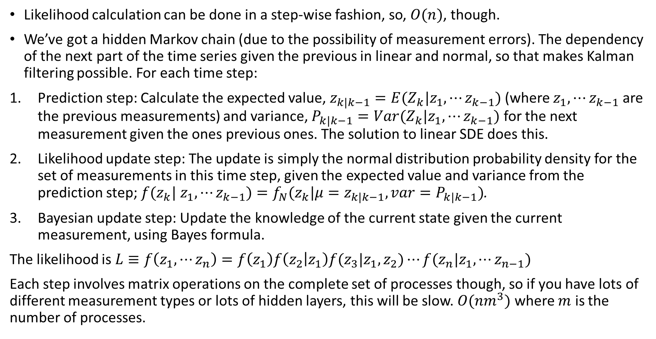
Likelihood calculation using Kalman filtering
Likelihood calculation can be done in a step-wise fashion, so, $O(n)$, though.
We’ve got a hidden Markov chain (due to the possibility of measurement errors). The dependency of the next part of the time series given the previous in linear and normal, so that makes Kalman filtering possible. For each time step:
Prediction step: Calculate the expected value, $z_{k|k−1}=E(Z_{k}|z_{1},⋯z_{k−1})$ (where $z_{1},⋯z_{k−1}$ are the previous measurements) and variance, $P_{k|k−1}=Var(Z_{k}|z_{1},⋯z_{k−1})$ for the next measurement given the ones previous ones. The solution to linear SDE does this.
Likelihood update step: The update is simply the normal distribution probability density for the set of measurements in this time step, given the expected value and variance from the prediction step; $f(z_{k}|$ $z_{1},⋯z_{k−1})=f_{N}(z_{k}|μ=z_{k|k−1},var=P_{k|k−1})$.
Bayesian update step: Update the knowledge of the current state given the current measurement, using Bayes formula.
The likelihood is $L≡f\left(z_{1},⋯z_{n}\right)=f\left(z_{1}\right)f\left(z_{2} | z_{1}\right)f(z_{3}|z_{1},z_{2})⋯f({z_{n}|z}_{1},⋯z_{n−1})$
Each step involves matrix operations on the complete set of processes though, so if you have lots of different measurement types or lots of hidden layers, this will be slow. $O({nm}^{3})$ where $m$ is the number of processes.

Slide 16
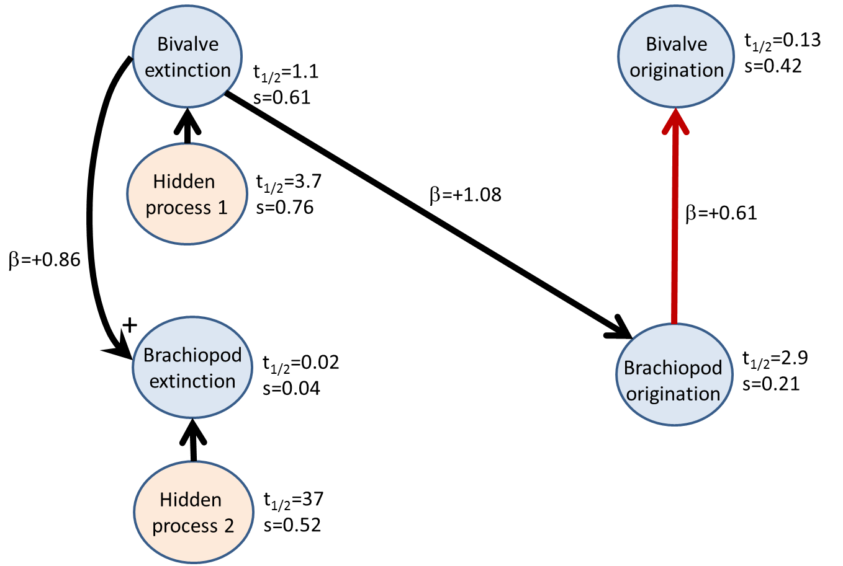
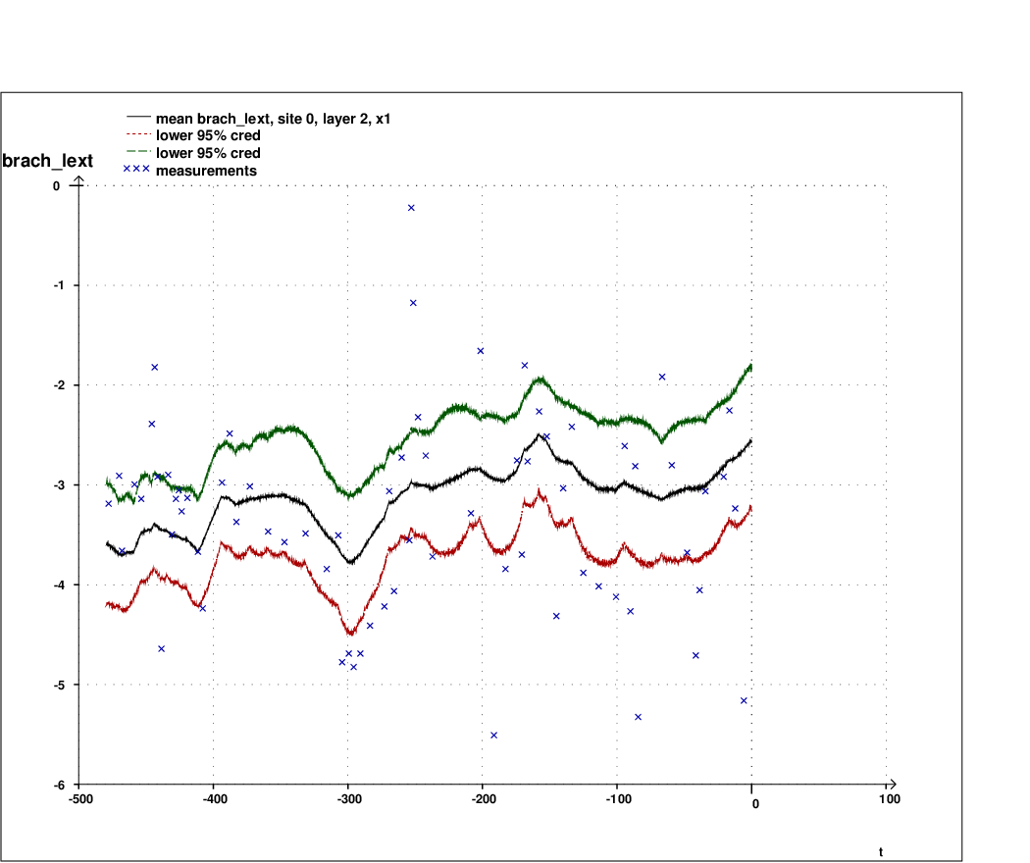
Kalman smoothing
Kalman smoothing is the act of getting a process estimates given all the measurement (not just the measurement that went before).
This is performed by working backwards from the last measurement, using the Rauch-Tung-Stribel smoother.
Can be used for interpolation and extrapolation on measured processes.
Can also give inference for hidden layers!
Example: We found that brachiopod extinction rates were affected by bivalve extinction rates and a hidden layer. We could post a reconstruction of this layer and ask the paleo-community if they’ve seen this time series.

Slide 17
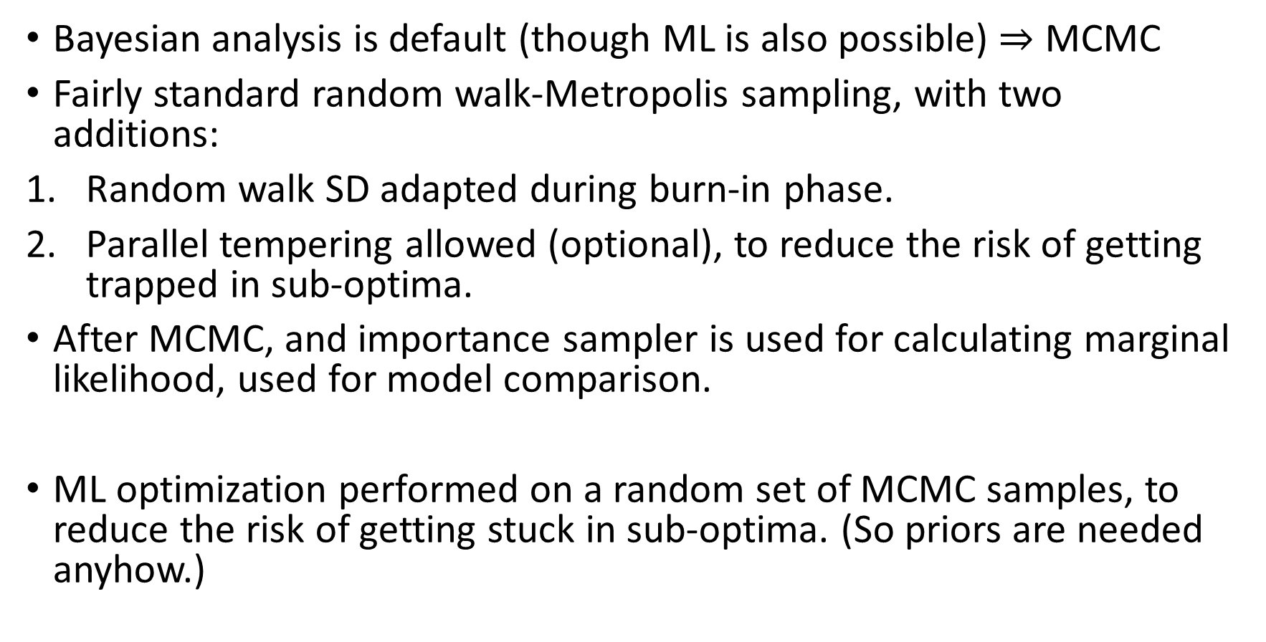
MCMC sampling
Bayesian analysis is default (though ML is also possible) $⇒$ MCMC
Fairly standard random walk-Metropolis sampling, with two additions:
Random walk SD adapted during burn-in phase.
Parallel tempering allowed (optional), to reduce the risk of getting trapped in sub-optima.
After MCMC, and importance sampler is used for calculating marginal likelihood, used for model comparison.
ML optimization performed on a random set of MCMC samples, to reduce the risk of getting stuck in sub-optima. (So priors are needed anyhow.)

Slide 18
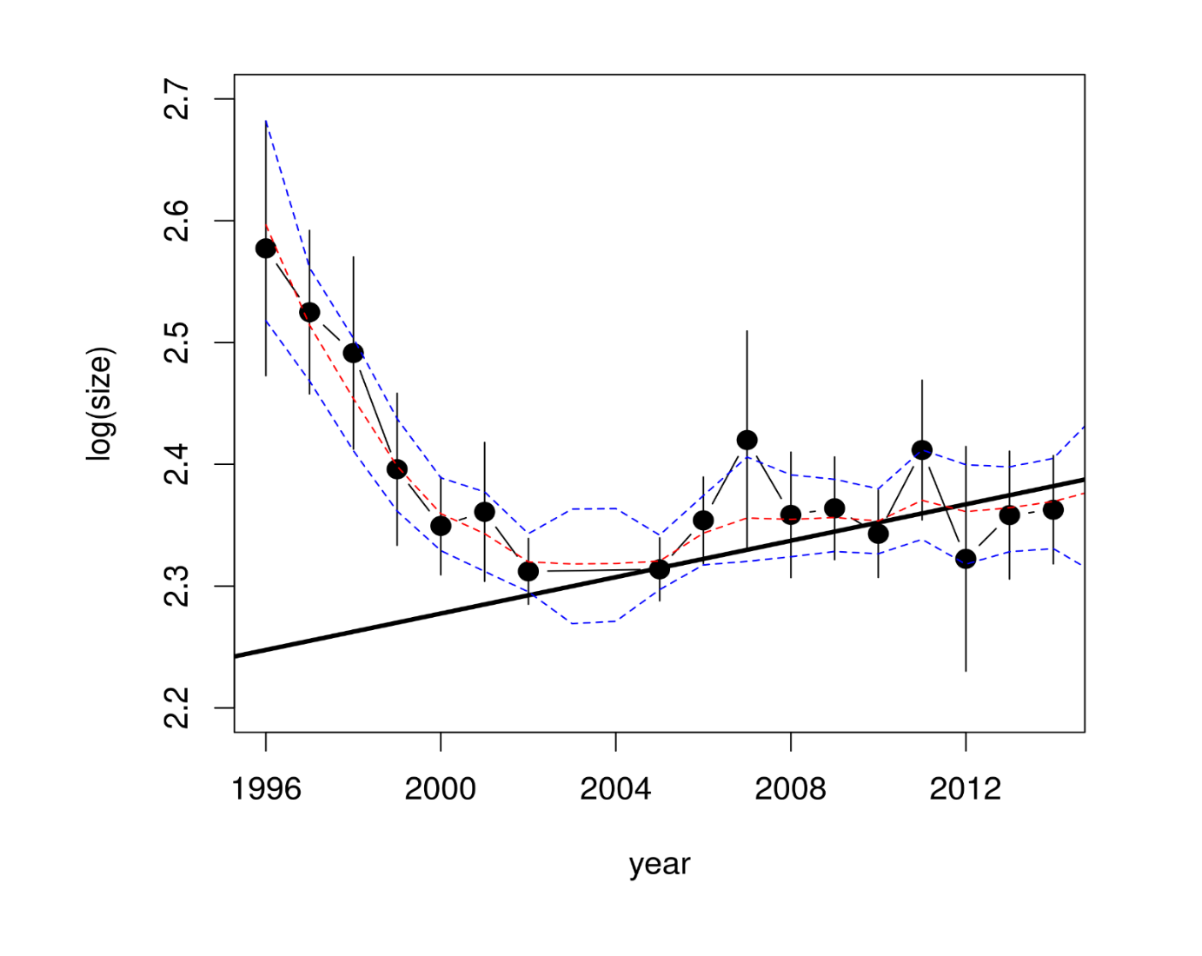
Example, one phenotypic time series
One time series of reed warbler sizes (mass, g) measured over 19 year.
Original: OU (natural selection) or Wiener process (neutral drift). Adding more structures (linear trend, layered processes) in the model search.
Log-transformed before use.
Result: OU with linear trend.
X=layer.data.series(time.points=malta$Time.Year,
value.points=malta$Mean..log.body.mass.,
std.dev=sqrt(malta$Variance),
num.meas.per.value=malta$Sample.size,
name="log.body.size")
models.ml=
traverse.standalone.layered(X, max.layers=2,
do.maximum.likelihood = TRUE,
maximum.likelihood.numstart = 1000)
compare.layered(models.ml, ML.IC = "AICc")

Slide 19
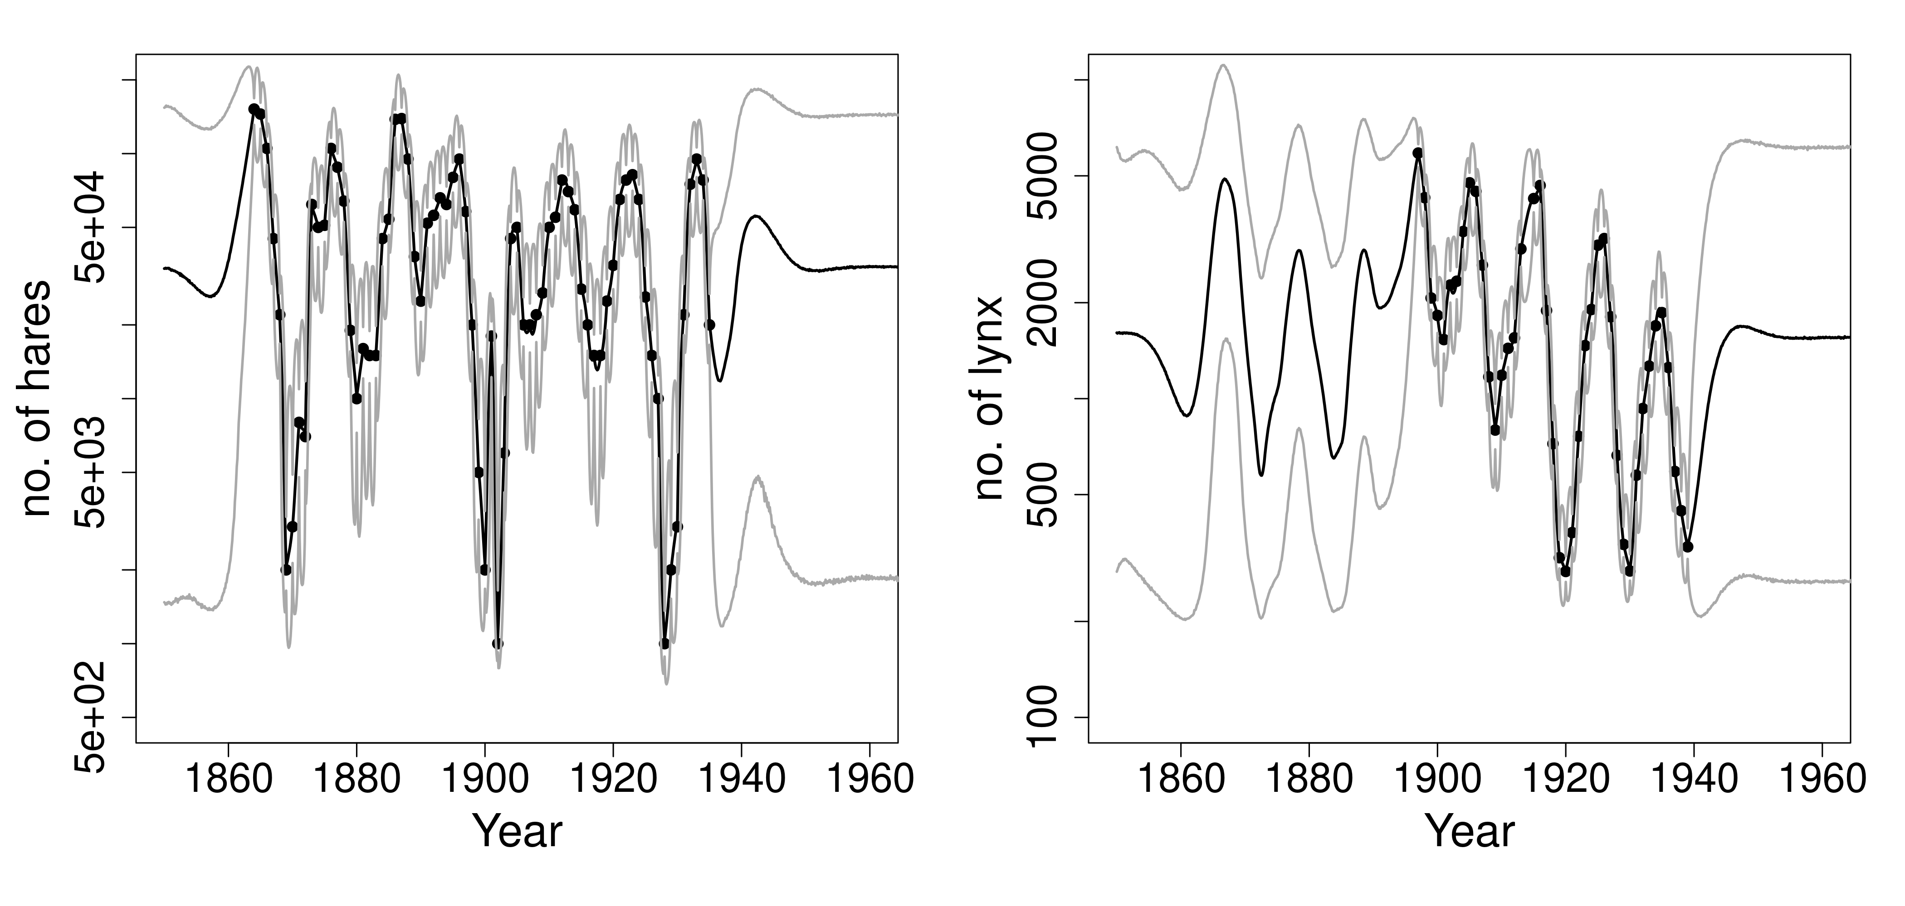
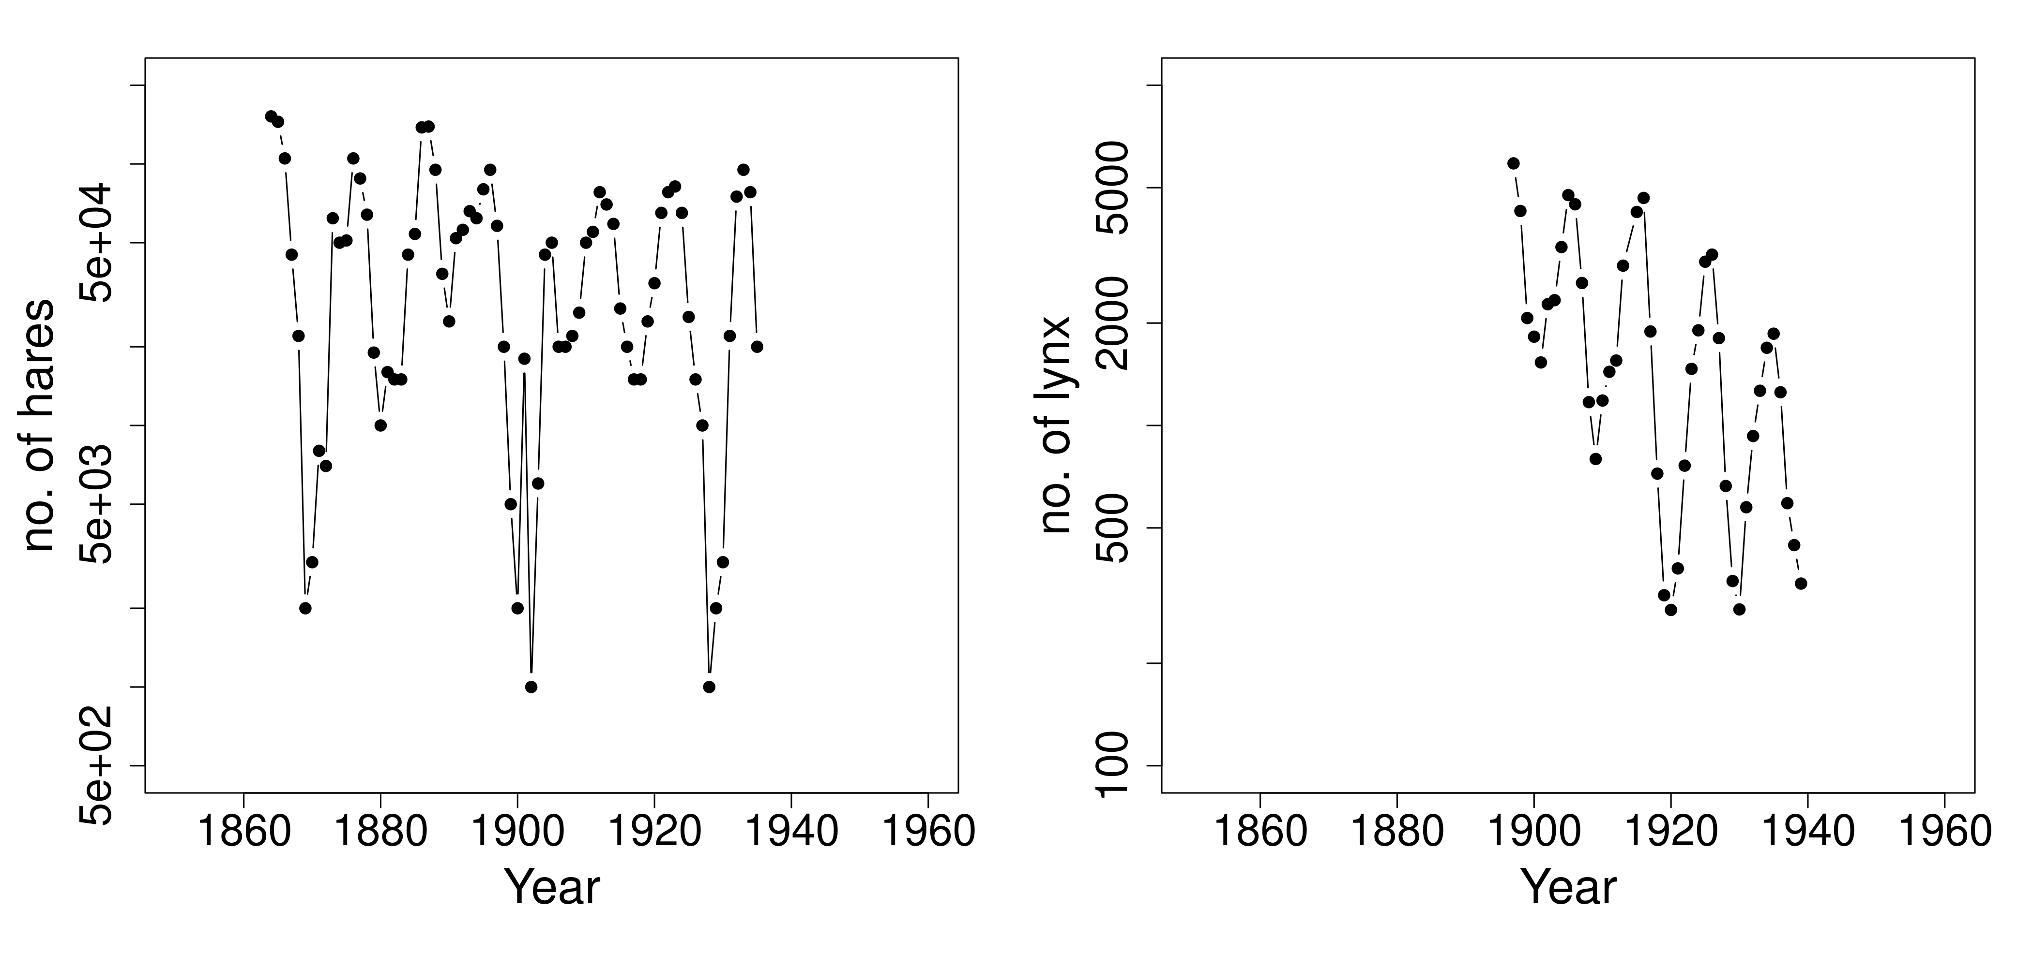
Example, two possibly connected ecological series
Hare and lynx capture data spanning over 100 year. Assumed indicative of abundance.
Normalized before use.
Connection analysis: 2-way causal feedback loop. Positive from hares to lynx, negative from lynx to hares.
hare.struct=layer.series.structure(hare.norm, numlayers=1)
lynx.struct=layer.series.structure(lynx.norm, numlayers=1)
res=traverse.connections.layered(hare.struct,lynx.struct)

Slide 20
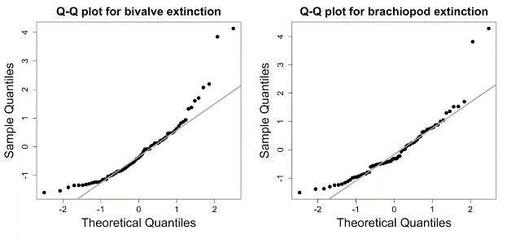
Residual analysis
The difference between predictions and measurement in the Kalman filter are called the residuals.
Residuals should be independent and when standardized with the prediction standard deviation, standard normally distributed.
Thus QQ-plots/Shapiro-Wilks test, autocorrelation plots/tests, regression tests on prediction vs residuals can all be used for diagnostics.

Slide 21
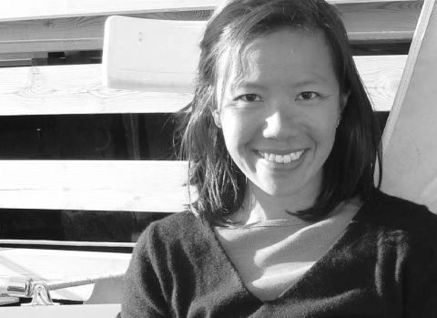



Closing words
Project web page: https://github.com/trondreitan/layeranalyzer.
Intro for R package: Reitan, T., Liow, L. H. (2019) layeranalyzer: Inferring correlative and causal connections from time series data in R Methods in Ecology and Evolution, DOI: 10.1111/2041-210X.13299
Installation: install_github(repo="trondreitan/layeranalyzer") or install.packages("https://github.com/trondreitan/layeranalyzer/raw/master/layeranalyzer_0.1.0.tar.gz",type="source",verbose=T)
Made as part of the BLEED project.
Lee Hsiang Liow – project leader + text&testing.
Funded by the RCN and ERC.
Original ideas, Tore Schweder.

