Slide 1
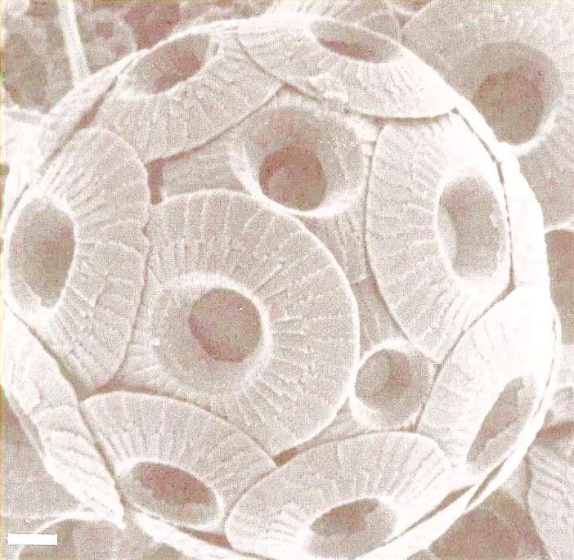
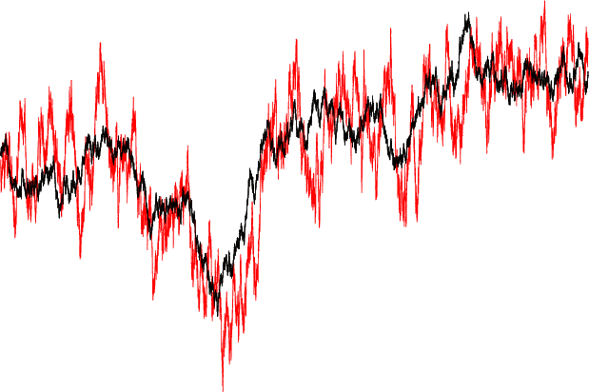
Modelling phenotypic evolution using layered stochastic differential equations (with applications for Coccolith data)
How to model layers of continuous time processes and check these against the data.
Trond Reitan
CEES, institute of biology, UiO

Slide 2
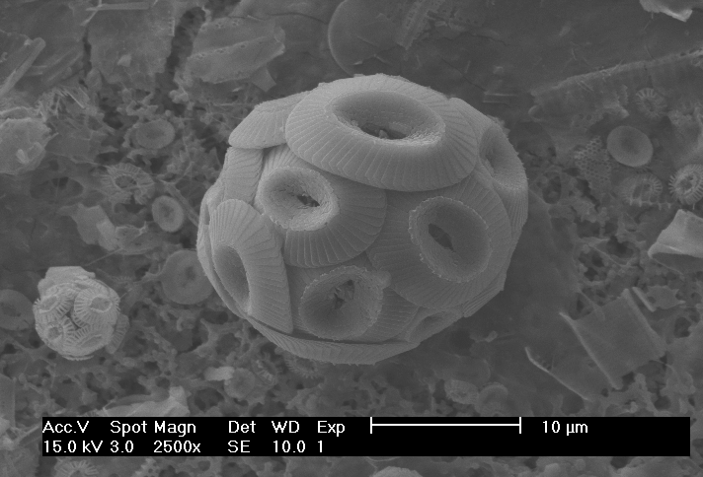
Our data - Coccoliths
Measurements are on the diameter of Coccoliths from marine, calcifying single cell algae (Haptophyceae).
These are covered by calcite platelets (‘coccoliths’ forming a ‘coccosphere’)
SEM image: J. Henderiks, Stockholm University

Slide 3
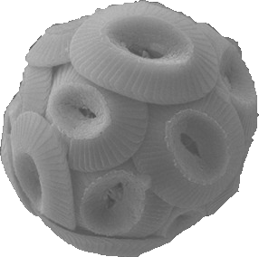
Size (phenotype) variation
Generation 0:
Generation 1:
Assume that the variance
is maintained
Optimum

Slide 4
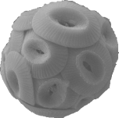
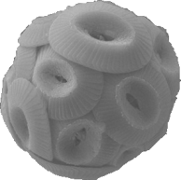
Change of the average in time
0
500
1000
1500
2000
2500
Generations
Mean changes. Pulled towards the optimum, but always with some fluctuations. => Stochastic process
Lande, 1976: This is an Ornstein-Uhlenbeck process
But: The optimum may also change!

Slide 5
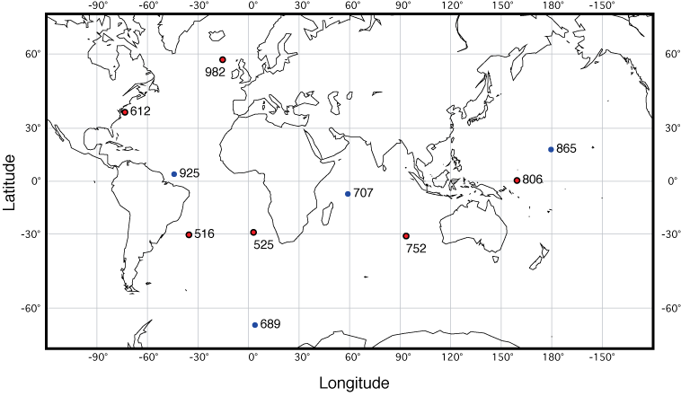
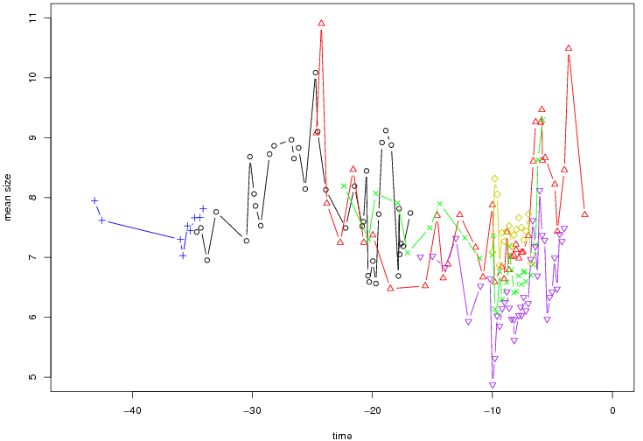
Our data – Coccolith size measurements
For each site and each observed time: The size of several (1-400) Coccoliths was measured. Mean size shown. (For analysis, the data was log-transformed. After data massage: n=178 different mean sizes.)

Slide 6
Concepts
Data: Several size measurements for different ages and sites. => average and variance
Should express something about an underlying set of processes, optima-layers, belonging to the lineage.
Non-equidistant time series: Continuous in time
Stochastic
Can we use the data to say something about the processes?

Slide 7
Background
Data:Jorijntje Henderiks.
Tore Schweder: Idea and mathematical foundation.
Me: Inference, programming and control calculations.

Slide 8
Multiple layers of hidden processes – why?
Measured mean size is a noisy indicator of overall mean size at a given moment.
Even with perfect measurements, what happens between needs inference.
A phenotype character will track an evolutionary optimum (natural selection).
The optimum changes also. Can be further divided into layers describing global and local contributions.
Each layer is responding to what happens in a lower layer.

Slide 9
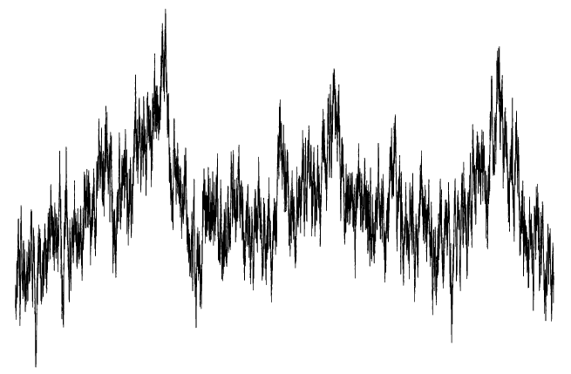
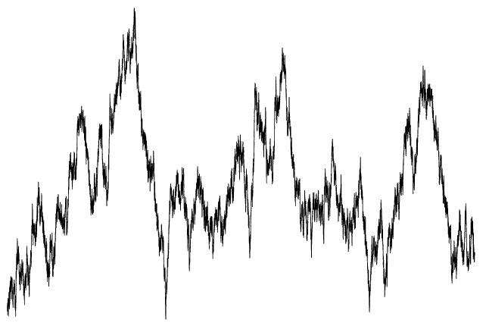
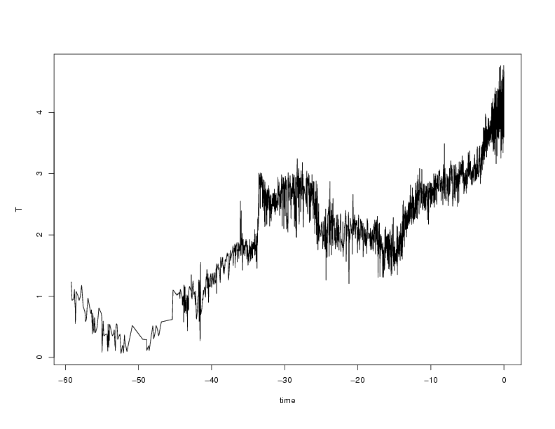
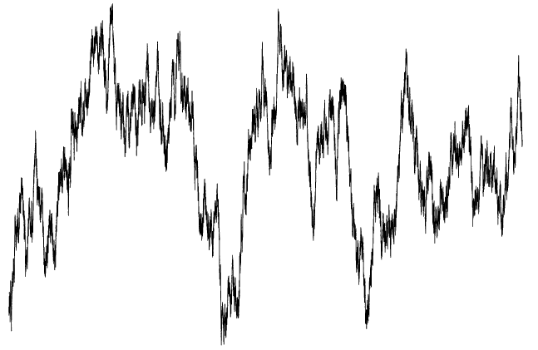
Process layers - illustration
o
Observations
o
o
o
o
o
o
o
Layer 1 – local phenotypic character
local contributions to the optimum
Layer 2 –
T
External
series
global contributions to the optimum
Layer 3 –
Fixed layer

Slide 10
Variants
Can have different number of layers.
In a single layer, one has the choice of:
  Local or global parameters
  The stochastic contribution can be global or local (site-specific)
  Correlation between sites (inter-regional correlation)
  Deterministic response to the lower layer
  Random walk (not responding to anything else, no tracking)
In total: 750 models examined

Slide 11
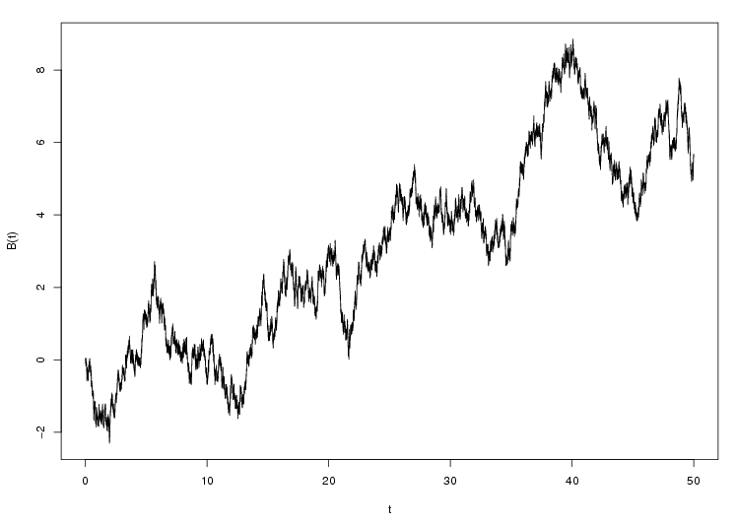
The toolbox – stochastic differential equations, the Wiener process
Need something that is continuous in time, has a direction and a stochastic element.
Stochastic differential equations (SDEs): Combines differential equations with the Wiener process.
Wiener process: continuous time random walk (Brownian motion).
B(t)

Slide 12

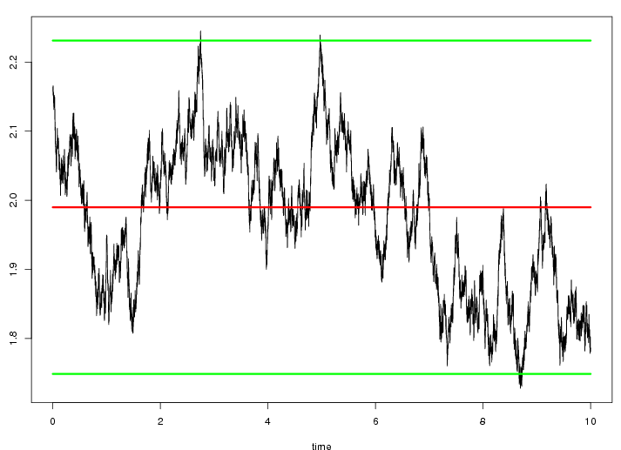
The Ornstein-Uhlenbeck (mean-reverting) process
Attributes:
Normally distributed
Markovian
Expectancy: μ
Standard deviation: s=σ/√2a
a: pull
Time for the correlation to drop to 1/e: Δt =1/a
μ+1.96 s
μ
Δt
μ-1.96 s
The parameters (μ, Δt, s) can be estimated from the data. In this case: μ≈1.99, Δt≈0.80Myr, s≈0.12.

Slide 13
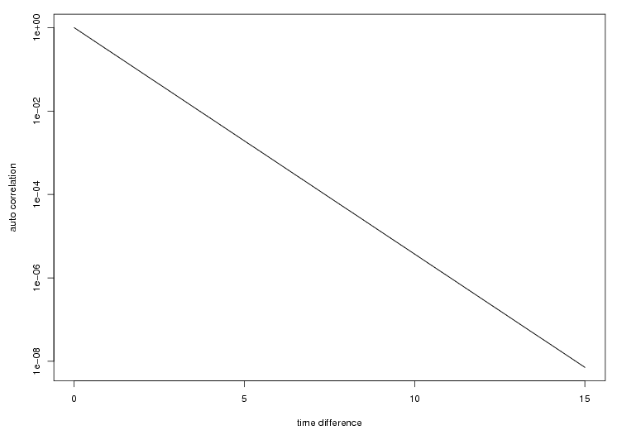
Autocorrelation
The autocorrelation function is the correlation between the process state at one time, t₁, and the process state a later time, t₂.
A function of the time difference, t₂-t₁.
For a single layer OU process,

Slide 14
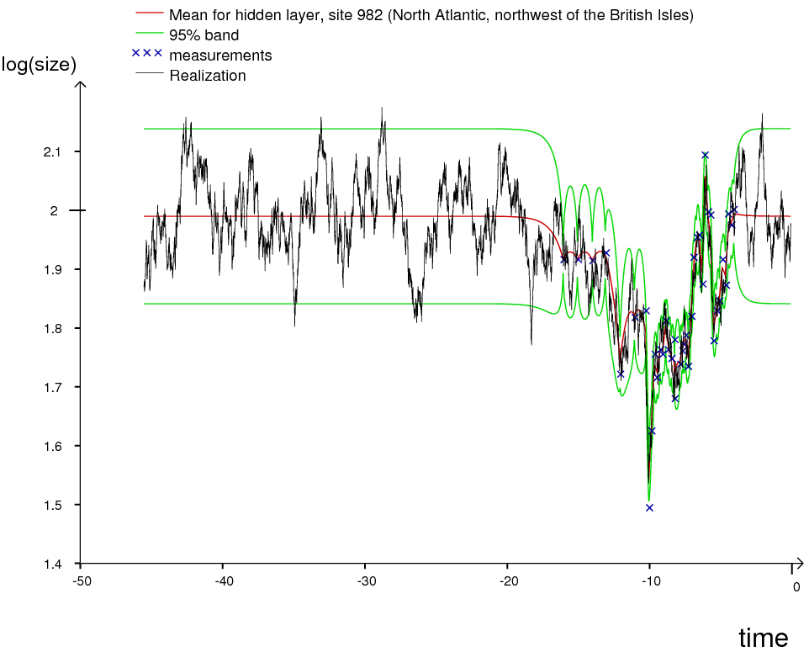
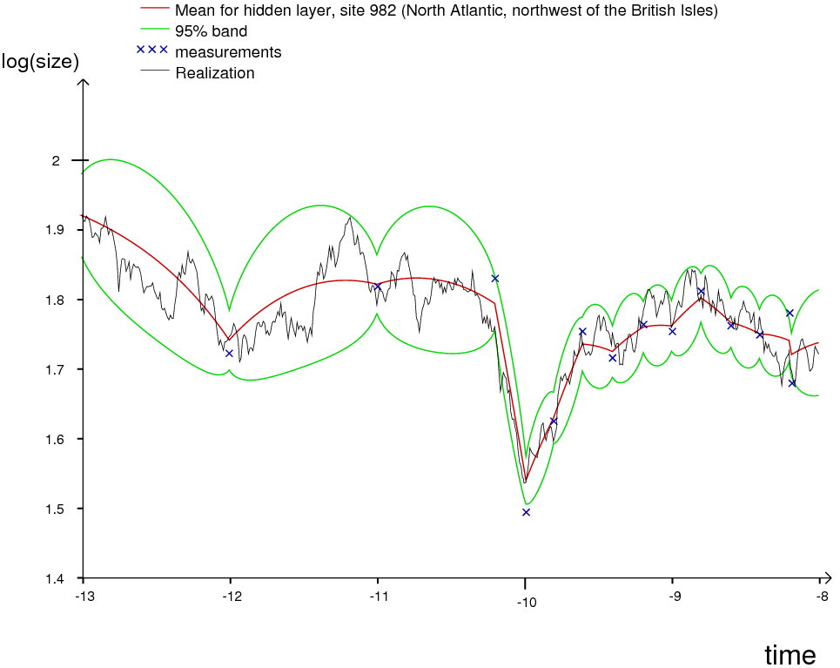
Curiosity: OU process conditioned on data
It’s possible to realize an OU process conditioned on the data, also (using the Kalman framework, which will be described later).

Slide 15
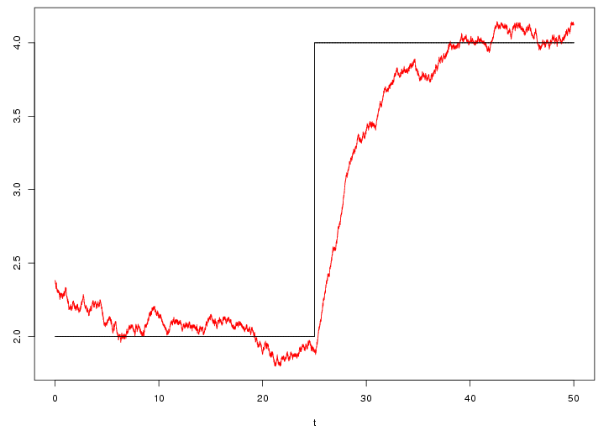
OU process tracking another process
Tracks the underlying function/process, μ(t), with response time equal to the characteristic time, Δt=1/a
Idea: Let the underlying process be expressed the same way.

Slide 16
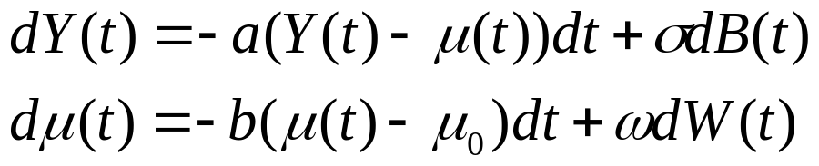
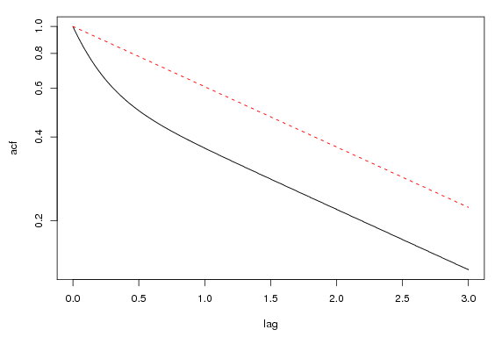
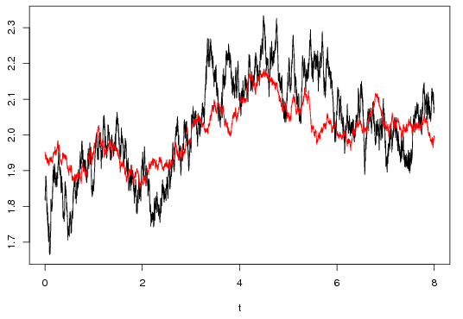
OU-like process tracking another OU process
Auto-correlation
of the upper (black) process, compared to a one-layered OU model.
Red process (Δt=0.2, s=2) tracking black process (Δt=2,s=1)

Slide 17
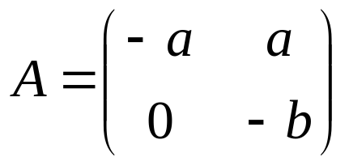
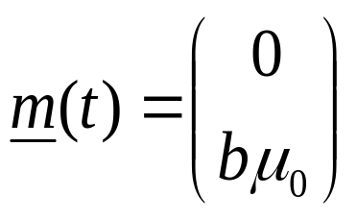
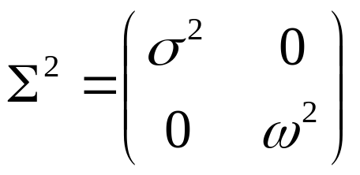
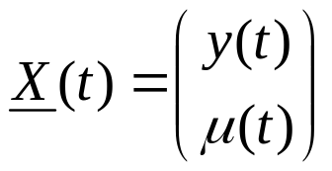
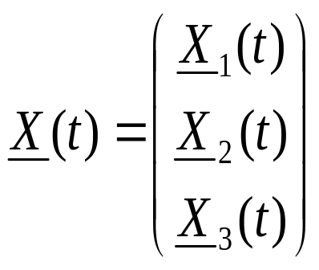
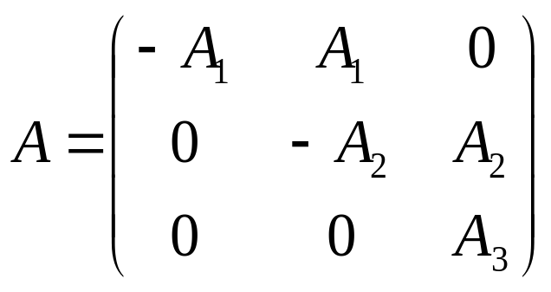
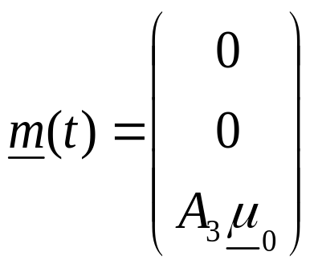
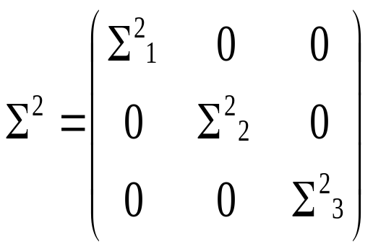
Vectorial linear stochastic differential equation
The two coupled SDEs on the previous slide can be
written as:
when
Generalization to 3 layers and several sites per layer:

Slide 18

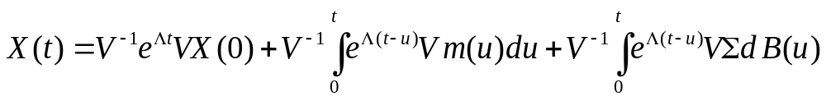
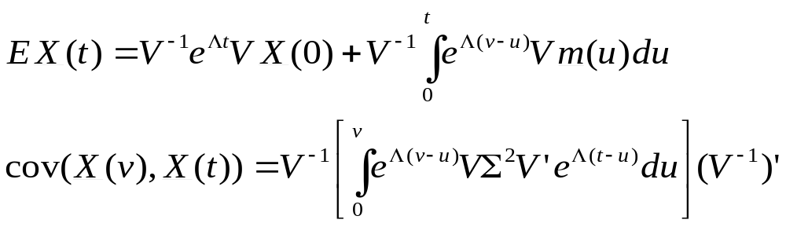
Solving vectorial linear SDEs
Solve by eigen-representation:
Eigenvectors: V
Eigenvalues, Λ=diag(λ)
Formal solution:
Gaussian process, only expectation and covariance needed!

Slide 19
Why linear SDE processes?
Parsimonious: Simplest way of having a stochastic continuous time process that can track something else.
Tractable: The likelihood, L(θ) ≡ f(Data | θ), can be analytically calculated. (θ = model parameter set)
Some justification from biology, see Lande (1976), Estes and Arnold (2007), Hansen (1997), Hansen et. al (2008).
Great flexibility...

Slide 20
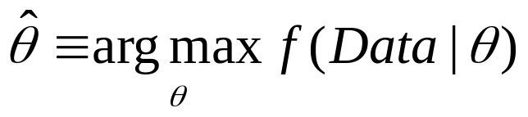
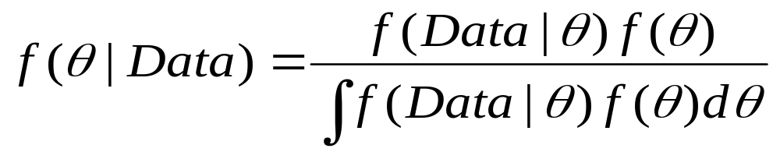
Inference
Don’t know the details of the model or the model parameters, θ. Need to do inference.
Classic: Search for
  Use BIC for model comparison.
Bayesian:
  Need a prior distribution, f(θ), on the model parameters.
  Use f(Data|M) for model comparison.
Technical: Numeric methods for both kinds of analysis.
  ML: Multiple hill-climbing
  Bayesian: MCMC + Importance sampling

Slide 21
Calculating the likelihood - Kalman filtering
Basis:
  Hidden linear normal Markov process,
  Observations centered normally around the hidden process,
We can find the transition and covariance matrices for the processes.
Analytical results for doing inference on a given state and observation given the previous observations.
Can also do inference on the state given all the observations (Kalman smoothing)
X₁
X₂
X₃
. . .
X_{k-1}
X_{k}
. . .
X_{n}
Z₁
Z₂
Z₃
Z_{k-1}
Z_{k}
Z_{n}

Slide 22
Do we have enough data for full model selection?
Assume the data has been produced by a given model in this framework.
  Can we detect it with the given amount of data?
  How much data is needed in order to reliably detect this by classic and Bayesian means?
Check artificial data against the original model plus 25 likely suspects.
So far: Slight tendency to find the correct number of layers with the Bayesian approach. BIC seems generally too stingy on the number of layers.

Slide 23
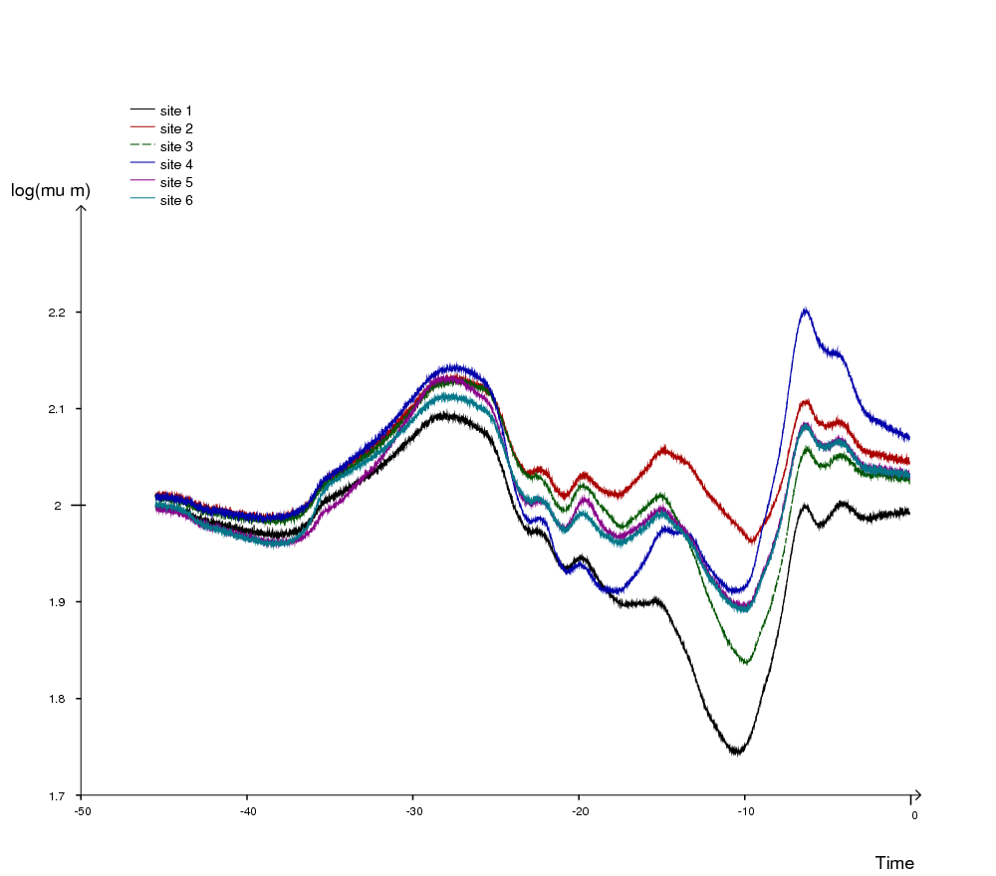
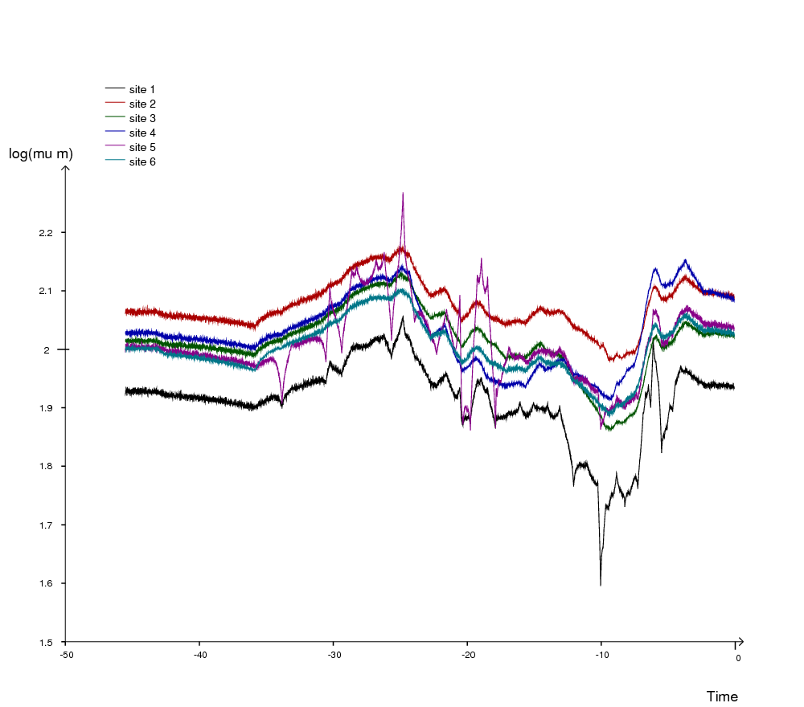
Bayesian model comparison result
Best: 3 layer model (Pr(M|D)=9.9%)
  Lowest layer: Inter-regional correlations, ρ=0.63. Δt≈6.1 Myr.
  Middle layer: Deterministic, Δt≈1.4 Myr.
  Upper layer: Wide credibility band for the pull, which is local, Δt∈(1yr,1Myr)

Slide 24
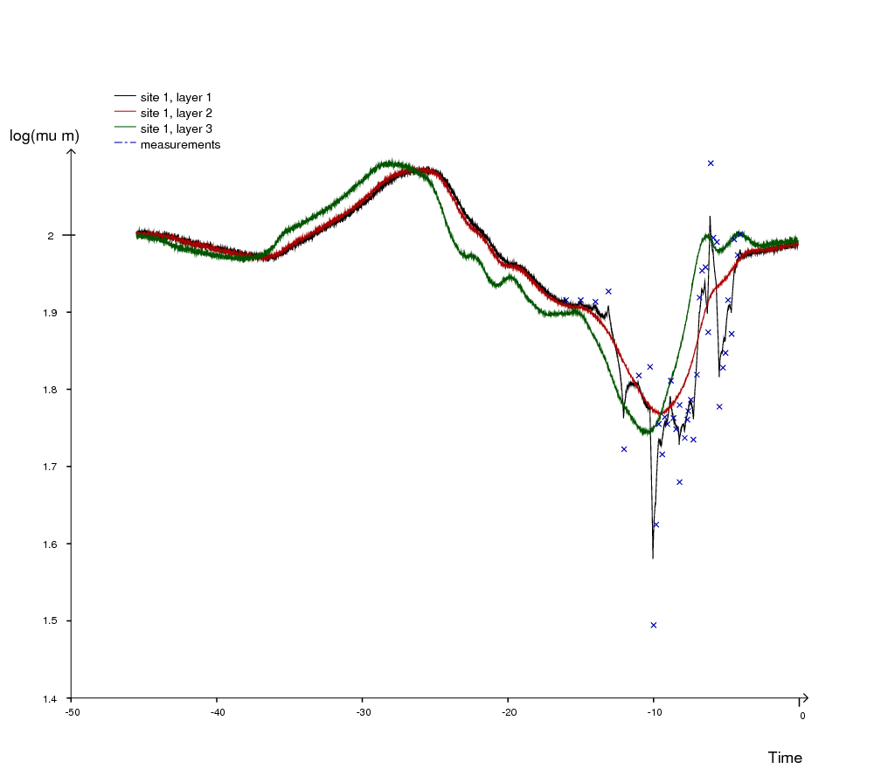
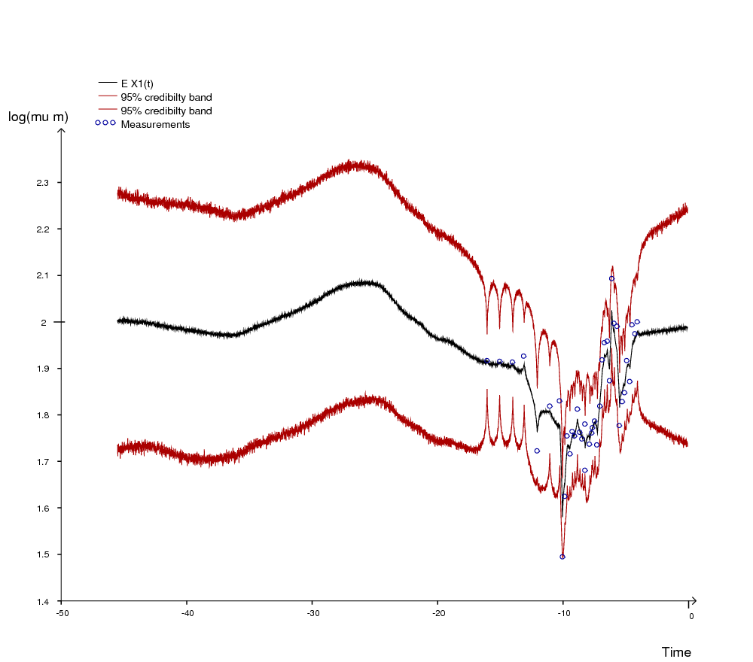
Bayesian model comparison result
Best: 3 layer model (Pr(M|D)=9.9%)
  Lowest layer: Inter-regional correlations, ρ=0.63. Δt≈6.1 Myr.
  Middle layer: Deterministic, Δt≈1.4 Myr.
  Upper layer: Wide credibility band for the pull, which is local, Δt∈(1yr,1Myr)

Slide 25
Problems / Future developments
Identifiability
Multimodal observations - speciation
Handling several lineages and several phenotypes of each lineage: phylogeny, hierarchical models
Observations
Observations
Observations
Slow tracking
Fast tracking
Slow OU + Fast OU
Fast OU
Slow OU

Slide 26
Conclusions
Possible to do inference on a model with multiple layers.
There are methods for doing model comparison.
Not enough data to get conclusive results regarding the model choice.
Possible to find sites that “don’t follow the norm”.
Productive framework which may be used in other settings also.
Gives biological insight into processes in spite of sparse data.
Bayesian priors wanted!

Slide 27
Links and bibliography
Presentation: http://folk.uio.no/trondr/stoch_layers7.ppt http://folk.uio.no/trondr/stoch_layers7.pdf
Bibliography:
  Lande R (1976), Natural Selection and Random Genetic Drift in Phenotypic Evolution, Evolution 30, 314-334
  Hansen TF (1997), Stabilizing Selection and the Comparative Analysis of Adaptation, Evolution, 51-5, 1341-1351
  Estes S, Arnold SJ (2007), Resolving the Paradox of Stasis: Models with Stabilizing Selection Explain Evolutionary Divergence on All Timescales, The American Naturalist, 169-2, 227-244
  Hansen TF, Pienaar J, Orzack SH (2008), A Comparative Method for Studying Adaptation to a Randomly Evolving Environment, Evolution 62-8, 1965-1977

