Slide 1
Synergistic Execution of Stream Programs on Multicores with Accelerators
Abhishek Udupa et. al.
Indian Institute of Science

Slide 2
Abstract
Orchestrating the execution of a stream program on a multicore platform
  with an accelerator [GPUs, CellBE]
Formulate the partitioning of work between CPU cores and the GPU by ILP considering
  The latencies for data transfer and
  The required data layout transformation
Also propose a heuristic partitioning algorithm
Speedup of 50.96X over a single threaded CPU execution
Notes:
- heuristic partitioning algorithm for the work partitioning between the CPU and the GPU, which provides solutions which are within 9.05% of the optimal solution on an average across the benchmark suite.
- The partitioned tasks are then software pipelined to execute on the multiple CPU cores and the Streaming Multiprocessors (SMs) of the GPU.

Slide 3
Challenges
The CPU cores and GPU operate on separate address spaces
  requires explicit DMA from the CPU to transfer data into or out of the GPU address space
The communication buffers between StreamIt filters need to be laid out in a specific fashion
  Access needs to coalesced for GPU
  But this coalesced memory access cause cache misses for CPU
The work partitioning between the CPU and the GPU is complicated by
  the DMA and buffer transformation latencies
  the filters have non-identical execution times on the two devices

Slide 4
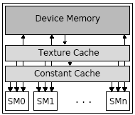
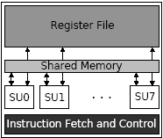
Organization of the NVIDIA GeForce 8800 series of GPUs
Architecture of GeForce 8800 GPU
Architecture of individual SM

Slide 5
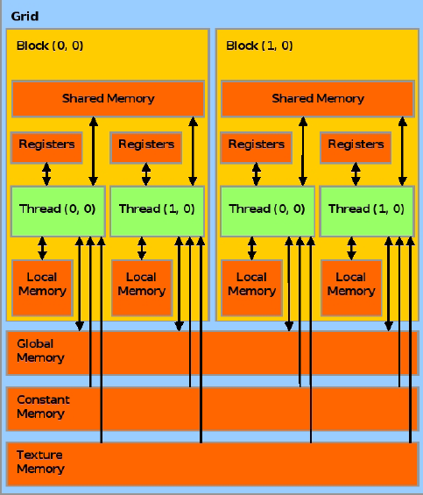
CUDA Memory Model
All threads of upto 8 thread blocks can
be assigned to one SM
A group of thread blocks forms a grid
Finally, a kernel call dispatched to the
GPU through the CUDA runtime
consists of exactly one grid

Slide 6
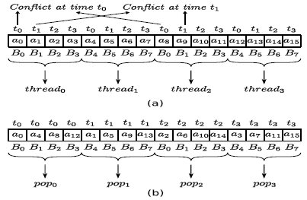
Buffer Layout Consideration
Device | Serial (ms) | Shuffled (ms)
CPU | 14.55 | 187
GPU | 176.6 | 8.1
Notes:
tn is time of access
an is the nth data element
Bn is the bank number
4 threads and 8 banks are assumed

Slide 7
A Motivating Example
Assuming steady state multiplicity is one for each of the actor
B is a stateful actor which run on CPU
Shuffle and deshuffle costs are zero
A
CPU: 10
GPU: 20
20
B
CPU: 20
10
C
CPU: 80
GPU: 20
10
D
CPU: 15
GPU: 20
60
E
CPU: 10
GPU: 25
Original Stream Graph

Slide 8
Naïve Partitioning
Naively map filter B on the CPU and execute all the other filters on the GPU
CPU Load = 20
GPU Load = 75
DMA Load = 30
MII = 75
A
CPU: 10
GPU: 20
A
GPU: 20
20
20
B
CPU: 20
B
CPU: 20
10
10
C
CPU: 80
GPU: 20
C
GPU: 20
10
10
D
CPU: 15
GPU: 10
D
GPU: 10
60
60
E
CPU: 10
GPU: 25
E
GPU: 25
Original Stream Graph
Naïve partitioning

Slide 9
Greedy Partitioning
Greedily moving an actor to either the CPU or the GPU, where it is most beneficial to be executed
CPU Load = 40
GPU Load = 35
DMA Load = 70
MII = 70
A
CPU: 10
GPU: 20
A
CPU: 10
20
20
B
CPU: 20
B
CPU: 20
10
10
C
CPU: 80
GPU: 20
C
GPU: 20
10
10
D
CPU: 15
GPU: 10
D
GPU: 10
60
60
E
CPU: 10
GPU: 25
E
CPU: 10
Original Stream Graph
Greedy partitioning

Slide 10
Optimal Partitioning
CPU Load = 45
GPU Load = 40
DMA Load = 40
MII = 45
A
CPU: 10
GPU: 20
A
GPU: 20
20
20
B
CPU: 20
B
CPU: 20
10
10
C
CPU: 80
GPU: 20
C
GPU: 20
10
10
D
CPU: 15
GPU: 10
D
CPU: 15
60
60
E
CPU: 10
GPU: 25
E
CPU: 10
Original Stream Graph
Optimal partitioning

Slide 11
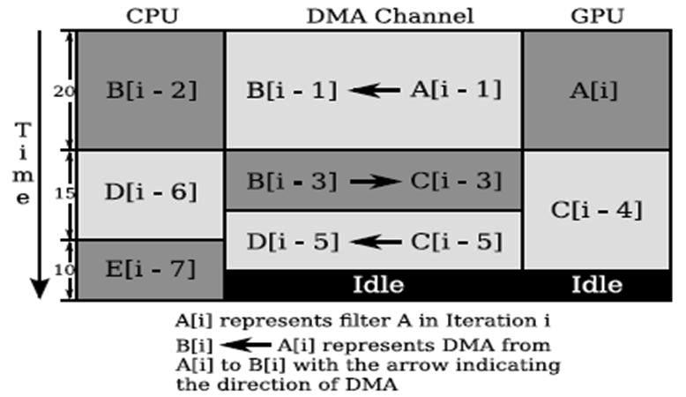
Software Pipelined Kernel

Slide 12
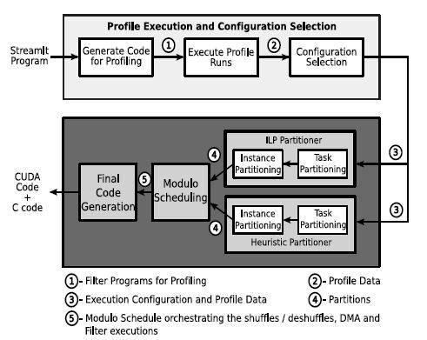
Compilation Process

Slide 13
Overview of the Proposed Method
To obtain performance increase the multiplicities of the steady state
All filters that execute on the CPU are assumed to execute 128 times on each invocation
  To reduce the complication
  128 is a common factor of GPU threads number, i.e. 128, 256, 384, 512
Identify the number of instances of each actor

Slide 14
Partitioning: Two Steps
Task Partitioning [ILP or Heuristic Algorithm]
  Partition the stream graph into two sets, one for GPU and one for CPU cores
  A filter (all its instances) executes either on the CPU cores or on the GPU [Reduced complexity]
Instance Partitioning [ILP]
  Partition the instances of each filter across the CPU cores or across the SMs of the GPU
  To obtain performance increase the multiplicities of the steady state

Slide 15
DMA Transfers and Shuffle and Deshuffle Operation
Whenever data is transferred from the CPU to the GPU
  DMA from CPU to GPU and
  A shuffle operation is performed
For the GPU to CPU transfers
  A deshuffle is performed on the GPU
  Then DMA transfer takes place

Slide 16
Orchestrate the Execution
Orchestrate the execution [simple modulo scheduling]
  Filters
  DMA transfers and
  Shuffle and deshuffle operations
The shuffle and deshuffle operations are always assigned to the GPU

Slide 17
Stage Assignment
A
5
A
S
Stage 0
2
S
B1
20
B1
20
B2
C
10
DMA
DMA
DMA
Stage 1
2
J
Proc 1 = 32
5
D
Proc 2 = 32
B2
C
Stage 2
J
Fission and processor assignment
DMA
DMA
Stage 3
D
Stage 4
Notes:
- DMAs are separated from consumers by one stage thus ensures complete overlap of computation and communication

Slide 18
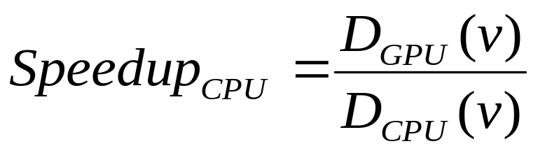

Heuristic Algorithm
Intuitively the nodes assigned to the CPU to be the nodes most beneficial to execute on the CPU
Defining
The intuition is
  The highest to be assigned to the CPU
  Also some of their neighbouring nodes assigned to the CPU
    Considering DMA and shuffle and deshuffle costs

Slide 19
Performance of Heuristic Partitioning
Benchmark | II (ILP) (ns) | II (Heur) (ns) | %Degrade
Bitonic | 78778 | 82695 | 4.97
Bitonic-Rec | 120576 | 143965 | 19.4
ChannelVocoder | 8942998 | 10126982 | 13.24
DCT | 1655026 | 1747211 | 5.57
DES | 426207 | 454630 | 6.67
FFT-C | 330979 | 405003 | 22.37
FFT-F | 428332 | 443251 | 3.48
Filterbank | 729004 | 785793 | 7.79
FMRadio | 207985 | 217004 | 4.34
MatrixMult | 1299710 | 1422917 | 9.48
MPEG2Subset | 1918754 | 1991250 | 3.78
TDE | 14646894 | 15751827 | 7.54

Slide 20
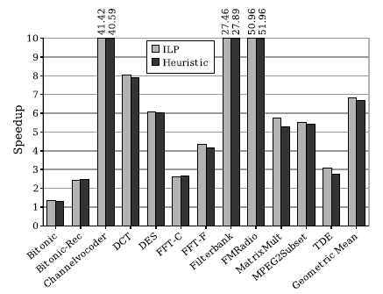
Performance of the ILP vs. Heuristic Partitioner

Slide 21
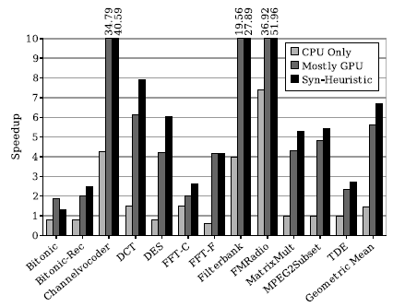
Comparison of Synergistic Execution with Other Schemes

Slide 22
Questions?

