Slide 1
Using Graphics Processors for High Performance IR Query Processing
Shuai Ding, Jinru He, Hao Yan, Torsten Suel
April,23 2009
Notes:
The topic of the talk is XXX
Cowork with jinru,Hao and torsten suel

Slide 2
The problem?
Search engine: 1000s queries/sec on billions of pages
Large hardware investment
Graphical processing units (GPUs)
Can we build a high performance IR system (query processing) on GPUs?
Notes:
Search engine needs to process thousands of queries on billions of pages. So it has to invest a lot of money to hardware
Recently Gpu computing becomes a hot topic for general computation. The reason is that GPU has more computation power due to the needs of computer games. So can we use GPU to help search engine to perform better?
This is the problem we are looking at.
Basiclly in this paper we study how to use GPU to do query processing in search engine and we achieve a better performance on GPU than on CPU

Slide 3
Outline
Graphical processing units (GPUs)
Query processing on CPUs
Query processing on GPUs
Discussion
Notes:
Here is the outline of my talk

Slide 4
Part I: Graphical processing units (GPUs)
Notes:
First let’s look at what is GPU and why it is interesting

Slide 5
Graphical processing units (GPUs)
Special purposes processors to accelerate applications
Driven by gaming industry
High degree of parallelism (96-way, 128-way,...)
Programmable via various libraries and SDEs
Notes:
Graphcai processing units or GPUs are designed to accelerate graphical applications, by using a lot of processors to work in parallel.
It is driven by the game industry and now more and more researchers are studying how to use it to do the general computing
Compared with CPU commonly it has more cores or processors

Slide 6
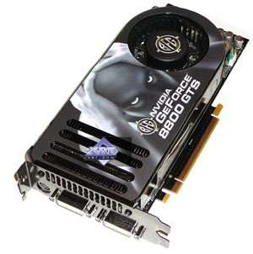
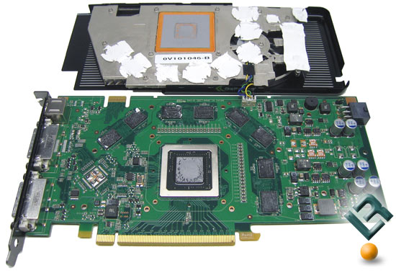
Notes:
Here is the GPUs used in our group

Slide 7
Some characteristics (GTS8800)
Lower clock speed (500Mhz) but more processors (96)
230 of GFlops for GPU
60 GB/s memory access to global GPU memory
A few GB/s transfer rate from main memory to GPU
Transfers can be overlapped with computing
Some startup overhead for starting tasks on GPU
Consider GPU as co-processor for CPU
Notes:
GPU has many cores and so has a higher peak power. Besides that, each core is slower than the cpu. GPU has its own memory and the transfering speed from GPU main memory to CPU main memory is fast. Also GPU has start up cost.

Slide 8
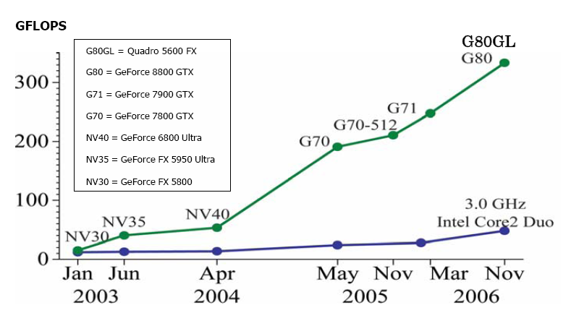
GPU vs. CPU performance (Released by NVIDIA)
Notes:
Gpu has more cores so it is faster than CPU. Here is the peak performance of GPU and CPU, we will guess GPU will be much faster than CPU in the future ☺

Slide 9
Related work
Scientific computing
  GPU terasort, Govindaraju et al, SIGMOD 06
  Joins on GPUS, He et al, SIGMOD 08
  Mapreduce on GPUs, He et al., PACT 08
GPU vendors (NVIDIA, ATI)
  General-purpose programming environment
Notes:
Some database researchers have studied how to do sorting and other stuff on GPUs
And recently NVIDIA released CUDA which makes GPU programming easier

Slide 10
Challenges in GPU programming
Need to program in parallel
SIMD type programming model
Memory issues: global memory, shared memory, register (Bank conflict)
Synchronization in CUDA
Notes:
Here are some challenges in GPU programming. Ok, the next part we will look at the query processing from the eyes of CPU.

Slide 11
Part II: Query processing on CPUs

Slide 12
Inverted index and inverted lists
A collection of N documents
Each document identified by an ID
Inverted index consists of lists for each term T
I_{armadillo} = { [678 2], [2134 3], [3970 1], …… }
aardvark 3452, 11437, …..
.
.
.
arm 4, 19, 29, 98, 143, ...
armada 145, 457, 789, ...
armadillo 678, 2134, 3970, ...
armani 90, 256, 372, 511, ...
.
.
zebra 602, 1189, 3209, ...
Notes:
In search engine, an index structure called inverted index is used to do fast retrieval of a certain collection.
An inverted index is composed of inverted lists.
Suppose in the collection each document is identified by a uniq ID. An inverted list for armadillo looks roughly like this:
It means this word appears in document 678 twice and 2134 three times and so on.
The inverted index consists of many such inverted lists.
Usually inverted lists are very long and sorted by docIDs. And each travesal of a list takes a long time
So usually we will compress the list

Slide 13
Inverted lists compression
Decrease size and increase overall performance
First take the gaps or differences then encode the smaller
numbers
I_{armadillo} = { [678 2], [2134 3], [3970 1], …… }
I_{armadillo} = { [678 2], [1456 3], [1836 1], …… }
Notes:
Compression decreases the size so decreases the traffic between main memory and disk. Also we can cache more stuff in memory. So it improves performance.
When compressing we take gap first then encode the smaller number

Slide 14
Compression techniques
Rice coding
PForDelta coding (Heman et al ICDE 2006)
Notes:
There are many compression techniques which are commonly used and in this paper we focus on two of them.
Rice coding and pfd,
For rice it has very good compression ratio and reasonably fast decompression speed and for pfd its decompression is very fast and has reasonal compression ratio
Next Let’s look at rice coding

Slide 15
Rice coding
Take the gaps, consider the average of the numbers (the gaps)
(34) (178) (291) (453) … becomes (34) (144) (113) (162)
so average is g = (34+144+113+162) / 4 = 113.33
Rice coding: round this to smaller power of two: b = 64 (6 bits)
then for each number x, encode it as
x/b in unary followed by x mod b binary (6 bits)
33 = 0*64+33 = 0 100001
143 = 2*64+15 = 110 001111
112 = 1*64+48 = 10 110000
161 = 2*64+33 = 110 100001
Result: 0100001 ,110001111, 10110000, 110100001
Unary length: not fixed
Binary length: fixed
Notes:
For rice coding one number is encoded into a unary part followed by a binary part.
For a batch of gaps First we will caculate the avg number of the gaps then round it down to the power of two: we call this number b
Then unary part equals to the number x divide by b, encoding in unary, binary part equals to the number mode b using b bita.
(add one slide)

Slide 16
PForDelta (PFD) (Heman et al ICDE 2006)
Idea: compress/decompress many values at a time (e.g., 128)
Choose b that 90% fit in the b slot, code the other 10% as exceptions
Suppose in next 128 numbers, 90% are < 32 : choose b=5
Allocate 128 x 5 bits, plus space for exceptions
exceptions stored at end as ints (using 4 bytes each)
Notes:
Search engines need VERY FAST methods. And PFORDELTA is very fast. Basically it compresses a batch of numbers at one time(128 usually) then choose b that 90% fits into b bit slot. For the numbers which do not fit treat them as exceptions

Slide 17
PForDelta (PFD)
example: b=5 and sequence 23, 41, 8, 12, 30, 68, 18, 45, 21, 9, ..
- exceptions (grey) form linked list within the locations (e.g., 3 means “next except. 3 away”)
- one extra slot at beginning points to location of first exception (or store in separate array)
1
23
3
8
12
30
1
18
2
21
9
45
68
41
location of
1st exception
space for 128 5-bit numbers
space for exceptions
(4 bytes each, back to front)
Notes:
Here is an example for pfordelta. A linked list is used for the exceptions.
Ok, after talking about compression, let’s come to query processing.

Slide 18
Query Processing
BM25
“AND” queries and “OR” queries
Notes:
intersect or merge inverted lists for query terms to find documents containing all (AND) or at least one (OR) term
In the real world a ranking function will be used to sort the result. In our case we use BM25 and mainly focus on “and” queries.
(add bm25)

Slide 19
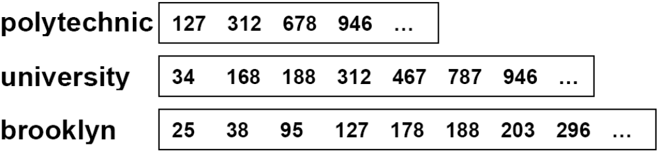
Query Processing
Document-At-A-Time (DAAT)
vs.
Term-At-A-Time (TAAT)
Notes:
For and query, suppose we have the lists for all the terms. And we want to find the documents which contain all the terms. Two techniques are commonly used. DAAT and TAAT.
For DAAT we keep one pointer for each list. And the intersection goes like this.

Slide 20
Query Processing
1 1 1 1
2 2
Document-At-A-Time (DAAT)
vs.
Term-At-A-Time (TAAT)
DAAT: Widely used, efficient, skipping, but sequential
Notes:
For TAAT, we start from the shortest list and keep one accumulator for each document we have seen.
It goes like this and in reality, it is not 1 and 2 but the score of the documents.
Comprared DAAT and TAAT, DAAT has some advantage:
First intermedia data structure is not needed, instead it consumes the document when it meets one. Note that the list can be very long so the intermedia list can be huge.
The second reason is related to compression.

Slide 21
Skipping
946
Polytechnic ...
University ...
Brooklyn ...
127 312 678 946
312
777
34 168 188 312
414 490 516 777
127
296
8296
25 38 85 127
178 188 203 296
378 388 403 8296
But it is sequential.
How can we adapt the skipping into TAAT?
Notes:
In the previous slide we assume we have the raw lists. In reality it is not the case. Instead we divide the list into chunks and compress each chunk separately. We also keep the last value in each chunk. In this case DAAT can skip most of the chunk without decompressing.
Next let’s look at what is the case in GPU
(delete the daat and taat and add skipping) but daat is widely used and highly efficient but by nature sequential. But it can skip. One of the question is how can you adapt the skipping into TAAT

Slide 22
Part III: Query Processing on GPUs
Notes:
First I will give the general architechture

Slide 23
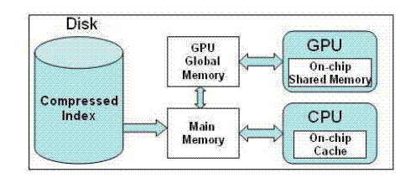
Architecture of Query Processor
Index is effectively in main memory
Index partially caching in GPU global memory
CPU can decide to execute query on CPU or GPU
Notes:
We assume the index is in main memory and also part of the index is in the memory of GPU. GPU is treated as a cache of CPU who has computation ability. CPU can decide to execute queries on CPU or GPU.

Slide 24
General steps
Sort the list from shortest to longest
Decompress the shortest list
Decompress the next list and combine with the previous one until no list is left
(How to use skipping to avoid decompressing the whole list?)
Rank the result
Notes:
Here is the basic steps of query processing on GPU.
Note that by nature DAAT is sequential so it is not suitable on GPU
Next we look at each step in more detail
(in the and how can we avoid decompress the whole list?)

Slide 25
Rice compression
Assign each number to a single thread
Divide the compressed data into sub-groups and assign each sub-group to different thread
gaps = { 33 143 112 161 }, b = 64
33 = 0*64+33 = 0 100001 143 = 2*64+15 = 110 001111
112 = 1*64+48 = 10 110000 161 = 2*64+33 = 110 100001
0100001 ,110001111, 10110000, 110100001
Notes:
Here are two very common ideas. But they are not working
We observe that rice decompression can be reduced to predix sum. What is prefix sum?

Slide 26
Rice compression
Prefix sum: (also known as the scan) each element in the result list is obtained from the sum of the elements in the list up to its index
for(i = 1 ; i < n; i++)
array[i] += array[i-1]
GPU can do prefix scan (M. Harris, Parallel prefix scan with CUDA)
Notes:
First note that we can do prefix scan on GPU, for details please refer to the previous work
(cite)

Slide 27
Rice compression—reduce to prefix scan
docids = { 33 176 288 449 } gaps = { 33 143 112 161 }, we get b = 64
33 = 0*64+33 = 0 100001 143 = 2*64+15 = 110 001111
112 = 1*64+48 = 10 110000 161 = 2*64+33 = 110 100001
0 100001 ,110 001111, 10 110000, 110 100001
unary : 0 110 10 110 binary: 100001, 001111, 110000, 100001
unary : 0 1 2 2 3 3 4 5 5 binary: 33 48 96 129
docids:33 176 288 449
Notes:
Our observation is rice decompression can be reduced to prefix scan.
We store unary and binary separately and for unary we treat each bit as a number and for binary we do scan on every b-bit
Then we combine the result in certain manner, we can get the docid (not gap)

Slide 28
Rice compression
b-bit prefix on binary part I_{b}
1-bit prefix on unary part I_{u}
Compact the result (prefix again)
Combine the result

Slide 29
Rice compression—can we do better?
Localize the prefix ☺☺
946
Polytechnic ...
University ...
Brooklyn ...
127 312 678 946
312
777
34 168 188 312
414 490 516 777
127
296
8296
25 38 85 127
178 188 203 296
378 388 403 8296
Helpful in skipping
Notes:
Note that when we compress each chunk we keep one number uncompressed. Using this number we can localize the prefix
(one stone two birds)

Slide 30

PForDelta (PFD) compression
The original PFD:
Notes:
The original pfd is not suitable for GPU

Slide 31
PForDelta compression
The original PFD:
Not suitable for GPU, especially the linked list part.
GPU-based PFD
Use the same b for each list
Store the exceptions in two arrays
Recursively compress these two arrays
Notes:
As rice coding we reengine the compression of PFD

Slide 32
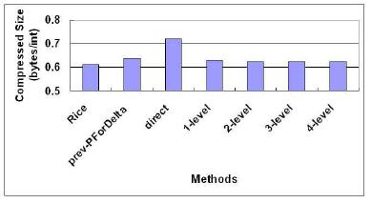
Size for Rice and PFD
After two levels the size is as small as or even better than before
Notes:
Here is the result size for rice and PFD

Slide 33

Speed for Rice and PFD
Millions of integers per second
Prefix vs. without prefix
Notes:
Note that for rice using GPU we get docid and CPU only gaps
And for PFD we have slightly better result

Slide 34
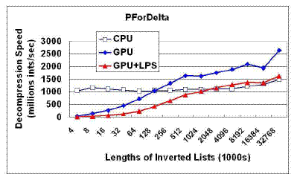
Speed for PForDelta
CPU performs better for short lists
GPU has better performance especially without prefix
Notes:
Note that for shorted list CPU performs better. GPU has start up overhead. ANd also GPU needs to have more data to use all the processors.

Slide 35
List intersection algorithm
DAAT is by nature sequential so not suitable for GPUs.
We try something like TAAT
Assign each docid to one thread in the shorter lists
then binary search in the longer lists

Slide 36
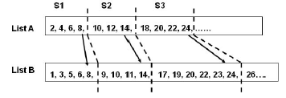
List intersection algorithm—can we do better?
Recursive intersection ! (R.Cole Parallel merge sort)
Notes:
We divide the shorter lists into subchunks and find the range of the subchunk in the longer list.

Slide 37
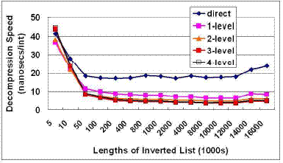
Result
It works especially for long lists
2 level gives best result

Slide 38
Skipping??
946
Polytechnic ...
University ...
Brooklyn ...
127 312 678 946
312
777
34 168 188 312
414 490 516 777
127
296
8296
25 38 85 127
178 188 203 296
378 388 403 8296
First, merge the “last docid” to decide which blocks need decompressing
Then do the decompression and intersection
Notes:
Note that we have one uncompressed number for each chunk, so we can get the benefit of skipping of DAAT. By merging the uncompressed number.

Slide 39
Ranked query
Given a list of N results, how to rank them?

Slide 40
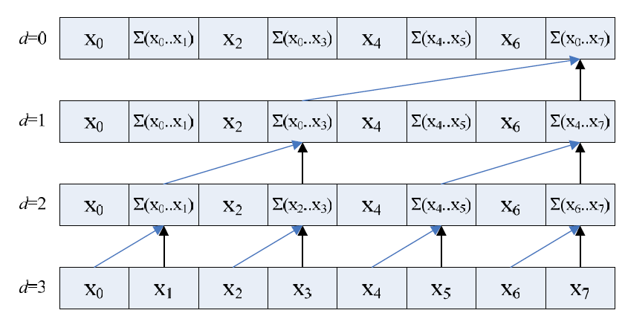
Ranked query
Reduce K times for top K result, K*N operations

Slide 41
Ranked query—Can we do better?(trick ☺)
Top result
reduce
reduce
reduce
reduce
reduce
reduce
Block of
size c
block
block
block
block
N*(K/C+1) operations
Notes:
we divide the result into blocks and reduce on each block. Then we have an intermedia array we reduce on it to get the first top result. Then we only goes back to the corresponding block to replace the element in the intermedia array.

Slide 42
Conjunctive (AND) queries and disjunctive (OR) queries
Up to this point we only talk about conjunctive queries. What about disjunctive queries?
Brute force TAAT works well on GPUs.
Process one list at a time.
This just fits into the GPU parallel model
Notes:
(change the animation)

Slide 43

Experiments on gov2
On 25.2M documents, single core for CPU
Randomly 1000 queries from the trace
Time in ms
GPU outperforms CPU

Slide 44
Scheduling
One observation: For queries with “short” lists CPU outperforms GPU and for queries with “long” list GPU outperforms CPU
Assign queries to GPU or CPU
Use both CPU and GPU
Learning the cost: the shortest list length, etc.
Three queues, job stealing, etc.

Slide 45
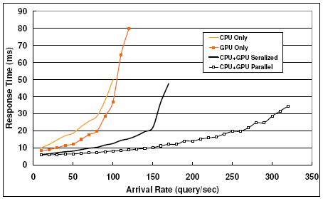
Scheduling
GPU+CPU serialized outperforms using only one of them
Using GPU+CPU in parallel works best
Using GPU+CPU is better than 2 times CPU or GPU

Slide 46
Part IV Discussion

Slide 47
Discussion
So, should we we build search engines using GPUs?
Ranking function and energy consumption
Using GPUs to learn about opportunities for future CPUs (multi-core )
Learn about opportunities for future GPUs (energy iuuse, memory issue)

Slide 48
Thanks for your time ☺

