Slide 1
CaseZ
In Verilog there is a casez statement, a variation of the case statement that permits "z" and "?“ values to be treated during case-comparison as "don't care" values. "Z" and "?" are treated as a don't care if they are in the case expression and/or if they are in the case item
Guideline: Exercise caution when coding synthesizable models using the Verilog casez statement
Coding Style Guideline: When coding a case statement with "don't cares," use a casez statement and use "?" characters instead of "z" characters in the case items to indicate "don't care" bits.

Slide 2
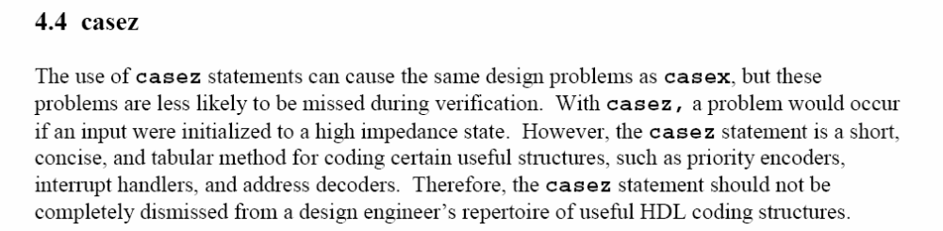

Slide 3
CaseX
In Verilog there is a casex statement, a variation of the case statement that permits "z", "?" and "x" values to be treated during comparison as "don't care" values. "x", "z" and "?" are treated as a don't care if they are in the case expression and/or if they are in the case item
Guideline: Do not use casex for synthesizable code

Slide 4
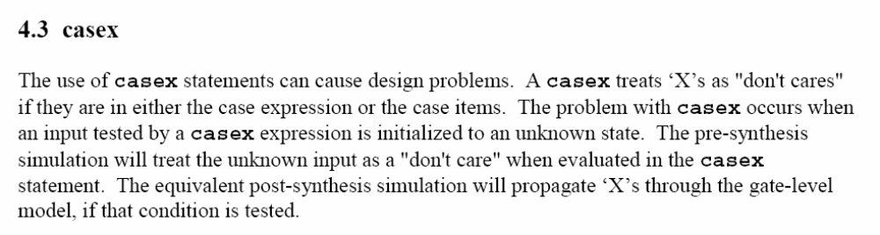

Slide 5
Full case statement
A "full" case statement is a case statement in which all possible case-expression binary patterns can be matched to a case item or to a case default. If a case statement does not include a case default and if it is possible to find a binary case expression that does not match any of the defined case items, the case statement is not "full."

Slide 6
module mux3a (y, a, b, c, sel);
output y;
input [1:0] sel;
input a, b, c;
reg y;
always @(a or b or c or sel)
case (sel)
2'b00: y = a;
2'b01: y = b;
2'b10: y = c;
endcase
endmodule

Slide 7
synopsys full_case
module mux3b (y, a, b, c, sel);
output y;
input [1:0] sel;
input a, b, c;
reg y;
always @(a or b or c or sel)
case (sel) // synopsys full_case
2'b00: y = a;
2'b01: y = b;
2'b10: y = c;
endcase
endmodule

Slide 8
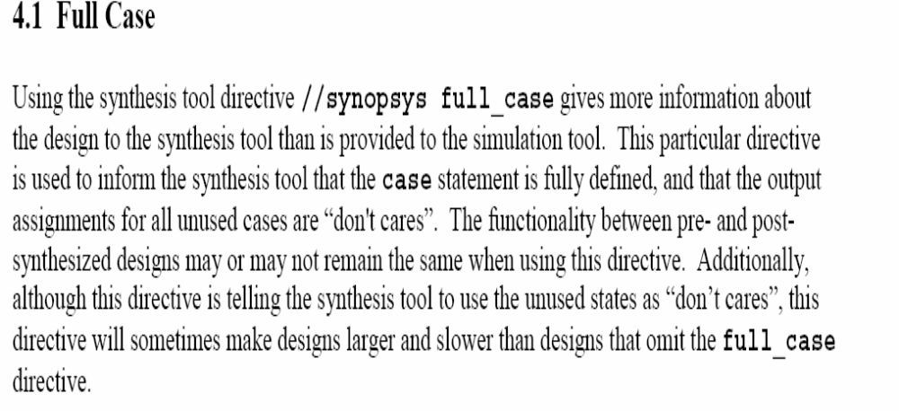

Slide 9
Parallel case
A "parallel" case statement is a case statement in which it is only possible to match a case expression to one and only one case item. If it is possible to find a case expression that would match more than one case item, the matching case items are called "overlapping" case items and the case statement is not "parallel."

Slide 10
module intctl1a (int2, int1, int0, irq);
output int2, int1, int0;
input [2:0] irq;
reg int2, int1, int0;
+
always @(irq) begin
{int2, int1, int0} = 3'b0;
casez (irq)
3'b1??: int2 = 1'b1;
3'b?1?: int1 = 1'b1;
3'b??1: int0 = 1'b1;
endcase
end
endmodule

Slide 11
synopsys parallel_case
module intctl1b (int2, int1, int0, irq);
output int2, int1, int0;
input [2:0] irq;
reg int2, int1, int0;
always @(irq) begin
{int2, int1, int0} = 3'b0;
casez (irq) // synopsys parallel_case
3'b1??: int2 = 1'b1;
3'b?1?: int1 = 1'b1;
3'b??1: int0 = 1'b1;
endcase
end
endmodule

Slide 12
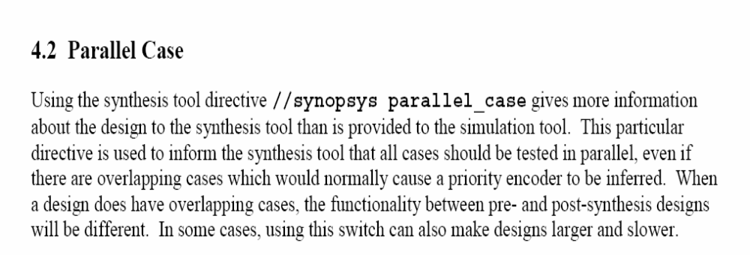

Slide 13
Do not use // synopsys full_case directive -if this is used, and all cases are not defines, it will hide the fact that all cases are not defined. It masks errors.
In general, do not use Synopsys synthesis directives like “full_case” and “parallel_case” in the RTL code. These directives act as comments in the simulation tool, but provide extra information to the synthesis tool, thereby creating a possibility of mismatch in the results between pre-synthesis simulation and post-synthesis simulation. (Full_case and parallel_case are for use with the Synopsys tool only and do not act on the Xilinx FPGA synthesis tools.)

Slide 14
Guideline: In general, do not use "full_case parallel_case" directives with any Verilog case statements.
Guideline: There are exceptions to the above guideline but you better know what you're doing if you plan to add "full_case parallel_case" directives to your Verilog code.
Guideline: Educate (or fire) any employee or consultant that routinely adds "full_case parallel_case" to all case statements in their Verilog code, especially if the project involves the design of medical diagnostic equipment, medical implants, or detonation logic for thermonuclear devices!
Guideline: only use full_case parallel_case to optimize one hot FSM designs.

Slide 15
Myth: "// synopsys full_case" removes all latches that would otherwise be inferred from a case statement.
Truth: The "full_case" directive only removes latches from a case statement for missing case items. One of the most common ways to infer a latch is to make assignments to multiple outputs from a single case statement but neglect to assign all outputs for each case item. Even adding the "full_case" directive to this type of case statement will not eliminate latches.

Slide 16
module addrDecode1a (mce0_n, mce1_n, rce_n, addr);
output mce0_n, mce1_n, rce_n;
input [31:30] addr;
reg mce0_n, mce1_n, rce_n;
always @(addr)
casez (addr) // synopsys full_case
2'b10: {mce1_n, mce0_n} = 2'b10;
2'b11: {mce1_n, mce0_n} = 2'b01;
2'b0?: rce_n = 1'b0;
endcase
endmodule

Slide 17
The easiest way to eliminate latches is to make initial default value assignments to all outputs immediately beneath the sensitivity list, before executing the case statement,

Slide 18
module addrDecode1d (mce0_n, mce1_n, rce_n, addr);
output mce0_n, mce1_n, rce_n;
input [31:30] addr;
reg mce0_n, mce1_n, rce_n;
always @(addr) begin
{mce1_n, mce0_n, rce_n} = 3'b111;
casez (addr)
2'b10: {mce1_n, mce0_n} = 2'b10;
2'b11: {mce1_n, mce0_n} = 2'b01;
2'b0?: rce_n = 1'b0;
endcase
end
endmodule

Slide 19
Coding priority encoders
Non-parallel case statements infer priority encoders. It is a poor coding practice to code priority encoders using case statements. It is better to code priority encoders using if-else-if statements.
Guideline: Code all intentional priority encoders using if-else-if statements. It is easier for a typical design engineer to recognize a priority encoder when it is coded as an if-else-if statement.
Guideline: Case statements can be used to create tabular coded parallel logic. Coding with case statements is recommended when a truth-table-like structure makes the Verilog code more concise and readable.
Guideline: Examine all synthesis tool case-statement reports.
Guideline: Change the case statement code, as outlined in the above coding guidelines, whenever the synthesis tool reports that the case statement is not parallel (whenever the synthesis tool reports "no" for "parallel_case")
Although good priority encoders can be inferred from case statements, following the above coding guidelines will help to prevent mistakes and mismatches between pre-synthesis and post synthesis simulations.

Slide 20
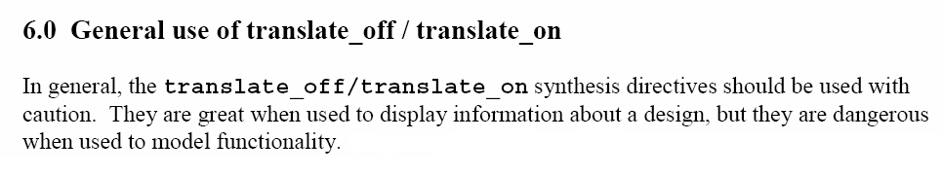

Slide 21
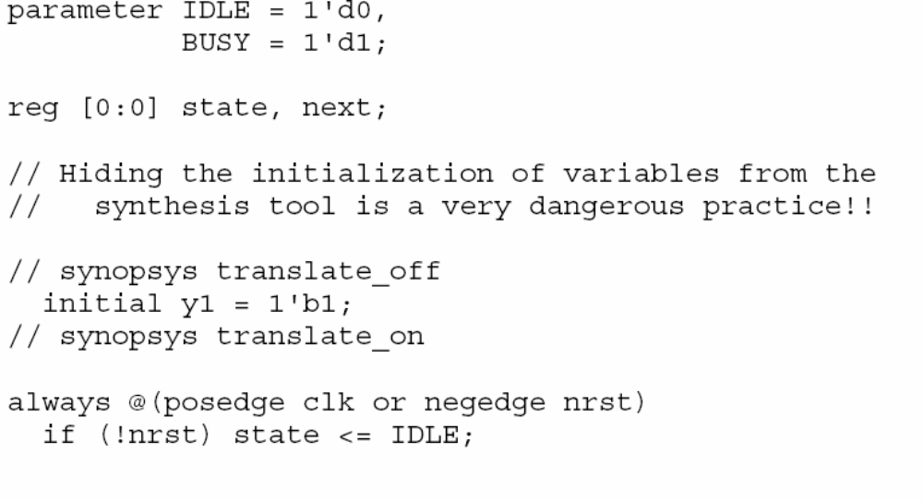

Slide 22
RTL code should be as simple as possible - no fancy stuff
RTL Specification should be as close to the desired structure as possible w/o sacrificing the benefits of a high level of abstraction
Detailed documentation and readability (indentation and alignment). Signal and variable names should be meaningful to enhance the readability
Do not use initial construct in RTL code there is no equivalent hardware for initial construct in Verilog
All the flops in the design must be reset, especially in the control path

Slide 23
All assignments in a sequential procedural block must be non-blocking - Blocking assignments imply order, which may or may not be correctly duplicated in synthesized code
Use non-blocking assignments for sequential logic and latches, Do not mix blocking and non-blocking assignments within the same always block.

Slide 24
When modelling latches → nonblocking assignments
Combinational and sequential in same always block → nonblocking assignments
Do not make assignments to the same variable from more than one always block
Use $strobe to display values that have been assigned using nonblocking assignments
Do not make assignments using #0 delays (inactive events queue)

Slide 25
RTL specification should be as close to the desired structure as possible with out scarifying the benefits of a high level of abstraction
Names of signals and variables should be meaningful so that the code becomes self commented and readable
Mixing positive and negative edge triggered flip-flops mat introduce inverters and buffers into the clock tree. This is often undesirable because clock skews are introduced in the circuit

Slide 26
Small blocks reduce the complexity of optimization for the logic synthesis tool
In general, any construct that is used to define a cycle-by-cycle RTL description is acceptable to the logic synthesis tool
While and forever loops must contain @ (posedge clk) or @ (negedge clk) for synthesis
Disabling of named blocks allowed in synthesis
Delay info is ignored in the synthesis
=== !== related “X” and “Z” are not supported by synthesis

Slide 27
Use parenthesis to group logic the way you want into appear. Do not depend on operator precedence – coding tip
Operators supported for synthesis
* / + - % +(unary) - (unary) → arithmetic
! && || → logical
> < >= <= → relational
== != → equality
~ & | ^ ~^ → bitwise
& ~& | ~| ^ ~^ → reduction
>> << → shift
{ } → concatenation
? : → conditional

Slide 28
Design is best to be synchronous and register based
Latches should only be used to implement memories or FIFOs
Should aim to have edge triggering for all register circuits
Edge triggering ensures that circuits change events – easier for timing closure

Slide 29
Use as few as clock domains as possible
If using numerous clock domains – document fully
Have simple interconnection in one simple module
By-pass phase Lock Loop circuits for ease of testing

Slide 30
Typically, synchronous reset is preferred as it
- easy to synthesize
- avoids race conditions on reset

Slide 31
Asynchronous resets. Designer has to:
- worry about pulse width through the circuit
- synchronize the reset across system to ensure that every part of the circuit resets properly in one clock cycle
- makes static timing analysis more difficult

Slide 32
Tri state is favored in PCB design as it reduces the number of wires
On chip, you must ensure that
- only one driver is active
- tri-state buses are not allowed to float
These issues can impact chip reliability
MUX-based is preferred as it is safer and is easy to implement

Slide 33
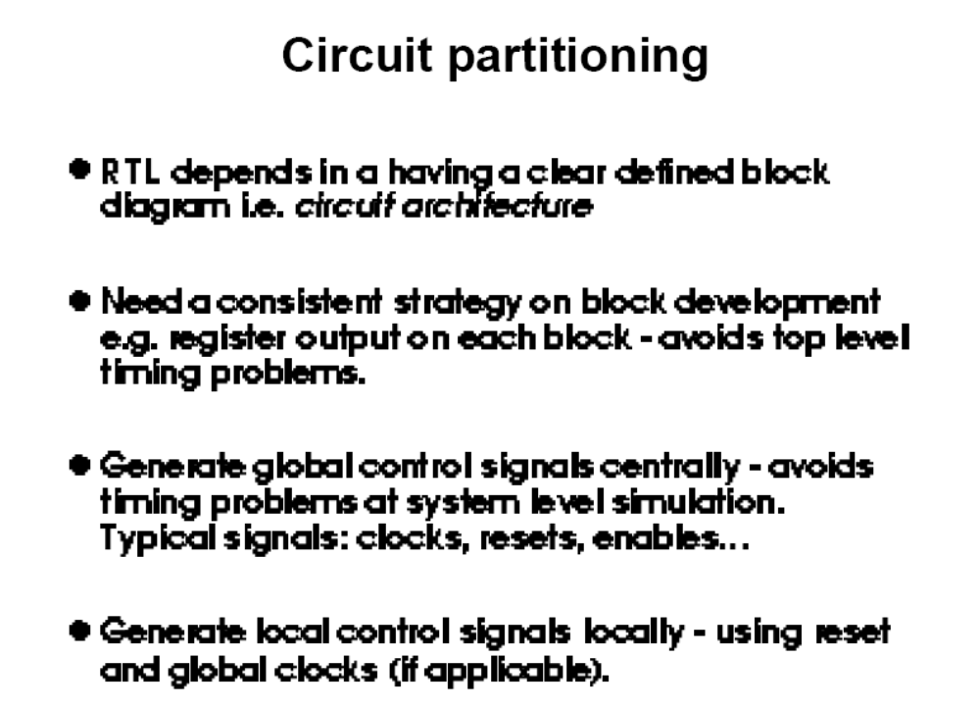

Slide 34
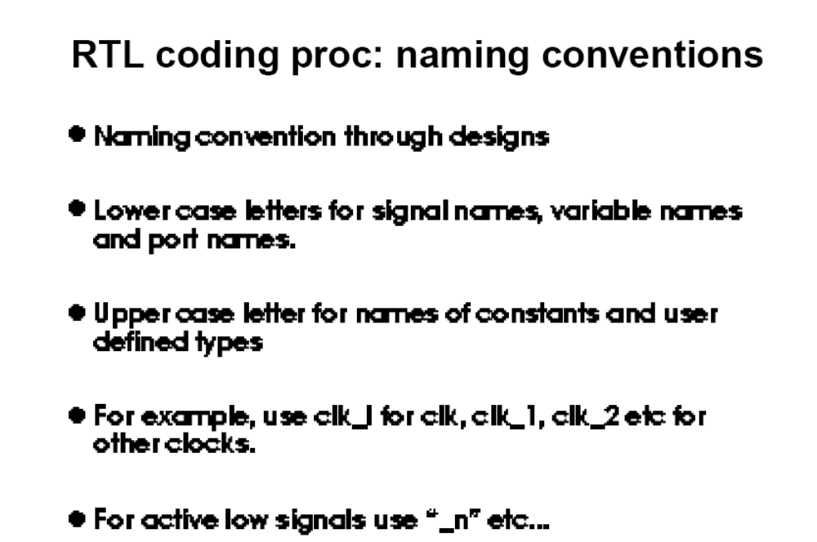

Slide 35
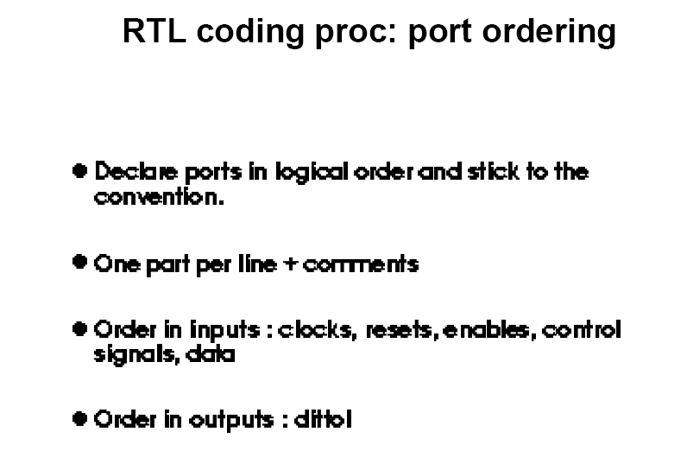

Slide 36
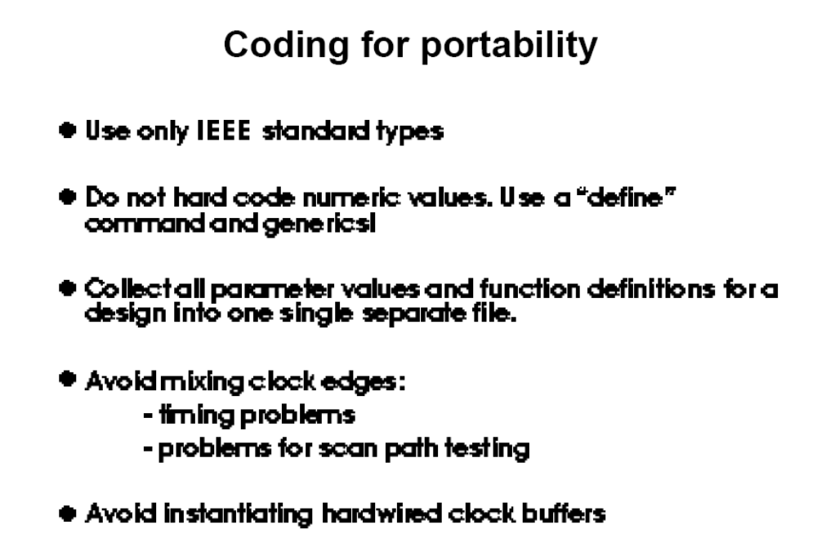

Slide 37
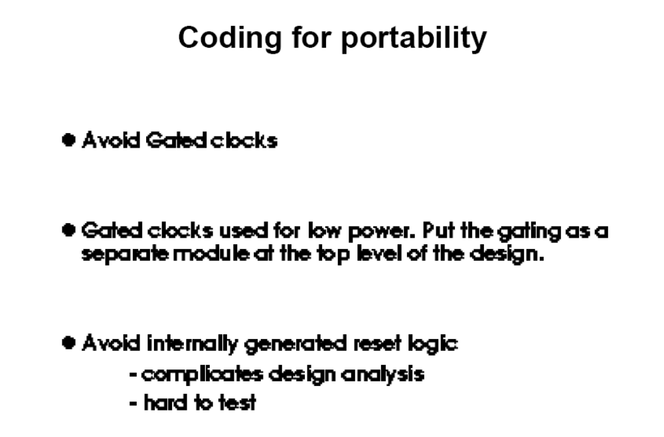

Slide 38
Combinatorial procedural blocks should be fully specified, latches will be inferred otherwise
De-assert all the control signals, once the purpose is served (proper else conditions apart from “reset”).

Slide 39
Do not make any assignments in the RTL code using #delays, whether in the blocking assignment or in the non-blocking assignment. Do not even use #0 construct in the assignments.

Slide 40
Do not use any internally generated clocks in the design. These will cause a problem during the DFT stage in the ASIC flow.

Slide 41
Use the clock for synthesizing only sequential logic and not combinational logic, i.e. do not use the clock in “always @ (clk or reset or state)”.

Slide 42
Do not use the `timescale directive in the RTL code. RTL code is meant to be technology independent and using timescale directive which works on #delays has no meaning in the RTL code.

Slide 43
  If an output does not switch/toggle, then it should not be an output, it can be hardwired into the logic.
  Do not put any logic in top level file except instantiations.
  Divide the bi-directional signals to input and output at top level in hierarchy.

Slide 44
Code all intentional priority encoders using if-else-if-else constructs
The “reset” signal is not to be used in any combinational logic. (It does not make sense to use “reset” in combinational logic.)

Slide 45
Use only one clock source in every “non-top” module. Ideally only the top module can have multiple clock sources. This eases timing closure for most of the timing analysis tools.

Slide 46
All state machines must be either initialized to known state or must self-clear from every state
Future state determination will depend on registered state variables
State machines should be coded with case statements and parameters for state variables
State machines, initialization and state transitions from unused states must be specified to prevent incorrect operation

Slide 47
Code RTL with timing in mind → levels of combinatorial logic
Minimize ping-pong signals (signals combinatorially bounce back to same block) → register inputs and outputs to avoid loops

Slide 48
All the elements within a combinatorial always block should be specified in the sensitivity list

Slide 49
The design must be fully synchronous and must use only the rising edge of the clock
This rule results in insensitivity to the clock duty cycle and simplifies STA

Slide 50
All clock domain boundaries should be handled using 2-stage synchronizers
Never synchronize a bus through 2-stage synchronizer

Slide 51
Major block modules should insert a number of spare gate modules on each clock domain.
RTL code should be completely synthesizable by WHATEVERSYNTHESISTOOL (basic)

Slide 52
Signals must be defined only in non-independent processes - A signal cannot be defined and assigned in a process in which it is also in the sensitivity list
Do not ignore warnings in synthesis report

Slide 53
Avoid using asynchronous resettable flip-flops – asynchronous lines are susceptible to glitches caused by cross talk -Use asynchronous reset in the design only for Power-On reset.
In case used (central reset generation), such nets should undergo crosstalk analysis in the physical design phase

Slide 54
Combinational loops are not allowed, they must be broken by flip-flop.
Pulse generators are not allowed, susceptible to post layout discrepancies and duty cycle variations

Slide 55
Instantiation of I/O buffers in the core logic is not allowed, internal logic must consists of core-logic elements only
Do not use partial decoding logic

Slide 56
Register element coding
always @ (posedge clk)
begin
if(rst)
out <= 1’b0;
else
out <= in1 & in2;
end
always @ (posedge clk)
begin
if(rst)
out <= 1’b0;
else
out <= out_d;
end
assign out_d = in1&in2;
Right side code results in correct sync-clear-D-flip-flop inferral in synthesis

Slide 57
No lathes should be used
Lathes severely complicate the STA and more difficult to test.

Slide 58
3-state bus should not be used, susceptible to testing problems, delay inaccuracies and exceptionally high loads

Slide 59
STA driven rules
Create a chip-level, inter module timing budget spread sheet with set up and hold times
Synchronous memories are preferred, less glitch sensitive, faster STA
No timing loops, multi cycle, false timing, zero timing paths

Slide 60
Use a clock naming convention to identify the clock source of every signal in a design
Reason: A naming convention helps all team members to identify the clock domain for every signal in a design and also makes grouping of signals for timing analysis easier to do using regular expression “wild-carding” from within a synthesis script

Slide 61
Only allow one clock per module
Reason: STA and creating synthesis scripts is more easily accomplished on single-clock modules or group of single-clock modules

Slide 62
Simulation driven rules
Avoid PLI –slows down the simulation
Hierarchical references to ports only, there is no guarantee that the net will be present after synthesis or P&R, therefore complicating gate level simulations
Documentation of code
Monitors should be disabled when not in use- speeds up the simulations

Slide 63
Use $strobe instead of $display to display variables that have been assigned using the non-blocking assignment.
Verification suite must demonstrate 100% code coverage

