Slide 1
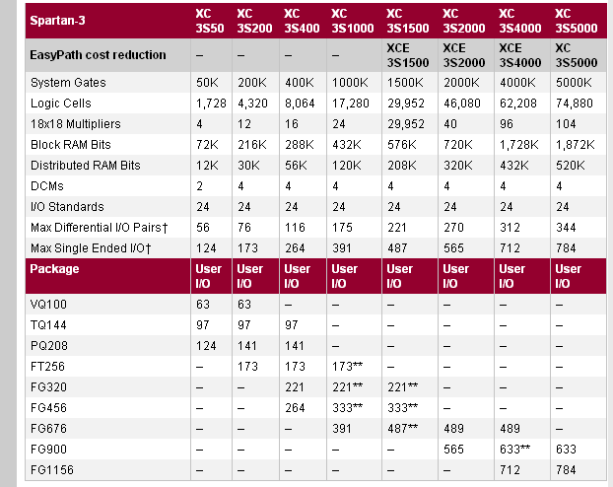
OVERVIEW OF Spartan-3

Slide 2
DESIGNFLOW
Plan & Budget
Create Code/
Schematic
HDL RTL
Simulation
Implement
Functional
Simulation
Synthesize
to create netlist
Translate
Map
Place & Route
Attain Timing
Closure
Timing
Simulation
Create
BIT File

Slide 3
What is Implementation?
More than just Place & Route
Implementation includes many phases
  Translate: Merge multiple design files into a single netlist
  Map: Group logical symbols from the netlist (gates) into physical components (slices and IOBs)
  Place & Route: Place components onto the chip, connect the components, and extract timing data into reports
Each phase generates files that allow you to use other Xilinx tools
  Floorplanner, FPGA Editor, XPower

Slide 4
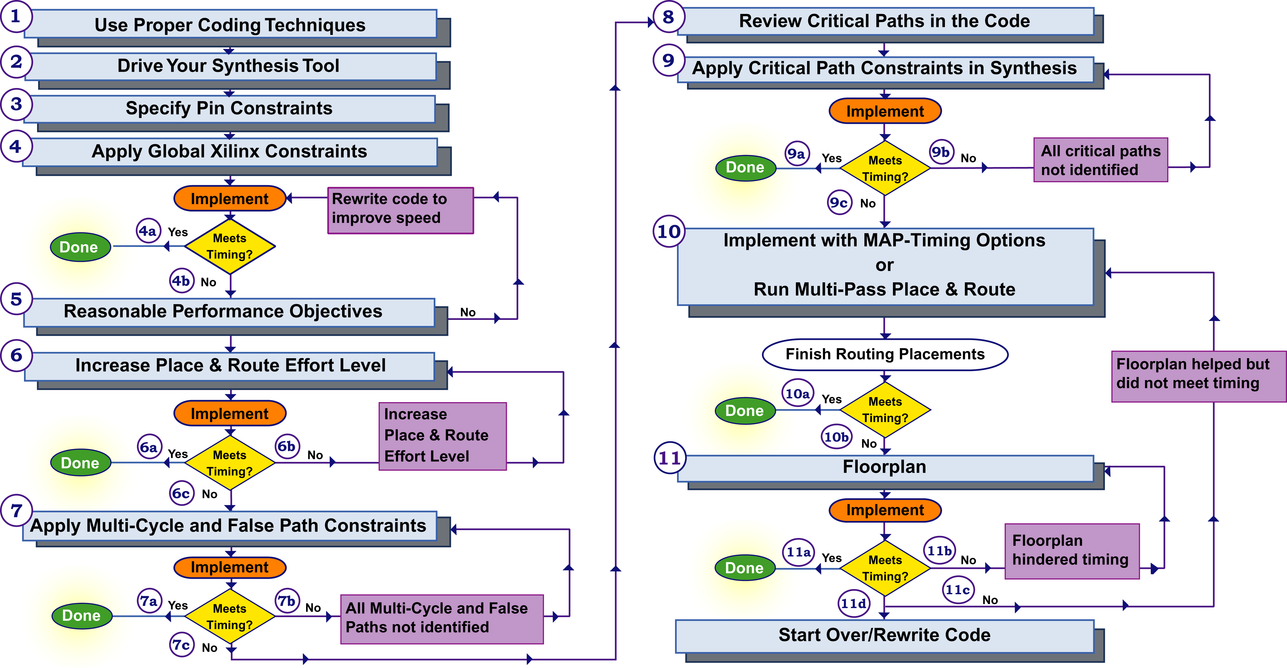
Timing Closure

Slide 5
USING PROJECT NAVIGATOR
There are six main steps to using Project Navigator, as detailed below.
1. Create a Project
2. Add Files to Your Project
3. Using ModelSim from Project Navigator
4. Synthesize, Place and Route
5. Program the board
6. Clean the Project for Archiving

Slide 6
Step 1 – Create a Project
1. Start by opening Project Navigator from the Desktop.
2. Go to File -> New Project
3. New Project – Name, Location and Top-Level Module
a. Give the project some kind of apropriate name which describes it.
b. Remember spaces are not allowed.
c. Set the project location to C:\users\, Project Navigator will automatically create a subdirectory for your project.
d. Set the Top-Level Module Type to HDL
e. Click Next

Slide 7
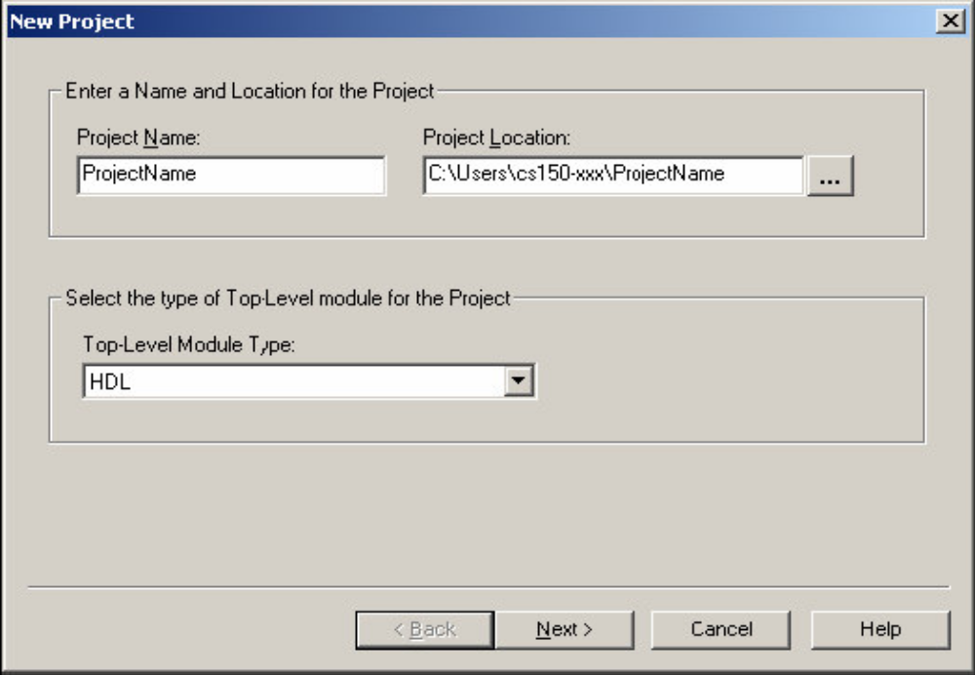

Slide 8
New Project – Device and Design Flow
a. Device Family: Spartan-3
b. Device: xc3S5000
c. Package: fg900
d. Speed Grade: -5
e. Synthesis Tool: XST (VHDL/Verilog)
f. Simulator: Modelsim
g. Generated Simulation Language: Verilog
h. Click Next

Slide 9
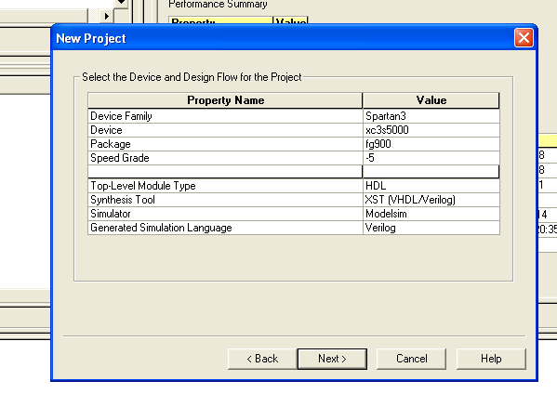

Slide 10
New Project – Create New Source
or
New Project – Add Existing Sources
You should keep your Verilog source files in a subdirectory of
C:\local from your project. Please use good sense and make sure to keep your files organized, CVS is a good idea.

Slide 11
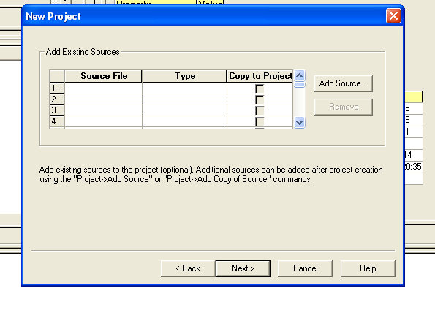
Make sure that the Copy to Project box is checked,

Slide 12
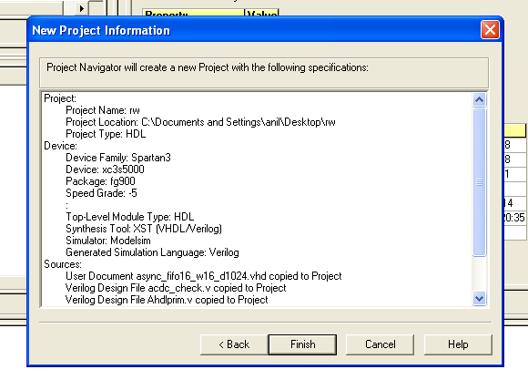
New Project – Information
Please make sure to double check the information displayed in this screen.

Slide 13
Step 2 – Add Files to Your Project
1. Right-click in the Sources in Project box and select Add Source from the drop down menu.
a. The Sources in Project box is in the upper left of the Project Navigator main window.
b. By select Add Source instead of Add Copy of Source, you can avoid having duplicate files and accidentally using an old version of a file.
2. Navigate to the folder that contains your Verilog source code.
3. Select the various verilog files as required by your project.
4. Click Open to add these files to your project.
Modules listed with a ? next to them are missing.

Slide 14
Step 3 – Using ModelSim from Project Navigator
Since we all are familiar using NCSim or running ModelSim directly from desktop we can skip detailed information of this step.

Slide 15
Step 4 – Synthesize, Place and Route
Xilinx Project Navigator was designed primarily to manage this step, the
Processes for Source box is the primary way to access all of the tools and reports
generated during the implementation process.
V means that that step in the implementation process completed
successfully.
! means that that step has warnings, which you may need to look into.
Most of the warnings given by Project Navigator can be safely ignored.
Design Rule Check or DRC violations are very serious and cannot
be ignored
X means that that step failed and you will need to examine the error log
(at the bottom of the Project Navigator Window) to see why.
? means that something has been changed since the last time that step
was run, and it should therefore be rerun.
Select the top level Verilog module in the Sources in Project box.
This will almost always be NOVA_TOP.v
Double-Click Generate Programming File step in the Processes for Source
box.
This will cause Project Navigator to attempt to synthesize, place, route and
generate a bitfile from the Verilog you have given it.
If there are synthesis errors
Double-Click View Synthesis Report
You may wish to examine the Synthesis warnings even if there are no errors,
the warnings may explain a particular bug or problem you are seeing.
If all goes well, proceed to step 5.

Slide 16

Step 5 – Program the Board

Slide 17
SYNTHESYS PROCESS PROPERTIES AND USEAGE

Slide 18
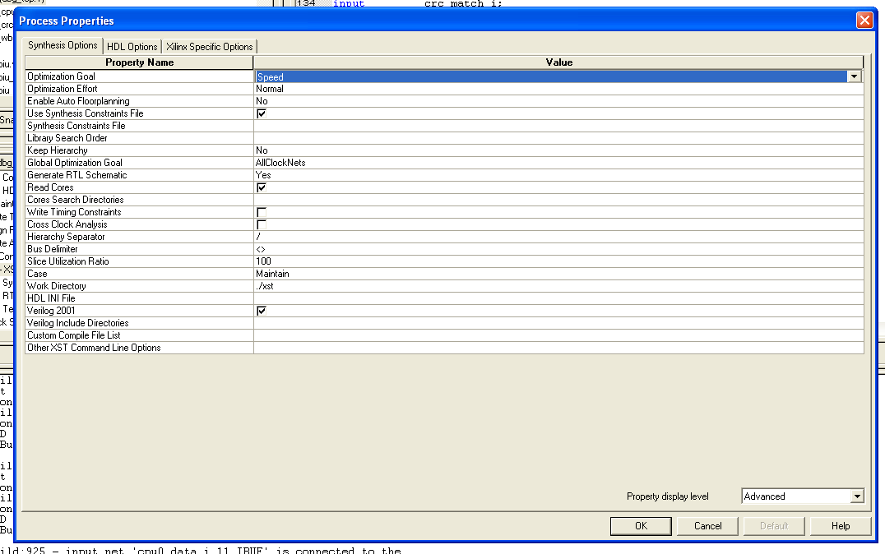

Slide 19
Library Search Order File ->The Library Search Order (LSO) file specifies the search order that XST uses to link the libraries used in VHDL/Verilog mixed language designs
KEEP_HIERARCHY
true: allows the preservation of the design hierarchy, as described in the HDL project.
• false: hierarchical blocks are merged in the top level module.
• soft: allows the preservation of the design hierarchy in synthesis, but the KEEP_HIERARCHY constraint is not propagated to implementation.
SLICE_UTILIZATION_RATIO is an area constraint that defines the area size (in %) that XST must not exceed during timing optimization.
If the area constraint cannot be satisfied, XST will make timing optimization regardless of the area constraint.

Slide 20
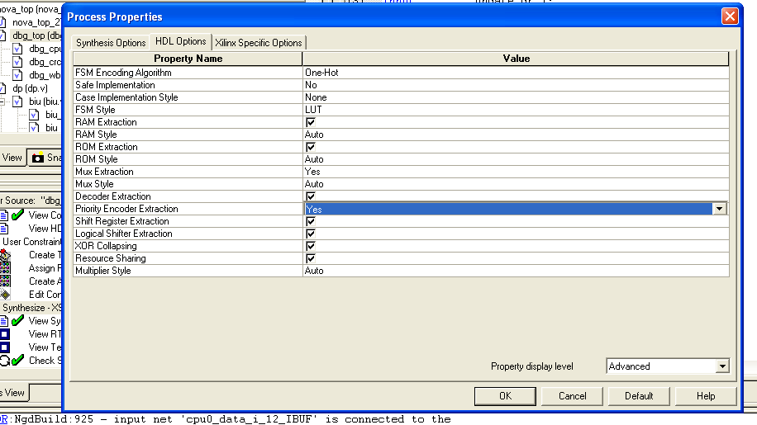

Slide 21
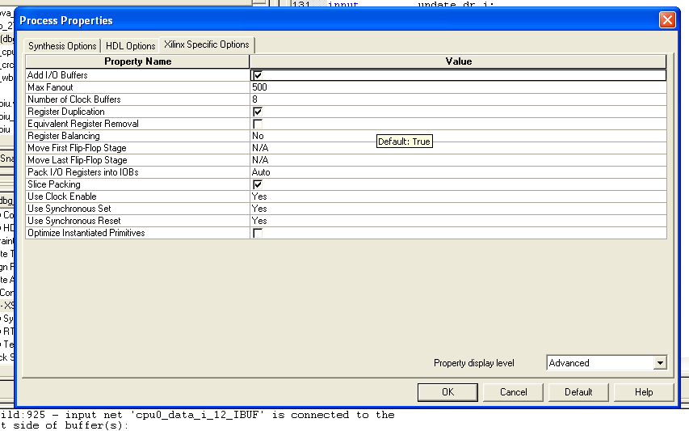

Slide 22
Xilinx Synthesis Constructs
BOX_TYPE
LOC
REGISTER_DUPLICATION
BUFFER_TYPE
LUT_MAP
REGISTER_POWERUP
MAP
RESOURCE_SHARING
MAX_FANOUT
RESYNTHESIZE
CLK_FEEDBACK
MOVE_FIRST_STAGE
RLOC
CLOCK_BUFFER
MOVE_LAST_STAGE
ROM_EXTRACT
CLOCK_SIGNAL
MULT_STYLE
ROM_STYLE
DECODER_EXTRACT
MUX_EXTRACT
SHIFT_EXTRACT
ENUM_ENCODING
MUX_STYLE
EQUIVALENT_REGISTER_REMOVAL
OPT_LEVEL
SLEW
FSM_ENCODING
OPT_MODE
SLICE_PACKING
FSM_EXTRACT
PARALLEL_CASE
SLICE_UTILIZATION_RATIO
FULL_CASE
PERIOD
INCREMENTAL_SYNTHESIS
PRIORITY_EXTRACT TIG
IOB
RAM_EXTRACT
TRANSLATE_OFF and
TRANSLATE_ON
IOSTANDARD
RAM_STYLE
USELOWSKEWLINES
KEEP REGISTER_BALANCING
XOR_COLLAPSE
KEEP_HIERARCHY

