Slide 1
PD Flow Basic Training

Slide 2
Basic PD Flow chart
DC netlist
Tech file
FE(Floor planning, Power Planning, Pre place/Pre route)
BP Info
Design Doc/data flow diagram
PIE/UPF/CPF Sheet
LIBs
Floorplan DEF
PT ECO
Don’t touch cells & nets
ICC (PnR)
Netlist & constraints
NO
Stdcell mway & DBs
PnR DEF
Timing met??
STARXT (RC extraction)
LEF
SPEF
PT (STA)
YES
DBs
Netlist & constraints
CALIBRE (physical verification)
PV Inputs from PnR DB & cadence/cdl views

Slide 3
Floor Planning
Objective : To define the area of a chip based on utilization and Aspect Ratio.
→ Exception : Above parameter will not be useful if it is a PAD/IO LIMITED Design.
Key Steps :
Define core width & height based on utilization and aspect ratio.
Define core to die spacing based on IO height requirement.
IP placement driven by Frequency, domain Power domains and bump info of he design.
Provide common area as much as possible for std cells placement.
Narrow Channel’s width calculation. I
Island Creation for non generic PG domains.
ESD Protection circuits placement.

Slide 4
Floor Planning
ENDCAP, HMY, TAP & DECAP cells placement.
PAD/IO Placement based on connectivity.
Bump Placement based on Bump package info given by package team.
Pad fillers placement to have continuous Pad ring around the core.
Generate Routing Tracks.

Slide 5
Power Planning
Objective : To reduce the Power Drop as much as possible to provide required Power to different cells/IPs.
Key Steps :
PG rings creation around the IPs. (Ring width will be based on Resistance requirement given by IP owner)
Create Followpins for std cells Power supply.
Generic (Most used PG in a chip) PG Stripes generation.
Convert generic PG in to non generic PG over non generic Power domain related IPs.
Create PG pins for Top Level hook up (in case of HM level )
RDL Connectivity.
DRC/Soft check Cleanup.

Slide 6
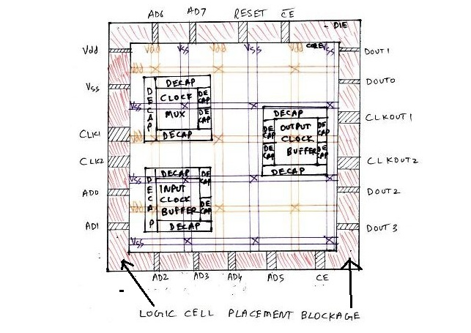
Pre Placement and Pre Routes
Objective :
Pre Place : To decide the physical location of highly timing critical cells like clock marker given by Design team.
Pre Route : To get the shortest possible routes for the critical paths.

Slide 7
Placement
Objective : To get a std cells placed design with Timing optimization with minimum congestion issues.
Create route guides for blocks to restrict routing within the specified number of tracks of the boundary.
Placement engine uses RC values from Virtual Route (VR) to calculate timing. VR is the shortest distance between two pins.
Phases of Placement :
1.) Pre-placement optimization :
To optimize the netlist before placement, HFNs will be collapsed.
2.) Global route driven placement and optimization
To perform Coarse placement, Placement optimization and Scan chain reordering.
3.) Post Placement Optimization :
To perform Area recovery, Power optimization and congestion removal by refine placement without affecting timing.

Slide 8
Clock Tree Synthesis
Objective : Clock tree synthesis (CTS) is to minimize skew and insertion delay.
Trace the DC Clock tree or use the Clock Diagram given by Design Team to place the clock marker cells which are clock tree building points.
Create custom clock tree for the given requirements and set them as clock tree exceptions.
Compile clock tree.
Optimize clock tree.
Balance inter clock delay.
Clock tree routing with specific Non default routing rules.
Clock shielding Implementation.
Post clock route optimize clock tree.

Slide 9
Routing
Objective : To convert all the Signal logical connectivity in to physical connectivity with minimum DRC violations.
Phases of Routing :
1.) Global Route assigns nets to specific metal layers and global routing cells. Global route tries to avoid congested global cells while minimizing detours. Global route also avoids pre-routed P/G, placement blockages and routing blockages.
2.) Track Routing :
It assigns each net to a specific track and actual metal traces are laid down by it. It tries to make long, straight traces to avoid the number of vias. DRC is not followed in TA stage. TA operates on the entire design at once.
3.) Detail Routing :
tries to fix all DRC violations after track assignment using a fixed size small area known as “SBox”. Detail route traverses the whole design box by box until entire routing pass is complete. 4.) Search and Repair fixes remaining DRC violations through multiple iterative loops using progressively larger SBox sizes.

Slide 10
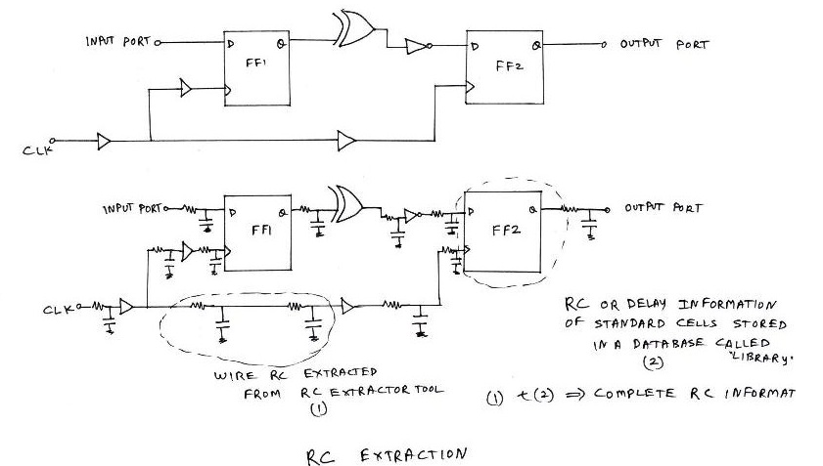
RC Extraction
Objective : To extract the nets related resistors & capacitors for Static Timing Analysis.

Slide 11
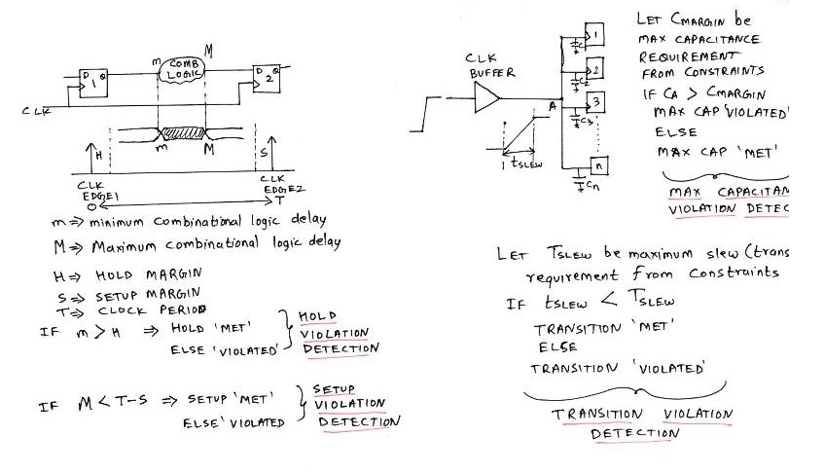
Static Timing Analysis
Objective : To analyze all the Timing failure of the design to ensure the operating frequency of the design.

Slide 12
Static Timing Analysis
Setup Violation Fixes :
By replacing a buffer with 2 inverters in the violated path.
By reducing capacitance value on the o/p pin of the cells.
By upsizing the cells to increase their drive strength.
By using faster cells in the violated path. (VT Swap)
Can create some +ve skew to help setup checks.
We can delete some of the long paths and reroute them by ECO routing.
By reducing the amount of buffering in the violated path. (Very risky method)
By reducing the clock frequency (speed). This is a very poor design technique and should be used as the worst last case.

Slide 13
Static Timing Analysis
Hold Violation Fixes :
By adding buffers in the violated path.
Can create some –ve skew to help hold checks.
By downsizing the cells to decrease their drive strength. (Again Very Risky).
By using slower cells in the violated combo path. (VT Swap)
By adding extra RC using longer routes. (Generally used to fix after Base Tapeout)
By Swapping capture flop of minimum library hold value flop.

Slide 14
Static Timing Analysis
Max_transition violation fixes :
If the transition violation is at o/p pin of a cell then we can upsize or make that cell to faster to solve transition violation but if is at i/p pin of a cell then we have to upsize or faster cell swap with its driver cell (previous cell) in that violated path.
By decreasing the capacitance & resistance value by moving the source gate closer to the sink gate.
By increasing the width of the route at the violation instance pin. This will also decrease the resistance of that route and may help to solve transition violation at that instance pin.
Max_cap violation fixes :
By increasing the drive strength of the violated cell.
By buffering some of the fan-out paths to reduce capacitance seen by the o/p pin or by fan-out distribution which is called as cloning concept.

Slide 15
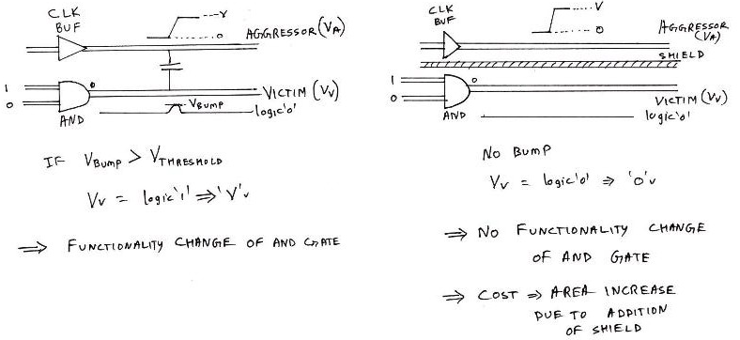
Static Timing Analysis
SI Check :: Cross Talk :
Since, a logic change or voltage level change on clock net, is causing a voltage level change on the nearby output net of AND gate, the clock net is called as 'AGGRESSOR' whereas the output net of AND gate is called as 'VICTIM'. If the bump voltage Vbump on VICTIM exceeds a certain margin or threshold, the output of AND gate switches to logic '1' which changes the functionality of the design. This phenomenon is called Crosstalk.

Slide 16
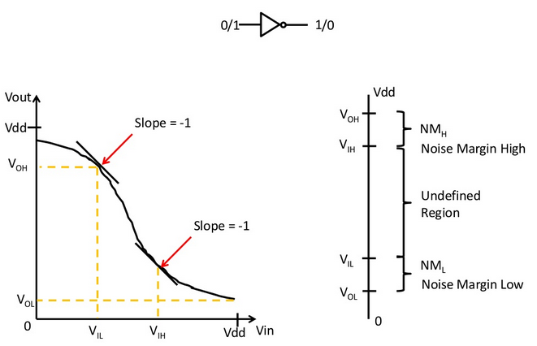
Static Timing Analysis
SI Check :: Noise Margin :
Noise margin is the amount of noise that a CMOS circuit could withstand without compromising the operation of circuit.
Noise margin does makes sure that any signal which is logic '1' with finite noise added to it, is still recognised as logic '1' and not logic '0'.
It is basically the difference between signal value and the noise value.

Slide 17
ECO (Engineering Change Order)
Objective : To implement Timing fixes on Post Route Opt DB
Key Steps :
Prepare ECO file fro STA
ECO file will be sourced to existing PRO DB
Incremental Placement : To place ECO inserted cells
ECO Route : To Fix Open nets.
Detail Route : To fix DRC
Again Extraction & STA will be done in iterative manner until we get a timing clean DB.

Slide 18
Physical Verification Checks
DRC
LVS
Soft Check
Antenna Check
ERC Check
PERC Check
Formal Verification
Its the comparison between DC netlist & PnR implemented netlist to make sure the functionality is not altered while PD implementation.

Slide 19
THANK YOU

