Slide 1
CMOS VLSI Design Lecture 11: Combinational Circuit Design
Notes:
Hello and welcome.

Slide 2
Learning Objectives
At the end of this lecture, you should be able to:
Explain and demonstrate how to optimize combinatorial logic circuits critical paths using bubble pushing, compound gates, input ordering, asymmetric gates and Skewed gates
Use P/N ratio to determine the best delay/power trade-off for logic gates.
Notes:
Bubble pushing: a shortcut method for forming equivalent logic circuits, based on De Morgan’s theorem.
Compound gates: here we follow a similar method to the complementary COMS logic with pull-up (VDD) and pull-down (0 V) networks.
Input ordering: fiscal location of gates to determine the signal and delay.
Asymmetric gates: asymmetrical gates can speed up critical paths in a network by reducing logical effort along the critical paths.
Skewed gates: The size of the transistors is adjusted to make one of them faster than the other.

Slide 3
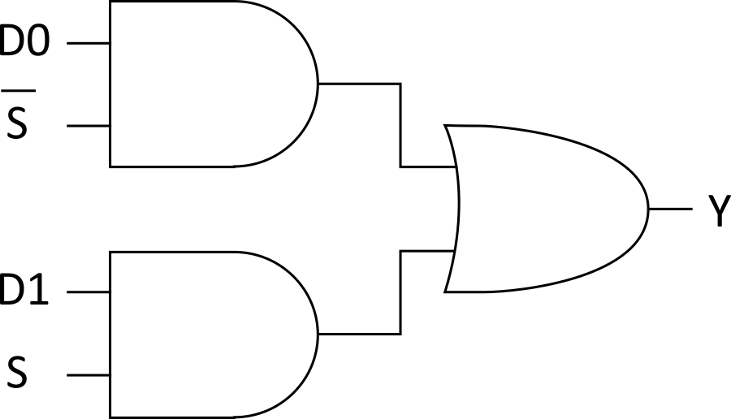
Example 1
module mux(input s, d0, d1,
output y);
assign y = s ? d1 : d0;
endmodule
1) Sketch a design using AND, OR, and NOT gates.
Notes:
Example, describes a two-input multiplexer using Verilog.
Inputs: s, d0, d1
Output: y
If s is true, then y=d1
Else, if s is false, then y=d0

Slide 4
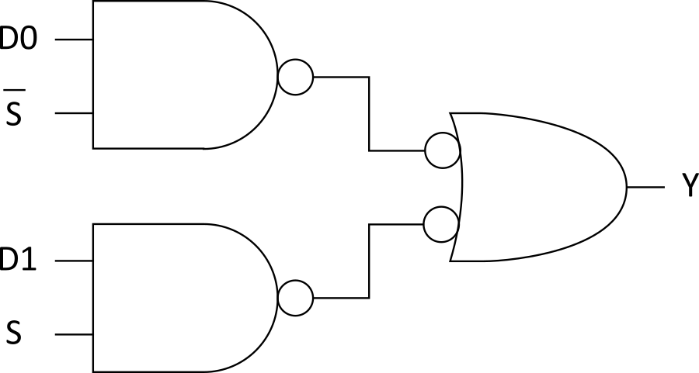
Example 2
2) Sketch a design using NAND, NOR, and NOT gates. Assume ~S is available.
Notes:
Example 2:
Here, the two-input multiplexer is designed using 2 NAND gates and 2 inverters and one OR gate.

Slide 5
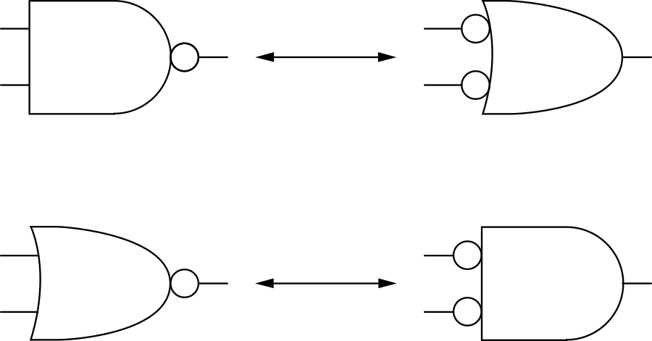
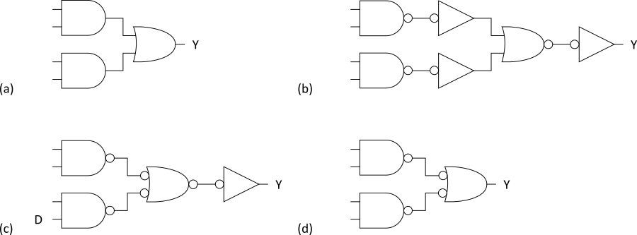
Bubble Pushing
Start with network of AND/OR gates
Convert to NAND/NOR + inverters
Push bubbles around to simplify logic
Remember DeMorgan’s Law
Notes:
Here we see how we use the bubble pushing method to go from the solution of example 1 to the more convenient solution of example 2.
The method is similar to DeMorgan’s Law. First, we change all the AND/OR gates into NAND/NOR gates and inverters. (a - b)
Then, you push bubbles around to cancel out inverters since two inverters give you the same output always.
In this case, the two inverters at the output of the NAND gates cannot be canceled out. These inverters will remain at the input of the NOR gate (b-c).
The NOR gate also has an inverter at its output. This inverter negates the NOR gate output, thus making it an OR gate (c-d).

Slide 6
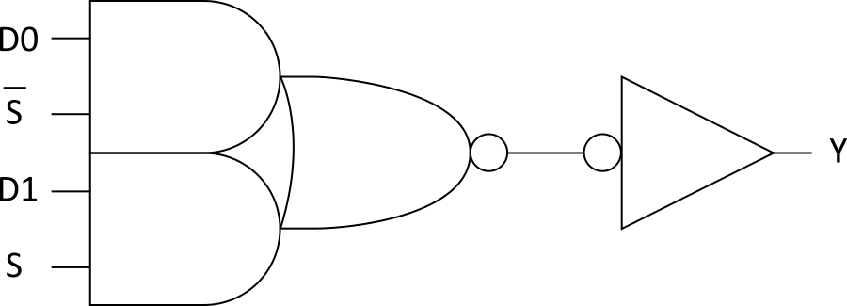
Example 3
3) Sketch a design using one compound gate and one NOT gate. Assume ~S is available.
Notes:
The example from the previous slide can be realized as a compound gate as shown in this slide. The design shown in this slide is AOI22 compound gate + inverter.

Slide 7
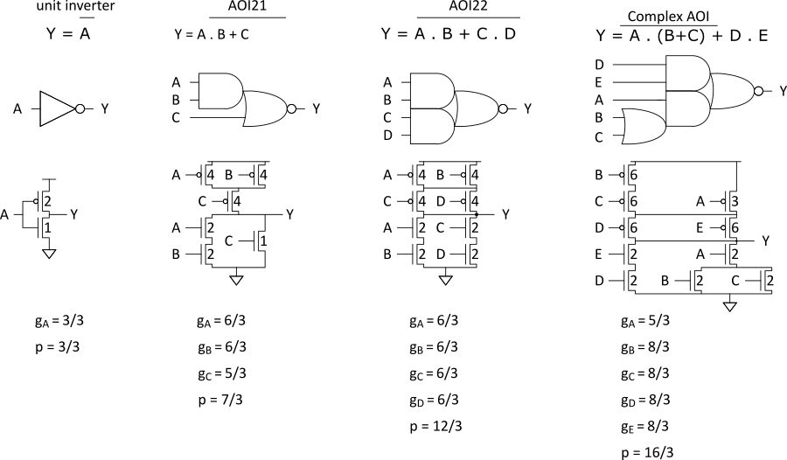
Compound Gates
Logical Effort of compound gates
Notes:
Compound gates can perform the functions of a combination of basic logic gates. Compound gates are simple devices and they are formed from a combination of transistors which are fewer in number if such logic function is built using basic gates.
To calculate the parasitic capacitance of the gate, look at the output sum the width of the transistors driving it divided by 3 (for inverter).

Slide 8
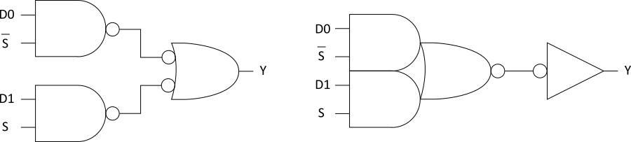
Example 4
The multiplexer has a maximum input capacitance of 16 units on each input. It must drive a load of 160 units. Estimate the delay of the two designs.
H = 160 / 16 = 10 B = 1 N = 2
Notes:
NAND Solution
H = 160 / 16 = 10
B = 1
N = 2
P = 2 + 2 = 4
G = (4 / 3) · (4 / 3) = 16 / 9
F = GBH = 160 / 9
ˆ f = N √ F = 4 . 2
D = N ˆ f + P = 12 . 4 τ
Compound Solution
H = 160 / 16 = 10
B = 1
N = 2
P = 4 + 1 = 5
G = (6 / 3) · (1) = 2
F = GBH = 20
ˆ f = N √ F = 4 . 5
D = N ˆ f + P = 14 τ

Slide 9
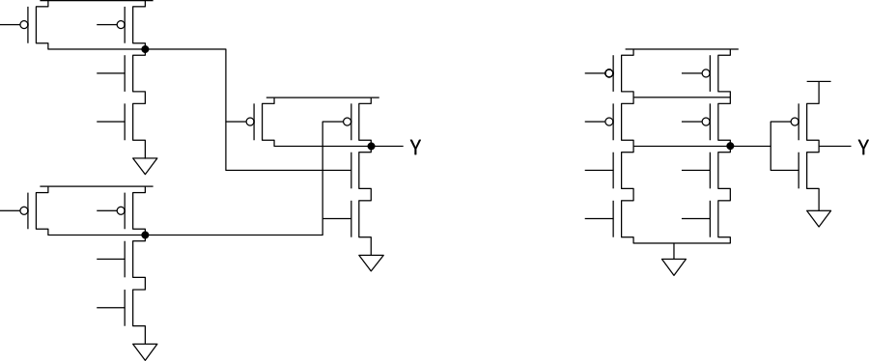
Example 5
Annotate your designs with transistor sizes that achieve this delay.

Slide 10
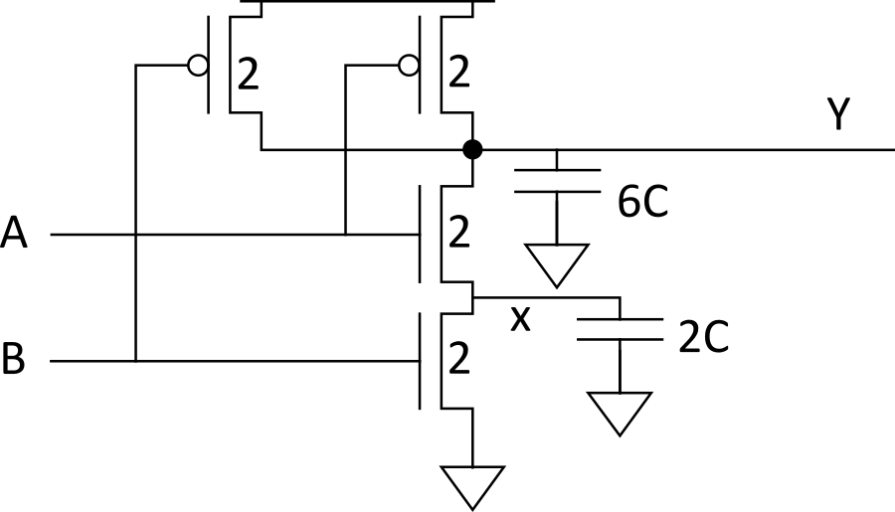
Input Order
Our parasitic delay model was too simple
Calculate parasitic delay for Y falling
If A arrives latest? 2τ
If B arrives latest? 2.33τ
Notes:
Parasitic delay is the ratio between the output capacitance of a complex gate and the capacitance input of the inverter.
If A arrives last, then: 6/3=2ταυ
If B arrives last, then: 7/3=2.33tau

Slide 11
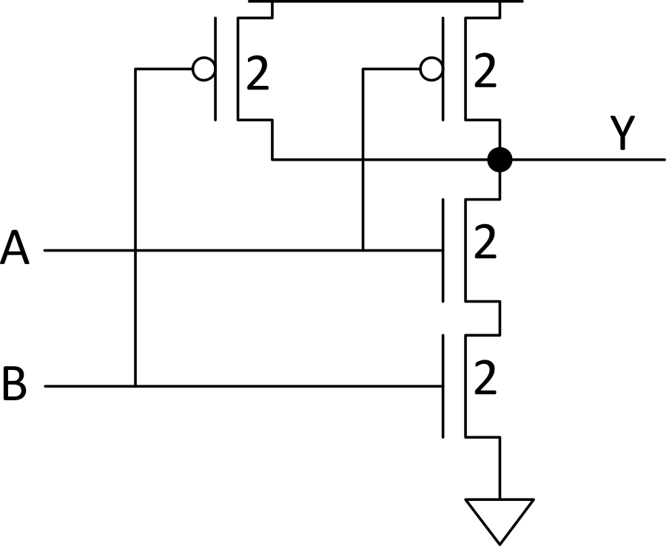
Inner & Outer Inputs
Inner input is closest to output (A)
Outer input is closest to rail (B)
If input arrival time is known
Connect latest input to inner terminal
Notes:
Architecturally speaking, the flow of data has signals arriving faster. In this case, it is A, since transistor gates connected to A are the closest to the output. In contrast, signal B has to first go to the gates and then go through the second transistor creating a delay.
A is faster and B is slower.

Slide 12
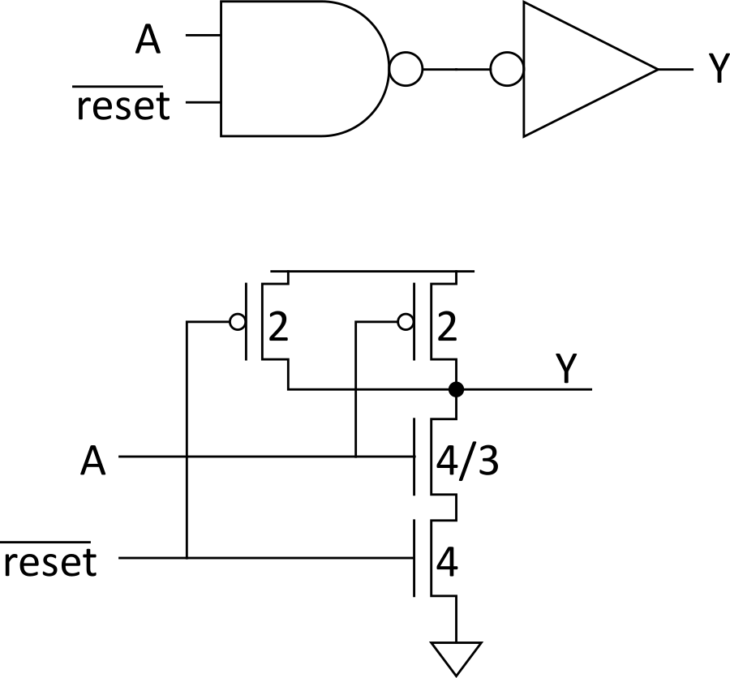
Asymmetric Gates
Asymmetric gates favor one input over another
E.g., suppose input A of a NAND gate is most critical
Use smaller transistor on A (less capacitance)
Boost size of noncritical input
So total resistance is same
g_{A} = 10/9
g_{B} = 2
g_{total} = g_{A} + g_{B} = 28/9
Asymmetric gate approaches g = 1 on critical input
But total logical effort goes up
Notes:
Logic gates sometimes have different logical efforts for different inputs. We call such gates asymmetric. Asymmetric gates can speed up critical paths in a network by reducing the logical effort along the critical paths. This attractive property has a price since the total logical effort of the logic gate increases. This slide discusses design issues arising from biasing a gate to favor particular inputs.

Slide 13
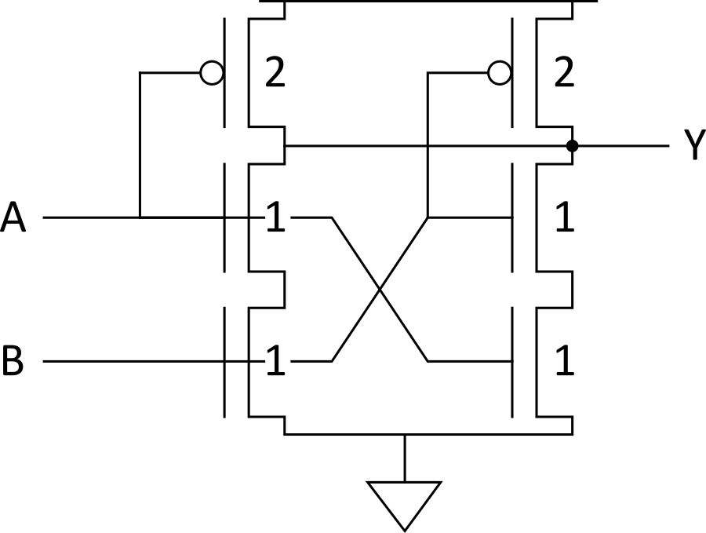
Symmetric Gates
Inputs can be made perfectly symmetric

Slide 14
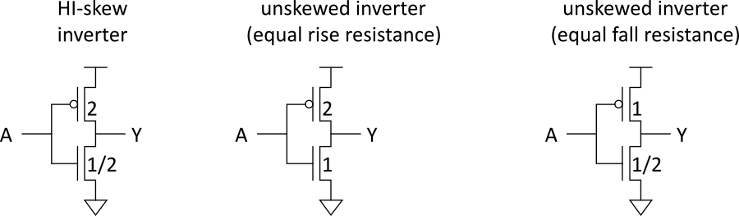
Skewed Gates
Skewed gates favor one edge over another
E.g., suppose rising output of inverter is most critical
Downsize noncritical nMOS transistor
Calculate logical effort by comparing unskewed inverter with same effective resistance on that edge.
g_{u} = 2.5 / 3 = 5/6
g_{d} = 2.5 / 1.5 = 5/3
Notes:
Changing the driving capabilities of PMOS and CMOS transistor networks to favor one transistor direction is referred as skewing.

Slide 15
HI- and LO-Skew
Def: Logical effort of a skewed gate for a particular transition is the ratio of the input capacitance of that gate to the input capacitance of an unskewed inverter delivering the same output current for the same transition.
Skewed gates reduce size of noncritical transistors
HI-skew gates favor rising output (small nMOS)
LO-skew gates favor falling output (small pMOS)
Logical effort is smaller for favored direction
But larger for the other direction
Notes:
Hi-Lo Skew allows to change the balance in the logical effort of the transistors, making one path faster while making the other one slower; this is intentional and is a good trick to design architectures where one input is important, for example, an asynchronous FSM or a reset in a flip-flop.

Slide 16
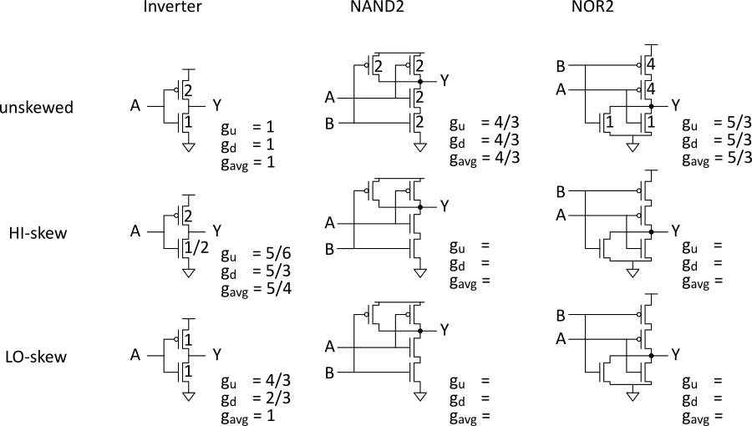
Catalog of Skewed Gates
Notes:
Examples to apply low and high skew in different transistors.
In all cases, either low or high, we reduce the value W by half.

Slide 17
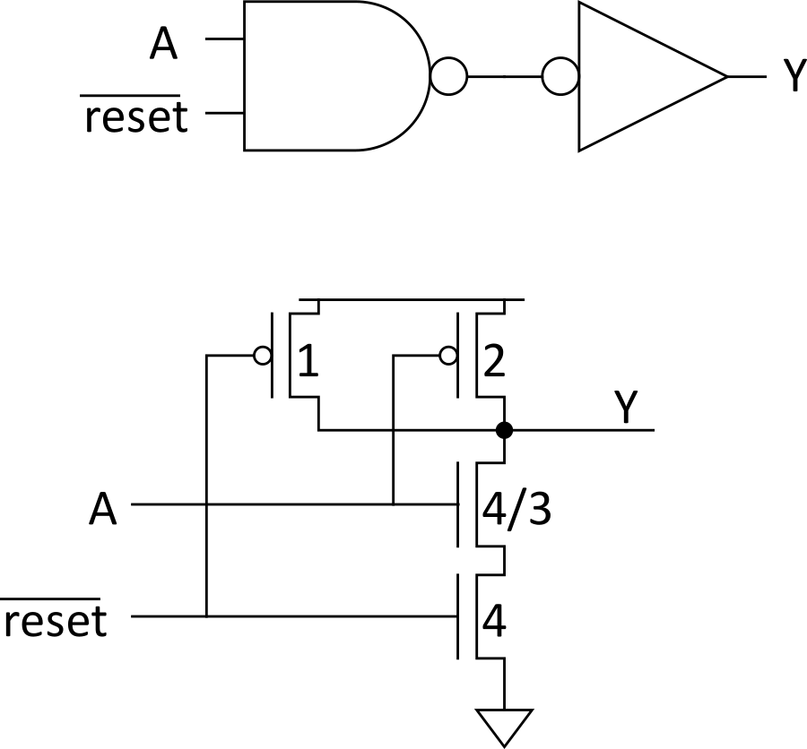
Asymmetric Skew
Combine asymmetric and skewed gates
Downsize noncritical transistor on unimportant input
Reduces parasitic delay for critical input
Notes:
Here we apply the two methods at the same time. In this case, A is reduced in size and is located to allow an intentional speed increase but reducing the parasitic delay.

Slide 18
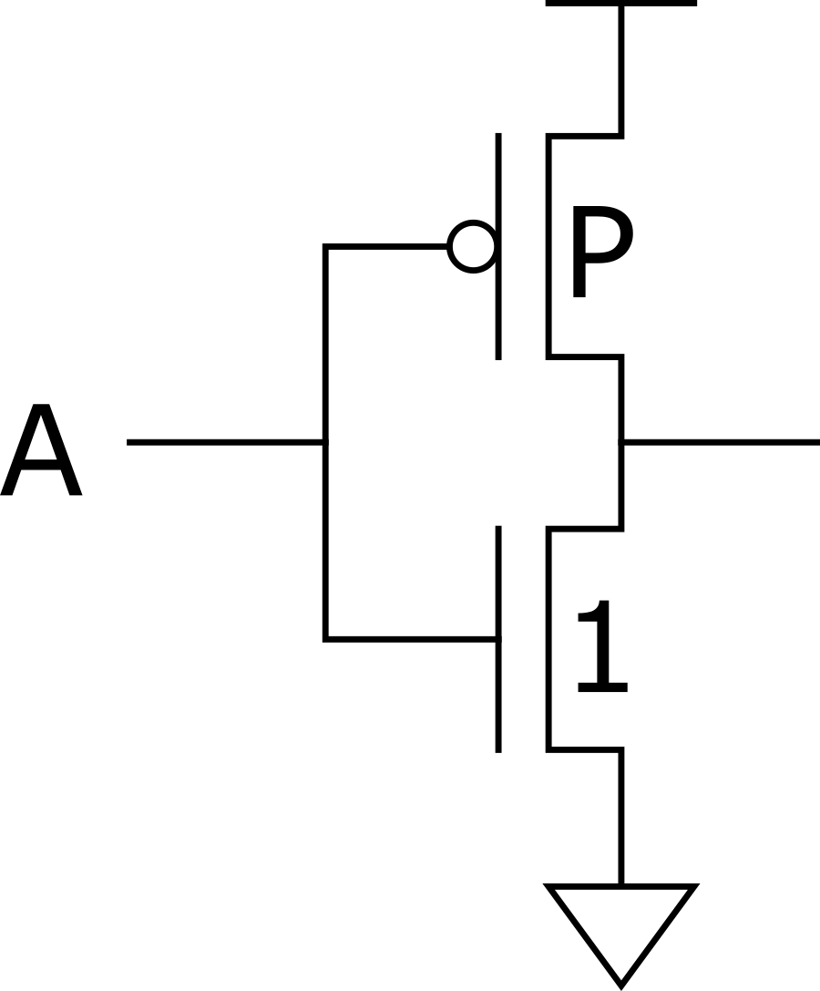
Best P/N Ratio
We have selected P/N ratio for unit rise and fall resistance (μ = 2-3 for an inverter).
Alternative: choose ratio for least average delay
E.g., inverter
Delay driving identical inverter
t_{pdf} = (P+1)
t_{pdr} = (P+1)(μ /P)
t_{pd} = (P+1)(1+ μ/P)/2 = (P + 1 + μ + μ/P)/2
dt_{pd} / dP = (1- μ/P²)/2 = 0
Least delay for P =
Notes:
Normal skew gates have equal rise and fall resistances. However, this is not optimal for average circuit delay. By using a smaller P/N ratio, the input load can be significantly reduced while only somewhat slowing the rising output.

Slide 19
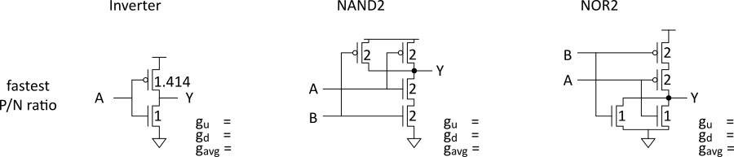
P/N Ratios
In general, best P/N ratio is sqrt of equal delay ratio.
Only improves average delay slightly for inverters
But significantly decreases area and power
Notes:
Therefore, the optimal P/N ratio to minimize average path delay is the square root of the ratio that gives equal rise/fall resistances. Since the mobility ratios are 2-3, the best P/N ratios for average delay are 1.4-1.7; 1.5 is a convenient number to use.
In the case of the inverter when P is equal to 2, then the most efficient ratio is P=sqrt(s)=1.414.

Slide 20
Observations
For speed:
NAND vs. NOR
Many simple stages vs. fewer high fan-in stages
Latest-arriving input
For area and power:
Many simple stages vs. fewer high fan-in stages
Notes:
As a summary, we need to decide what is best for the design to make it more efficient in speed and strength of signal but keep functionality first.
Use compound gates to create faster signals by adding complexity or keep it simple but sacrifice a little delay.
Play with the inputs if this helps make it faster or ensure no bugs.
However, speed isn't everything; the design needs to maintain a consumption of energy and space to avoid issues with temperature or delays due to parasitics.

