Slide 1
CMOS VLSI Design Lecture 14: Adders
Notes:
Hello and welcome.

Slide 2
Learning Objectives
At the end of this lecture, you should be able to:
Sketch transistor-level implementations of adder cells
Describe and explain the feature of different adder architectures including: Carry-Ripple Adder, Carry-Skip Adder, Carry-Lookahead Adder, Carry-Select Adder, Carry-Increment Adder and Tree Adder
Use parallel prefix networks to design circuits with logarithmic time complexity

Slide 3
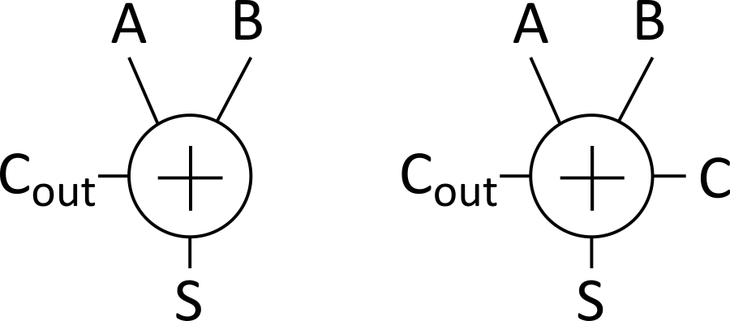
Single-Bit Addition
Half Adder Full Adder
S = A ⊕ B
C_{out} = A • B
A | B | C_{out} | S
0 | 0 | 0 | 0
0 | 1 | 0 | 1
1 | 0 | 0 | 1
1 | 1 | 1 | 0
A | B | C | C_{out} | S
0 | 0 | 0 | 0 | 0
0 | 0 | 1 | 0 | 1
0 | 1 | 0 | 0 | 1
0 | 1 | 1 | 1 | 0
1 | 0 | 0 | 0 | 1
1 | 0 | 1 | 1 | 0
1 | 1 | 0 | 1 | 0
1 | 1 | 1 | 1 | 1
Notes:
Half adder circuit adds two binary numbers (A and B) and produces two outputs, a sum bit (S) and carry bit (Cout).
The sum bit (S) is derived by XORing A and B, while the carry bit (Cout) is generated by ANDing A and B.
Full adder circuit adds two binary numbers (A and B ) plus a carry in (C) with which it produces two outputs, a sum bit (S) and carry bit (Cout).
The sum bit (S) is derived by XORing A, B, and C, while the carry bit (Cout) is generated by a combinational circuit that detects the highest number of “0”s or “1”s.

Slide 4
PGK
For a full adder, define what happens to carries
(in terms of A and B)
Generate: C_{out} = 1 independent of C
G = A • B
Propagate: C_{out} = C
P = A ⊕ B
Kill: C_{out} = 0 independent of C
K = ~A • ~B
Notes:
Let us examine the carry-in (C) and carry-out (Cout) bits of the full adder.
The operation of the adder is thus when both input operands (A & B) are “1”s, the full adder will GENERATE Cout = 1. This is irrespective of the value of input Carry C.
The operation of the adder is thus when only one of input operands (A or B) is a “1”, the full adder will PROPAGATE Cout = input Carry C.
The operation of the adder is thus when both input operands (A & B) are “0”s, the full adder will KILL Cout = 0. This is irrespective of the value of input Carry C.

Slide 5
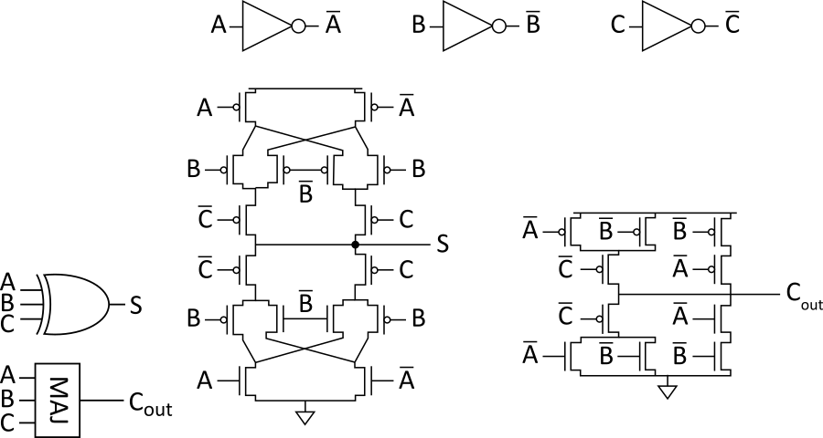
Full Adder Design I
Brute force implementation from eqns
Notes:
The transistor-level circuits in this slide implement a 3-input XOR gate, which takes the two input operands (A & B) plus the carry-in (C) to compute the output of the sum and a majority vote circuit to implement the carry-out circuit for output Cout.
This approach implements the adder directly from the equations.

Slide 6
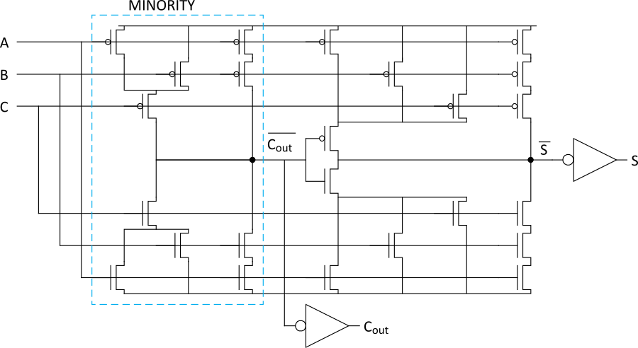
Full Adder Design II
Factor S in terms of C_{out}
S = ABC + (A + B + C)(~C_{out})
Critical path is usually C to C_{out} in ripple adder
Notes:
Full adder design second method
In this circuit, S is a function of ~Cout. The term ~Cout is generated from a minority computation circuit.

Slide 7
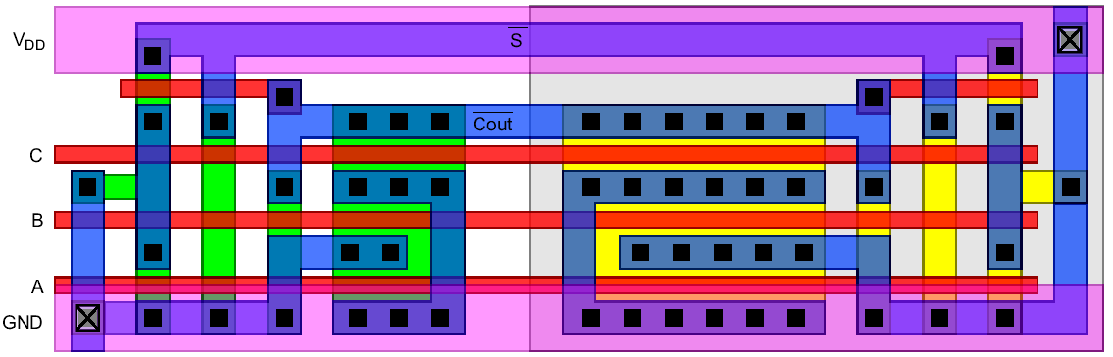
Layout
Clever layout circumvents usual line of diffusion
Use wide transistors on critical path
Eliminate output inverters

Slide 8
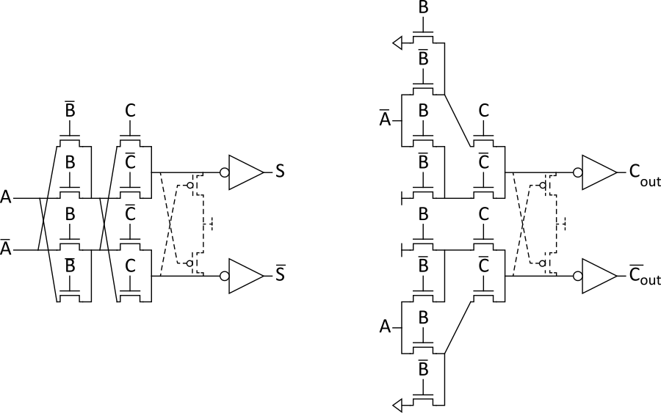
Full Adder Design III
Complementary Pass Transistor Logic (CPL)
Slightly faster, but more area
Notes:
Full adder design third method.
This method uses Pass Transistor Logic. The circuit is slightly faster but uses more area due to increased number of transistors.

Slide 9
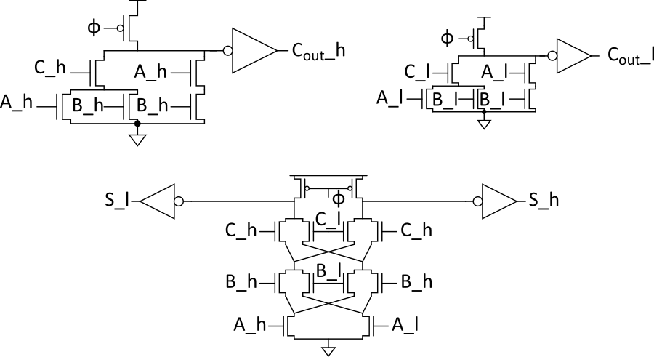
Full Adder Design IV
Dual-rail domino
Very fast, but large and power hungry
Used in very fast multipliers

Slide 10
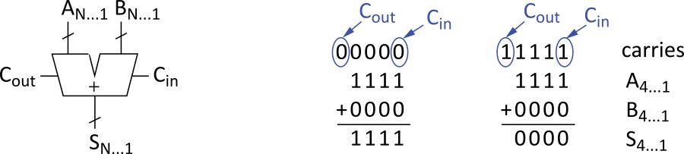
Carry-Propagate Adders
N-bit adder called CPA
Each sum bit depends on all previous carries
How do we compute all these carries quickly?
Notes:
Shows a N-bits adder and illustrates the interaction between the operands and the propagated carries.
In the additions shown, the top-most 5 bits are the carries generated by a single full adder for each adjacent bits of A and B.
For the first addition, we have a “0” carried in. Subsequent single adders propagated this “0” because only one of the two operands is a “1”. This propagate operation is also seen when the carry-in is also a “1”.
This each 1-bit adder depends on the carry of the previous adder. This can increase the time it takes to compute the sum of two binary numbers of N-bits as N increases.

Slide 11
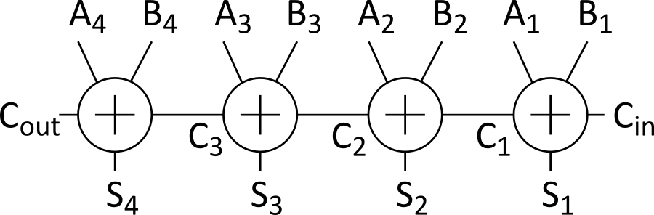
Carry-Ripple Adder
Simplest design: cascade full adders
Critical path goes from C_{in} to C_{out}
Design full adder to have fast carry delay
Notes:
Carry-Ripple Adder is a type of implementation of Carry-Propagate Adder in which N number of full adders are chained together to form an N-bit adder.
The time it takes to fully compute the sum and carry in ripple carry adder can increase when many bits need to be added.

Slide 12
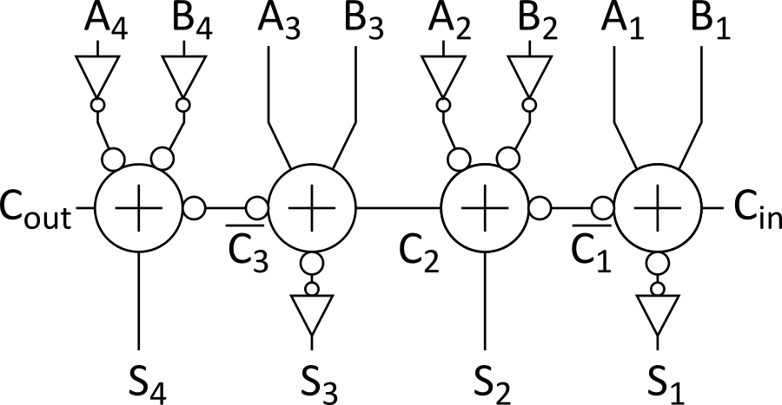
Inversions
Critical path passes through majority gate
Built from minority + inverter
Eliminate inverter and use inverting full adder
Notes:
This shows another structure of the adder circuit, which generates/propagates the carries using majority gate built from minority circuit plus inverter.

Slide 13
Generate/Propagate
Equations often factored into G and P
Generate and propagate for groups spanning i:j
Base case
Sum:
G_{i:j}= P_{i:k} + P • G_{k-1:j}
P_{i:j} = P_{i:k} • P_{k-1:j}
G_{i:i}= G_{i} + A_{i} • B_{i}
P_{i:i} = P_{i} = A_{i} ⊕ B_{i}
Notes:
To solve the carry-delay problem, we need to calculate the carry signals in advance, using the input signals to derive the generate and propagate terms previously discussed.

Slide 14
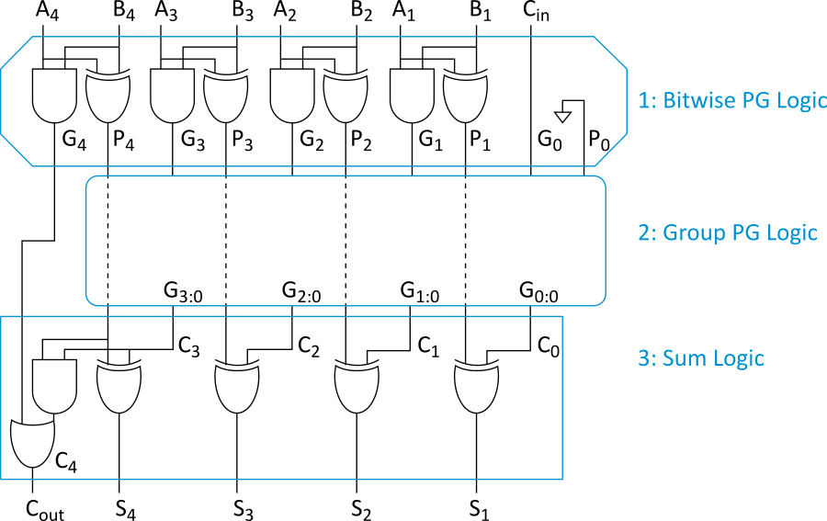
PG Logic
Notes:
In this illustration, the generate and propagate signals are computed in the first stage.
In the second stage, the generate and propagate signals are combined to produce generate signals.
In the third stage, the sum is computed using the group generate signals and the bitwise propagate signals.
Let’s examine different architectures used to realise the Group propagate logic.

Slide 15
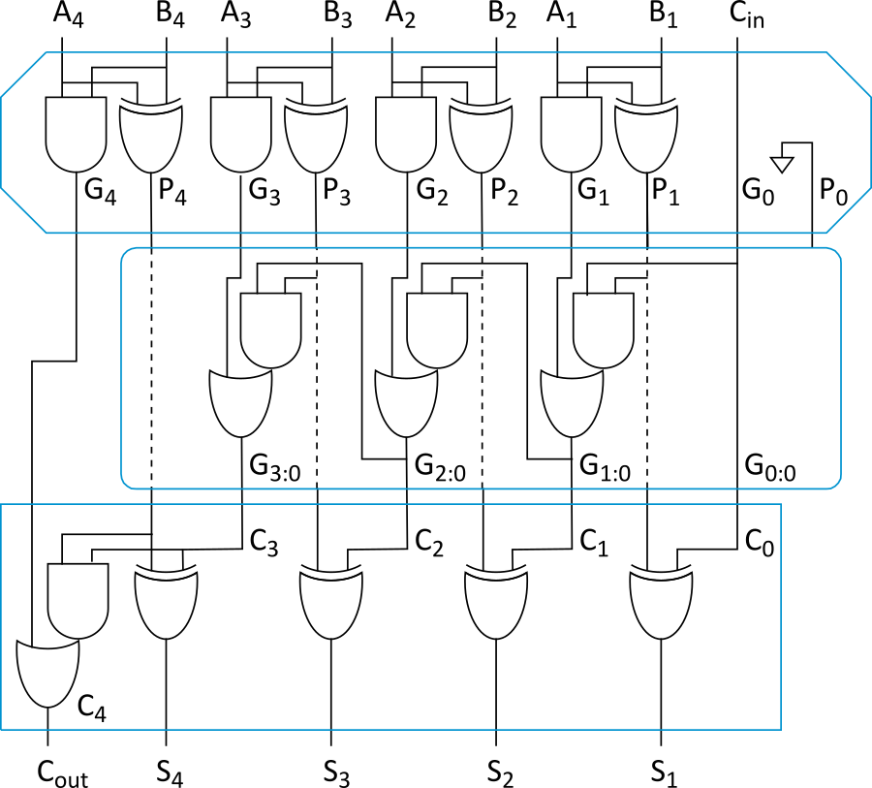
Carry-Ripple Revisited
G_{i:0}= G_{i} + P_{i} • G_{i-1:0}

Slide 16
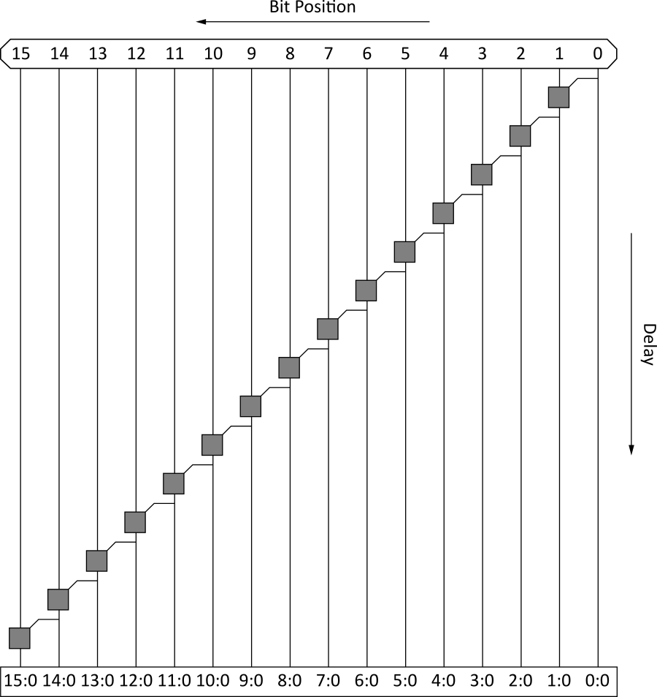
Carry-Ripple PG Diagram
Notes:
Diagram illustrates the delay due to carry ripple from least significant bit to most significant bit of the adder.

Slide 17
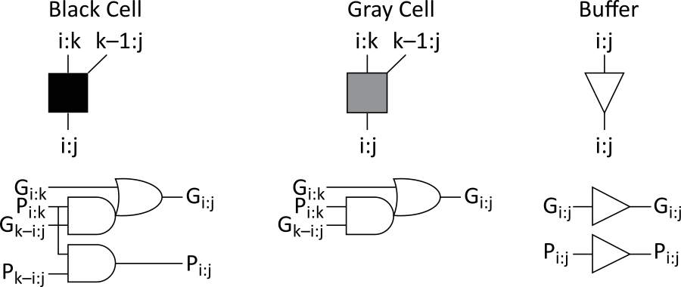
PG Diagram Notation
Notes:
Slide shows PG notation that will be used in the rest of the slides.

Slide 18
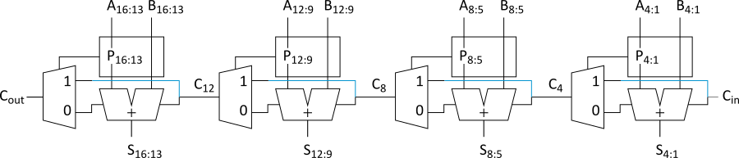
Carry-Skip Adder
Carry-ripple is slow through all N stages
Carry-skip allows carry to skip over groups of n bits
Decision based on n-bit propagate signal
Notes:
Carry-skip Adder also known as carry-bypass adder improves delay by employing generate propagate logic, which either sets the multiplexer in each stage to either propagate the carry into that stage or output the generated carry from that stage.
A careful look at the circuit of the CSA, one would notice that if the first 4 bits block of the adder generates a carry, the multiplexer will select ‘0’ to propagate this carry. Looking at the next two blocks, depending on their input bits combinations for each adder block, the carry generated in the first block can skip to the last 4 bits block for the correct sum of the two 16 bits number can be computed.

Slide 19
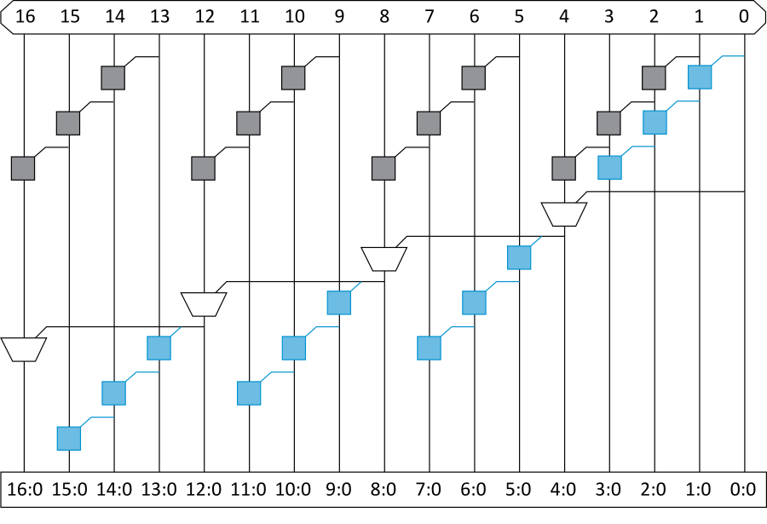
Carry-Skip PG Diagram
For k n-bit groups (N = nk)
Notes:
This diagram illustrates the sequence of operation of the CSA
At the top is a 4-bit ripple chain. The output of the third block in this chain determines if that group generates a carryout.
At the second level of the diagram is the carry skip chain. This chain either takes the carry out for its corresponding 4 bits adder or it skips the generated or propagated carry of the previous adder across.
The blue boxes are two input adders.

Slide 20
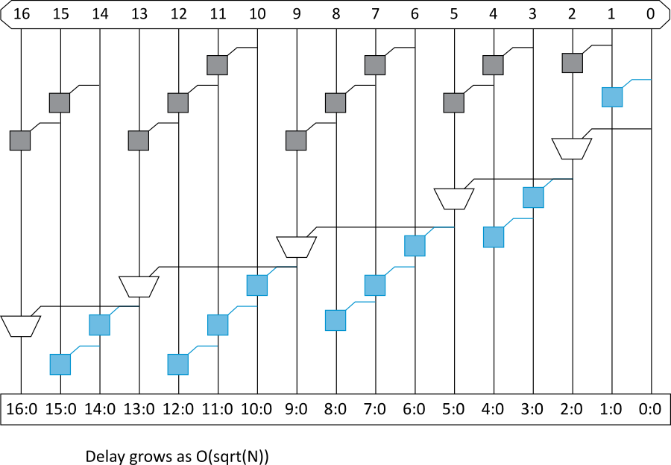
Variable Group Size
Delay grows as O(sqrt(N))

Slide 21
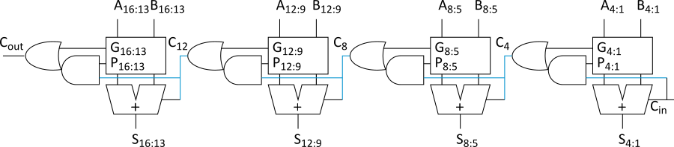
Carry-Lookahead Adder
Carry-lookahead adder computes G_{i:0} for many bits in parallel.
Uses higher valency cells with more than two inputs.
Notes:
Carry-Lookahead adder is another type of Carry-Propagate Adder. In this design, the adder is divided into blocks in which the carry signal for each block is computed quickly. It computes group generate and group propagate and therefore does not require the carry output from the first of adders.

Slide 22
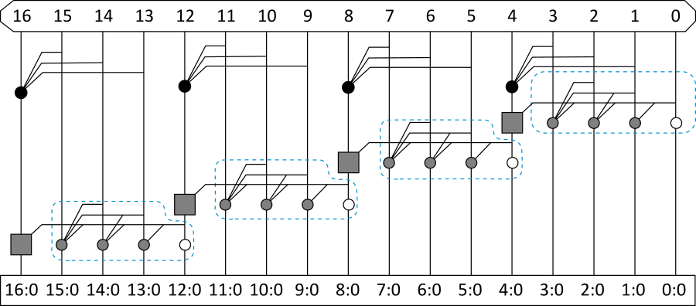
CLA PG Diagram

Slide 23
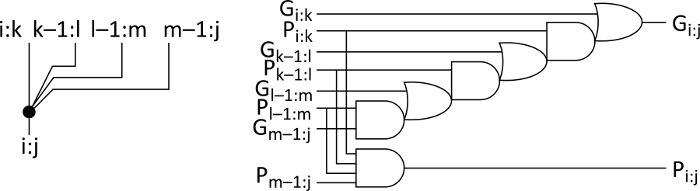
Higher Valency Cells
Notes:
Ripple operation can be sped up using Higher-valency cells.

Slide 24
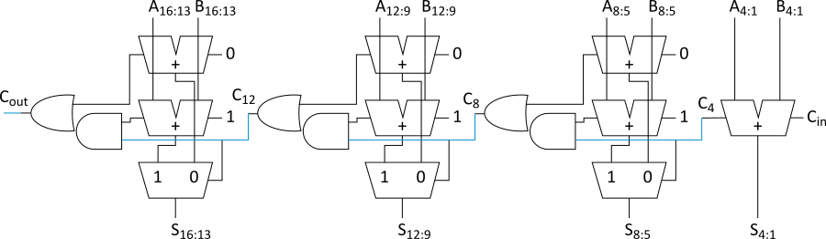
Carry-Select Adder
Trick for critical paths dependent on late input X
Precompute two possible outputs for X = 0, 1
Select proper output when X arrives
Carry-select adder precomputes n-bit sums
For both possible carries into n-bit group
Notes:
In this adder structure, since the carry-in can either be a 0 or 1, two full adders with preset carry-ins are used. A multiplexer is used to select either of the adders based on the carry out from the previous stage.

Slide 25
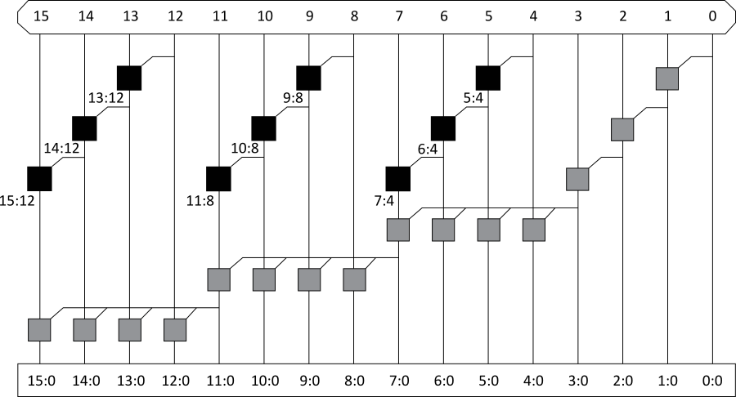
Carry-Increment Adder
Factor initial PG and final XOR out of carry-select

Slide 26
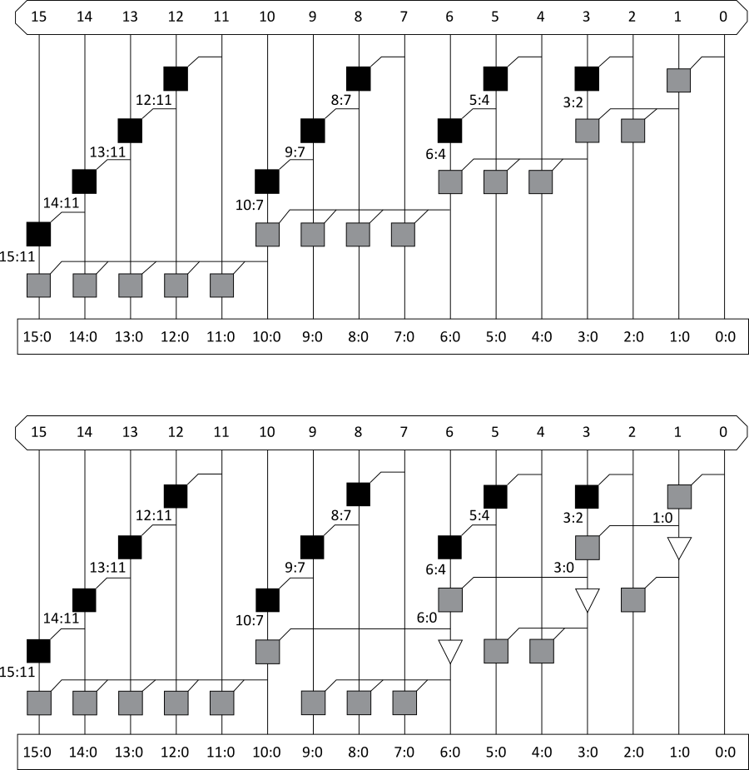
Variable Group Size
Also buffer
noncritical
signals

Slide 27
Tree Adder
If lookahead is good, lookahead across lookahead!
Recursive lookahead gives O(log N) delay
Many variations on tree adders

Slide 28
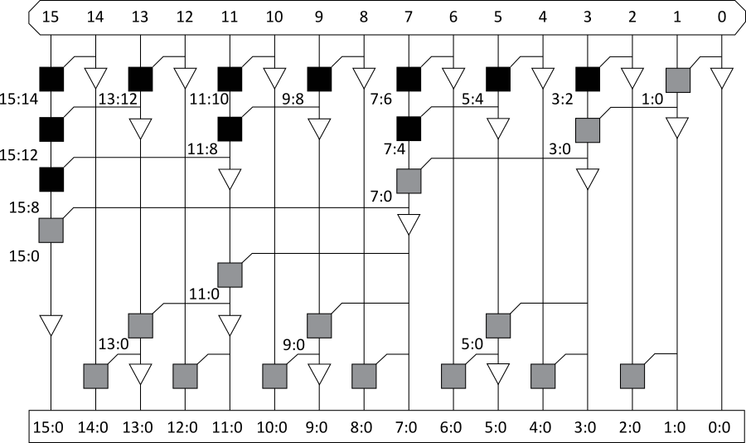
Brent-Kung
Notes:
Brent-Kung Adder is one architecture of a Parallel Prefix Adder (PPA). The PPA is another form of Carry-Lookahead Adder.
To minimize area and routing (compared to Kogge-Stone adder),
this adder works thus:
It has group generate and group propagate. A group generate and propagate is denoted by GX:Y and PX:Y, respectively.
Starting from the first row, only one pair is formed with two neighboring bits.
Another carry can be generated by combining the carry generated from the previous paired bits.
This approach allows the adder to start combining AND computing its carry in parallel.
The order of this adder grows logarithmically with the number of bits (ceil of Log2 N, when N is the number of bits), thus this adder is fast.
The number of dot operators is much smaller than the Kogge-Stone adder.
In physical implementation, the amount of wires needed is much smaller than the Kogge-Stone adder.

Slide 29
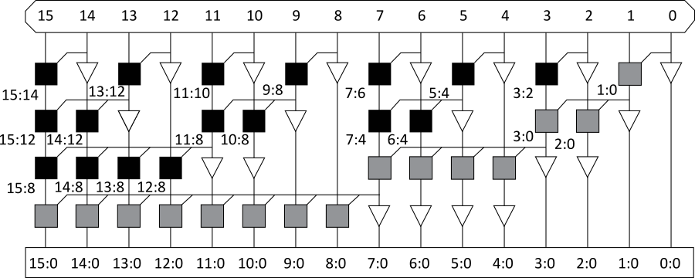
Sklansky
Notes:
In this adder, the number of computational node is given by n/2[Log2n]. For a 16-bit adder, this is 32 computational nodes.
The optimal depth is given by log2n, which is equal to 4 for a 16-bit adder.

Slide 30
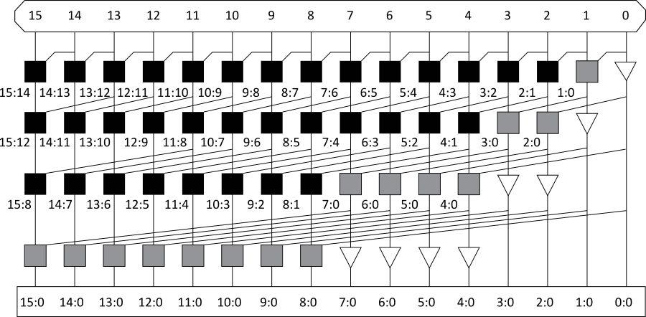
Kogge-Stone
Notes:
Kogge-Stone Adder is one architecture of a Parallel Prefix Adder (PPA). The PPA is another form of Carry-Lookahead Adder.
This adder works thus:
It has group generate and group propagate. A group generate and propagate is denoted by GX:Y and PX:Y, respectively.
In the first row, each bit is paired with its next neighbors on either side, generating a carry from that pair.
For each bit to complete generating its carry, it should have combined all propagated carry using the dot operator from its lower bits. For example, bit 3 completed generating carry when it propagated 3:0.
Examine the first four bits (0, 1, 2, 3) after the first row is generated. Notice that for bit 3, 2, 1, the paired output is 3:2, 2:1, 1:0, respectively.
To complete bit 3, combine the generated carry 1:0 to get 3:0.
To complete bit 2, combine generated carry from bit 0 to get 2:0.
Bit 1 is already completed since its generated carry is 1:0.
The adder carry generation is done when it has calculated the carry outs for all bits
The order of this adder grows logarithmically with the number of bits (ceil of Log2 N, when N is the number of bits), thus this adder is fast.
However, there would be high number of dot operators, which grows really quickly with the number of bits.
In physical implementation, the amount of wires needed should be of concern.

Slide 31
Tree Adder Taxonomy
Ideal N-bit tree adder would have
L = log N logic levels
Fanout never exceeding 2
No more than one wiring track between levels
Describe adder with 3-D taxonomy (l, f, t)
Logic levels: L + l
Fanout: 2^{f} + 1
Wiring tracks: 2^{t}
Known tree adders sit on plane defined by
l + f + t = L-1

Slide 32
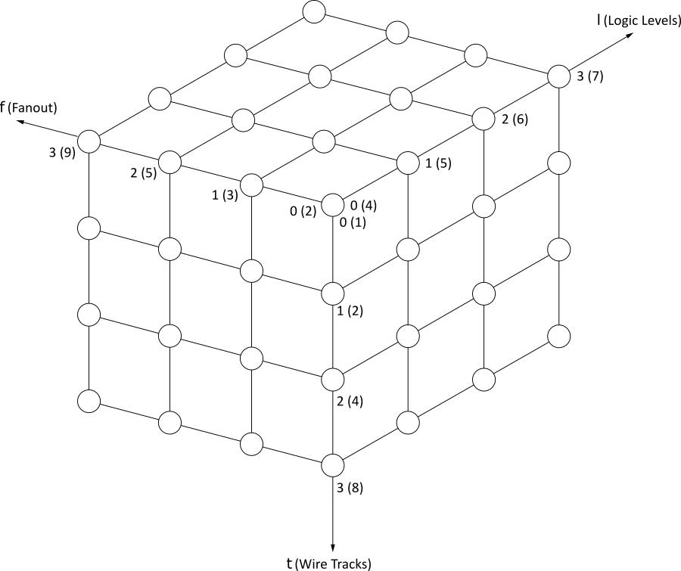
Tree Adder Taxonomy

Slide 33
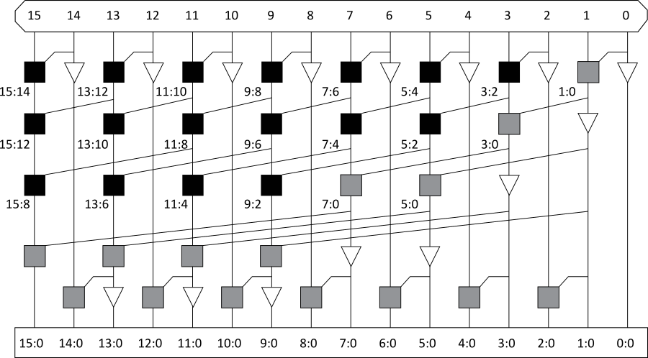
Han-Carlson
Notes:
This adder structure combines both Kogge-Stone and Ladner-Fisher architectures.
In this adder, the number of computational node is given by n/2[Log2n]. For a 16-bit adder, this is 32 computational nodes.
The optimal depth is given by log2n + 1, which is equal to 5 for a 16-bit adder.

Slide 34
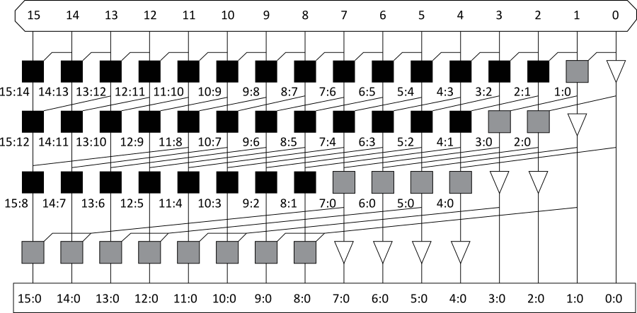
Knowles [2, 1, 1, 1]

Slide 35
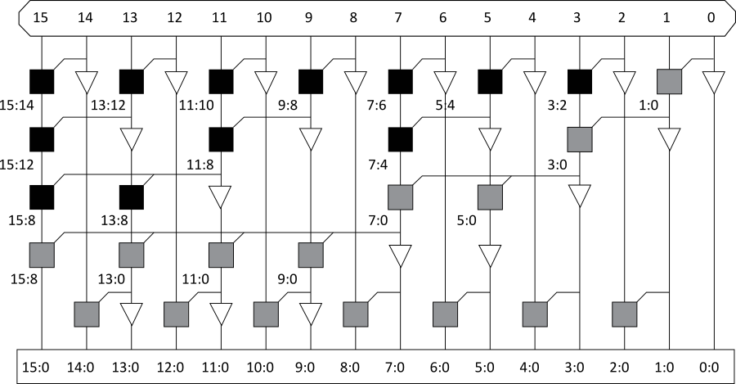
Ladner-Fischer

Slide 36
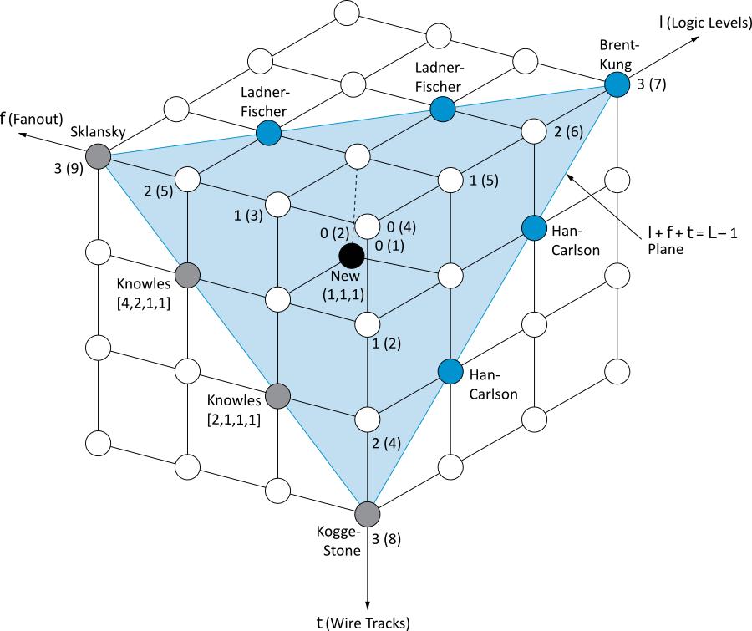
Taxonomy Revisited

Slide 37
Summary
Adder architectures offer area/power/delay trade-offs.
Choose the best one for your application.
Architecture | Classification | Logic Levels | Max Fanout | Tracks | Cells
Carry-Ripple |  | N-1 | 1 | 1 | N
Carry-Skip n=4 |  | N/4 + 5 | 2 | 1 | 1.25N
Carry-Inc. n=4 |  | N/4 + 2 | 4 | 1 | 2N
Brent-Kung | (L-1, 0, 0) | 2log₂N – 1 | 2 | 1 | 2N
Sklansky | (0, L-1, 0) | log₂N | N/2 + 1 | 1 | 0.5 Nlog₂N
Kogge-Stone | (0, 0, L-1) | log₂N | 2 | N/2 | Nlog₂N

