Slide 1
CMOS VLSI Design Lecture 15: Datapath Functional Units
Notes:
Hello and welcome.

Slide 2
Learning Objectives
At the end of this lecture, you should be able to
Design and describe the operation of datapath circuits such as comparators, shifters, multi-input adders and multipliers.

Slide 3
Comparators
0’s detector: A = 00…000
1’s detector: A = 11…111
Equality comparator: A = B
Magnitude comparator: A < B
Notes:
Comparators are used to detect patterns in binary numbers.
A 0’s/1’s detector will indicate when all the bits are 0’s/1’s, respectively.
An equality comparator compares two binary operators.

Slide 4
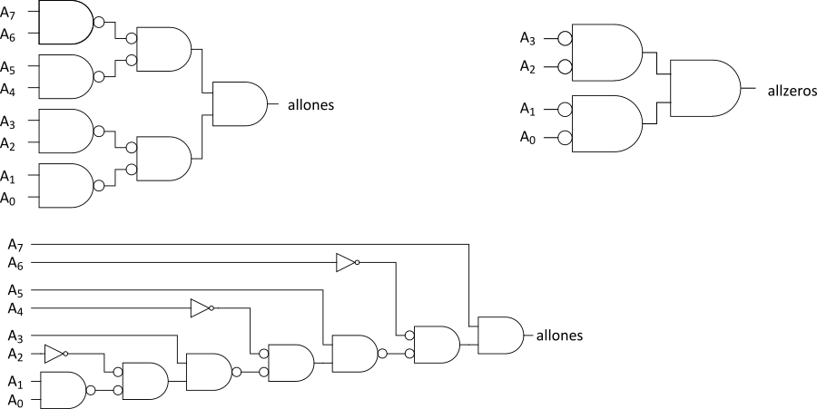
1’s & 0’s Detectors
1’s detector: N-input AND gate
0’s detector: NOTs + 1’s detector (N-input NOR)
Notes:
Circuit shows 1’s detector using N-input AND gates.
It is shown that a )’s detector can be realized from a 1’s detector by negating all its inputs.

Slide 5
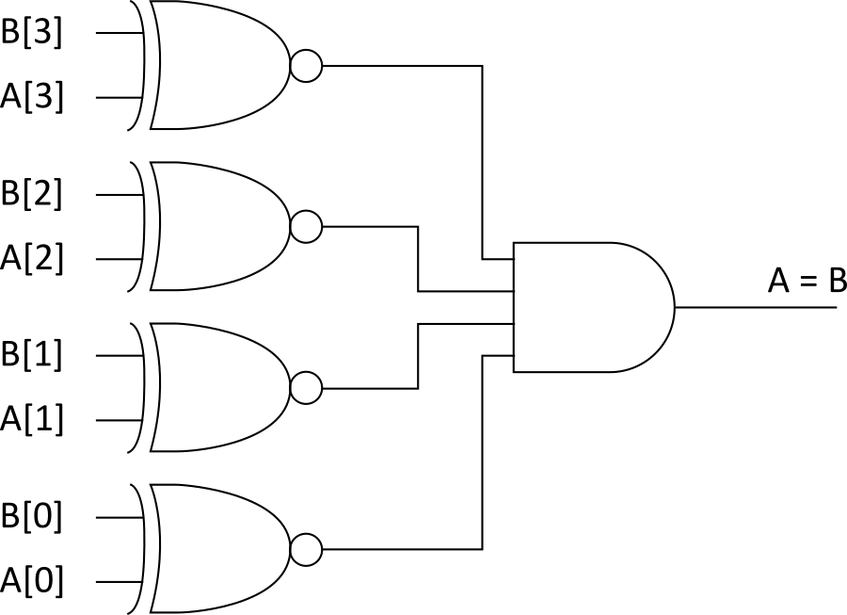
Equality Comparator
Check if each bit is equal (XNOR, aka equality gate)
1’s detect on bitwise equality
Notes:
Equality detector between two binary numbers of each N-bits can be realized using N XNOR gates plus an N-input AND gate.

Slide 6
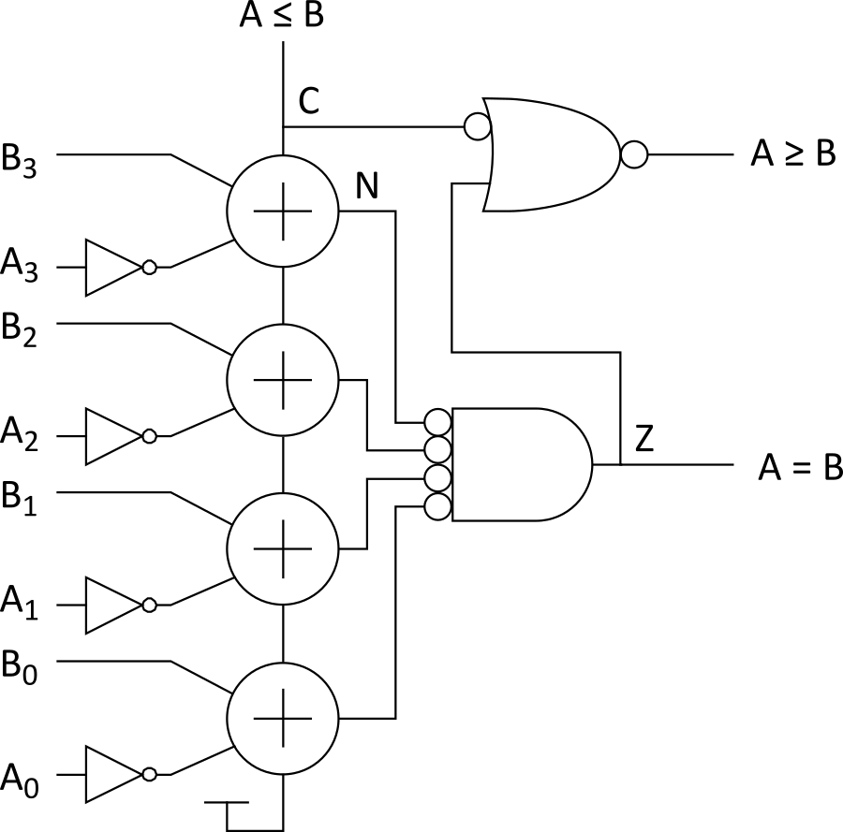
Magnitude Comparator
Compute B – A and look at sign
B – A = B + ~A + 1
For unsigned numbers, carry out is sign bit
Notes:
Circuit shows a magnitude comparator. It basically subtracts A from B. The circuits at the output determines if A is less than, greater than or equal to B.

Slide 7
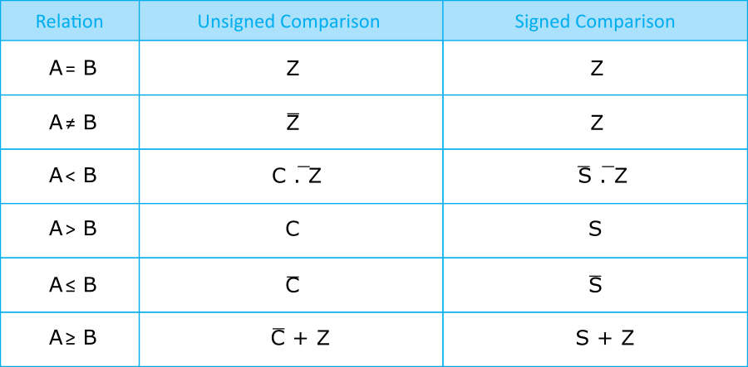
Signed vs. Unsigned
For signed numbers, comparison is harder
C: carry out
Z: zero (all bits of A – B are 0)
N: negative (MSB of result)
V: overflow (inputs had different signs, output sign ≠ B)
S: N xor V (sign of result)

Slide 8
Shifters
Logical Shift:
Shifts number left or right and fills with 0’s
1011 LSR 1 = 0101 1011 LSL1 = 0110
Arithmetic Shift:
Shifts number left or right. Rt shift sign extends
1011 ASR1 = 1101 1011 ASL1 = 0110
Rotate:
Shifts number left or right and fills with lost bits
1011 ROR1 = 1101 1011 ROL1 = 0111
Notes:
Three types of shifts mentioned here.
Note tail
Logical shift, an operation in which the binary number is shifted either left or right with a 0 added at the tail.
Arithmetic shift, an operation in which the binary number is shifted either left or right with the sign bit added at the left tail when shifted right and a zero added to the right tail when shifted left.
Rotate an operation in which the binary number is shifted right or left with tail replaced with the previous bit at the head.

Slide 9
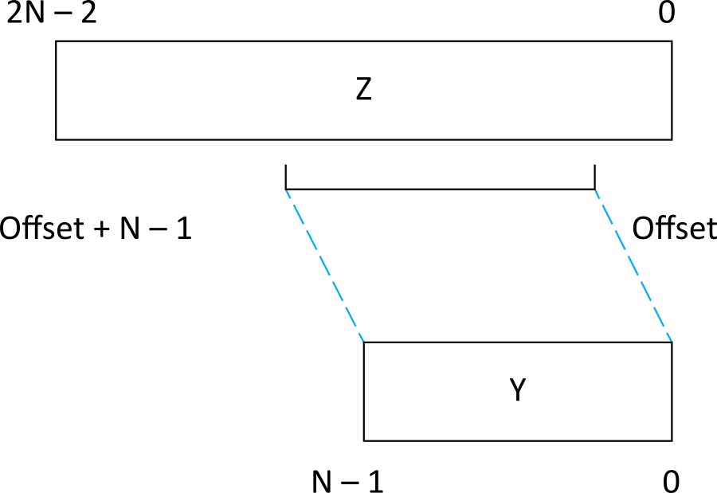
Funnel Shifter
A funnel shifter can do all six types of shifts
Selects N-bit field Y from 2N–1-bit input
Shift by k bits (0 ≤ k < N)
Logically involves N N:1 multiplexers
Notes:
A funnel shifter can perform all six types of shift operations (Logical Shift Right & Left; Arithmetic Shift Right & Left; and Rotate Right & Left).

Slide 10
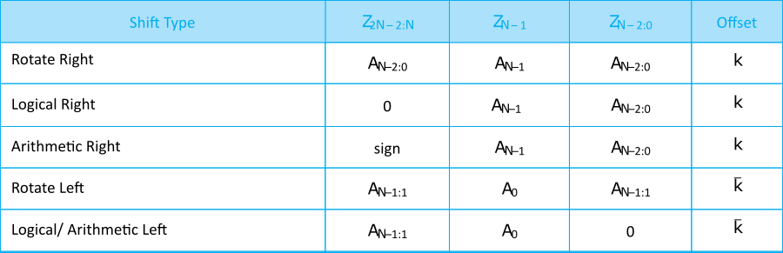
Funnel Source Generator

Slide 11
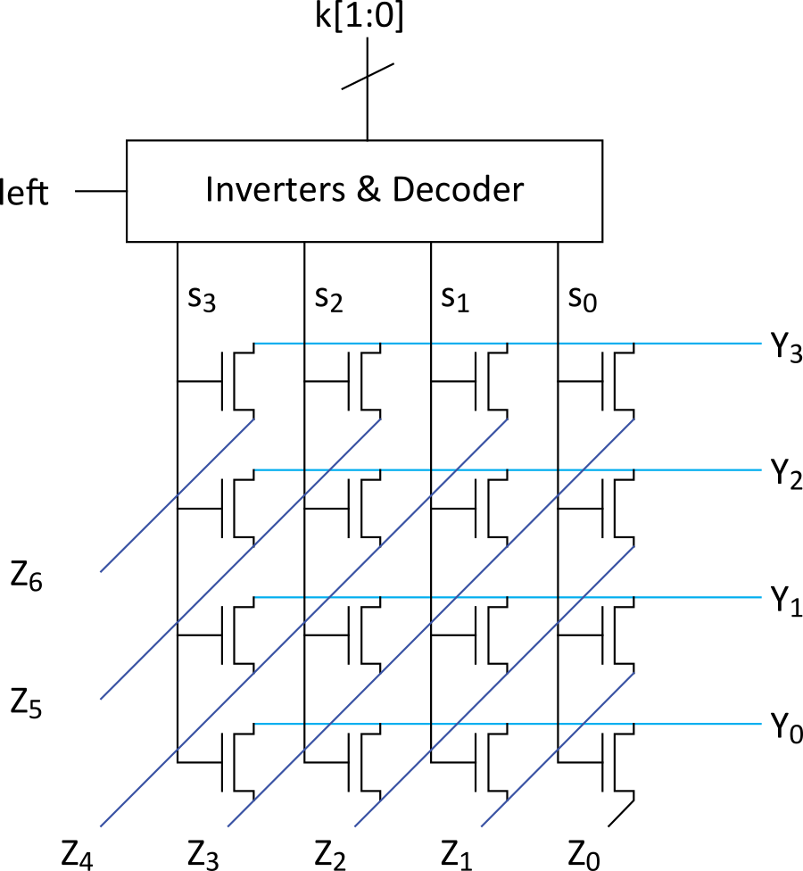
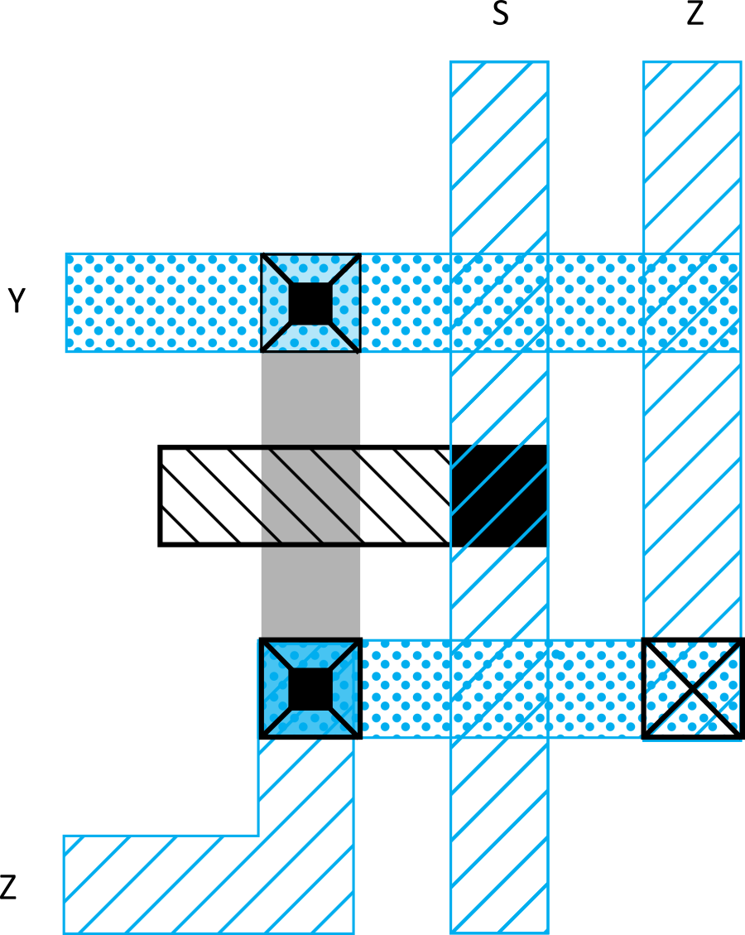
Array Funnel Shifter
N N-input multiplexers
Use 1-of-N hot select signals for shift amount
nMOS pass transistor design (V_{t} drops!)
Notes:
An array funnel shifter can be designed using a nMOS pass transistors, although this circuit suffers from Vt drops.

Slide 12
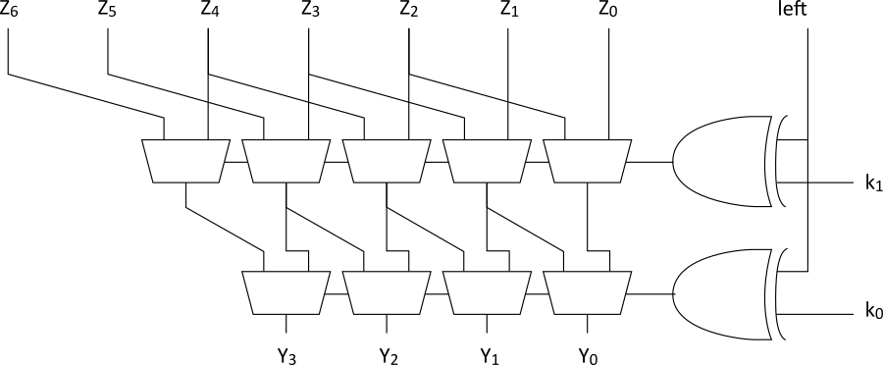
Logarithmic Funnel Shifter
Log N stages of 2-input muxes
No select decoding needed

Slide 13
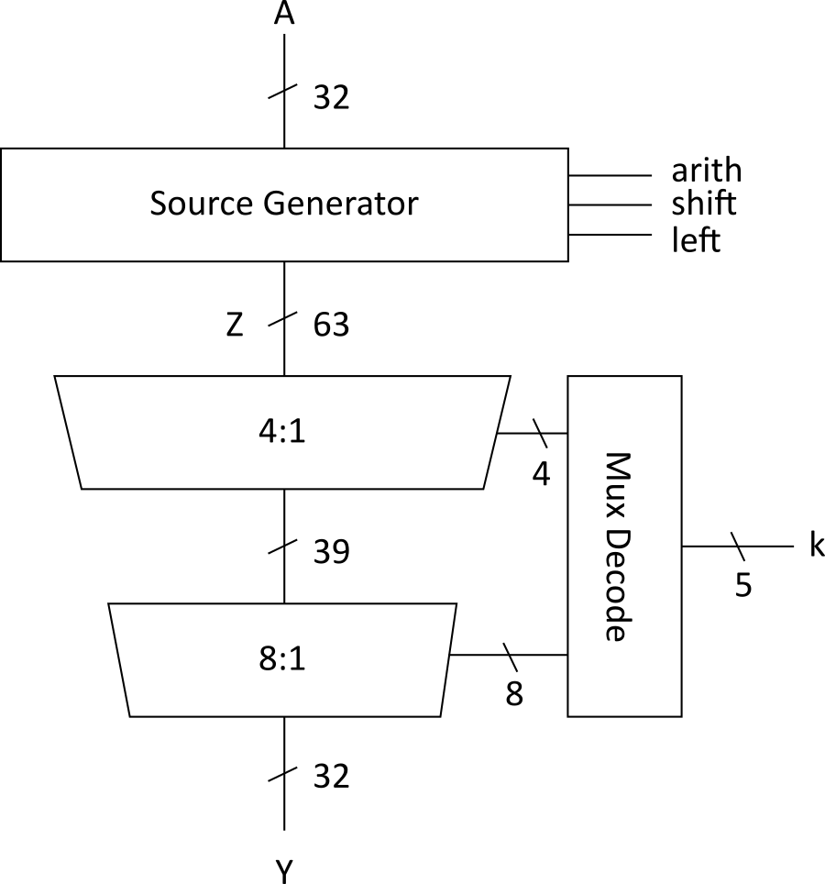
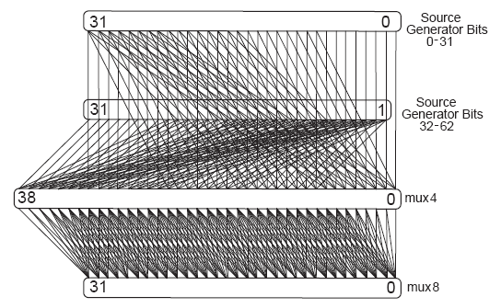
32-bit Logarithmic Funnel
Wider multiplexers reduce delay and power
Operands >32 bits introduce datapath irregularity

Slide 14
Barrel Shifter
Barrel shifters perform right rotations using wraparound wires.
Left rotations are right rotations by N – k = k + 1 bits.
Shifts are rotations with the end bits masked off.
Notes:
A barrel shifter is a digital circuit that can shift a data word of N-bits to up to N-1 places in right or left direction.

Slide 15
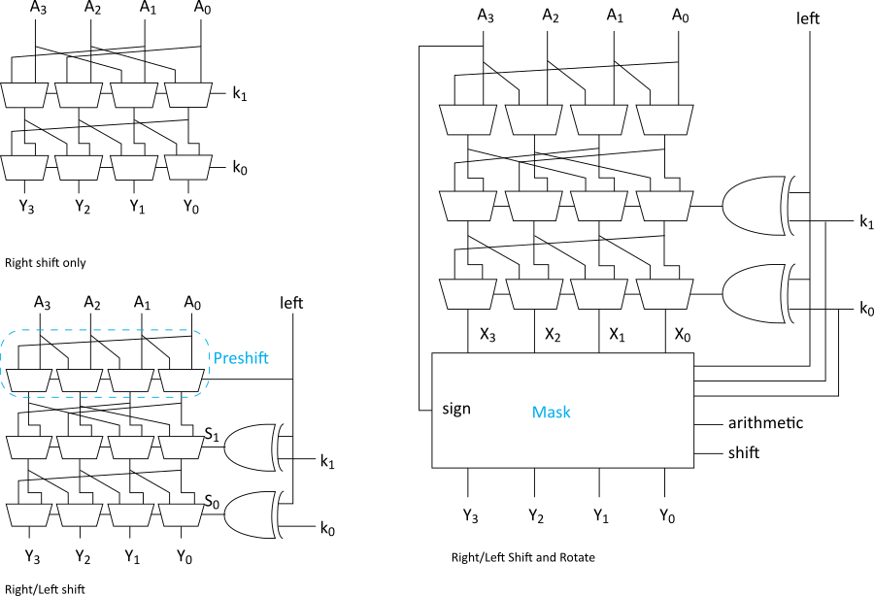
Logarithmic Barrel Shifter
Notes:
Logarithmic barrel shifter can be built using a combination of multiplexers and a sign mask. The logarithmic barrel shifter can perform arithmetic shifts, which is a signed shift and logical shift in both left and right directions.

Slide 16
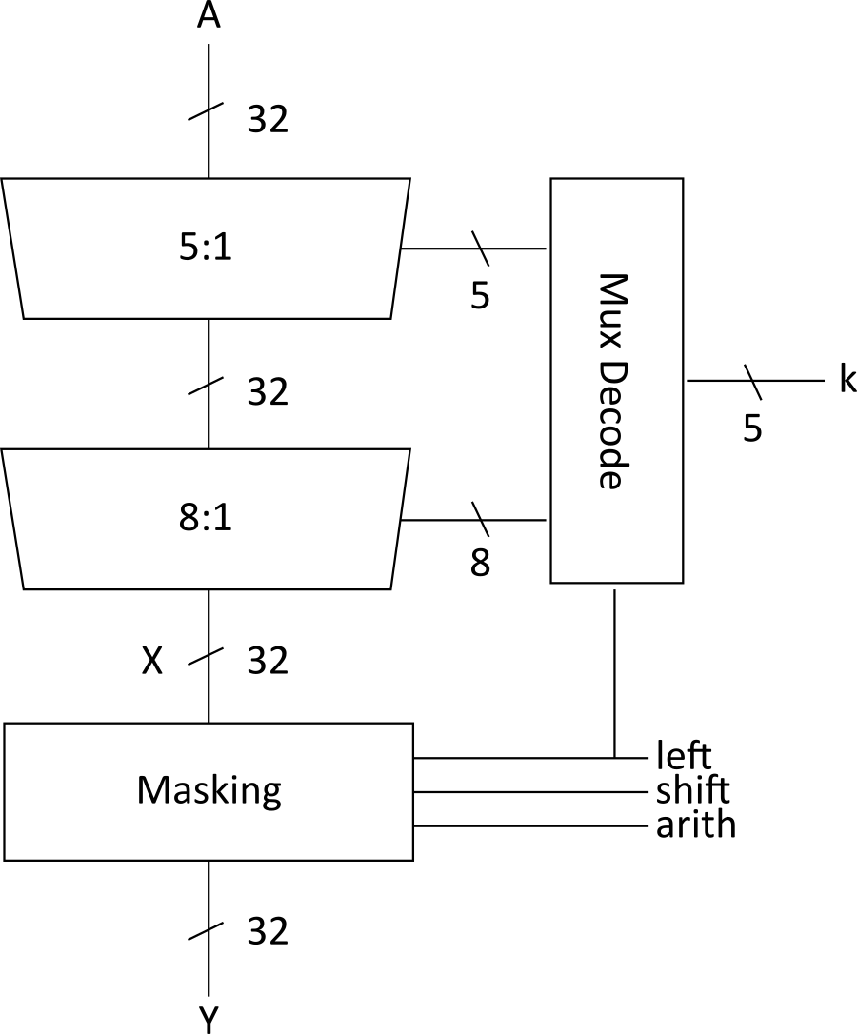
32-bit Logarithmic Barrel
Datapath never wider than 32 bits
First stage preshifts by 1 to handle left shifts

Slide 17
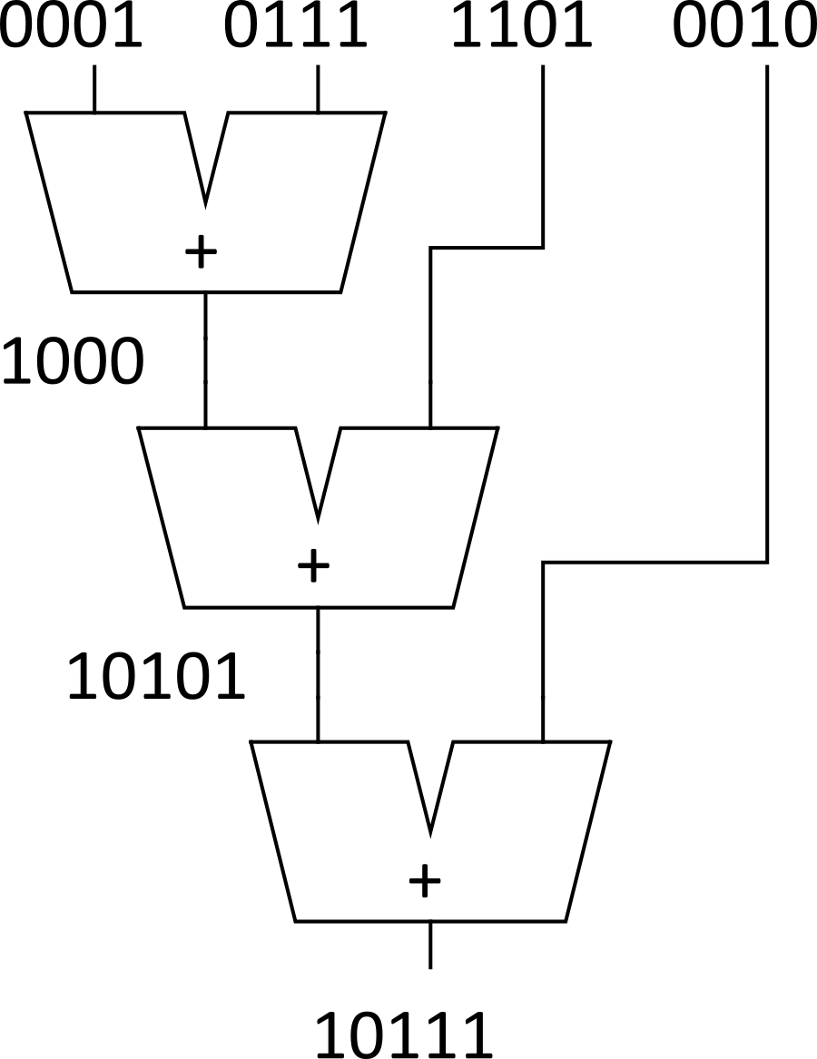
Multi-input Adders
Suppose we want to add k N-bit words
E.g., 0001 + 0111 + 1101 + 0010 = 10111
Straightforward solution: k-1 N-input CPAs
Large and slow
Notes:
This carry-propagate adder structure is large and can grow with K.

Slide 18
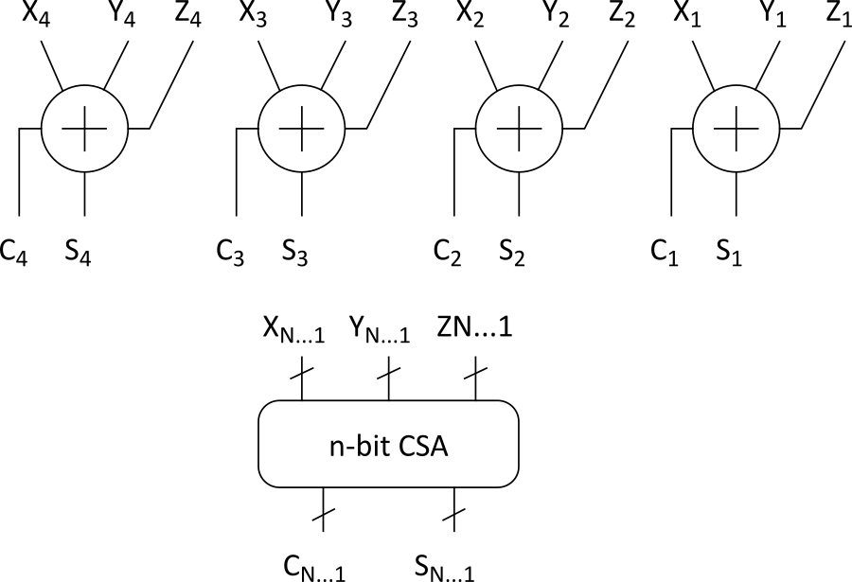
Carry-Save Addition
A full adder sums 3 inputs and produces 2 outputs
Carry output has twice the weight of sum output
N full adders in parallel are called carry-save adder
Produce N sums and N carry outs
Notes:
A carry-save adder efficiently computes the sum of three or more binary numbers and produces a sum and carry output.

Slide 19
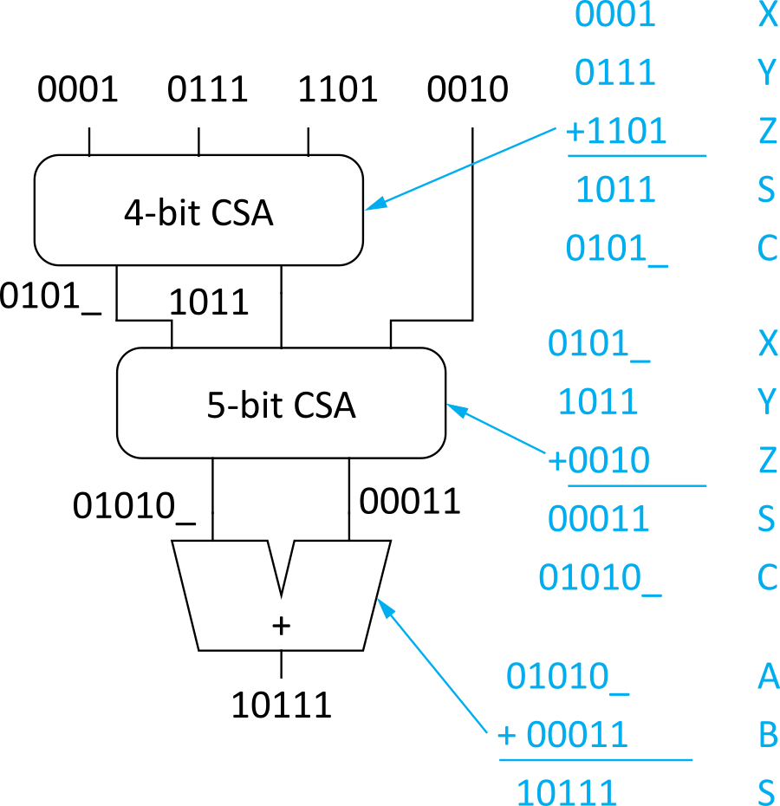
CSA Application
Use k-2 stages of CSAs
Keep result in carry-save redundant form
Final CPA computes actual result
Notes:
To get the result of the addition of K N-bit numbers, the outputs (carry outputs ) using a carry-save adder, one would need K-2 CSA stages plus a CPA adder.

Slide 20
Multiplication
Example:
M x N-bit multiplication
Produce N M-bit partial products
Sum these to produce M+N-bit product
Notes:
Multiplication steps involve partial products and sum of the partial product.

Slide 21
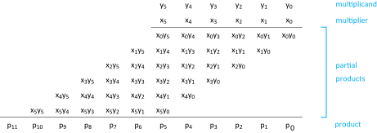
General Form
Multiplicand: Y = (y_{M-1}, y_{M-2}, …, y₁, y₀)
Multiplier: X = (x_{N-1}, x_{N-2}, …, x₁, x₀)
Product:
Notes:
This slide breaks down the steps for the multiplication of two binary numbers.

Slide 22
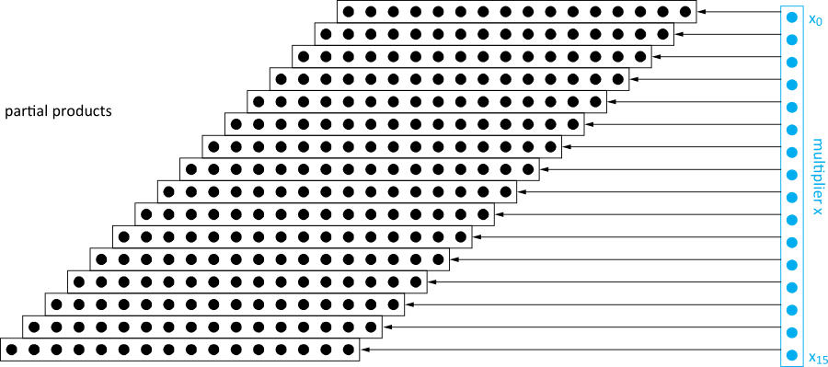
Dot Diagram
Each dot represents a bit
Notes:
Dot diagram to illustrate partial product. Each dot represents the product of two bits

Slide 23
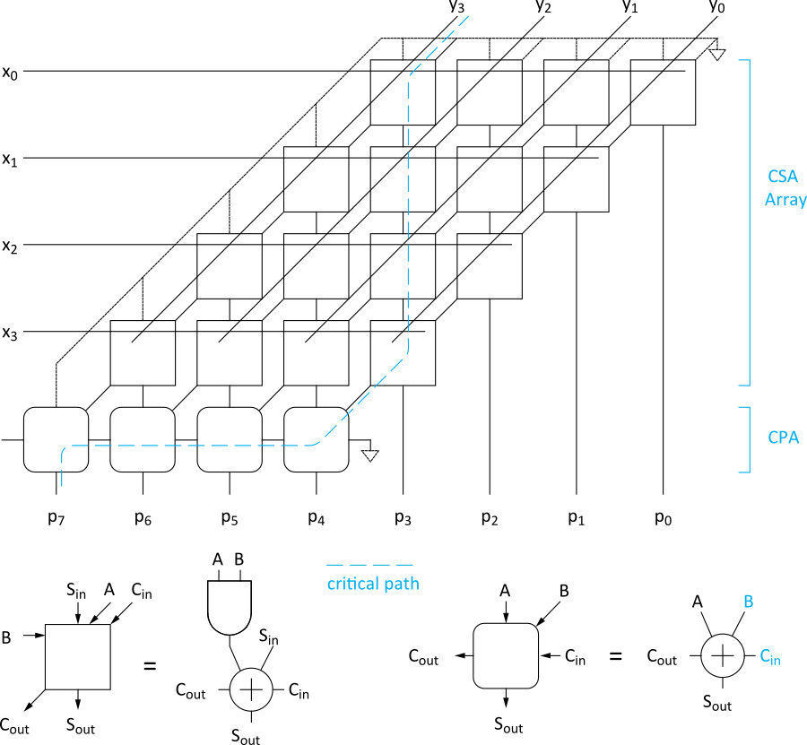
Array Multiplier
Notes:
An array multiplier has a regular structure of digital combinational circuit that will multiply two binary numbers using an array of adders.

Slide 24
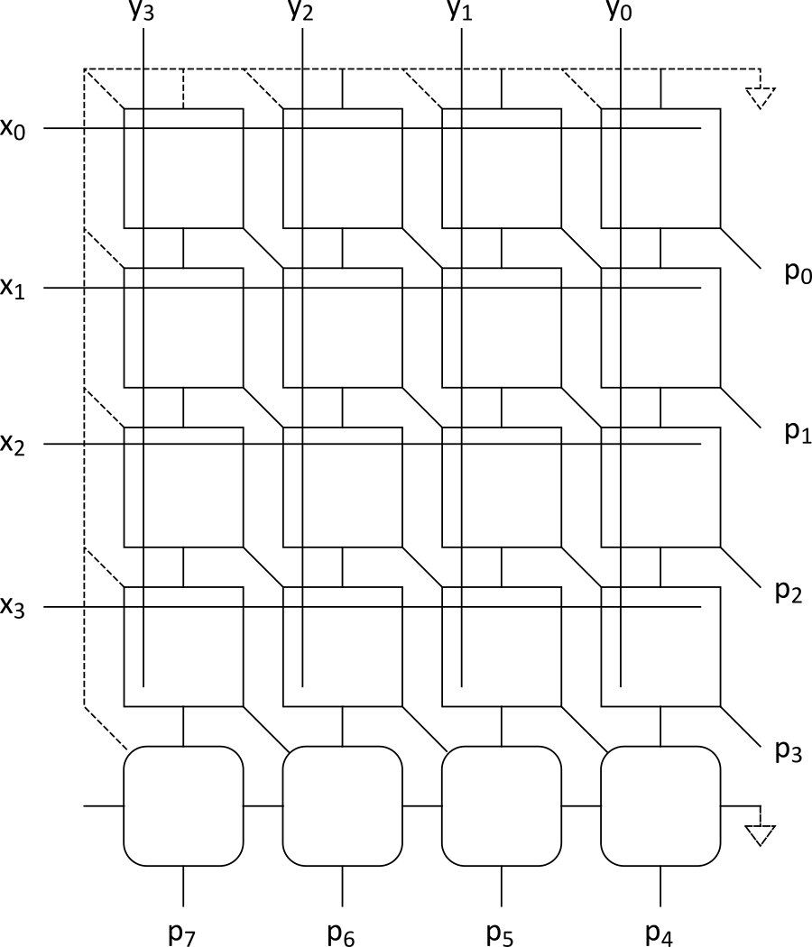
Rectangular Array
Squash array to fit rectangular floorplan

Slide 25
Fewer Partial Products
Array multiplier requires N partial products
If we looked at groups of r bits, we could form N/r partial products.
Faster and smaller?
Called radix-2^{r} encoding
E.g., r = 2: look at pairs of bits
Form partial products of 0, Y, 2Y, 3Y
First three are easy, but 3Y requires adder ☹

Slide 26
Booth Encoding
Instead of 3Y, try –Y, then increment the next partial product to add 4Y
Similarly, for 2Y, try –2Y + 4Y in the next partial product
Inputs |  |  | Partial Product | Booth Selects
X_{2i+1} | X_{2i} | X_{2i-1} | PP_{i} | SINGLE_{i} | DOUBLE_{i} | NEG_{i}
0 | 0 | 0 | 0 | 0 | 0 | 0
0 | 0 | 1 | Y | 1 | 0 | 0
0 | 1 | 0 | Y | 1 | 0 | 0
0 | 1 | 1 | 2Y | 0 | 1 | 0
1 | 0 | 0 | -2Y | 0 | 1 | 1
1 | 0 | 1 | -Y | 1 | 0 | 1
1 | 1 | 0 | -Y | 1 | 0 | 1
1 | 1 | 1 | -0(=0) | 1 | 0 | 1
Notes:
Booth encoding is a method used to reduce the number of partial products in the multiplier.

Slide 27
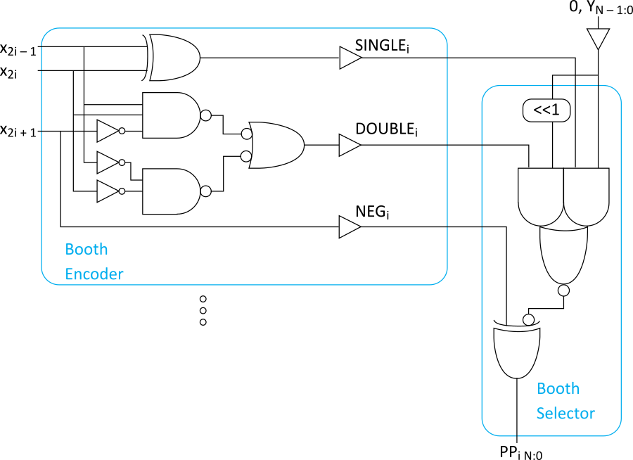
Booth Hardware
Booth encoder generates control lines for each PP
Booth selectors choose PP bits

Slide 28
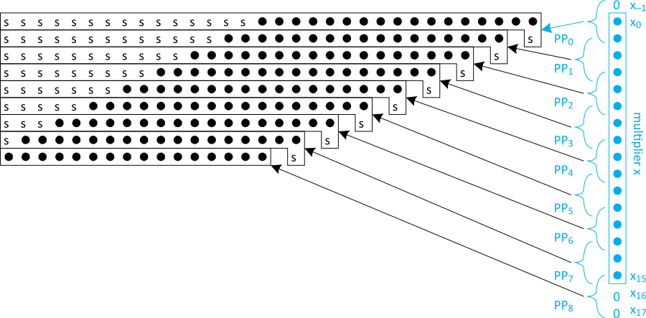
Sign Extension
Partial products can be negative
Require sign extension, which is cumbersome
High fanout on most significant bit

Slide 29
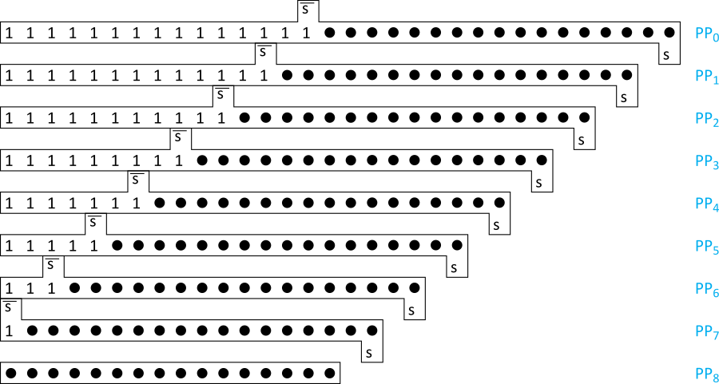
Simplified Sign Ext.
Sign bits are either all 0’s or all 1’s
Note that all 0’s are all 1’s + 1 in proper column
Use this to reduce loading on MSB

Slide 30
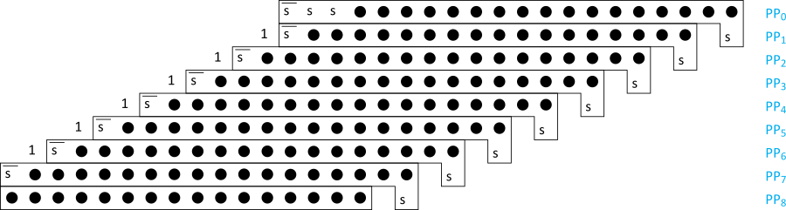
Even Simpler Sign Ext.
No need to add all the 1’s in hardware
Precompute the answer!

Slide 31
Advanced Multiplication
Signed vs. unsigned inputs
Higher radix Booth encoding
Array vs. tree CSA networks

