Slide 1
CMOS VLSI Design Lecture 18: Variation and Reliability
Notes:
Hello and welcome.

Slide 2
Learning Objectives
At the end of this lecture, you should be able to:
Describe sources and effects of on-chip variation due to process, voltage, temperature and aging.
Outline the major sources of on-chip noise.
Outline the differences between soft and hard errors.

Slide 3
Variation
Process
Threshold
Channel length
Interconnect dimensions
Environment
Voltage
Temperature
Aging/Wearout
Notes:
Variation when not taken into consideration during design can cause product delays, respins, yield loss, which may increase the overall cost of production.
Process variation can occur within-die, die-to-die, or wafer-to-wafer. This can cause variance in the performance of circuits due to deviations. The main source of process variations include random dopant fluctuations, line edge roughness, and oxide thickness variation.
Environmental variables include temperature, power supply voltage, which affect the performance of the design during operation, that can be at the user end.

Slide 4
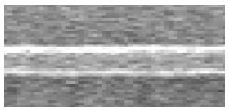
Process Variation
Threshold Voltage
Depends on placement of dopants in channel
Standard deviation inversely proportional to channel area
Channel Length
Systematic across-chip linewidth variation (ACLV)
Random line edge roughness (LER)
Interconnect
Etching variations affect w, s, h
[Bernstein06]
Courtesy Texas Instruments
Notes:
Threshold voltage: This source of process variation occurs due to random number of dopant placement in the channel. Increasing the size of the transistor helps in reducing the dopant placement variability.
Channel length: Variation in channel length will reflect on the device output current characteristics and the transistor delay.

Slide 5
Spatial Distribution
Variations show spatial correlation
Lot-to-lot (L2L)
Wafer-to-wafer (W2W)
Die-to-die (D2D)/inter-die
Within-die (WID)/intradie
Closer transistors match better
Courtesy M. Pelgrom
Notes:
Variation can be die-to-die (D2D), within-die (WID),

Slide 6
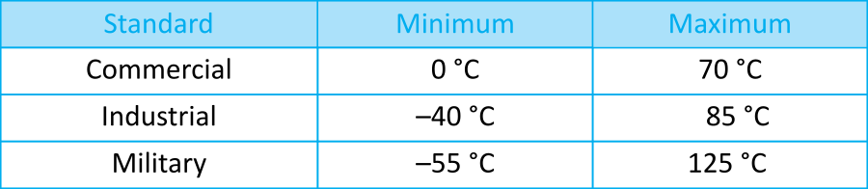
Environmental Variation
Voltage
V_{DD} is usually designed +/- 10%
Regulator error
On-chip droop from
switching activity
Temperature
Ambient temperature ranges
On-die temperature elevated
by chip power consumption
Courtesy IBM
[Harris01b]
Notes:
Environmental variation could be from voltage and temperature.
Unstable voltage supply can lead to undesirable circuit behavior. Source of voltage supply include regulator error, on-chip droop, etc. On-chip droop occurs when gates draw large current from the power supply source during switching.
When circuits operate, the temperature increases due to power consumption. Temperature also has impact on threshold voltage and thermal voltage and resultantly the leakage current.

Slide 7
Aging
Transistors change over time as they wear out
Hot carriers
Negative bias temperature instability
Time-dependent dielectric breakdown
Causes threshold voltage changes
More on this later…
Notes:
Aging occurs over time as transistor wears out due to
hot carriers: Here electron and holes from the channel acquire high kinetic energy, which is enough to inject them in the gate oxide.

Slide 8
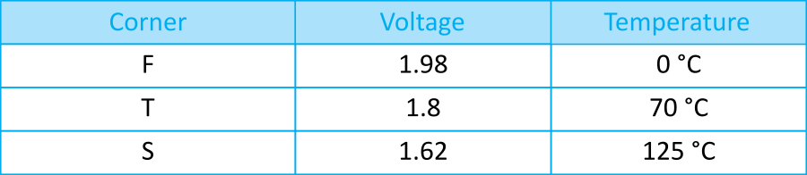
Process Corners
Model extremes of process variations in simulation
Corners
Typical (T)
Fast (F)
Slow (S)
Factors
nMOS speed
pMOS speed
Wire
Voltage
Temperature
Notes:
Process corners refer to the operating conditions for both nmos and pmos transistors.
In these corners, each transistor could operate in slow, fast, or typical speed.
The factors that affect the operation of a transistor in any of these corners are nMOS speed, pMOS speed, wire, voltage, and temperature.

Slide 9
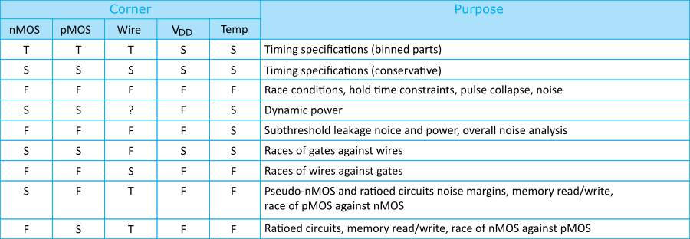
Corner Checks
Circuits are simulated in different corners to verify different performance and correctness specifications
Notes:
When verifying the performance and correctness of a design, it is usually simulated in different corners.

Slide 10
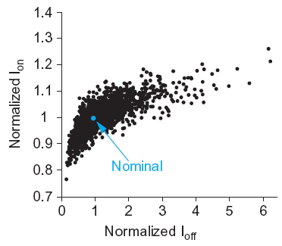
Monte Carlo Simulation
As process variation increases, the worst-case corners become too pessimistic for practical design
Monte Carlo: repeated simulations with parameters randomly varied each time
Look at scatter plot of results to predict yield
E.g., impact of V_{t} variation
ON-current
leakage
Notes:
In Monte Carlo simulation, a ton of varied random parameters are set as inputs to the design. The computed results enable one to see areas where the design operates nominally.

Slide 11
Noise
Sources
Power supply noise/ground bounce
Capacitive coupling
Charge sharing
Leakage
Noise feedthrough
Consequences
Increased delay (for noise to settle out)
Or incorrect computations
Notes:
Noise can negatively affect the computation result as well as other factors like increased delay and incorrect computations.

Slide 12
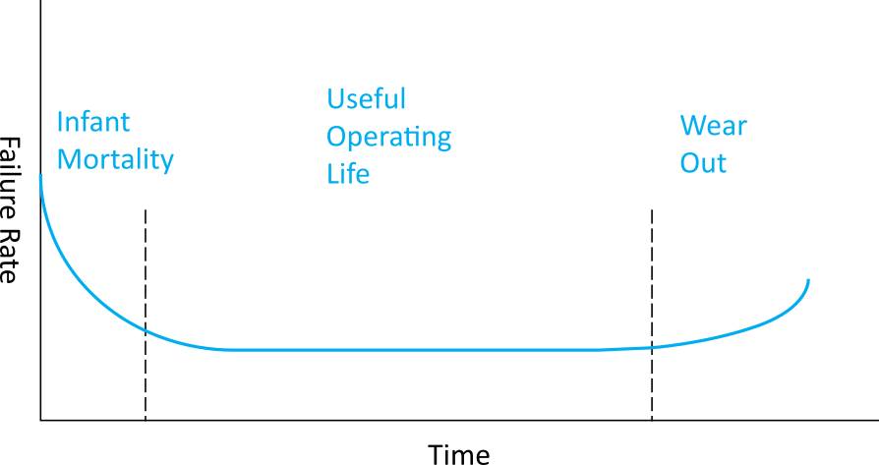
Reliability
Hard Errors
Oxide wearout
Interconnect wearout
Overvoltage failure
Latchup
Soft Errors
Characterizing reliability
Mean time between failures (MTBF)
# of devices × hours of operation / number of failures
Failures in time (FIT)
# of failures / thousand hours / million devices
Notes:
Reliability in VLSI depends on a number of factors, which includes hard errors and soft errors.

Slide 13
Accelerated Lifetime Testing
Expected reliability typically exceeds 10 years
But products come to market in 1-2 years
Accelerated lifetime testing required to predict adequate long-term reliability
[Arnaud08]

Slide 14
Hot Carriers
Electric fields across channel impart high energies to some carriers
These “hot” carriers may be blasted into the gate oxide where they become trapped
Accumulation of charge in oxide causes shift in V_{t} over time
Eventually, V_{t} shifts too far for devices to operate correctly
Choose V_{DD} to achieve reasonable product lifetime
Worst problems for inverters and NORs with slow input risetime and long propagation delays

Slide 15
NBTI
Negative bias temperature instability
Electric field applied across oxide forms dangling bonds called traps at Si-SiO₂ interface
Accumulation of traps causes V_{t} shift
Most pronounced for pMOS transistors with strong negative bias (V_{g} = 0; V_{s} = V_{DD}) at high temperature

Slide 16
TDDB
Time-dependent dielectric breakdown
Gradual increase in gate leakage when an electric field is applied across an oxide
aka stress-induced leakage current
For 10-year life at 125 C, keep E_{ox} below ~0.7 V/nm

Slide 17
Electromigration
“Electron wind” causes movement of metal atoms along wires
Excessive electromigration leads to open circuits
Most significant for unidirectional (DC) current
Depends on current density J_{dc} (current/area)
Exponential dependence on temperature
Black’s Equation:
Typical limits: J_{dc} < 1 – 2 mA / μm²
[Christiansen06]

Slide 18

Electromigration Video

Slide 19
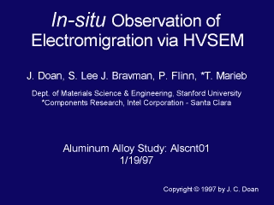
Electromigration Video 2

Slide 20
Self-Heating
Current through wire resistance generates heat
Oxide surrounding wires is a thermal insulator
Heat tends to build up in wires
Hotter wires are more resistive, slower
Self-heating limits AC current densities for reliability
Typical limits: J_{rms} < 15 mA / μm²
Notes:
Current through wires can cause heating. The hotter the wire, the more resistive and slower it gets.

Slide 21
Overvoltage Failure
High voltages can blow out tiny transistors
Electrostatic discharge (ESD)
kilovolts from static electricity when the package pins are handled
Oxide breakdown
In a 65 nm process, V_{g} ≈ 3 V causes arcing through thin gate oxides
Punchthrough
High V_{ds} causes depletion region between source and drain to touch, leading to high current flow and destructive overheating
Notes:
Electrostatic discharge is the sudden flow of electricity between two electrically charged objects when a conduction path is created. Usually, the direction of current flow is from the object with higher charge to the object with lower charge.
When a strong electric field is applied, this could lead to destruction of an oxide layer. This is known as oxide breakdown.

Slide 22
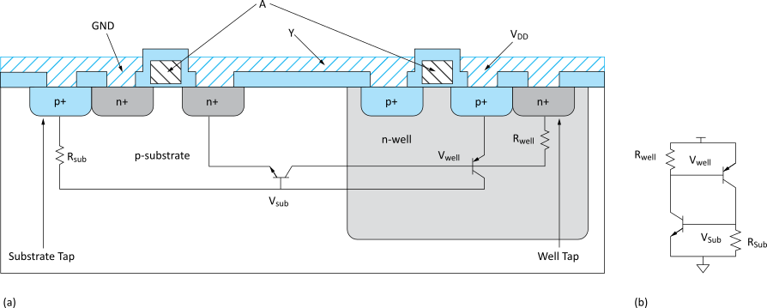
Latchup
Latchup: positive feedback leading to V_{DD} – GND short
Major problem for 1970’s CMOS processes before
it was well understood
Avoid by minimizing resistance of body to GND/V_{DD}
Use plenty of substrate and well taps
Notes:
Latchup refers to a short circuit formed between power and ground rails.
From the equivalent circuit, when one of the transistors is forward biased, it creates a positive feedback with the other transistor through both bases, and this increases the current flow in the system until the circuit fails.

Slide 23
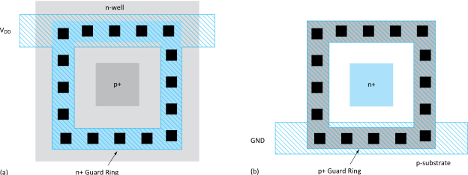
Guard Rings
Latchup risk greatest when diffusion-to-substrate diodes could become forward-biased
Surround sensitive region with guard ring to collect injected charge
Notes:
Guard rings protect active devices from latchup. For P+ active devices, n+ guard rings are used and vice versa.

Slide 24
Soft Errors
In 1970’s, DRAMs were observed to randomly flip bits
Ultimately linked to alpha particles and cosmic ray neutrons
Collisions with atoms create electron-hole pairs in a substrate
These carriers are collected on p-n junctions, disturbing the voltage
[Baumann05]
Notes:
Ionized tracks are formed when high-energy neutrons pass through silicon. These high-energy neutrons may collide with the nuclei of the atoms, which can then drift to form multiple ionized tracks that are diffused in the silicon.
These ionized tracks can create surge in the presence of electric field and change the value stored in the DRAM.

Slide 25
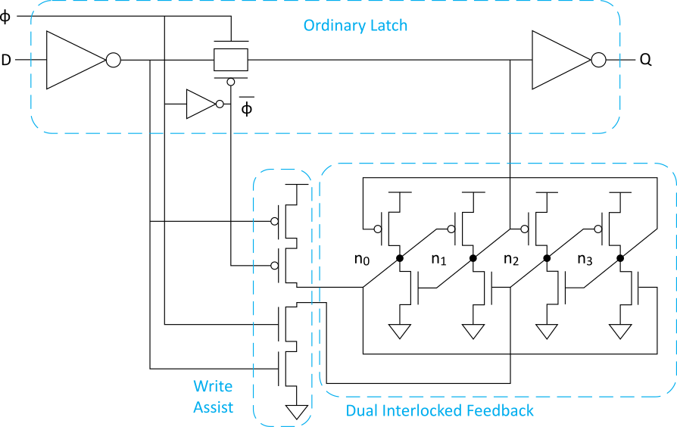
Radiation Hardening
Radiation hardening reduces soft errors
Increase node capacitance to minimize impact of collected charge
Or use redundancy
E.g., dual-interlocked cell
Error-correcting codes
Correct for soft errors that do occur
Notes:
Electronic components and circuits can be operated in environment with high levels of ionizing radiation. Radiation hardening is making circuits that are resistant to the effects of such hostile environment to prevent damage or malfunction.

Slide 26
Circuit Pitfalls
Detective puzzle
Given circuit and symptom, diagnose cause and recommend solution
All these pitfalls have caused failures in real chips

Slide 27
Bad Circuit 1
Circuit
2:1 multiplexer
Symptom
Mux works when selected D is 0 but not 1.
Or fails at low V_{DD}.
Or fails in SFSF corner.
Principle: Threshold drop
X never rises above V_{DD}-V_{t}
V_{t} is raised by the body effect
The threshold drop is most serious as V_{t} becomes a greater fraction of V_{DD}.
Solution: Use transmission gates, not pass transistors

Slide 28
Bad Circuit 2
Circuit
Latch
Symptom
Load a 0 into Q
Set φ = 0
Eventually, Q spontaneously flips to 1
Principle: Leakage
X is a dynamic node holding value as charge on the node
Eventually subthreshold leakage may disturb charge
Solution: Staticize node with feedback
Or periodically refresh node (requires fast clock,
not practical processes with big leakage)

Slide 29
Bad Circuit 3
Circuit
Domino AND gate
Symptom
Precharge gate (Y=0)
Then, evaluate
Eventually, Y spontaneously flips to 1
Principle: Leakage
X is a dynamic node holding value as charge on the node
Eventually subthreshold leakage may disturb charge
Solution: Keeper

Slide 30
Bad Circuit 4
Circuit
Pseudo-nMOS OR
Symptom
When only one input is true, Y = 0.
Perhaps only happens in SF corner.
Principle: Ratio Failure
nMOS and pMOS fight each other.
If the pMOS is too strong, nMOS cannot pull X low enough.
Solution: Check that ratio is satisfied in all corners

Slide 31
Bad Circuit 5
Circuit
Latch
Symptom
Q stuck at 1.
May only happen for certain latches where input is driven by a small gate located far away.
Principle: Ratio Failure (again)
Series resistance of D driver, wire
resistance, and tgate must be much
less than weak feedback inverter.
Solutions: Check relative strengths
Avoid unbuffered diffusion inputs where driver is unknown

Slide 32
Bad Circuit 6
Circuit
Domino AND gate
Symptom
Precharge gate while
A = B = 0; so Z = 0
Set φ = 1
A rises
Z is observed to sometimes rise
Principle: Charge Sharing
If X was low, it shares charge with Y
Solutions: Limit charge sharing
Safe if C_{Y} >> C_{X}
Or precharge node X too

Slide 33
Bad Circuit 7
Circuit
Dynamic gate + latch
Symptom
Precharge gate while transmission gate latch is opaque
Evaluate
When latch becomes transparent, X falls
Principle: Charge Sharing
If Y was low, it shares charge with X
Solution: Buffer dynamic nodes before
driving transmission gate

Slide 34
Bad Circuit 8
Circuit
Latch
Symptom
Q changes while latch is opaque
Especially, if D comes from a faraway driver
Principle: Diffusion Input Noise Sensitivity
If D < -V_{t}, transmission gate turns on
Most likely because of power supply noise or coupling on D
Solution: Buffer D locally

Slide 35
Summary
Static CMOS gates are very robust
Will settle to correct value if you wait long enough
Other circuits suffer from a variety of pitfalls
Tradeoff between performance & robustness
Essential to check circuits for pitfalls
For large chips, you need an automatic checker.
Design rules aren’t worth the paper they are printed on unless you back them up with a tool.

