Slide 1
CMOS VLSI Design Lecture 19: Test
Notes:
Hello and welcome.

Slide 2
Learning Objectives
At the end of this lecture, you should be able to:
Describe the stages of testing in chip design, debug, and manufacturing
Describe the stuck-at-fault model
Develop test vectors to find stuck-at-faults in combinational logic
Use scan chains to gain observability and controllability over a digital circuit
Design built-in self-test circuits
Describe the IEEE boundary scan methodology

Slide 3
Testing
Testing is one of the most expensive parts of chips
Logic verification accounts for > 50% of design effort for many chips
Debug time after fabrication has enormous opportunity cost
Shipping defective parts can sink a company
Example: Intel FDIV bug (1994)
Logic error not caught until > 1 M units shipped
Recall cost $450 M (!!!)

Slide 4
Logic Verification
Does the chip simulate correctly?
Usually done at HDL level
Verification engineers write test bench for HDL
Can’t test all cases
Look for corner cases
Try to break logic design
E.g., 32-bit adder
Test all combinations of corner cases as inputs:
0, 1, 2, 2³¹-1, -1, -2³¹, a few random numbers
Good tests require ingenuity

Slide 5
Silicon Debug
Test the first chips back from fabrication
If you are lucky, they work the first time
If not…
Logic bugs vs. electrical failures
Most chip failures are logic bugs from inadequate simulation
Some are electrical failures
Cross talk
Dynamic nodes: leakage, charge sharing
Ratio failures
A few are tool or methodology failures (e.g., DRC)
Fix the bugs and fabricate a corrected chip

Slide 6
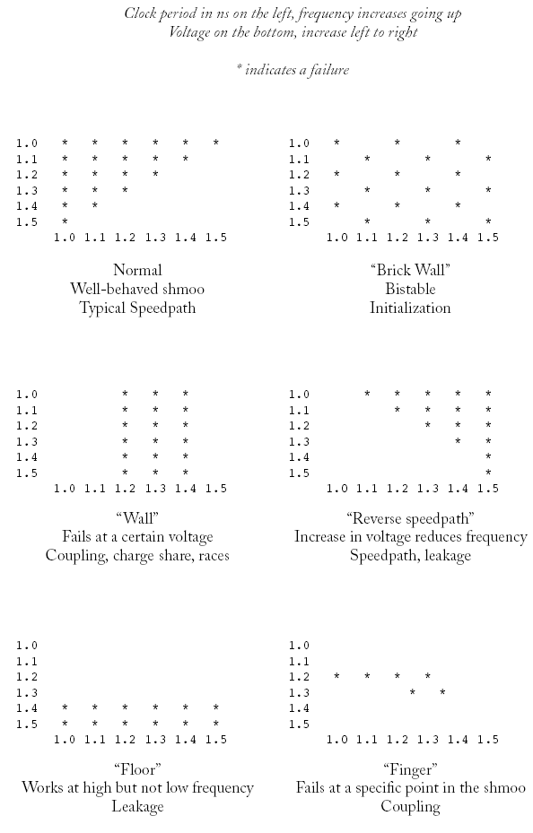
Shmoo Plots
How to diagnose failures?
Hard to access chips
Picoprobes
Electron beam
Laser voltage probing
Built-in self-test
Shmoo plots
Vary voltage, frequency
Look for cause of
electrical failures
Notes:
Shmoo plot graphically displays the systems response to a range of varying inputs.

Slide 7
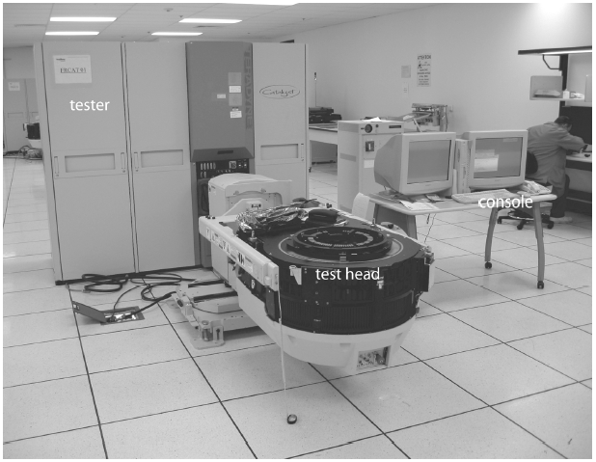
Manufacturing Test
A speck of dust on a wafer is sufficient to kill chip
Yield of any chip is <100%
Must test chips after manufacturing before delivery to customers to only ship good parts
Manufacturing testers are
very expensive
Minimize time on tester
Careful selection of
test vectors
Notes:
Extensive testing can be done at the manufacturer’s end. However, this can be expensive.

Slide 8
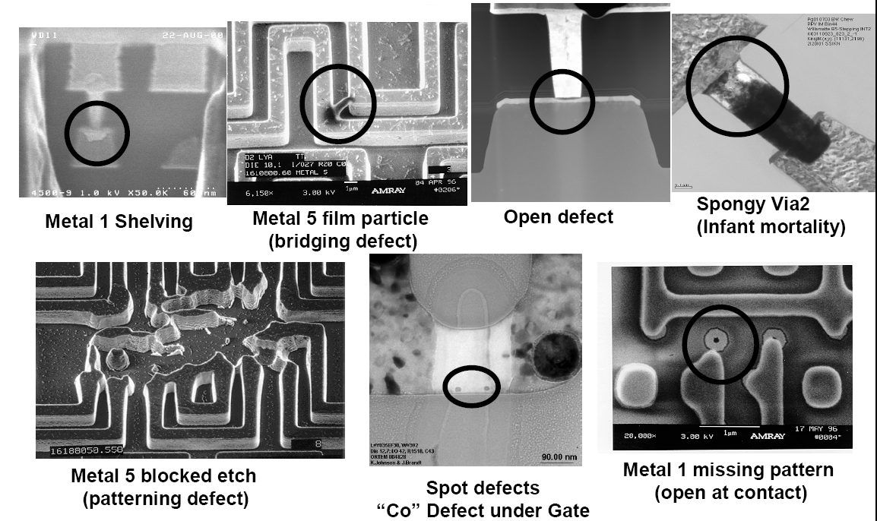
Manufacturing Failures
SEM images courtesy Intel Corporation

Slide 9
Stuck-At-Faults
How does a chip fail?
Usually failures are shorts between two conductors or opens in a conductor
This can cause very complicated behavior
A simpler model: Stuck-At
Assume all failures cause nodes to be “stuck-at” 0 or 1, i.e., shorted to GND or V_{DD}
Not quite true, but works well in practice
Notes:
Stuck-At-Faults are functional fault model, which operates at the logic models of digital circuits. It models the input(s) or output of the logic gates when stuck at 1 or 0.

Slide 10
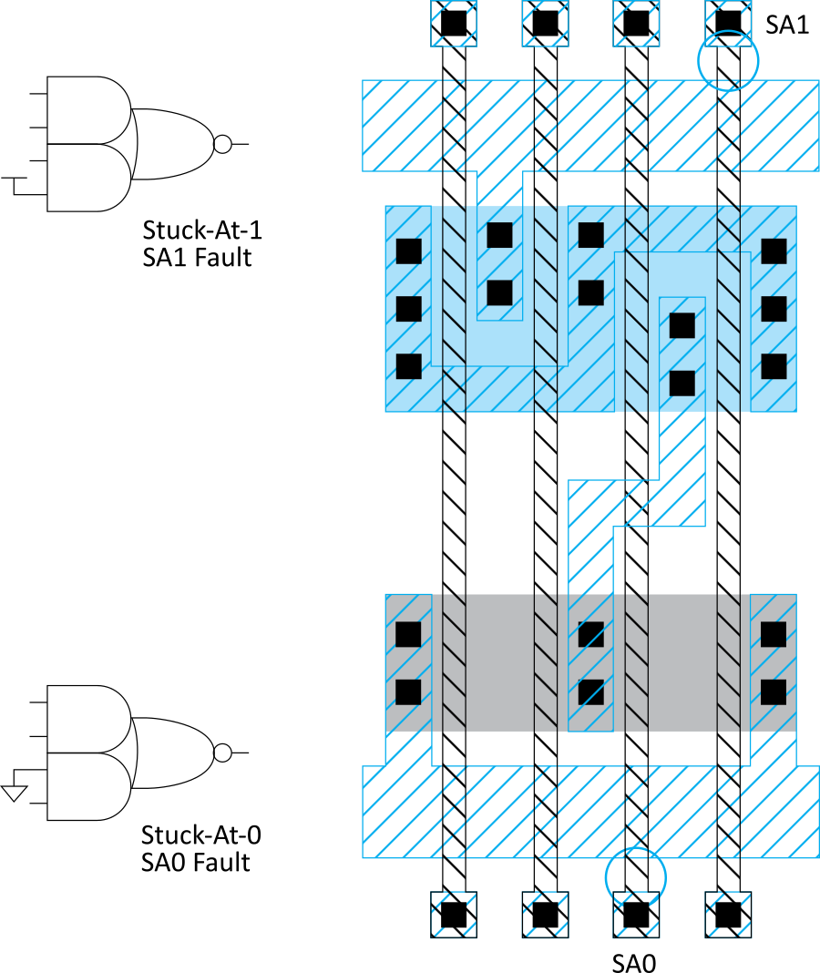
Examples
Notes:
Illustrates that the inputs to the gates can be connected to either power (stuck at 1) or ground (stuck at 0). This could be as a result of defects in manufacturing or error by the designer.

Slide 11
Observability & Controllability
Observability: ease of observing a node by watching external output pins of the chip
Controllability: ease of forcing a node to 0 or 1 by driving input pins of the chip
Combinational logic is usually easy to observe and control
Finite-state machines can be very difficult, requiring many cycles to enter desired state
Especially if state transition diagram is not known to the test engineer
Notes:
The designer can also examine the VLSI system by observing the output from a set of input combination. It is also easy to force the input pins to a 0 or 1 and then observe the output.
Some circuits are difficult to test due to their different possible states, which may be complex.

Slide 12
Test Pattern Generation
Manufacturing test ideally would check every node in the circuit to prove it is not stuck.
Apply the smallest sequence of test vectors necessary to prove each node is not stuck.
Good observability and controllability reduce the number of test vectors required for manufacturing test.
Reduces the cost of testing
Motivates design-for-test
Notes:
Test pattern generation takes into consideration the list of possible faults and the lists of tests to check for those faults. Therefore, a set of test vectors will be used to detect the possible faults.
Good and careful TPG reduces the number of required test vectors.

Slide 13
Test Example
SA1 SA0
A₃ {0110} {1110}
A₂ {1010} {1110}
A₁ {0100} {0110}
A₀ {0110} {0111}
n1 {1110} {0110}
n2 {0110} {0100}
n3 {0101} {0110}
Y {0110} {1110}
Minimum set: {0100, 0101, 0110, 0111, 1010, 1110}
Notes:
For the test example, let us examine the test pattern for stuck at 1 (SA1) fault for A3.
The A3 SA1, the test pattern ensures that if A3 is not stuck at 1, then Y = 0, else Y = 1. The same can be said for the rest test patterns.

Slide 14
Design for Test
Design the chip to increase observability and controllability
If each register could be observed and controlled, test problem reduces to testing combinational logic between registers.
Better yet, logic blocks could enter test mode where they generate test patterns and report the results automatically.
Notes:
DFT is a method of designing circuits, which eases test generation and applying the tests.
Sequential circuits contain flip-flops, which may be difficult to control and observe.

Slide 15
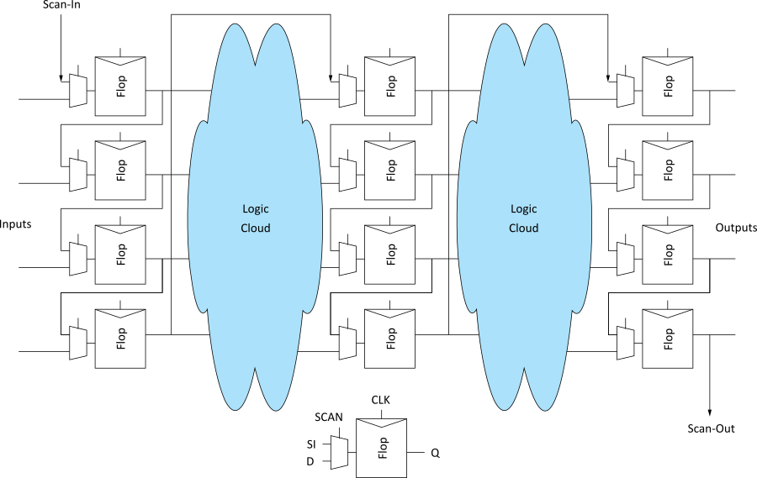
Scan
Convert each flip-flop to a scan register
Only costs one extra multiplexer
Normal mode: flip-flops behave as usual
Scan mode: flip-flops behave as shift register
Contents of flops
can be scanned
out and new
values scanned
in
Notes:
In this method, all flip-flops are converted to scan FFs, which are then connected as configurable shift-registers whose contents can be shifted out and observed.

Slide 16
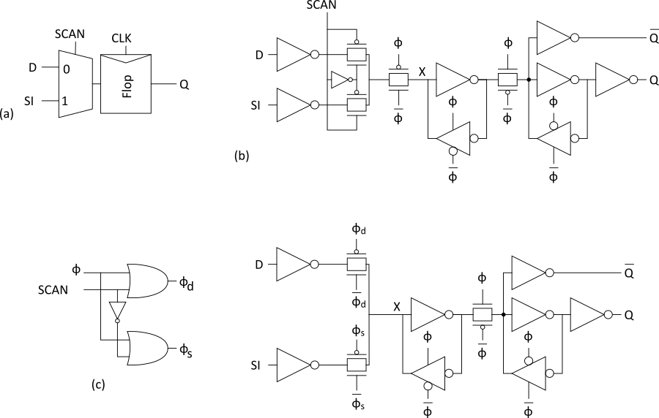
Scannable Flip-flops
Notes:
Circuit implementation of scannable FFs

Slide 17
ATPG
Test pattern generation is tedious
Automatic Test Pattern Generation (ATPG) tools produce a good set of vectors for each block of combinational logic
Scan chains are used to control and observe the blocks
Complete coverage requires a large number of vectors, raising the cost of test
Most products settle for covering 90+% of potential stuck-at-faults
Notes:
ATPG is the automation of test pattern generation using electronic design tools.

Slide 18
Built-in Self-test
Built-in self-test lets blocks test themselves
Generate pseudorandom inputs to comb. logic
Combine outputs into a syndrome
With high probability, block is fault-free if it produces the expected syndrome
Notes:
Built-in Self-test (BIST) uses circuits inside blocks of circuit to test themselves.

Slide 19
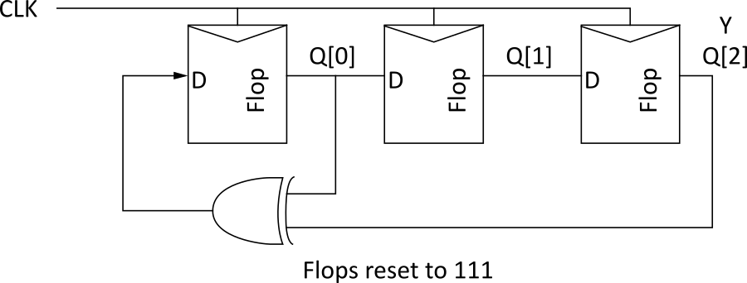
PRSG
Linear Feedback Shift Register
Shift register with input taken from XOR of state
Pseudorandom Sequence Generator
Step | Y
0 | 111
1 | 110
2 | 101
3 | 010
4 | 100
5 | 001
6 | 011
7 | 111 (repeats)
Y
Notes:
This circuit generates a pseudorandom sequence of numbers, which can be used for tests.

Slide 20
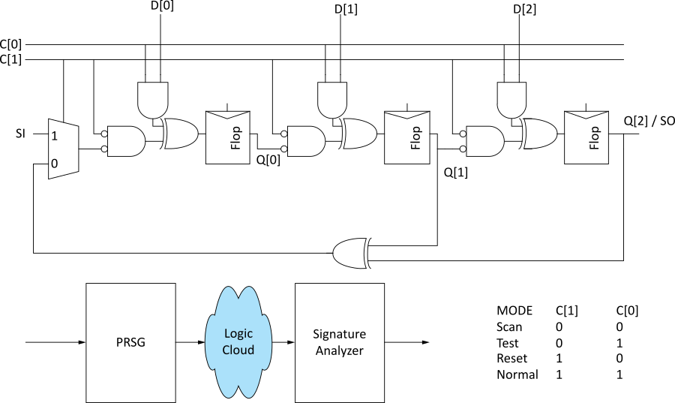
BILBO
Built-in Logic Block Observer
Combine scan with PRSG & signature analysis
Notes:
Using additional gates, more (total of 4) functions can be added to the test circuit.

Slide 21
Boundary Scan
Testing boards is also difficult
Need to verify solder joints are good
Drive a pin to 0 and then to 1
Check that all connected pins get the values
Through-hold boards used “bed of nails”
SMT and BGA boards cannot easily contact pins
Build capability of observing and controlling pins into each chip to make board test easier

Slide 22
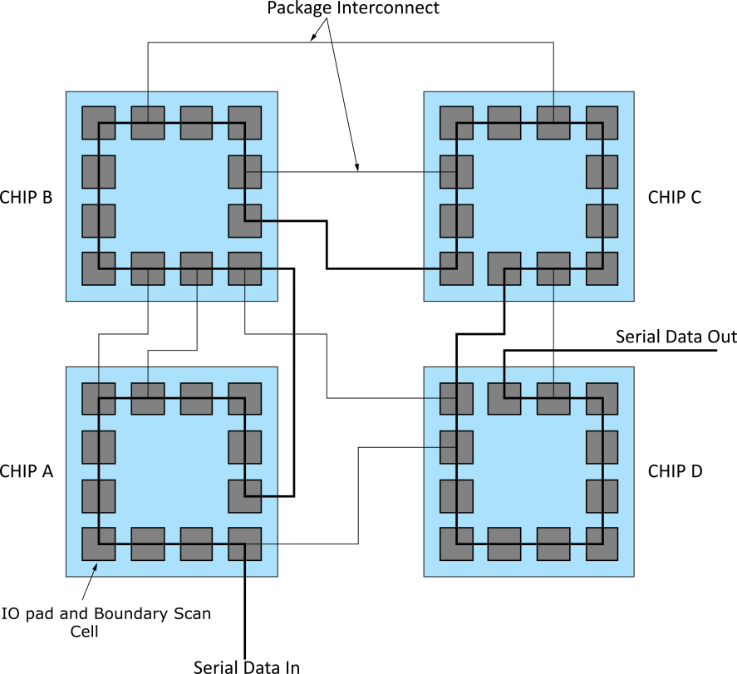
Boundary Scan Example
Notes:
Boundary scan is used to observe and analyze the states of sub-blocks and VLSI.

Slide 23
Boundary Scan Interface
Boundary scan is accessed through five pins
TCK: test clock
TMS: test mode select
TDI: test data in
TDO: test data out
TRST*: test reset (optional)
Chips with internal scan chains can access the chains through boundary scan for unified test strategy.

Slide 24
Summary
Think about testing from the beginning
Simulate as you go
Plan for test after fabrication
“If you don’t test it, it won’t work! (Guaranteed)”

