Slide 1
CMOS VLSI Design Lecture 20: Packaging, I/O & Power Distribution
Notes:
Hello and welcome. In this lecture, we will learn about Packaging, I/O & Power Distribution.

Slide 2
Learning Objectives
At the end of this lecture, you should be able to:
Describe the operation of ESD protection circuits using their circuit diagram.
Describe high-speed I/O transceivers and clock recovery.
Describe power distribution networks.
Explain package parasitic and how it affects signal integrity and Electromagnetic Compatibility of the chip.
Explain thermal resistance in chip and
Outline the I/O pad design for chips and describe their operation using their circuit diagrams.
Notes:
At the end of this lecture, you should be able to describe IC packaging and its impacts, estimate the heating caused by package thermal resistance, I/O pad design, ESD protection circuits, high-speed I/O transceivers and clock recovery, power distribution networks and estimate the noise caused by supply resistance and inductance.

Slide 3
Packages
Package functions
Electrical connection of signals and power from chip to board
Little delay or distortion
Mechanical connection of chip to board
Removes heat produced on chip
Protects chip from mechanical damage
Compatible with thermal expansion
Inexpensive to manufacture and test
Notes:
The chip package provides electrical connection of signals and power from chip to board. An ideal package has the following properties:
Little delay or distortion
Removes heat produced on chip
Protects the chip from mechanical damage and thermal expansion stress
Is inexpensive to manufacture and test

Slide 4
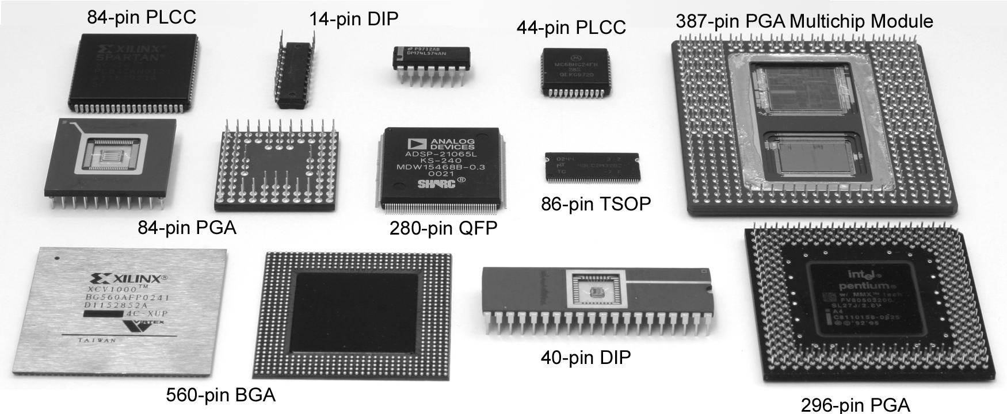
Package Types
Through-hole vs. surface mount
Notes:
The figure above shows various package types.
In through-hole mounting the component leads are placed into drilled holes on a PCB. Whereas, in surface mounting (SMT) components are secured by solder on the surface of the board.

Slide 5
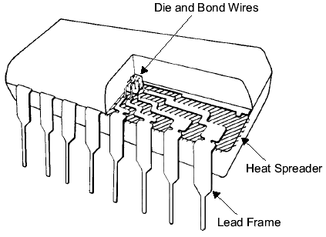
Chip-to-Package Bonding
Traditionally, chip is surrounded by pad frame
Metal pads on 100 – 200 μm pitch
Gold bond wires attach pads to package
Lead frame distributes signals in package
Metal heat spreader helps with cooling
Notes:
Traditionally, chips is connected to their packages through thin gold wires bonded to metal pads. The minimum pitch of the pads is approximately 100–200 um.
The figure above shows the cutaway view of dual-in-line package.
The metal lead frame in the package are connected to the bond wires.
This lead frame is the pin of the package and it is used to distribute signals.
Many packages also include metal heat spreader to help with cooling.

Slide 6
Advanced Packages
Bond wires contribute parasitic inductance
Fancy packages have many signal, power layers
Like tiny printed circuit boards
Flip-chip places connections across surface of die rather than around periphery
Top-level metal pads covered with solder balls
Chip flips upside down
Carefully aligned to package (done blind!)
Heated to melt balls
Also called C4 (Controlled Collapse Chip Connection)
Notes:
The bond wires contribute to the parasitic inductance.
More advanced packages have many signal lines and power layers. They internally resemble like tiny printed circuit boards.
In flip-chip design, the connections are placed across surface of the die rather than around periphery. Top-level metal pads are covered with solder balls and the chip is flipped upside down and connected to the package by heating the balls until they melt. The bonding requires careful alignment.

Slide 7
Package Parasitics
Use many V_{DD}, GND in parallel
Inductance, I_{DD}
Notes:
In the figure above, an integrated circuit package is modeled to show the inductive and capacitive couplings between bond wires and bond wires-lead frames.
VDD and GND bond wires have series inductance and capacitive coupling between them and also an induction network between bond wires and the lead frame.
Note that for chips that draw large supply current, the wire resistance is non-negligible and is important.

Slide 8
Heat Dissipation
60 W light bulb has surface area of 120 cm²
Itanium 2 die dissipates 130 W over 4 cm²
Chips have enormous power densities
Cooling is a serious challenge
Package spreads heat to larger surface area
Heat sinks may increase surface area further
Fans increase airflow rate over surface area
Liquid cooling used in extreme cases ($$$)
Notes:
Comparing a 60-watt light bulb which has a surface area of about 120 cm^2 and gets very hot with a high-performance chip which has enormous power density, then cooling becomes a serious challenge.
To remove heat from the chip following methods can be used:
Increase the surface area using heat sinks.
Increase the airflow rate over the surface area using fans and use liquid cooling in extreme cases.

Slide 9
Thermal Resistance
ΔT = θ_{ja}P
ΔT: temperature rise on chip
θ_{ja}: thermal resistance of chip junction to ambient
P: power dissipation on chip
Thermal resistances combine like resistors
Series and parallel
θ_{ja} = θ_{jp} + θ_{pa}
Series combination
Notes:
The heat is generated from the transistor junctions and flows through the substrate and package. Heat sink is used to absorb and spread the heat, which is then carried away through the air-cooling system.
Thus, the temperature difference between the transistor junctions and the ambient air is shown by the first equation.

Slide 10
Example
Your chip has a heat sink with a thermal resistance to the package of 4.0 ℃/W.
The resistance from chip to package is 1 ℃/W.
The system box ambient temperature may reach 55 ℃.
The chip temperature must not exceed 100 ℃.
What is the maximum chip power dissipation?
(100-55 C) / (4 + 1 C/W) = 9 W
Notes:
Let's consider an example:
You are planning to package a chip with the following specifications:
The chip has a heat sink with a thermal resistance to the package of 4.0 ℃/W.
The resistance from chip to package is 1 ℃/W.
The system box ambient temperature may reach 55 ℃.
The chip temperature must not exceed 100 ℃.
What is the maximum chip power dissipation?

Slide 11
Temperature Sensor
Monitor die temperature and throttle performance if it gets too hot
Use a pair of pnp bipolar transistors
Vertical pnp available in CMOS
Voltage difference is proportional to absolute temp
Measure with on-chip A/D converter
Notes:
A chip may rapidly overheat to the point of self-destruction if the cooling system fails (fan or clogged air intake vents). Therefore, one or more temperature sensors are included in most high-performance microprocessors. These sensors monitor die temperature and throttle performance if it gets too hot.
The figure above shows the circuit of the temperature sensor. It uses a pair of pnp bipolar transistors.
The base-emitter voltage VBE is a complex function of temperature because of the Is dependence.
However, the difference between base-emitter voltages of two identical transistors operating at different collector currents Ic1 and Ic2 eliminates the Is term and becomes directly proportional to absolute temperature as shown in the equation above.
The output voltage is measured with an A/D converter to produce a digital representation of temperature.

Slide 12
Input/Output Circuits
Basic I/O Pads
I/O Channels
Transmission Lines
Noise and Interference
High-Speed I/O
Transmitters
Receivers
Clock Recovery
Source-Synchronous
Mesochronous
Notes:
The basic I/O pads include various types of pins such as VDD, GND, digital input and output, bidirectional and analog pads.
Noise and interference problems may arise due to a high number of transmission lines in a chip.
The high-speed I/O pins are used as transmitters and receivers.

Slide 13
Input/Output
Input/Output System functions
Communicate between chip and external world
Drive large capacitance off chip
Operate at compatible voltage levels
Provide adequate bandwidth
Limit slew rates to control di/dt noise
Protect chip against electrostatic discharge
Use small number of pins (low cost)
Notes:
The input/output system is responsible for communicating data between the chip and the external world. A good I/O system has the following properties:
Drive large load capacitance off chip
Operate at compatible voltage levels with other external devices
Provide adequate bandwidth
Limit slew rates to control di/dt noise
Protect chip against electrostatic discharge
Use small number of pins (low cost)

Slide 14
I/O Pad Design
Pad types
V_{DD}/GND
Output
Input
Bidirectional
Analog
Notes:
The basic I/O pads include various types of pins such as VDD, GND, digital input and output, bidirectional and analog pads.

Slide 15
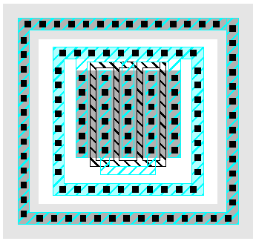
Output Pads
Drive large off-chip loads (2 – 50 pF)
With suitable rise/fall times
Requires chain of successively larger buffers
Guard rings to protect against latchup
Noise below GND injects charge into substrate
Large nMOS output transistor
p+ inner guard ring
n+ outer guard ring
In n-well
Notes:
The drive capability of an output pad must be sufficient to deliver adequate rise and fall times into the driven capacitive load.
Latchup is a problem near output pads. This is a type of short circuit between power rails as a result of low impedance path. To avoid it, guard rings are used to separate the nMOS and pMOS transistors.
The figure above shows the double guard rings around folded nMOS output transistor. p+ are inner guard ring and n+ is the outer guard ring.

Slide 16
Input Pads
Level conversion
Higher or lower off-chip V
May need thick oxide gates
Noise filtering
Schmitt trigger
Hysteresis changes V_{IH}, V_{IL}
Protection against electrostatic discharge
Notes:
The input pads contain a buffer that performs level conversion i.e. converts a signal in a voltage level to an appropriate voltage level valid for the logic in the core circuitry.
Some input pads also contain Schmitt triggers, which are used to filter out glitches, as shown in the figure.
A Schmitt trigger has hysteresis (new behavior depends on past input value) with the aid of a feedback system, it raises the switching point when the input is low and lowers the switching point when the input is high. This filters out glitches which might occur as a result of slowly rising or noisy input.
The input pad also provide protection against electrostatic discharge.

Slide 17
ESD Protection
Static electricity builds up on your body
Shock delivered to a chip can fry thin gates
Must dissipate this energy in protection circuits before it reaches the gates
ESD protection circuits
Current limiting resistor
Diode clamps
ESD testing
Human body model
Views human as charged capacitor
Notes:
The input pads interface with the external world and are connected to the chip core through circuits made of transistor gates. These transistors can get damaged from electrostatic discharge (ESD) which can puncture and break down the oxide. Therefore, we must dissipate this energy in protection circuits before it reaches the gates.
The figure above shows a typical ESD input protection circuit which consists of current-limiting resistor and diode clamps.
The last figure shows the ESD test circuit, to which a device under test can be attached to characterize ESD robustness.

Slide 18
Bidirectional Pads
Combine input and output pad
Need tristate driver on output
Use enable signal to set direction
Optimized tristate avoids huge series transistors
Notes:
The first circuit above is a bidirectional pad. It can function as both input and output pads.
The second circuit is the improved tristate buffer that merge NAND and NOR gates in a six-transistor network to give two outputs. Optimized tristate avoids huge series transistors.

Slide 19
Analog Pads
Pass analog voltages directly in or out of chip
No buffering
Protection circuits must not distort voltages
Notes:
In analog pads, voltages are passed directly in or out of the chip and no buffering is required.
Protection circuits are required in analog pads and it must be ensured that these circuits do not distort the signals.

Slide 20
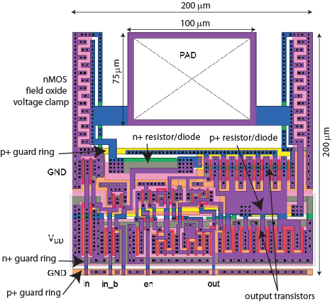
MOSIS I/O Pad
1.6 μm two-metal process
Protection resistors
Protection diodes
Guard rings
Field oxide clamps
Notes:
The figure above shows the layout of a MOSIS I/O pad with 1.6 um two-metal process.
From the schematic of MOSIS I/O pad, it can be observed that the protection circuitry consists of some protection resistors and diodes, guard rings and field oxide clamps to protect the pad from ESD.

Slide 21
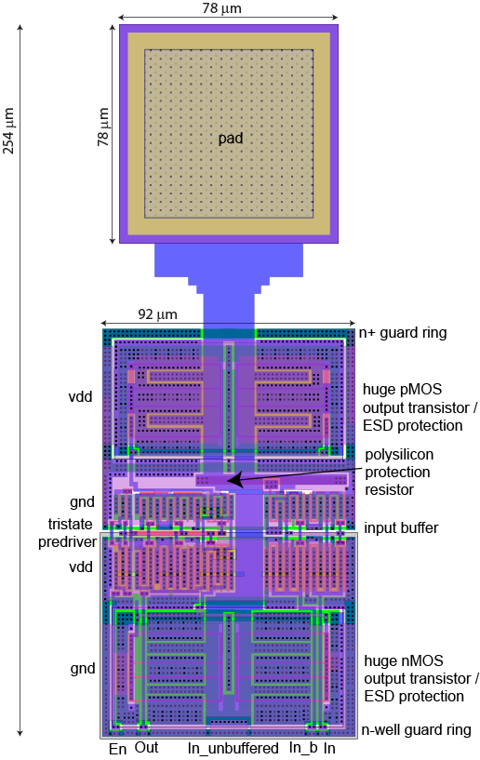
UofU I/O Pad
0.6 μm three-metal process
Similar I/O drivers
Big driver transistors provide ESD protection
Guard rings around driver
Notes:
This figure above shows the layout of the UofU I/O pad, which has 0.6um three-metal process.

Slide 22
I/O Channels
I/O Channel: connection between chips
Low frequency: ideal equipotential net
High frequency: transmission line
Transmission lines model
Finite velocity of signal along wire
Characteristic impedance of wire
Notes:
The figure above shows a basic digital I/O, where a transmitter chip which sends an electrical signal to the receiver chip. The channel of communication is via a wire. At low frequency, this wires acts as an ideal equipotential net. Whereas, at higher frequency, it acts as a transmission line for the currents and voltages to propagate as waves.
Remember that, the transmitter chip does not know what is connected at the receiver end when it sends a signal on the channel. It knows only the characteristic impedance, Z0, of the channel. i.e. 50 ohms.

Slide 23
When is a wire a T-Line?
When propagation delay along the wire is comparable to the edge rate of the signal propagating
Depends on
Length
Speed of light in the medium
Edge rate
Notes:
A wire is a T-line when the propagation delay along the wire is comparable to the edge rate of the propagating signal.
The propagation delay depends on the length of the channel, speed of light in the medium and the edge rate.

Slide 24
Example
When must a 10 cm trace on a PCB be treated as a transmission line?
FR4 epoxy has k = 4.35 (ε = kε₀)
Assume rise/fall times are ¼ of cycle time
Signal propagation velocity
Wire flight time
Thus, the wire should be treated as a transmission line when signals have a period <2.8 ns (>350 MHz)
Notes:
Let's consider an example: When must a 10 cm trace on a PCB be treated as a transmission line?
The flame-retardant epoxy (FR4) has dielectric constant of approximately: k = 4.35 (e = ke0).
Using the formulas above, we determine that the wire should be treated as a transmission line when signals period <2.8 ns (>350 MHz).

Slide 25
Characteristic Impedance
Z₀: ratio of voltage to current of a signal along the line
Depends on the geometry of the line
Microstrip: Outer layer of PCB
Stripline: Inner layer of PCB
Notes:
The characteristic impedance, Z0, is the ratio of voltage to current of a signal along the line and depends on the geometry of the line.
The figures above shows two common ways in which signals can be routed:
When a signal is running on an outer layer of PCB, it is called a microstrip. It is shown in the first figure with its formula for characteristic impedance.
When a signal is running on an inner layer of PCB, it is called a stripline. It is shown in the second figure with its formula for characteristic impedance.

Slide 26
Example
A 4-layer PCB contains power and ground planes on the inner layers and signals on the outer layers. The board uses 1 oz copper (1.4 mils thick) and the FR4 dielectric is 8.7 mils thick. How wide should the traces be to achieve 50 Ω characteristic impedance?
This is a microstrip design. Solve for w with
t = 1.4 mils
h = 8.7 mils
k = 4.35
Z₀ = 50 Ω
w = 15 mils
Notes:
In this example, we calculate the width of the trace to achieve the 50-ohm characteristic impedance. Using the specification above, we calculated that the required width of the trace w=15 mils.

Slide 27
Reflections
When a wave hits the end of a transmission line, part of the energy will reflect if the load impedance does not match the characteristic impedance.
Reflection coefficient:
A wave with an amplitude of V_{reflected} = ΓV_{incident} returns along the line.
Notes:
When the transmitted wave hits the end of a transmission line, the energy is reflected back if there is mismatch between the load impedance and the characteristic impedance. Reflections are undesirable in a communication channel.
The reflection coefficient is expressed in terms of ZL (load impedance) and Z0 (characteristic impedance) as shown above.

Slide 28
Example: Reflections
A strong driver with a Thevenin equivalent resistance of 10 Ω drives an unterminated transmission line with Z₀ = 50 Ω and flight time T. Plot the voltage at the 1/3 point and end of the line.
Reflection coefficients:
Initial wave: 50/(10+50) = 5/6
Observe ringing at load
Notes:
Let's consider an example to study reflections in transmission lines:
Here, a strong driver with a Thevenin equivalent resistance of 10 ohm is driving an unterminated transmission line with Z0 = 50 ohm. The figure above shows a plot of voltages (y-axis) against flight time T (x-axis). The reflections can be clearly observed in transmission line and are calculated using reflection coefficients formula.

Slide 29
Intersymbol Interference
Must wait until reflections damp out before sending next bit
Otherwise, intersymbol interference will occur
With an unterminated transmission line, minimum bit time is equal to several round trips along the line
Notes:
The intersymbol interference occurs when one signal's energy is interferes with another signal's energy, causing distortion.
Certain time must elapse for reflections to dampen out before sending the next bit.
When a transmission line is unterminated, the minimum bit time is equal to several round trips along the line.

Slide 30
Example: Load Termination
Redo the previous example if the load is terminated with a 50 Ω resistor.
Reflection coefficients:
Initial wave: 50/(10+50) = 5/6
No ringing
Power dissipation in load resistor
Notes:
Let's redo the previous example:
In this case, the load is terminated with a 50-ohm resistor. After calculating the reflection coefficients and plotting the graphs, we conclude that there are no reflections in this case and all the power is dissipated in the load resistor.

Slide 31
Example: Source Termination
Redo the previous example if the source is terminated with an extra 40 Ω resistor.
Reflection coefficients:
Initial wave: 50/(50+50) = 1/2
No ringing
No power dissipation in load
Taps along T-line momentarily see invalid levels
Notes:
Now, let's redo the previous example again:
But in this case, the source is terminated with an extra 40-ohm resistor. We calculate the reflection coefficients and plot the graphs again and observe that in this case, there is no ringing and no power dissipation in the load.

Slide 32
Termination Summary
For point-to-point links, source terminate to save power
For multidrop busses, load terminate to ensure valid logic levels
For busses with multiple receivers and drivers, terminate at both ends of the line to prevent reflections from either end
Notes:
The figures above show various configuration in which the device I/Os can be connected. For point-to-point configuration, the source terminates to save the power whereas, in multidrop busses configuration, the load terminates to ensure valid logic levels.
Busses with multiple receivers and drivers terminate at both ends of the line to prevent reflections from either end.

Slide 33
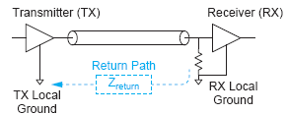
Noise and Interference
Other sources of intersymbol interference:
Dispersion
Caused by nonzero line resistance
Cross talk
Capacitive or inductive coupling between channels
Ground Bounce
Nonzero return path impedance
Simultaneous Switching Noise
Notes:
The other sources of intersymbol interference that can corrupt the signal propagation in the channel are:
Dispersion: It is caused by the nonzero line resistance.
Crosstalk: It is caused by the capacitive or inductive coupling between the channel in which the signal is propagated.
Ground Bounce: It is caused by nonzero return path impedance.
Simultaneous switching noise.

Slide 34
High-Speed I/O
Transmit data faster than the flight time along the line
Transmitters must generate very short pulses
Receivers must be accurately synchronized to detect the pulses
Notes:
Besides minimum reflection and interference in the channel, we want high-speed I/O to transmit data faster than the flight time along the line and ensure that the transmitters generate very short pulses. On the other hand, we want the receivers to be accurately synchronized to detect the pulses.

Slide 35
High-Speed Transmitters
How to handle termination?
High impedance current-mode driver + load term?
Or low-impedance driver + source termination
Single-ended vs. differential
Single-ended uses half the wires
Differential is Immune to common mode noise
Pull-only vs. Push-Pull
Pull-only has half the transistors
Push-pull uses less power for the same swing
Notes:
In this slide, we explain the issues for building high-speed transmitters circuits:
How can we handle termination? Options: use high impedance current-mode driver and load terminal or should use low-impedance driver with source termination.
Should we use single-ended transmitters or differential transmitters? Consider area vs noise immunity.
Whether to use a pull-only driver or push-pull driver? Consider area vs power requirement.

Slide 36
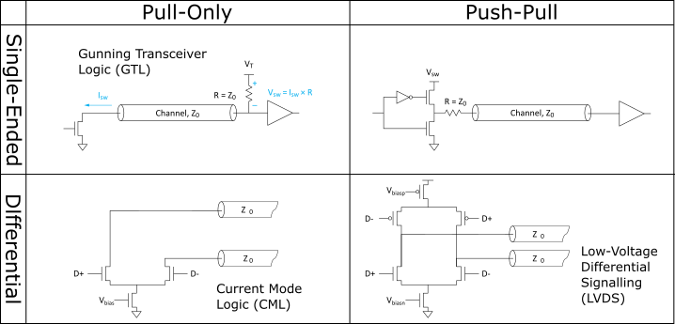
High-Speed Transmitters
Notes:
The figure above shows, the transmission line drivers at the top and differential transmitters at the bottom.
In single ended transmitter:
(a) Pull-only is a current-mode driver with high output impedance. You can observe, a parallel termination at the receiving end which converts the current to voltage.
(b) Push-pull is a voltage-mode driver with low output impedance.. It has a series termination at the transmitting end.
Differential drivers:
(a) Current mode logic (CML): It can operate beyond 10 Gb/s but requires more power consumption.
(b) Low-Voltage Differential Signaling (LVDS): It can operate up to 3.125 Gb/s and requires less power consumption.
Push-pull drivers use less current and thus consume less power compared to pull-only drivers. Pull-only drivers are easier to build.

Slide 37
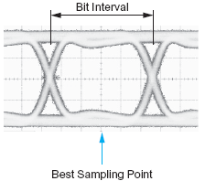
High-Speed Receivers
Sample data in the middle of the bit interval
How do we know when?
Notes:
The figure above shows the bit interval and the best sampling point of the signal as a function of its time offset within each bit period. Normally, we sample data in the middle of the bit interval.

Slide 38
Source-Synchronous Clocking
Send clock with the data
Flight times roughly match each other
Transmit on falling edge of tclk
Receive on rising edge of rclk
Notes:
The figure above shows the source-synchronous system configuration. The transmitter sends a clock signal aligned with the data. The flight times are roughly matched with other. The transmitter chip transmits the data on falling edge of tclk, whereas, the receiver chip receives the data on the rising edge of rclk.

Slide 39
Single vs. Double Data Rate
In ordinary single data rate (SDR) system, clock switches twice as often as the data
If the system can handle this speed clock, the data is running at half the available bandwidth
In double-data-rate (DDR) transmit and receive on both edges of the clock
Notes:
This slide explains the difference between the single and double data rate.
In single data rate (SDR) system, data is sampled on the rising edge of the clock and the clock frequency is twice the frequency of the data. If the system can handle the clock speed, then, that means the data is running at half the available bandwidth.
In double-data-rate (DDR) system, data is sampled on both the rising edge and falling edge of the clock. It can operate at full bandwidth of the channel.

Slide 40
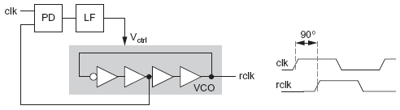
Phase Alignment
If the DDR clock is aligned to the transmitted clock, it must be shifted by 90º before sampling
Use PLL
Notes:
This slide explains the concept of phase alignment. If the DDR clock is aligned to the transmitted clock, it must be shifted by 90 degree before sampling. The figure above shows the circuit for the clock recovery using PLL to shift phase by 90 degree.

Slide 41
Mesochronous Clocking
As speeds increase, it is difficult to keep clock and data aligned
Mismatches in trace lengths
Mismatches in propagation speeds
Different in clock vs. data drivers
Mesochronous: clock and data have same frequency but unknown phase
Use PLL/DLL to realign clock to each data channel
Notes:
This slide explains the concept of clock recovery in mesochronous systems. As the transmission speed increases, it becomes difficult to keep clock and data aligned due to mismatches in trace lengths and propagation speeds.
In mesochronous systems, the clock and data have same frequencies but unknown phase. We use PLL/DLL to realign clock to each data channel, as described earlier.

Slide 42
Phase Calibration Loop
Special phase detector compares clock & data phase
Notes:
The above figure shows the block diagram of the phase calibration loop for mesochronous timing recovery. It is a special phase detector that compares clock and data phase for timing recovery.

Slide 43
Power Distribution
Power Distribution Network functions
Carry current from pads to transistors on chip
Maintain stable voltage with low noise
Provide average and peak power demands
Provide current return paths for signals
Avoid electromigration & self-heating wearout
Consume little chip area and wire
Easy to lay out
Notes:
Power distribution network ensures that current is carried from pads to transistors on the chip.
The power distribution network must also ensure stable and clean power supply and must meet the average and peak power demands of the system.
Other attributes of a good power distribution network are:
Avoid electromigration & self-heating wearout
Consume little chip area and wire
Easy to lay out

Slide 44
Power Requirements
V_{DD} = V_{DDnominal} – V_{droop}
Want V_{droop} < +/- 10% of V_{DD}
Sources of V_{droop}
IR drops
L di/dt noise
I_{DD} changes on many time scales
Notes:
Plot shows the profile of current due to circuit switching events during chip operation.

Slide 45
IR Drop
A chip draws 24 W from a 1.2 V supply. The power supply impedance is 5 mΩ. What is the IR drop?
I_{DD} = 24 W / 1.2 V = 20 A
IR drop = (20 A)(5 mΩ) = 100 mV
Notes:
Slide shows an example calculation of IR drop due to the current drawn by a chip.
First calculate the current and then multiple it with the supply impedance to get the voltage drop.

Slide 46
L di/dt Noise
A 1.2 V chip switches from an idle mode consuming 5 W to a full-power mode consuming 53 W. The transition takes 10 clock cycles at 1 GHz. The supply inductance is 0.1 nH. What is the L di/dt droop?
ΔI = (53 W – 5 W)/(1.2 V) = 40 A
Δt = 10 cycles * (1 ns / cycle) = 10 ns
L di/dt droop = (0.1 nH) * (40 A / 10 ns) = 0.4 V

Slide 47
Bypass Capacitors
Need low supply impedance at all frequencies
Ideal capacitors have impedance decreasing with ω
Real capacitors have parasitic R and L
Leads to resonant frequency of capacitor

Slide 48
Power System Model
Power comes from regulator on system board
Board and package add parasitic R and L
Bypass capacitors help stabilize supply voltage
But capacitors also have parasitic R and L
Simulate system for time and frequency responses

Slide 49
Frequency Response
Multiple capacitors in parallel
Large capacitor near regulator has low impedance at low frequencies
But also has a low self-resonant frequency
Small capacitors near chip and on chip have low impedance at high frequencies
Choose caps to get low impedance at all frequencies

Slide 50
Example: Pentium 4
Power supply impedance for Pentium 4
Spike near 100 MHz caused by package L
Step response to sudden supply current chain
1st droop: on-chip bypass caps
2nd droop: package capacitance
3rd droop: board capacitance
[Xu08]
[Wong06]

Slide 51
Charge Pumps
Sometimes a different supply voltage is needed, but little current is required
20 V for flash memory programming
Negative body bias for leakage control during sleep
Generate the voltage on-chip with a charge pump
Notes:
A charge pump is a DC to DC converter used to generate voltage on chip. The charge pump circuit shown above uses capacitors as the energy-storage element to raise or lower voltage.

Slide 52
Energy Scavenging
Ultra-low power systems can scavenge their energy from the environment rather than needing batteries
Solar calculator (solar cells)
RFID tags (antenna)
Tire pressure monitors powered by vibrational energy of tires (piezoelectric generator)
Thin-film microbatteries deposited on the chip can store energy for times of peak demand
Notes:
Energy scavenging systems derive energy from external sources such as the environment using transducers like solar cells, RFID tags and pressure monitors. The energy gotten by scavenging are used to drive ultra-low power systems. These system usually have means of storing the energy scavenged when not active.

Slide 53
Power Gating
Turn off power to idle blocks to reduce leakage
Insert large pMOS transistors between VDD and Virtual VDD (VVDD) nets
Provide a sleep signal to turn off these power gating transistors
Maintain the state of the system
Keep power applied to the flip-flops and memories
Or scan out and save state before turning blocks off, restore before turning back on
Add isolation cells (AND gates) to prevent floating outputs from sleeping blocks from presenting invalid logic levels to nonsleeping blocks
Energy to save and restore state limits how short it is worth sleeping
Notes:
Power Gating is a method used to turn OFF idle blocks to minimize power loss due to leakage.
A large pMOS transistor between Vdd and the virtual Vdd nets of the circuit blocks can be used for power gating. The operation of the power gating transistor can be controlled using a sleep signal.

