Slide 1
Extentreport Guideline

Slide 2
Overview
In this guideline, we are going to show you how to use ExtentReport, the way to make a pretty report when you use TestNG framework.
To understand this guideline, you should know about Java, TestNG and Maven basically.

Slide 3
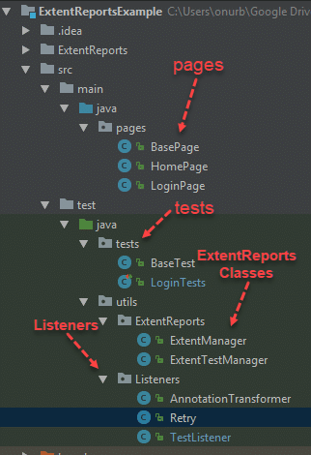
Project Structure
To make this guideline easy to understand, I will
create a Maven project with structure like this:

Slide 4
Let’s start step by step

Slide 5

Step 1: Add ExtentReport Maven dependency
You should add ExtentReport dependency with version2.x because from version 3.x, ExtentReport was not full free anymore.

Slide 6
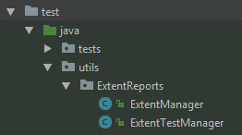
Step 2: Add ExtentReport classes
In a running session, we need some class to manage test data to generate report, that why ExtentReport classes is existed. I create a utils packed to hold them.

Slide 7
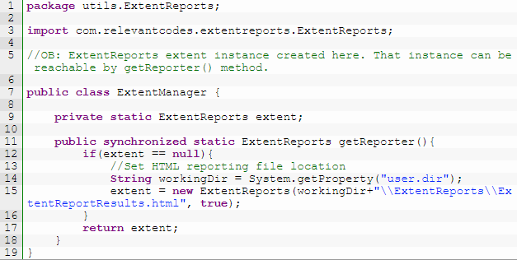
Step 2: Add ExtentReport classes
ExtentManager class: in a running session, we only need one instance of ExtentReport object. ExtentManager is a “Singleton” to manage this instance.
Note: you can get the instance via getReporter() method and the synchronized keyword here is for the case that you run test in parallel mode.

Slide 8
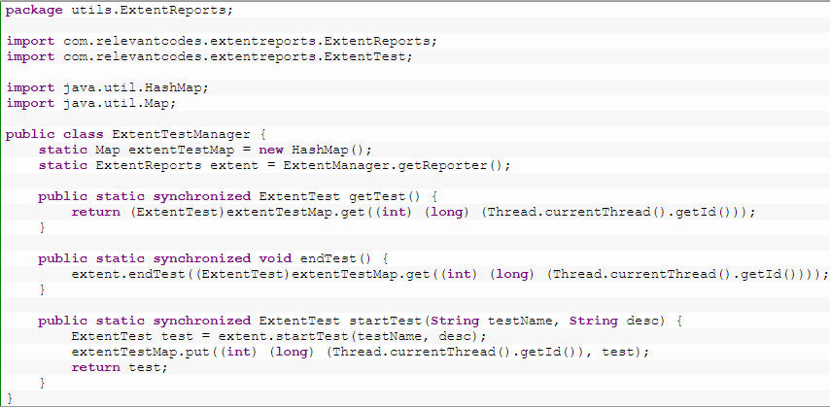
Step 2: Add ExtentReport classes
ExtentTestManager class: is a class that manage all Test object of ExtentReport in a running session. In parallel mode, the Test object may be duplicated, so this class hold Test by a map with map’s keys is thread id.

Slide 9
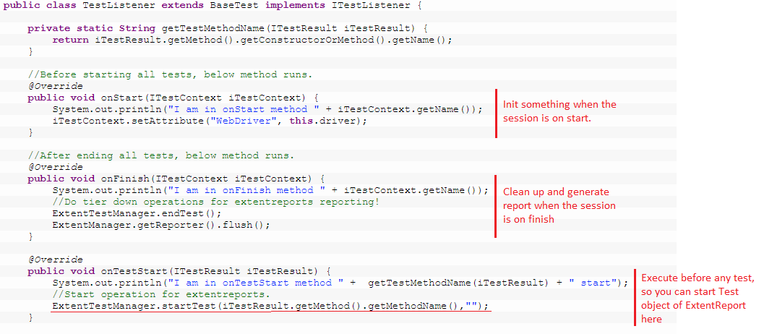
Step 3: Add listener for TestNG
To integrate ExtentReport with TestNG framework, you can implement a new TestNG listener to start test, end test, and log the status of test:

Slide 10
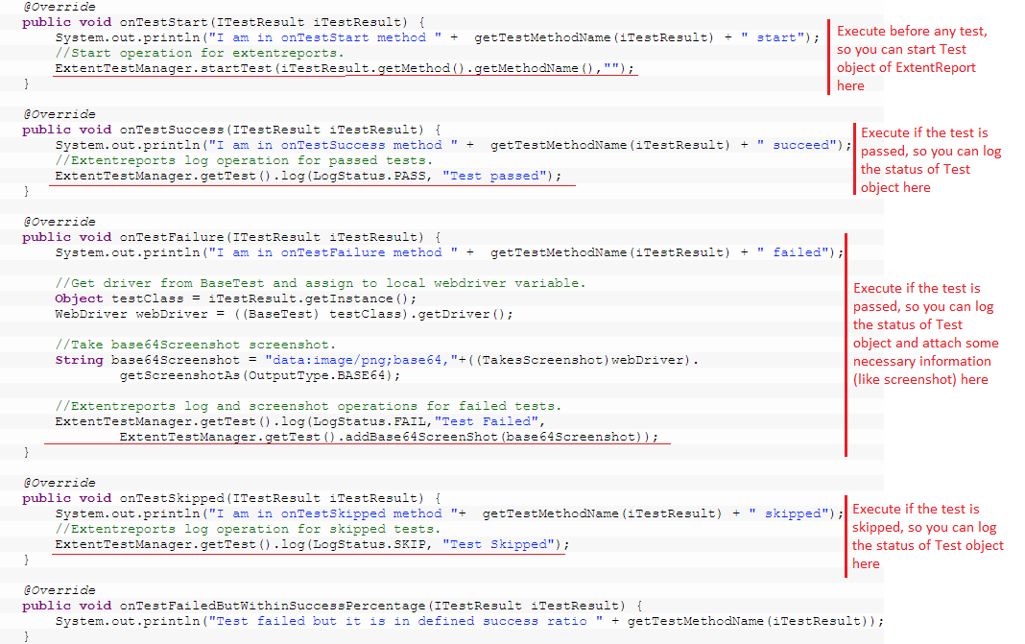
Step 3: Add listener for TestNG
Log test status in TestNG listener:

Slide 11

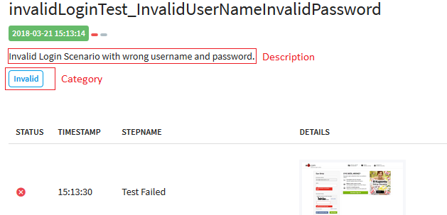
Step 4: Add test Description and Category (Optional)
You can also add a description to a Test or assign it to one or multiple categories like this:

Slide 12
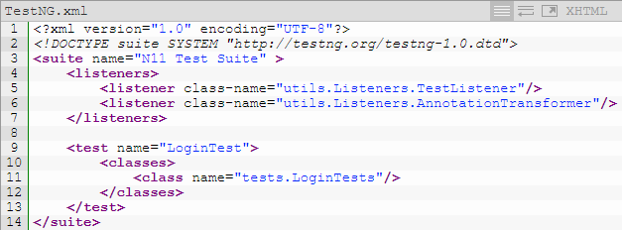
Step 5: Add listener to TestNG.xml
To apply the listener implemented in step 3, add it to TestNG.xml

Slide 13

Step 6: Run you project as Maven clean test
Execute your test as Maven clean test and the html report will be generated in ExtentReport folder:

Slide 14
Improve filter of the report.
In report, you can find a button to display a search box and you can search any test with regular expression. However, you can search test in a range of timestamp.
To solve this problem, I embed a Javascript source to html file. You need some extra step to do this:
Step 1: Create config.xml file with the content in this link https://github.com/trongnhan1312400/ExtentReportExample/blob/master/config.xml

Slide 15
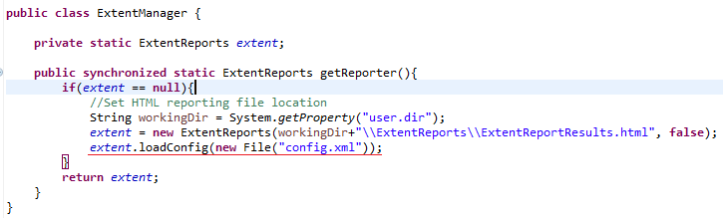
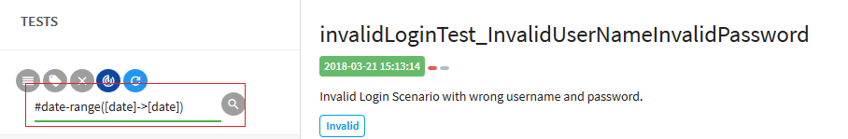
Improve filter of the report.
Step 2: Load config.xml to your ExtentReport like this:
And when your report generated, you can filter your test in the range of timestamp with syntax like this:

Slide 16
Related
Example project: https://github.com/trongnhan1312400/ExtentReportExample
Guideline in web: https://www.swtestacademy.com/extentreports-testng/
Homepage of ExtentReport: http://extentreports.com/

Slide 17
How to use report

Slide 18
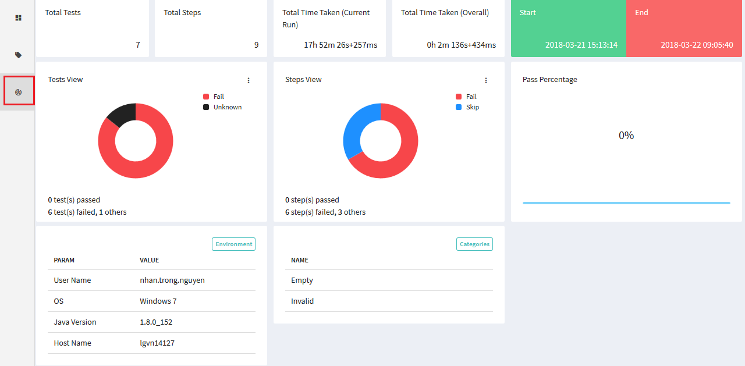
Dashboard
In Dashboard, you can see the summary of your report like, summary
of tests status, summary of steps status, start time, end time, duration,
environment information, categories… of your tests:

Slide 19
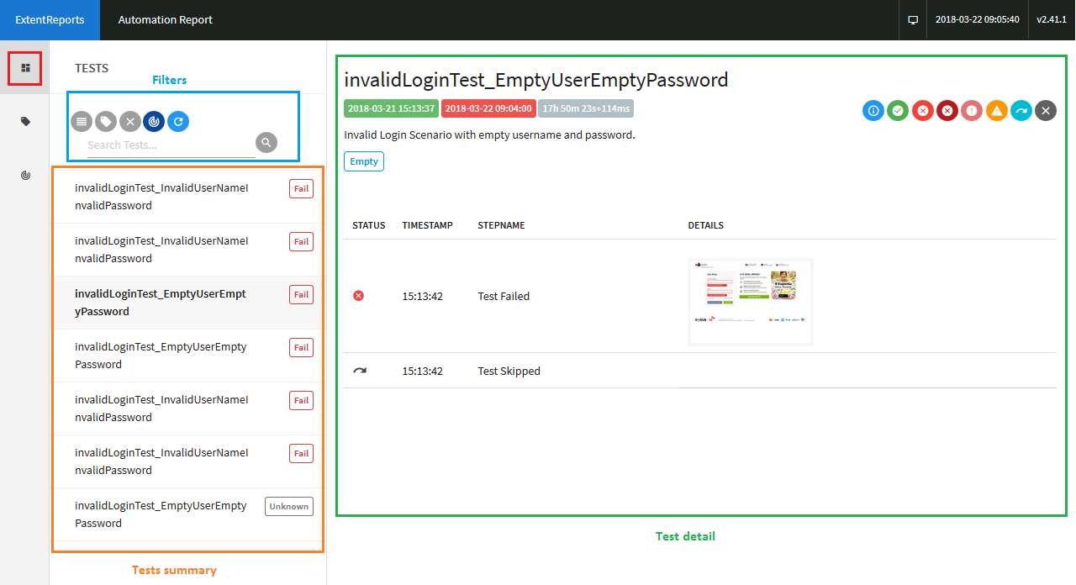
TESTS window

Slide 20

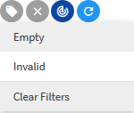
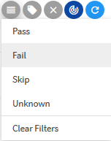

TESTS window
Filters:
Filter by Tests categories:
Filter by Tests status:
Search box:
Clear all filter effect:
Note: in Search box, you can search tests by its name, its timestamp,
or search tests that have started time within a time range by syntax:
#date-range(date [time]->date [time])

Slide 21
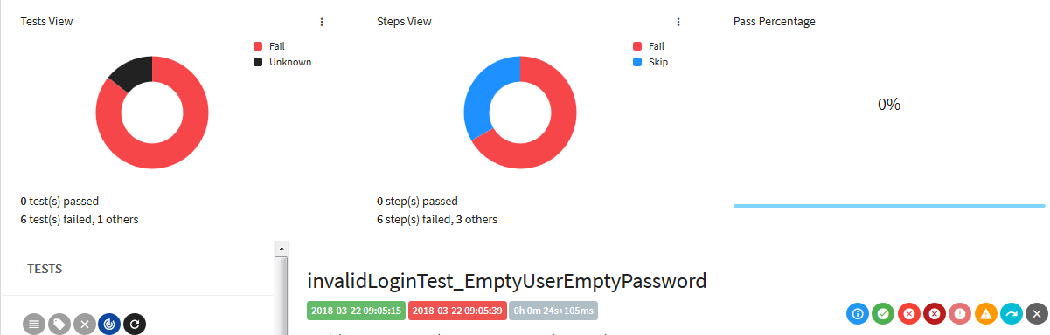
TESTS window
See dashboard in TESTS window:
Note: when the displayed tests change because of filtering, your Dashboard also changes to match with those tests.

Slide 22
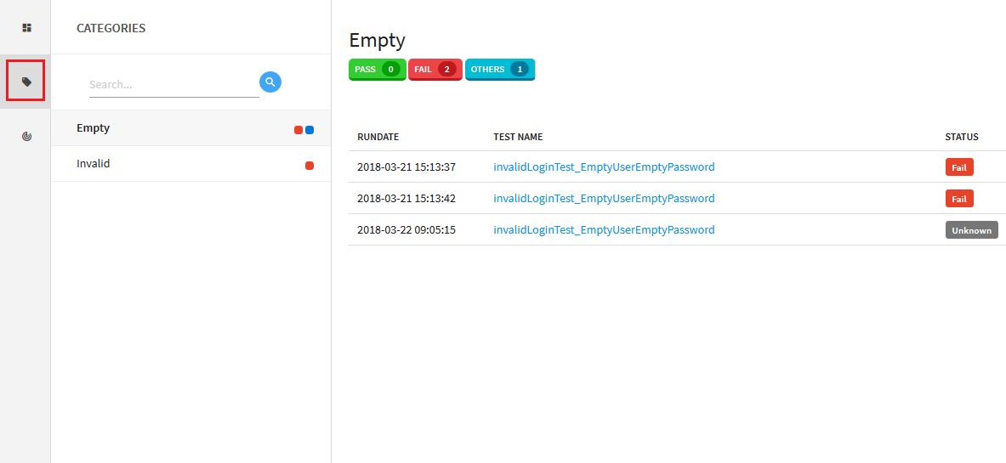
CATEGORIES window
This window contains all categories of your test. When clicking on a category, all the tests associate with this category will be listed out:

Slide 23
Thank for reading!

