Slide 1

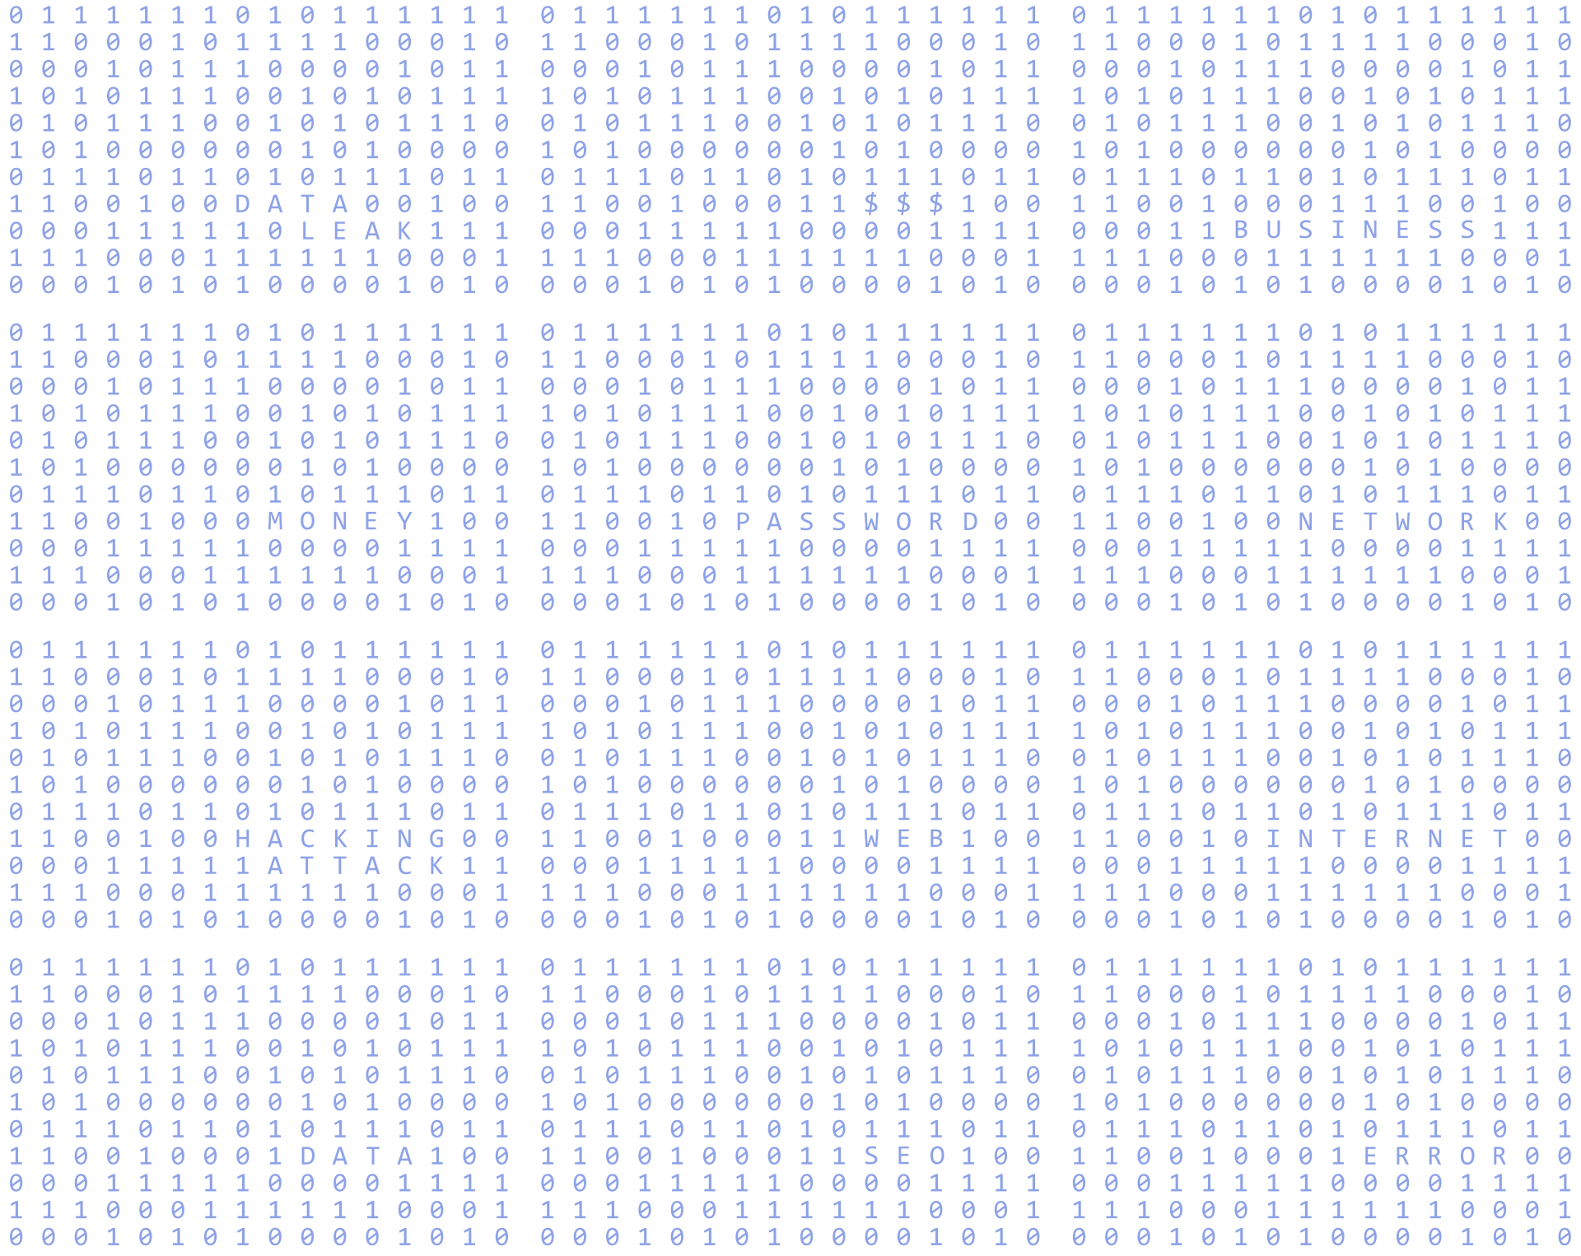









AI
FOR SE

Slide 2


Timeline
180 phút
1
2
3
5
6
4
Analyze & Select Features
Generate Test Code
Documentation & Demo
Design Test Cases
Debug Tests
Optimization & Mocking

Slide 3


1.Analyze & Select Features
1️⃣ Logic nghiệp vụ rõ ràng
→ Dễ mô tả quy trình mua hàng (Add → Update → Calculate → Checkout).
2️⃣ Nhiều edge cases để test
→ Có nhiều tình huống đặc biệt giúp kiểm thử toàn diện (product không tồn tại, user sai ID, giỏ hàng trống...).
3️⃣ Có dependencies (Product, User)
→ Gắn chặt với module khác, thể hiện quan hệ giữa thực thể trong hệ thống.
4️⃣ Mang tính thực tế cao
→ Là tính năng cốt lõi trong mọi ứng dụng đặt đồ ăn (ShopeeFood, GrabFood...).

Slide 4
1.Analyze & Select Features
Function:
addItem(product, quantity)
removeItem(productId)
updateQuantity(productId, qty)
calculateTotal()
clearCart()

Slide 5



2. Design Test Case

Slide 6
a.Unit Testing
Unit Testing
Intergration Testing
End-to-End Testing
Performance Testing

Slide 7
a.Unit Testing
Test cases include:
Add product to a new cart
Add product to an existing cart
Update product quantity
Remove product from cart
Clear all items from cart
Calculate cart total price
Validate empty cart state
Handle non-existent product error
Handle negative quantity
Handle zero quantity

Slide 8
b.Integration Testing
Retrieve cart information
Add product to cart
Remove product
Update quantity
Clear all items
Authentication handling
Validation error handling

Slide 9
c.End-to-End (E2E) Testing
Manual UI Testing via Web Interface
Access: http://localhost:3000
Login: With a customer account
Add product: Click “Add to Cart”
View cart: Click cart icon
Update quantity: Use +/- buttons
Remove product: Click “Remove”
Checkout: Click “Checkout”

Slide 10
d. Performance Testing
Stress Testing
Test with 100+ items in cart
Test with high concurrency (multiple simultaneous users)
Test with large-scale database

Slide 11
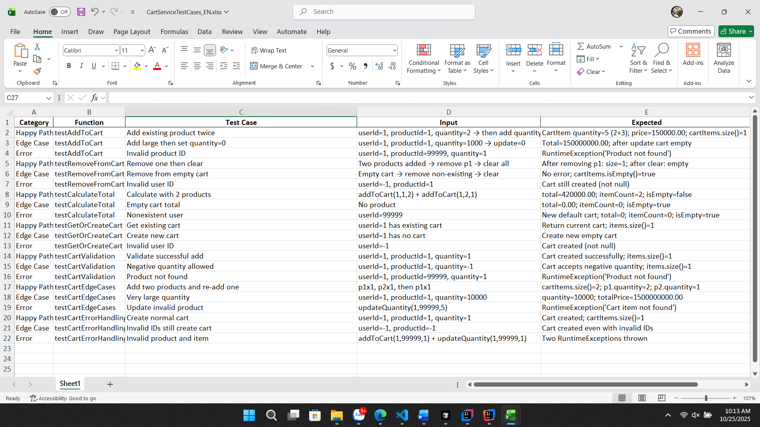



Slide 12
3.1 Analyze Source Code
"Analyze this Spring Boot Cart API source and list everything required to write MockMvc integration tests for CartControllerIntegrationTestGrouped.java.
Scope:
Endpoints:
GET /api/cart
POST /api/cart/add
PUT /api/cart/update
DELETE /api/cart/remove/{id}
DELETE /api/cart/clear
Security: Authorization: Bearer <token> (valid / invalid / missing)
Deliver:
For each endpoint, specify:
Request contract (method, path, headers, JSON body, path variables)
Response schema fields (e.g., success, message, data.totalAmount, data.items[])
Validation rules (required fields, constraints like quantity, content type)
Edge cases (empty cart, remove non-existing id, quantity=0 = remove, duplicate product merges quantity)
Auth behavior (200 vs 401)
Test data/fixtures needed for deterministic tests:
Product #1 price=150000
Product #2 price=120000
A checklist of JSONPath assertions per endpoint.
Setup/Cleanup strategy so tests are independent."

Slide 13
3.2 Generate Test Cases
"Generate comprehensive integration test cases for CartControllerIntegrationTestGrouped.java using JUnit 5 + MockMvc. Use Given – When – Then format and include for each case:
Request (method + URL + headers + JSON body)
Seed/Setup steps (if any)
Expected (HTTP status + JSONPath assertions like $.success, $.message, $.data.totalAmount)
Notes (business rule remarks)
GetCart — GET /api/cart
Happy: cart has items → 200, success=true, data.totalAmount=300000
Seed: POST /api/cart/add {"productId":1,"quantity":2} (valid token)
Edge: empty cart → 200, success=true, data.totalAmount=0 (clear first)
Error: no token → 401
AddToCart — POST /api/cart/add
Happy: {"productId":1,"quantity":2} → 200, success=true, message contains "added"
Edge: {"productId":1,"quantity":-1} → 200 if current rule allows negative (else 400)
Error: {"productId":99999,"quantity":1} → 400, success=false, message contains "Product not found"
UpdateCart — PUT /api/cart/update
Happy: {"productId":1,"quantity":5} → 200, success=true, message contains "updated" (seed add p1 first)
Edge: {"productId":1,"quantity":0} → item removed → 200, success=true
Error: {"productId":99999,"quantity":1} → 400, message contains "Cart item not found"
RemoveFromCart — DELETE /api/cart/remove/{id}
Happy: remove existing id → 200, success=true, message contains "removed" (seed first)
Edge: remove non-existing id → 200, success=true (no-op)
Error: no token → 401

Slide 14
3.2 Generate Test Cases
5. ClearCart — DELETE /api/cart/clear
Happy: clear non-empty → 200, success=true, message contains "cleared"
Edge: clear empty → 200, success=true
Error: no token → 401
6.Validation (payload/schema/content-type)
Happy: valid JSON payload → 200, success=true
Edge: missing field / quantity=0 when invalid → 400
Error: wrong Content-Type or malformed JSON → 400/415 (match actual config)
7.CartEdgeCases (stateful & idempotent)
Happy: add two distinct products → 200; GET shows merged total (e.g., 270000 for p1×1 + p2×1)
Edge: add same product multiple times → merged quantity → 200
Error: malformed JSON → 400
8.Authentication
Happy: valid token → 200
Edge: invalid/expired token → 401
Error: missing token → 401
Assume Product #1 price=150000, Product #2 price=120000. Return the full Given–When–Then matrix."

Slide 15
3.3 Generate MockMvc Test Code
"Create JUnit 5 + Spring MockMvc test code for CartControllerIntegrationTestGrouped.java that implements the test cases above.
Requirements:
Annotations: @SpringBootTest, @AutoConfigureMockMvc, @ActiveProfiles("test")
Group tests with @Nested into 8 groups (GetCart, AddToCart, UpdateCart, RemoveFromCart, ClearCart, Validation, CartEdgeCases, Authentication)
Use status() and jsonPath() assertions; include contentType checks where helpful
Provide helpers:
Authorization header: Authorization: Bearer <token>
Token factory or placeholders for valid/invalid/missing tokens
Seed deterministic data:
Ensure Product #1 price=150000, Product #2 price=120000 (via @Sql, repository calls, or test fixtures)
Make each test independent (setup/teardown or inline seeding)
Implement sample tests for each group (at least 3 per group), including:
GET /api/cart (happy/empty/401)
POST /api/cart/add (happy/negative edge/error not found)
PUT /api/cart/update (happy/zero removes/error)
DELETE /api/cart/remove/{id} (happy/no-op/401)
DELETE /api/cart/clear (happy/empty/401)
Return a single Java test class skeleton named CartControllerIntegrationTestGrouped.java, ready to compile and run."

Slide 16
3.4 Debug Test Failures
"Debug the following failing MockMvc integration test for CartController and propose fixes.
Error:
Expected $.data.totalAmount = 300000 but was 0
Test snippet:
mockMvc.perform(get("/api/cart")
.header(HttpHeaders.AUTHORIZATION, "Bearer " + token))
.andExpect(status().isOk())
.andExpect(jsonPath("$.success").value(true))
.andExpect(jsonPath("$.data.totalAmount").value(300000));
Seed/Assumptions:
POST /api/cart/add with {"productId":1,"quantity":2} executed before GET
Product #1 price=150000

Slide 17
3.4 Debug Test Failures
Tasks:
Identify likely root causes: wrong user context/token? seed executed in a different test or not committed? product price not loaded in test profile? state cleared by @BeforeEach?
Provide minimal, concrete fixes:
Inline seeding in the same test, ensure same token/user
Verify product seeding (via @Sql or repository) and price mapping
Ensure transactions are committed/visible to the GET
Avoid cross-test state (clear cart in @AfterEach or isolate users)
Return corrected test code (MockMvc calls) and any test configuration changes (profile test, data seeding, JWT helpers)."

Slide 18
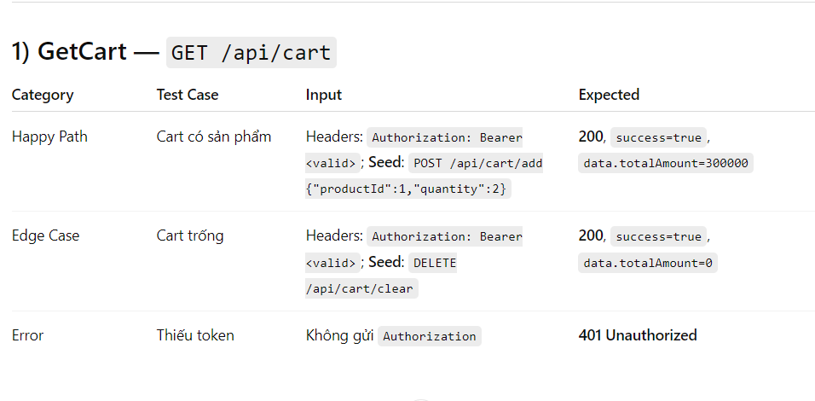
Test cases Matrix

Slide 19
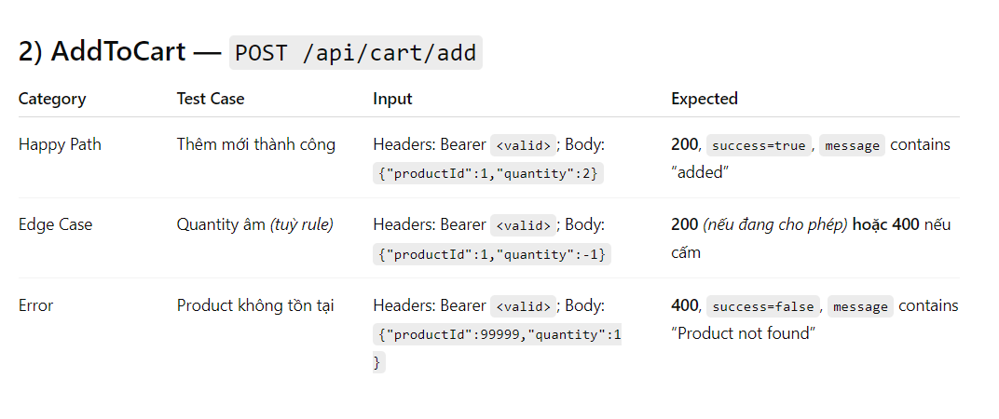
Test cases Matrix

Slide 20
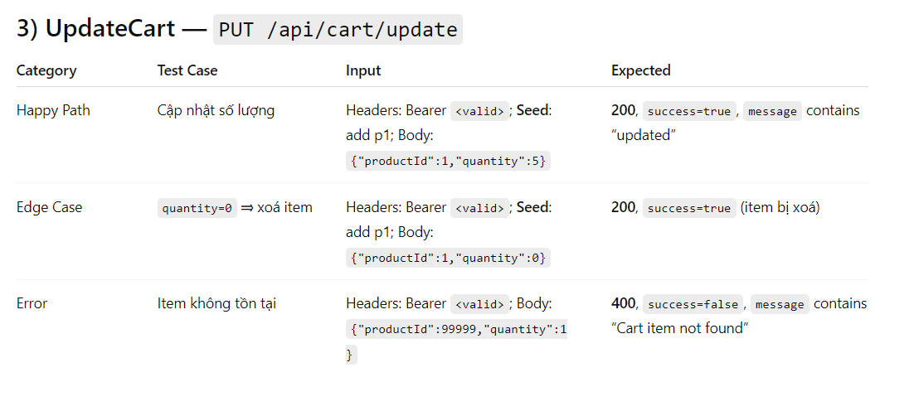
Test cases Matrix

Slide 21
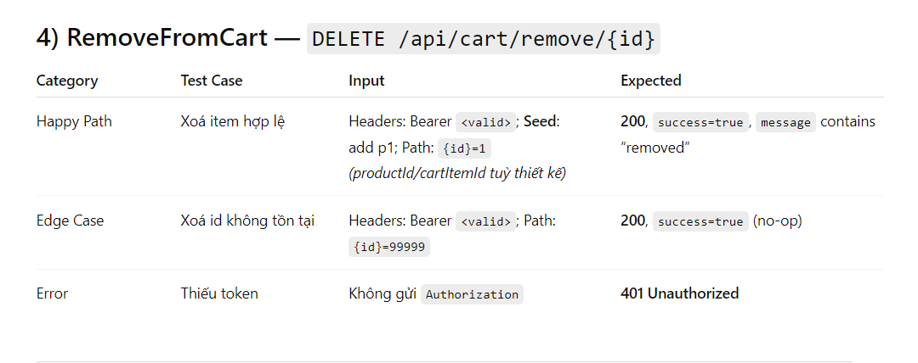
Test cases Matrix

Slide 22
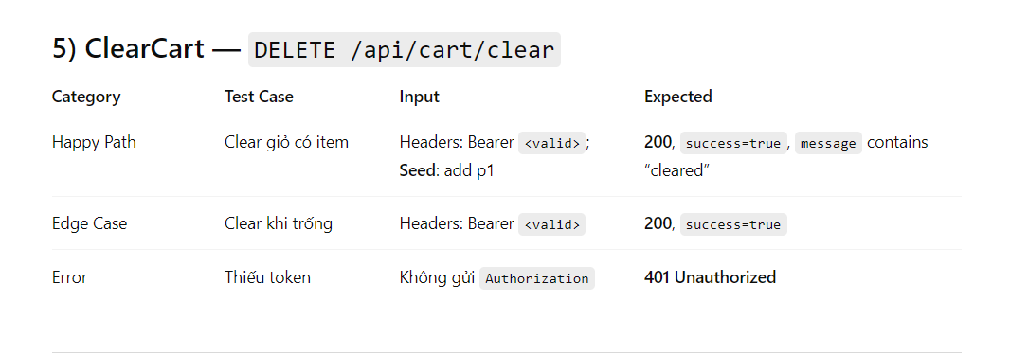
Test cases Matrix

Slide 23
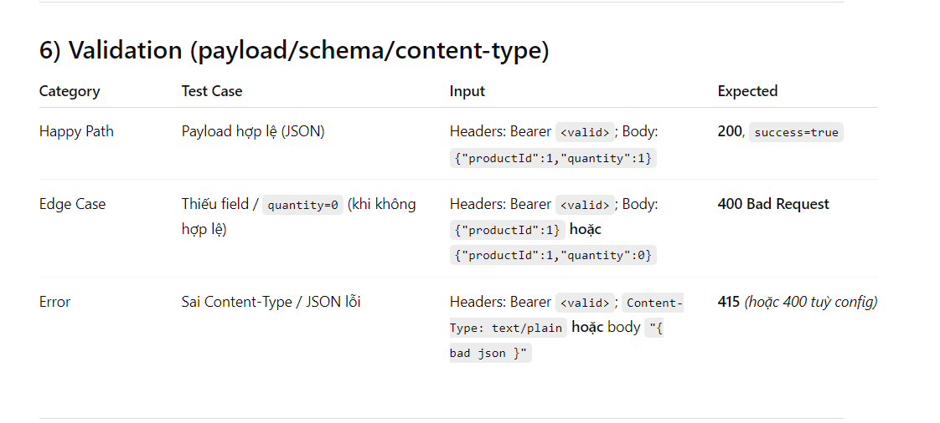
Test cases Matrix

Slide 24
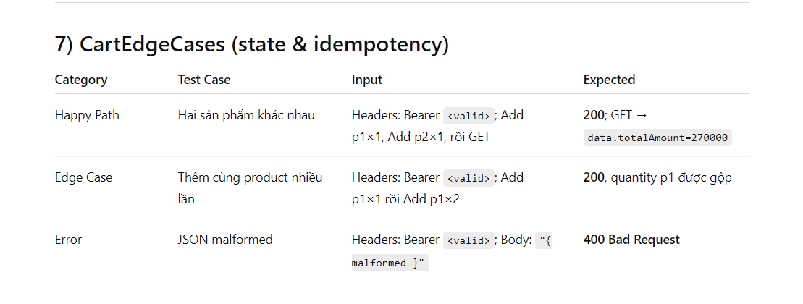
Test cases Matrix

Slide 25
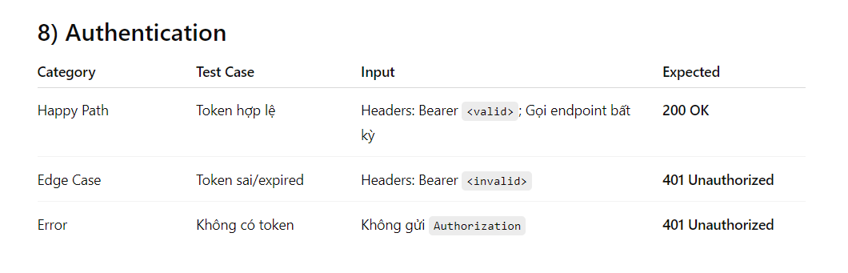
Test cases Matrix

Slide 26
TESTADDTOCART_WITHINVALIDPRODUCT_SHOULDTHROWEXCEPTION
CATEGORY (Phân loại): ❌ ERROR CASE
MỤC ĐÍCH (Purpose):
Kiểm tra hệ thống xử lý lỗi khi người dùng thêm sản phẩm không tồn tại.
Verify that the system throws an exception when trying to add a non-existent product to the cart.
HÀM ĐƯỢC TEST (Function Under Test):
CartService.addToCart(userId, nonExistentProductId, quantity)
KỲ VỌNG (Expected Result):
Hệ thống ném ra RuntimeException
Message: "Product not found"

Slide 27
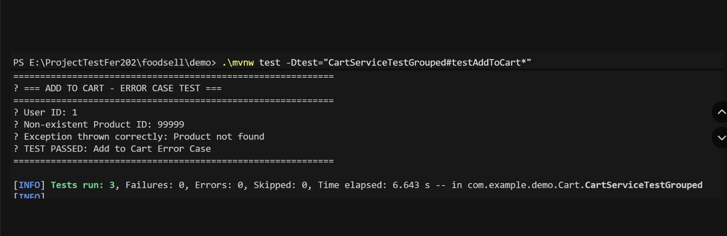

Slide 28
TESTREMOVEFROMCART_WITHINVALIDUSERID_SHOULDNOTTHROWEXCEPTION
CATEGORY (Phân loại): ❌ ERROR CASE
MỤC ĐÍCH (Purpose):
Kiểm tra hành vi của hệ thống khi người dùng thực hiện xóa sản phẩm hoặc làm trống giỏ hàng với userId không hợp lệ.
Verify that the system handles invalid user ID gracefully when removing items or clearing the cart without throwing exceptions.
HÀM ĐƯỢC TEST (Function Under Test):
CartService.removeFromCart(userId, productId)
CartService.clearCart(userId)

Slide 29
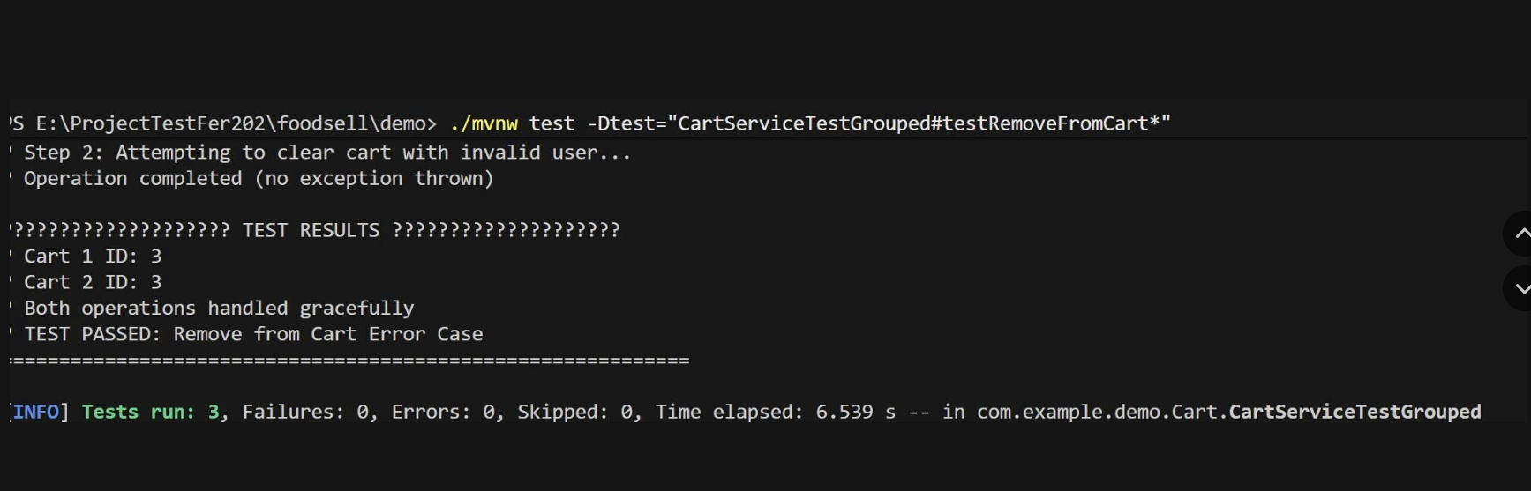

Slide 30
TESTCALCULATETOTAL_WITHVALIDCART_SHOULDSUCCESS
CATEGORY (Phân loại): ✅ HAPPY PATH
MỤC ĐÍCH (Purpose):
Kiểm tra luồng tính tổng tiền, số lượng sản phẩm, và trạng thái giỏ hàng khi dữ liệu hợp lệ.
Verify that the system correctly calculates total amount, counts items, and checks if the cart is empty with valid data.
HÀM ĐƯỢC TEST (Function Under Test):
CartService.calculateTotal(userId)
CartService.getCartItemCount(userId)
CartService.isCartEmpty(userId)

Slide 31
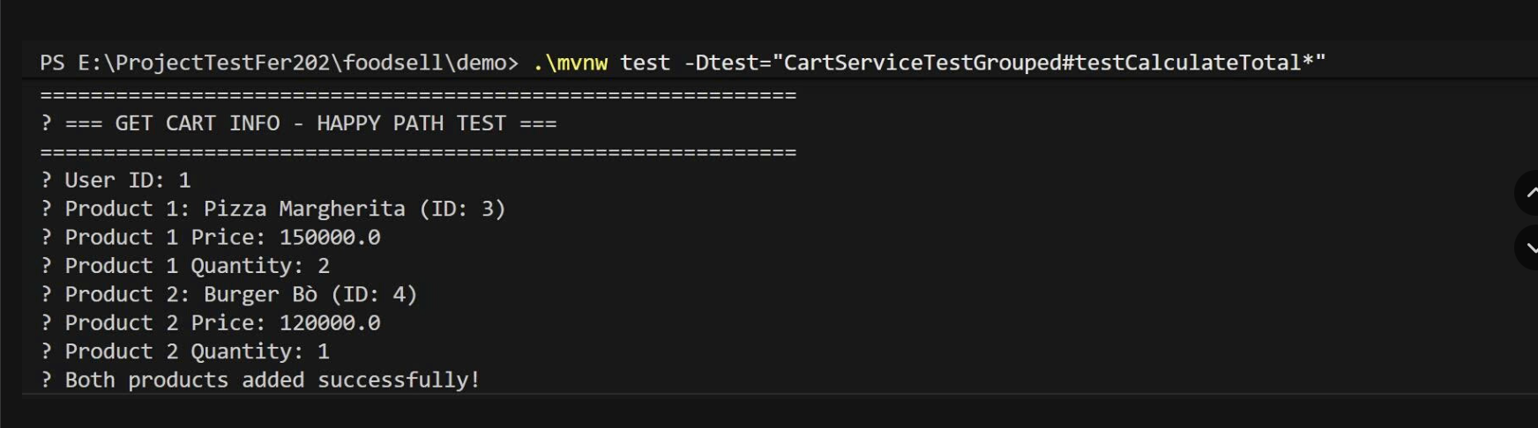

Slide 32

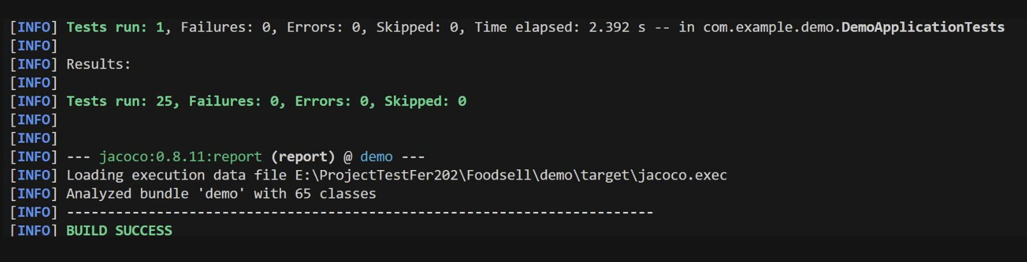
4.Debug

Slide 33

for
Thanks
listening
!

