Slide 1


Slide 2
Who Am I?
Trần Trọng Thanh
3 years working with Flash / Flex / Air
Pyramid Consulting (HCM city)
VNFX: ttt_conan
Twitter: @trongthanh
Email: trongthanh@gmail.com

Slide 3

Augmented Reality
In Flash
(Tương tác bổ sung trong Flash)
Insert Logo Here
Trần Trọng Thanh
11/2010

Slide 4
Content
1. What is Augmented Reality? (5')
2. AR in Flash: FLARToolKit (2')
3. Making a Hello World demo (10')
4. Using animated 3D objects (5')
5. Creating custom marker (10')
6. Multiple markers (5')
7. Inspiring real applications (3')
8. Conclusion (5')

Slide 5
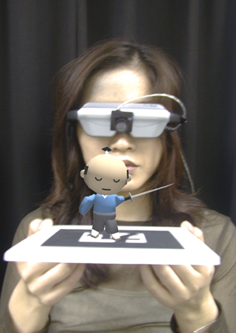
What is Augmented Reality?
live view of reality which is augmented (bổ sung) with computer-generated elements: sound, graphics
advanced AR uses computer vision and object recognition
the surrounding of the user becomes interactive and digitally usable.
AR frameworks for Flash: FLARToolKit, FLARE*

Slide 6
FLARToolKit
ARToolKit (C/C++) → NyARToolKit (Java) → FLARToolKit
Ported by Saqoosha/Libspark.org (2008)
Recognize real-world monochrome (đơn sắc) markers
You have to draw your own 3D graphics (with Papervision3D / Away3D / Sandy / Alternativa3D)
License: GPL or Commercial

Slide 7
Hello FLARToolKit: Build your first demo
Download or check out source of FLARToolKit at: http://www.libspark.org/wiki/saqoosha/FLARToolKit/en
Create new AS3 Project (with FlashDevelop)
Copy libraries and example from FLARToolKit source folder:
- FLARToolKit\libs\Papervision3D\src
- FLARToolKit\libs\NyARToolKitAS3\src
- FLARToolKit\src → org → copy all
- FLARToolKit\src → examples → copy only: ARAppBase.as, PV3DARApp.as, FLARToolKitExample_PV3D.as
- data/camera_para.dat, data/flarlogo.pat

Slide 8
Hello FLARToolKit: Build your first demo
Start Flash CS*
Create a new ActionScript 3 FLA
Set source path to: lib, src (default source folder of FlashDevelop)
Set stage size to 640x480
Set document class as: FLARToolKitExample_PV3D
Run the demo
(See Simple Cube demo & Earth Collada demo)

Slide 9
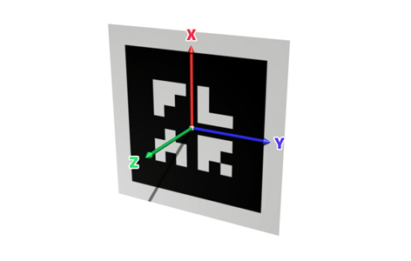
Hello FLARToolKit: Build your first demo
Note: marker's local 3D coordinates (các trục tọa độ của marker)
Image courtesy of Shaqoo.sh

Slide 10
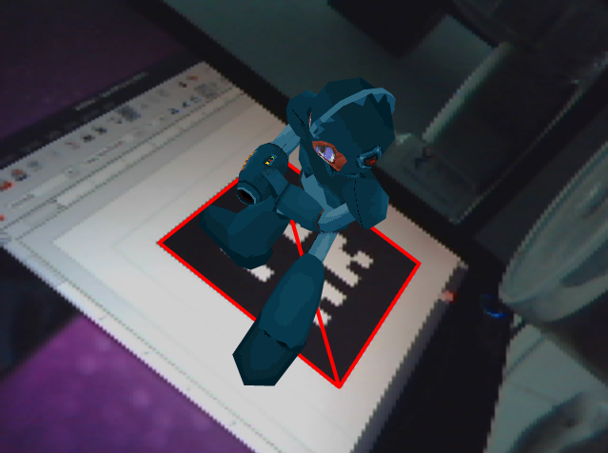
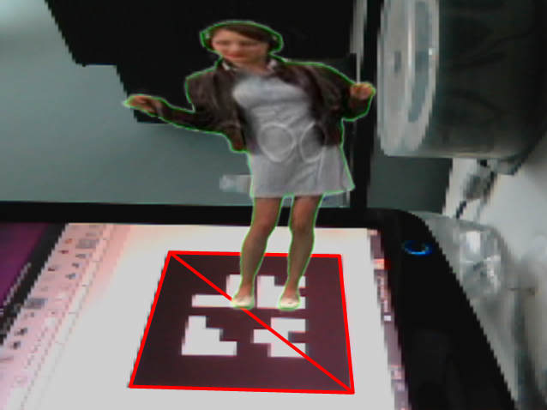
FLARToolKit and Animated 3D objects
A demo of animated MD2
A demo of transparent video plane

Slide 11
Create your own marker
Online marker maker: http://flash.tarotaro.org/ar/MGO2.swf
Marker:
  Monochrome
  Low resolution (4x4 - 64x64)
  Marker percentage:
25%
50%
25%

Slide 12
Multiple markers
Copy FLARTK_Example_Multiple_SimpleCube_PV3D.as from FLARToolKit source code
Correct path to camera_para.dat, flarlogo.pat, L.pat
Setting up and build this application similar to first demo
(see multiple picture planes demo)

Slide 13
Inspiring real applications
Earth Structure Book: http://www.youtube.com/watch?v=1RuZY1NfJ3k
Augmented Reality Tower Defense v0.2 for Nokia N95: http://www.youtube.com/watch?v=zyWVH6jkDHg

Slide 14
Conclusion
Pros:
  On the web = everywhere, no installation
  Flash is a rich interactive platform
  Free and open source
Cons:
  Low processing power
  Low 3D quality

Slide 15
Conclusion
Knowledge of 3D frameworks and 3D programming is key
Improve performance with Alchemy port
Combine with other techniques: motion detection, object recognition...
Limitation is your creativity

Slide 16
Questions & Answers

Slide 17
Links and references
Demo source: http://thanhtran-sources.googlecode.com/svn/trunk/training/AR_in_Flash/ardemos.zip
FLARToolKit: http://www.libspark.org/wiki/saqoosha/FLARToolKit/en
FLARE*: http://www.imagination.at/en/?Products:Augmented_Reality_for_Flash
Wiki about AR: http://en.wikipedia.org/wiki/Augmented_reality
ATOMIC Web Authoring Tool: http://www.sologicolibre.org/projects/atomicweb/en/
Marker maker: http://flash.tarotaro.org/blog/2009/07/12/mgo2/
FLARToolKit Starterkit: http://saqoo.sh/a/flartoolkit/start-up-guide?lang=en
FLARManager: http://words.transmote.com/wp/flarmanager/
Quake 2 models used in Megaman demo: http://www.noderunner.net/~llin/old/models.html

Slide 18
Thank you

