Slide 1
Chapter 3: Spectrum Analysis

Slide 2
References
[1] Simon Haykin, Adaptive Filter Theory, Prentice Hall,
1996 (3rd Ed.), 2001 (4th Ed.).
[2] Steven M. Kay, Fundamentals of Statistical Signal Processing: Estimation Theory, Prentice Hall, 1993.
[3] Alan V. Oppenheim, Ronald W. Schafer, Discrete-Time Signal Processing, Prentice Hall, 1989.
[4] Athanasios Papoulis, Probability, Random Variables, and Stochastic Processes, McGraw-Hill, 1991 (3rd Ed.), 2001 (4th Ed.).

Slide 3
3. Power Spectrum (1)
For a deterministic signal x(t), the spectrum is well defined: If X(ω)
represents its Fourier transform, i.e., if
then | X(ω) |² represents its energy spectrum. This follows from Parseval’s
theorem since the signal energy is given by
Thus, | X(ω) |²Δω represents the signal energy in the band (ω, ω + Δω).
(3-1)
(3-2)
Energy in

Slide 4
3. Power Spectrum (2)
However for stochastic processes, a direct application of (3-1) generates a sequence of random variables for every ω. Moreover, for a stochastic process, E{| X(t) |²} represents the ensemble average power (instantaneous energy) at the instant t.
To obtain the spectral distribution of power versus frequency for stochastic processes, it is best to avoid infinite intervals to begin with, and start with a finite interval (– T, T ) in (3-1). Formally, partial Fourier transform of a process X(t) based on (– T, T ) is given by
so that
represents the power distribution associated with that realization based
on (– T, T ). Notice that (3-4) represents a random variable for every ω and its ensemble average gives, the average power distribution based on (– T, T ). Thus
(3-3)
(3-4)

Slide 5
3. Power Spectrum (3)
(3-5)
represents the power distribution of X(t) based on (– T, T ). If X(t) is
assumed to be w.s.s, then R_{XX}(t₁, t₂) = R_{XX}(t₁ - t₂), and (3-5) simplifies to
Let τ = t₁ – t₂ , we get
to be the power distribution of the w.s.s. process X(t) based on (– T, T ). Finally letting T → ∞ in (3-6), we obtain
(3-6)

Slide 6
3. Power Spectrum (4)
(3-7)
to be the power spectral density of the w.s.s process X(t). Notice that
(3-8)
i.e., the autocorrelation function and the power spectrum of a w.s.s process form a Fourier transform pair, a relation known as the Wiener-Khinchin Theorem. From (3-8), the inverse formula gives
(3-9)
and in particular for τ = 0, we get
(3-10)
From (3-10), the area under S_{XX}(ω) represents the total power of the process X(t), and hence S_{XX}(ω) truly represents the power spectrum.

Slide 7
3. Power Spectrum (5)
represents the power
in the band
The nonnegative-definiteness property of the autocorrelation function translates into the “nonnegative” property for its Fourier transform (power spectrum)
(3-11)
From (3-11), it follows that
(3-12)

Slide 8
3. Power Spectrum (6)
If X(t) is a real w.s.s process, then R_{XX}(τ ) = R_{XX}(-τ ), so that
(3-13)
so that the power spectrum is an even function, (in addition to being real and nonnegative).

Slide 9
3. Power Spectra and Linear Systems (1)
If a w.s.s process X(t) with autocorrelation
function R_{XX}(τ ) → S_{XX}(ω) is applied to a
linear system with impulse response h(t), then
the cross correlation function R_{XY}(τ ) and the output autocorrelation function
R_{YY}(τ ) can be determined. From there
X(t)
h(t)
Y(t)
(3-14)
If
(3-15)
then
(3-16)
since
(3-17)

Slide 10
3. Power Spectra and Linear Systems (2)
Using (3-15)-(3-17) in (3-14) we get
(3-18)
since
where
(3-19)
represents the transfer function of the system, and
(3-20)
From (3-18), the cross spectrum need not be real or nonnegative. However the output power spectrum is real and nonnegative and is related to the input spectrum and the system transfer function as in (3-20). Eq. (3-20) can be used for system identification as well.
Example of Thermal noise (Example 11.1, p. 351, [4])

Slide 11
3. Power Spectra and Linear Systems (3)
W.S.S White Noise Process: If W(t) is a w.s.s white noise process, then
(3-21)
Thus the spectrum of a white noise process is flat, thus justifying its
name. Notice that a white noise process is unrealizable since its total
power is indeterminate.
From (3-20), if the input to an unknown system is a white noise process,
then the output spectrum is given by
(3-22)
Notice that the output spectrum captures the system transfer function
characteristics entirely, and for rational systems Eq (3-22) may be used to determine the pole/zero locations of the underlying system.

Slide 12
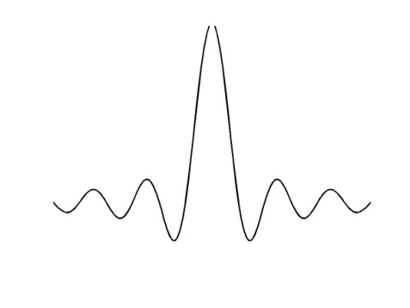
3. Power Spectra and Linear Systems (4)
Example 3.1: A w.s.s white noise process W(t) is passed through a low pass filter (LPF) with bandwidth B/2. Find the autocorrelation function of the output process.
Solution: Let X(t) represent the output of the LPF. Then from (3-22)
(3-23)
Inverse transform of S_{XX}(ω) gives the output autocorrelation function to be
(3-24)

Slide 13
3. Power Spectra and Linear Systems (5)
Eq (3-23) represents colored noise spectrum and (3-24) its autocorrelation function.
Example 3.2: Let
(3-25)
represent a “smoothing” operation using a moving window on the input
process X(t). Find the spectrum of the output Y(t) in term of that of X(t).
Solution: If we define an LTI system with impulse response h(t) as in the figure, then in term of h(t),
(3-25) reduces to
(3-26)
so that
(3-27)
where
(3-28)

Slide 14
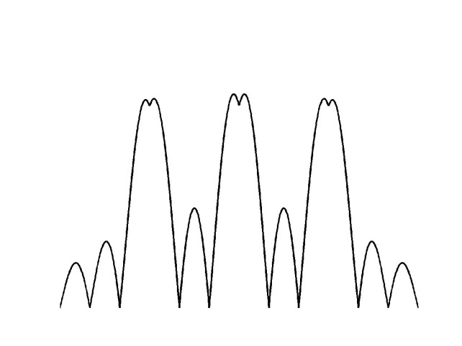
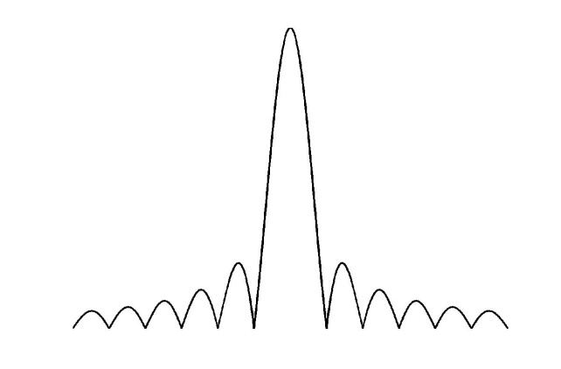
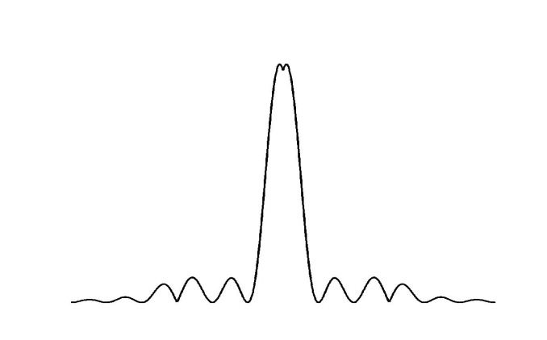
3. Power Spectra and Linear Systems (6)
so that
(3-29)
Notice that the effect of the smoothing operation in (3-25) is to suppress
the high frequency components in the input (beyond π / T), and the
equivalent linear system acts as a low-pass filter (continuous-time moving average) with bandwidth 2π / T in this case.

Slide 15
3. Discrete-Time Processes (1)
For discrete-time w.s.s stochastic processes X(nT) with autocorrelation sequence (proceeding as above) or formally defining a continuous time process we get the corresponding autocorrelation function to be
Its Fourier transform is given by
(3-30)
and it defines the power spectrum of the discrete-time process X(nT).
From (3-30),
(3-31)
so that S_{XX}(ω) is a periodic function with period
(3-32)

Slide 16
3. Discrete-Time Processes (2)
This gives the inverse relation
(3-33)
and
(3-34)
represents the total power of the discrete-time process X(nT). The
input-output relations for discrete-time system h(nT) translate into
(3-35)
and
(3-36)
where
(3-37)
represents the discrete-time system transfer function.

Slide 17
3. Matched Filter (1)
Let r(t) represent a deterministic signal s(t) corrupted by noise. Thus
(3-38)
where r(t) represents the observed data,
and it is passed through a receiver with
impulse response h(t). The output y(t) is
given by
r(t)
h(t)
y(t)
(3-39)
where
and it can be used to make a decision about the presence of absence of
s(t) in r(t). Towards this, one approach is to require that the receiver
output signal to noise ratio (SNR)₀ at time instant t₀ be maximized.
Notice that

Slide 18
3. Matched Filter (2)
(3-41)
represents the output SNR, where we have made use of (3-20) to determine the average output noise power, and the problem is to maximize (SNR)₀ by optimally choosing the receiver filter H(ω).
Optimum Receiver for White Noise Input: The simplest input noise model assumes w(t) to be white noise in (3-38) with spectral density N₀, so that (3-41) simplifies to
(3-42)

Slide 19
3. Matched Filter (3)
Direct application of Cauchy-Schwarz’ inequality in (3-42) gives
(3-43)
and equality in (3-43) is guaranteed if and only if
(3-44)
or
(3-45)
From (3-45), the optimum receiver that maximizes the output SNR at
t = t₀ is given by (3-44)-(3-45). Notice that (3-45) need not be causal, and the corresponding SNR is given by (3-43).

Slide 20
3. Matched Filter (4)
t₀
(a)
(b) t₀=T/2
(c) t₀=T
The figure shows the optimum h(t) for two different values of t₀. In figure(b), the receiver is noncausal, whereas in figure (c) the receiver represents a causal waveform.
If the receiver is causal, the optimum causal receiver can be shown to be
(3-46)
and the corresponding maximum (SNR)₀ in that case is given by
(3-47)

Slide 21
3. Matched Filter (5)
Optimum Transmit Signal: In practice, the signal s(t) in (3-38) may
be the output of a target that has been illuminated by a transmit signal
f (t) of finite duration T. In that case
q(t)
(3-48)
where q(t) represents the target impulse response. One interesting question in this context is to determine the optimum transmit signal f (t) with normalized energy that maximizes the receiver output SNR at t = t₀ in the Matched filter. Notice that for a given s(t), (3-45) represents the optimum receiver, and (3-43) gives the corresponding maximum (SNR)0. To maximize (SNR)₀ in (3-43), we may substitute (3-48) into (3-43). This gives

Slide 22
3. Matched Filter (6)
(3-49)
where
is given by
(3-50)
and is the largest eigenvalue of the integral equation
(3-51)
and
(3-52)

Slide 23
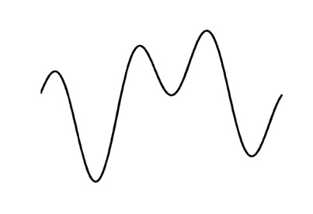
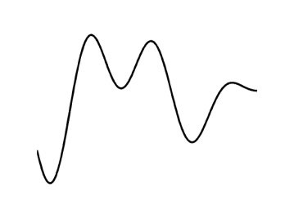
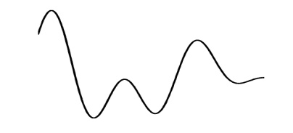
3. Matched Filter (7)
Observe that the kernel in (3-50) captures the target
characteristics so as to maximize the output SNR at the observation
instant, and the optimum transmit signal is the solution of the integral
equation in (3-51) subject to the energy constraint in (3-52). The figure
below shows the optimum transmit signal and the companion receiver
pair for a specific target with impulse response q(t) as shown there.
(a)
(b)
(c)
If the causal solution in (3-46)-(3-47) is chosen, in that case the kernel in (3-50) simplifies to
(3-53)
and the optimum transmit signal is given by (3-51). Notice that in the causal case, information beyond t = t₀ is not used.

Slide 24
3. Matched Filter (8)
What if the additive noise in (3-38) is not white?
Let S_{WW}(ω) represent a (non-flat) power spectral density. In that case,
what is the optimum matched filter?
If the noise is not white, one approach is to whiten the input noise first by passing it through a whitening filter, and then proceed with the whitened output as before.
Whitening Filter
g(t)
colored noise
white noise
Notice that the signal part of the whitened output s_{g}(t) equals
(3-54)
where g(t) represents the whitening filter, and the output noise n(t) is
white with unit spectral density.

Slide 25
3. Matched Filter (9)
Whitening Filter: What is a whitening filter? From the discussion above, the output spectral density of the whitened noise process S_{nn}(ω) equals unity, since it represents the normalized white noise by design. But from (3-20)
which gives
(3-55)
i.e., the whitening filter transfer function G(ω) satisfies the magnitude
relationship in (3-55). To be useful in practice, it is desirable to have the whitening filter to be stable and causal as well. Moreover, at times
its inverse transfer function also needs to be implementable so that it
needs to be stable as well. How does one obtain such a filter (if any)?

Slide 26
3. Matched Filter (10)
From there, any spectral density that satisfies the finite power constraint
(3-56)
and the Paley-Wiener constraint (see Eq. (12-4), p. 402, [4])
(3-57)
can be factorized as
(3-58)
where H(s) together with its inverse function 1/H(s) represent two
filters that are both analytic in Re s > 0. Thus H(s) and its inverse 1/ H(s)
can be chosen to be stable and causal in (3-58). Such a filter is known as the Wiener factor, and since it has all its poles and zeros in the left half plane, it represents a minimum phase factor. In the rational case, if X(t) represents a real process, then S_{XX}(ω) is even and hence (3-58) reads

Slide 27
3. Matched Filter (11)
(3-59)
Example 18.3: Consider the spectrum
which translates into
The poles ( × ) and zeros ( º ) of this
function are shown in the figure. From there to maintain the symmetry condition in (3-59), we may group together the left half factors as

Slide 28
3. Matched Filter (12)
and it represents the Wiener factor for the spectrum S_{XX}(ω) above. Observe that the poles and zeros (if any) on the jω-axis appear in even multiples in S_{XX}(ω) and hence half of them may be paired with H(s) (and the other half with H(– s)) to preserve the factorization condition in (3-58). Notice that H(s) is stable, and so is its inverse.
More generally, if H(s) is minimum phase, then ln H(s) is analytic on
the right half plane so that
(3-60)
gives
Thus

Slide 29
3. Matched Filter (13)
Since cosωt and sinωt are Hilbert transform pairs, it follows that the phase function ϕ(ω) in (3-60) is given by the Hilbert transform of ln A(ω). Thus
(3-61)
Eq. (3-60) may be used to generate the unknown phase function of a minimum phase factor from its magnitude.
For discrete-time processes, the factorization conditions take the form
(3-62)
and
(3-63)
In that case
where the discrete-time system

Slide 30
3. Matched Filter (14)
is analytic together with its inverse in |z| >1. This unique minimum phase function represents the Wiener factor in the discrete-case.
Matched Filter in Colored Noise: Returning back to the matched filter
problem in colored noise, the design can be completed as shown in figure
below
h₀(t)=s_{g}(t₀ – t)
Whitening Filter
Matched Filter
where G(jω) represents the whitening filter associated with the noise
spectral density S_{WW}(ω) as in (3-55)-(3-58). Notice that G(s) is the inverse of the Wiener factor L(s) corresponding to the spectrum S_{WW}(ω) i.e.,
(3-64)
The whitened output s_{g}(t) + n(t) in the figure is similar to (3-38), and from (3-45) the optimum receiver is given by

Slide 31
3. Matched Filter (15)
where
If we insist on obtaining the receiver transfer function H(ω) for the original colored noise problem, we can deduce it easily from the below figure
L⁻¹(s)
L(s)
144424443
H
ω
0
()
where
(3-65)

Slide 32
3. AM/FM Noise Analysis (1)
Consider the noisy AM signal
(3-66)
and the noisy FM signal
(3-67)
where
(3-68)
Here m(t) represents the message signal and θ a random phase jitter in the received signal. In the case of FM, ω(t) = ϕ’(t) = c m(t) so that the instantaneous frequency is proportional to the message signal. We will assume that both the message process m(t) and the noise process n(t) are w.s.s with power spectra S_{mm}(ω) and S_{nn}(ω) respectively. We wish to determine whether the AM and FM signals are w.s.s, and if so their respective power spectral densities.

Slide 33
3. AM/FM Noise Analysis (2)
Solution: AM signal: In this case from (3-66), if we assume θ ∼ U(0, 2π), then
(3-69)
so that (see figure below)
(3-70)
(a)
(b)
Thus AM represents a stationary process under the above conditions.

Slide 34
3. AM/FM Noise Analysis (3)
FM signal: In this case (suppressing the additive noise component in (3-67), we obtain
(3-71)
since

Slide 35
3. AM/FM Noise Analysis (4)
Eq (3-71) can be rewritten as
(3-72)
where
(3-73)
and
(3-74)
In general, a(t,τ) and b(t,τ) depend on both t and τ so that noisy FM is not w.s.s in general, even if the message process m(t) is w.s.s. In the special case when m(t) is a stationary Gaussian process, from (3-68), ϕ(t) is also a stationary Gaussian process with autocorrelation function
(3-75)
for the FM case.

Slide 36
3. AM/FM Noise Analysis (5)
In that case the random variable
(3-76)
where
(3-77)
Hence its characteristic function is given by
(3-78)
which for ω = 1 gives
(3-79)
where we have made use of (3-76) and (3-73)-(3-74). On comparing
(3-79) with (3-78), we get
(3-80)
and
(3-81)

Slide 37
3. AM/FM Noise Analysis (6)
so that the FM autocorrelation function in (3-72) simplifies into
(3-82)
Notice that for stationary Gaussian message input m(t) (or ϕ(t)), the
nonlinear output X(t) is indeed strict sense stationary with autocorrelation function as in (3-82).
Find R_{XX}(τ) for narrowband FM and wideband FM?

Slide 38
Chapter 4: Eigenanalysis

Slide 39
4. Eigenanalysis: Definitions (1)
Let R denote (M×M)-correlation matrix of wide-sense DTStP represented by (M×1)-observation vector u(n). Finding (M×1)-vector q such that:
for some constant λ, rewriting in form:
(4.2) has nonzero solution in vector q if:
Equation (4.3) called characteristic equation, whose roots λ₁, λ₂,…, λ_{M} called eigenvalues. General, (4.3) has M distinct roots → M solutions in the vector q.
(4.1)
(4.2)
(4.3)

Slide 40
4. Eigenanalysis: Definitions (2)
Let λ_{I} denote i-th eigenvalue of matrix R, q_{i} be a nonzero vector such that:
Vector q_{i} called eigenvector associated with λ_{i}
Example: see pp. 161-162, [1]
(4.4)

Slide 41
4. Eigenanalysis: Properties (1)
λ₁, λ₂,…, λ_{M} are eigenvalues of correlation matrix R, then eigenvalues of correlation matrix R^{k} equal λ₁^{k}, λ₂^{k},…, λ_{M}^{k} for any k > 0.
Let q₁, q₂,…, q_{M} be eigenvector corresponding to distinct eigenvalues λ₁, λ₂,…, λ_{M} of (M×M)-correlation matrix R. Then, q₁, q₂,…, q_{M} are linearly independent.
Let λ₁, λ₂,…, λ_{M} be eigenvalues of (M×M)-correlation matrix R. Then all these eigenvalues are real and nonnegative.
Let q₁, q₂,…, q_{M} be eigenvector corresponding to distinct eigenvalues λ₁, λ₂,…, λ_{M} of (M×M)-correlation matrix R. Then, q₁, q₂,…, q_{M} are orthogonal to each other.

Slide 42
4. Eigenanalysis: Properties (2)
Let q₁, q₂,…, q_{M} be eigenvector corresponding to distinct eigenvalues λ₁, λ₂,…, λ_{M} of (M×M)-correlation matrix R. Define (M×M)-matrix:
where
Define (M×M)-diagonal matrix:
Then, original matrix R may be diagonalized as:
where Q is nonsingular with Q⁻¹=Q^{H} → Q is unitary matrix.
(4.5)

Slide 43
4. Eigenanalysis: Properties (3)
(4.5) can be written:
Let λ₁, λ₂,…, λ_{M} be eigenvalues of (M×M)-correlation matrix R. Then sum of these eigenvalues equals the trace of R:
trace of a square matrix defined as sum of diagonal elements of the matrix.
(4.6)
(4.7)

Slide 44
4. Eigenanalysis: Properties (4)
Condition number = eigenvalue spread = eigenvalue factor:
Eigenvalues of correlation matrix of a DTStP are bounded by min and max values of power spectral density of the process:
Condition number is bounded by:
(4.8)
(4.9)

Slide 45
4. Eigenanalysis: Properties (5)
Minimax Theorem: Let (M×M)-correlation matrix R have eigenvalues λ₁, λ₂,…, λ_{M} that are arranged in decreasing order as:
Then:
where C is subspace of vector space of all (M×1)-complex vector; dim(C): dimension of subspace C.
Subspace of dimension k defined as set of complex vectors that can be written as a linear combination of q₁, q₂,…,q_{k}
(4.10)

Slide 46
4. Eigenanalysis: Properties (6)
Karhunen-Loeve expansion: Let (M×1)-vector u(n) drawn from a wide-sense stationary process of zero mean and correlation matrix R. Let q₁, q₂,…, q_{M} be eigenvector corresponding to M eigenvalues of R. Vector u(n) may be expanded as linear combination of these eigenvector:
Coefficients of the expansion are zero-mean, uncorrelated random variables defined by:
(4.11)
(4.12)

Slide 47
4. Eigenanalysis: Properties (7)
where
Physical interpretation: viewing eigenvectors q₁, q₂,…,q_{M} as coordinates of an M-dimensional space, thus representing random vector u(n) by set of its projections c₁(n), c₂(n), …, c_{M}(n) on these axes.
From (4.11):
From (4.12), (4.13):
(4.13)
(4.14)
(4.15)

Slide 48
4. Eigenanalysis: Low-Rank Modeling (1)
Dimensionality reduction: Transformation in a way that a data vector (in data space) can be represented by a reduced number of effective feature (in feature space) and yet retain most of intrinsic content of input data.
Consider M-dimensional data vector u(n) (representing realization of a wide sense stationary process) that may be expanded as a linear combination of eigenvectors q₁, q₂,…, q_{M} corresponding to distinct eigenvalues λ₁, λ₂,…, λ_{M} of (M×M)-correlation matrix R of u(n). See (4.11). If knowing prior knowledge that (M-p) eigenvalues λ_{p+1},…, λ_{M} are all very small, then truncating (4.11) at term i=p. Then, an approximate reconstruction of data vector u(n) can be defined:

Slide 49
4. Eigenanalysis: Low-Rank Modeling (2)
Vector u’(n) has rank p < M of original data vector u(n). Model in (4.16): low-rank model.
Meaning: approximation u’(n) can be reconstructed by using a set of p numbers c₁(n), c₂(n), …, c_{p}(n). In other words, new vector c(n)=[c₁(n), c₂(n), …, c_{p}(n)] is viewed as a reduced-rank representation for u(n).
Transformation: M-dimensional data space to p-dimensional feature space → subspace decomposition
(4.16)

Slide 50
4. Eigenanalysis: Low-Rank Modeling (3)
Reconstruction error vector:
Mean-square error:
→ Error is small → good data reconstruction if eigenvalues λ_{p+1},…, λ_{M} are all very small.
Example: Application of Low-Rank Modeling (see pp.179-180, [1])
(4.17)
(4.18)

Slide 51
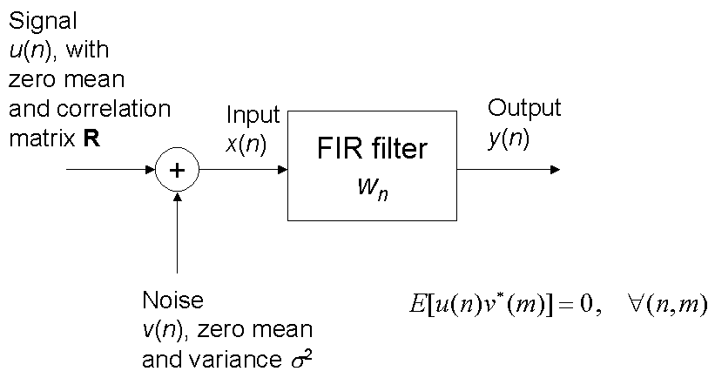
4. Eigenanalysis: Eigenfilters (1)
Design optimum FIR filter with optimization criterion of maximizing output signal-to-noise ratio

Slide 52
4. Eigenanalysis: Eigenfilters (2)
Effects of signal only: Average power of signal at filter output:
Effects of noise only: Average power of noise at filter output:
Output signal-to-noise ratio:
(4.18)
(4.19)
(4.20)

Slide 53
4. Eigenanalysis: Eigenfilters (3)
Optimum problem: max (SNR)_{o} subject to w^{H}w=1.
Applying minimax theorem (4.10):
Optimum FIR filter that produces (4.21) having coefficient vector w_{o}=q_{max} is called eigenfilter,
where q_{max}: eigenvector associated with λ_{max} .
Note: Eigen filter maximizes the output SNR for a random signal (w.s.s) in additive white noise,
while a matched filter maximizes the output SNR for a known signal in additive white noise.
(4.21)

