Slide 1
Chapter 5: Wiener Filter
Wiener filter
Principle of orthogonality
Wiener-Hopf equations
Error performance surface
Linearly Constrained Minimum Variance Filter
(LCMV Filter)
Examples: Fixed Weight Beamforming

Slide 2
References
[1] Simon Haykin, Adaptive Filter Theory, Prentice Hall, 1996.
[2] Steven M. Kay, Fundamentals of Statistical Signal Processing: Estimation Theory, Prentice Hall, 1993.
[3] Alan V. Oppenheim, Ronald W. Schafer, Discrete-Time Signal Processing, Prentice Hall, 1989.
[4] Athanasios Papoulis, Probability, Random Variables, and Stochastic Processes, McGraw-Hill, 1991.

Slide 3
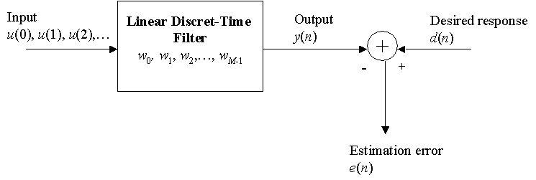
5. Wiener Filter: Linear Optimum Filtering
Block diagram representation of the optimum filtering problem:
The goal of the optimum filter is to provide an estimate of the desired response that is “as close as possible”.
Questions :
Is the filter impulse response finite or infinite?
What statistical criterion is used for optimization?

Slide 4
5. Wiener Filter: Statistical Criteria for Optimization
Typical choices
Mean-squared value of the error
Expectation of the absolute value of the error
Expectation of third or higher order powers of the absolute value of the error.
The first choice is most preferred as it leads to a mathematically tractable solution.
Minimum Mean-Squared Error (MMSE) criteria
Design the linear discrete time filter such that the mean-squared value of the estimation error is minimum.

Slide 5
5. WF: Mean-Squared Error (Cost Function)
Mean-Squared Error (Cost Function):
where
Question: Condition for J→J_{min} ?

Slide 6
5. WF: Principle of Orthogonality (1)
Taking derivative of J with respect to w*:
Let : Principle of orthogonality
Moreover:
with optimum condition:
then
and

Slide 7
5. WF: Principle of Orthogonality (2)
The principle of orthogonality states that:
The necessary and sufficient condition for the cost function J to attain its minimum value is that the estimation error and the input values are orthogonal to each other.
The corollary:
When the filter operates in its optimum condition, the output of the filter is orthogonal to the estimation error.

Slide 8
5. WF: Wiener-Hopf Equations (1)
The MMSE criterion for designing the optimal filter leads to a set of equations given by:
then
where r(k) is the auto-correlation function of the input, p(k) is the cross-correlation between the input and the desired response, and w_{opt,i} is the i^{th} optimal weight value.
These equations are known as the Wiener - Hopf equations and form the basis for adaptive filtering algorithms.

Slide 9
5. WF: Wiener-Hopf Equations (2)
In matrix form:
where
then

Slide 10
5. WF: Error Performance Surface
The cost function J for the transversal filter can be written as:
where σ_{d}² is the variance of the desired signal.
In optimum condition, we obtain MMSE:
The cost function is a second order function of the tap weights. It can be visualized as a bowl-shaped (M+1) dimensional surface with M degrees of freedom.

Slide 11
5. WF: Example 1 (1)
In a Wiener filtering problem, the correlation matrix and the cross-correlation vector are:
Evaluate the tap weights of the Wiener filter.
Express the cost function in terms of the weights.
Plot the error performance surface assuming that the variance of the desired input is 0.5. What is the minimum mean squared error?

Slide 12
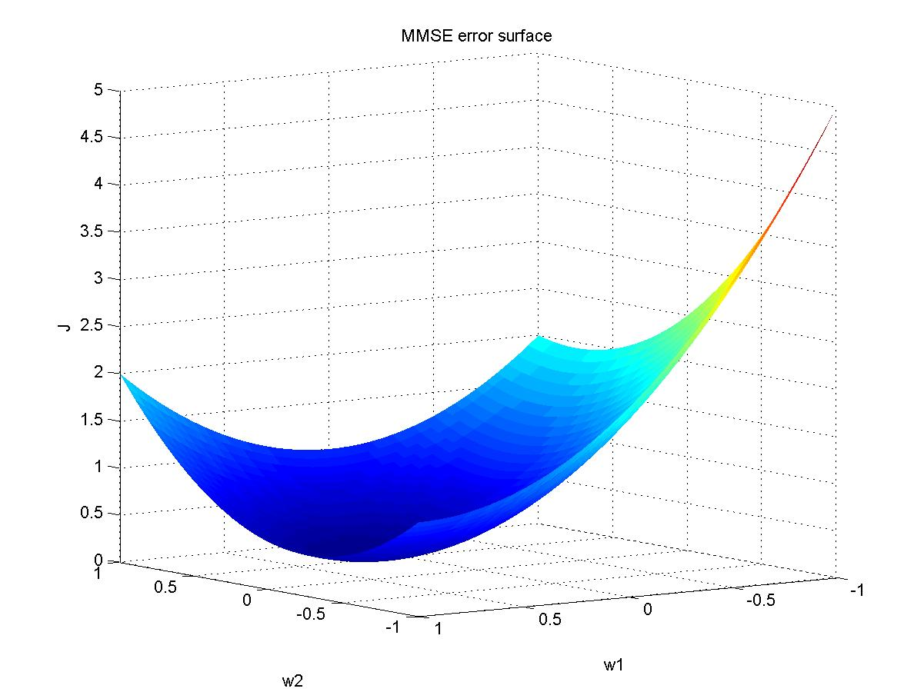
5. WF: Example 1 (2)

Slide 13
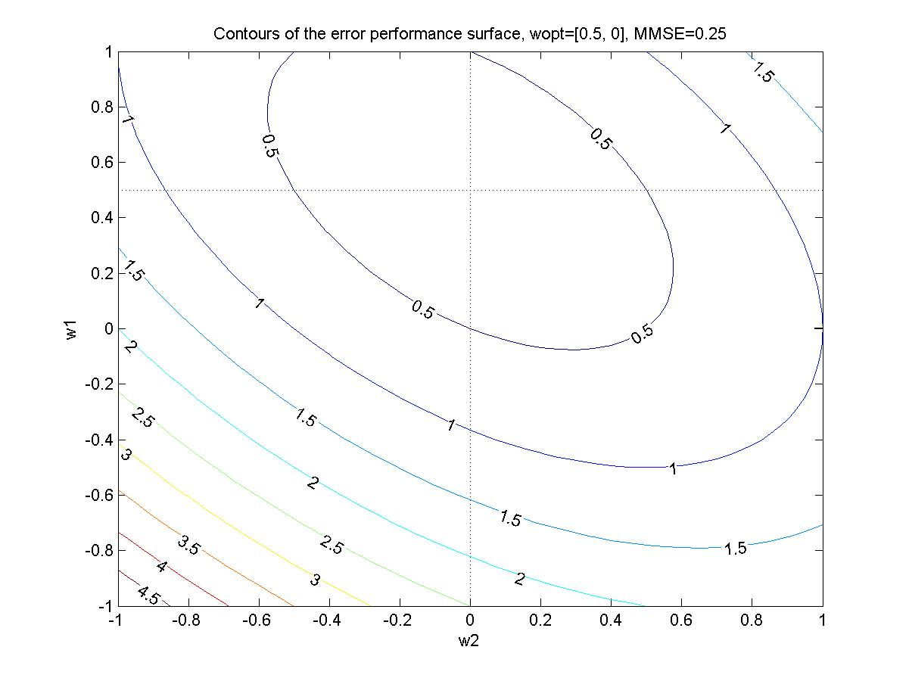
5. WF: Example 1 (3)

Slide 14
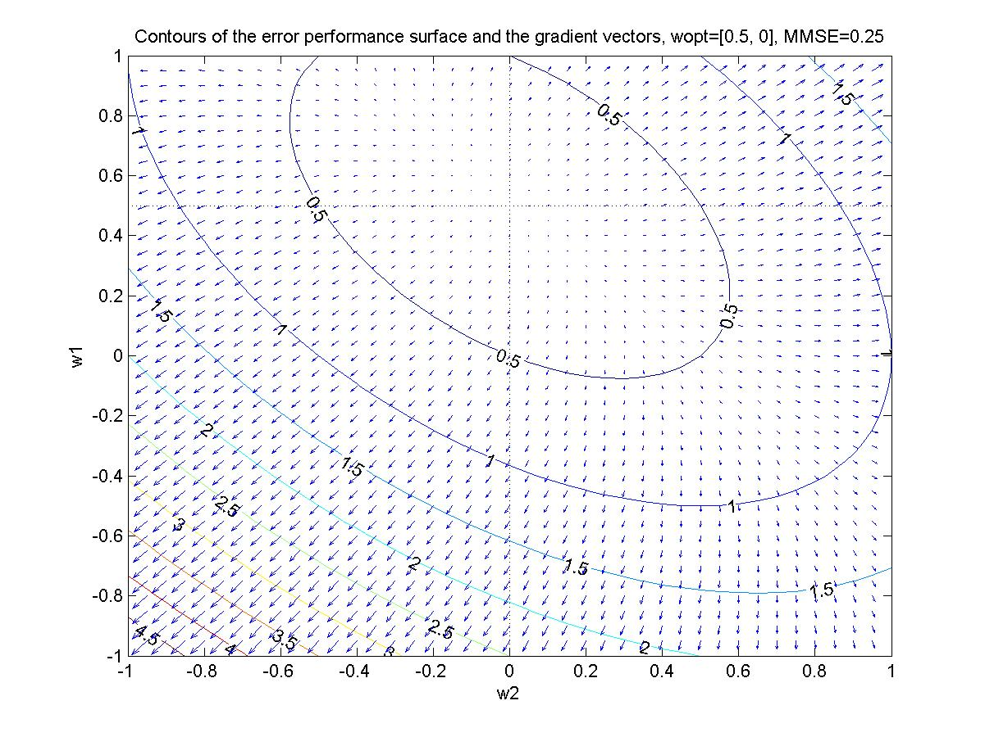
5. WF: Example 1 (4)

Slide 15
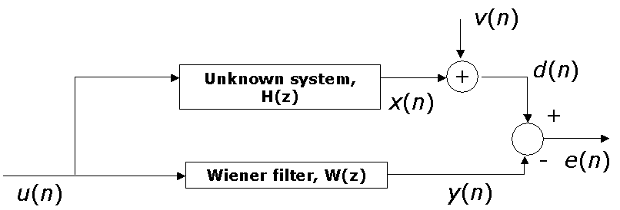
5. WF: Example 2
Consider the system identification problem shown below:
Both u(n) and v(n) are zero-mean, white noise sequences with variances 0.5 and 0.1 respectively.
If H(z) = 1-0.5z⁻¹+0.25z⁻², find the optimum Wiener solution for filter lengths of 1, 2, 3, and 4. In each case, calculate the minimum mean squared error.

Slide 16
5. WF: Constrained Optimization
The Wiener-Hopf equations are sometimes referred to as unconstrained optimization.
In some situations, a constraint is placed on finding the solution with minimum mean squared error.
The solution, termed Linearly Constrained Minimum Variance (LCMV), is found using Lagrange multipliers.

Slide 17
5. WF: LCMV Filter (1)
Output of the filter:
Assumed a complex sinusoidal excitation:
then:
where
The linear constraint: , enforcing a:
certain value g* of the transfer function of the filter at frequency ω₀=φ₀/T (case of temporal frequency),
certain antenna gain at an angle of arrival θ₀ with φ₀=2πΔsinθ₀ /λ, where Δ is inter-antenna element spacing and λ is wavelength of the incomming signal (case of spatial frequency),
while trying to find a weight vector w_{opt}, which minimizes the output power E[y(n)y*(n)]

Slide 18
5. WF: LCMV Filter (2)
It means:
subject to
Using Lagrange multipliers (see Reference [1]), we obtain finally:
When g=1 ⇒ Minimum Variance Distortionless Response (MVDR), with

Slide 19
5. Smart Antennas (1)
Traditional array antennas, where the main beam is steered to directions of interest, are called phased arrays, beamsteered arrays, or scanned arrays. The beam is steered via phase shifters oftenly implemented at RF frequencies. This general approach to phase shifting has been referred to as electronic beamsteering because of the attempt to change the phase of the current directly at each antenna element.
Modern beamsteered array antennas, where the pattern is shaped according to certain optimum criteria, are called smart antennas. Smart antennas have alternatively been called digital beamformed (DBF) arrays or adaptive arrays (when adaptive algorithms are employed). The term smart implies the use of digital signal processing in order to shape the beam pattern according to certain conditions. Since an antenna pattern (or beam) is formed by digital signal processing, this process is often referred to as digital beamforming.

Slide 20
5. Smart Antennas (2)
Smart antennas can be applied for improved radar systems, improved system capacities with mobile wireless, and improved wireless communications through the implementation of space division multiple access (SDMA).
Smart antenna patterns are controlled via algorithms based upon certain criteria. These criteria could be maximizing the signal-tointerference ratio (SIR), minimizing the variance, minimizing the means-quare error (MSE), steering toward a signal of interest, or nulling the interfering signals.
The implementation of these algorithms can be performed electronically through analog devices but it is generally more easily performed using digital signal processing. This requires that the array outputs be digitized through the use of an A/D converter. This digitization can be performed at either IF or baseband frequencies.

Slide 21
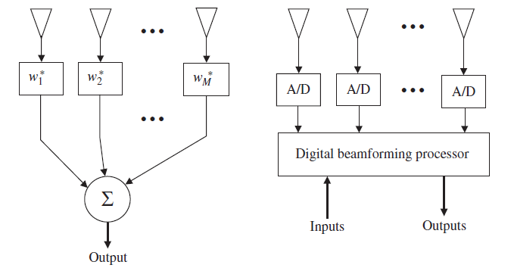
5. Smart Antennas (3)
The main advantage of digital beamforming is that phase shifting and array weighting can be performed on the digitized data rather than by being implemented in hardware. If the parameters of operation are changed or the detection criteria are modified, the beamforming can be changed by simply changing an algorithm rather than by replacing hardware.

Slide 22
5. Smart Antennas (4)
There are two types of digital beamforming:
Fixed weight beamforming.
Adaptive beamforming.
In this chapter, we consider algorithms for fixed weight beamforming. Algorithms for adaptive beamforming will be considered in chapter 8.

Slide 23
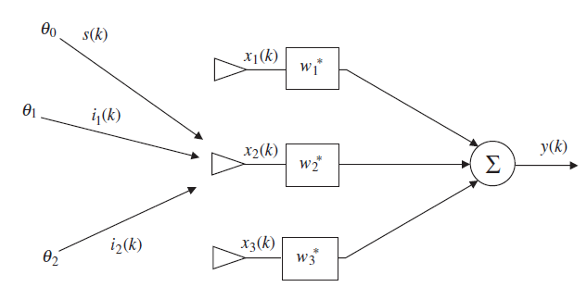
5. Fixed Weight Beamforming (1)
Maximum signal-to-interference ratio:
One criterion which can be applied to enhancing the received signal and minimizing the interfering signals is based upon maximizing the SIR.
Example: 3-element array with one fixed known desired source and two fixed undesired interferers. All signals are assumed to operate at the same carrier frequency.

Slide 24
5. Fixed Weight Beamforming (2)
The required complex weights w₁, w₂, and w₃ can be determined as
where
is matrix of steering vectors, and u₁ = [1 0 … 0]^{T}. The steering vector for each source is given by
and σ_{n}² is the noise variace (noise power).
Example: if the desired signal is arriving from θ₀ = 0◦, while θ₁ = −45◦ and θ₂ = 60◦, the necessary weights can be calculated to be

Slide 25
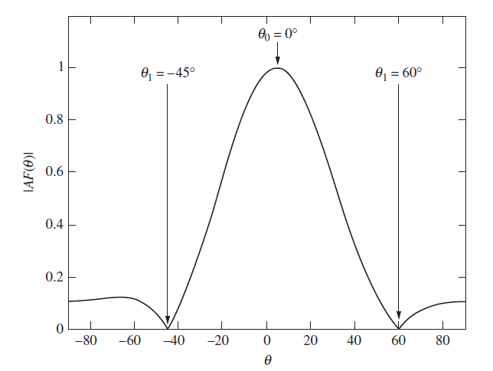
5. Fixed Weight Beamforming (3)
The array factor is plotted as

Slide 26
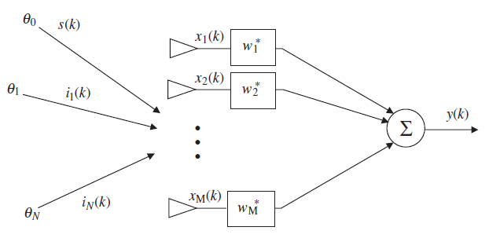
5. Fixed Weight Beamforming (4)
The general case for max SIR:
It shows one desired signal arriving from the angle θ₀ and N interferers arriving from angles θ₁, . . . , θ_{N}. The signal and the interferers are received by an array of M elements with M potential weights. Each received signal at element m also includes additive Gaussian noise. Time is represented by the kth time sample.

Slide 27
5. Fixed Weight Beamforming (5)
The array output y can be given in the following form:
where
and w = [w₁ w₂ … w_{M}]^{T} is array weights; x_{s}(k): desired signal vector; x_{i}(k): interfering signals vector; n(k): zero-mean Gaussian noise for each channel; and a_{i}: M-element array steering vector for the θ_{i} direction of arrival.

Slide 28
5. Fixed Weight Beamforming (6)
Therefore, the array output can be re-written as
where u(k) = x_{i}(k) + n(k) is undesired signal.
The SIR is defined as the ratio of the desired signal power divided by the undesired signal power
where R_{ss} = E[x_{s}x_{s}^{H}] is signal correlation matrix; R_{ii} = E[x_{i}x_{i}^{H}] is correlation matrix for interferers; and R_{nn} = E[nn^{H}] is correlation matrix for noise. The SIR can be maximized by taking the derivative with respect to w and setting the result equal to zero, then we obtain

Slide 29
5. Fixed Weight Beamforming (7)
This equation is an eigenvector equation with SIR being the eigenvalues.The maximum SIR (SIR_{max}) is equal to the largest eigenvalue λ_{max} for the Hermitian matrix R⁻¹_{uu}R_{ss}. The eigenvector associated with the largest eigenvalue is the optimum weight vector w_{opt}. Thus
The final optimized weight for max SIR is
where
Example: M = 3-element array with spacing d = 0.5λ has a noise variance σ²_{n} = 0.001, a desired received signal arriving at θ₀ = 30◦, and two interferers arriving at angles θ₁ = −30◦ and θ₂ = 45◦. Assume that the signal and interferer amplitudes are constant.

Slide 30
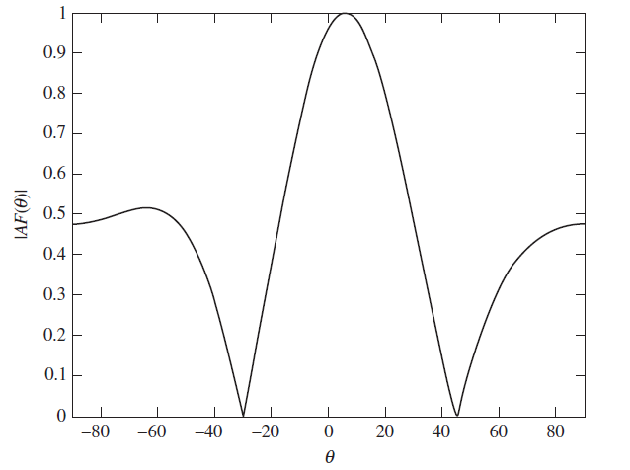
5. Fixed Weight Beamforming (8)

Slide 31
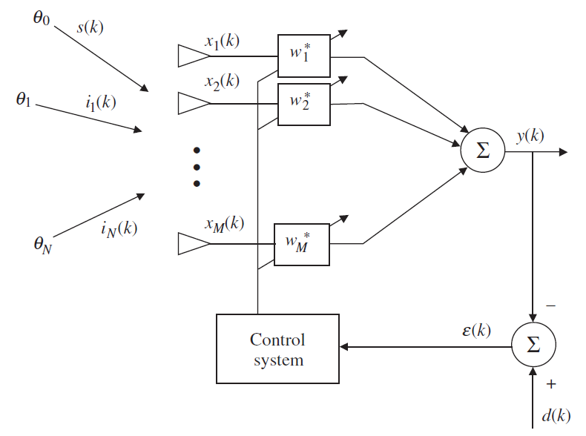
5. Fixed Weight Beamforming (9)
Minimum mean-square error

Slide 32
5. Fixed Weight Beamforming (10)
The signal d(k) is the reference signal. Preferably the reference signal is either identical to the desired signal s(k) or it is highly correlated with s(k) and uncorrelated with the interfering signals i_{n}(k). If s(k) is not distinctly different from the interfering signals, the minimum mean square technique will not work properly. The signal ε(k) is the error signal such that
The mean-square error is given by
where

Slide 33
5. Fixed Weight Beamforming (11)
The optimum weights provide the minimum mean-square error, the optimum Wiener solution given as
If we allow the reference signal d to be equal to the desired signal s, and if s is uncorrelated with all interferers, we may simplify as
where
The optimum weights can then be identified as

Slide 34
5. Fixed Weight Beamforming (12)
Minimum variance - MV (or minimum variance distortionless response - MVDR):
The goal of the minimum variance method is to minimize the array output noise variance. The weighted array output is given by
In order to ensure a distortionless response, we must also add the constraint that
Finally, the minimum variance optimum weights can be obtained as
where
is the correlation matrix of unwanted signals and noise.

Slide 35
Chapter 6: Linear Prediction
Forward Linear Prediction.
Backward Linear Prediction.
Levinson-Durbin Algorithm.

Slide 36
6. Linear Prediction: Definitions (1)
(M+1) samples of time series (Stationary DTSt process) :
Linear prediction of order M-Forward Prediction: Predicting (estimating) the future value u(n) using the M samples u(n-1), u(n-2),…, u(n-M)
u(n-1): tap inputs
Predictor vector (tap weight vector) of order M-Forward Predictor:

Slide 37
6. Linear Prediction: Definitions (2)
Prediction error of order M-Forward Prediction Error:
⇒ Mean-squared prediction error:
if tap inputs u(n-1) have zero-mean, then P_{M} called forward prediction error power.
Correlation matrix of tap inputs:

Slide 38
6. Linear Prediction: Definitions (3)
Cross correlation vector between tap inputs u(n-1) and the future value u(n):
Variance of u(n) equals r(0) since u(n) has zero-mean
Vector reversing (backward):

Slide 39
6. LP: Optimal Forward Linear Prediction
Optimal criterion:
Optimal solution: based on optimal Wiener filter design with:
output filter: w^{H}u(n-1)
desired signal: d(n)=u(n)
Therefore, optimal predictor vector:
Similar to Chapter 5, we obtain forward prediction error power:

Slide 40
6. LP: Augmented Wiener-Hopf Equations (1)
Optimum predictor vector and optimal prediction error power satisfy:
but . Then, augmented Wiener-Hopf equations for optimal forward prediction error filter are:
When R_{M+1} is nonsingular and a_{M,0}=1, there are unique solutions a_{M} and P_{M} . See Example 2, p. 247, [1].
or in matrix form:

Slide 41
6. LP: Optimal Backward Linear Prediction (1)
Linear prediction of order M-Backward Prediction: Predicting (estimating) the past value u(n-M) using the M samples u(n), u(n-1),…, u(n-M+1):
where g is backward predictor vector.
Prediction error of order M-Backward Prediction Error:
Optimum criterion

Slide 42
6. LP: Optimal Backward Linear Prediction (2)
Optimal backward predictor vector:
Optimal backward prediction error power:
The optimal backward predictor filter solution and the optimal backward prediction error power satisfy:
Let
⇒

Slide 43
6. LP: Optimal Backward Linear Prediction (3)
⇒ Finally, we obtain the augmented Wiener-Hopf equations for optimal backward prediction error filter:

Slide 44
6. LP: Levinson-Durbin Algorithm (1)
Purpose: Recursive method with computational efficiency for computing the prediction error filter vectors (a_{M}, c_{M}) and the prediction error power (P_{M}) by solving the augmented Wiener-Hopf equations.
Using the solution of the augmented Wiener-Hopf equations for a prediction error filter of order m-1 to compute the corresponding solution for a prediction error filter of order m (m=1, 2, …, M; M is the final order of the filter).
All variables are with a subscript expressing the order of the predictor: R_{m}, r_{m}, a_{m}, w_{opt,m}

Slide 45
6. LP: Levinson-Durbin Algorithm (2)
Some order recursive equations can be written:
See more in [1].

Slide 46
6. LP: Levinson-Durbin Algorithm (3)
Summary of First Form:
Given the values of the autocorrelation function (for the lags k = 0, 1, … M) r(0), r(1),…, r(M). These values can be estimated from the input data u(1), u(2), …, u(N), where N is total length of the input data, N>>M; by time average:
Initialize Δ₀=r(1), P₀=r(0)
For m=1,…, M
2.1 : Reflection coefficients
2.2
2.3
2.4

Slide 47
6. LP: Levinson-Durbin Algorithm (4)
Summary of Second Form:
Given r(0) and Γ₁, Γ₂, …, Γ_{M}
Initialize P(0)= r(0)
For m=1, …, M
2.1
2.2
See Example 2, p. 260, [1]

Slide 48
6. LP: Inverse Levinson-Durbin Algorithm
Inverse problem: Given prediction error filter vector a_{M,1}, a_{M,2},…, a_{M,M}, solve for the corresponding set of reflection coefficients Γ₁, Γ₂,…, Γ_{M}.
Starting with set of {a_{M,k}}
Using:
with m=M, M-1, …, 2; to compute the vectors of the corresponding prediction error filters of order
M-1, M-2,…, 1.
Finally, using:
to determine the desired set of Γ_{M}, Γ_{M-1},…, Γ₁.
See Example 3, p. 261, [1]

