Slide 1
Chapter 7: Kalman Filter
State-space formulation
Kalman filtering algorithm
Examples of Kalman filtering
Scalar random variable estimation
Position estimation
System Identification
System tracking.

Slide 2
References
[1] Simon Haykin, Adaptive Filter Theory, Prentice Hall,
1996 (3rd Ed.), 2001 (4th Ed.)..
[2] Steven M. Kay, Fundamentals of Statistical Signal Processing: Estimation Theory, Prentice Hall, 1993.
[3] Alan V. Oppenheim, Ronald W. Schafer, Discrete-Time Signal Processing, Prentice Hall, 1989.
[4] Athanasios Papoulis, Probability, Random Variables, and Stochastic Processes, McGraw-Hill, 1991 (3rd Ed.), 2001 (4th Ed.).

Slide 3
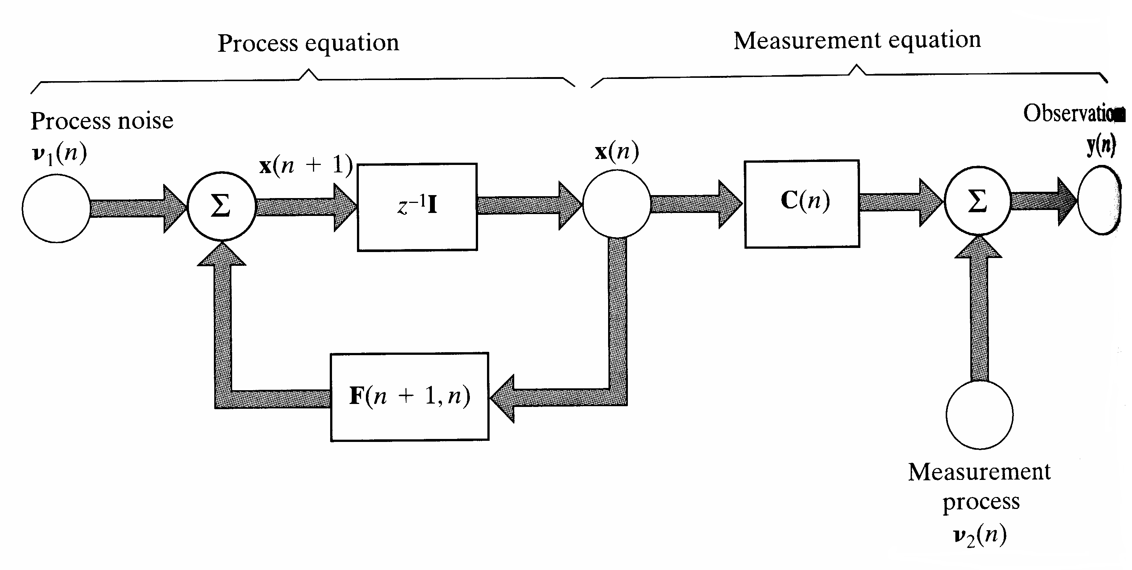
7. Kalman Filter: State-Space Formulation (1)
Linear discrete-time dynamical system: State vector x(n) with dimension M is unknown. To estimate x(n), using the observation vector y(n) with dimension N.

Slide 4
7. Kalman Filter: State-Space Formulation (2)
Process equation:
where F(n+1,n) is (M×M)-state transition matrix relating the state of the system at times n+1 and n. (M×1)-process noise vector v₁(n) is zero-mean white-noise process with correlation matrix:
Measurement equation describing observation vector:
where C(n) is (N×M)-measurement matrix. (N×1)-measurement noise vector v₂(n) is zero-mean white- noise process with correlation matrix:

Slide 5
7. Kalman Filter: State-Space Formulation (3)
Assumed that the initial state x(0) is uncorrelated to v₁(n) and v₂(n) for n ≥ 0 and v₁(n) and v₂(n) are statistically independent.
Statement of Kalman filterring: Using entire observed data y(1), y(2),…, y(n), to find for each n ≥1 the minimum mean-squared estimates of the components of the state x(i). If
i=n: Filtering problem
i>n: Predicting problem
n>i ≥1: Smoothing problem

Slide 6
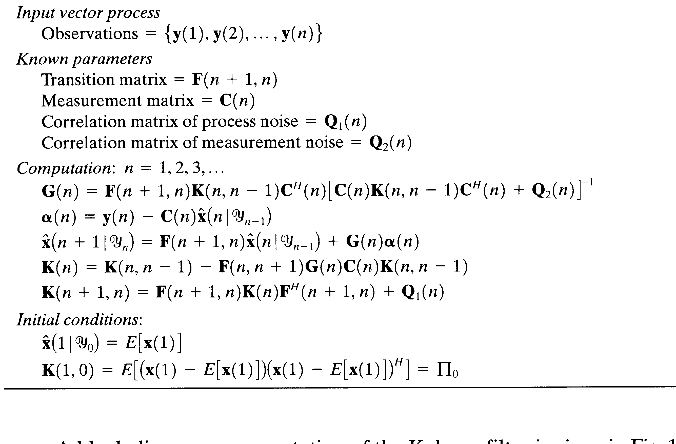
7. Kalman Filter: Algorithm (1)
Detail derivation in [1]

Slide 7
7. Kalman Filter: Algorithm (2)
where α(n) is innovation process and G(n) is Kalman gain. K(n+1,n) is the predicted state-error correlation matrix:
with ε(n+1, n): the predicted state-error vector:

Slide 8
7. Kalman Filter: Example 1 (1)
Formulate a scalar voltage measurement experiment using state-space equations if the true voltage is 0.5 and the process and measurement noise variances are 0.001 and 0.1 respectively. Investigate the performance of the Kalman filter for this problem.

Slide 9
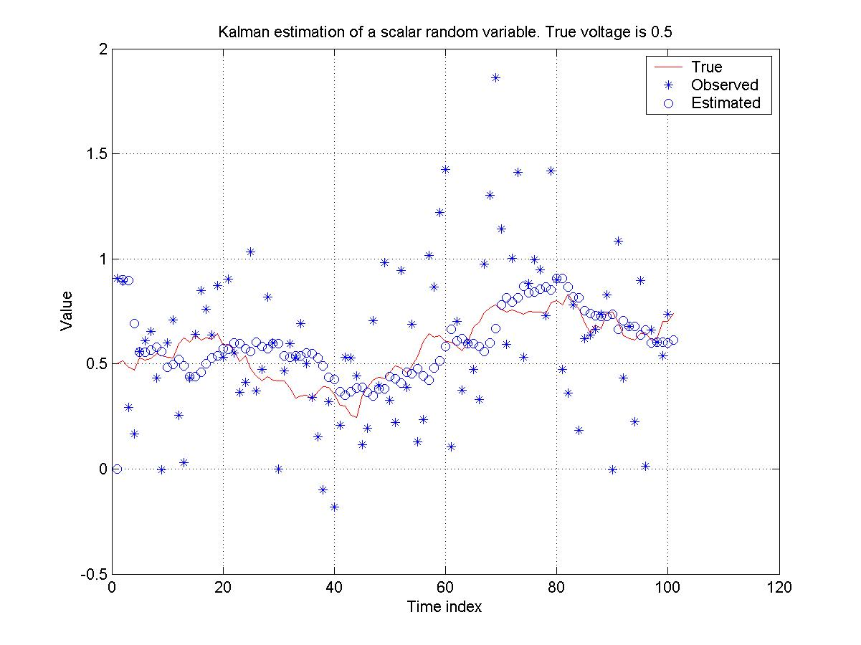
7. Kalman Filter: Example 1 (2)

Slide 10
7. Kalman Filter: Example 2 (1)
Formulate the state-space equations for a particle moving with a constant velocity and apply the Kalman filter to track its trajectory.

Slide 11
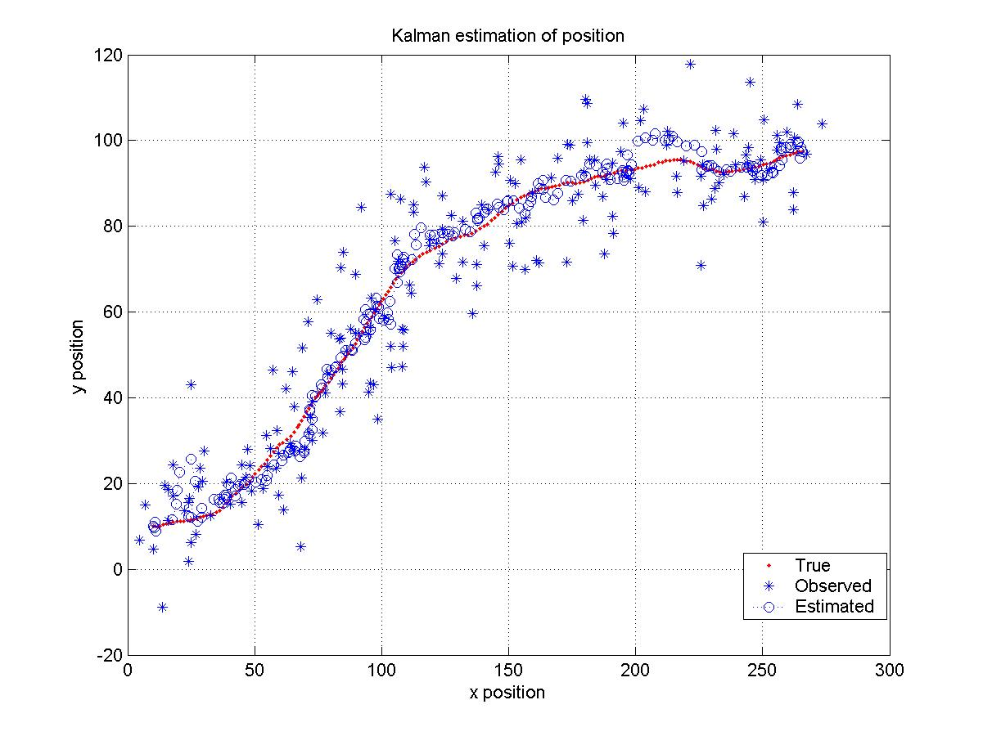
7. Kalman Filter: Example 2 (2)

Slide 12
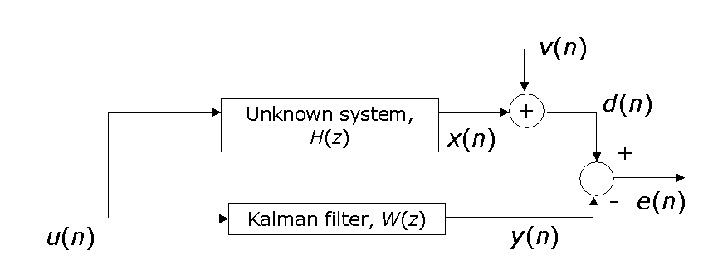
7. Kalman Filter: Example 3 (1)
Consider the system identification problem shown below:
v(n) is a zero-mean, white noise sequences with variance 0.1. If H(z) = 1+0.5z⁻¹ - z⁻²+0.3 z⁻³ - 0.4 z⁻⁴, evaluate the performance of the Kalman filtering algorithm when u(n) is (a) a white noise sequence, and (b) a colored noise sequence.

Slide 13
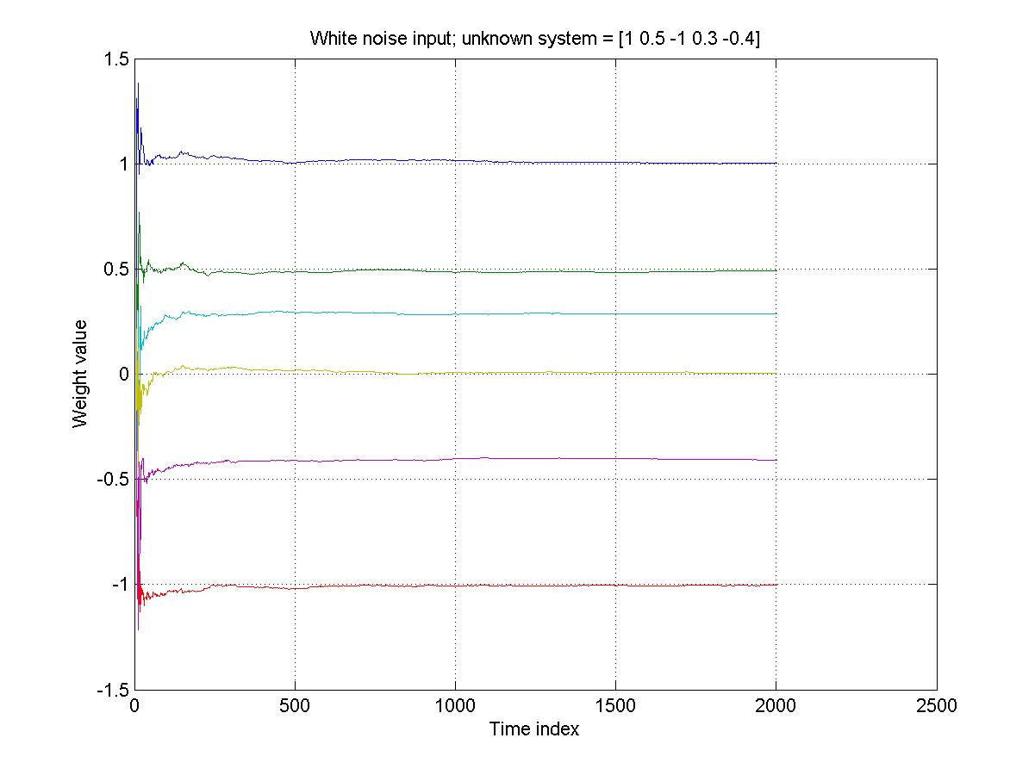
7. Kalman Filter: Example 3 (2)

Slide 14
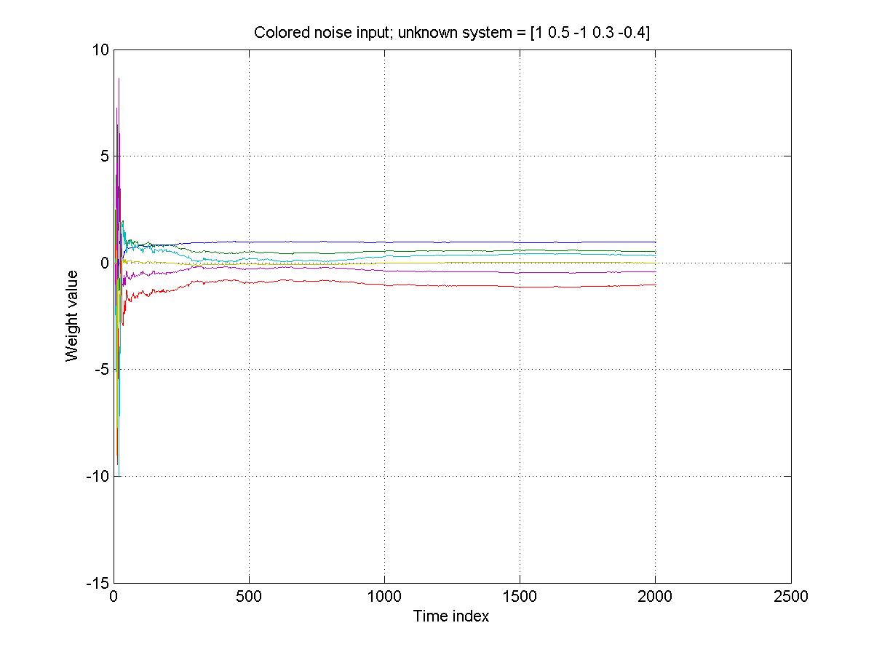
7. Kalman Filter: Example 3 (3)

Slide 15
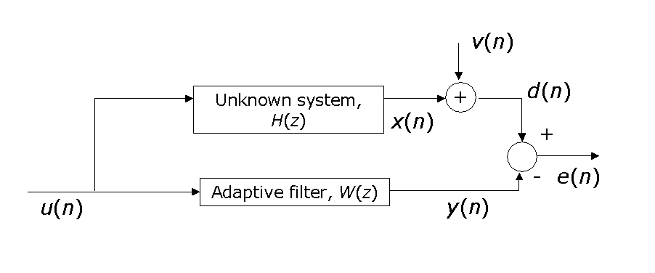
7. Kalman Filter: Example 4 (1)
Consider the system identification problem shown below:
v(n) is a zero-mean, white noise sequences with variance 1. The unknown system has a time-varying impulse response represented by h(n)=a h(n-1)+b(n), where a is the model parameter, b(n) is a white noise process with variance of 0.01, and h(0)=[1 0.5 -1 0.3 -0.4]. Evaluate the tracking performance of the Kalman filtering algorithm when u(n) is (a) a white noise sequence, and (b) a colored noise sequence.

Slide 16
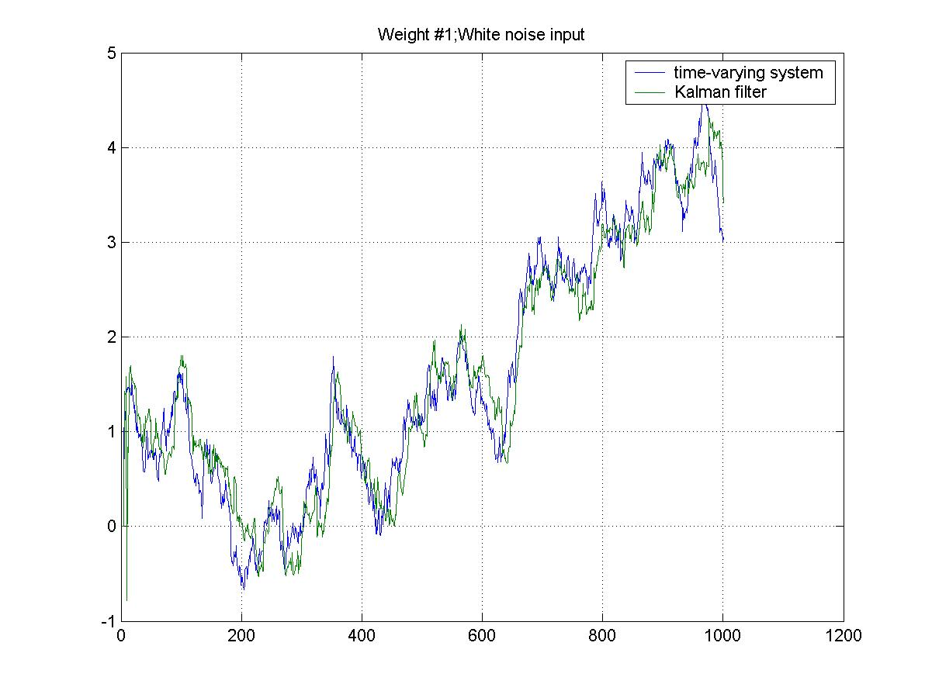
7. Kalman Filter: Example 4 (2)

Slide 17
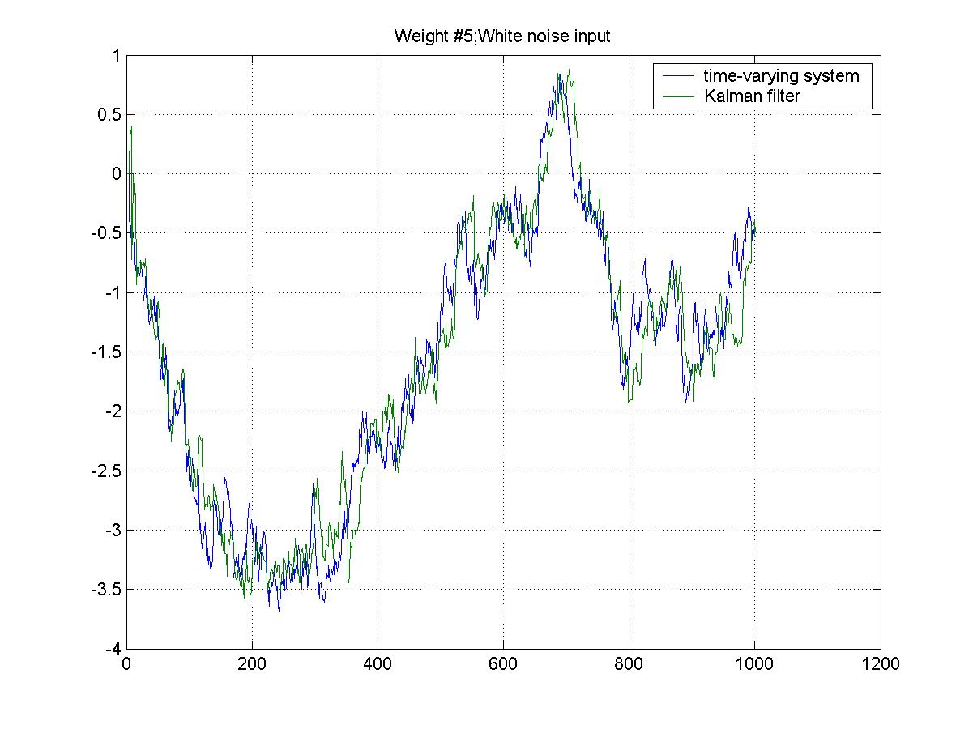
7. Kalman Filter: Example 4 (3)

Slide 18
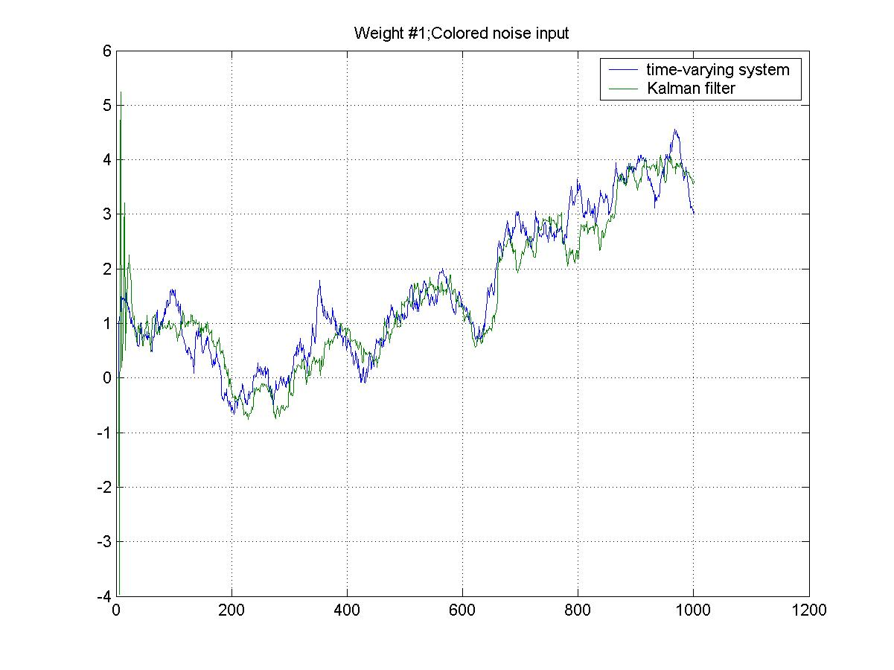
7. Kalman Filter: Example 4 (4)

Slide 19
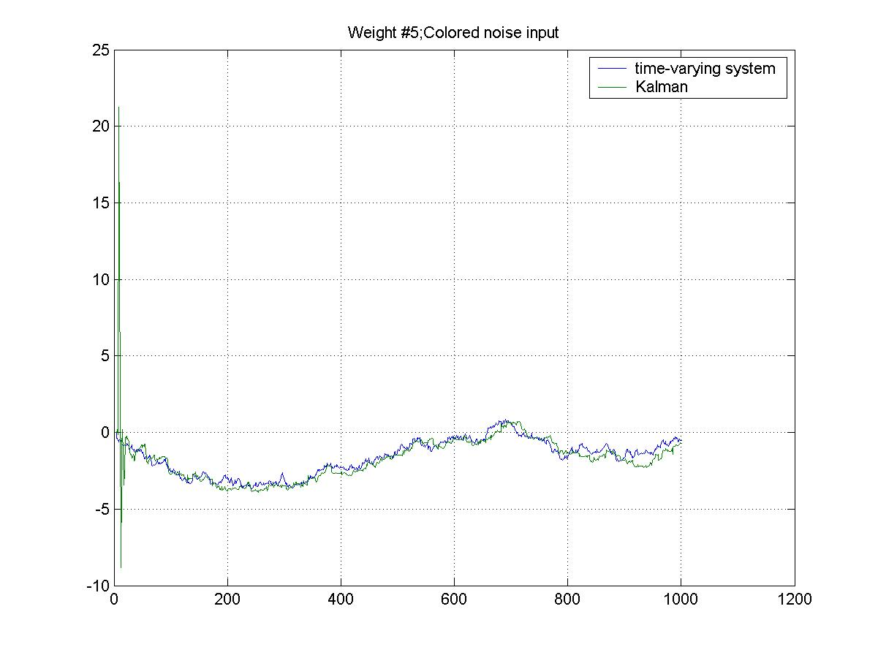
7. Kalman Filter: Example 4 (5)

Slide 20
7. Extended Kalman Filter (1)
Nonlinear state-space models:
Process equation:
(M×1)-process noise vector v₁(n) is zero-mean white-noise process with correlation matrix:
Measurement equation:
(N×1)-measurement noise vector v₂(n) is zero-mean white- noise process with correlation matrix:

Slide 21
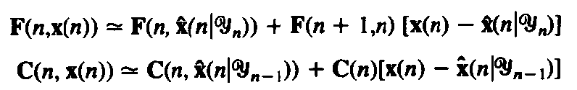
7. Extended Kalman Filter (2) [1]
Using first-order Taylor approximation, with:
Therefore:

Slide 22
7. Extended Kalman Filter (3) [1]

Slide 23
Chapter 8: Adaptive Filter
Method of Steepest Descent.
Least-Mean-Square Algorithm.
Examples of Adaptive Filtering:
Adaptive Equalization and
Adaptive Beamforming.

Slide 24
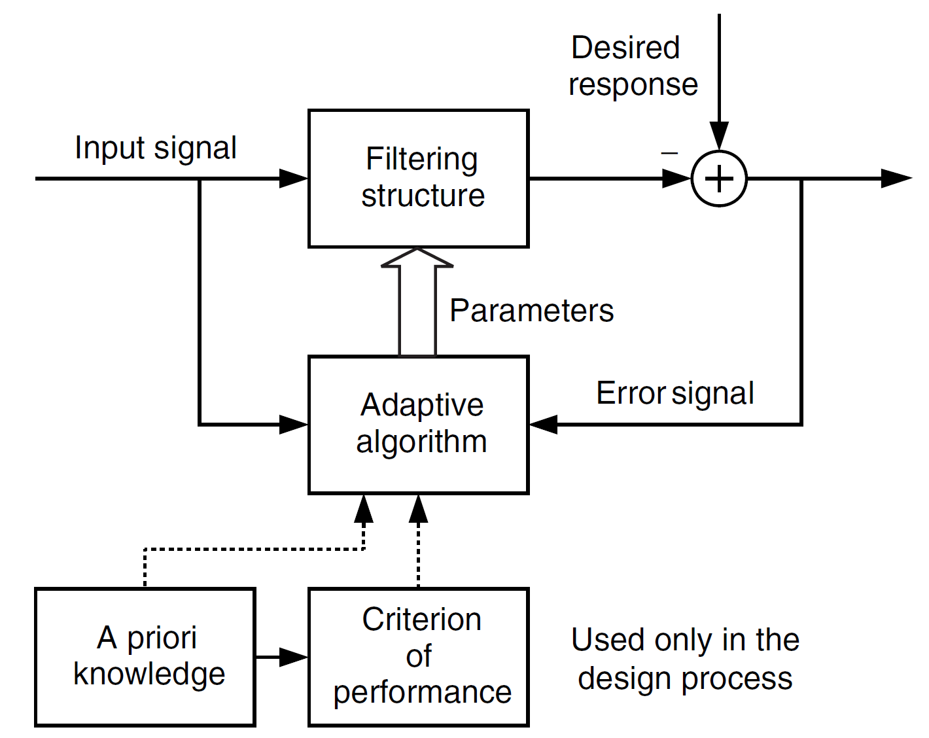
8. Linear Adaptive Filter: Principles
General principle of adaptive filter

Slide 25
8. LAF: Method of Steepest Descent
The method of steepest descent is the iterative solution of the Wiener-Hopf equations.
Wiener-Hopf equations:
Cost function:
MMSE:

Slide 26
8. LAF: Steepest Descent Algorithm (1)
Summary:
Begin with an initial guess of the weight vector: w(0)
Compute the direction of steepest descent pointing from the initial location on the error surface
Compute the next guess of the weight vector w by making a change in accordance with the direction of steepest descent
Go back to step 2 and repeat the process

Slide 27
8. LAF: Steepest Descent Algorithm (2)
Weight vector at iteration n+1:
Therefore:
where μ is the stepsize, controls the incremental correction.
Question:
How to choose μ ?
How many iterations to obtain the optimum weight vector ?…

Slide 28
8. LAF: Stability of the Algorithm
To meet the stability, choosing μ in accordance with:
where is the maximum eigenvalue of the correlation matrix R.
Other useful criterion for choosing μ:

Slide 29
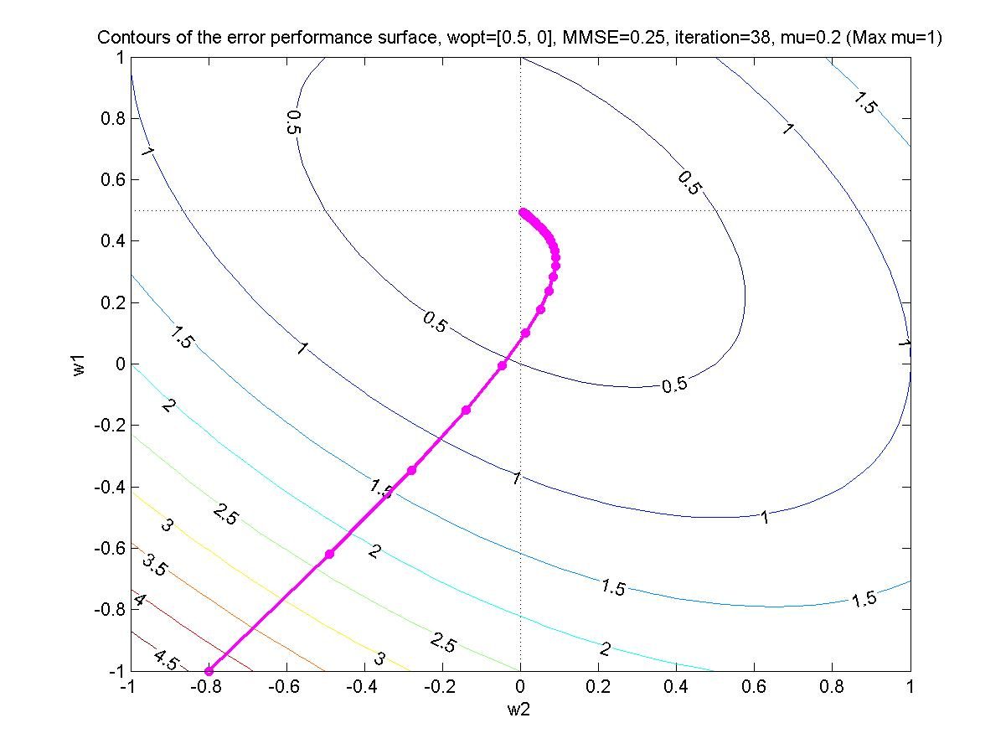
8. LAF: Examples (1)
Refer to Example 1, Chapter 5

Slide 30
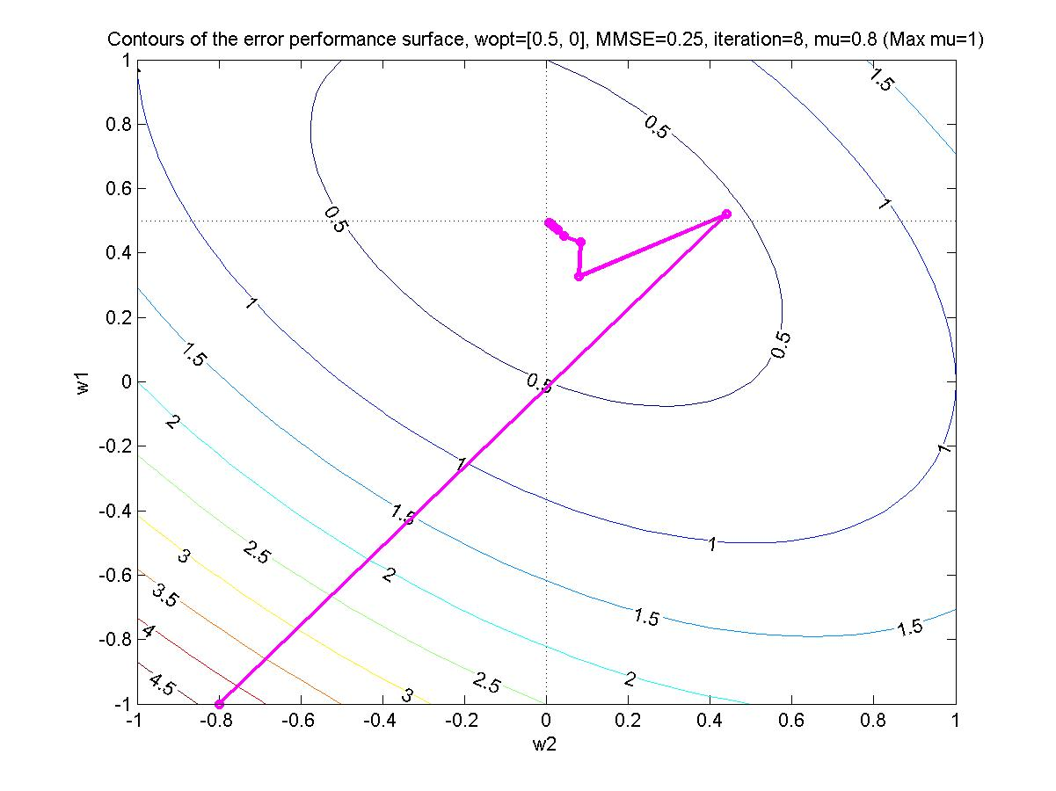
8. LAF: Examples (2)

Slide 31
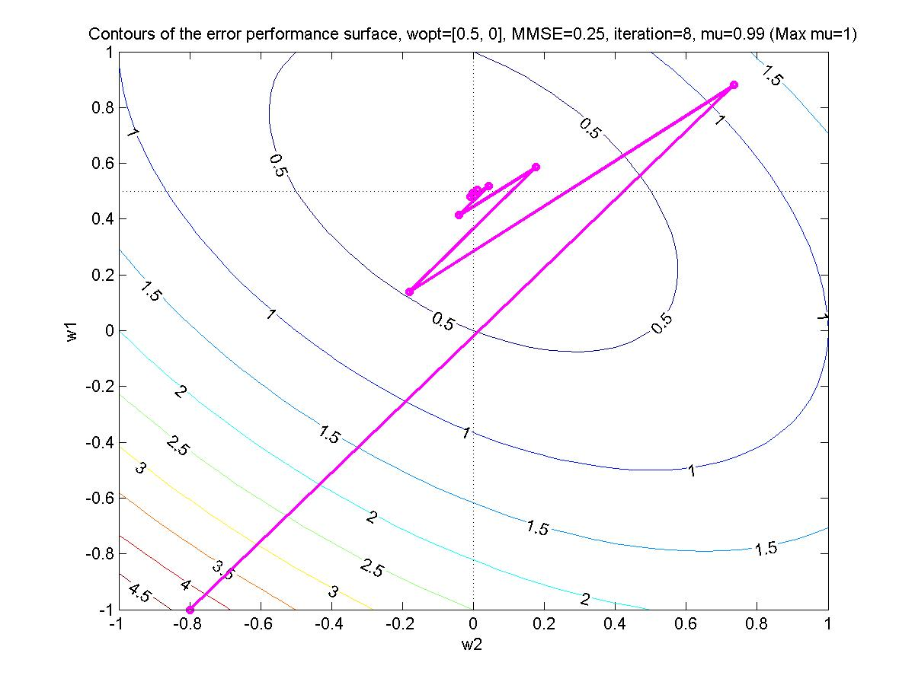
8. LAF: Examples (3)

Slide 32
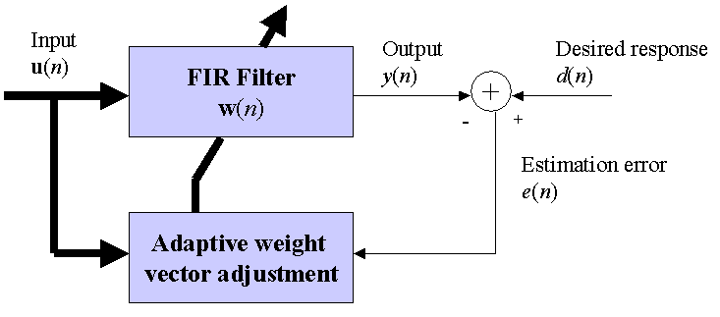
8. LAF: Least Mean Square (LMS) Algorithm (1)
The LMS algorithm is a stochastic gradient algorithm consisting of 2 basic processes:
Filtering process: computing the output of FIR filter y(n)=w^{H}(n)u(n) and generating an estimation error e(n)
Adaptation process: automatic adjustment of the weight vector of the FIR filter in accordance with the estimation error e(n)

Slide 33
8. LAF: LMS Algorithm (2)
The steepest descent algorithm is given by:
Note that this equation requires the knowledge of the autocorrelation matrix R and the crosscorrelation vector p.
In the LMS formulation, these matrix and vector are replaced by the instantaneous values, i.e.,
R(n) = u(n)u^{H}(n) and p(n) = u(n)d*(n).
With this replacement, the weight update equation becomes:

Slide 34
8. LAF: Convergence Analysis (1)
Because of the use of instantaneous estimates of the autocorrelation matrix and the crosscorrelation vector, the convergence of the LMS algorithm is noisy.
Similar to the steepest descent algorithm, the convergence of the LMS algorithm is controlled by the stepsize μ.
The bounds on μ for the stability of LMS adaptation are
0 ≤ μ ≤ 2/λ_{max}, where λ_{max} is the maximum eigenvalue of the input autocorrelation matrix.
Other useful criterion for choosing μ:

Slide 35
8. LAF: Convergence Analysis (2)
Convergence criterion in mean square:
The average time constant of the LMS algorithm is given by:
Thus smaller values of the stepsize parameter, μ, result in longer convergence times.

Slide 36
8. LAF: Excess Mean-Squared Error (1)
Let J(n) denote the mean-squared error due to LMS algorithm at iteration n:
where J_{min} is the minimum mean-squared error produced by the optimum Wiener filter, and J_{ex}(n) is the excess mean-squared error.
⇒ The LMS algorithm alaways produces mean-squared error J(n) that is in excess of minimum mean-squared error J_{min}

Slide 37
8. LAF: Excess Mean-Squared Error (2)
When the LMS algorithm is convergent in the mean square, J_{ex}(n) → J_{ex}(∞): is steady-state value as n→∞:
Smaller values of the stepsize μ, will therefore provide lower excess mean-squared error.
Misadjustment K: is a measure providing how close the mean-squared error of the LMS algorithm is to the minimum mean-squared error J_{min} (after completing adaptation process)

Slide 38
8. LAF: Example of Adaptive Predictor (1)
Consider the first-order AR model, u(n)+a₁u(n-1)=v(n), where v(n) is zero-mean white noise. Evaluate the performance of the steepest-descent, and LMS algorithms when,
a₁ = 0.9;
use different μ values. Assume that the variance of v(n) is unity.
See p. 406, [1]

Slide 39
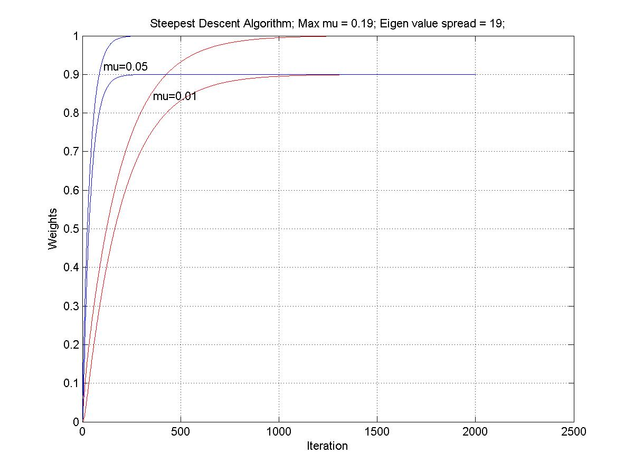
8. LAF: Example of Adaptive Predictor (2)

Slide 40
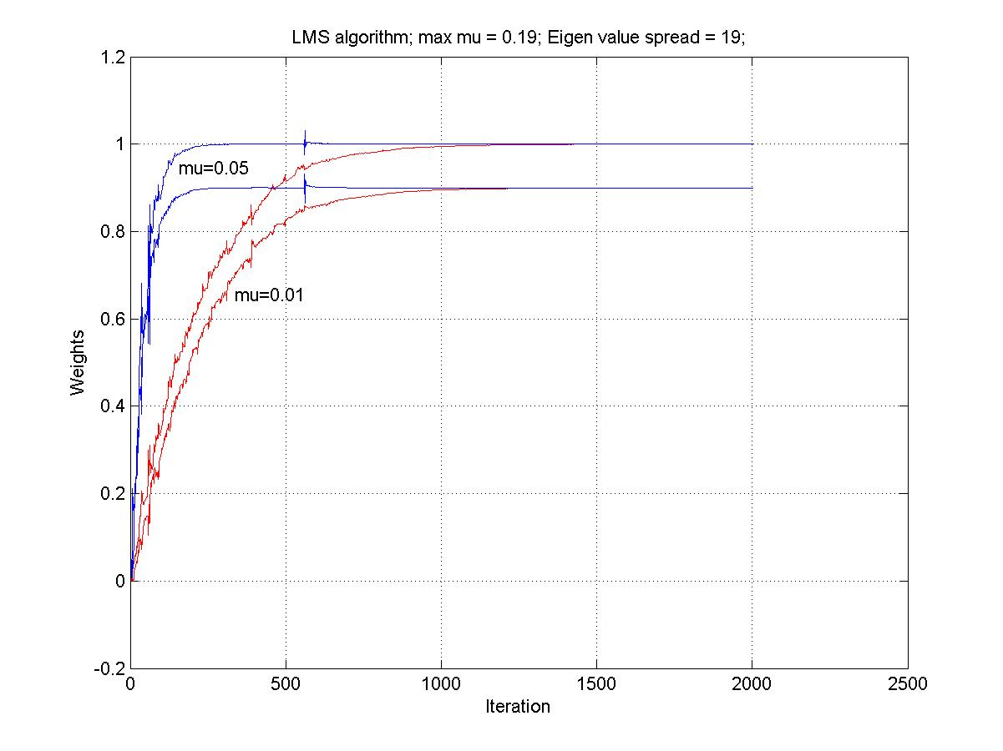
8. LAF: Example of Adaptive Predictor (3)

Slide 41
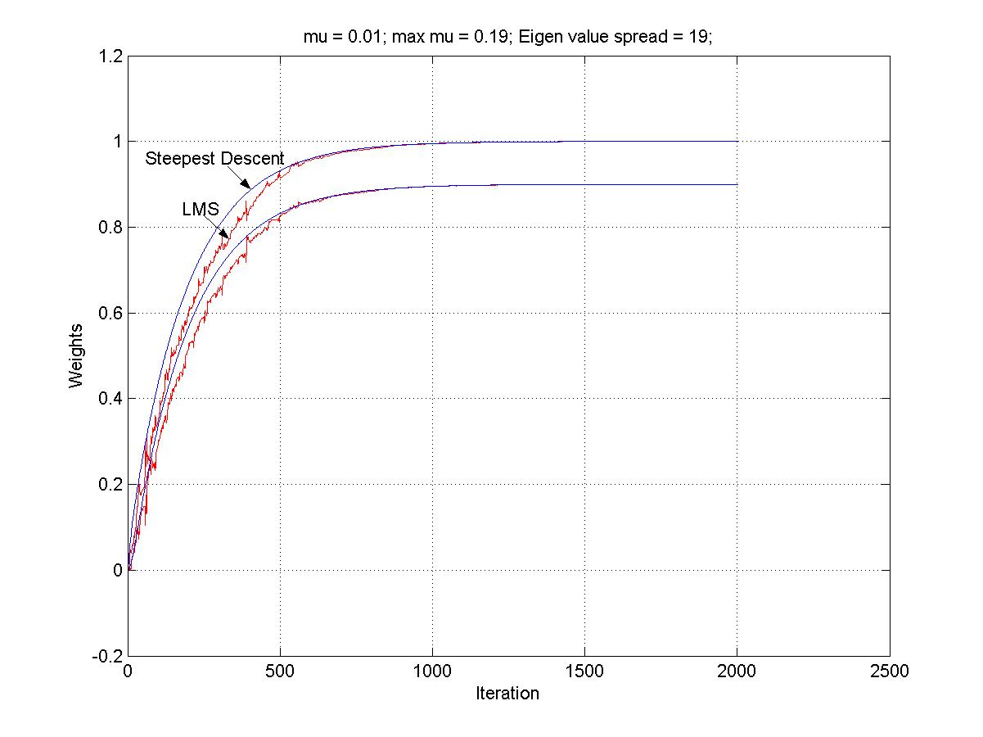
8. LAF: Example of Adaptive Predictor (4)

Slide 42
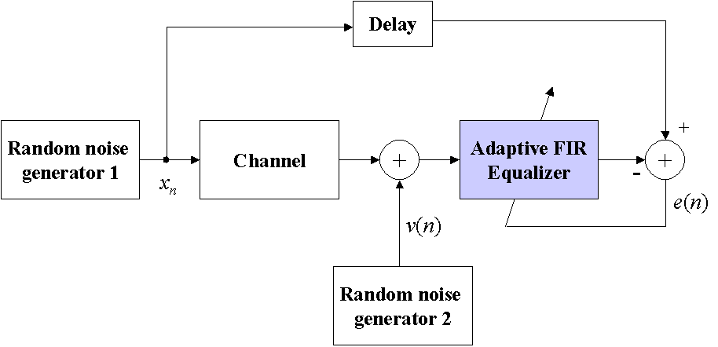
8. LAF: Example of Adaptive Equalizer (1)
The following block diagram shows a typical adaptive equalizer. The input x_{n} is a zero-mean Bernoulli random variable with unit variance. The noise v(n) has zero-mean and a variance of 0.001.

Slide 43
8. LAF: Example of Adaptive Equalizer (2)
Characterize the performance of the LMS algorithm when the impulse response of the channel is given by the raised cosine, W = 2.9:
See p. 412, [1]

Slide 44
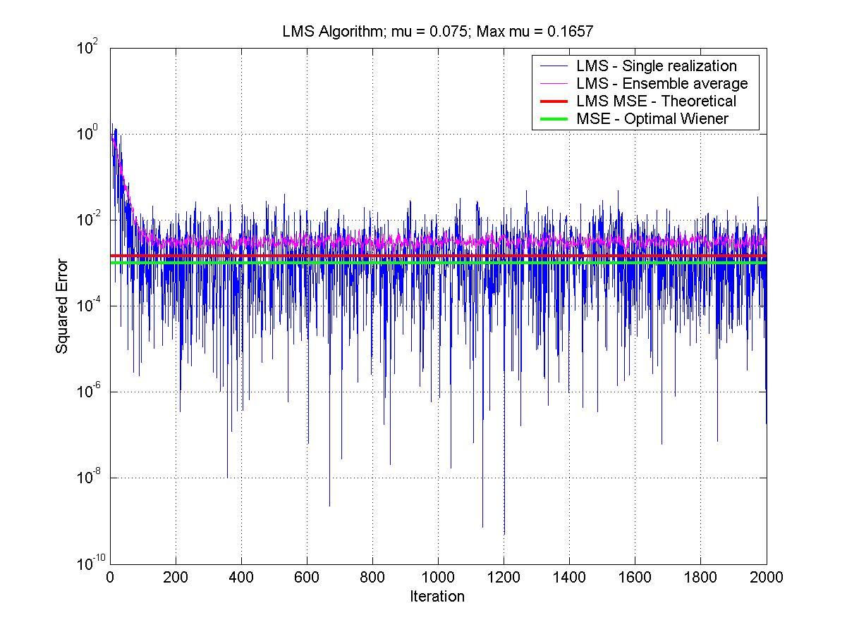
8. LAF: Example of Adaptive Equalizer (3)

Slide 45
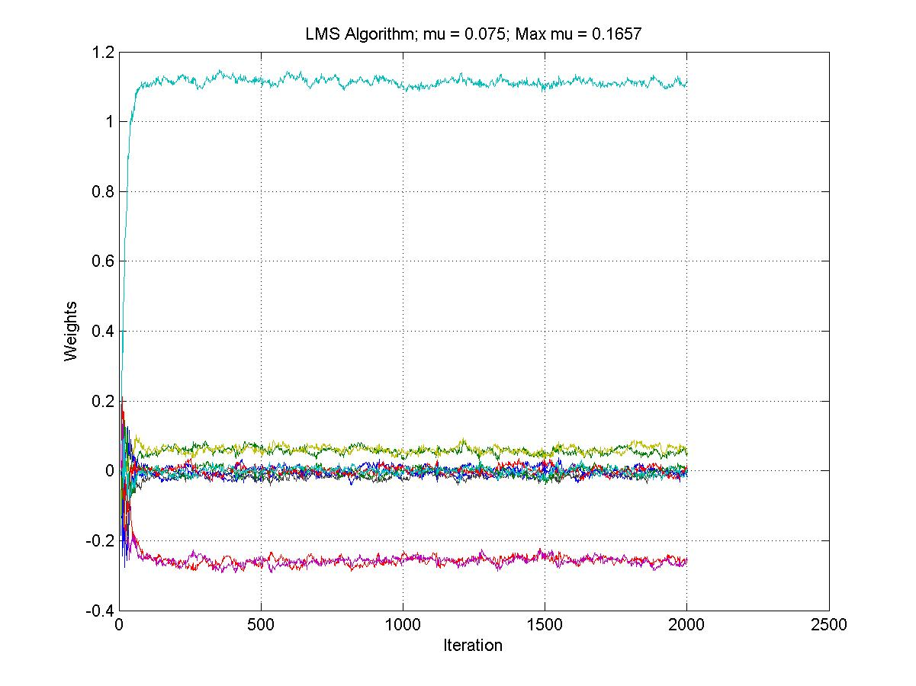
8. LAF: Example of Adaptive Equalizer (4)

Slide 46
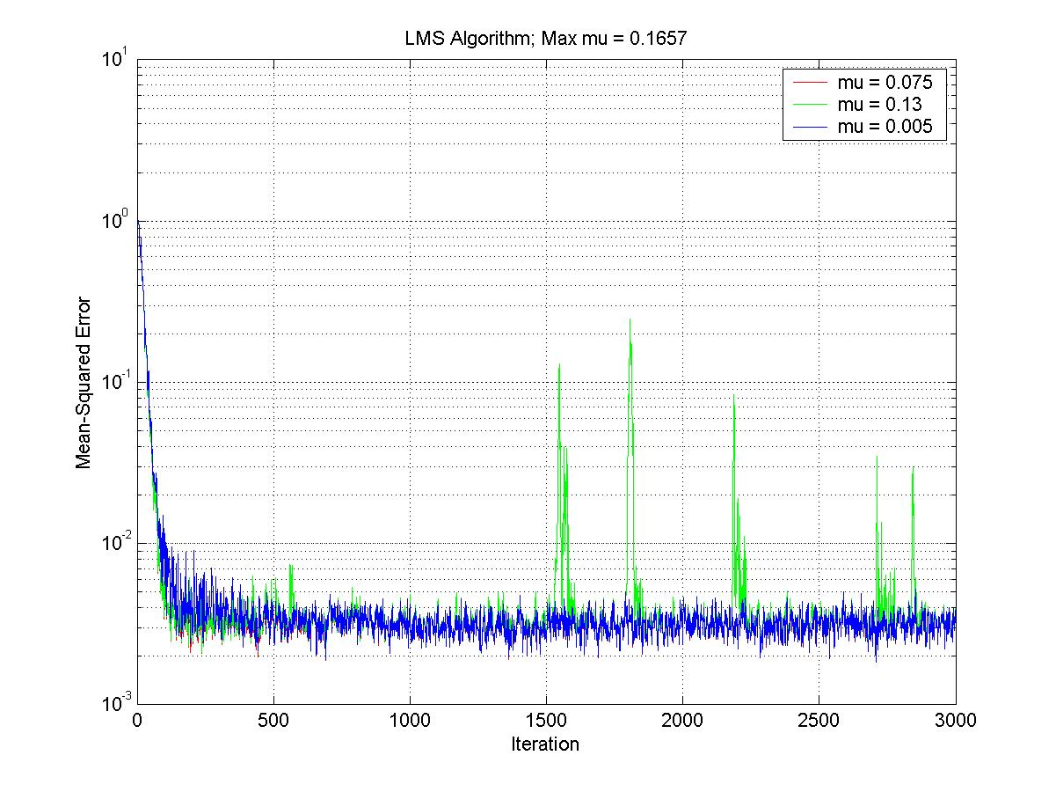
8. LAF: Example of Adaptive Equalizer (5)

Slide 47
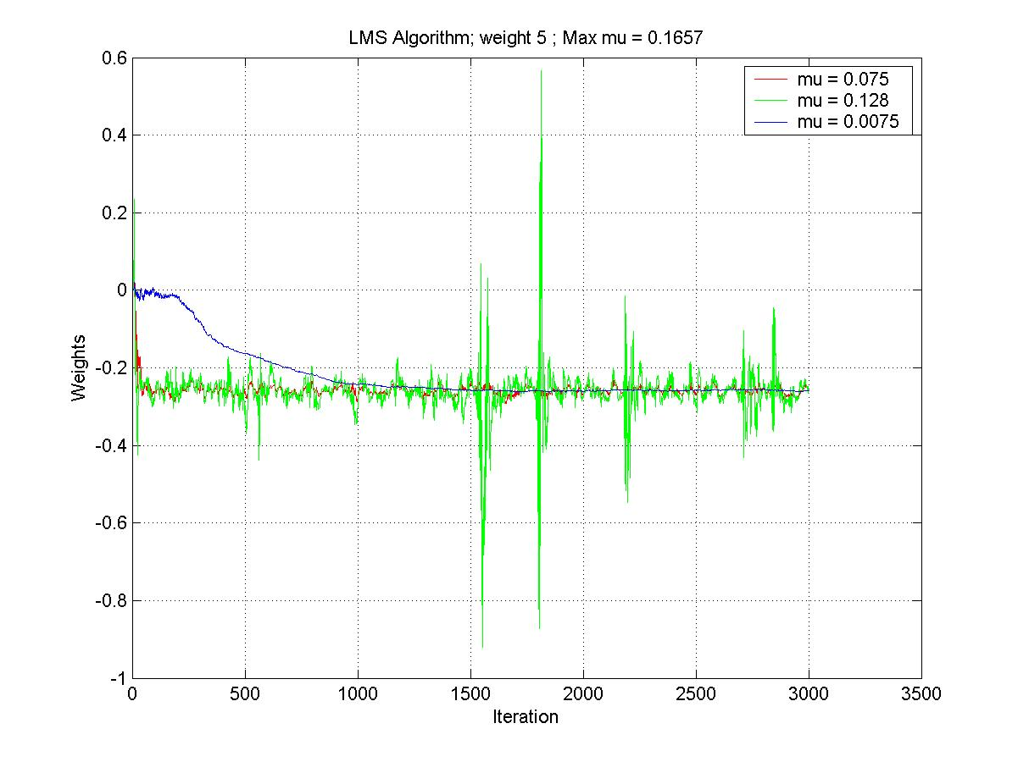
8. LAF: Example of Adaptive Equalizer (6)

Slide 48
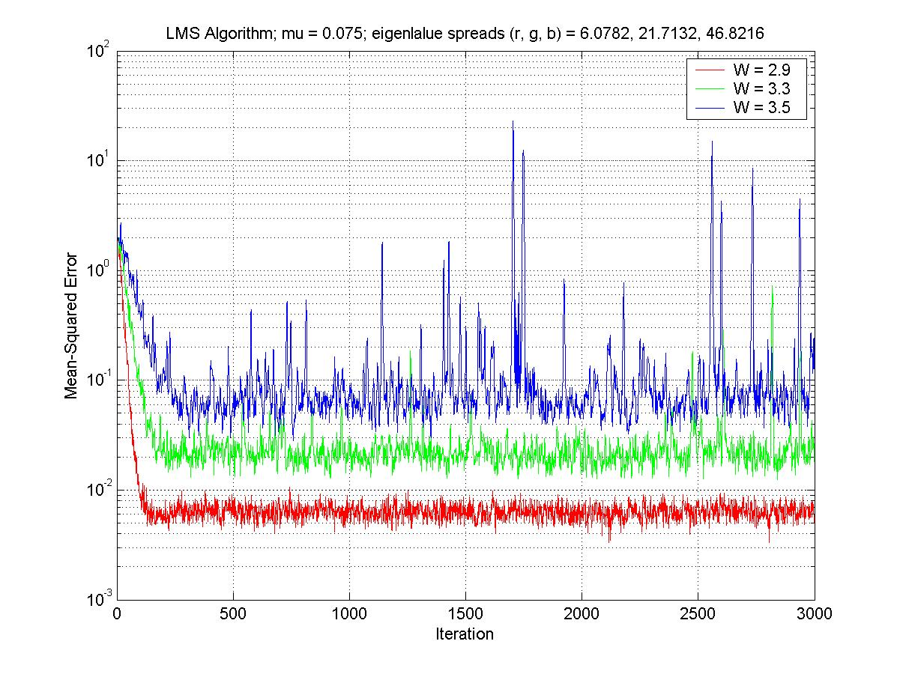
8. LAF: Example of Adaptive Equalizer (7)

Slide 49
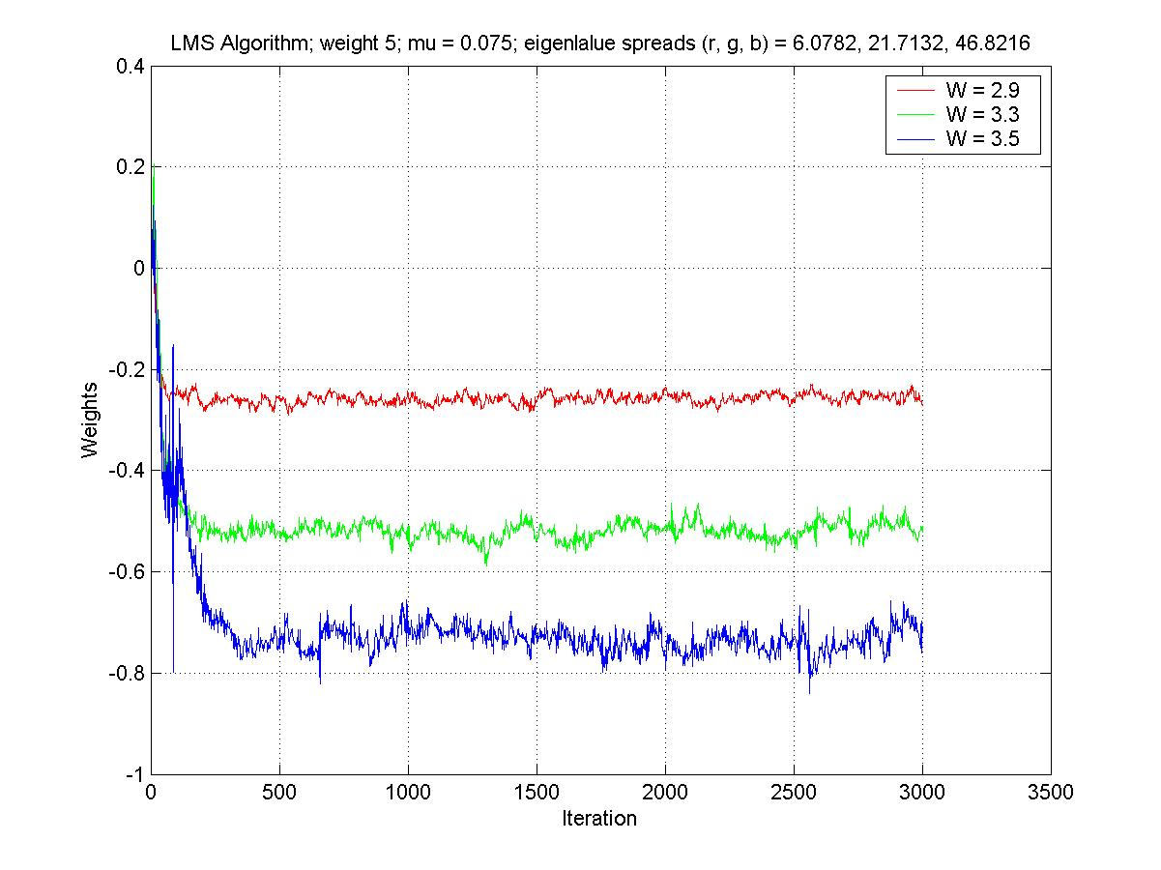
8. LAF: Example of Adaptive Equalizer (8)

Slide 50
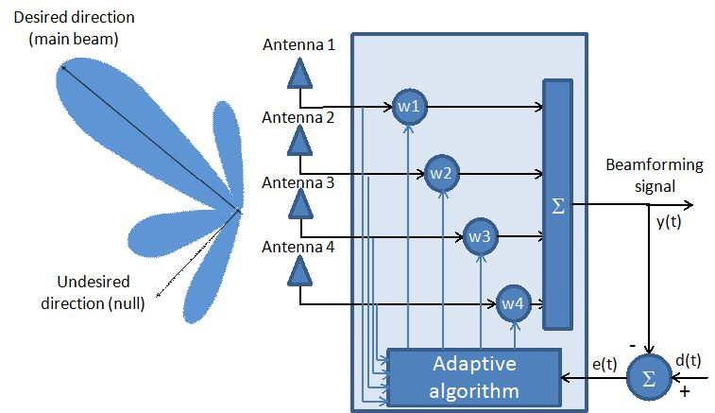
8. LAF: Example of Adaptive Beamformer (1)

Slide 51
8. LAF: Example of Adaptive Beamformer (2)
The fixed beamforming approaches, mentioned in chapter 5, which included the maximum SIR, the MSE method, and the MV method were assumed to apply to fixed arrival angle emitters. If the arrival angles don’t change with time, the optimum array weights won’t need to be adjusted. However, if the desired arrival angles change with time, it is necessary to devise an optimization scheme that operates on-the-fly so as to keep recalculating the optimum array weights. The receiver signal processing algorithm then must allow for the continuous adaptation to an ever-changing electromagnetic environment. The adaptive beamforming (with adaptive algorithms) takes the fixed beamforming process one step further and allows for the calculation of continuously updated weights. The adaptation process must satisfy a specified optimization criterion.
Several examples of popular optimization techniques include LMS, SMI, recursive least squares (RLS), the constant modulus algorithm (CMA), conjugate gradient, etc.

Slide 52
8. LAF: Example of Adaptive Beamformer (3)
Example: Adaptive beamforming using LMS algorithm:
An M = 8-element array with spacing d = .5λ has a received signal arriving at the angle θ₀ = 30◦, an interferer at θ₁ = −60◦. Use MATLAB to write an LMS routine to solve for the desired weights. Assume that the desired received signal vector is defined by x_{s}(k) = a₀s(k), where
s(k) = cos(2π t(k)/T); with T = 1 ms and t = (1:100)T/100. Assume the interfering signal vector is defined by x_{i}(k) = a₁i(k), where
i(k) = randn(1,100). Both signals are nearly orthogonal over the time interval T. Let the desired signal d(k) = s(k). Assumed that the step size
μ = .02.

Slide 53
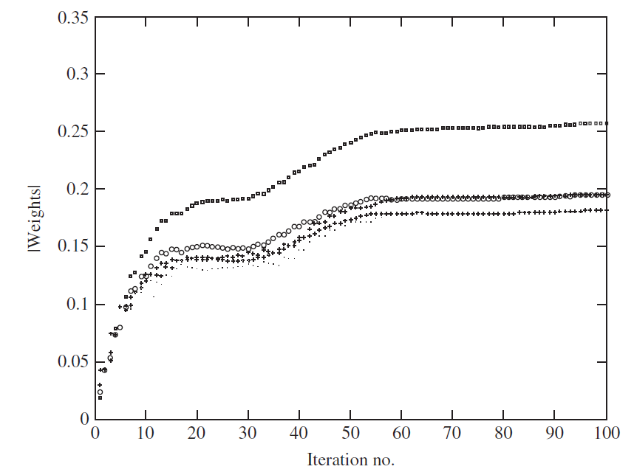
8. LAF: Example of Adaptive Beamformer (4)
Magnitude of array weights (convergence after about 60 iterations):

Slide 54
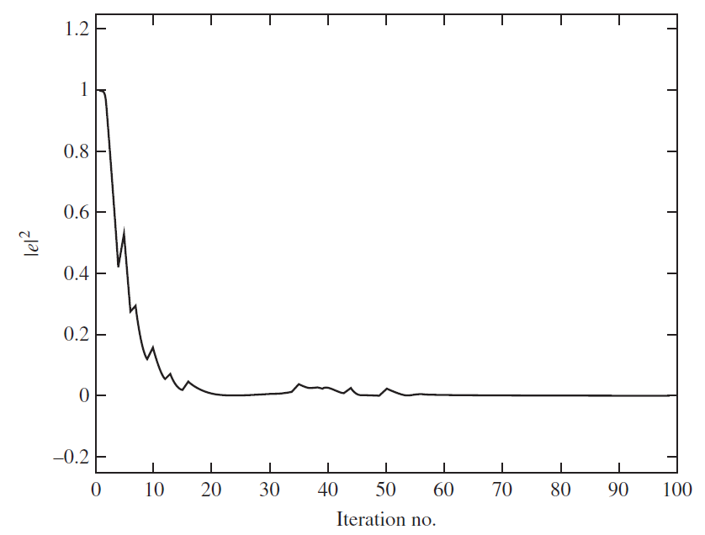
8. LAF: Example of Adaptive Beamformer (5)
Mean-square error (convergence after about 60 iterations):

Slide 55
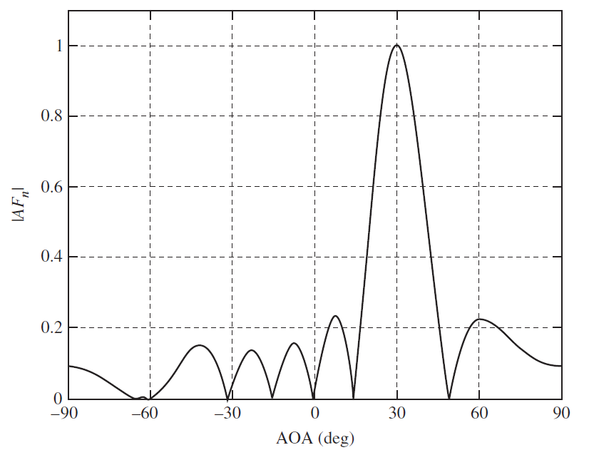
8. LAF: Example of Adaptive Beamformer (6)
Final array factor (after convergence) which has a peak at the desired direction of 30◦ and a null at the interfering direction of −60◦:

Slide 56
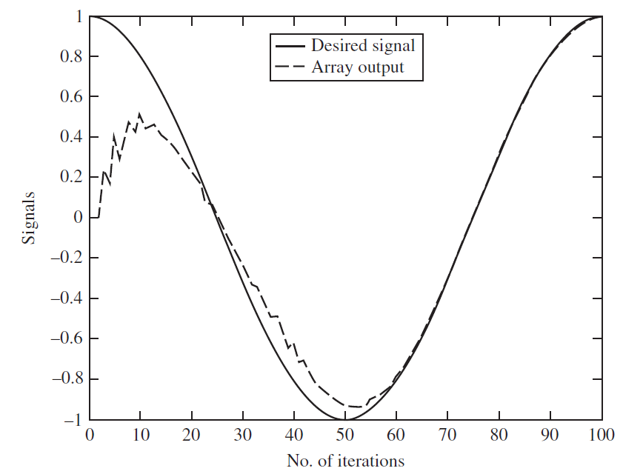
8. LAF: Example of Adaptive Beamformer (7)
The array output acquires and tracks the desired signal after about 60 iterations:

