Slide 1
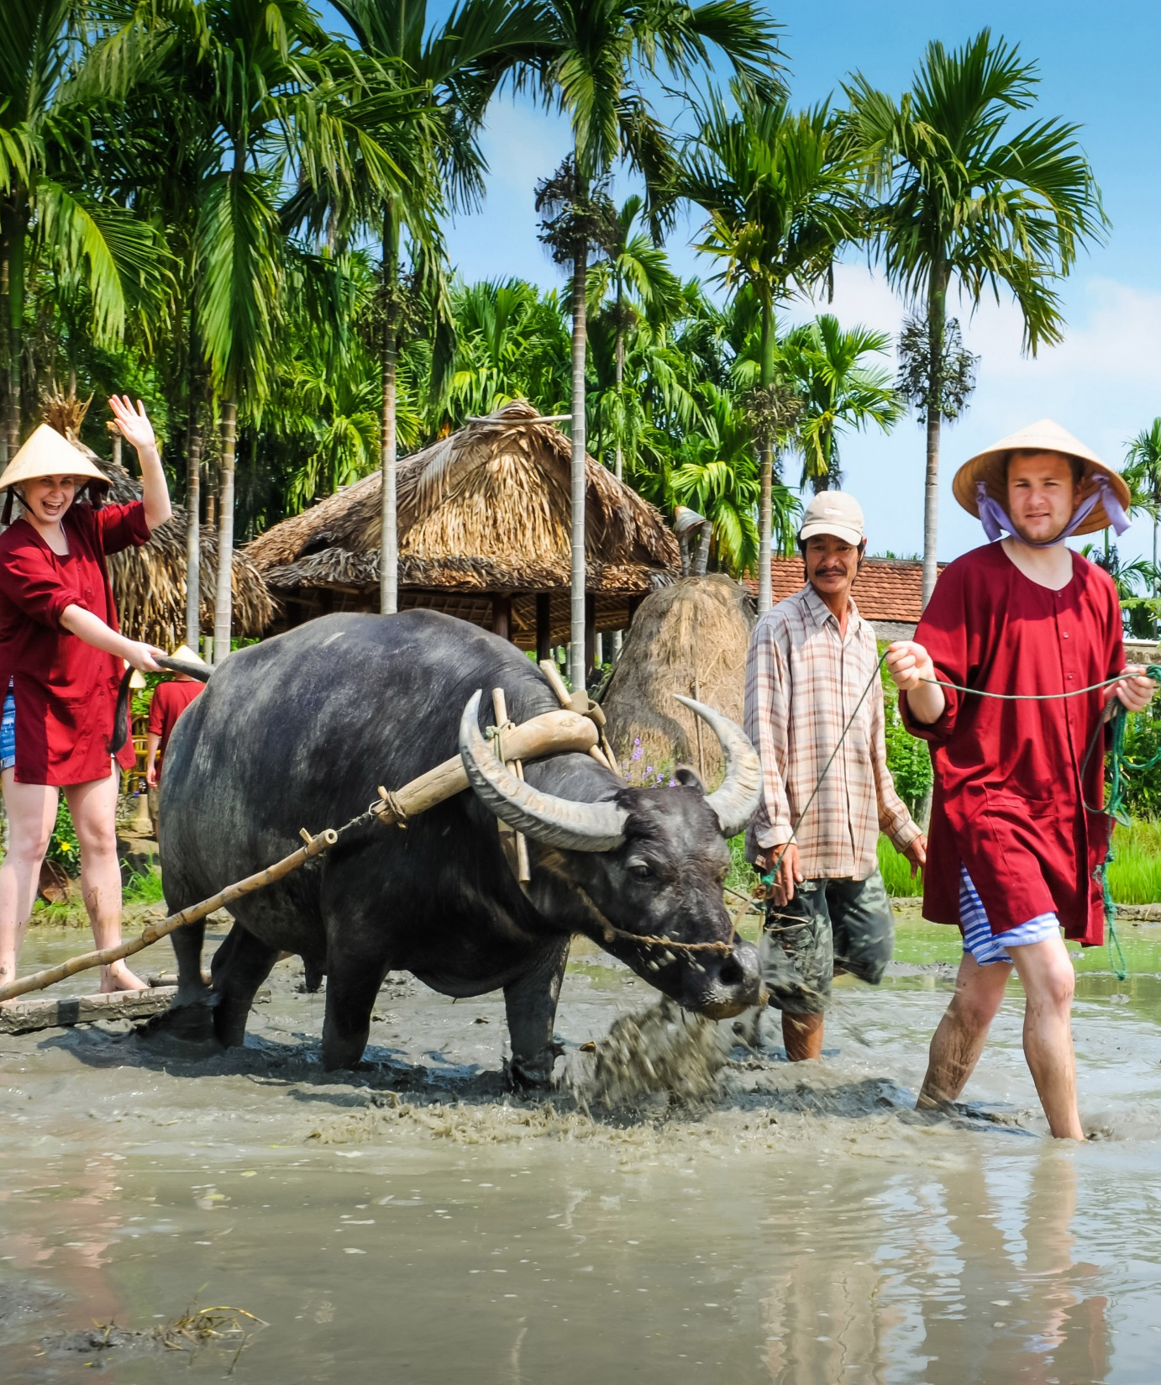
PROJECT
PERPETUAL CALENDAR
Group : God of wind
Presenter : Tran Lam Hai An
Document maker : Tran Van Trong
Coder : Tien Hoang Tri Nghia

Slide 2




Agenda
1. Why do we choose this project?
3. How do we proceed this project?
3. The product and the result
4. Development strategy

