Slide 1
Recover $2.4M in FY2026 through barista hiring and the seasonal menu
Pre-read for the Operating Committee
November 2026 Store Operations and Finance

Slide 2
Seasonal drinks fell while core drinks kept growing.
Average year-over-year sales change (%) by menu segment, FY2025
Two menu segments
Core drinks averaged +9.4% while seasonal drinks averaged -7.8%.
Implication and action
Look inside the seasonal lineup before cutting it wholesale.
Source: Copperleaf point-of-sale data, FY2025 vs. FY2024 (140 stores).
FY2026 menu and staffing · 1

Slide 3
Mint Chill and Hazelnut Cloud fell the most among seasonal drinks.
Year-over-year sales change (%) by drink, FY2025, ranked
Ten drinks, ranked
Maple Oat (-3%) and Cocoa Crunch (-6%) also fell, by far less.
Implication and action
Replace Mint Chill and Hazelnut Cloud first; keep watching Maple Oat and Cocoa Crunch.
Source: Copperleaf point-of-sale data, FY2025 vs. FY2024 (140 stores).
FY2026 menu and staffing · 2

Slide 4
Barista hiring gaps leave stores 22 baristas short by December.
Store staff vs. plan by month (left) and year-end forecast by role with its gap to plan (right)
Stores end the year 30 staff below plan
Baristas make up 22 of the 30
The gap widened from May, peaked at 37 in July and holds at 30 through December.
Supervisors are 6 short and managers 2; bakers are on plan.
Store staff vs. plan, by month
Year-end forecast headcount by role
Against plan
-30 staff vs. plan by December
−22
−2
−6
0
Focus Q1 recruiting on baristas; other roles are within six of plan.
Source: Copperleaf HR system and FY2026 staffing forecast.
FY2026 menu and staffing · 3

Slide 5
Fill barista roles and refresh seasonal drinks to recover $2.4M.
Six recovery initiatives compared on payoff and effort
Payoff
Effort
Barista hiring leads on payoff at $1.5M; the menu refresh adds $0.9M.
Both proposals need little effort: 2 and 1 on a six-point scale.
Modeled sales recovery ($M)
Effort rating (1 easiest, 6 hardest)
Approve 22 barista hires in Q1 and the two-drink refresh (fallback: hire now, decide the menu at the Q2 review).
Source: Copperleaf FY2026 sales recovery model and operations effort ratings.
FY2026 menu and staffing · 4

Slide 6
Harbor Street is the flagship store furthest behind on baristas.
Flagship store scorecard, FY2025
 | Customers
Store | Sales change, % | Avg wait (min) | Baristas short
Harbor Street | -4.1 | 6.8 | 3
Union Square | -2.6 | 5.9 | 2
Riverside | -1.8 | 5.4 | 1
Old Town | +0.6 | 4.9 | 1
Market Hall | +1.2 | 4.6 | 1
Lakeview | +2.4 | 4.2 | 1
Station Plaza | +3.0 | 4.0 | 0
Hillcrest | +3.8 | 3.7 | 0
All eight stores | +0.3 | 4.9 | 9
Source: Copperleaf point-of-sale data and HR system, FY2025 (eight flagship stores).
Appendix 1

Slide 7
The three slowest stores are the only ones losing sales.
Sales change vs. average wait, by flagship store, FY2025
Eight flagship stores
Implication and action
Staff the three slowest stores first; the other five grew.
Waits under 5 min
Waits over 5 min
Source: Copperleaf point-of-sale data and HR system, FY2025 (eight flagship stores).
Appendix 2
Notes:
[Beat 1] Each store is one dot: average wait across, sales change up and down. The three stores to the right of the five-minute line are the only ones below zero.

Slide 8
Baristas account for 22 of the 30 positions missing at year-end.
Year-end headcount against the plan of 760, by role
Roles against plan
Implication and action
Filling the 22 barista roles closes most of the gap, so hire them first.
Source: Copperleaf HR system, year-end plan and forecast by role.
Appendix 3
Notes:
[Beat 1] Start from the plan: each bar is one role falling short of its planned headcount, stacked one after another until the net gap on the right. Baristas alone are most of it.

Slide 9
Hiring in two waves is the longest step.
Recruiting plan for the 22 barista roles
Approve budget
15 Jan
Open the roles
1 Feb
Hire in two waves
15 Mar and 30 Apr
Train on shift
Two weeks each
All roles filled
30 Jun
Source: Copperleaf recruiting plan, FY2026.
Appendix 4

Slide 10
All 22 barista roles are filled by 30 June.
Recruiting plan for the 22 barista roles, 2026
Budget approved
15 Jan
Wave 1 starts
15 Mar
Wave 2 starts
30 Apr
90-day review
15 Sep
Jan
Feb
Mar
Apr
May
Jun
Jul
Aug
Sep
Roles open
1 Feb
Wave 1 trained
31 Mar
All 22 roles filled
30 Jun
Source: Copperleaf recruiting plan, FY2026.
Appendix 5

Slide 11
Filling barista roles recovers the most for modest effort.
Recovery initiatives by effort and modeled sales recovery
High
Fill 22 barista roles
Price changes
Sales recovery
Refresh two seasonal drinks
Loyalty app
Extend evening hours
Remodel flagships
Low
Low
Effort
High
Source: Copperleaf operations effort ratings and sales recovery model, FY2026.
Appendix 6

Slide 12
Applicants without barista experience reach the trial shift through a training cohort.
Screening of barista applicants
Barista experience?
Passed trial?
Application received
Yes
Trial shift
4 hours, paid
Yes
Offer
No
No
Training cohort
Two weeks
Invite to reapply
Source: Copperleaf recruiting plan, FY2026.
Appendix 7

Slide 13
Waiting for a regional trainer is the slowest hand-off in hiring.
Hiring steps by owner
Store manager
Request hire
Decide
HR
Post role
Screen applicants
Send offer
Regional trainer
5-day wait
Trial shift
Source: Copperleaf recruiting plan, FY2026.
Appendix 8

Slide 14
Baristas make up 22 of the 30 roles short at year end.
Year-end staffing gap by role, planned minus forecast
Baristas
22 roles
Shift supervisors
6 roles
Roles short
30 roles
Store managers
2 roles
Bakers
0 roles
Source: Copperleaf staffing plan and forecast, FY2026.
Appendix 9

Slide 15
Harbor Street is in the slowest fifth at every daypart.
Average wait by daypart (min), all 48 stores, FY2025
Each dot is one store
Implication and action
Staff Harbor Street for the whole day, not only the morning rush.
Median
Slowest fifth
Morning rush
9.1 min · rank 7
Midday
6.1 min · rank 6
Evening
5.3 min · rank 7
Source: Copperleaf point-of-sale timestamps, FY2025 (48 stores).
Appendix 10
Notes:
[Beat 1] Each dot is one of our 48 stores; Harbor Street is the orange one. The grey band in each row is the slowest fifth of stores, and Harbor Street sits inside it at every daypart.

Slide 16
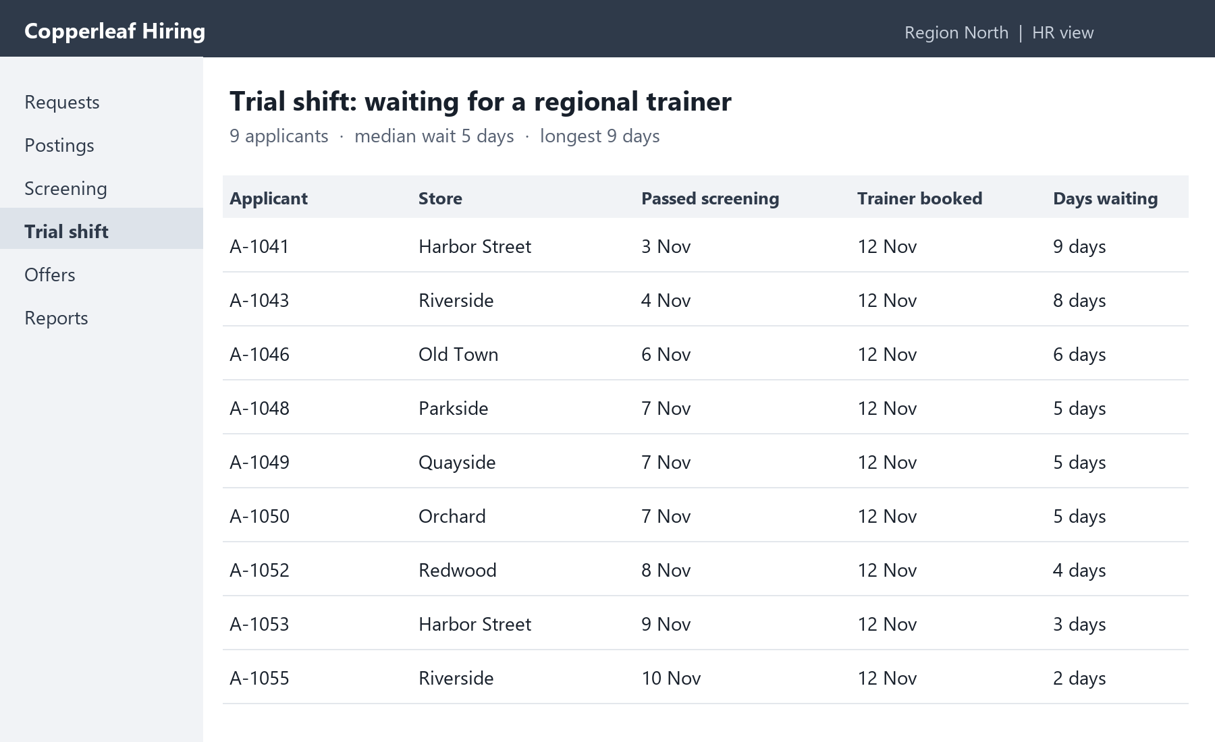
Applicants wait a median of five days for a regional trainer.
Trial-shift queue in the applicant tracker, Region North, 12 November
Applicant tracker, trial-shift step
Nine applicants are waiting; the longest wait is nine days, at Harbor Street.
Implication and action
Add a second regional trainer before the first hiring wave on 15 March.
Source: Copperleaf HR process review, FY2025; applicant tracker, 12 November.
Appendix 11
Notes:
[Beat 1] This is the tracker as HR sees it. Every applicant here passed screening and is waiting for a regional trainer to run the trial shift; the median wait is five days, the longest of any hand-off.

Slide 17
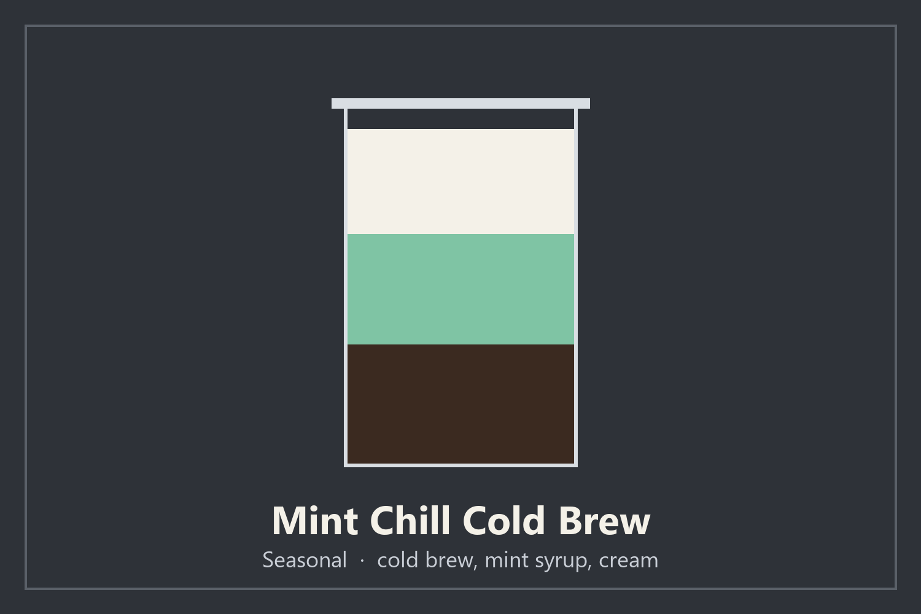
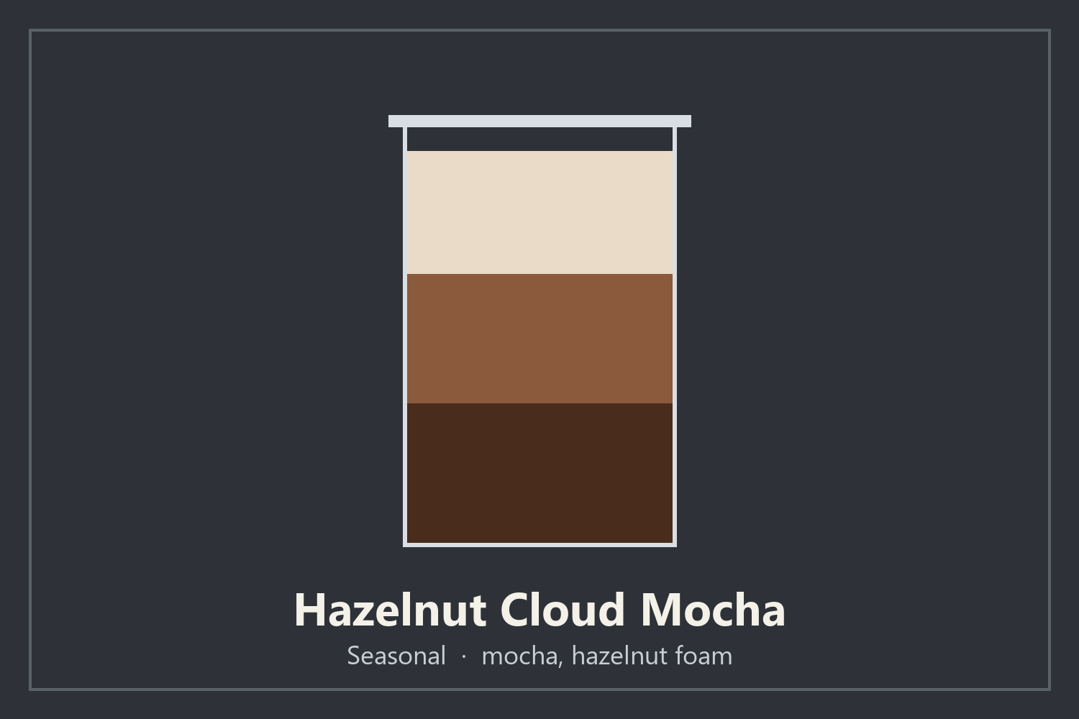
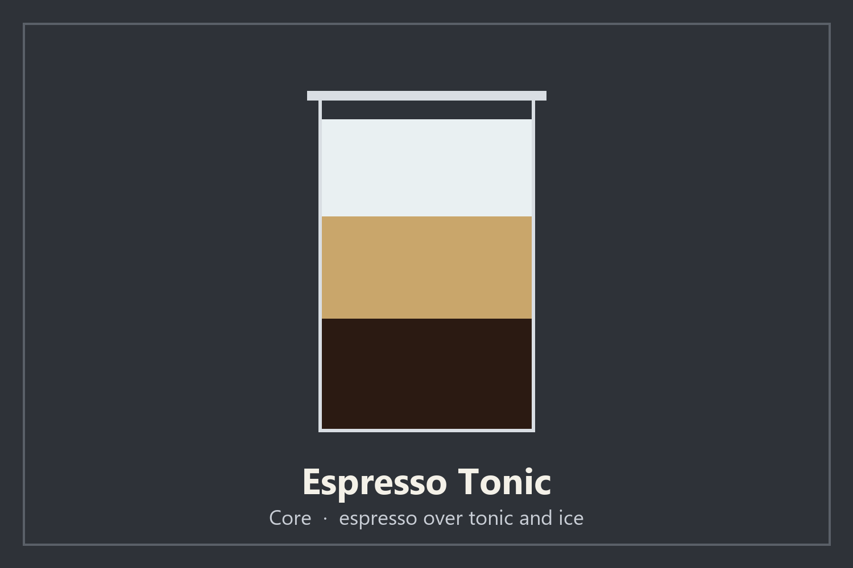
Mint Chill fell 18%, the most of any drink.
Menu-board cards and year-over-year sales change, FY2025
Mint Chill Cold Brew
Hazelnut Cloud Mocha
Espresso Tonic
-18%, the steepest fall
-14%, the second steepest
+15%, the fastest growth
Replace Mint Chill and Hazelnut Cloud in March; model the new drink on Espresso Tonic.
Source: Copperleaf point-of-sale data, FY2025 vs. FY2024 (140 stores); menu-board cards, FY2025.
Appendix 12
Notes:
[Beat 1] These are the three drinks the refresh turns on. Mint Chill and Hazelnut Cloud fell the most and leave the menu in March; Espresso Tonic grew fastest and is the model for the new seasonal drink.

Slide 18
The trainer wait was the top reason applicants withdrew.
Withdrawn barista applicants by reason, with one answer for each, FY2025
Waited for a trainer: 14 applicants
Pay offer too low: 9 applicants
Shift hours did not fit: 7 applicants
“I passed the interview, then heard nothing about a trial shift for over a week… I had taken another job.”
Barista applicant, Harbor Street
“The hourly rate in the offer was lower than the café across the street pays.”
Barista applicant, Union Square
“They could only offer early mornings, and I have classes until ten.”
Barista applicant, Riverside
14 of 40 applicants who withdrew named the wait for a trainer, more than pay or hours.
Book every trial shift within two days of the interview from the March wave.
Source: Copperleaf applicant withdrawal survey, FY2025 (40 barista applicants who withdrew).
Appendix 13
Notes:
[Beat 1] These are the three most common reasons, each with one applicant’s own words. Fourteen of forty withdrew while they waited for a trainer to run the trial shift, more than left over pay or hours; ten gave other reasons.

