Slide 1
My Diet App
נאור דוד 204510077
עדי עזרן 041698226

Slide 2
Introduction
My Diet App is a social network for people that need help with their diet.
A place where you can process your meal for calorie counting and history.
A place where you can share your difficulties in the diet process.
A place where you can help other users carry on with their diets and make the process easer.
A service that you can use as a web site , mobile and desktop app.

Slide 3
Modules
Express
Express is preferred because it adds simple routing and support for Connect middleware, allowing many extensions and useful features.
Easy to install and you can find examples and tutorial online.
Mongoose
Mongoose allows us to have access to the MongoDB commands for CRUD simply and easily.
Easy to install and you can find examples and tutorial online.
Learned in class,
Body-parser –
Simple way to use JSON Easley.

Slide 4
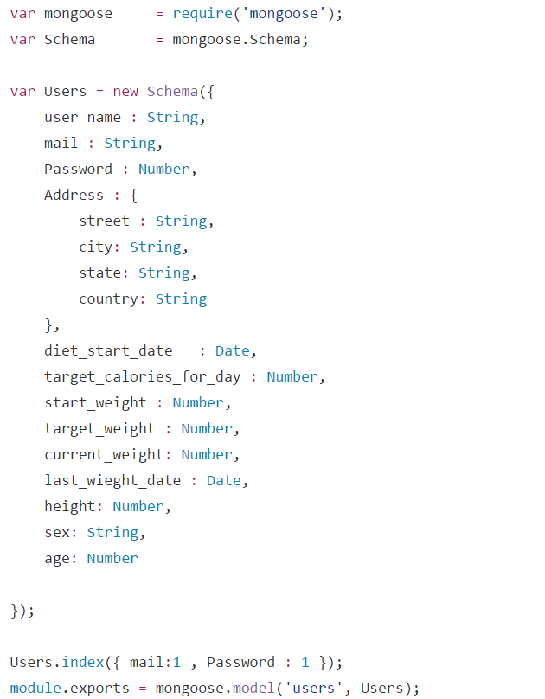
Schema – users

Slide 5
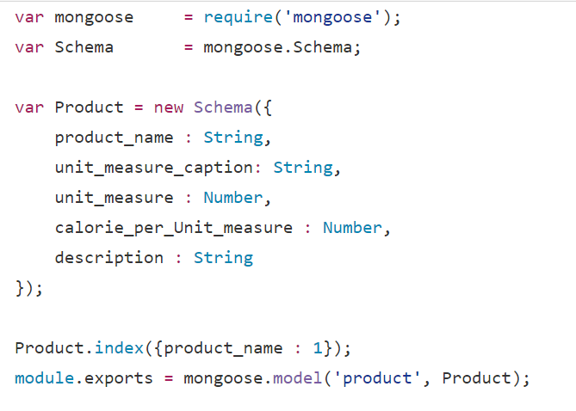
Schema – Product

Slide 6
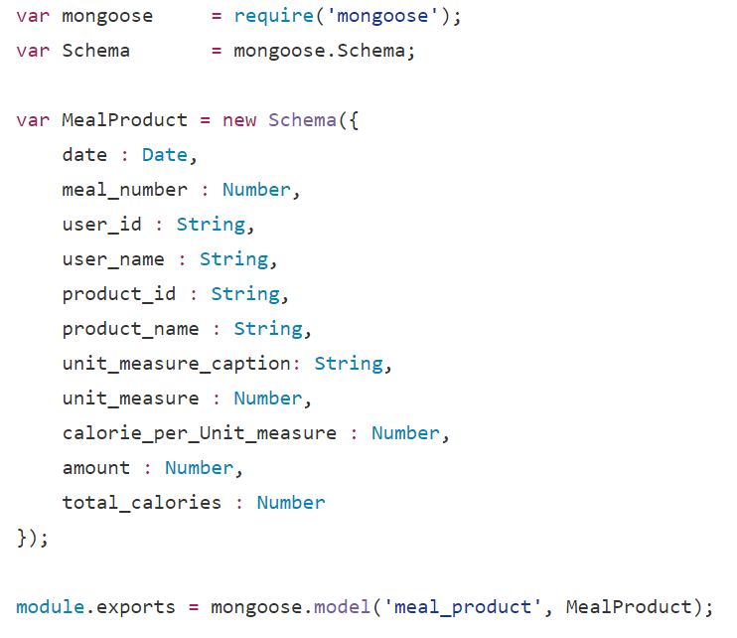
Schema - Meal_products

Slide 7
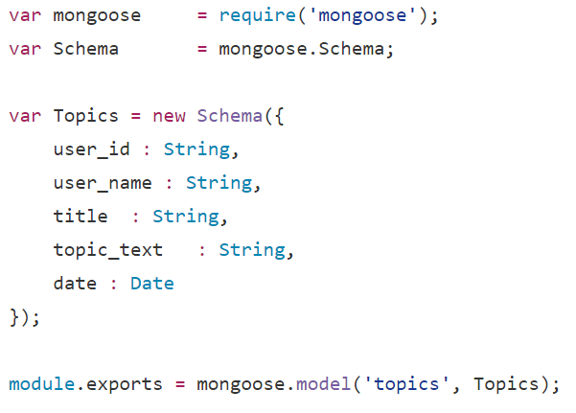
Schema - Topics

Slide 8
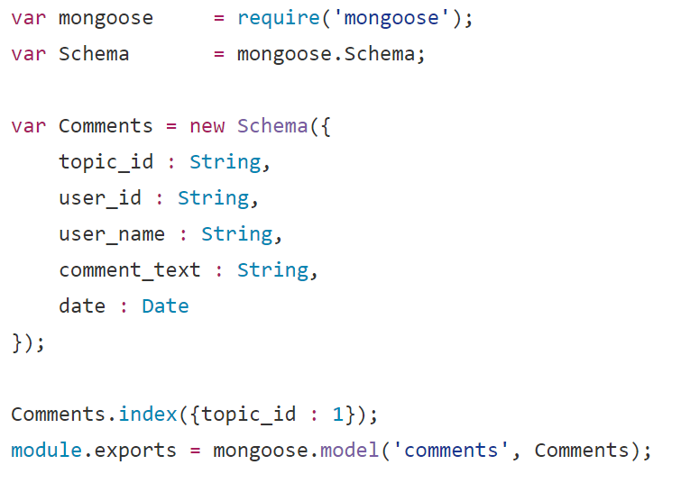
Schema - comments

Slide 9
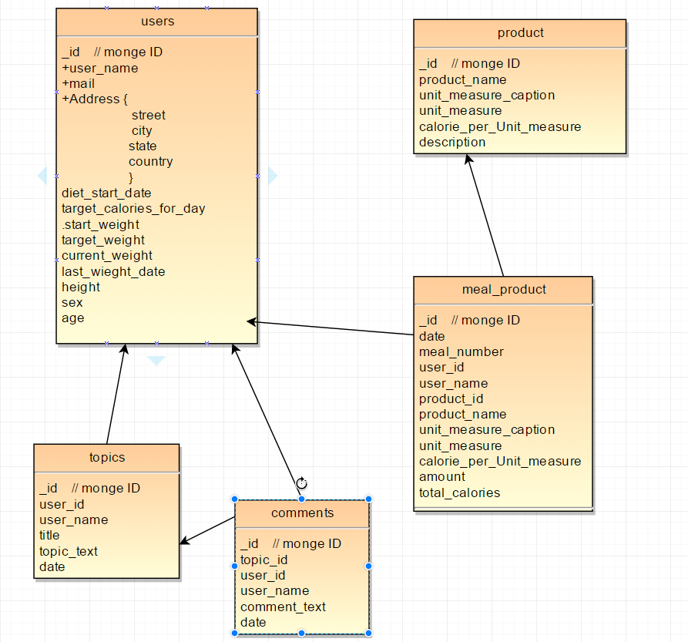
ERD

Slide 10
indexes
All schemas get defaults indexes from mongo which is the Objectid _id
In user : {user_name , password} - faster search when a user tries to log in
In product : {product_name} – most of the product query is for product_name
In comments : {topic_id} – all comments are related to a topic so when a user queries for comments he needs to search a relevant topic_id

Slide 11
Some code example

Slide 12
Difficulties
Short time
New environments and customizing them
Working with new DB with different structure

Slide 13
Questions ? No ? Thanks

