Slide 1




Operator evolution from the similarity renormalization group
Anthony Tropiano¹, Dick Furnstahl¹, Scott Bogner²
¹Ohio State University, ²Michigan State University
APS DNP Meeting – Arlington, Virginia
October 15, 2019

Slide 2
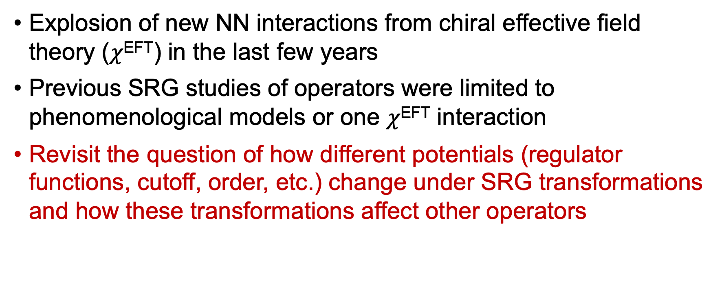
Motivation
Explosion of new NN interactions from chiral effective field theory ($χ$^{EFT}) in the last few years
Previous SRG studies of operators were limited to phenomenological models or one $χ$^{EFT} interaction
Revisit the question of how different potentials (regulator functions, cutoff, order, etc.) change under SRG transformations and how these transformations affect other operators

Slide 3
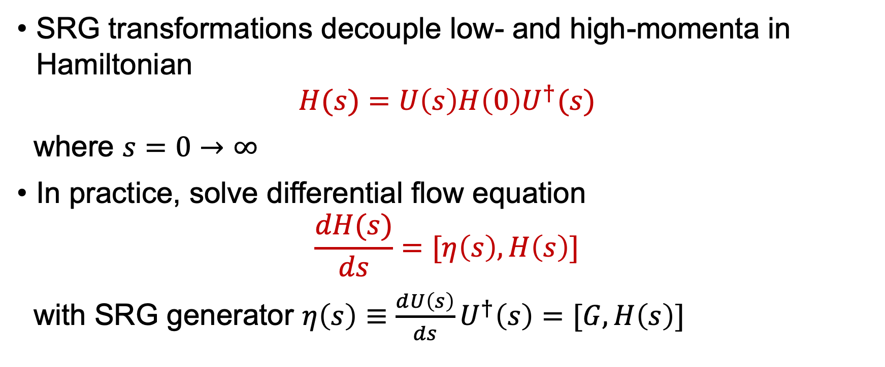
SRG formalism
SRG transformations decouple low- and high-momenta in Hamiltonian
$$H(s)=U\left(s\right)H\left(0\right)U^{†}(s)$$
where $s=0→∞$
In practice, solve differential flow equation
$$\frac{dH(s)}{ds}=[η\left(s\right),H\left(s\right)]$$
with SRG generator $η\left(s\right)≡\frac{dU\left(s\right)}{ds}U^{†}\left(s\right)=[G,H\left(s\right)]$

Slide 4


SRG formalism
RKE N⁴LO $Λ=450$ MeV
$G=H_{D}(s)$ for band-diagonal decoupling and $G=H_{BD}(s)$ for block-diagonal decoupling
Fig. 1: SRG evolution of $V_{λ}(k,k^{′})$ for several values of $λ$ and $Λ$ in the ¹P₁ channel. Potentials from P. Reinert et al., Eur. Phys. J. A 54, 86 (2018) which will be referred to as the RKE potentials.

Slide 5
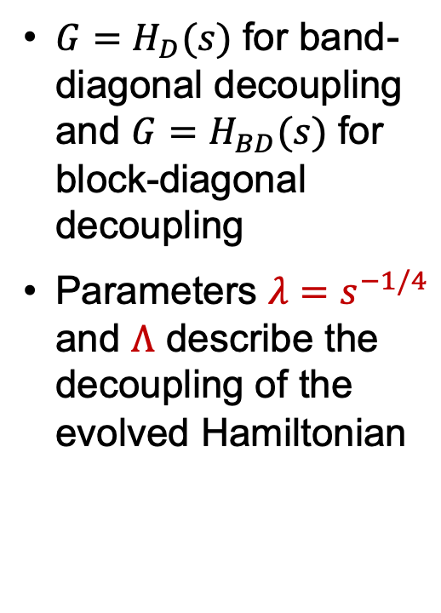
SRG formalism
RKE N⁴LO $Λ=450$ MeV
$G=H_{D}(s)$ for band-diagonal decoupling and $G=H_{BD}(s)$ for block-diagonal decoupling
Parameters $λ=s^{−1/4}$ and $Λ$ describe the decoupling of the evolved Hamiltonian
Fig. 1: SRG evolution of $V_{λ}(k,k^{′})$ for several values of $λ$ and $Λ$ in the ¹P₁ channel. Potentials from P. Reinert et al., Eur. Phys. J. A 54, 86 (2018) which will be referred to as the RKE potentials.

Slide 6
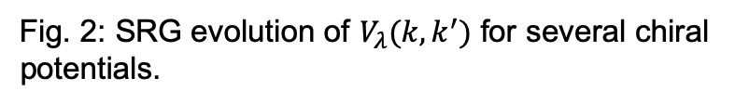
SRG evolution of modern chiral potentials
How do different potentials change under SRG transformations?
Fig. 2: SRG evolution of $V_{λ}(k,k^{′})$ for several chiral potentials.

Slide 7
SRG evolution of modern chiral potentials
How do different potentials change under SRG transformations?
Use non-local Entem-Machleidt¹ (500 MeV), semi-local RKE² (450 MeV), and local Gezerlis et al.³ (1 fm) potentials as examples
¹D.R. Entem and R. Machleidt, Phys. Rev. C 68, 041001 (2003)
²P. Reinert, H. Krebs, and E. Epelbaum, Eur. Phys. J. A 54, 86 (2018)
³A. Gezerlis, et al., Phys. Rev. C 90, 054323 (2014)
Fig. 2: SRG evolution of $V_{λ}(k,k^{′})$ for several chiral potentials.

Slide 8
SRG evolution of modern chiral potentials
How do different potentials change under SRG transformations?
Use non-local Entem-Machleidt¹ (500 MeV), semi-local RKE² (450 MeV), and local Gezerlis et al.³ (1 fm) potentials as examples
Different potentials evolve to the same low-momentum matrix elements!
Fig. 2: SRG evolution of $V_{λ}(k,k^{′})$ for several chiral potentials.

Slide 9

Universality in SRG-evolved potentials
Evolved matrix elements collapse to the same lines
Fig. 3: Diagonal and far off-diagonal matrix elements of $V_{λ}(k,k^{′})$ for several chiral potentials with band- and block-diagonal decoupling.

Slide 10
Universality in SRG-evolved potentials
Universality in potential matrix elements is due to equivalent low-energy phase shifts¹
¹B. Dainton et al., Phys. Rev. C 89, 014001 (2014)

Slide 11
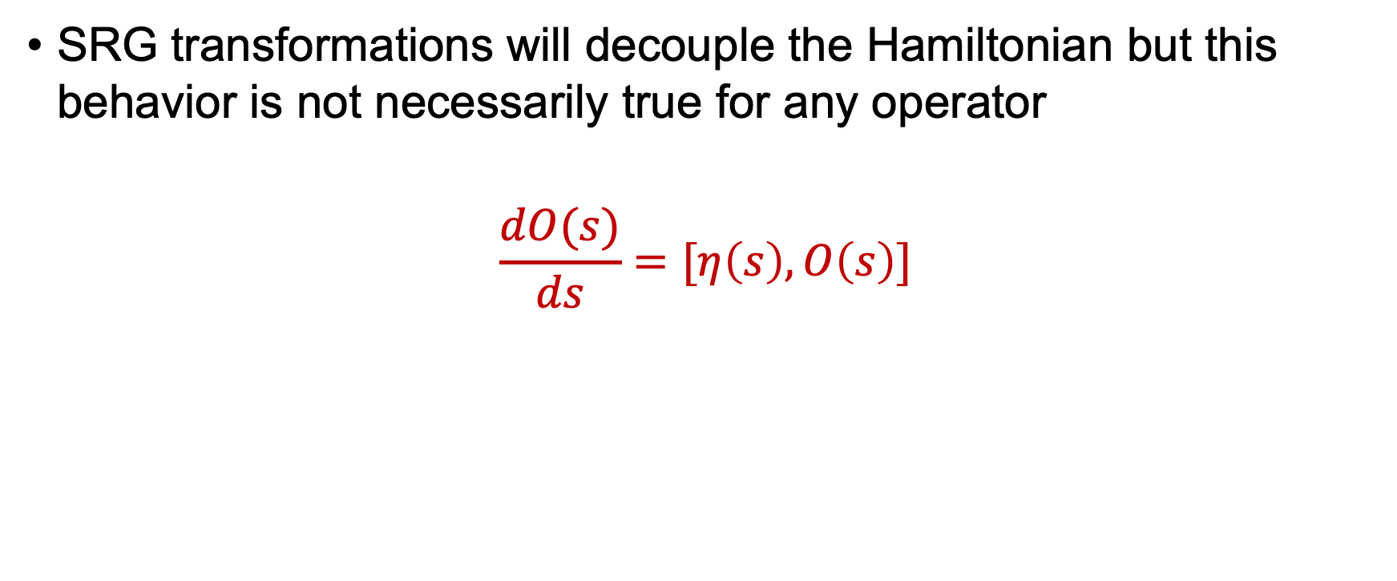
SRG evolution for other operators
SRG transformations will decouple the Hamiltonian but this behavior is not necessarily true for any operator
$$\frac{dO(s)}{ds}=[η\left(s\right),O\left(s\right)]$$

Slide 12
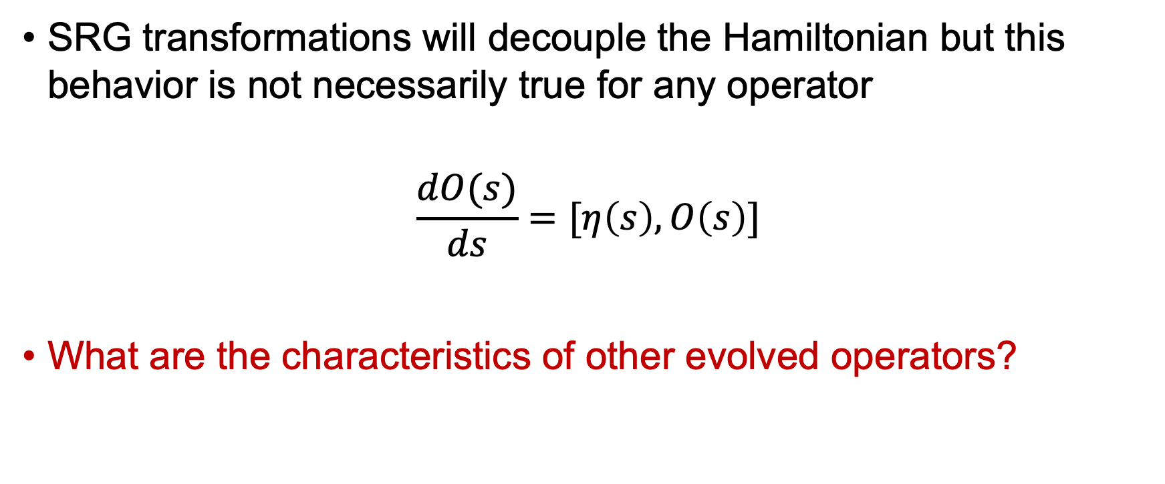
SRG evolution for other operators
SRG transformations will decouple the Hamiltonian but this behavior is not necessarily true for any operator
$$\frac{dO(s)}{ds}=[η\left(s\right),O\left(s\right)]$$
What are the characteristics of other evolved operators?

Slide 13
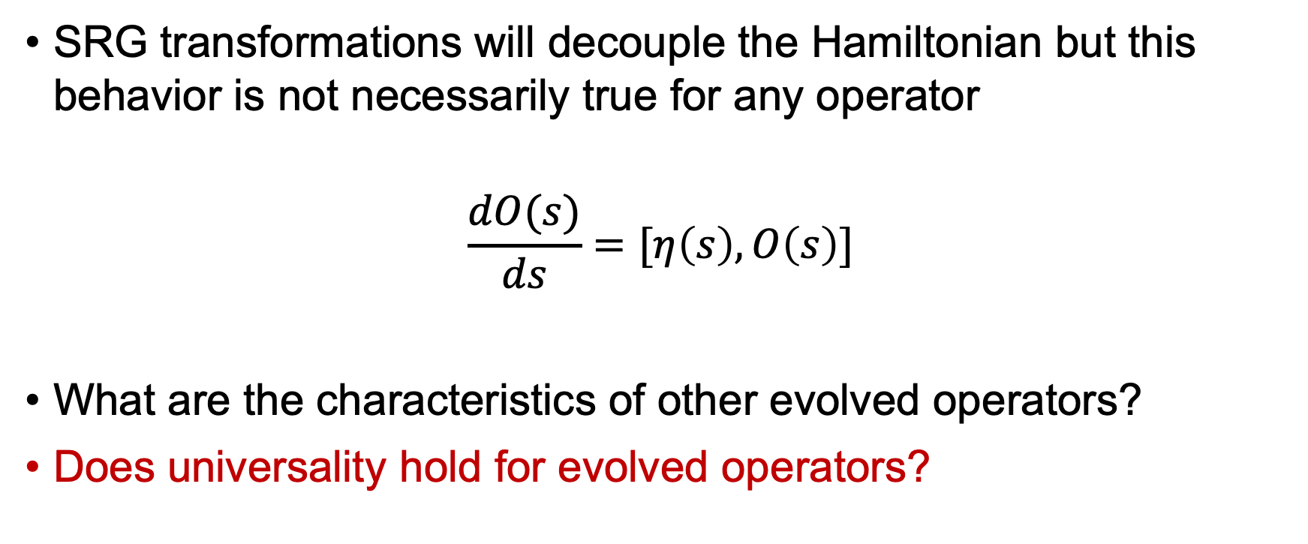
SRG evolution for other operators
SRG transformations will decouple the Hamiltonian but this behavior is not necessarily true for any operator
$$\frac{dO(s)}{ds}=[η\left(s\right),O\left(s\right)]$$
What are the characteristics of other evolved operators?
Does universality hold for evolved operators?

Slide 14


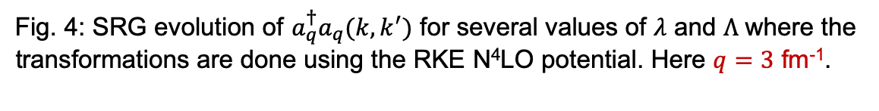
Momentum projection operator
RKE N⁴LO $Λ=450$ MeV
We use the momentum projection operator $a_{q}^{†}a_{q}$as a test case
$$a_{q}^{†}a_{q}ψ\left(k\right)=\int{d^{3}k}δ^{3}(\vec{k}−\vec{q})ψ(k)$$
Fig. 4: SRG evolution of $a_{q}^{†}a_{q}(k,k^{′})$ for several values of $λ$ and $Λ$ where the transformations are done using the RKE N⁴LO potential. Here $q=3$ fm⁻¹.

Slide 15
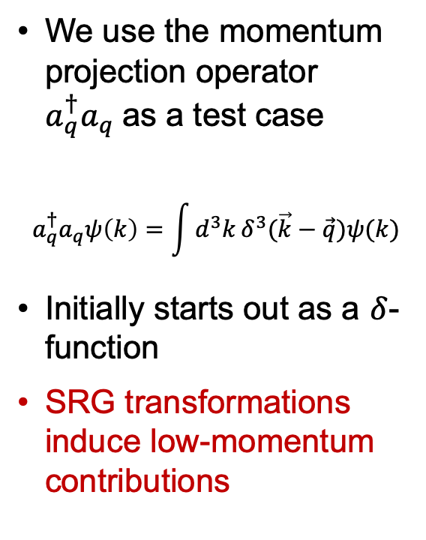
Momentum projection operator
RKE N⁴LO $Λ=450$ MeV
We use the momentum projection operator $a_{q}^{†}a_{q}$as a test case
$$a_{q}^{†}a_{q}ψ\left(k\right)=\int{d^{3}k}δ^{3}(\vec{k}−\vec{q})ψ(k)$$
Initially starts out as a $δ$-function
SRG transformations induce low-momentum contributions
Fig. 4: SRG evolution of $a_{q}^{†}a_{q}(k,k^{′})$ for several values of $λ$ and $Λ$ where the transformations are done using the RKE N⁴LO potential. Here $q=3$ fm⁻¹.

Slide 16


Momentum projection operator
RKE N⁴LO $Λ=450$ MeV
We use the momentum projection operator $a_{q}^{†}a_{q}$as a test case
$$a_{q}^{†}a_{q}ψ\left(k\right)=ψ(q)$$
Initially starts out as a $δ$-function
SRG transformations induce low-momentum contributions
Fig. 4: SRG evolution of $a_{q}^{†}a_{q}(k,k^{′})$ for several values of $λ$ and $Λ$ where the transformations are done using the RKE N⁴LO potential. Here $q=3$ fm⁻¹.

Slide 17

Momentum projection operator
RKE N⁴LO $Λ=450$ MeV
We use the momentum projection operator $a_{q}^{†}a_{q}$as a test case
$$a_{q}^{†}a_{q}ψ\left(k\right)=ψ(q)$$
Initially starts out as a $δ$-function
SRG transformations induce low-momentum contributions
Strength of wave function shifted to low-momentum
$\left\langle ψ(0) | O(0) | ψ(0)\right\rangle =$ $\left\langle ψ(s) | O(s) | ψ(s)\right\rangle$
$⟹$ Transformations on the operator must induce low-momentum contributions!
Fig. 4: SRG evolution of $a_{q}^{†}a_{q}(k,k^{′})$ for several values of $λ$ and $Λ$ where the transformations are done using the RKE N⁴LO potential. Here $q=3$ fm⁻¹.

Slide 18
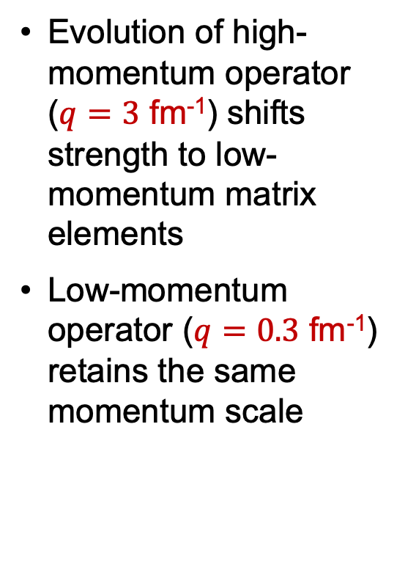

Momentum projection operator
RKE N⁴LO $Λ=450$ MeV
Evolution of high-momentum operator ($q=3$ fm⁻¹) shifts strength to low-momentum matrix elements
Low-momentum operator ($q=0.3$ fm⁻¹) retains the same momentum scale
Fig. 6: Integrand of $\left\langle ψ_{d} | a_{q}^{†}a_{q} | ψ_{d}\right\rangle$ in momentum-space for $q=3$ (top) and $0.3$ (bottom) fm⁻¹ with SRG transformations for several values of $λ$ where the transformations are done using the RKE N⁴LO potential.

Slide 19
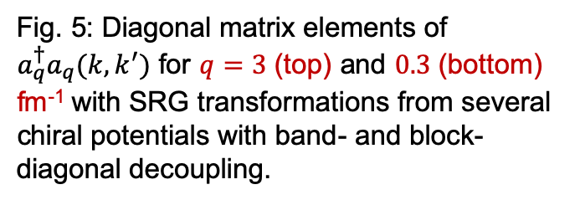
Momentum projection operator
Matrix elements do not collapse for different cases
Fig. 5: Diagonal matrix elements of $a_{q}^{†}a_{q}(k,k^{′})$ for $q=3$ (top) and $0.3$ (bottom) fm⁻¹ with SRG transformations from several chiral potentials with band- and block-diagonal decoupling.

Slide 20
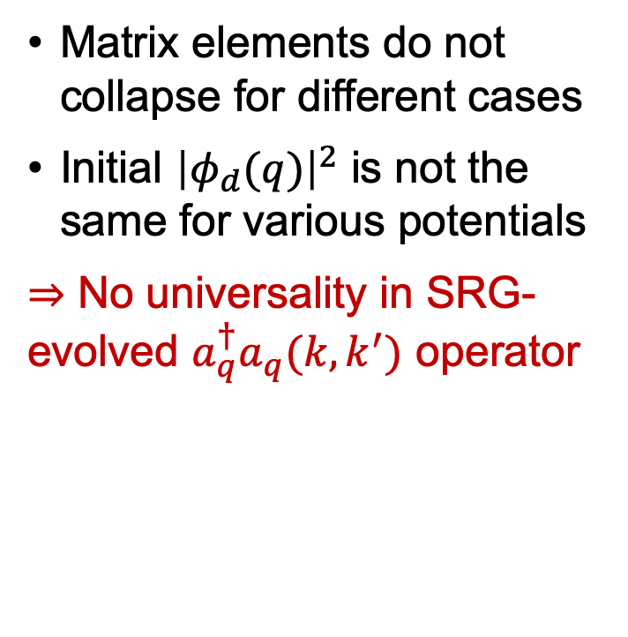
Momentum projection operator
Momentum projection operator
Matrix elements do not collapse for different cases
Initial ${\left|φ_{d}(q)\right|}^{2}$ is not the same for various potentials
$⇒$ No universality in SRG-evolved $a_{q}^{†}a_{q}(k,k^{′})$ operator
Fig. 5: Diagonal matrix elements of $a_{q}^{†}a_{q}(k,k^{′})$ for $q=3$ (top) and $0.3$ (bottom) fm⁻¹ with SRG transformations from several chiral potentials with band- and block-diagonal decoupling.

Slide 21
Summary
Different SRG softened interactions collapse to universal form at low-energy if corresponding phase shifts are the same
Universality depends on the pattern of SRG decoupling – the SRG generator (band- or block-diagonal)
Other operators do not necessarily decouple like evolved potentials but shift strength to low-momentum to reflect changes in the evolved wave function

Slide 22

Outlook
Further test SRG-evolution of other operators (${\hat{r}}^{2}$, $\hat{Q}$, etc.)

Slide 23
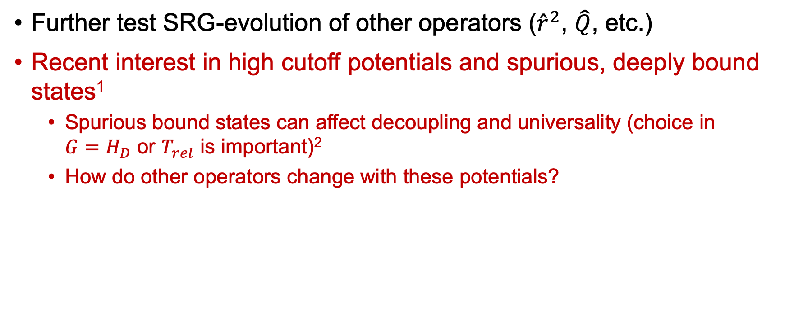
Outlook
Further test SRG-evolution of other operators (${\hat{r}}^{2}$, $\hat{Q}$, etc.)
Recent interest in high cutoff potentials and spurious, deeply bound states¹
Spurious bound states can affect decoupling and universality (choice in $G=H_{D}$ or $T_{rel}$ is important)²
How do other operators change with these potentials?
¹I. Tews et al., Phys. Rev. C 98, 024001 (2018), ²K.A. Wendt et al., Phys. Rev. C 83, 034005 (2011)

Slide 24
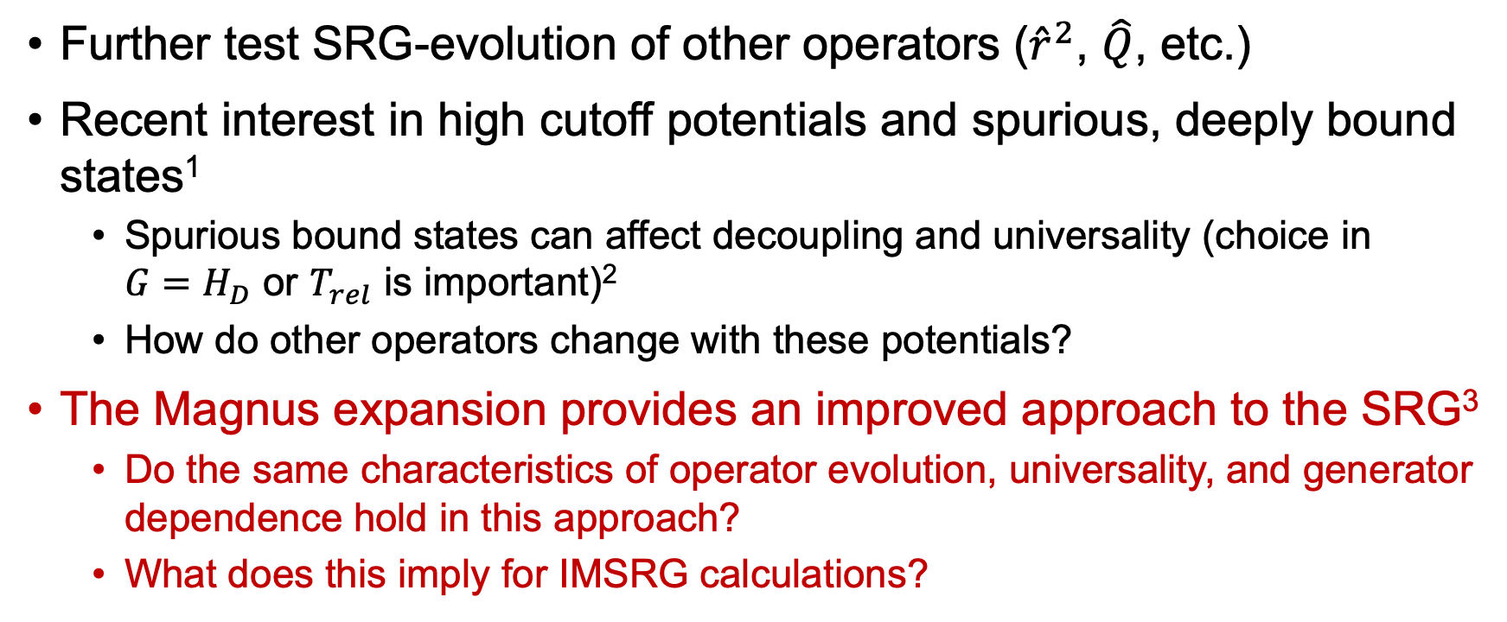
Outlook
Further test SRG-evolution of other operators (${\hat{r}}^{2}$, $\hat{Q}$, etc.)
Recent interest in high cutoff potentials and spurious, deeply bound states¹
Spurious bound states can affect decoupling and universality (choice in $G=H_{D}$ or $T_{rel}$ is important)²
How do other operators change with these potentials?
The Magnus expansion provides an improved approach to the SRG³
Do the same characteristics of operator evolution, universality, and generator dependence hold in this approach?
What does this imply for IMSRG calculations?
¹I. Tews et al., Phys. Rev. C 98, 024001 (2018), ²K.A. Wendt et al., Phys. Rev. C 83, 034005 (2011), ³T.D. Morris et al., Phys. Rev. C 92, 034331 (2015)

Slide 25
Extras

