Slide 1
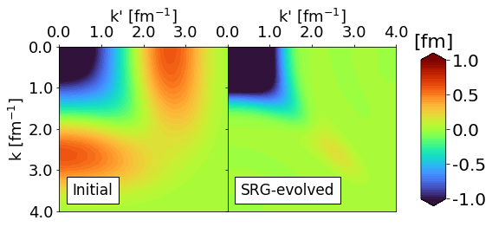
Similarity Renormalization Group (SRG)
Nucleon-nucleon interactions are complicated by coupling of low- and high-energy scales
This coupling limits our capability in solving nuclear many-body problems that rely on basis truncations
SRG transformations decouple energy scales (“soften”) to allow for accurate calculations
Fig. 1: Example of how the SRG decouples momentum scales in a nucleon-nucleon potential in momentum-space. The potential is driven to band-diagonal form.

Slide 2
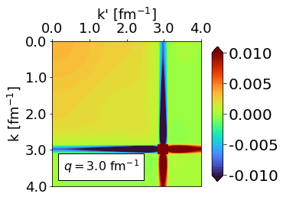
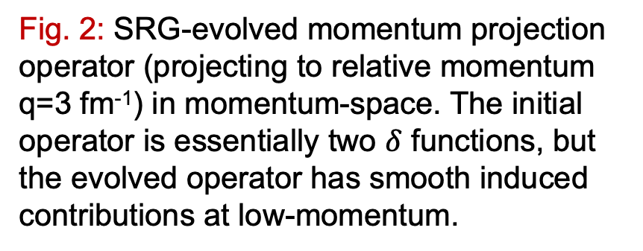
SRG current research
Operator evolution
How do non-Hamiltonian operators change under SRG transformations?
Implementation of SRG transformations
Different ways to decouple the Hamiltonian (e.g. band- or block-diagonal decoupling)
The Magnus expansion
Universality
Different nuclear potentials can be driven to the same form via SRG transformations
How is this characterized in other operators?
Fig. 2: SRG-evolved momentum projection operator (projecting to relative momentum q=3 fm⁻¹) in momentum-space. The initial operator is essentially two $δ$ functions, but the evolved operator has smooth induced contributions at low-momentum.

Slide 3
SRG future topics
Gain insight on scale and scheme dependence in nuclear reactions
Apply SRG transformations to nuclear optical potentials
Extend our analysis of the Magnus expansion to nuclear many-body problems (in-medium SRG)
Add evolved current figure or figure from optical potentials analysis?

