Slide 1




Short-range correlation physics at low RG resolution
Anthony Tropiano¹, Dick Furnstahl¹, Scott Bogner²
¹Ohio State University, ²Michigan State University
APS April Meeting – Virtual Meeting
April 19, 2021
ajt, S.K. Bogner, and R.J. Furnstahl, arXiv:2006.11186
Phys. Rev. C 102, 034005 (2020)
ajt, S.K. Bogner, and R.J. Furnstahl, in progress

Slide 2
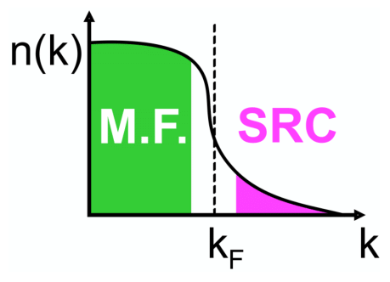
Motivation
knock-out 2 high-k nucleons
Recent experiments have been able to isolate processes where short-range correlation (SRC) physics is dominant and well accounted for by SRC phenomenology
High RG resolution description of SRC physics
SRC pairs are components in the nuclear wave function with relative momenta above the Fermi momentum
excite SRC pair
same expt. resolution
low-k initial pair
Notes:
Figure out where to put the high-k tail figure.
White out the low RG part as before.

Slide 3
Motivation
knock-out 2 high-k nucleons
Recent experiments have been able to isolate processes where short-range correlation (SRC) physics is dominant and well accounted for by SRC phenomenology
High RG resolution description of SRC physics
SRC pairs are components in the nuclear wave function with relative momenta above the Fermi momentum
Low RG resolution description of SRC physics
Using renormalization group (RG) methods we can tune the scale to low RG resolution
The SRC physics is shifted into the reaction operators from the nuclear wave function (which becomes soft)
excite SRC pair
same expt. resolution
low-k initial pair
Notes:
Replace high RG bullet with low RG bullet?
Get rid of high-k figure?

Slide 4
Motivation
knock-out 2 high-k nucleons
Recent experiments have been able to isolate processes where short-range correlation (SRC) physics is dominant and well accounted for by SRC phenomenology
High RG resolution description of SRC physics
SRC pairs are components in the nuclear wave function with relative momenta above the Fermi momentum
Low RG resolution description of SRC physics
Using renormalization group (RG) methods we can tune the scale to low RG resolution
The SRC physics is shifted into the reaction operators from the nuclear wave function (which becomes soft)
ADD: Same observables but different physical interpretation!
excite SRC pair
same expt. resolution
low-k initial pair
Notes:
Add this last point as box overlay.

Slide 5
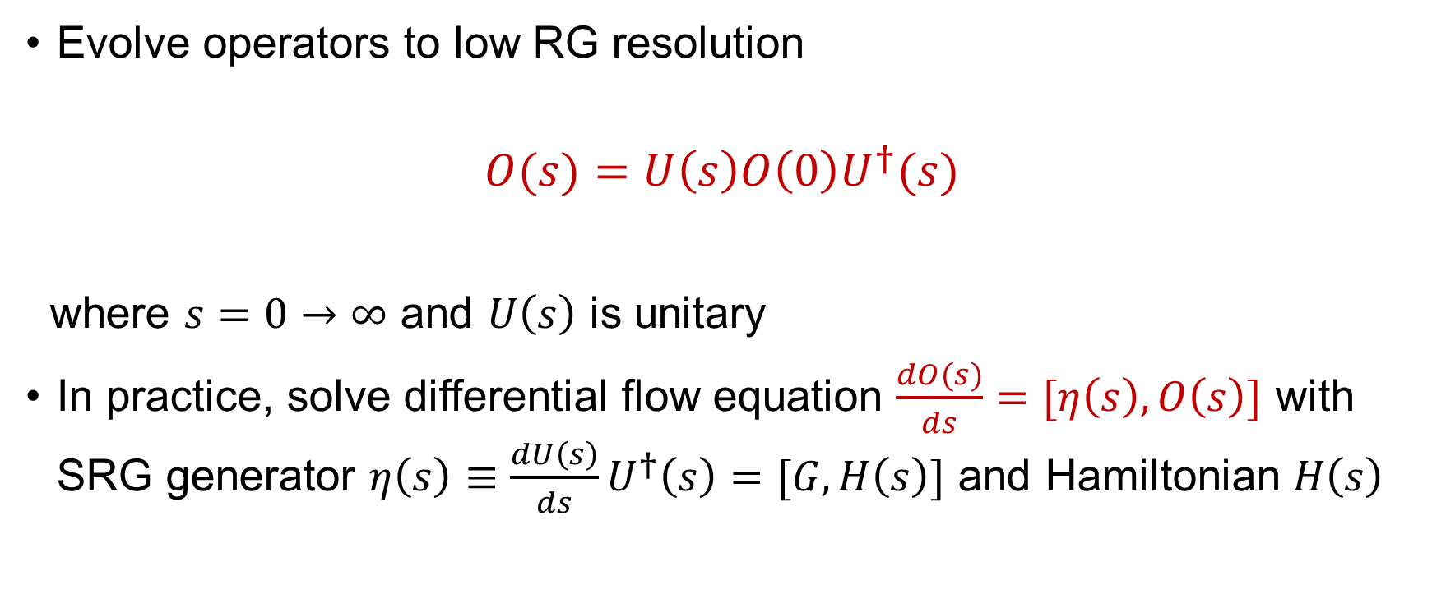
Similarity Renormalization Group (SRG)
Evolve operators to low RG resolution
$$O(s)=U\left(s\right)O\left(0\right)U^{†}(s)$$
where $s=0→∞$ and $U\left(s\right)$ is unitary
In practice, solve differential flow equation $\frac{dO(s)}{ds}=[η\left(s\right),O\left(s\right)]$ with SRG generator $η\left(s\right)≡\frac{dU\left(s\right)}{ds}U^{†}\left(s\right)=[G,H\left(s\right)]$ and Hamiltonian $H\left(s\right)$

Slide 6
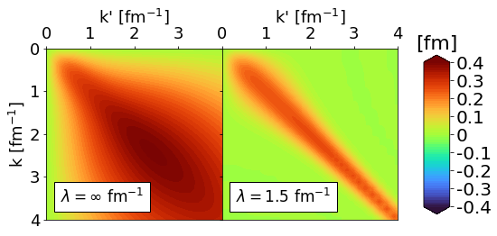
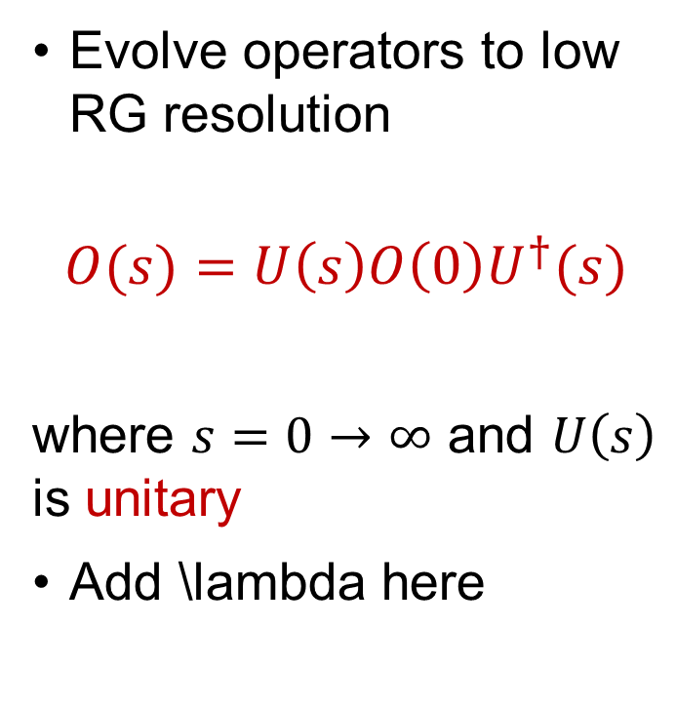
Similarity Renormalization Group (SRG)
Evolve operators to low RG resolution
$$O(s)=U\left(s\right)O\left(0\right)U^{†}(s)$$
where $s=0→∞$ and $U\left(s\right)$ is unitary
Add \lambda here
Fig. 1: SRG evolution of AV18 in ¹P₁ channel.
Notes:
\lambda bullet point and add arrows to plot.

Slide 7
Deuteron wave function at low RG resolution
AV18 wave function has significant SRC
What happens to the wave function at low RG resolution?
SRC physics in AV18 (scheme dependent) is gone from wave function at low RG resolution
Deuteron wave functions become soft and D-state probability goes down
Observables such as asymptotic D-S ratio are the same
Notes:
This should be the same as previous two slides on the wave function.

Slide 8
Deuteron wave function at low RG resolution
SRC in AV18
No SRC
AV18 wave function has significant SRC
What happens to the wave function at low RG resolution?
SRC physics in AV18 (scheme dependent) is gone from wave function at low RG resolution
Deuteron wave functions become soft and D-state probability goes down
Observables such as asymptotic D-S ratio are the same
Fig. 2: SRG evolution of deuteron wave function in coordinate space for AV18 and Gezerlis N2LO¹.
¹A. Gezerlis et al., Phys. Rev. C 90, 054323 (2014)

Slide 9
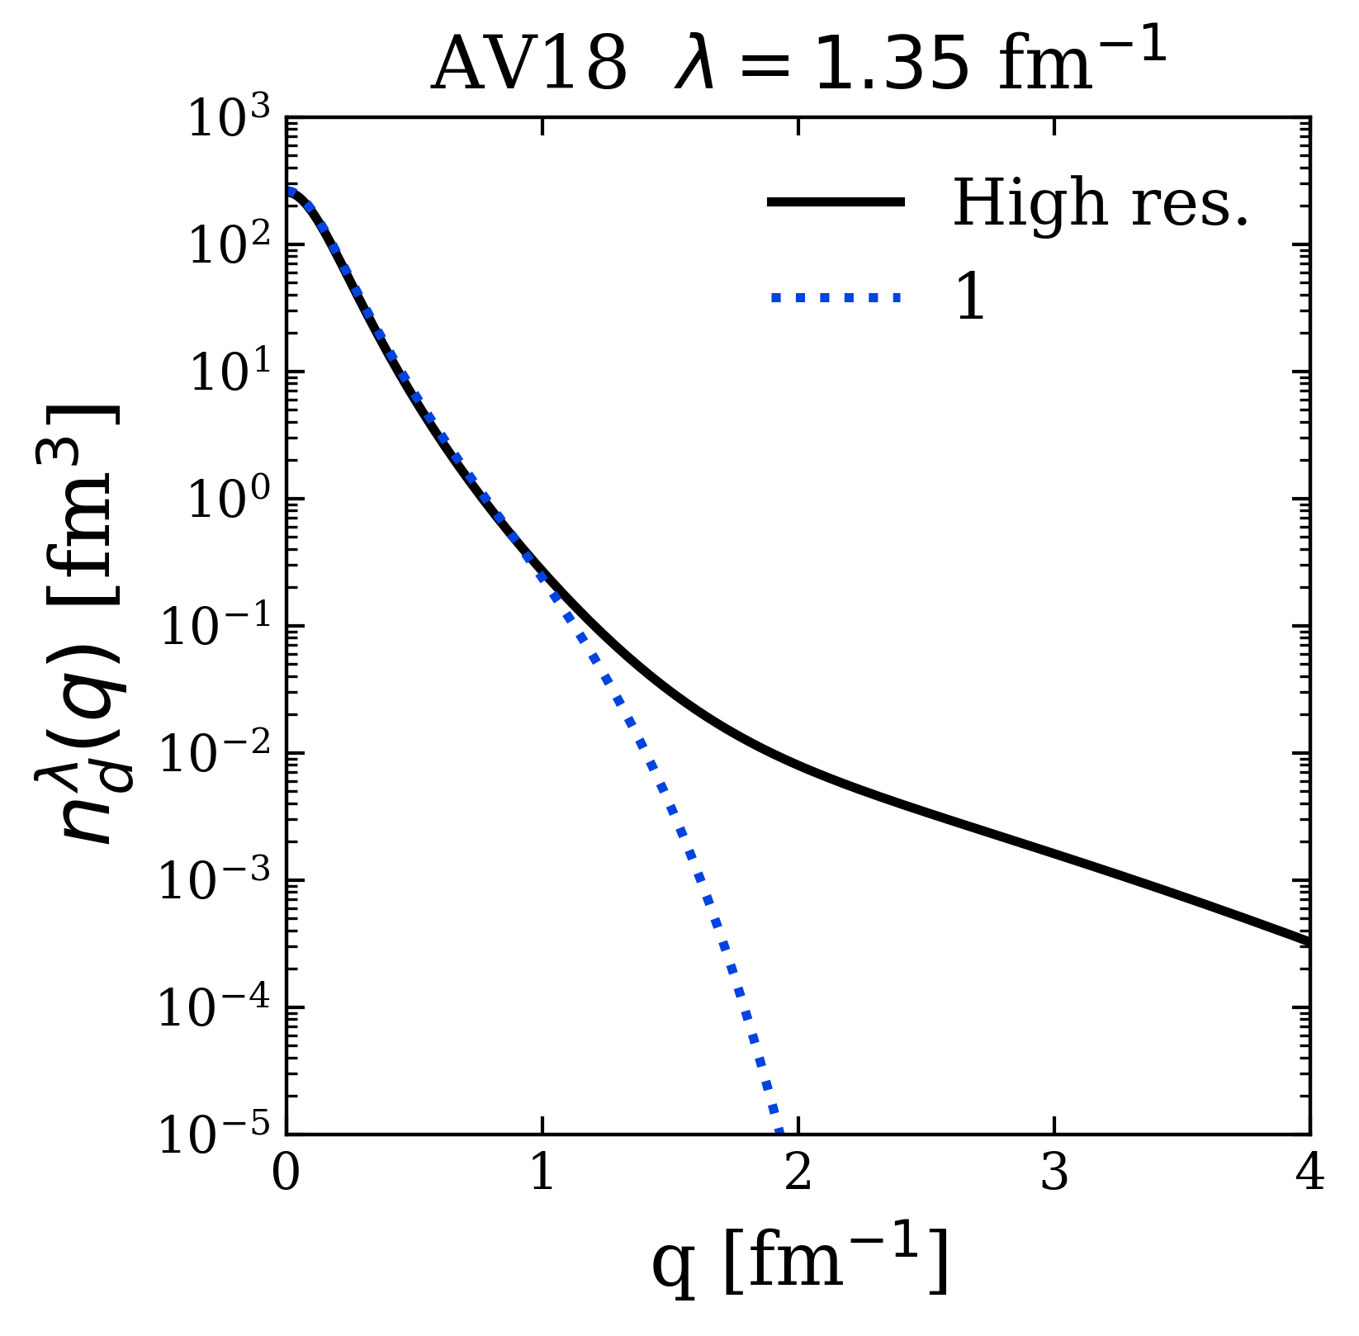
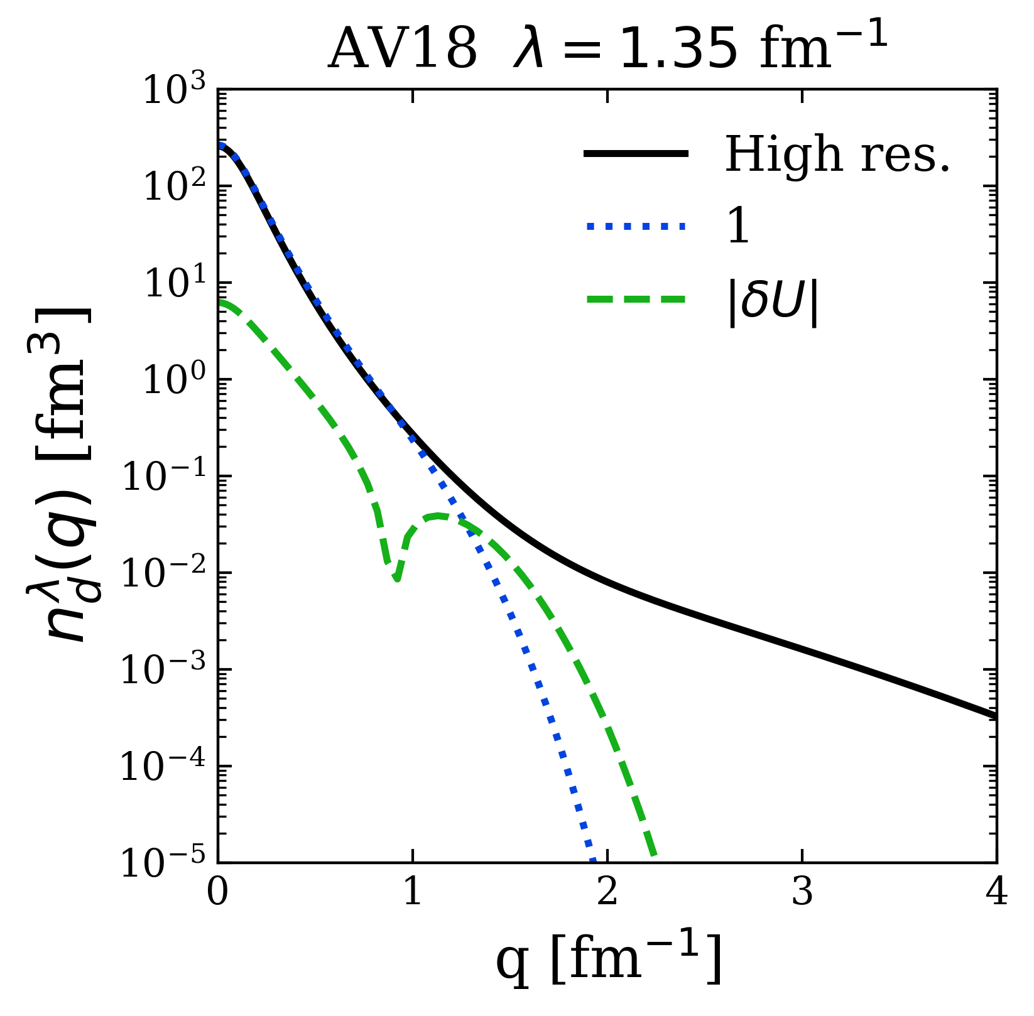
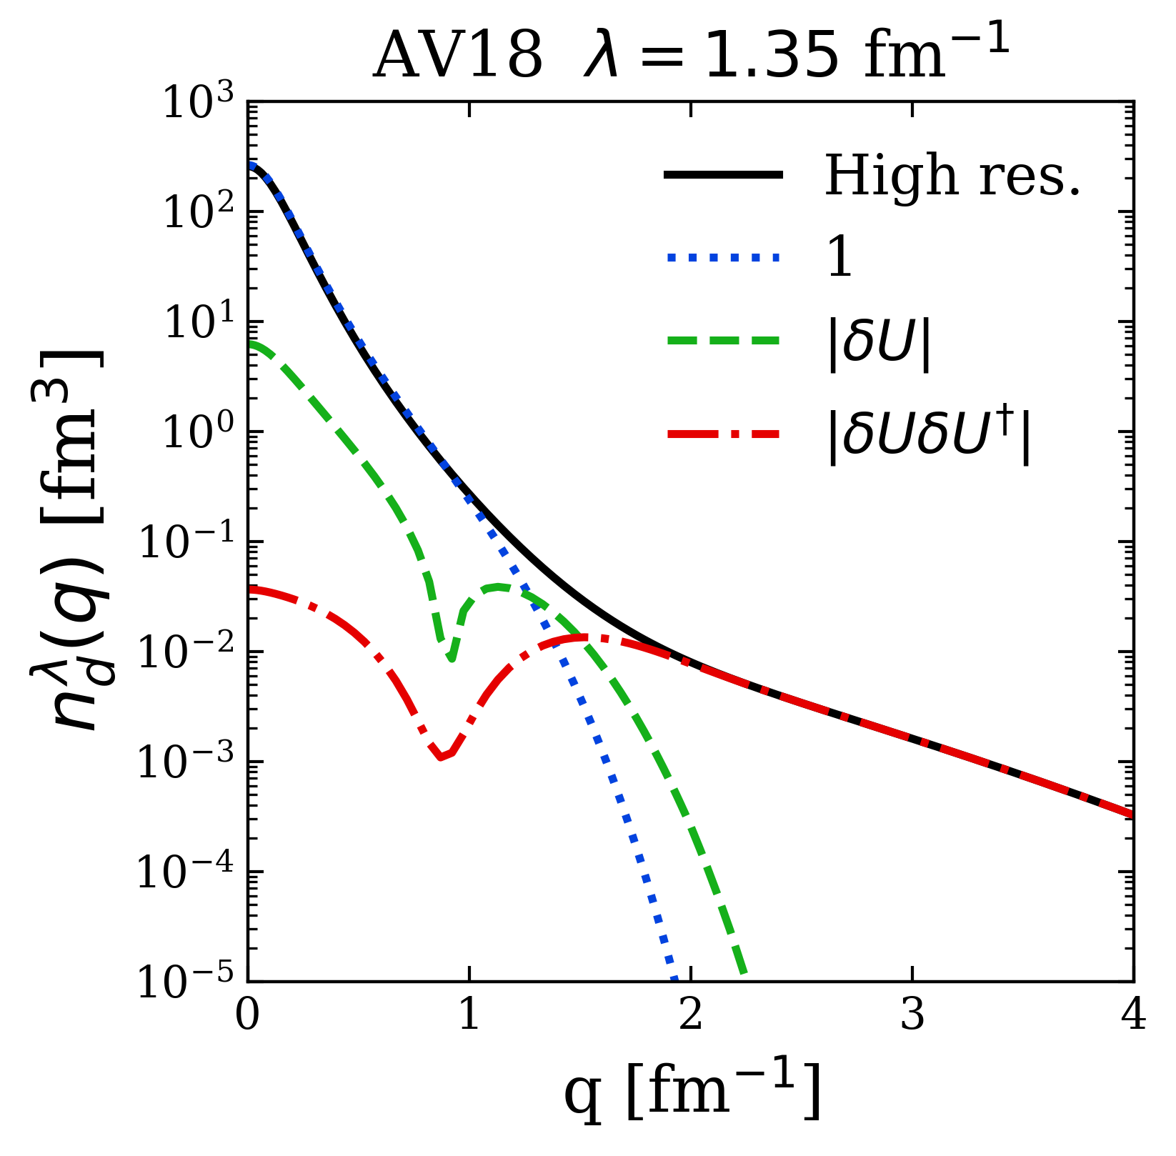
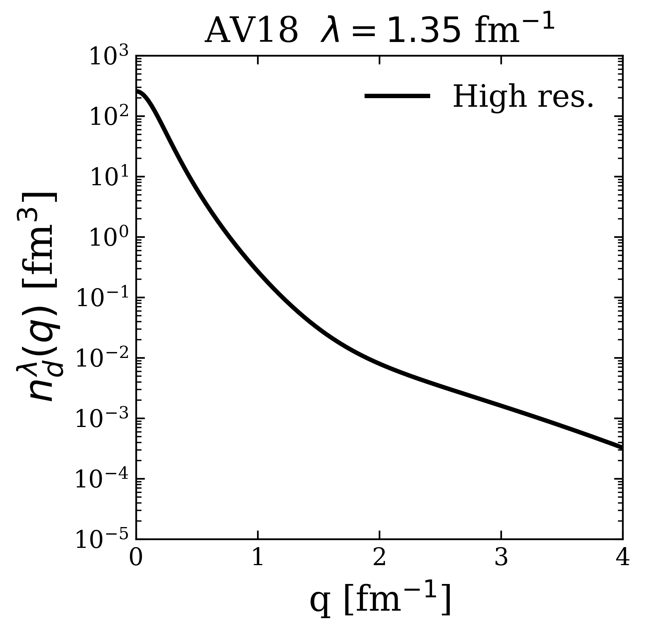
Factorization
Very brief second quantized equations of U(k,k'), n(q), etc. (Maybe write final expression stating what is important (high-q piece).)
Highlight factorization (add schematic)
Evaluate A-body matrix elements with LDA
Notes:
Where does the short distance physics go?
Expand SRG transformation. For high-q operator (high-q momentum distribution tails), we isolate the \delta U \delta U^\dagger term.
Factorization of \delta U’s gives high-q function and low-q A-body matrix element.
Deuteron example. Step through each piece (see SB talk)
Evaluate A-body matrix elements using LDA.

Slide 10
Factorization
Very brief second quantized equations of U(k,k'), n(q), etc. (Maybe write final expression stating what is important (high-q piece).)
Highlight factorization
Evaluate A-body matrix elements with LDA

Slide 11
Factorization
Very brief second quantized equations of U(k,k'), n(q), etc. (Maybe write final expression stating what is important (high-q piece).)
Highlight factorization
Evaluate A-body matrix elements with LDA

Slide 12
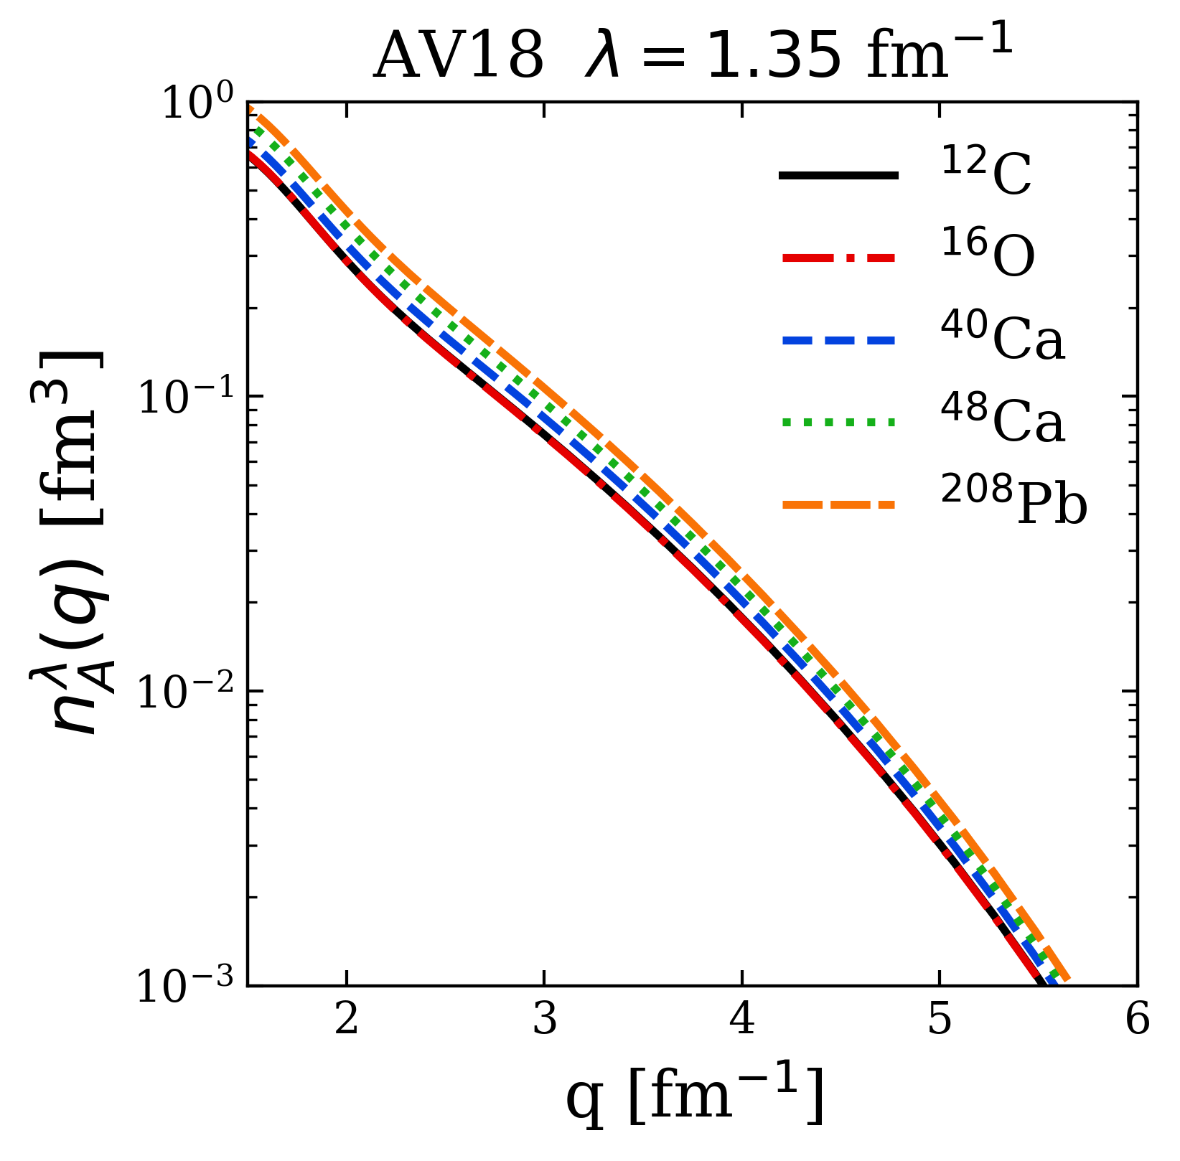
LDA results
Universality from factorization
Show factorized ratios
Normalization work in progress
Compare to Argonne after universality
Notes:
Analogous to deuteron, look at high-q part of proton distribution in several nuclei.
Dividing by Z, we get roughly the same distribution. Illustrate this with factorization equation F^hi(q)^2 < A_\lambda | F^lo(k)^2 | A_\lambda > / Z ~ F^hi(q)^2 -> does not depend on A!
Overlay this slide with AV18 results for 12C, 16O, 40Ca separately.

Slide 13
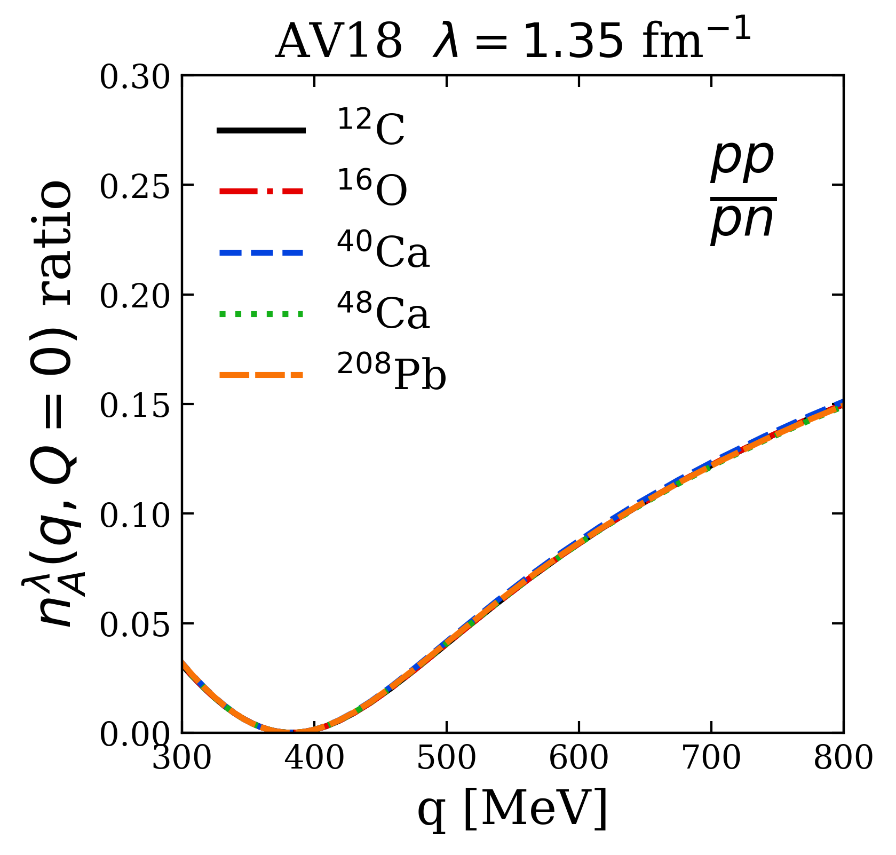
LDA results
Highlight np dominance and weak A dependence from factorization
Notes:
Connect to SRC phenomenology: np dominance from tensor force.
Highlight weak nuclear dependence from factorization (and LDA).
Add pp/p np/p pictures?

Slide 14
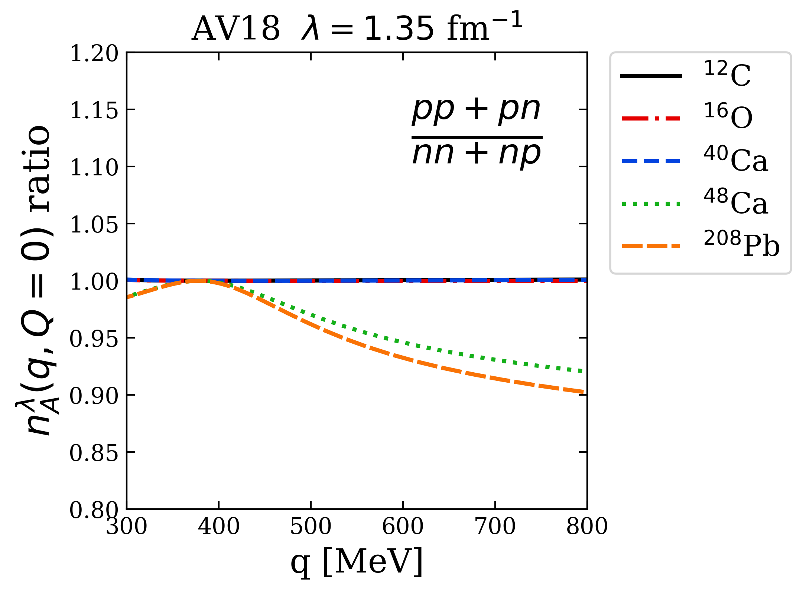
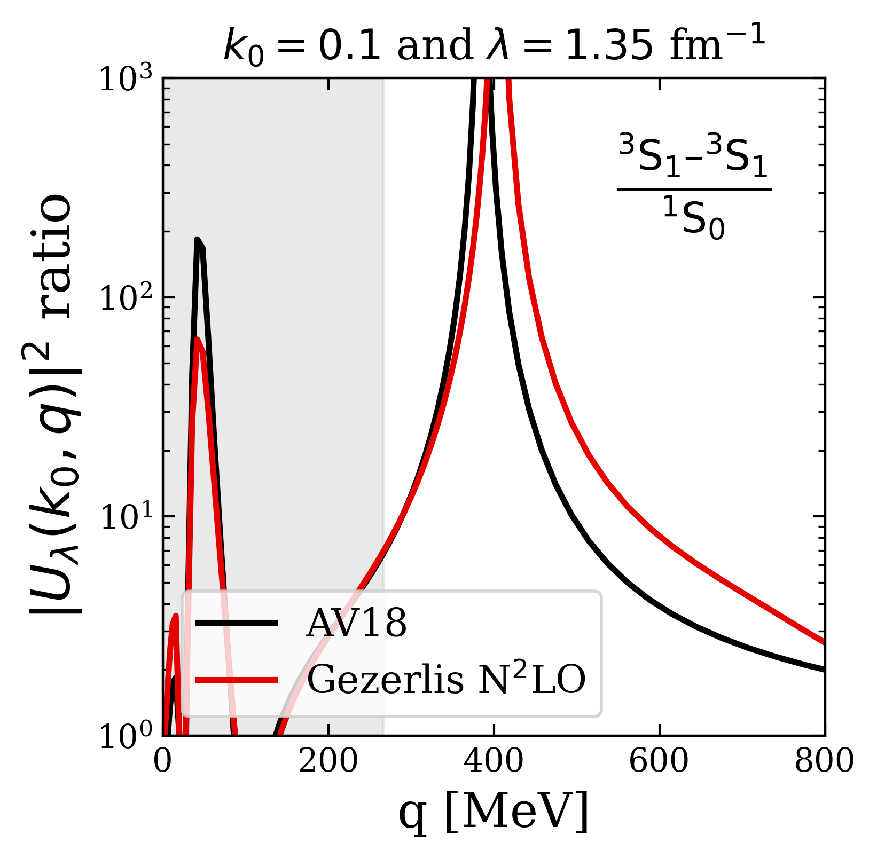
LDA results
Highlight np dominance to scalar counting
Notes:
Add pp/p np/p pictures?
Node in 1S0. Tensor dominance at 400 MeV -> np dominance.

Slide 15
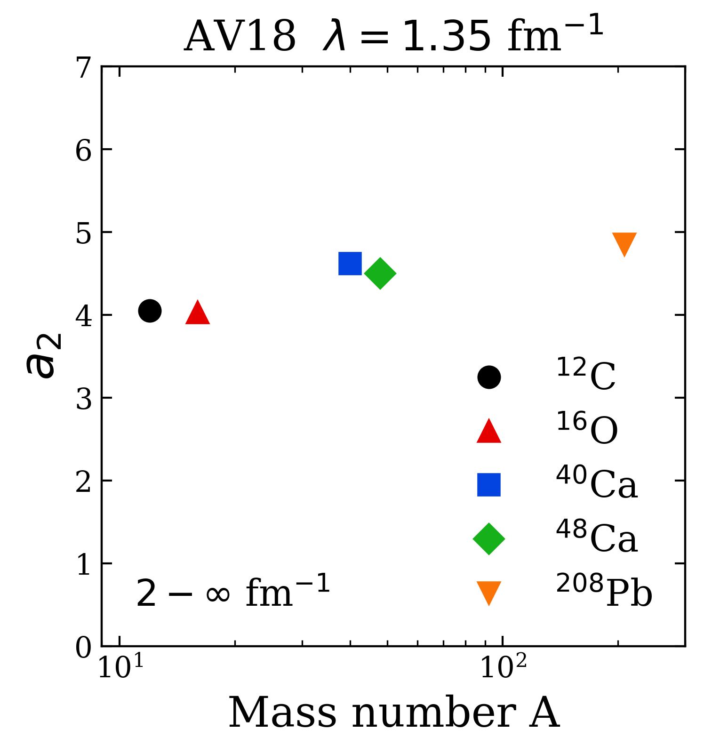
LDA results
Add equation and state decent agreement with LCA calculations
Notes:
Add in experimental results.

Slide 16
Summary and outlook
Summary
Cross sections, scale/scheme dependence of extracted properties
Impact of FSI's, how physical interpretations depend on the RG scale
Knock-out reactions (high resolution operators with low resolution structure mixes scales) – see Mostofa Hisham’s talk (add time)

Slide 17
Extras

