Slide 1
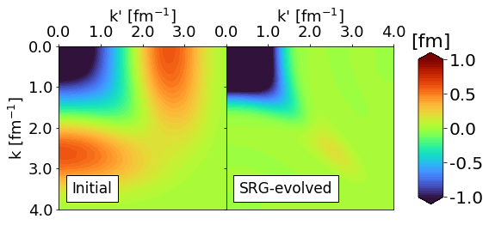
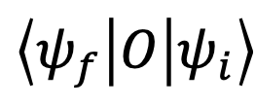
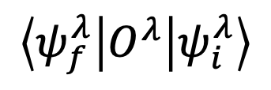
Similarity Renormalization Group (SRG)
Nucleon-nucleon interactions are complicated by coupling of low- and high-energy scales
This coupling limits our capability in solving nuclear many-body problems that rely on basis truncations
SRG transformations decouple energy scales (“soften”) to allow for accurate calculations
Fig. 1: Example of how the SRG decouples momentum scales in a nucleon-nucleon potential in momentum-space. The potential is driven to band-diagonal form.
SRG unitary transformation
$$\left\langle ψ_{f} | O | ψ_{i}\right\rangle$$
$$\left\langle ψ_{f}^{λ} | O^{λ} | ψ_{i}^{λ}\right\rangle$$

Slide 2
SRG evolution of wave functions
Fig. 2: SRG evolution of deuteron wave function in momentum space.
Fig. 3: SRG evolution of deuteron wave function in coordinate space.

Slide 3
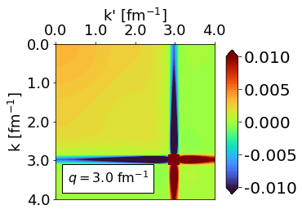
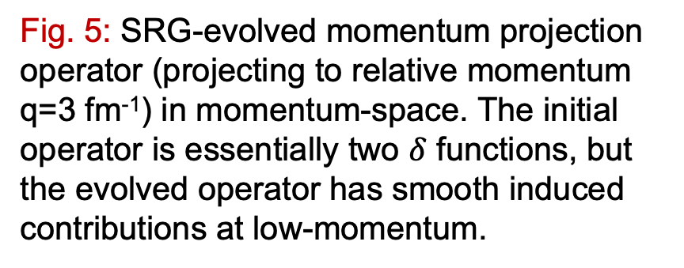
Extensions of the SRG
Operator evolution
How do non-Hamiltonian operators change under SRG transformations?
Implementation of SRG transformations
Different ways to decouple the Hamiltonian (e.g. band- or block-diagonal decoupling)
The Magnus expansion
Universality
Different nuclear potentials can be driven to the same form via SRG transformations
How is this characterized in other operators?
Fig. 5: SRG-evolved momentum projection operator (projecting to relative momentum q=3 fm⁻¹) in momentum-space. The initial operator is essentially two $δ$ functions, but the evolved operator has smooth induced contributions at low-momentum.

Slide 4
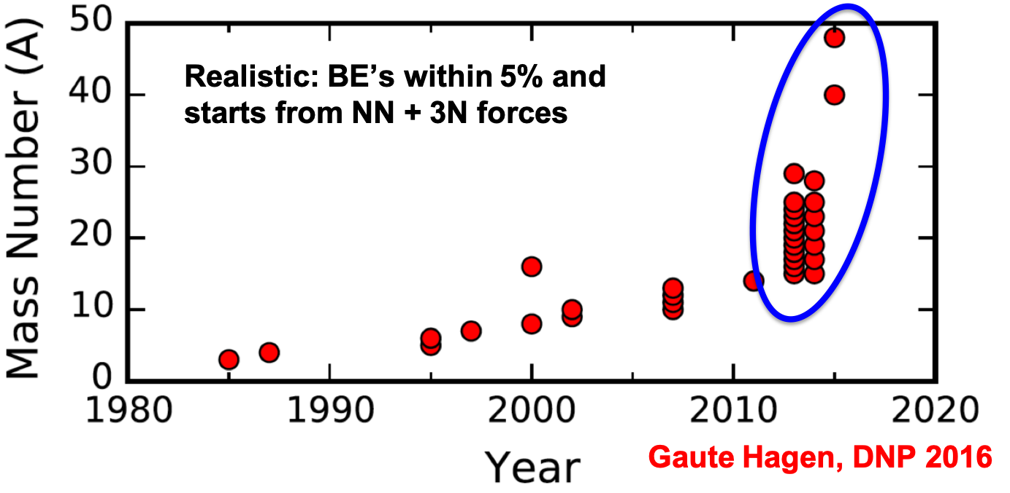
RG and effective field theory in nuclear physics
Fig. 4: Ab initio calculations for nuclei of mass A over the past few decades.

Slide 5
SRG work in progress
Gain insight on scale and scheme dependence in nuclear reactions
Investigate role of short-range correlation (SRC) physics in high-energy electron-scattering using the SRG
Apply SRG transformations to nuclear optical potentials
Extend our analysis of the Magnus expansion to nuclear many-body problems (in-medium SRG)

