Slide 1
Status of nuclear optical potentials and future prospects
Anthony Tropiano
August 6, 2019

Slide 2
Introduction/motivation
Nuclear reactions
FRIB (brief description – bait questions)
Nuclear chart

Slide 3
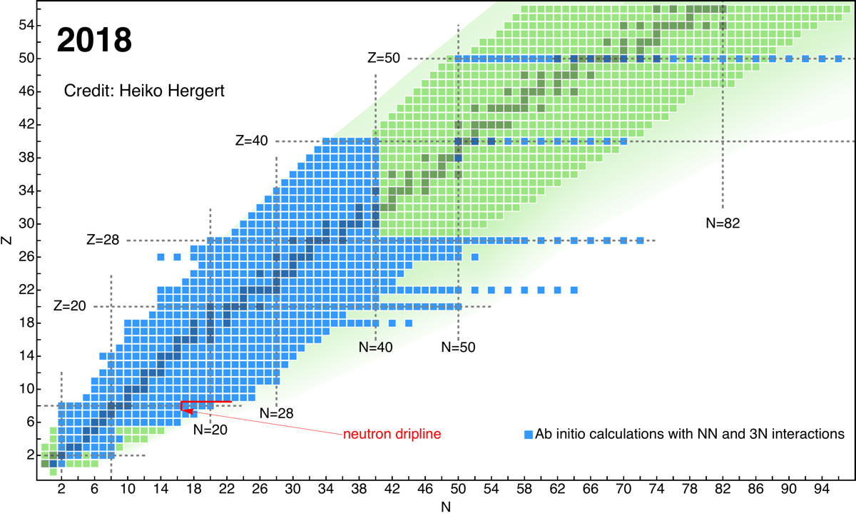
Introduction/motivation
Nuclear reactions
FRIB
Nuclear chart

Slide 4
Nuclear optical potential
Complex potentials (potentials with real & imaginary parts are called optical potentials)
Consequences of this: non-Hermitian, non-unitary S-matrix, if W<0, have absorptive potential=loss of flux
Analogy to optics (be careful about wording – keep it simple)

Slide 5
Quantum many-body scattering problem
Projectile-nucleus scattering with picture?
Difficulties
How optical potentials help (introduces an effective projectile-nucleus interaction to account for absorption of incident particles – inelastic scattering)

Slide 6
Formalism
Brief Feshbach formalism (only major equations)

Slide 7
Phenomenology
Basic form of a phenomenological optical potential
Explain the terms, physical meaning, graph of functional forms
Fitting procedure
Advantages and disadvantages (see paper)

Slide 8
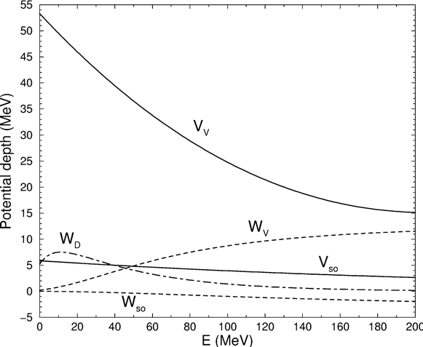
Phenomenology
Basic form of a phenomenological optical potential
Explain the terms, physical meaning, graph of functional forms
Fitting procedure
Advantages and disadvantages (see paper)

Slide 9
Motivate microscopic approaches
Transition from shortcomings of phenomenological models
Discuss recent progress
Figures: nuclear hockey stick, progress on nuclear chart

Slide 10
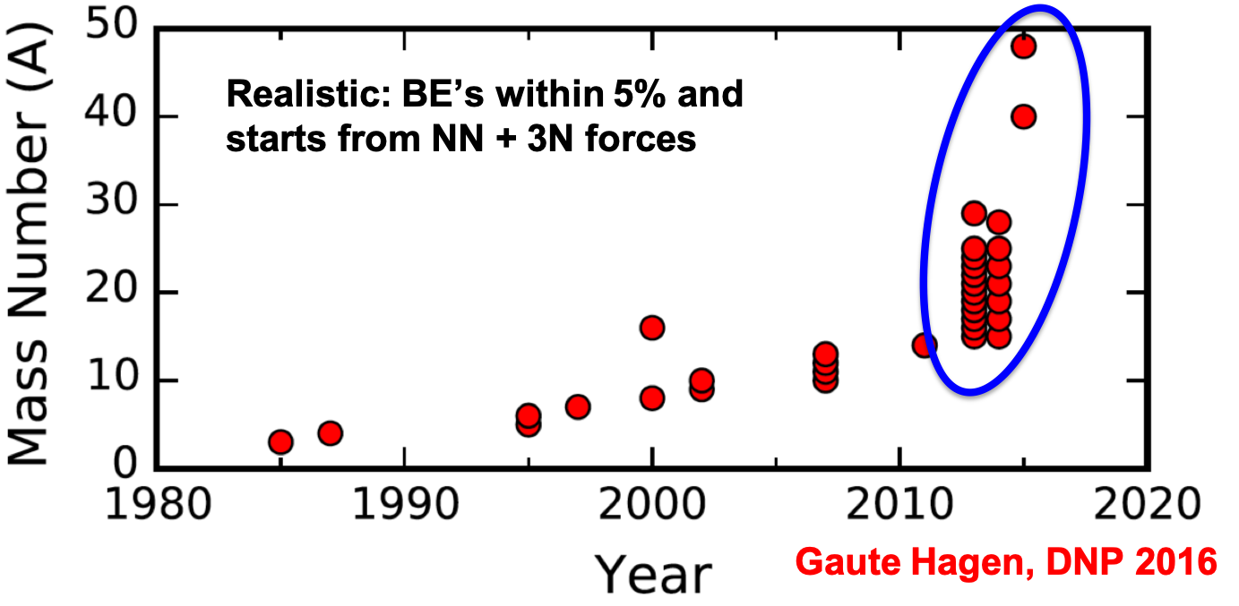
Motivate microscopic approaches
Transition from shortcomings of phenomenological models
Discuss recent progress
Figures: nuclear hockey stick, progress on nuclear chart

Slide 11
Multiple-scattering approach
Briefly summarize formalism (T-matrix and spectator expansion)
Successes and limitations with results to reference

Slide 12
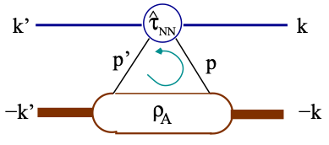
Multiple-scattering approach
Briefly summarize formalism (T-matrix and spectator expansion)
Successes and limitations with results to reference

Slide 13
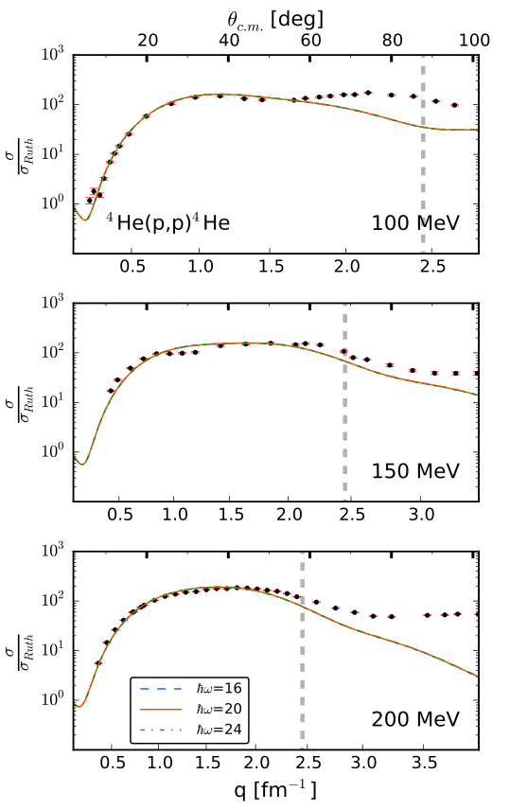
Multiple-scattering approach
Briefly summarize formalism (T-matrix and spectator expansion)
Successes and limitations with results to reference

Slide 14
Nucleon self-energy with chiral interactions
Briefly summarize nucleon self-energy and connection to optical potentials (diagrams from Holt paper)
Briefly summarize chiral EFT
Calculation of self-energy?
Successes and limitations with results to reference

Slide 15
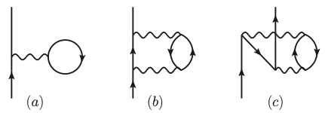
Nucleon self-energy with chiral interactions
Briefly summarize nucleon self-energy and connection to optical potentials (diagrams from Holt paper)
Briefly summarize chiral EFT
Calculation of self-energy?
Successes and limitations with results to reference

Slide 16
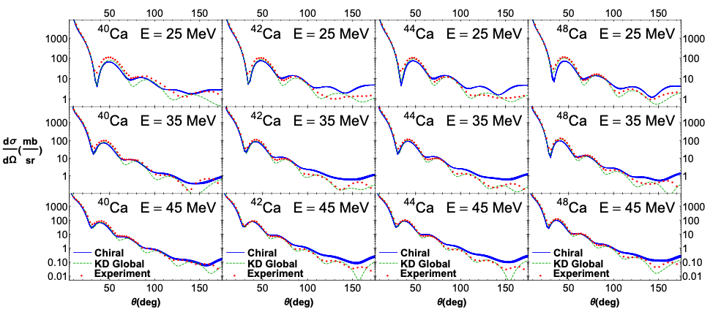
Nucleon self-energy with chiral interactions
Briefly summarize nucleon self-energy and connection to optical potentials (diagrams from Holt paper)
Briefly summarize chiral EFT
Calculation of self-energy?
Successes and limitations with results to reference

Slide 17
Summarize talk
Bullet

Slide 18
Outlook
How are optical potentials used currently and how can they be improved?
Uncertainty quantification
SRG

Slide 19
Slide title
Bullet

Slide 20
Slide title
Bullet

Slide 21
Slide title
Bullet

Slide 22
Slide title
Bullet

