Slide 1
Status of nuclear optical potentials and future prospects
Anthony Tropiano
August 6, 2019

Slide 2
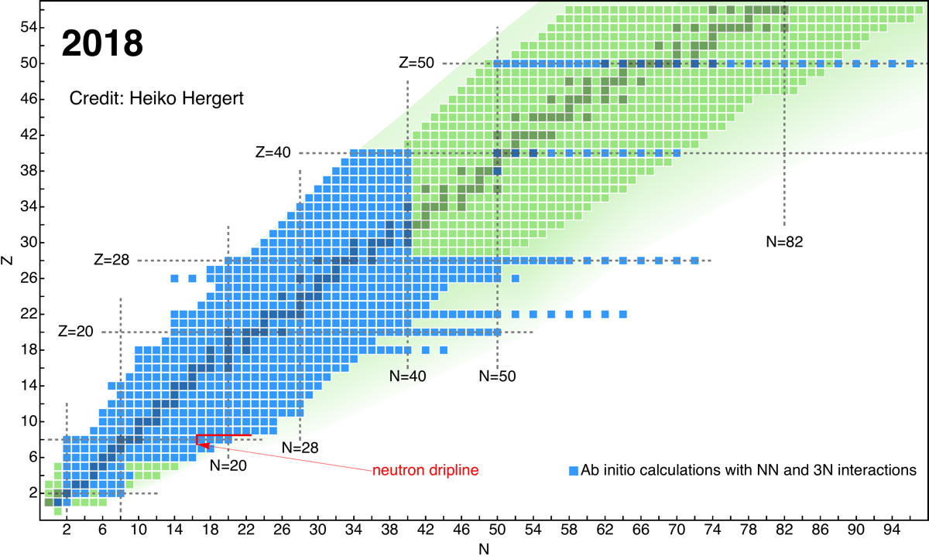
Introduction
Nuclear reactions play a key role in answering questions such as the origin of heavy elements in the universe, fundamental symmetries, and the limits of nuclear stability
Facilities seek to produce exotic isotopes and measure new data to better understand these areas
Fig. 1: Chart of nuclides with neutron number, N, counted
horizontally and proton number, Z, counted vertically.
(Figure from H. Hergert.)

Slide 3
Introduction
For example, the Facility for Rare Isotope Beams (FRIB) will target neutron-rich isotopes to study the rapid neutron-capture process (r-process)
The r-process is responsible for the formation of roughly half the atomic nuclei past iron on the periodic table
r-process occurs
here
Fig. 1: Chart of nuclides with neutron number, N, counted
horizontally and proton number, Z, counted vertically.
(Figure from H. Hergert.)

Slide 4
Introduction
Critical to understand nuclear reactions since facilities must use reactions to produce and study short-lived exotic nuclei
Fig. 1: Chart of nuclides with neutron number, N, counted
horizontally and proton number, Z, counted vertically.
(Figure from H. Hergert.)

Slide 5
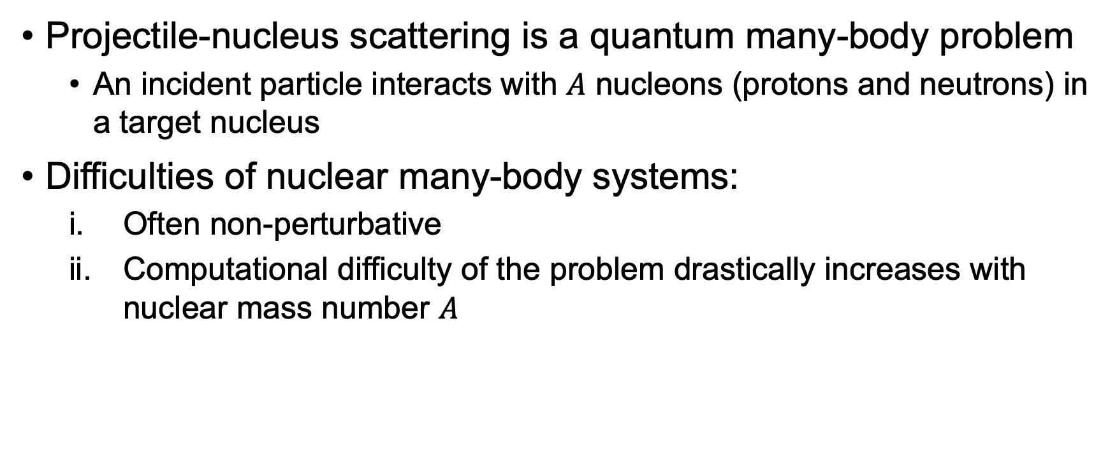
Nuclear scattering
Projectile-nucleus scattering is a quantum many-body problem
An incident particle interacts with $A$ nucleons (protons and neutrons) in a target nucleus
Difficulties of nuclear many-body systems:
Often non-perturbative
Computational difficulty of the problem drastically increases with nuclear mass number $A$

Slide 6
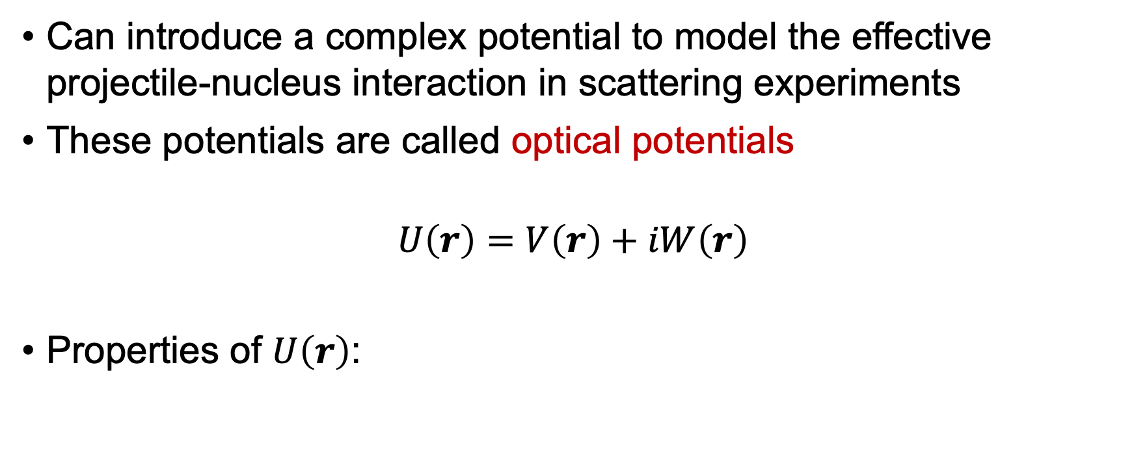
Nuclear optical potential
Can introduce a complex potential to model the effective projectile-nucleus interaction in scattering experiments
These potentials are called optical potentials
$$U\left(r\right)=V\left(r\right)+iW\left(r\right)$$
Properties of $U\left(r\right)$:

Slide 7
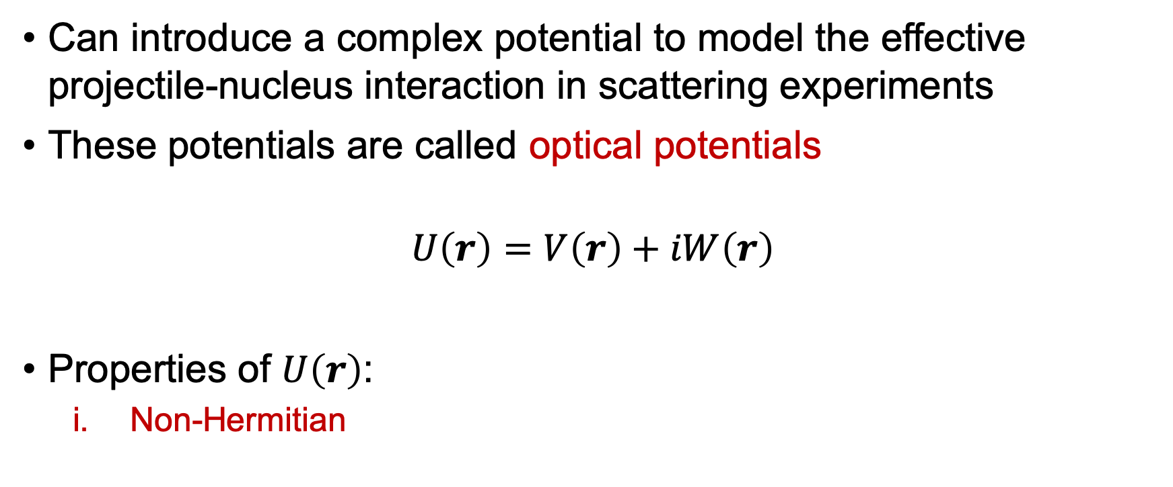
Nuclear optical potential
Can introduce a complex potential to model the effective projectile-nucleus interaction in scattering experiments
These potentials are called optical potentials
$$U\left(r\right)=V\left(r\right)+iW\left(r\right)$$
Properties of $U\left(r\right)$:
Non-Hermitian

Slide 8
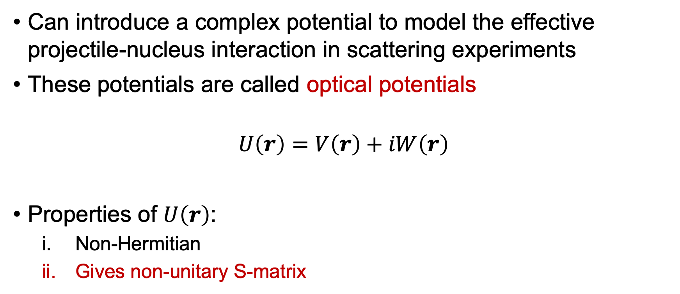
Nuclear optical potential
Can introduce a complex potential to model the effective projectile-nucleus interaction in scattering experiments
These potentials are called optical potentials
$$U\left(r\right)=V\left(r\right)+iW\left(r\right)$$
Properties of $U\left(r\right)$:
Non-Hermitian
Gives non-unitary S-matrix

Slide 9
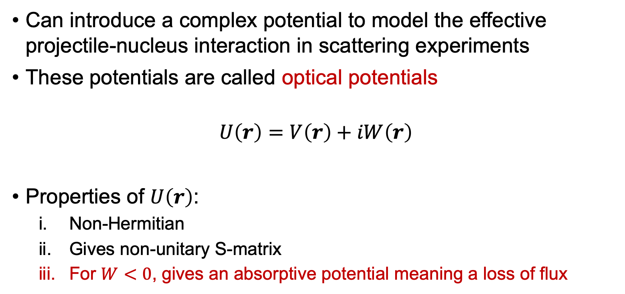
Nuclear optical potential
Can introduce a complex potential to model the effective projectile-nucleus interaction in scattering experiments
These potentials are called optical potentials
$$U\left(r\right)=V\left(r\right)+iW\left(r\right)$$
Properties of $U\left(r\right)$:
Non-Hermitian
Gives non-unitary S-matrix
For $W<0$, gives an absorptive potential meaning a loss of flux

Slide 10

Nuclear optical potential
$$U\left(r\right)=V\left(r\right)+iW\left(r\right)$$
Analogous to a complex index of refraction for describing light absorption/refraction in absorbing materials

Slide 11
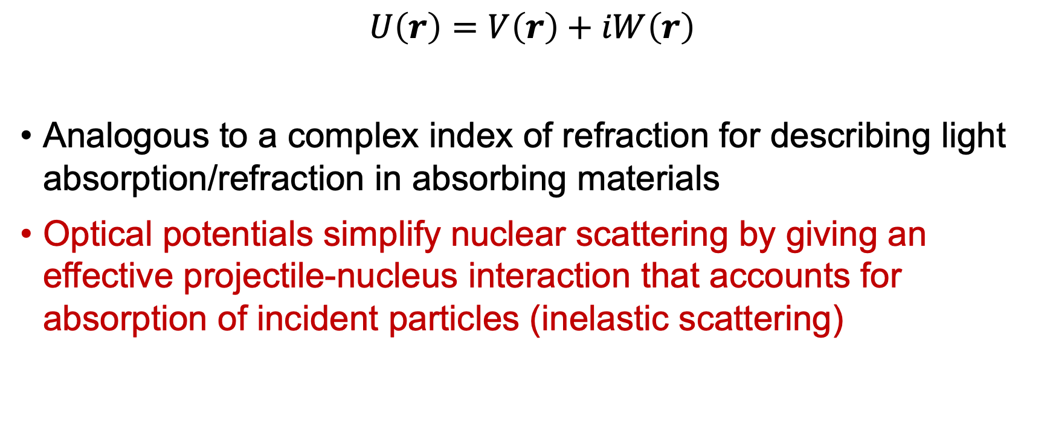
Nuclear optical potential
$$U\left(r\right)=V\left(r\right)+iW\left(r\right)$$
Analogous to a complex index of refraction for describing light absorption/refraction in absorbing materials
Optical potentials simplify nuclear scattering by giving an effective projectile-nucleus interaction that accounts for absorption of incident particles (inelastic scattering)

Slide 12
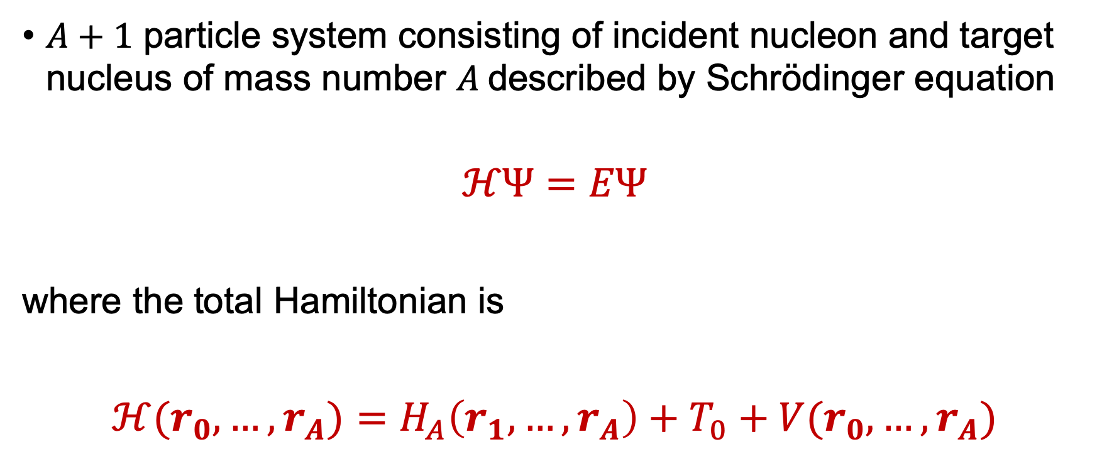
Formalism
$A+1$ particle system consisting of incident nucleon and target nucleus of mass number $A$ described by Schrödinger equation
$$ℋΨ=EΨ$$
where the total Hamiltonian is
$ℋ(r_{0},…,r_{A})=$ $H_{A}\left(r_{1},…,r_{A}\right)+T_{0}+V(r_{0},…,r_{A})$

Slide 13
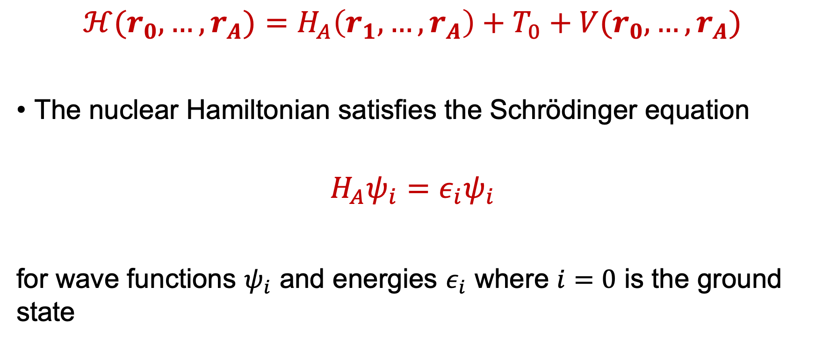
Formalism
$ℋ(r_{0},…,r_{A})=$ $H_{A}\left(r_{1},…,r_{A}\right)+T_{0}+V(r_{0},…,r_{A})$
The nuclear Hamiltonian satisfies the Schrödinger equation
$$H_{A}ψ_{i}=ε_{i}ψ_{i}$$
for wave functions $ψ_{i}$ and energies $ε_{i}$ where $i=0$ is the ground state

Slide 14
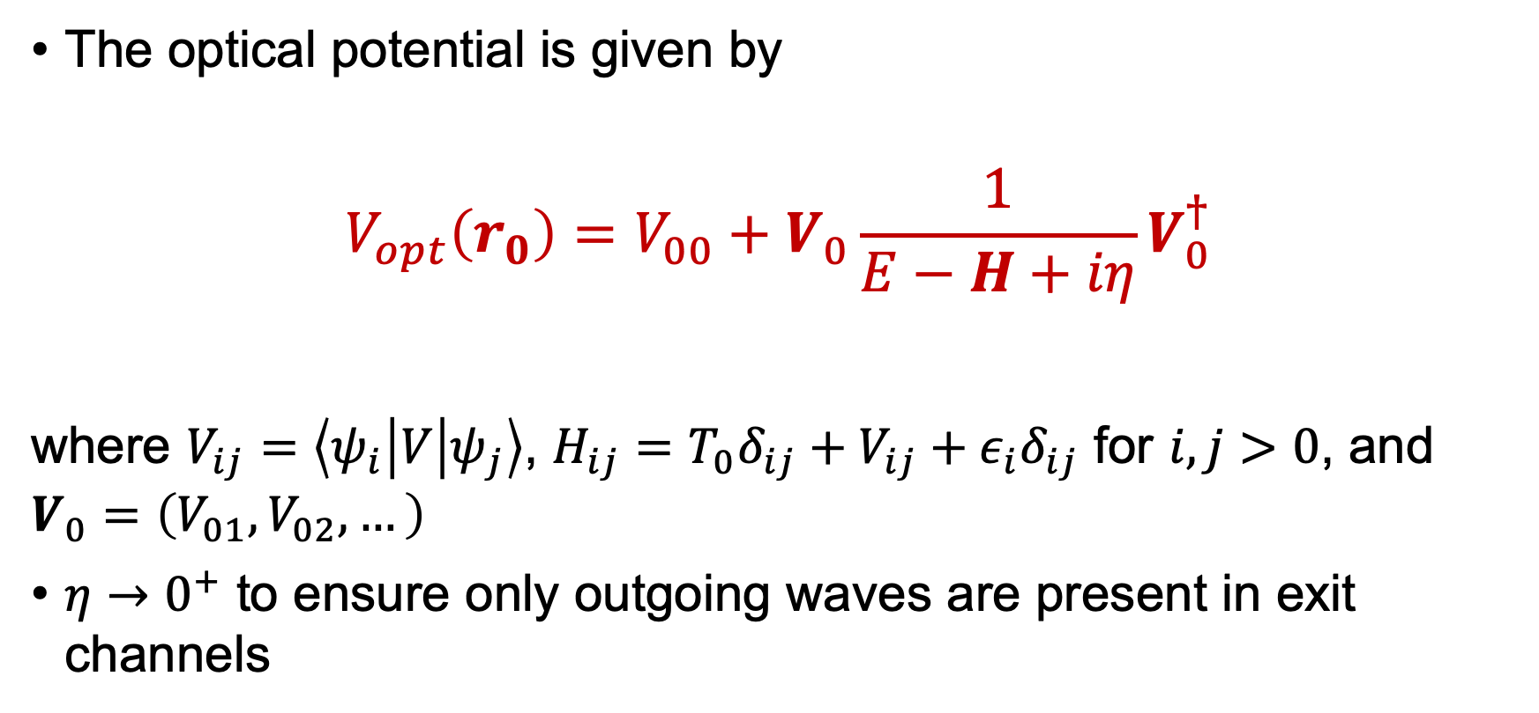
Formalism
The optical potential is given by
$$V_{opt}\left(r_{0}\right)=V_{00}+V_{0}\frac{1}{E−H+iη}V_{0}^{†}$$
where $V_{ij}=\left\langle ψ_{i} | V | ψ_{j}\right\rangle$, $H_{ij}=T_{0}δ_{ij}+V_{ij}+ε_{i}δ_{ij}$ for $i, j>0$, and $V_{0}=\left(V_{01},V_{02},…\right)$
$η→0^{+}$ to ensure only outgoing waves are present in exit channels

Slide 15
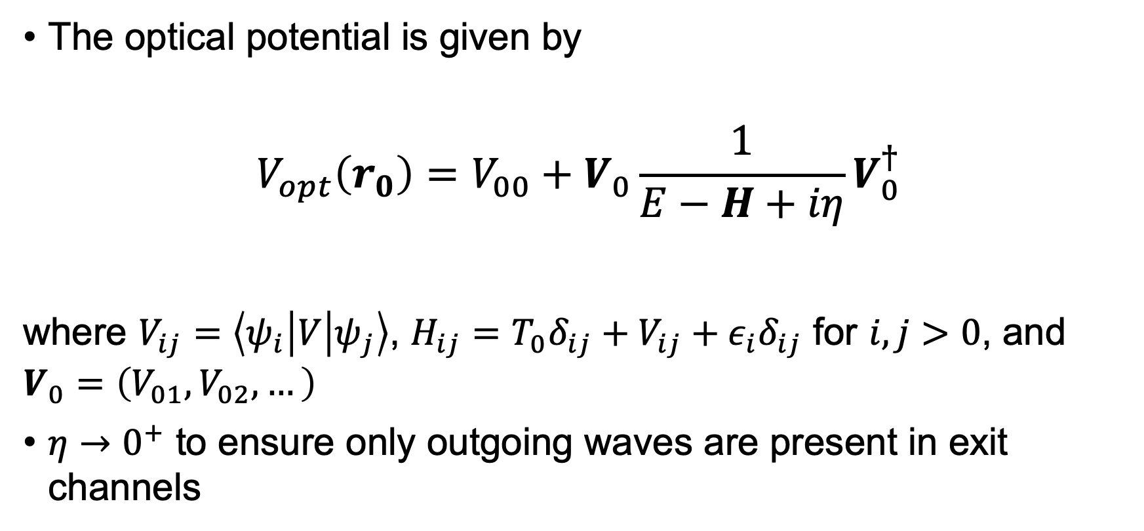
Formalism
The optical potential is given by
$$V_{opt}\left(r_{0}\right)=V_{00}+V_{0}\frac{1}{E−H+iη}V_{0}^{†}$$
where $V_{ij}=\left\langle ψ_{i} | V | ψ_{j}\right\rangle$, $H_{ij}=T_{0}δ_{ij}+V_{ij}+ε_{i}δ_{ij}$ for $i, j>0$, and $V_{0}=\left(V_{01},V_{02},…\right)$
$η→0^{+}$ to ensure only outgoing waves are present in exit channels
Elastic scattering
Inelastic scattering

Slide 16

Formalism
$$V_{opt}\left(r_{0}\right)=V_{00}+V_{0}\frac{1}{E−H+iη}V_{0}^{†}$$
$V_{opt}$ is complex, energy dependent, and non-local

Slide 17
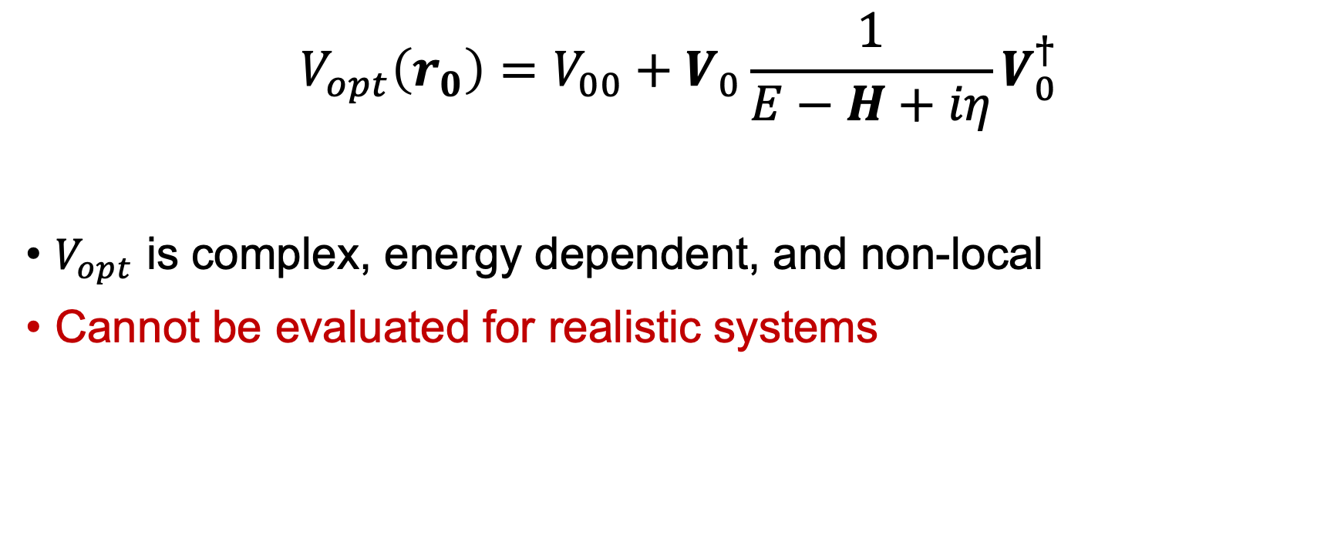
Formalism
$$V_{opt}\left(r_{0}\right)=V_{00}+V_{0}\frac{1}{E−H+iη}V_{0}^{†}$$
$V_{opt}$ is complex, energy dependent, and non-local
Cannot be evaluated for realistic systems

Slide 18
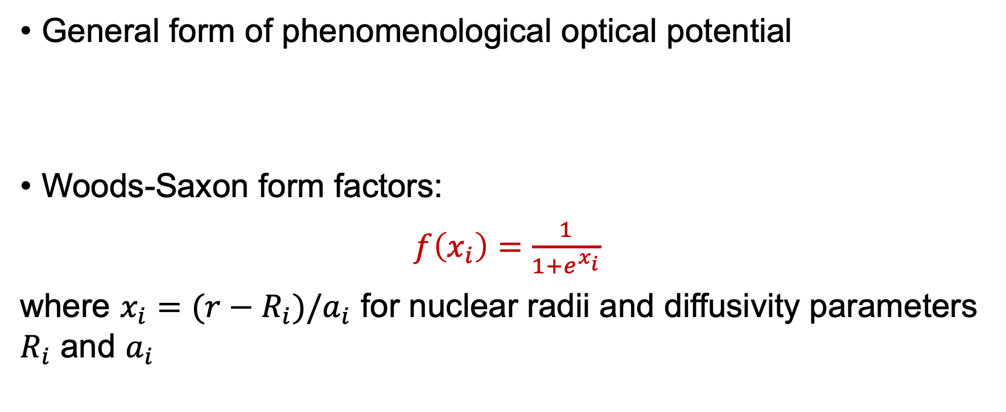
Phenomenology
General form of phenomenological optical potential
Woods-Saxon form factors:
$f\left(x_{i}\right)=\frac{1}{1+e^{x_{i}}}$
where $x_{i}=(r−R_{i})/a_{i}$ for nuclear radii and diffusivity parameters $R_{i}$ and $a_{i}$
$$V_{opt}\left(r,E\right)=V_{C}\left(r\right)−V_{V}\left(E\right)f\left(x_{0}\right)+({\frac{ℏ}{m_{π}c})}^{2}V_{SO}\left(E\right)σ∙l\frac{1}{r}\frac{d}{dr}f\left(x_{SO}\right)−i[W_{V}\left(E\right)f\left(x_{W}\right)−4W_{D}\left(E\right)\frac{d}{dx_{D}}f\left(x_{D}\right)]$$

Slide 19
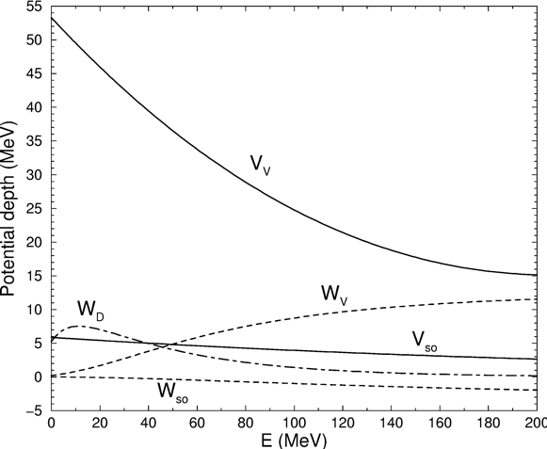

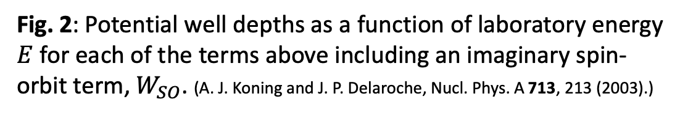
Phenomenology
General form of phenomenological optical potential
Obtained by $χ^{2}$ minimization fitting
scattering observables with radii and
diffusivity parameters
$$V_{opt}\left(r,E\right)=V_{C}\left(r\right)−V_{V}\left(E\right)f\left(x_{0}\right)+({\frac{ℏ}{m_{π}c})}^{2}V_{SO}\left(E\right)σ∙l\frac{1}{r}\frac{d}{dr}f\left(x_{SO}\right)−i[W_{V}\left(E\right)f\left(x_{W}\right)−4W_{D}\left(E\right)\frac{d}{dx_{D}}f\left(x_{D}\right)]$$
Potential depth (MeV)
Fig. 2: Potential well depths as a function of laboratory energy
$E$ for each of the terms above including an imaginary spin-
orbit term, $W_{SO}$. (A. J. Koning and J. P. Delaroche, Nucl. Phys. A 713, 213 (2003).)
E (MeV)

Slide 20
Phenomenology
Ambiguity in fitting
Several sets of parameters can give a good fit
Heavily dependent on data sets used

Slide 21
Phenomenology
Ambiguity in fitting
Several sets of parameters can give a good fit
Heavily dependent on data sets used
Cannot extend to exotic nuclei where no data are present

Slide 22
Phenomenology
Ambiguity in fitting
Several sets of parameters can give a good fit
Heavily dependent on data sets used
Cannot extend to exotic nuclei where no data are present
No reliable way to quantify uncertainty in phenomenological optical potentials

Slide 23
Microscopic approaches
Microscopic optical potentials are models based off realistic nuclear structure inputs
Can overcome shortcomings of phenomenological models (e.g. predictive power, uncertainty quantification)

Slide 24
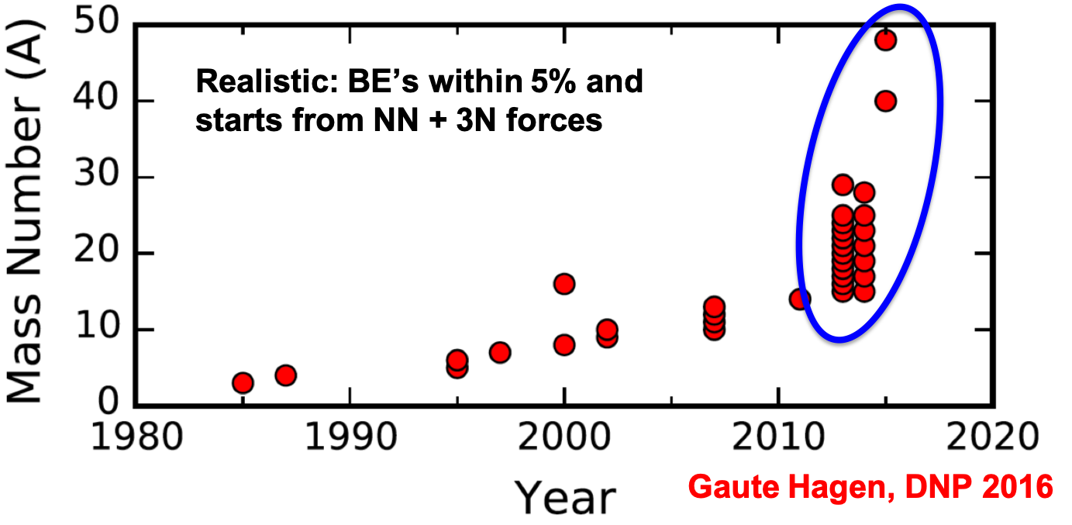
Microscopic approaches
Microscopic nuclear structure has made enormous progress in the past decade
Fig. 3: Binding energies for A-body nuclei within 5% of the experimental value calculated from ab initio methods. (Figure from G. Hagen.)

Slide 25
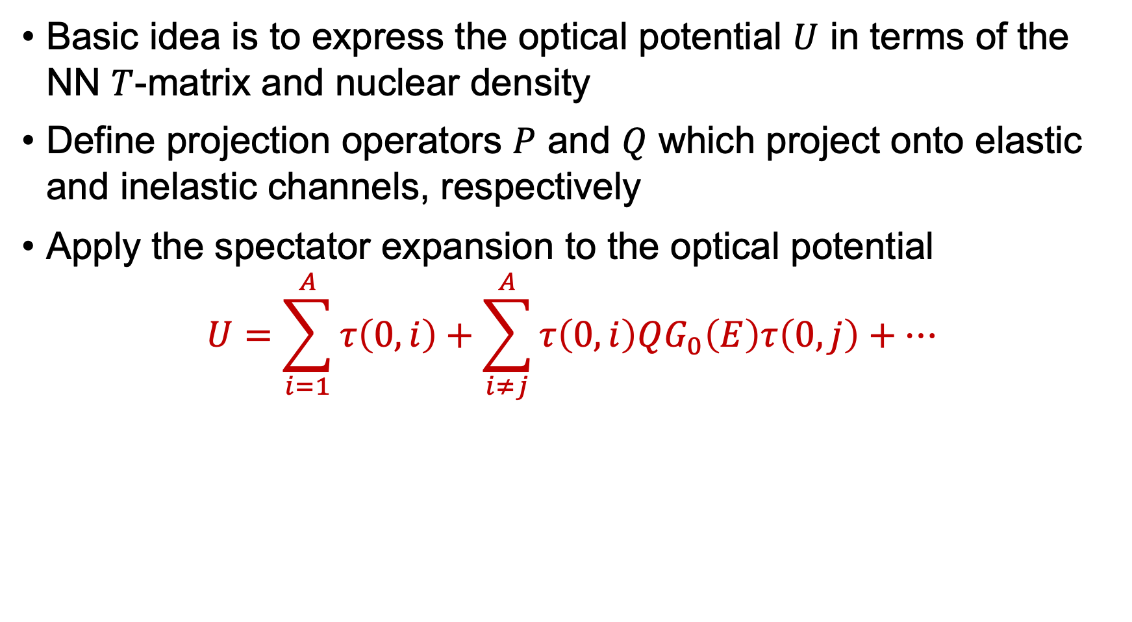
Multiple-scattering approach
Basic idea is to express the optical potential $U$ in terms of the NN $T$-matrix and nuclear density
Define projection operators $P$ and $Q$ which project onto elastic and inelastic channels, respectively
Apply the spectator expansion to the optical potential
$$U=\sum_{i=1}^{A}{τ\left(0,i\right)+\sum_{i≠j}^{A}{τ\left(0,i\right)QG_{0}\left(E\right)τ\left(0,j\right)+…}}$$
Projectile interacts with one nucleon
Projectile interacts with two nucleons

Slide 26
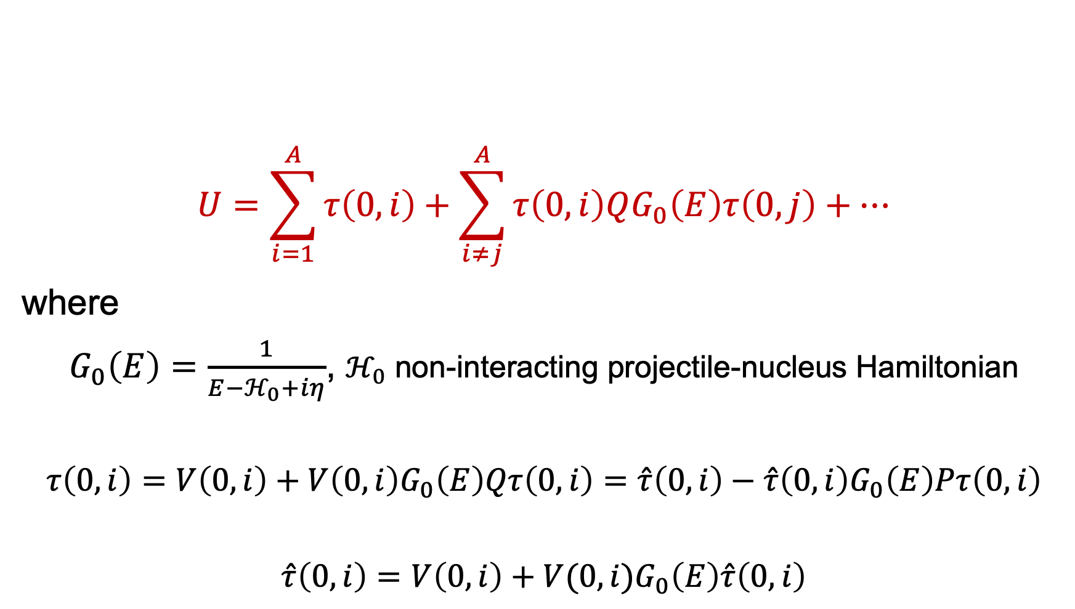
Multiple-scattering approach
$$U=\sum_{i=1}^{A}{τ\left(0,i\right)+\sum_{i≠j}^{A}{τ\left(0,i\right)QG_{0}\left(E\right)τ\left(0,j\right)+…}}$$
where
$G_{0}\left(E\right)=\frac{1}{E−ℋ_{0}+iη}$, $ℋ_{0}$ non-interacting projectile-nucleus Hamiltonian
$$τ\left(0,i\right)=V\left(0,i\right)+V\left(0,i\right)G_{0}\left(E\right)Qτ\left(0,i\right)=\hat{τ}\left(0,i\right)−\hat{τ}\left(0,i\right)G_{0}\left(E\right)Pτ\left(0,i\right)$$
$$\hat{τ}\left(0,i\right)=V\left(0,i\right)+V(0,i)G_{0}\left(E\right)\hat{τ}\left(0,i\right)$$

Slide 27
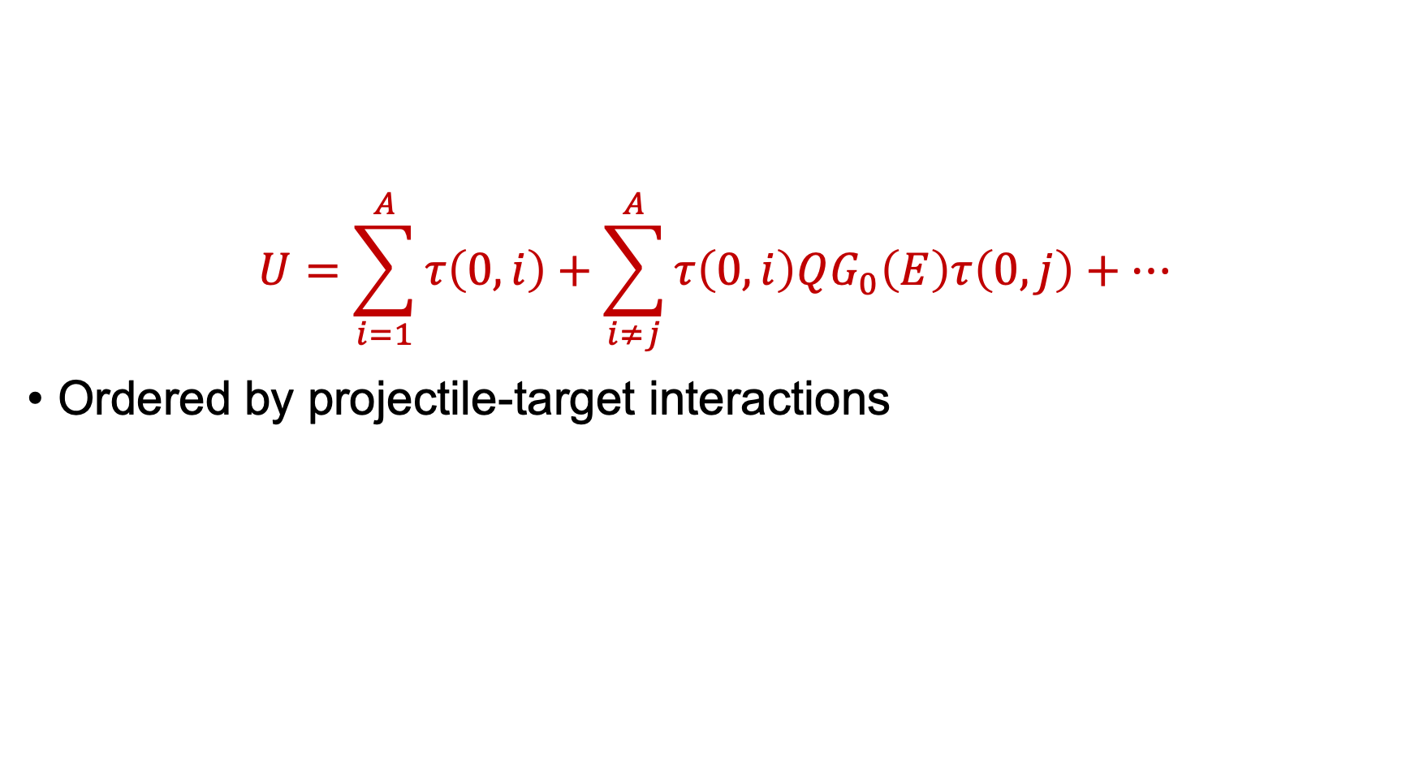
Multiple-scattering approach
$$U=\sum_{i=1}^{A}{τ\left(0,i\right)+\sum_{i≠j}^{A}{τ\left(0,i\right)QG_{0}\left(E\right)τ\left(0,j\right)+…}}$$
Ordered by projectile-target interactions

Slide 28
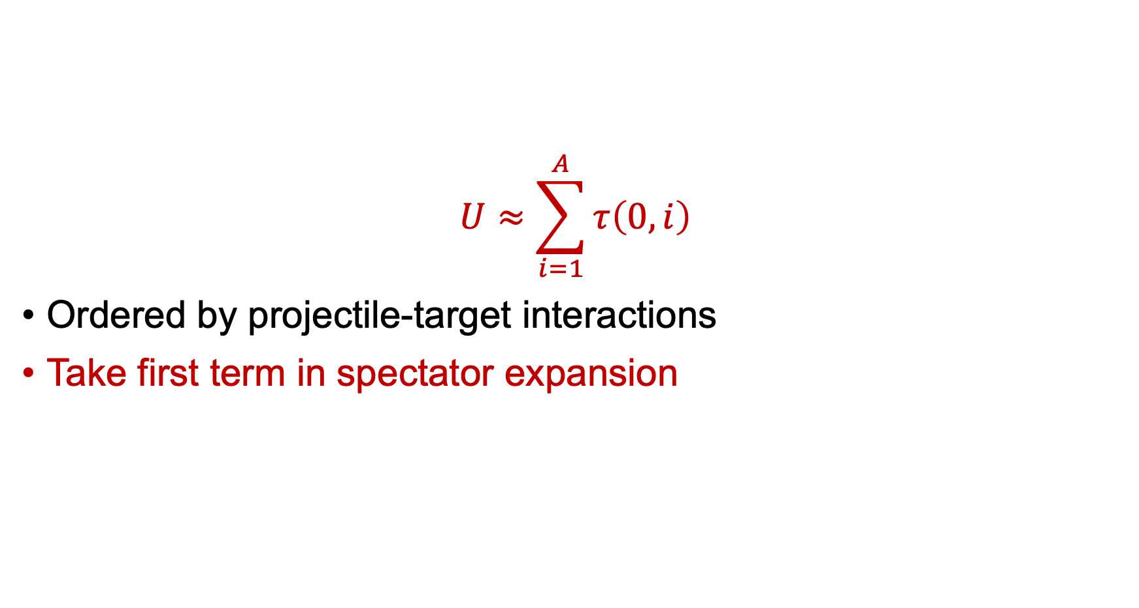
Multiple-scattering approach
$$U≈\sum_{i=1}^{A}{τ\left(0,i\right)}$$
Ordered by projectile-target interactions
Take first term in spectator expansion

Slide 29
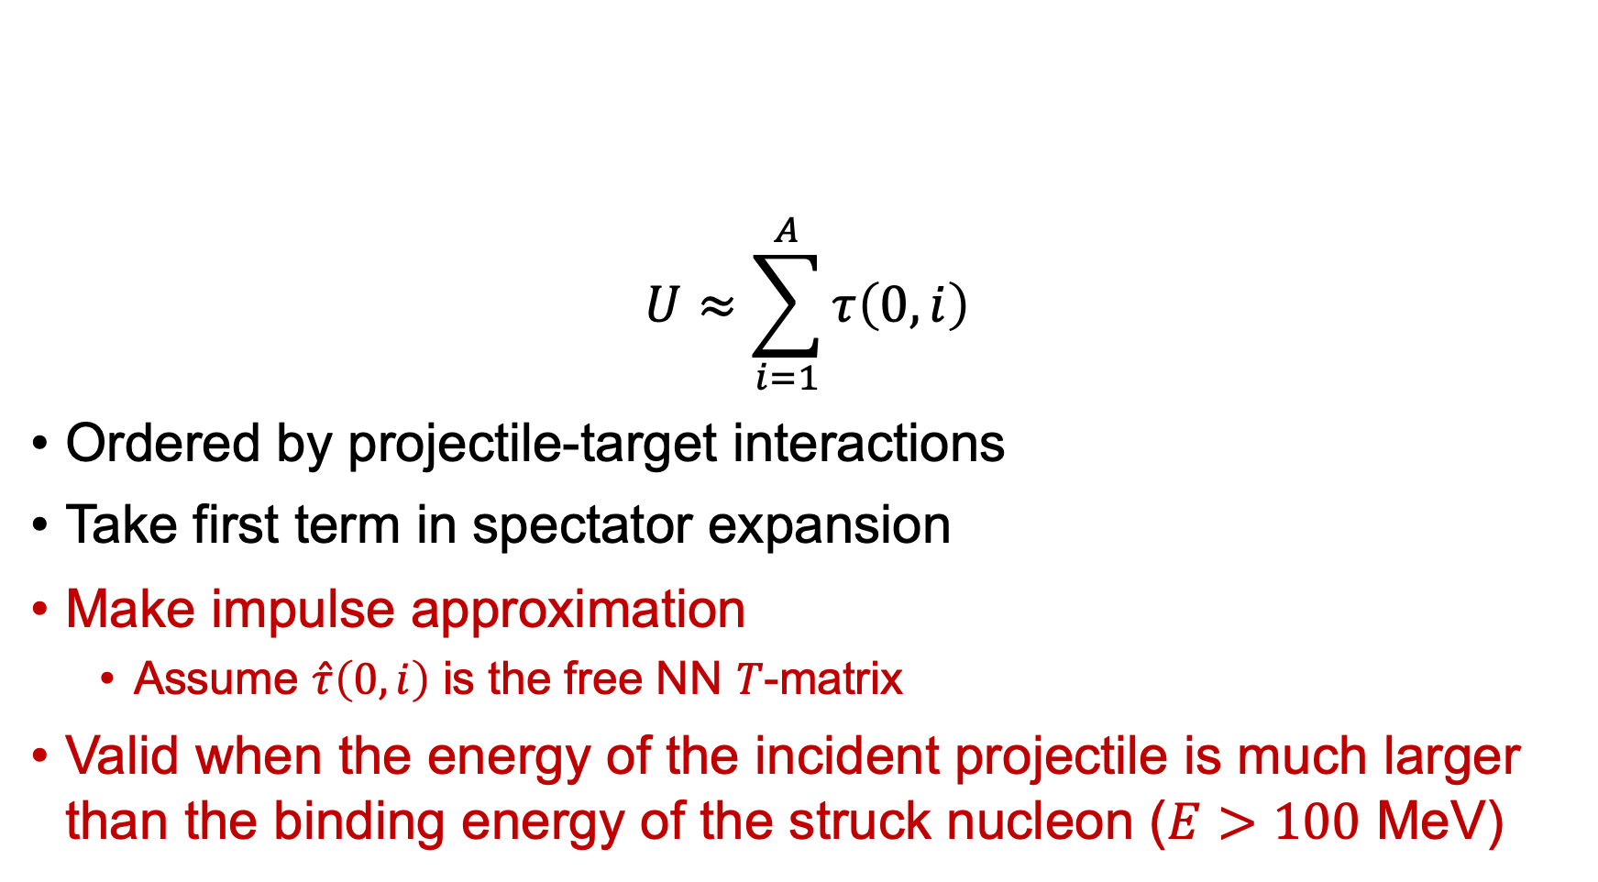
Multiple-scattering approach
$$U≈\sum_{i=1}^{A}{τ\left(0,i\right)}$$
Ordered by projectile-target interactions
Take first term in spectator expansion
Make impulse approximation
Assume $\hat{τ}\left(0,i\right)$ is the free NN $T$-matrix
Valid when the energy of the incident projectile is much larger than the binding energy of the struck nucleon ($E>100$ MeV)

Slide 30
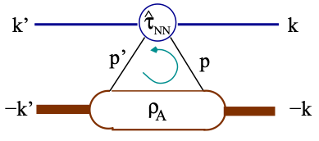
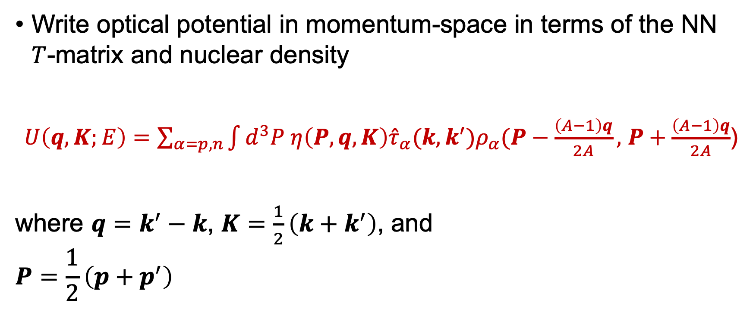
Multiple-scattering approach
Write optical potential in momentum-space in terms of the NN $T$-matrix and nuclear density
$U\left(q,K;E\right)=\sum_{α=p,n}{\int{d^{3}P η\left(P,q,K\right){\hat{τ}}_{α}(k,k^{′})ρ_{α}(P−\frac{\left(A−1\right)q}{2A},}}$ $P+\frac{\left(A−1\right)q}{2A}$)
where $q=k^{′}−k$, $K=\frac{1}{2}\left(k+k^{′}\right)$, and
$$P=\frac{1}{2}\left(p+p^{′}\right)$$
Fig. 4: Diagram of the single scattering term in the spectator expansion. (M. Burrows, et al., Phys. Rev. C 99, 044603 (2019).)

Slide 31
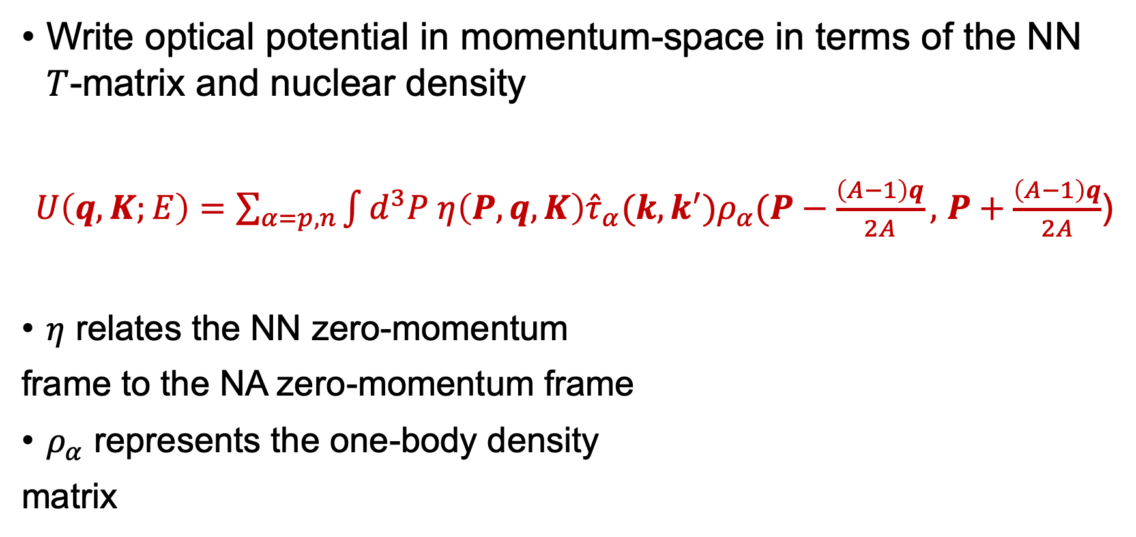
Multiple-scattering approach
Write optical potential in momentum-space in terms of the NN $T$-matrix and nuclear density
$U\left(q,K;E\right)=\sum_{α=p,n}{\int{d^{3}P η\left(P,q,K\right){\hat{τ}}_{α}(k,k^{′})ρ_{α}(P−\frac{\left(A−1\right)q}{2A},}}$ $P+\frac{\left(A−1\right)q}{2A}$)
$η$ relates the NN zero-momentum
frame to the NA zero-momentum frame
$ρ_{α}$ represents the one-body density
matrix
Fig. 4: Diagram of the single scattering term in the spectator expansion. (M. Burrows, et al., Phys. Rev. C 99, 044603 (2019).)

Slide 32
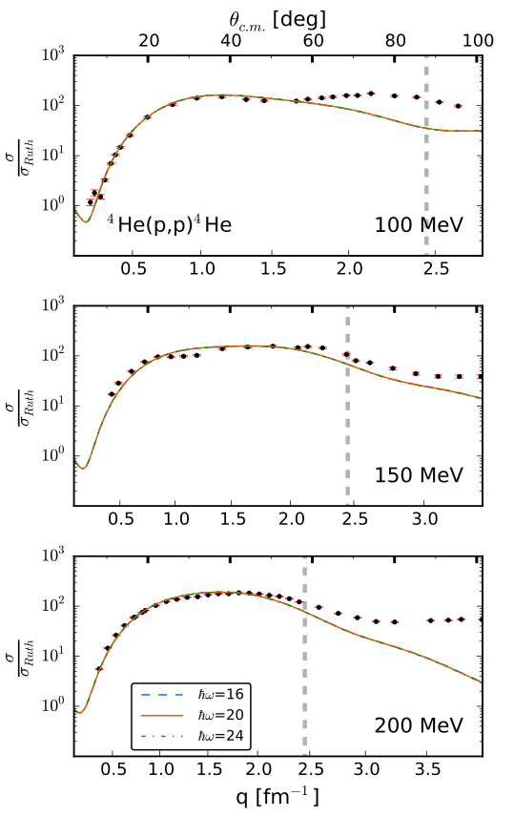

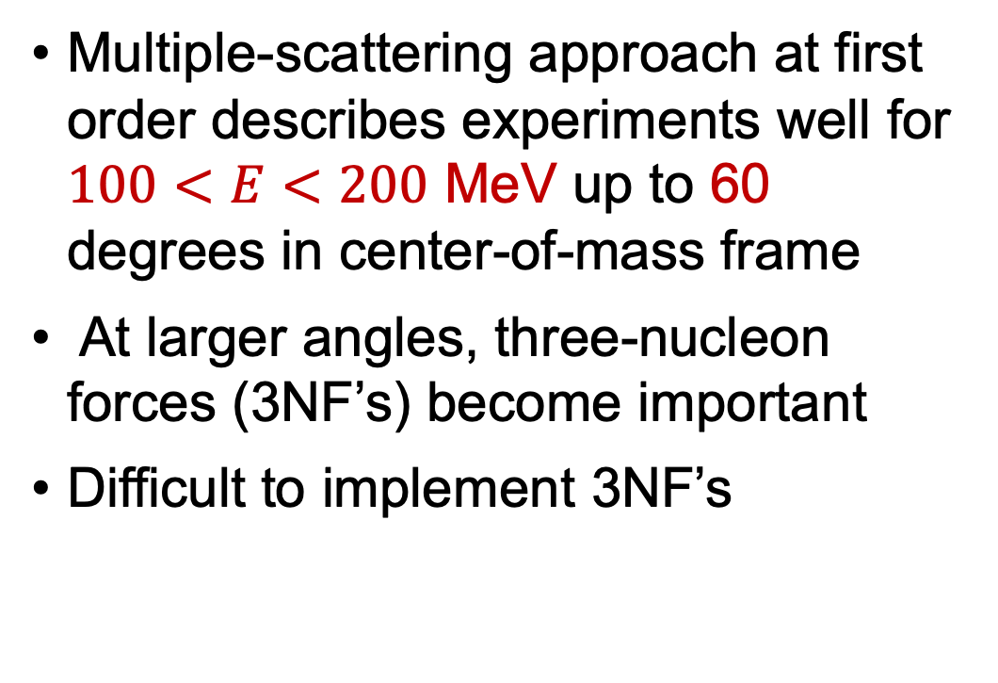



Multiple-scattering approach
$θ_{CM}$ [deg]
$$\frac{σ}{σ_{Ruth}}$$
Multiple-scattering approach at first order describes experiments well for $100<E<200$ MeV up to 60 degrees in center-of-mass frame
At larger angles, three-nucleon forces (3NF’s) become important
Difficult to implement 3NF’s
$$\frac{σ}{σ_{Ruth}}$$
$$\frac{σ}{σ_{Ruth}}$$
q [fm⁻¹]
Fig. 5: Cross section for elastic proton scattering from ⁴He using the multiple-scattering approach. (M. Burrows, et al., Phys. Rev. C 99, 044603 (2019).)

Slide 33
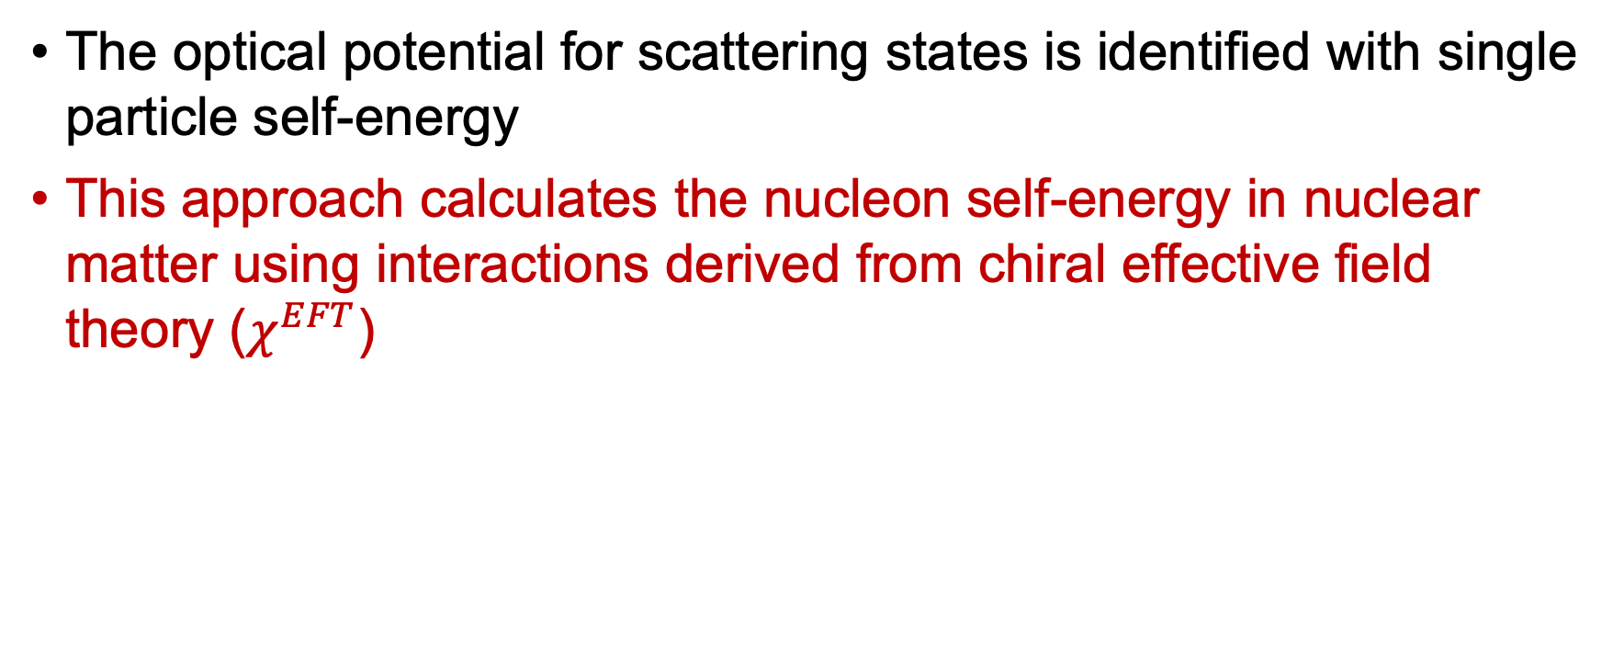
Nucleon self-energy with chiral interactions
The optical potential for scattering states is identified with single particle self-energy
This approach calculates the nucleon self-energy in nuclear matter using interactions derived from chiral effective field theory ($χ^{EFT}$)

Slide 34
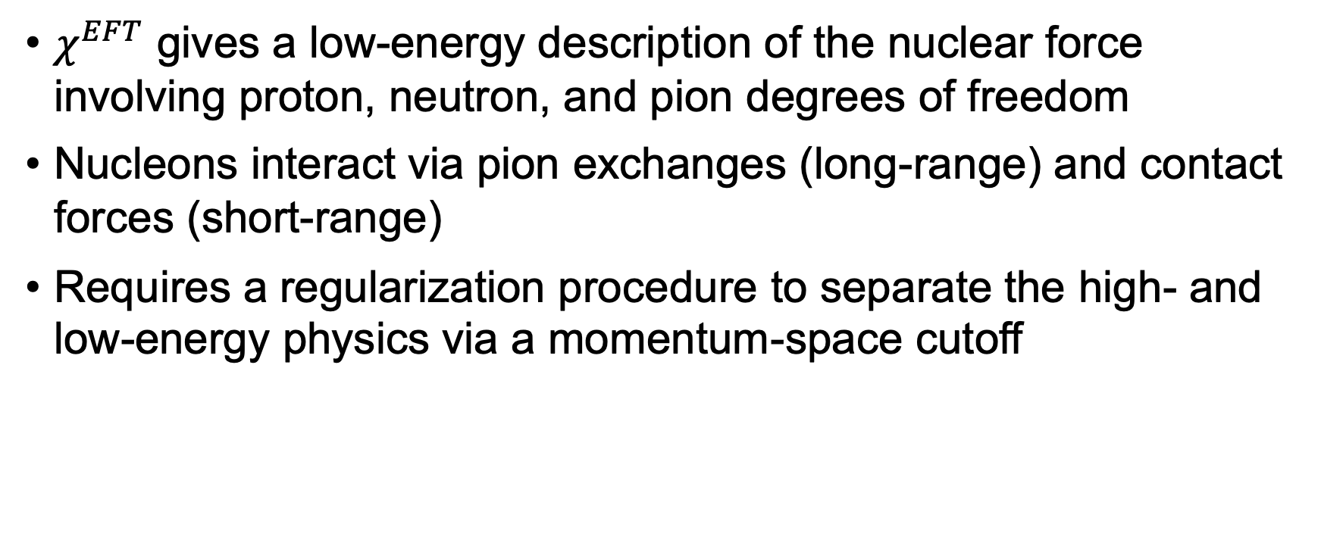
Nucleon self-energy with chiral interactions
$χ^{EFT}$ gives a low-energy description of the nuclear force involving proton, neutron, and pion degrees of freedom
Nucleons interact via pion exchanges (long-range) and contact forces (short-range)
Requires a regularization procedure to separate the high- and low-energy physics via a momentum-space cutoff

Slide 35
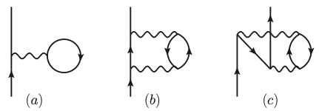

Nucleon self-energy with chiral interactions
Compute first- and second-order contributions to the nucleon self-energy $Σ$ with effective potentials $V_{2N}^{eff}$ derived from $χ^{EFT}$
$V_{2N}^{eff}$ consist of an NN potential with an effective, medium-dependent NN interaction (depends on 3NF)
Fig. 6: First- and second-order contributions to the nucleon self-energy where the solid lines indicate nucleon propagators and the wavy lines indicate the in-medium, anti-symmetrized NN interaction. (T. R. Whitehead, et al., Phys. Rev. C 100, 014601 (2019).)

Slide 36

Nucleon self-energy with chiral interactions
Optical potential given in terms of $Σ$
Well-suited to describe low-energy scattering
Momentum-space cutoff of the EFT limits the capability of this approach $E<200$ MeV

Slide 37
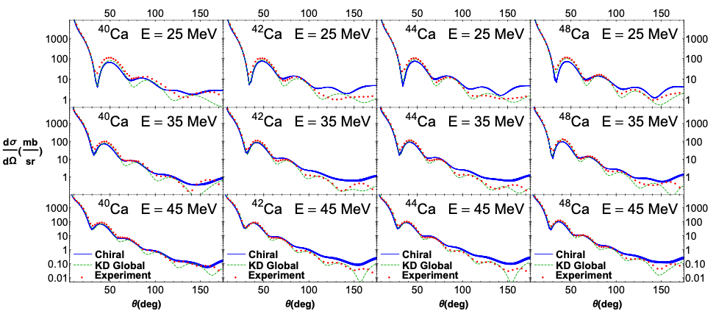
Nucleon self-energy with chiral interactions
Fig. 7: Cross section for elastic scattering of protons from calcium isotopes at several lab energies. Blue lines correspond to microscopic cross sections and green lines correspond to a phenomenological model. (T. R. Whitehead, et al., Phys. Rev. C 100, 014601 (2019).)

Slide 38
Summary
Nuclear optical potentials play an important role in modeling nuclear reactions

Slide 39
Summary
Nuclear optical potentials play an important role in modeling nuclear reactions
Phenomenological models are constrained by scattering data and work well where data are available
Ambiguity in fitting
Lack predictive power
No means for uncertainty quantification

Slide 40
Summary
Nuclear optical potentials play an important role in modeling nuclear reactions
Phenomenological models are constrained by scattering data and work well where data are available
Ambiguity in fitting
Lack predictive power
No means for uncertainty quantification
Microscopic methods use NN interactions from nuclear structure as inputs in computing optical potentials
Extends to reactions involving rare isotopes
Offers a means to quantify theoretical uncertainty estimates

Slide 41
Outlook
Currently microscopic approaches struggle in precision across kinematic ranges or nuclei
Can be used to guide phenomenological models
Necessary to understand what components are key in computing microscopic models

Slide 42
Outlook
Currently microscopic approaches struggle in precision across kinematic ranges or nuclei
Can be used to guide phenomenological models
Necessary to understand what components are key in computing microscopic models
Need to further understand uncertainty quantification in optical potentials to reliably compare different models

Slide 43
Outlook
Currently microscopic approaches struggle in precision across kinematic ranges or nuclei
Can be used to guide phenomenological models
Necessary to understand what components are key in computing microscopic models
Need to further understand uncertainty quantification in optical potentials to reliably compare different models
Can use renormalization group (RG) methods to investigate scheme dependence in factorization of nuclear structure from the scattering probe

Slide 44
Extras

Slide 45
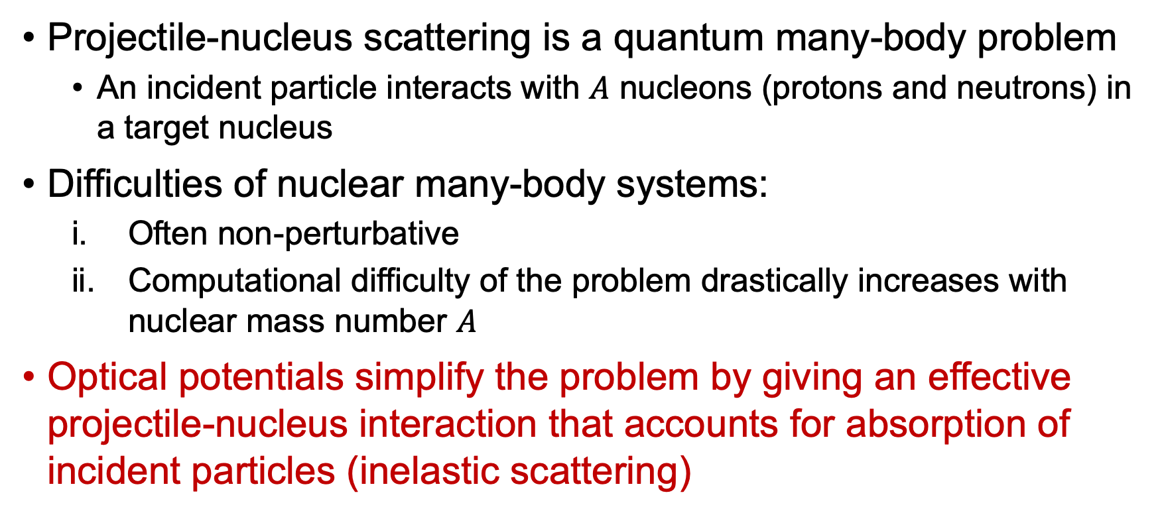
Nuclear scattering
Projectile-nucleus scattering is a quantum many-body problem
An incident particle interacts with $A$ nucleons (protons and neutrons) in a target nucleus
Difficulties of nuclear many-body systems:
Often non-perturbative
Computational difficulty of the problem drastically increases with nuclear mass number $A$
Optical potentials simplify the problem by giving an effective projectile-nucleus interaction that accounts for absorption of incident particles (inelastic scattering)

Slide 46
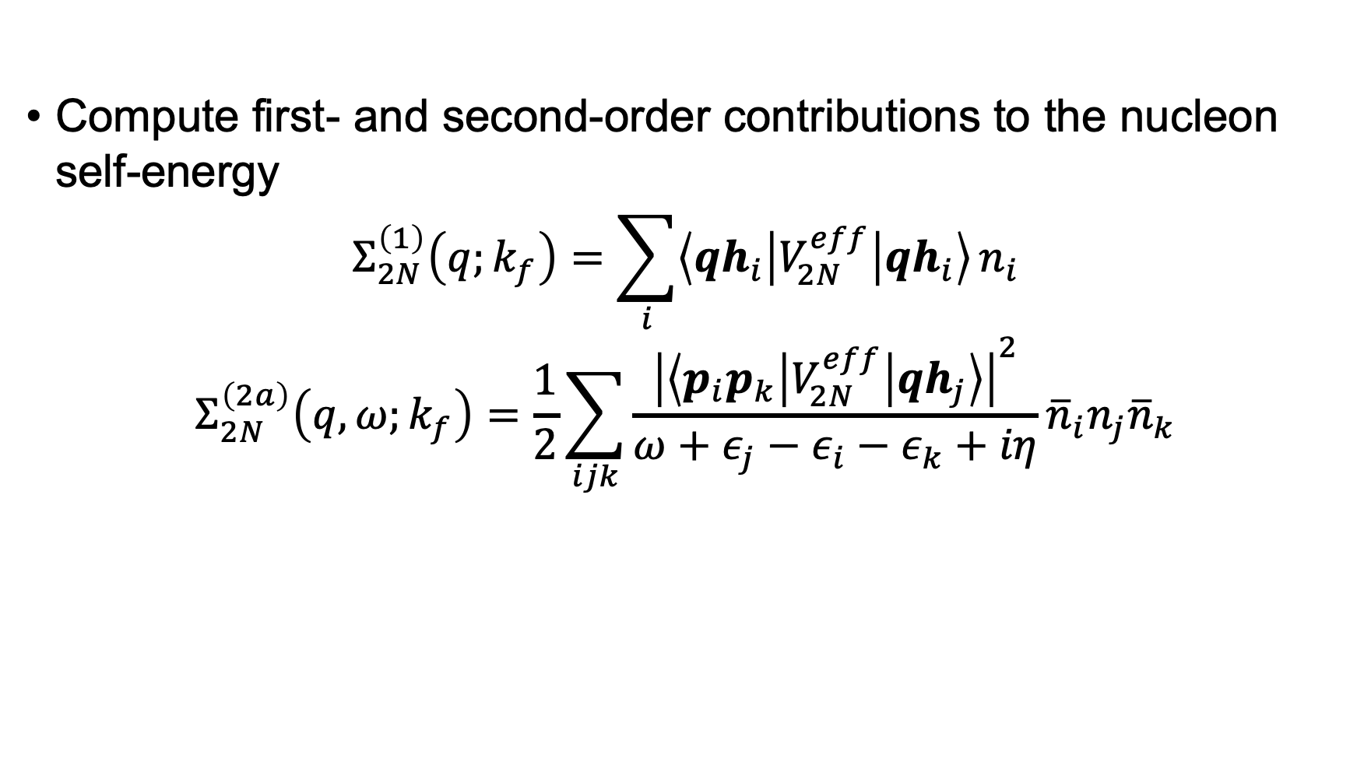
Nucleon self-energy with chiral interactions
Compute first- and second-order contributions to the nucleon self-energy
$$Σ_{2N}^{\left(1\right)}\left(q;k_{f}\right)=\sum_{i}{\left\langle qh_{i} | V_{2N}^{eff} | qh_{i}\right\rangle }n_{i}$$
$$Σ_{2N}^{\left(2a\right)}\left(q,ω;k_{f}\right)=\frac{1}{2}\sum_{ijk}{\frac{{\left|\left\langle p_{i}p_{k} | V_{2N}^{eff} | qh_{j}\right\rangle \right|}^{2}}{ω+ε_{j}−ε_{i}−ε_{k}+iη}}{\overline{n}}_{i}n_{j}{\overline{n}}_{k}$$

Slide 47
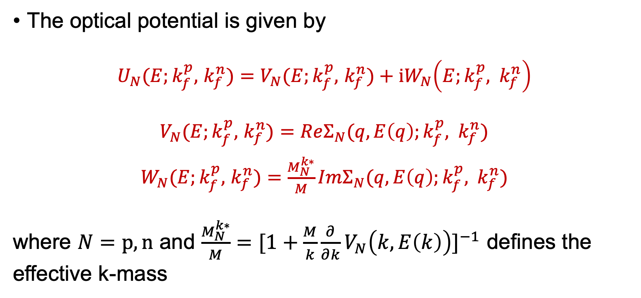
Nucleon self-energy with chiral interactions
The optical potential is given by
$U_{N}(E;k_{f}^{p},$ $k_{f}^{n})=$ $V_{N}(E;k_{f}^{p},$ $k_{f}^{n})+iW_{N}\left(E;k_{f}^{p}, k_{f}^{n}\right)$
$V_{N}(E;k_{f}^{p},$ $k_{f}^{n})=ReΣ_{N}(q,E\left(q\right);k_{f}^{p}, k_{f}^{n})$
$W_{N}(E;k_{f}^{p},$ $k_{f}^{n})=\frac{M_{N}^{k∗}}{M}ImΣ_{N}(q,E\left(q\right);k_{f}^{p}, k_{f}^{n})$
where $N=p,n$ and $\frac{M_{N}^{k∗}}{M}={[1+\frac{M}{k}\frac{∂}{∂k}V_{N}\left(k,E\left(k\right)\right)]}^{−1}$ defines the effective k-mass

