Slide 1


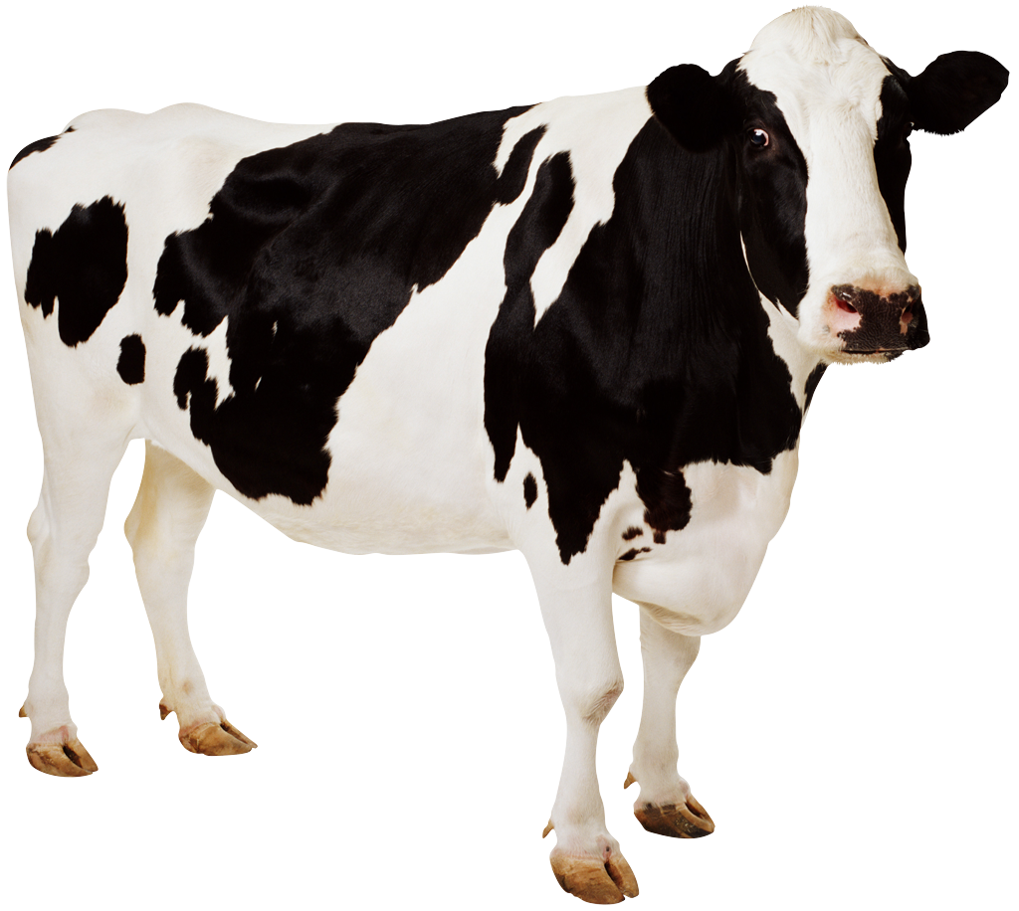
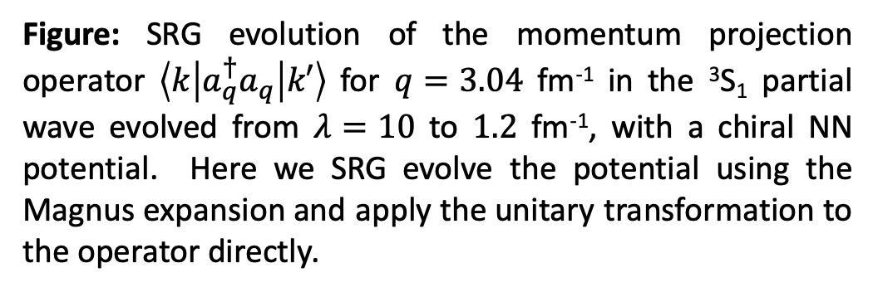
Using the Magnus expansion to SRG evolve operators
Objectives
Similarity renormalization group (SRG) operator evolution was studied using the Magnus expansion.
The Magnus implementation drastically reduces the memory needed to SRG evolve operators in addition to the nuclear Hamiltonian which can often be impossible for medium mass and heavier nuclei in the usual SRG approach.
Impact
The SRG transformation shifts the strength of operators to low-energy in accordance with SRG softening of nuclear Hamiltonians.
We can calculate observable quantities with consistently evolved wave functions and operators which is helpful for studies targeting non-energetic observables such as radii, electromagnetic moments and transitions, etc.
Calculations of deuteron observables with evolved wave functions and operators show very small error relative to the unevolved value due to exact unitarity in Magnus transformations.
The Magnus expansion provides an avenue for studying in-medium (IM)-SRG evolution of A-body operators.
Accomplishments
Work in progress.
Figure: SRG evolution of the momentum projection operator $\left\langle k | a_{q}^{†}a_{q} | k′\right\rangle$ for $q=3.04$ fm⁻¹ in the ³S₁ partial wave evolved from $λ=10$ to $1.2$ fm⁻¹, with a chiral NN potential. Here we SRG evolve the potential using the Magnus expansion and apply the unitary transformation to the operator directly.

