Slide 1




Short-range correlation physics at low RG resolution
Anthony Tropiano¹, Scott Bogner², Dick Furnstahl¹
¹Ohio State University, ²Michigan State University
NUCLEI Annual Meeting
June 2, 2021
ajt, S.K. Bogner, and R.J. Furnstahl, arXiv:2105.13936

Slide 2
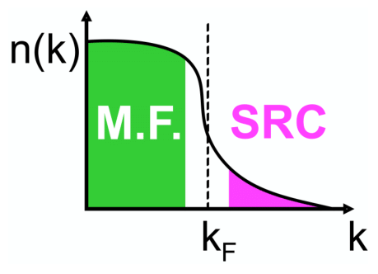
Motivation
knock-out 2 high-k nucleons
Recent experiments have been able to isolate processes where short-range correlation (SRC) physics is dominant and well accounted for by SRC phenomenology
SRC physics at high RG resolution
SRC pairs are components in the nuclear wave function with relative momenta above the Fermi momentum
excite SRC pair
same expt. resolution
low-k initial pair
Notes:
Read first bullet, define high RG resolution picture explaining cartoon in the process, and explain electron scattering diagram.

Slide 3
Motivation
knock-out 2 high-k nucleons
Recent experiments have been able to isolate processes where short-range correlation (SRC) physics is dominant and well accounted for by SRC phenomenology
SRC physics at low RG resolution
The SRC physics is shifted into the reaction operators from the nuclear wave function (which becomes soft)
Operators do not become hard which simplifies calculations
excite SRC pair
same expt. resolution
low-k initial pair
Notes:
Explain low RG resolution picture (read bullets), explain low RG resolution electron scattering.

Slide 4
Motivation
knock-out 2 high-k nucleons
Recent experiments have been able to isolate processes where short-range correlation (SRC) physics is dominant and well accounted for by SRC phenomenology
SRC physics at low RG resolution
The SRC physics is shifted into the reaction operators from the nuclear wave function (which becomes soft)
Operators do not become hard which simplifies calculations
Experimental resolution (set by momentum of probe) is the same in both pictures
Same observables but different physical interpretation!
excite SRC pair
same expt. resolution
low-k initial pair
Notes:
Comparison of pictures: same experimental resolution, same observables, but different physical interpretation.

Slide 5
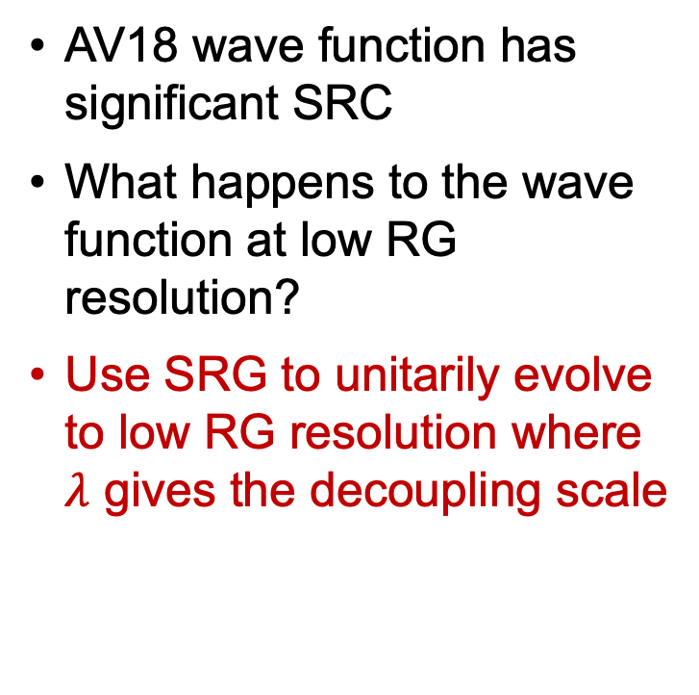
Similarity Renormalization Group (SRG)
SRC in AV18
AV18 wave function has significant SRC
What happens to the wave function at low RG resolution?
Use SRG to unitarily evolve to low RG resolution where $λ$ gives the decoupling scale
S-state
D-state
Fig. 2: SRG evolution of deuteron wave function in coordinate space for AV18 and Gezerlis N2LO¹.
¹A. Gezerlis et al., Phys. Rev. C 90, 054323 (2014)
Notes:
Consider deuteron wave function in coordinate space as an example, unevolved significant SRC, use SRG to go to low RG resolution.

Slide 6
Similarity Renormalization Group (SRG)
SRC in AV18
No SRC
SRC physics in AV18 is gone from wave function at low RG resolution
Deuteron wave functions become soft and D-state probability goes down
Observables such as asymptotic D-S ratio are the same
SRG evolved
S-state
S-state
D-state
D-state
Fig. 2: SRG evolution of deuteron wave function in coordinate space for AV18 and Gezerlis N2LO¹.
¹A. Gezerlis et al., Phys. Rev. C 90, 054323 (2014)
Notes:
At low RG resolution, SRC physics in AV18 wave function is gone, both curves collapse on one another, D-state probability is suppressed, but observables are the same.

Slide 7
Momentum distributions at low RG resolution
Soft wave functions at low RG resolution
Where does the SRC physics go?
Notes:
Ask question.

Slide 8
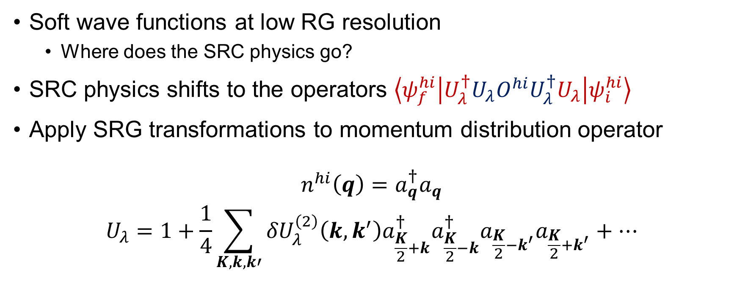
Momentum distributions at low RG resolution
Soft wave functions at low RG resolution
Where does the SRC physics go?
SRC physics shifts to the operators $\left\langle ψ_{f}^{hi} | U_{λ}^{†}U_{λ}O^{hi}U_{λ}^{†}U_{λ} | ψ_{i}^{hi}\right\rangle$
Apply SRG transformations to momentum distribution operator
$$n^{hi}\left(q\right)=a_{q}^{†}a_{q}$$
$$U_{λ}=1+\frac{1}{4}\sum_{K,k,k′}{{δU}_{λ}^{\left(2\right)}\left(k,k^{′}\right)a_{\frac{K}{2}+k}^{†}a_{\frac{K}{2}−k}^{†}a_{\frac{K}{2}−k^{′}}a_{\frac{K}{2}+k^{′}}+⋯}$$
Notes:
Answer: consider the matrix element -> SRC physics goes to operator. We will apply the transformation up to two-body on momentum distribution operator.

Slide 9
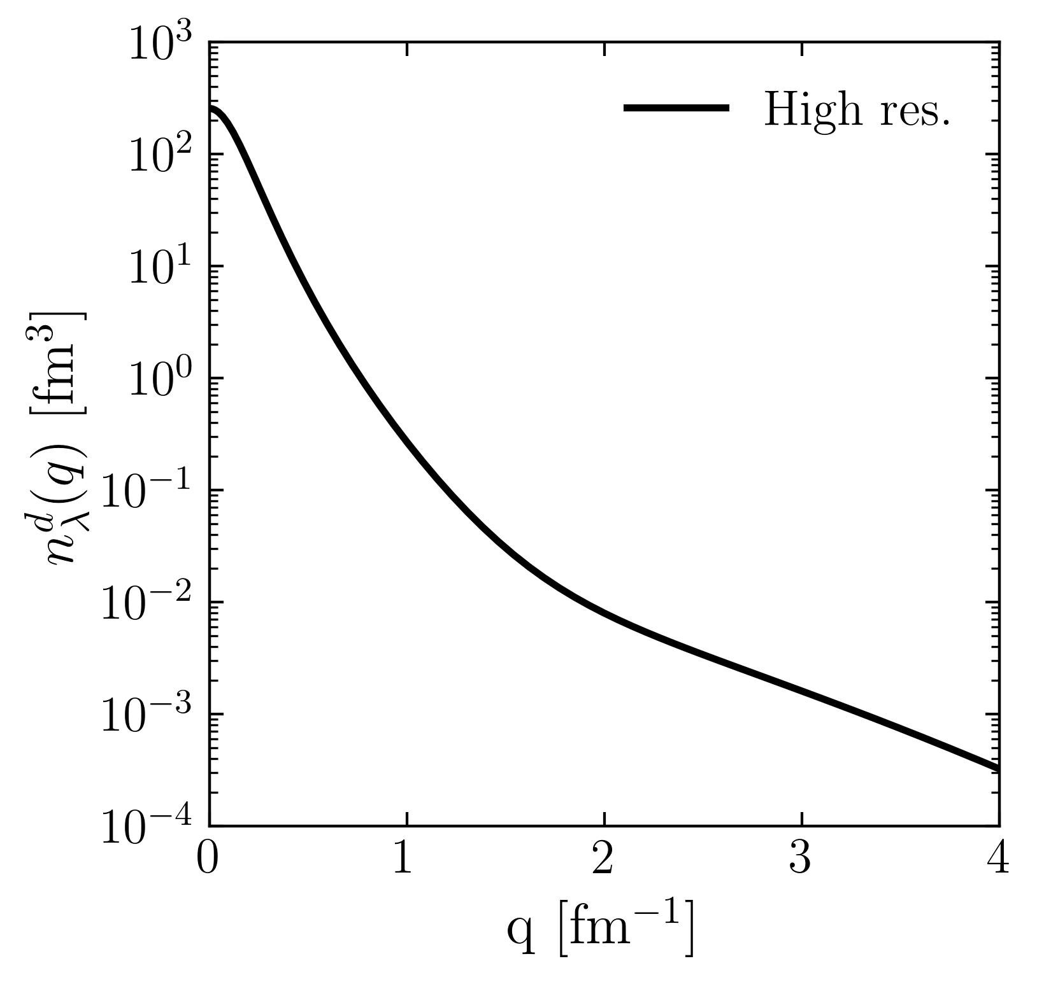

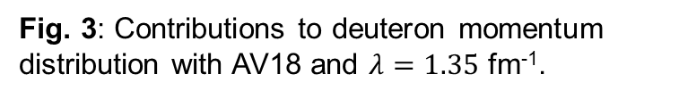
Momentum distributions at low RG resolution
Deuteron example
$$n^{lo}\left(q\right)=(1+δU)a_{q}^{†}a_{q}(1+δU^{†})$$
$$\left\langle ψ_{d}^{hi} | a_{q}^{†}a_{q} | ψ_{d}^{hi}\right\rangle$$
Fig. 3: Contributions to deuteron momentum distribution with AV18 and $λ=1.35$ fm⁻¹.
Notes:
Use deuteron in momentum space as an example and consider contributions to the full distribution in terms of 1 and \delta U. Here is the full result.

Slide 10
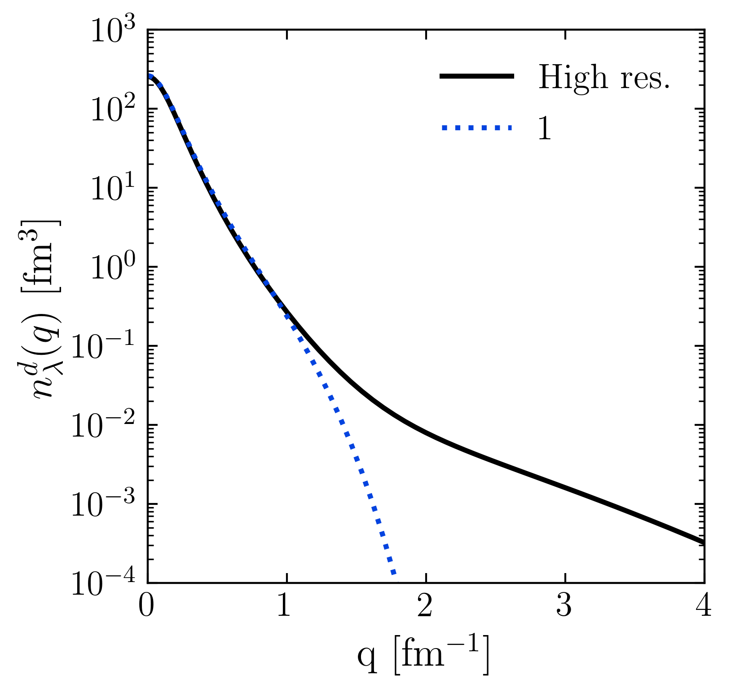
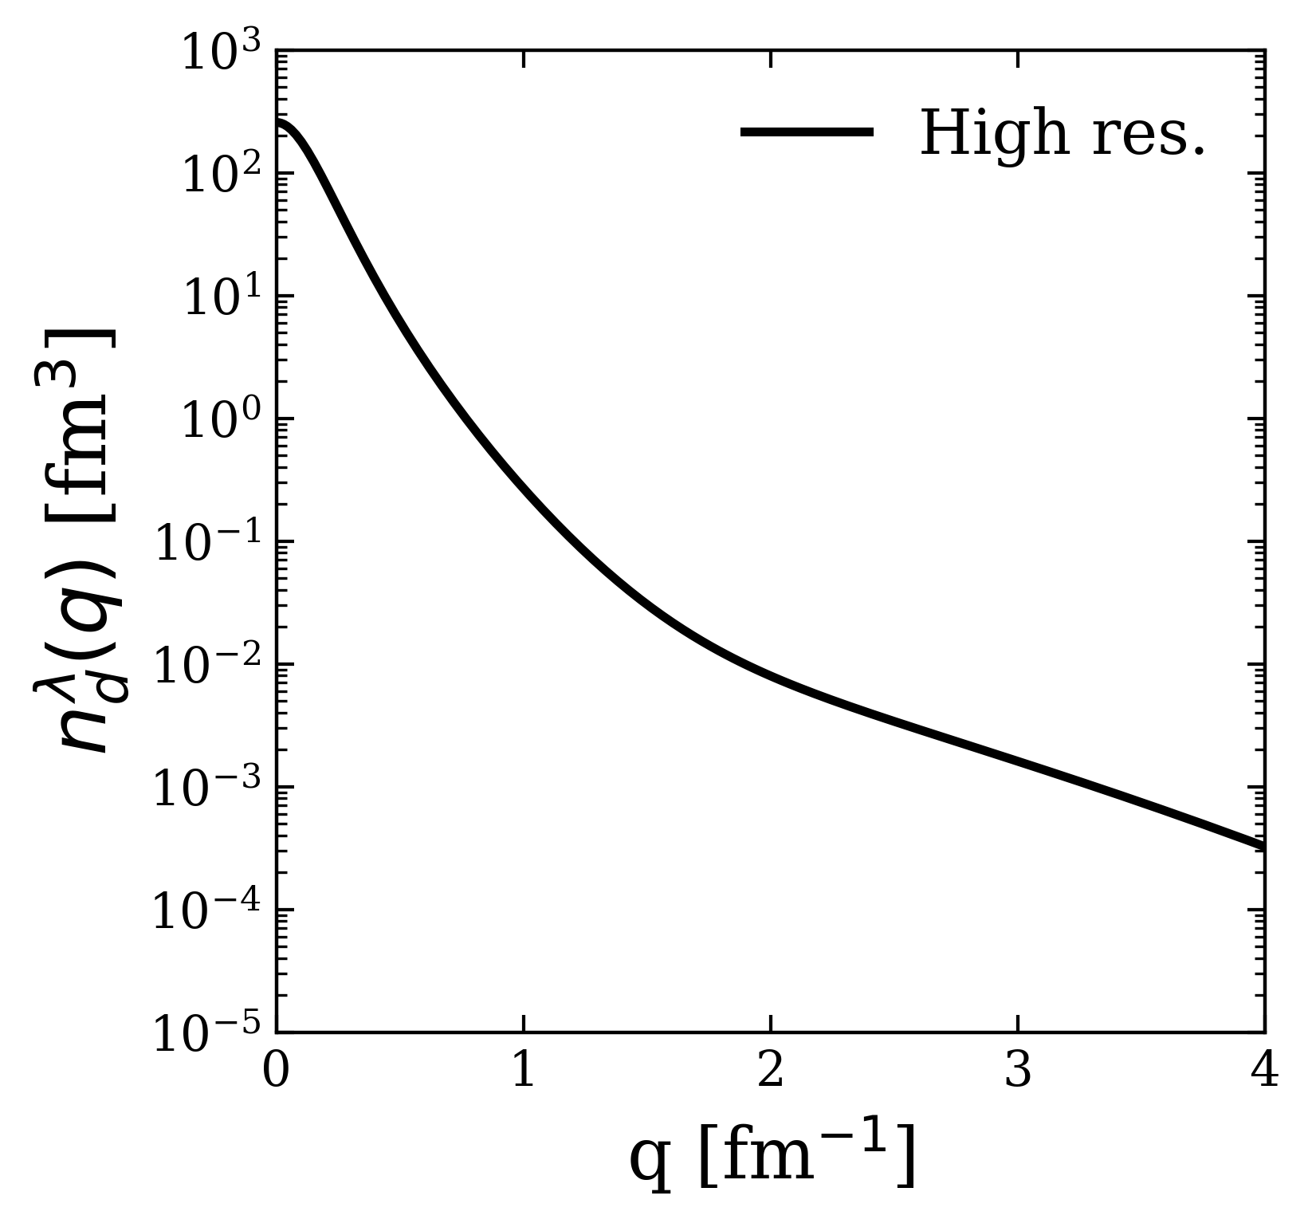
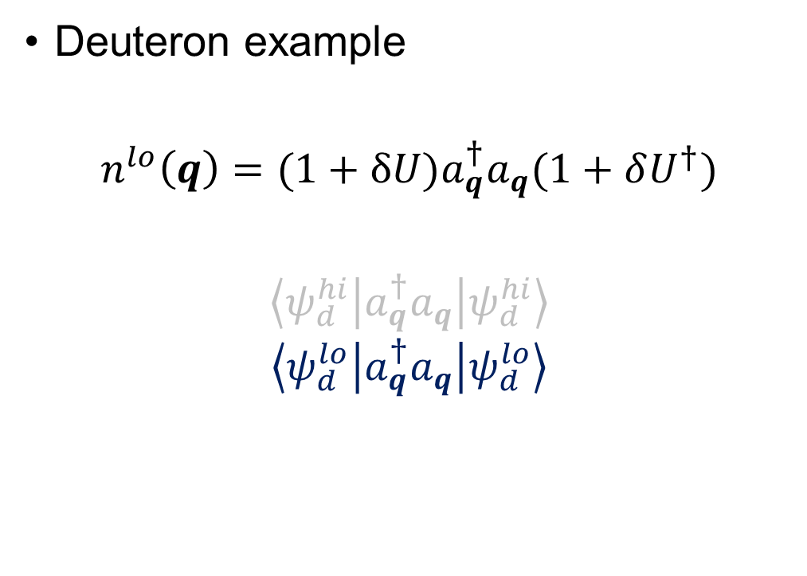
Momentum distributions at low RG resolution
Deuteron example
$$n^{lo}\left(q\right)=(1+δU)a_{q}^{†}a_{q}(1+δU^{†})$$
$$\left\langle ψ_{d}^{hi} | a_{q}^{†}a_{q} | ψ_{d}^{hi}\right\rangle$$
$$\left\langle ψ_{d}^{lo} | a_{q}^{†}a_{q} | ψ_{d}^{lo}\right\rangle$$
Fig. 3: Contributions to deuteron momentum distribution with AV18 and $λ=1.35$ fm⁻¹.
Notes:
Taking only 1.

Slide 11
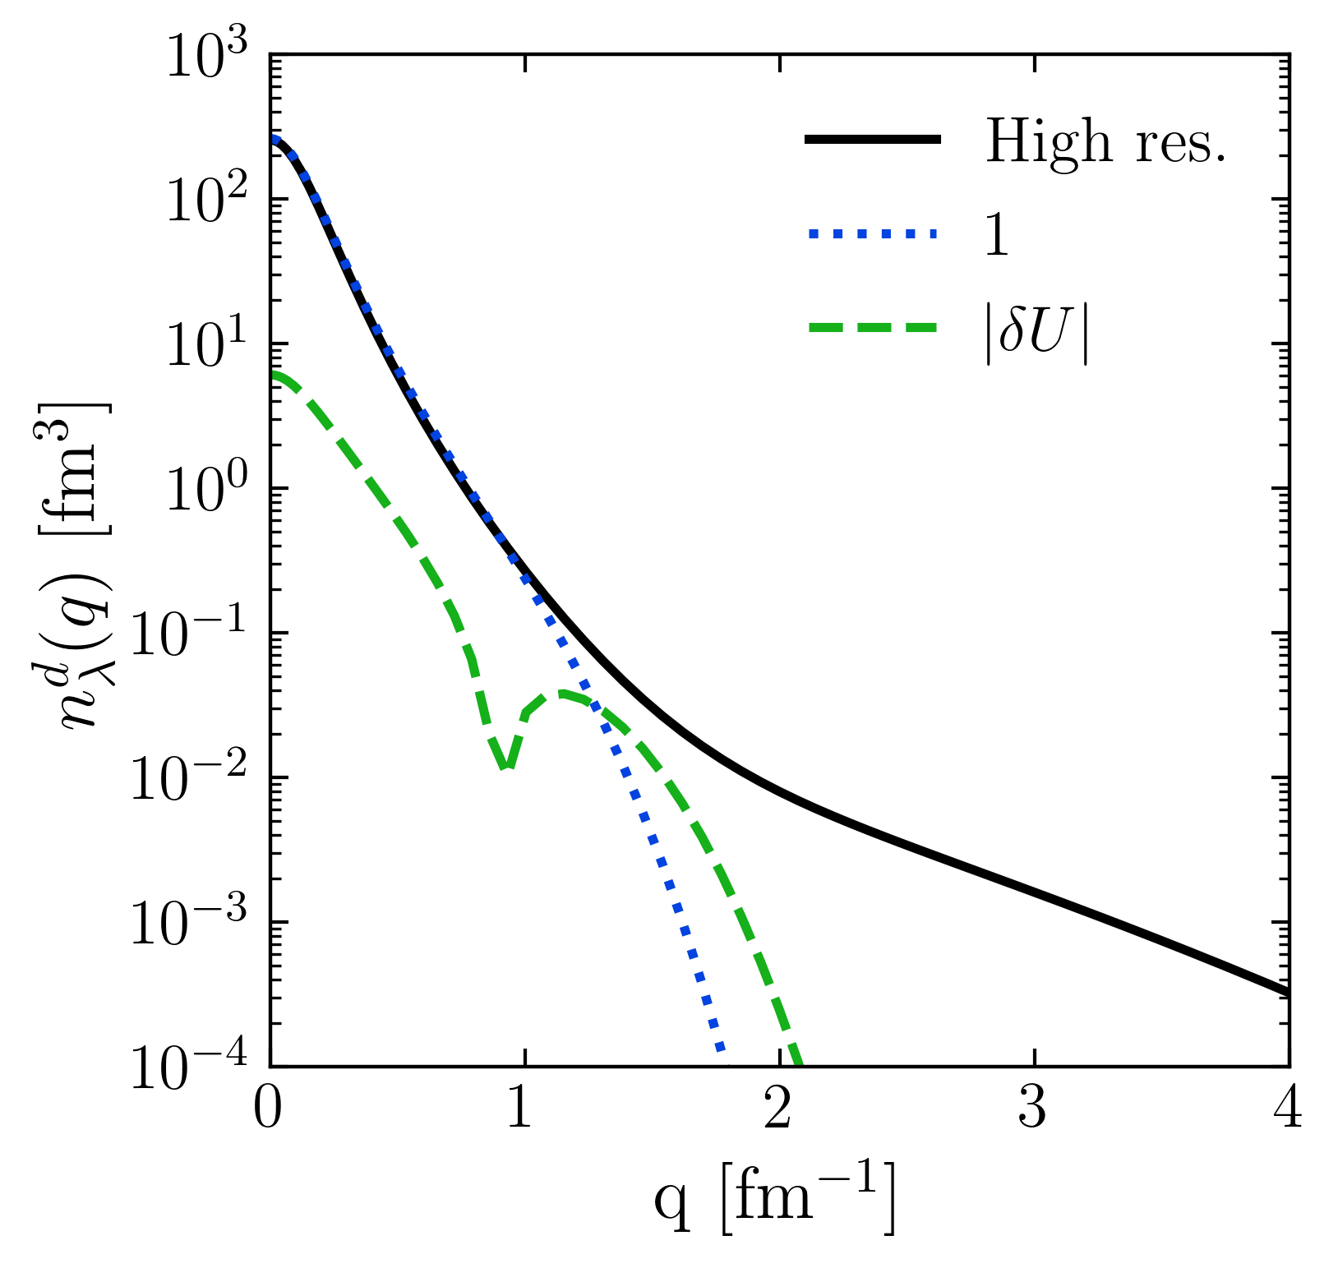
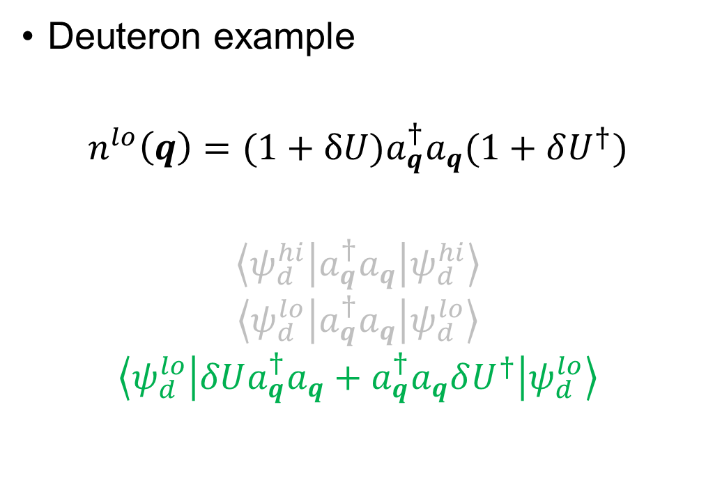
Momentum distributions at low RG resolution
Deuteron example
$$n^{lo}\left(q\right)=(1+δU)a_{q}^{†}a_{q}(1+δU^{†})$$
$$\left\langle ψ_{d}^{hi} | a_{q}^{†}a_{q} | ψ_{d}^{hi}\right\rangle$$
$$\left\langle ψ_{d}^{lo} | a_{q}^{†}a_{q} | ψ_{d}^{lo}\right\rangle$$
$$\left\langle ψ_{d}^{lo} | δUa_{q}^{†}a_{q}+a_{q}^{†}a_{q}δU^{†} | ψ_{d}^{lo}\right\rangle$$
Fig. 3: Contributions to deuteron momentum distribution with AV18 and $λ=1.35$ fm⁻¹.
Notes:
Taking only \delta U.

Slide 12
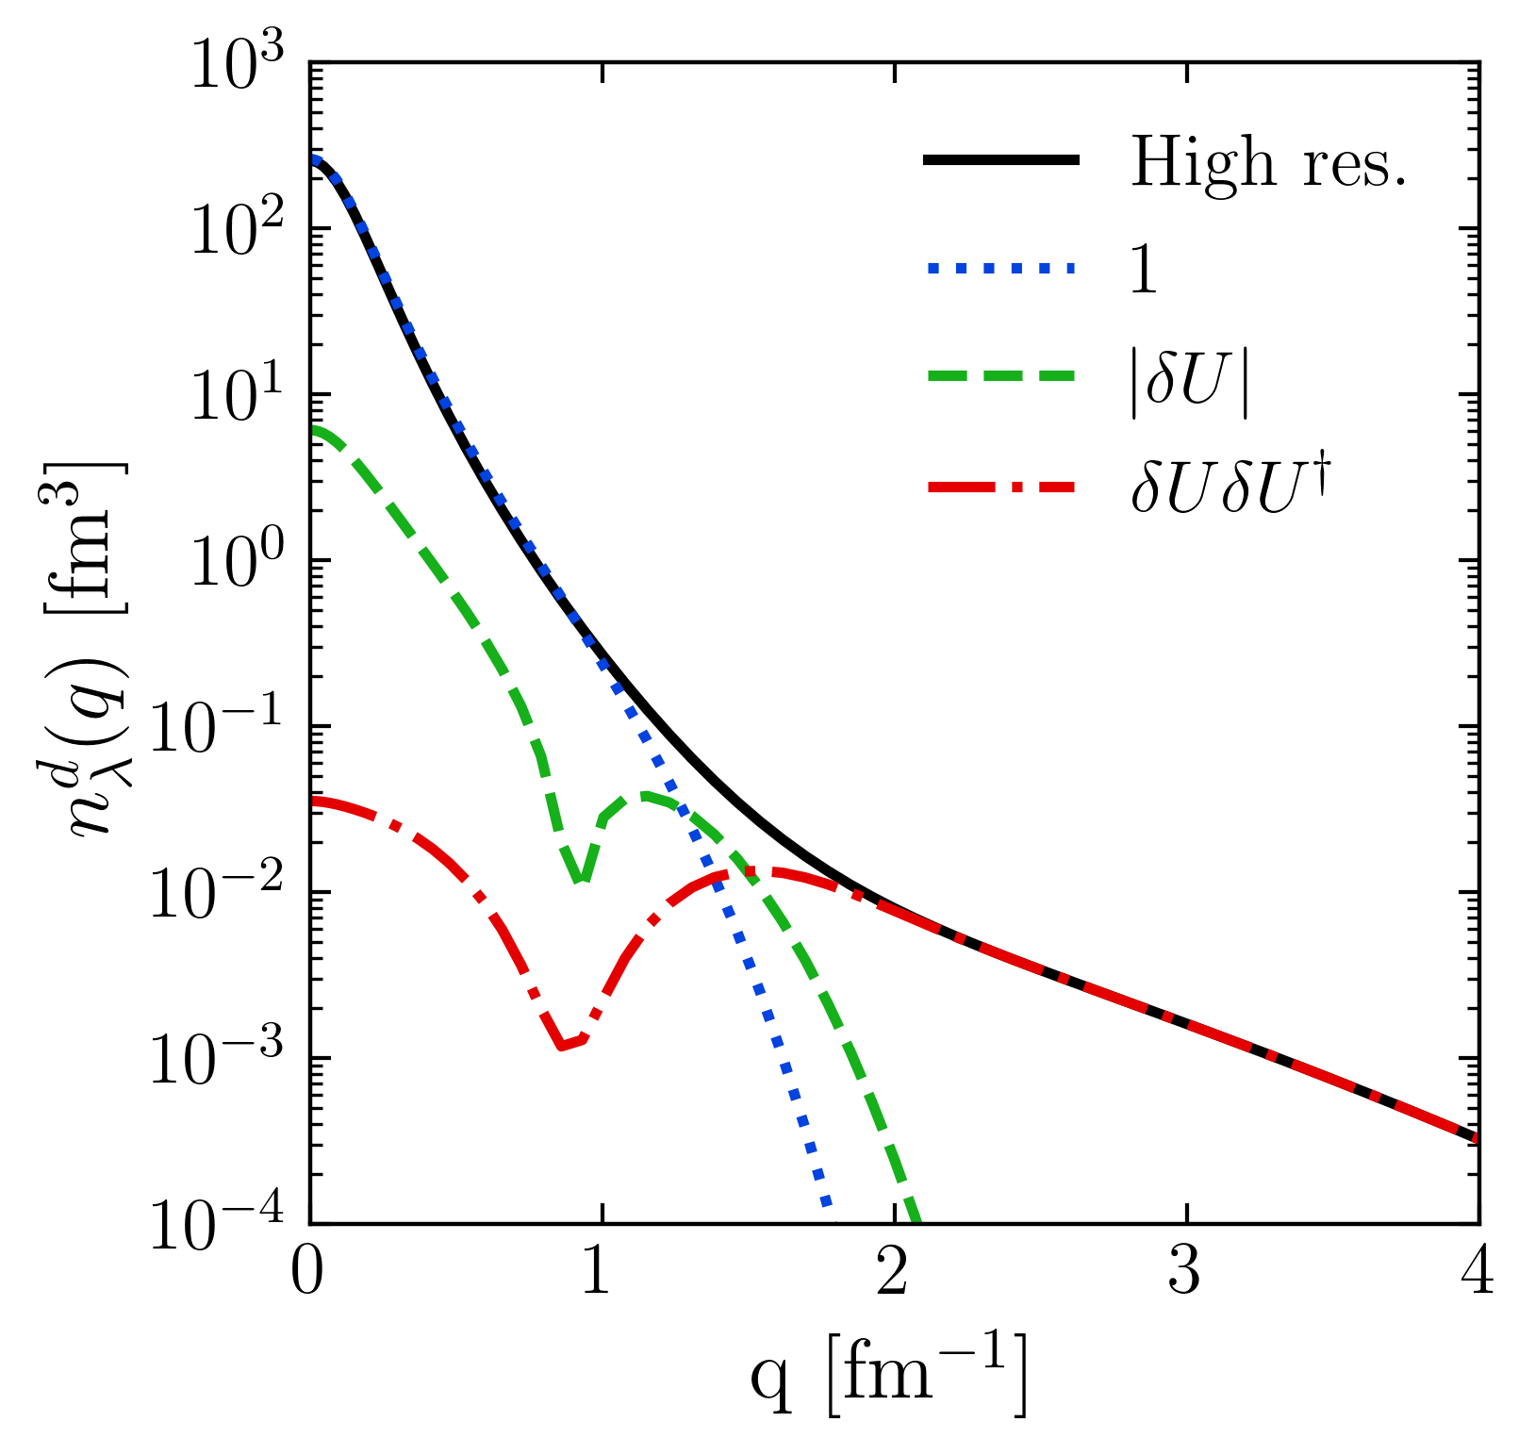
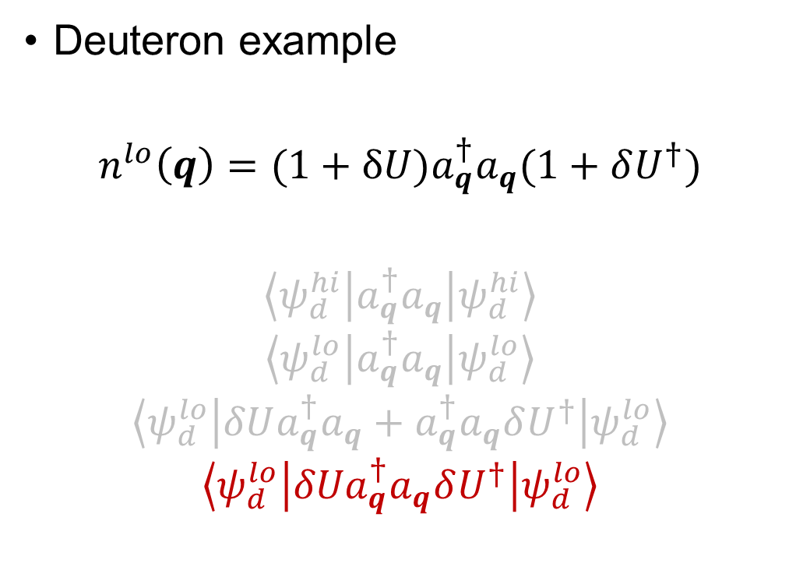
Momentum distributions at low RG resolution
Deuteron example
$$n^{lo}\left(q\right)=(1+δU)a_{q}^{†}a_{q}(1+δU^{†})$$
$$\left\langle ψ_{d}^{hi} | a_{q}^{†}a_{q} | ψ_{d}^{hi}\right\rangle$$
$$\left\langle ψ_{d}^{lo} | a_{q}^{†}a_{q} | ψ_{d}^{lo}\right\rangle$$
$$\left\langle ψ_{d}^{lo} | δUa_{q}^{†}a_{q}+a_{q}^{†}a_{q}δU^{†} | ψ_{d}^{lo}\right\rangle$$
$$\left\langle ψ_{d}^{lo} | {δUa}_{q}^{†}a_{q}δU^{†} | ψ_{d}^{lo}\right\rangle$$
Fig. 3: Contributions to deuteron momentum distribution with AV18 and $λ=1.35$ fm⁻¹.
Notes:
Taking \delta U \delta U^\dagger -> gives high-momentum tail.

Slide 13

Momentum distributions at low RG resolution
For high-$q$, the ${δU}_{λ}{δU}_{λ}^{†}$ 2-body term dominates
$$≈\sum_{K,k,k′}{{δU}_{λ}\left(k,q\right){{δU}_{λ}^{†}(q,k′)a}_{\frac{K}{2}+k}^{†}a_{\frac{K}{2}−k}^{†}a_{\frac{K}{2}−k^{′}}a_{\frac{K}{2}+k^{′}}}$$
Fig. 3: Contributions to deuteron momentum distribution with AV18 and $λ=1.35$ fm⁻¹.
Notes:
Read bullet.

Slide 14
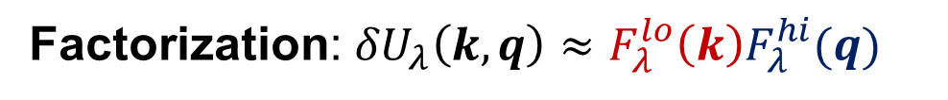
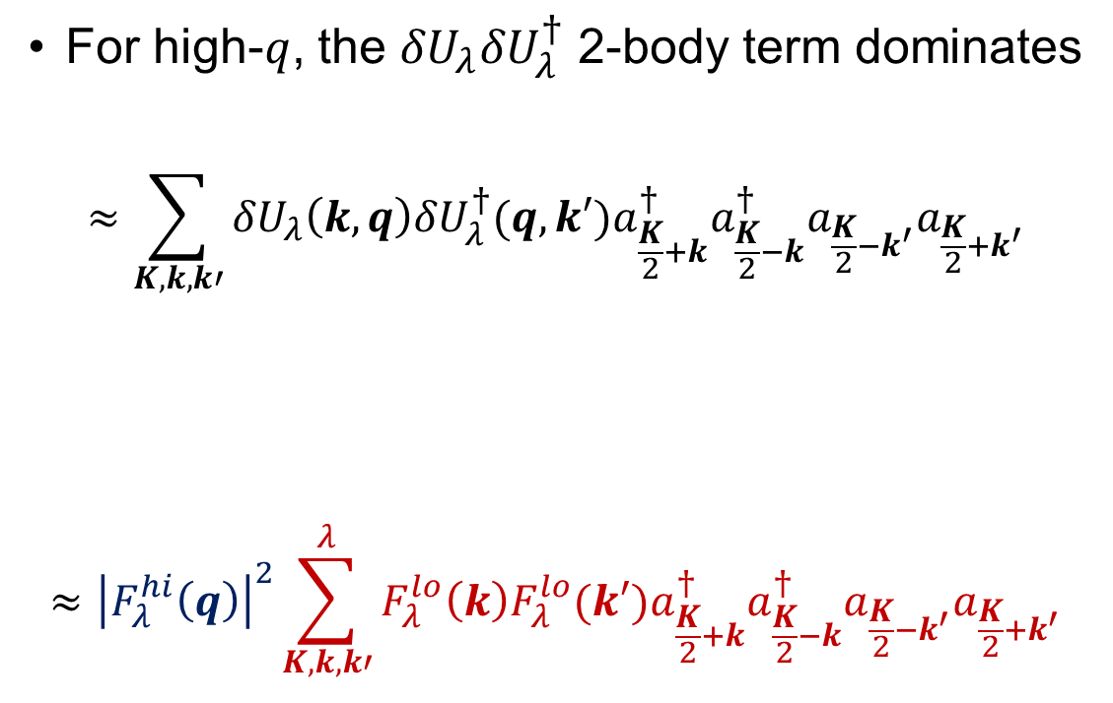
Momentum distributions at low RG resolution
For high-$q$, the ${δU}_{λ}{δU}_{λ}^{†}$ 2-body term dominates
$$≈\sum_{K,k,k′}{{δU}_{λ}\left(k,q\right){{δU}_{λ}^{†}(q,k′)a}_{\frac{K}{2}+k}^{†}a_{\frac{K}{2}−k}^{†}a_{\frac{K}{2}−k^{′}}a_{\frac{K}{2}+k^{′}}}$$
$$≈{\left|F_{λ}^{hi}\left(q\right)\right|}^{2}\sum_{K,k,k′}^{λ}{F_{λ}^{lo}\left(k\right){F_{λ}^{lo}(k′)a}_{\frac{K}{2}+k}^{†}a_{\frac{K}{2}−k}^{†}a_{\frac{K}{2}−k^{′}}a_{\frac{K}{2}+k^{′}}}$$
Factorization: ${δU}_{λ}\left(k,q\right)≈F_{λ}^{lo}{\left(k\right)F}_{λ}^{hi}(q)$
Fig. 3: Contributions to deuteron momentum distribution with AV18 and $λ=1.35$ fm⁻¹.
Notes:
Furthermore, this factorizes so we are left with the high-momentum dependence out in front here (point) and the rest is at low momentum.
Factorization from OPE.

Slide 15


Momentum distributions at low RG resolution
For high-$q$, the ${δU}_{λ}{δU}_{λ}^{†}$ 2-body term dominates
$$≈\sum_{K,k,k′}{{δU}_{λ}\left(k,q\right){{δU}_{λ}^{†}(q,k′)a}_{\frac{K}{2}+k}^{†}a_{\frac{K}{2}−k}^{†}a_{\frac{K}{2}−k^{′}}a_{\frac{K}{2}+k^{′}}}$$
$$≈{\left|F_{λ}^{lo}\left(q\right)\right|}^{2}\sum_{K,k,k′}^{λ}{F_{λ}^{lo}\left(k\right){F_{λ}^{lo}(k′)a}_{\frac{K}{2}+k}^{†}a_{\frac{K}{2}−k}^{†}a_{\frac{K}{2}−k^{′}}a_{\frac{K}{2}+k^{′}}}$$
Apply this strategy to nuclear momentum distributions using local density approximation (LDA)!
Factorization: ${δU}_{λ}\left(k,q\right)≈F_{λ}^{lo}{\left(k\right)F}_{λ}^{hi}(q)$
Fig. 3: Contributions to deuteron momentum distribution with AV18 and $λ=1.35$ fm⁻¹.
Notes:
Read textbox.

Slide 16
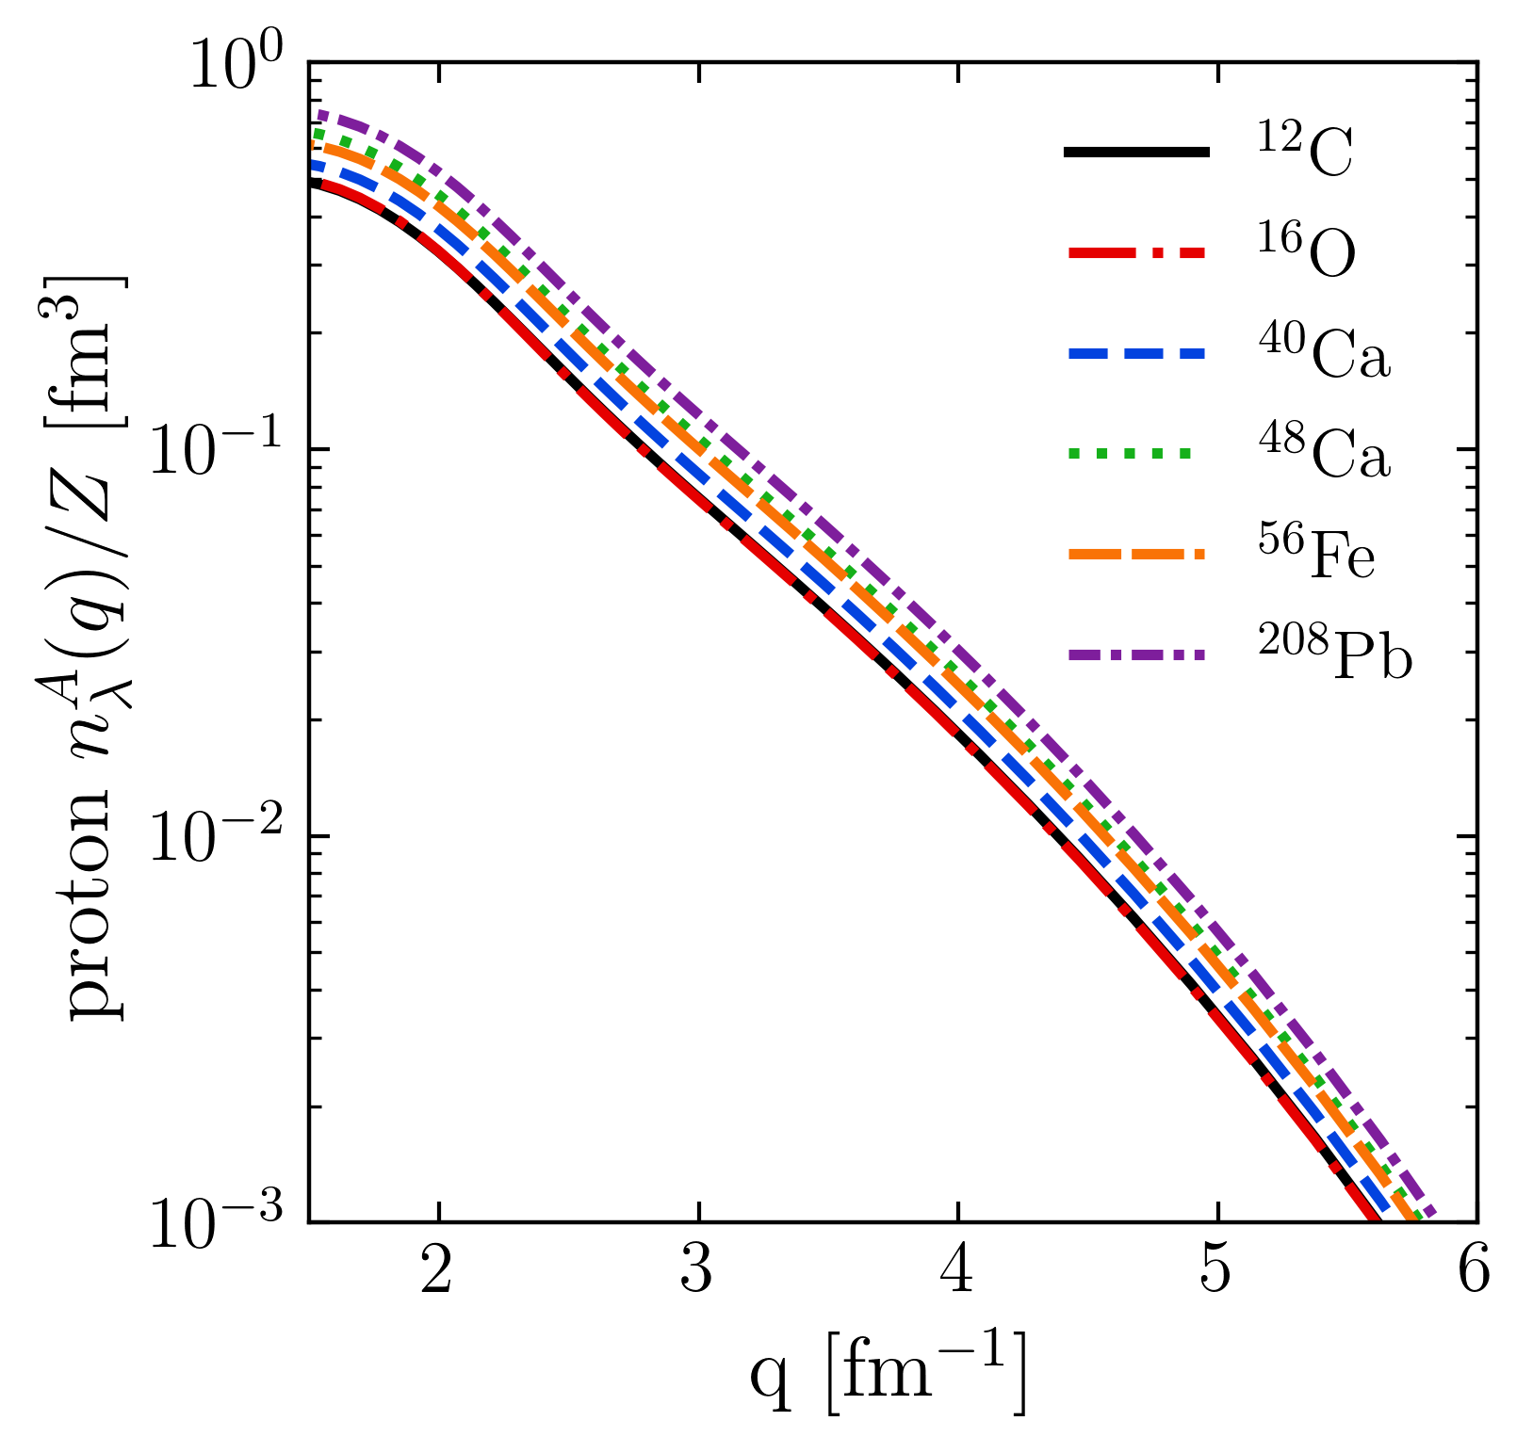
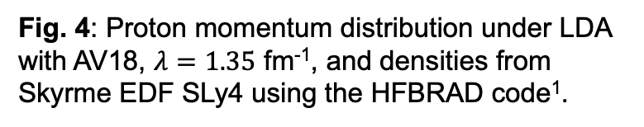

LDA results
Fig. 4: Proton momentum distribution under LDA with AV18, $λ=1.35$ fm⁻¹, and densities from Skyrme EDF SLy4 using the HFBRAD code¹.
Universality
High-$q$ tail collapses to universal function $≈{\left|F_{λ}^{hi}\left(q\right)\right|}^{2}$ fixed by 2-body
Results are insensitive to type of density
¹K. Bennaceur et al., Comput. Phys. Commun. 168, 96 (2005)
Notes:
Explain the figure, takeaway -> read bullet.

Slide 17
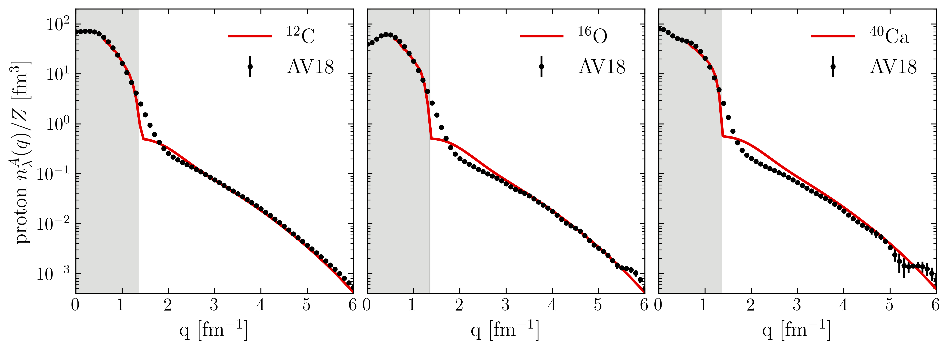

LDA results
¹R.B. Wiringa et al., Phys. Rev. C 89, 024305 (2014)
https://www.phy.anl.gov/theory/research/momenta/
Low RG resolution calculations reproduce momentum distributions of AV18 data¹ (high RG resolution calculation)
Low RG works well with simple approximations and is systematically improvable
Fig. 5: Proton momentum distributions for ¹²C, ¹⁶O, and ⁴⁰Ca under LDA with AV18 and $λ=1.35$ fm⁻¹.
Notes:
Compare to AV18 QMC calculations, read bullets, emphasize that the high-q tail works well.
Why is the intermediate q region the worst? Operator cut at 2-body and WF is just HF. (IMSRG decoupling example).
Why isn’t low-q showing? Low-q corresponds to large-r in LDA where a local density approximation will not work.

Slide 18
LDA results
np includes ¹S₀ and ³S₁-³D₁
Scalar limit
At high RG resolution, the tensor force and the repulsive core of the NN interaction kicks nucleon pairs into SRCs
np dominates because the tensor force requires spin triplet pairs (pp are spin singlets)
Do we describe this physics at low RG resolution?
Fig. 6: (a) Ratio of two-nucleon to single-nucleon electron-scattering cross sections for carbon as a function of missing momentum. (b) Fraction of np to p and pp to p pairs versus the relative momentum. Figure from CLAS collaboration publication¹.
¹I. Korover et al. (CLAS), arXiv:2004.07304 (2014)
Notes:
Don't bother describing (a) - just say these are cross section ratios on the left, on the right are the pair fraction of proton-neutron and proton-proton.
The takeaway is at high RG resolution, the tensor force… (fast!)

Slide 19
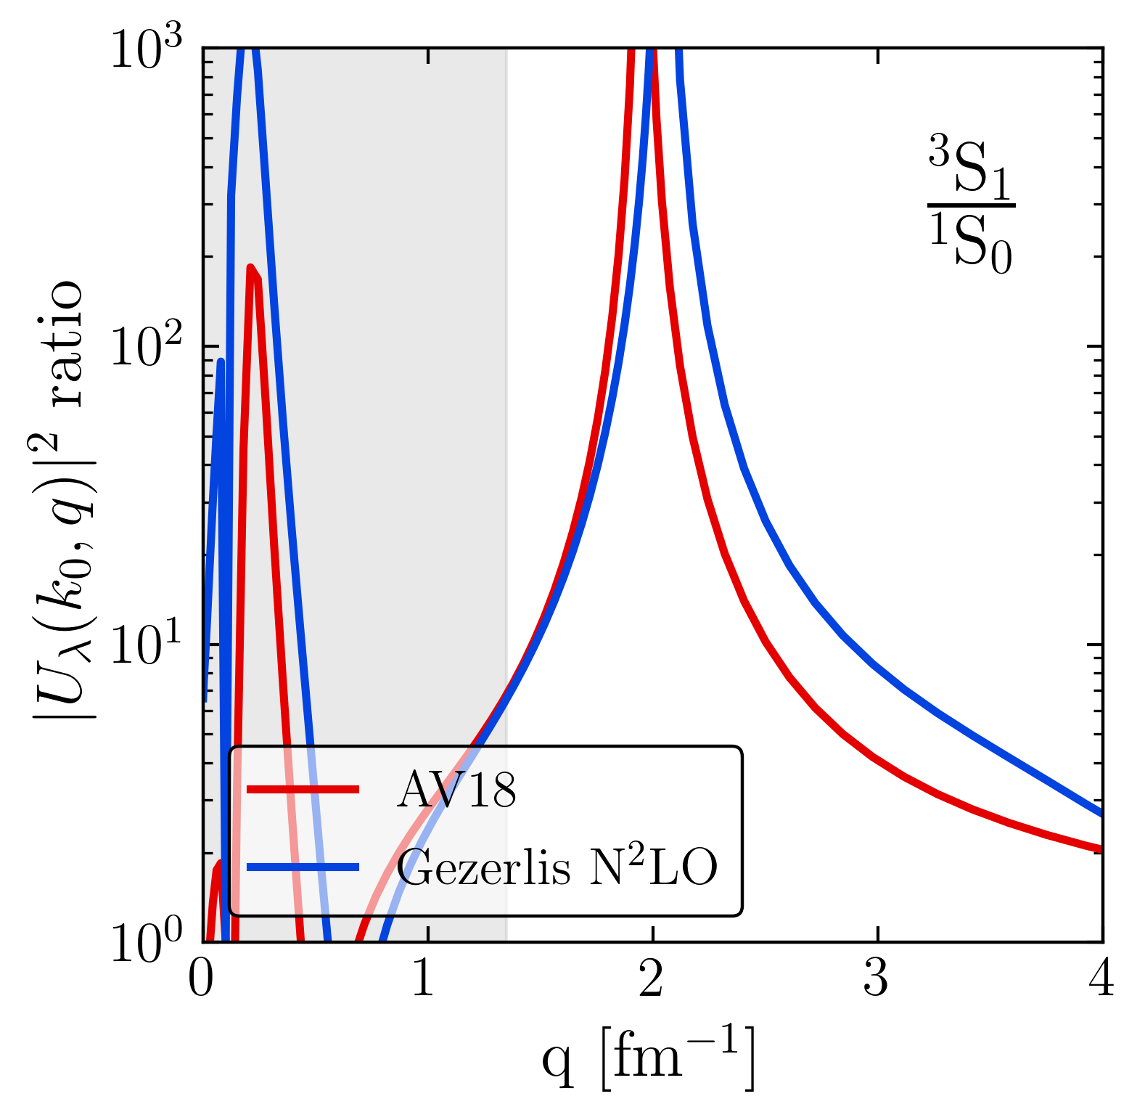
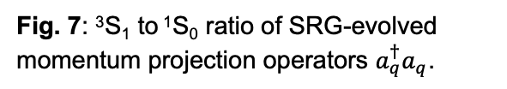
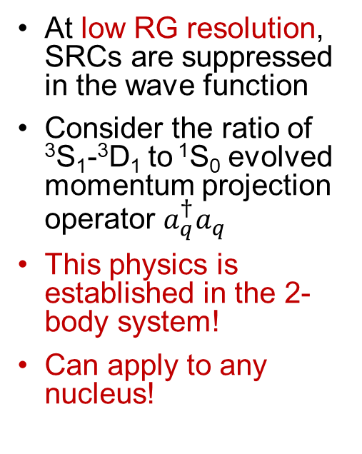
LDA results
np includes ¹S₀ and ³S₁-³D₁
Scalar limit
At low RG resolution, SRCs are suppressed in the wave function
Consider the ratio of ³S₁-³D₁ to ¹S₀ evolved momentum projection operator $a_{q}^{†}a_{q}$
This physics is established in the 2-body system!
Can apply to any nucleus!
pn dominance
Scalar limit
Fig. 7: ³S₁ to ¹S₀ ratio of SRG-evolved momentum projection operators $a_{q}^{†}a_{q}$.
Notes:
Start with 2 bullets on the right, then explain figure, then last two bullets.

Slide 20
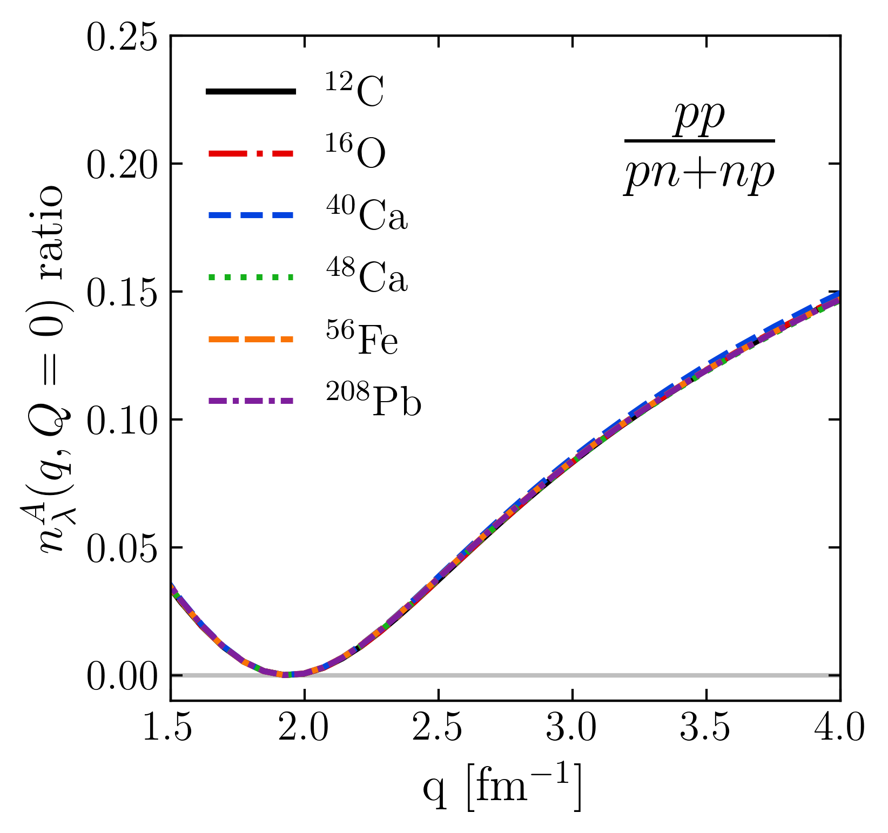
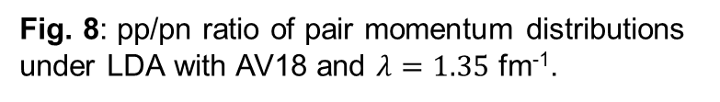
LDA results
np includes ¹S₀ and ³S₁-³D₁
Scalar limit
Reproduces the characteristics of cross section ratios using low RG resolution operator with simple approximations
pn dominance
Scalar limit
Fig. 8: pp/pn ratio of pair momentum distributions under LDA with AV18 and $λ=1.35$ fm⁻¹.
Notes:
So if we calculate the ratio of the momentum distributions for pp/np, we reproduce the general results where we see the pn dominance at 400 MeV and transition to the scalar limit.

Slide 21
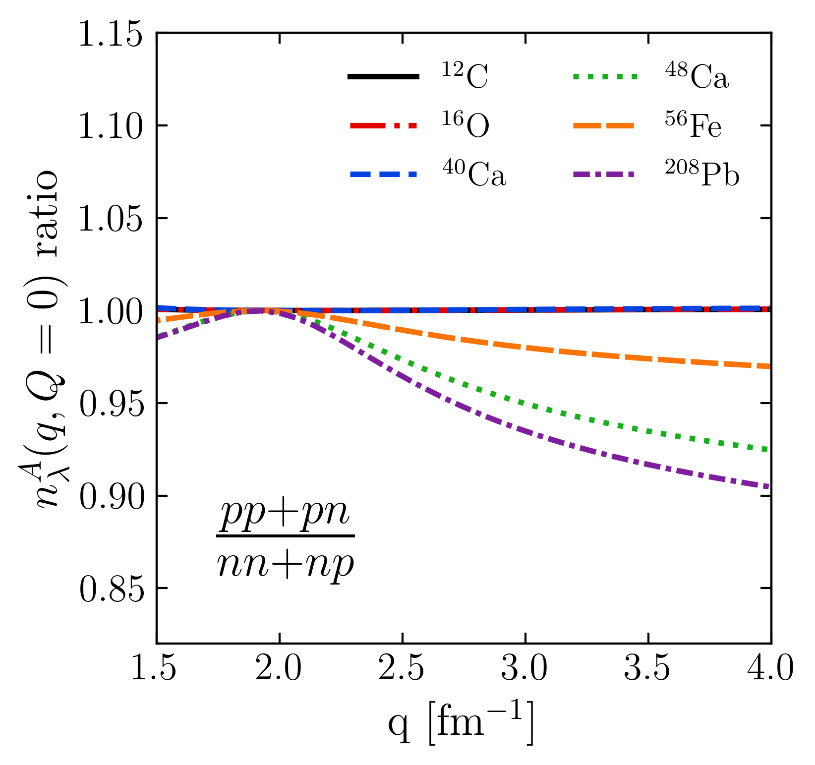
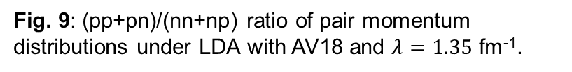
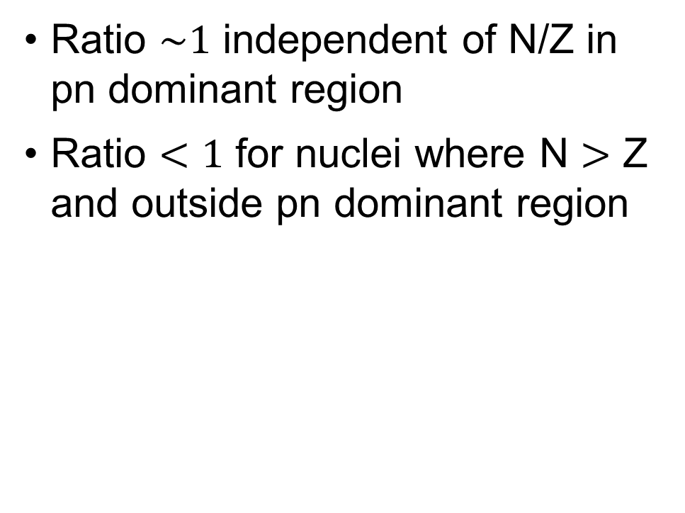
LDA results
Ratio $\sim 1$ independent of N/Z in pn dominant region
Ratio $<1$ for nuclei where N $>$ Z and outside pn dominant region
pn dominance
Fig. 9: (pp+pn)/(nn+np) ratio of pair momentum distributions under LDA with AV18 and $λ=1.35$ fm⁻¹.
Notes:
We can also look at isospin dependence: by taking ratios we see the pn-dominant region is independent of N/Z while the scalar limits depends on N/Z.

Slide 22
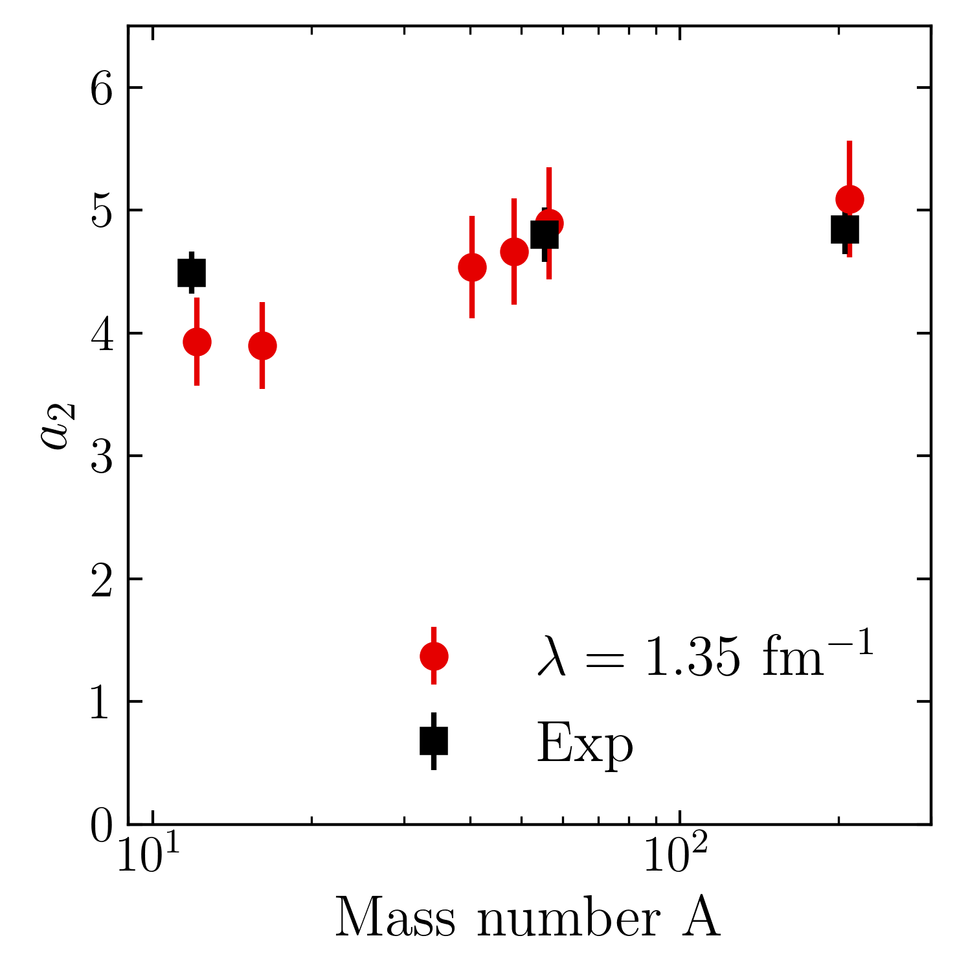
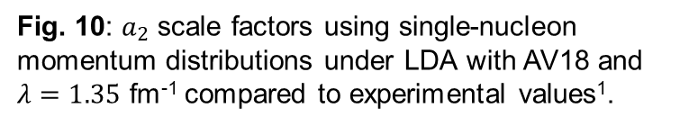
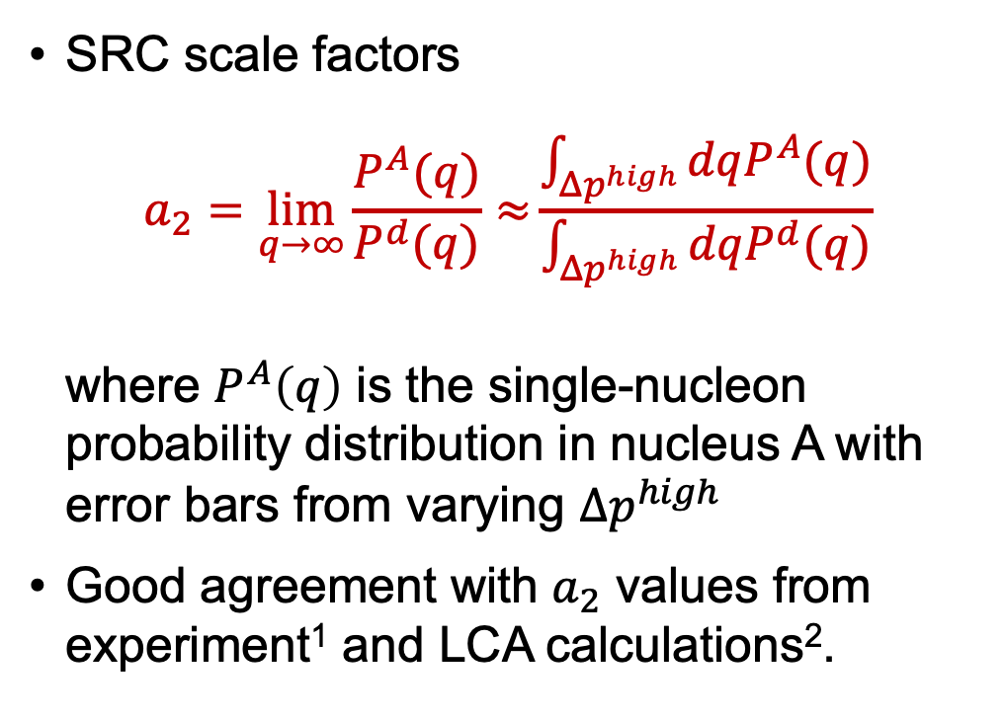
LDA results
SRC scale factors
$$a_{2}=\lim_{q→∞}{\frac{P^{A}(q)}{P^{d}(q)}≈}\frac{\int_{Δp^{high}}{dqP^{A}(q)}}{\int_{Δp^{high}}{dqP^{d}(q)}}$$
where $P^{A}\left(q\right)$ is the single-nucleon probability distribution in nucleus A with error bars from varying $Δp^{high}$
Good agreement with $a_{2}$ values from experiment¹ and LCA calculations².
Fig. 10: $a_{2}$ scale factors using single-nucleon momentum distributions under LDA with AV18 and $λ=1.35$ fm⁻¹ compared to experimental values¹.
¹B. Schmookler et al. (CLAS), Nature 566, 354 (2019)
²J. Ryckebusch et al., Phys. Rev. C 100, 054620 (2019)
Notes:
Lastly, we can produce SRC scale factors using this expression here (explain). Gives good agreement with experiment and LCA calculations from this reference (point).
a2 is given by the ratio of \sigma^A / \sigma^d inclusive cross section ratios which plateau at high Bjorken x.

Slide 23
Summary and outlook
Simple approximations work and are systematically improvable at low RG resolution
Results suggest that we can analyze high-energy nuclear reactions using low RG resolution structure (e.g., shell model) and consistently evolved operators
Matching resolution scale between structure and reactions is crucial!
Ongoing work:
Extend to cross sections and test scale/scheme dependence of extracted properties
Further investigate how final state interactions and physical interpretations depend on the RG scale
Apply to more complicated knock-out reactions (SRG with optical potentials)
Implement uncertainty quantification

Slide 24
Extras

Slide 25
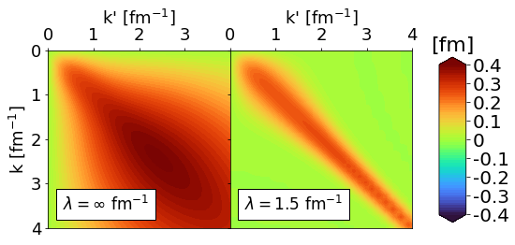
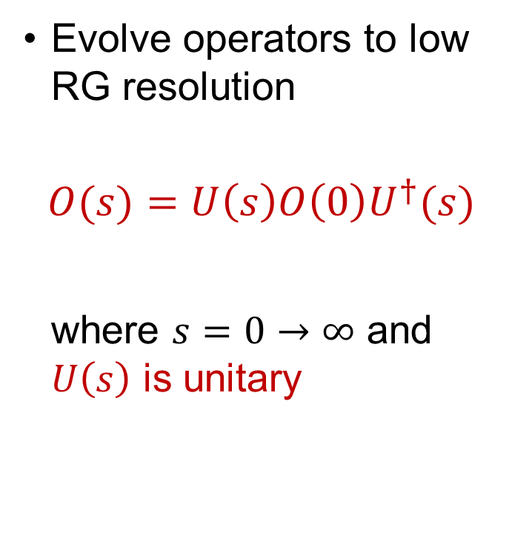
Similarity Renormalization Group (SRG)
Evolve operators to low RG resolution
$$O(s)=U\left(s\right)O\left(0\right)U^{†}(s)$$
where $s=0→∞$ and $U\left(s\right)$ is unitary
Fig. 1: Momentum space matrix elements of Argonne v18 (AV18) under SRG evolution in ¹P₁ channel.

Slide 26
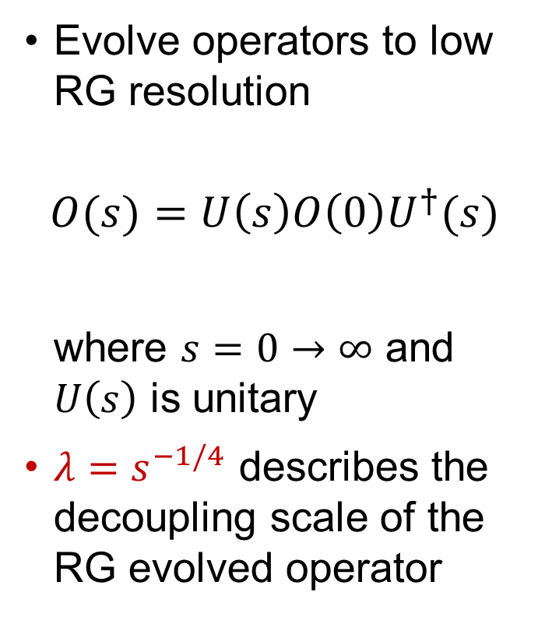
Similarity Renormalization Group (SRG)
Evolve operators to low RG resolution
$$O(s)=U\left(s\right)O\left(0\right)U^{†}(s)$$
where $s=0→∞$ and $U\left(s\right)$ is unitary
$λ=s^{−1/4}$ describes the decoupling scale of the RG evolved operator
Fig. 1: Momentum space matrix elements of Argonne v18 (AV18) under SRG evolution in ¹P₁ channel.

Slide 27
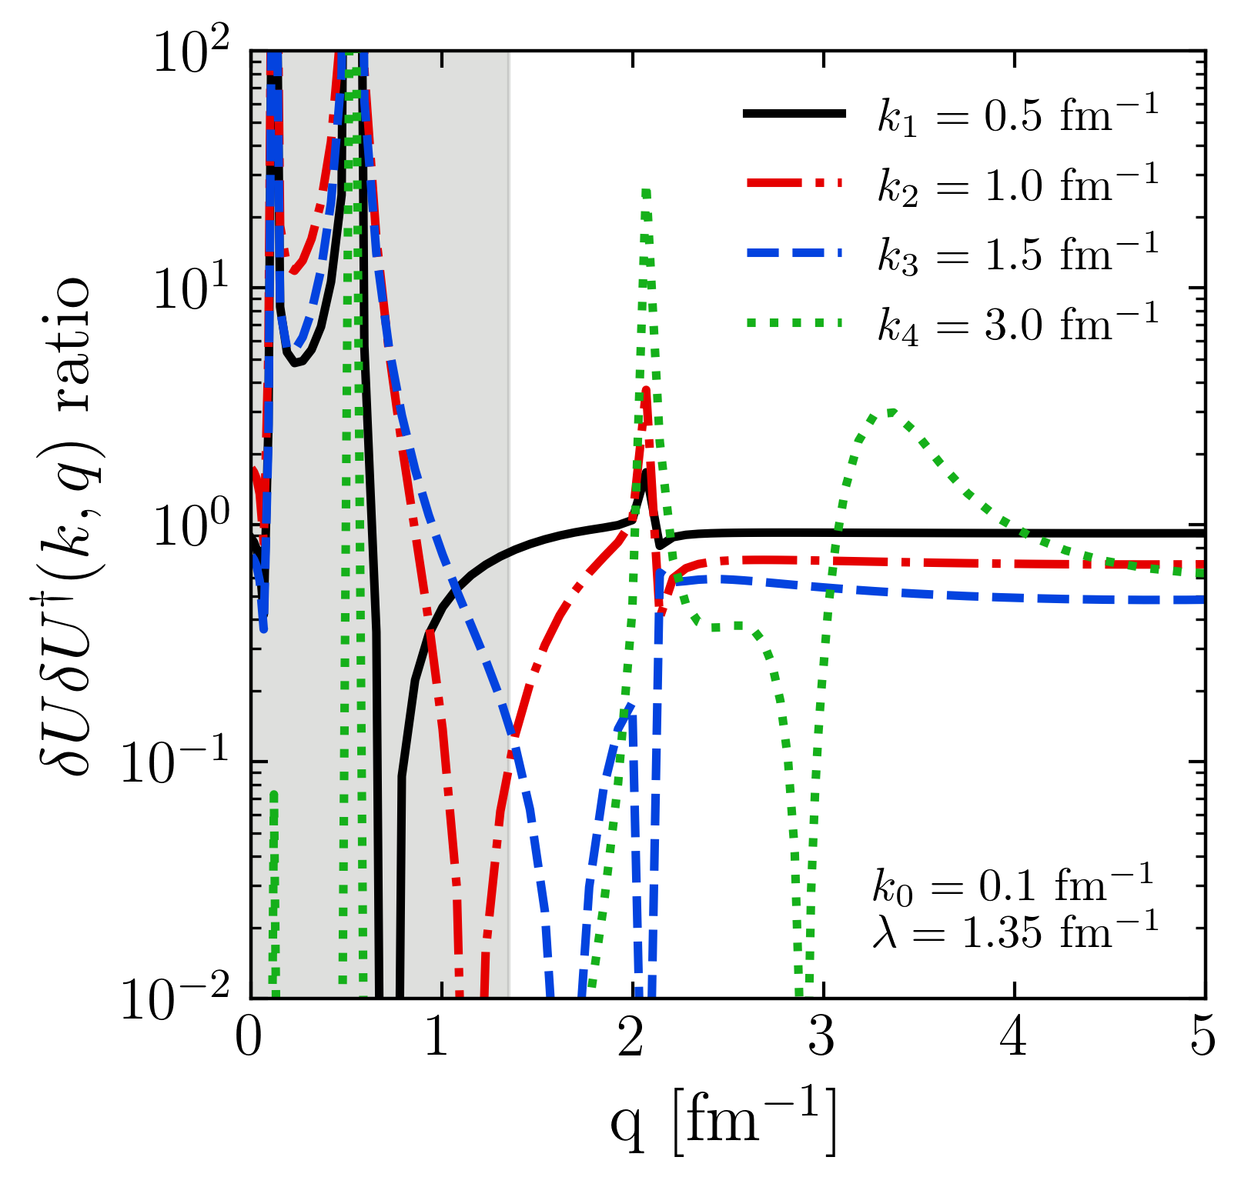
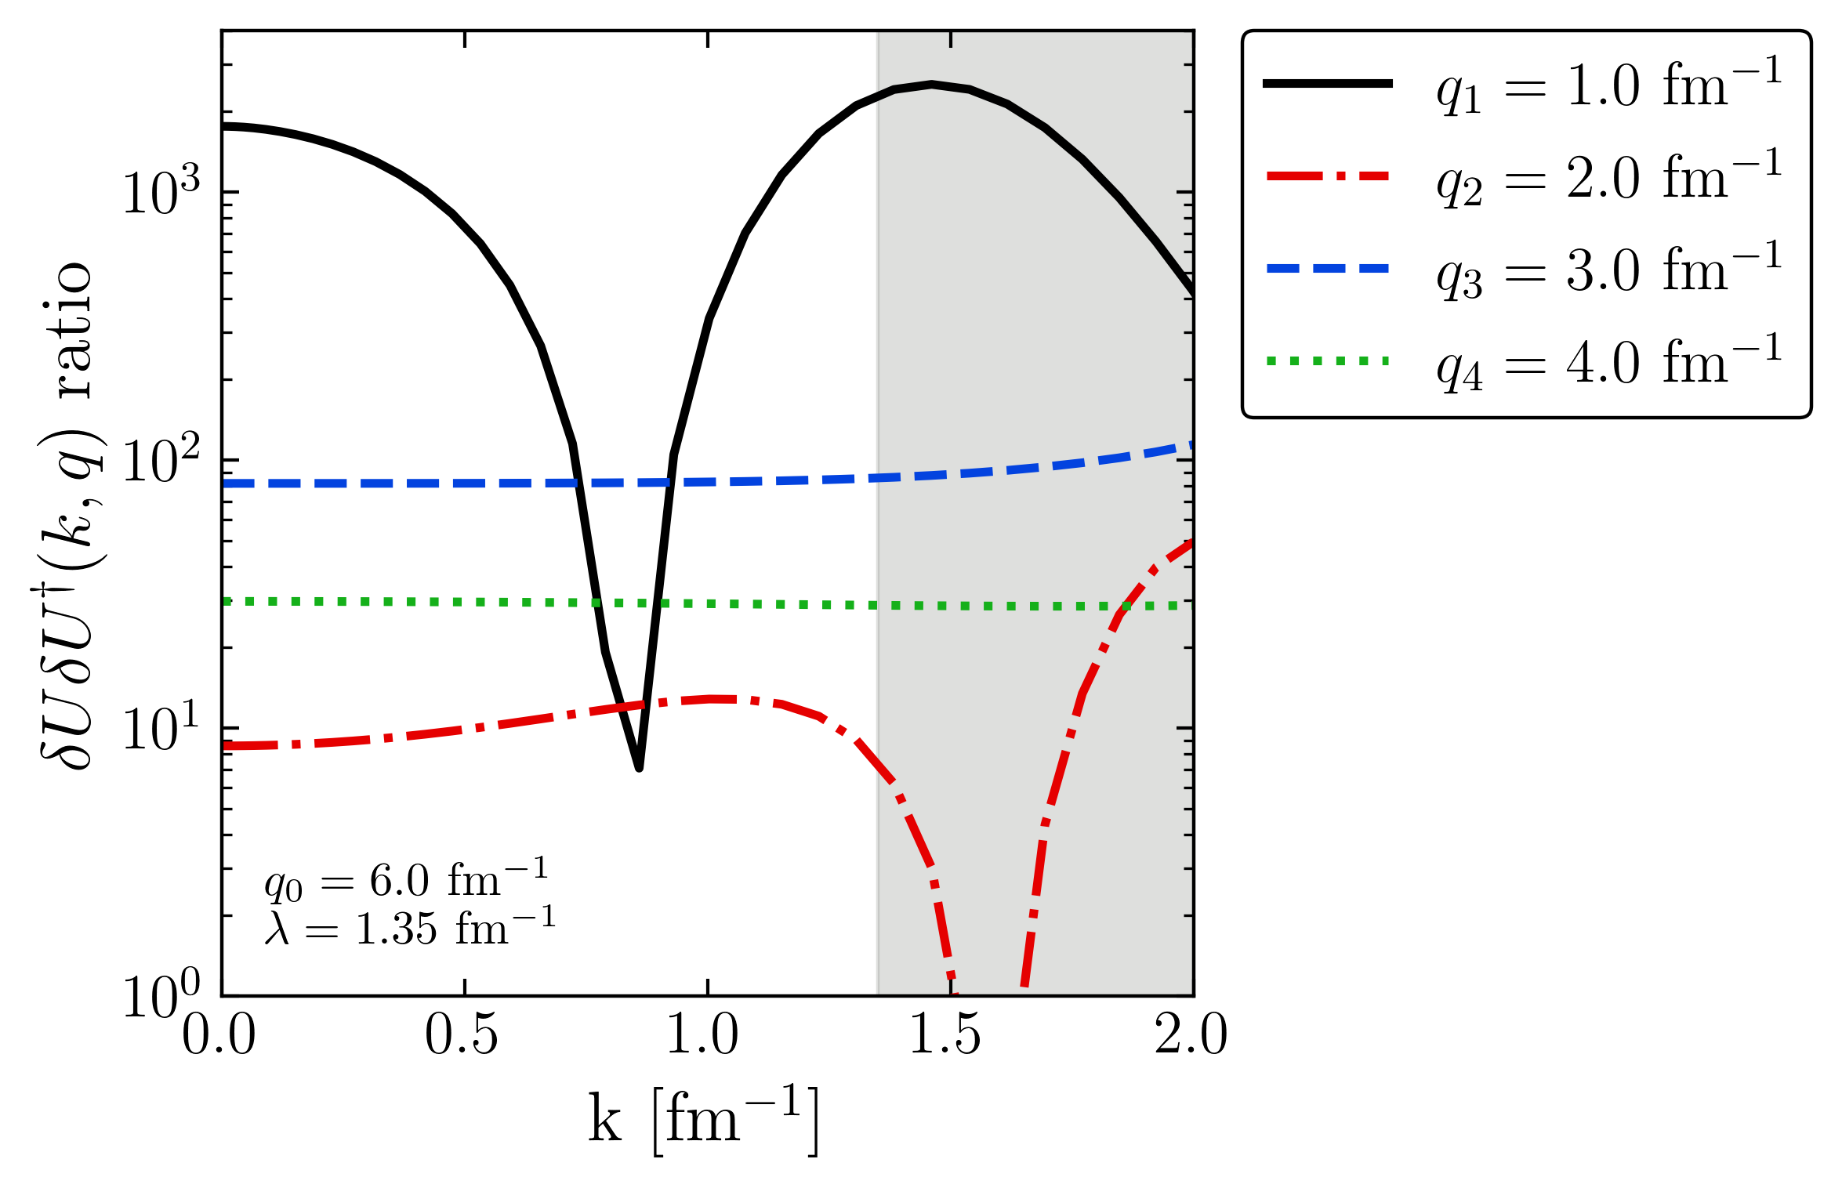
Factorization

