Slide 1




Analyzing scale and scheme dependence in NN operators with the SRG
Anthony Tropiano¹, Dick Furnstahl¹, Scott Bogner²
¹Ohio State University, ²Michigan State University
NUCLEI Meeting
June 9, 2020

Slide 2
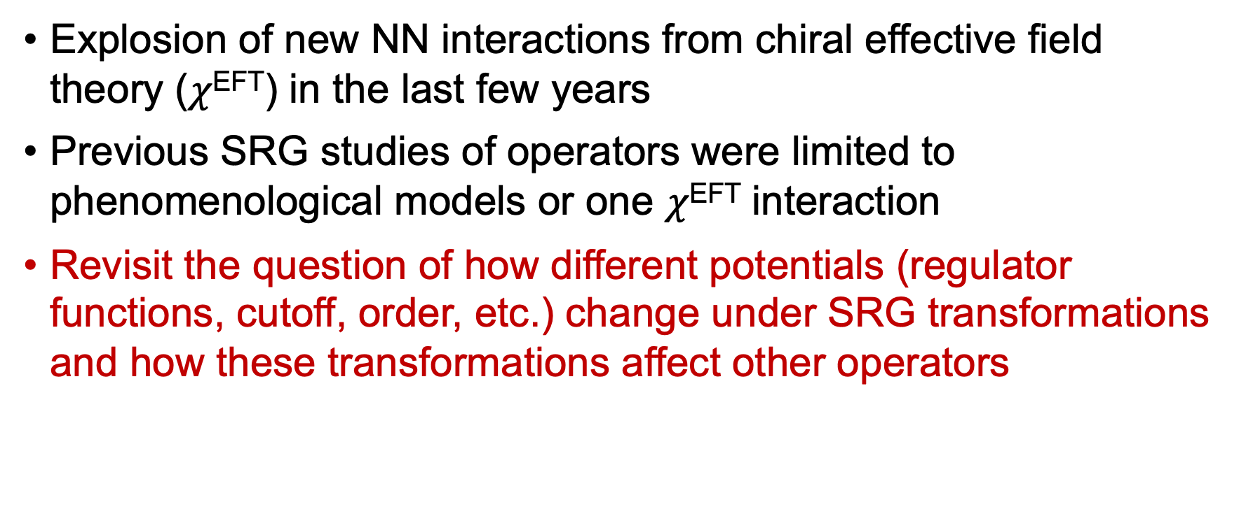
Motivation
Explosion of new NN interactions from chiral effective field theory ($χ$^{EFT}) in the last few years
Previous SRG studies of operators were limited to phenomenological models or one $χ$^{EFT} interaction
Revisit the question of how different potentials (regulator functions, cutoff, order, etc.) change under SRG transformations and how these transformations affect other operators

Slide 3
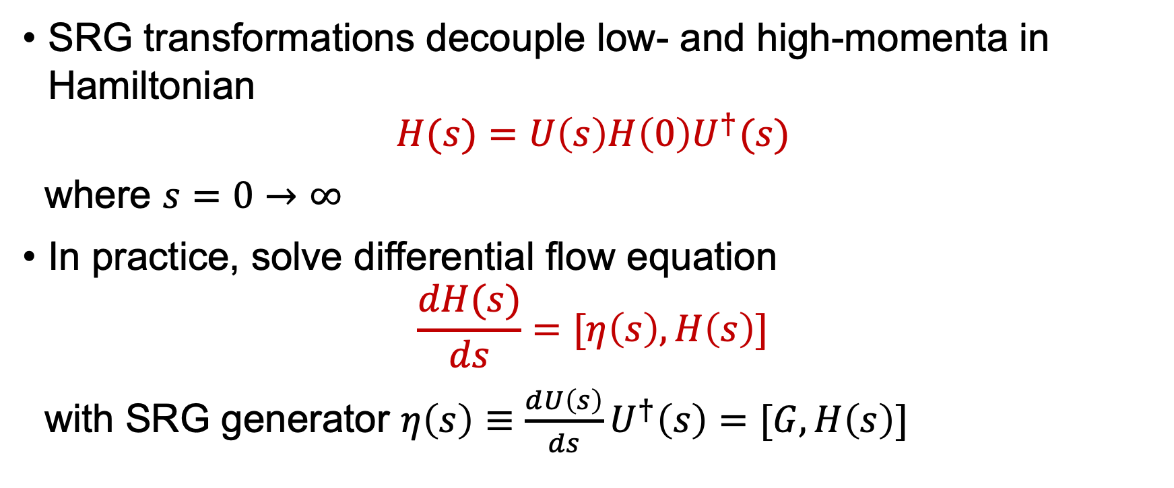
SRG Formalism
SRG transformations decouple low- and high-momenta in Hamiltonian
$$H(s)=U\left(s\right)H\left(0\right)U^{†}(s)$$
where $s=0→∞$
In practice, solve differential flow equation
$$\frac{dH(s)}{ds}=[η\left(s\right),H\left(s\right)]$$
with SRG generator $η\left(s\right)≡\frac{dU\left(s\right)}{ds}U^{†}\left(s\right)=[G,H\left(s\right)]$

Slide 4
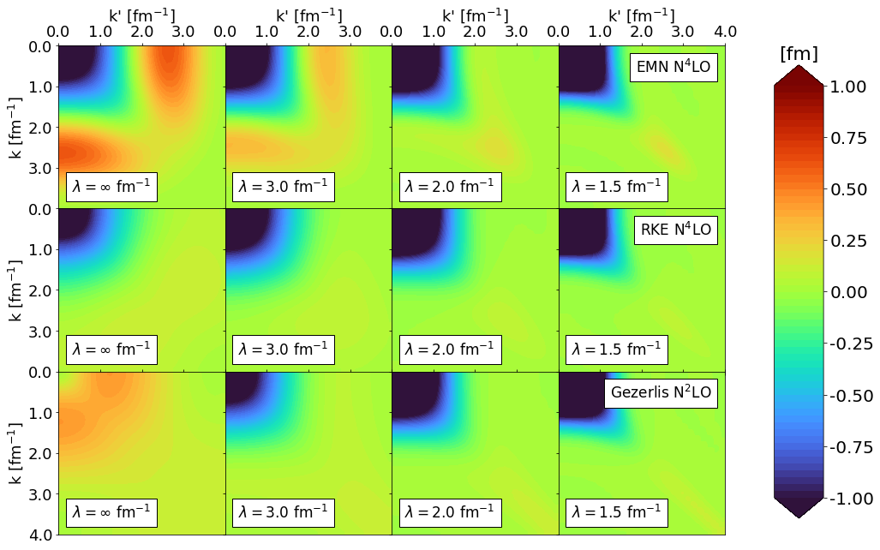
Universality of potentials
¹D.R. Entem and R. Machleidt, Phys. Rev. C 68, 041001 (2003)
²P. Reinert, H. Krebs, and E. Epelbaum, Eur. Phys. J. A 54, 86 (2018)
³A. Gezerlis, et al., Phys. Rev. C 90, 054323 (2014)
Variety of NN interactions - at low-resolution they are the same thing
Cite papers
Define \lambda
Explanation of universality: phase equivalence

Slide 5
Universality of potentials
Variety of NN interactions - at low-resolution they are the same thing
Cite papers
Define \lambda
Explanation of universality: phase equivalence

Slide 6
Universality of potentials
Variety of NN interactions - at low-resolution they are the same thing
Cite papers
Define \lambda
Explanation of universality: phase equivalence (maybe add 3S1 phase shifts on top)

Slide 7
SRG-evolved wave functions
Natural consequence: the low-energy states between drastically different potentials also exhibit universality
Figure: \psi(r) with EMN N4LO, RKE N4LO, Gez. N2LO, AV18 (need to generate this still)
SRC physics in AV18 is gone
All deuteron wave functions become soft and D-state probability goes down
Observables such as asymptotic D/S ratio the same

Slide 8
SRG-evolved wave functions
Natural consequence: the low-energy states between drastically different potentials also exhibit universality
Figure: \psi(r) with EMN N4LO, RKE N4LO, Gez. N2LO, AV18 (need to generate this still)
SRC physics in AV18 is gone
All deuteron wave functions become soft and D-state probability goes down
Observables such as asymptotic D/S ratio the same

Slide 9
SRG-evolved wave functions
Natural consequence: the low-energy states between drastically different potentials also exhibit universality
Figure: \psi(r) with EMN N4LO, RKE N4LO, Gez. N2LO, AV18 (need to generate this still)
SRC physics in AV18 is gone
All deuteron wave functions become soft and D-state probability goes down
Observables such as asymptotic D/S ratio the same

Slide 10
Connection to experiments
In analyzing scattering observables, there is scale and scheme dependence in factorization of structure and reaction
Factorization scale \mu_F and scheme
Can tune the scale with SRG transformations making a potential with SRC physics like AV18 much softer like a high-order chiral potential
Can use low-energy structure to calculate high-energy reactions by consistently evolving the reactions part
Mismatch of scales leads to incorrect observable

Slide 11
Where does the short-distance physics go?
Use ataq as an example, depending on time can provide further detail (just do band-diagonal decoupling)
Induced low-momentum contributions reflecting UV physics of the NN potential
Unitary transformations, with the evolved wave function, these changes are consistent

Slide 12



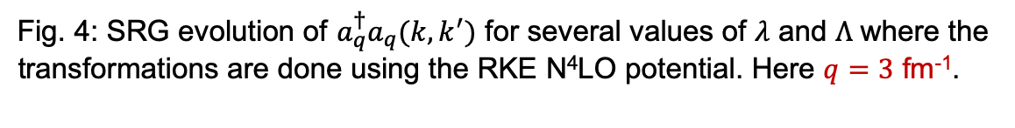
Momentum projection operator
RKE N⁴LO $Λ=450$ MeV
We use the momentum projection operator $a_{q}^{†}a_{q}$as a test case
$$a_{q}^{†}a_{q}ψ\left(k\right)=ψ(q)$$
Initially starts out as a $δ$-function
SRG transformations induce low-momentum contributions
Strength of wave function shifted to low-momentum
$\left\langle ψ(0) | O(0) | ψ(0)\right\rangle =$ $\left\langle ψ(s) | O(s) | ψ(s)\right\rangle$
$⟹$ Transformations on the operator must induce low-momentum contributions!
Fig. 4: SRG evolution of $a_{q}^{†}a_{q}(k,k^{′})$ for several values of $λ$ and $Λ$ where the transformations are done using the RKE N⁴LO potential. Here $q=3$ fm⁻¹.

Slide 13
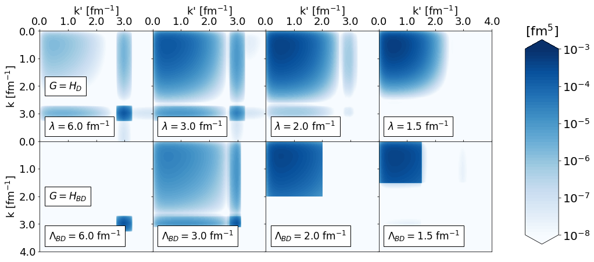
Expectation value under SRG
Walk through how the <\psi_d|ataq|\psi> changes connecting back to point that we can utilize high-order chiral potentials
Maybe do just band-diagonal decoupling

Slide 14
Ratios of different potentials
Reflects difference in UV physics, maybe show ataq(k,k) ratios
Transition into ratios of A/d ~ low-energy structure components

Slide 15
Summary
Universality in drastically different chiral potentials
Universality shows in low-energy states as well
Uncorrelated wave functions, consistently evolved operators with SRG induced terms from UV
Essentially decouples calculation from high-energy for low-energy states

Slide 16
Outlook
Universality in drastically different chiral potentials
Universality shows in low-energy states as well
Uncorrelated wave functions, consistently evolved operators with SRG induced terms from UV
Essentially decouples calculation from high-energy for low-energy states

