Slide 1




Short-range correlation physics from operator evolution
Anthony Tropiano¹, Dick Furnstahl¹, Scott Bogner²
¹Ohio State University, ²Michigan State University
APS DNP Meeting – Virtual Meeting
October 30, 2020
ajt, S.K. Bogner, and R.J. Furnstahl, arXiv:2006.11186
Phys. Rev. C 102, 034005 (2020)

Slide 2
Motivation
knock-out 2 high-k nucleons
Recent experiments have been able to isolate processes where short-range correlation (SRC) physics is dominant and well described by SRC phenomenology
High RG resolution description of SRC physics
SRC pairs are components in the nuclear wave function with relative momenta above the Fermi momentum
excite SRC pair
Notes:
Read first bullet (half)... such as in this diagram. One observes knock-out 2 high-k nucleons, with a one-body current, must mean SRC pair. Leads into third part.

Slide 3
Motivation
knock-out 2 high-k nucleons
Recent experiments have been able to isolate processes where short-range correlation (SRC) physics is dominant and well described by SRC phenomenology
High RG resolution description of SRC physics
SRC pairs are components in the nuclear wave function with relative momenta above the Fermi momentum
Alternative viewpoint
Using renormalization group (RG) methods we can tune the scale to low RG resolution
The SRC physics is shifted into the reaction operators from the nuclear wave function (which becomes soft)
excite SRC pair
same expt. resolution
low-k initial pair

Slide 4
Motivation
Experiments often rely on soft nuclear structure components (e.g., nuclear shell model) but mismatch scales by using high RG resolution reaction operators
One can use low RG resolution operators to consistently match scales in structure and reaction components

Slide 5
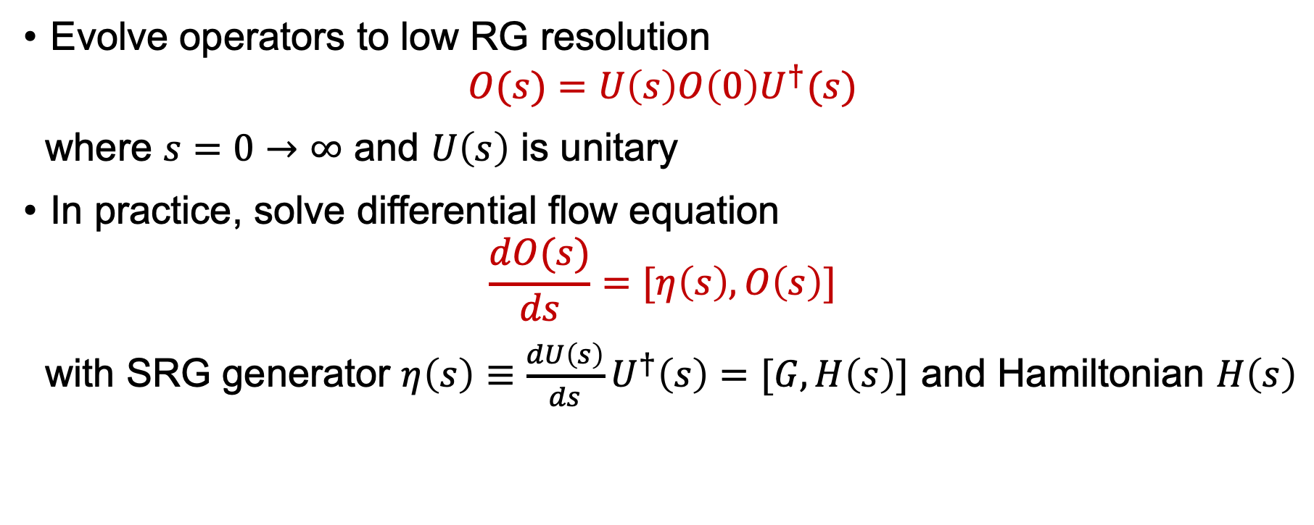
Similarity renormalization group (SRG)
Evolve operators to low RG resolution
$$O(s)=U\left(s\right)O\left(0\right)U^{†}(s)$$
where $s=0→∞$ and $U\left(s\right)$ is unitary
In practice, solve differential flow equation
$$\frac{dO(s)}{ds}=[η\left(s\right),O\left(s\right)]$$
with SRG generator $η\left(s\right)≡\frac{dU\left(s\right)}{ds}U^{†}\left(s\right)=[G,H\left(s\right)]$ and Hamiltonian $H\left(s\right)$

Slide 6
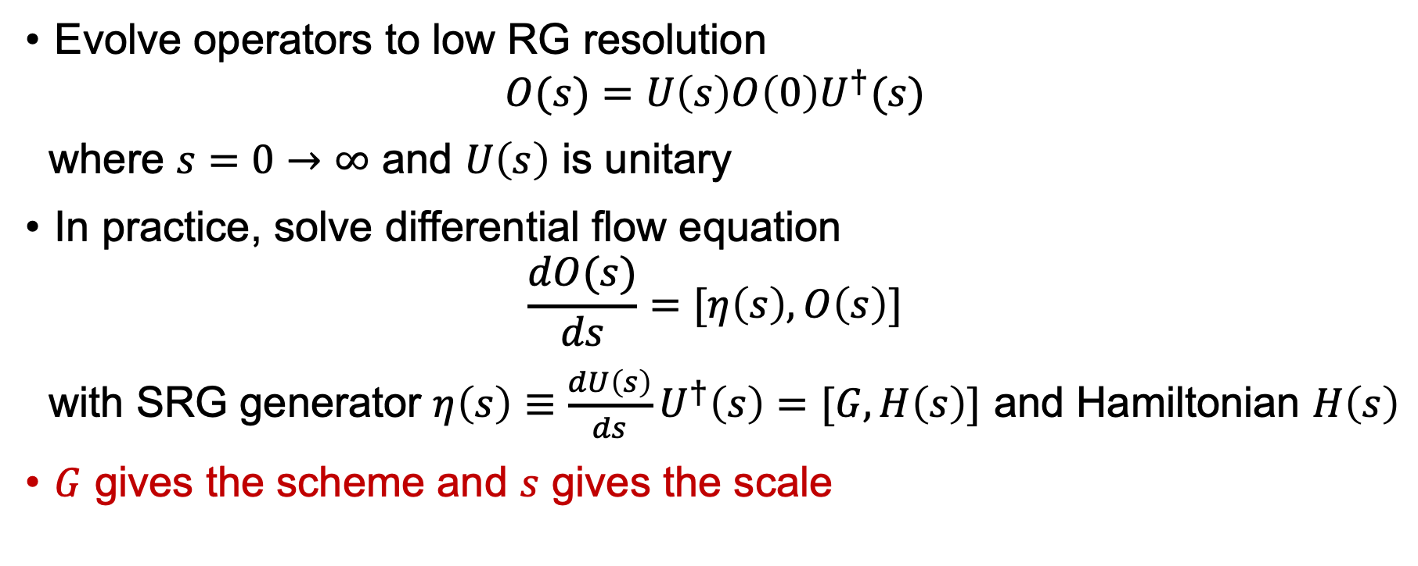
Similarity renormalization group (SRG)
Evolve operators to low RG resolution
$$O(s)=U\left(s\right)O\left(0\right)U^{†}(s)$$
where $s=0→∞$ and $U\left(s\right)$ is unitary
In practice, solve differential flow equation
$$\frac{dO(s)}{ds}=[η\left(s\right),O\left(s\right)]$$
with SRG generator $η\left(s\right)≡\frac{dU\left(s\right)}{ds}U^{†}\left(s\right)=[G,H\left(s\right)]$ and Hamiltonian $H\left(s\right)$
$G$ gives the scheme and $s$ gives the scale

Slide 7
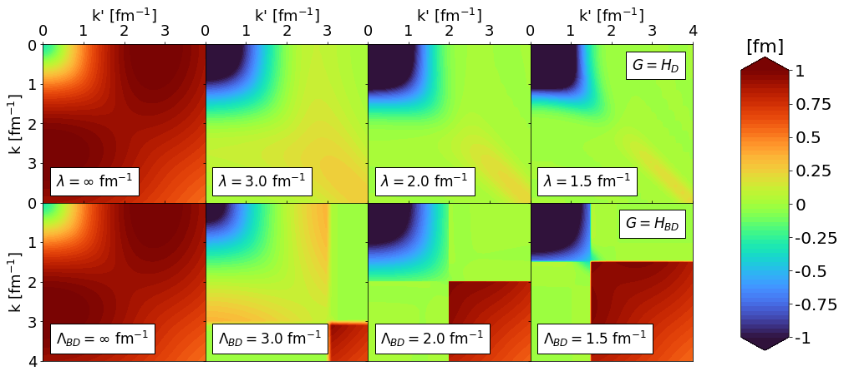

AV18 at low RG resolution
Scale
AV18 in ³S₁- ³S₁ channel
$G=H_{D}(s)$ for band-diagonal decoupling and $G=H_{BD}(s)$ for block-diagonal decoupling scheme
Scheme
Fig. 1: SRG evolution of $V(k,k^{′})$ for several values of $λ$ and $Λ$.
Notes:
Describe the figures, then explain what the SRG is doing. This will hit both bullet points.

Slide 8
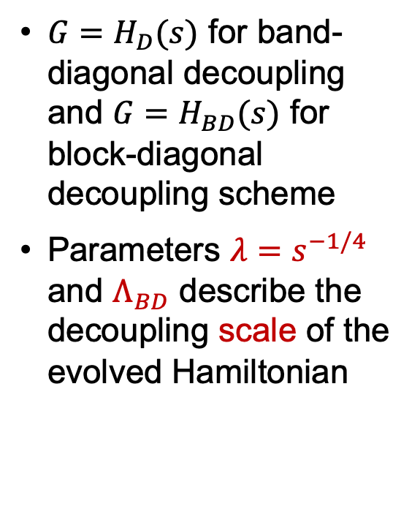
AV18 at low RG resolution
AV18 in ³S₁- ³S₁ channel
$G=H_{D}(s)$ for band-diagonal decoupling and $G=H_{BD}(s)$ for block-diagonal decoupling scheme
Parameters $λ=s^{−1/4}$ and $Λ_{BD}$ describe the decoupling scale of the evolved Hamiltonian
Fig. 1: SRG evolution of $V(k,k^{′})$ for several values of $λ$ and $Λ$.

Slide 9
Deuteron wave function at low RG resolution
AV18 wave function has significant SRC
What happens to the wave function at low RG resolution?
SRC in AV18
S-state
D-state
Fig. 2: SRG evolution of deuteron wave function in coordinate space for AV18 and Gezerlis N2LO¹.
¹A. Gezerlis, et al., Phys. Rev. C 90, 054323 (2014)

Slide 10
Deuteron wave function at low RG resolution
SRC physics in AV18 (scheme dependent) is gone from wave function at low RG resolution
Deuteron wave functions become soft and D-state probability goes down
Observables such as asymptotic D-S ratio are the same
SRC in AV18
No SRC
S-state
S-state
D-state
D-state
Fig. 2: SRG evolution of deuteron wave function in coordinate space for AV18 and Gezerlis N2LO¹.
¹A. Gezerlis et al., Phys. Rev. C 90, 054323 (2014)
Notes:
Where does the SRC physics go? Use this as transition into next slide.

Slide 11

Connection to experiments
In analyzing scattering observables, there is scale and scheme dependence in factorization of structure and reaction
General problem for any matrix element $\left\langle ψ_{f} | O | ψ_{i}\right\rangle$
Notes:
SRC physics from wave function goes to the operator. Use this as transition.

Slide 12
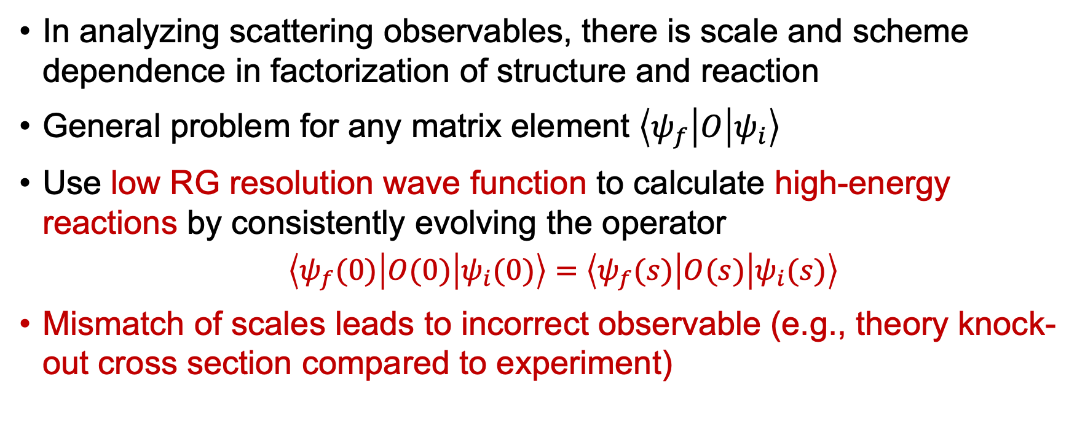
Connection to experiments
In analyzing scattering observables, there is scale and scheme dependence in factorization of structure and reaction
General problem for any matrix element $\left\langle ψ_{f} | O | ψ_{i}\right\rangle$
Use low RG resolution wave function to calculate high-energy reactions by consistently evolving the operator
$\left\langle ψ_{f}(0) | O(0) | ψ_{i}(0)\right\rangle =$ $\left\langle ψ_{f}(s) | O(s) | ψ_{i}(s)\right\rangle$
Mismatch of scales leads to incorrect observable (e.g., theory knock-out cross section compared to experiment)

Slide 13
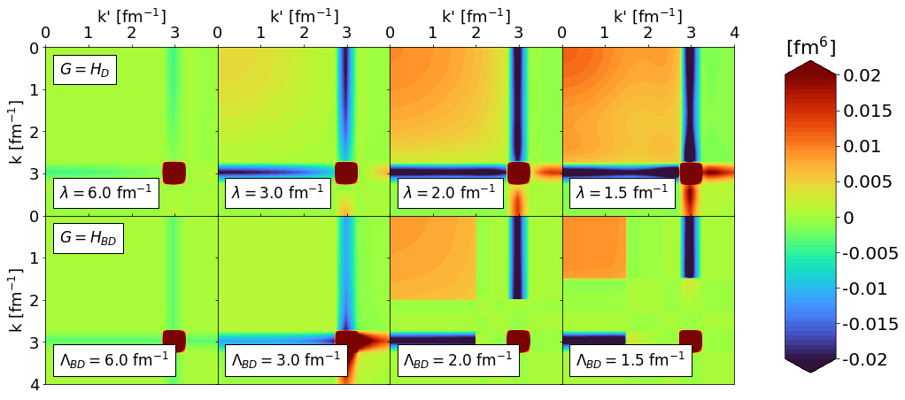
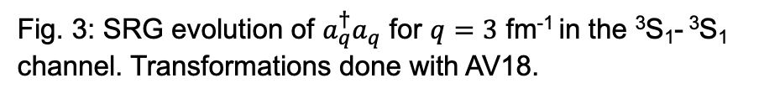

Deuteron momentum distribution
Use simple operator $a_{q}^{†}a_{q}$ which projects onto relative momentum $q$
$$a_{q}^{†}a_{q}\sim δ(k−q)δ(k^{′}−q)$$
Scale
Scheme
Fig. 3: SRG evolution of $a_{q}^{†}a_{q}$ for $q=3$ fm⁻¹ in the ³S₁- ³S₁ channel. Transformations done with AV18.

Slide 14
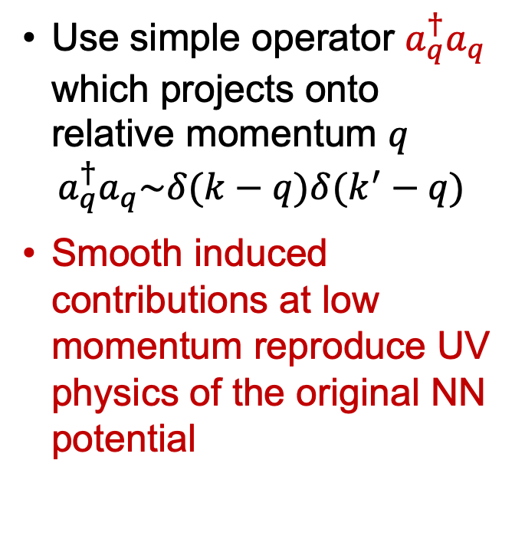
Deuteron momentum distribution
Use simple operator $a_{q}^{†}a_{q}$ which projects onto relative momentum $q$
$$a_{q}^{†}a_{q}\sim δ(k−q)δ(k^{′}−q)$$
Smooth induced contributions at low momentum reproduce UV physics of the original NN potential
Fig. 3: SRG evolution of $a_{q}^{†}a_{q}$ for $q=3$ fm⁻¹ in the ³S₁- ³S₁ channel. Transformations done with AV18.

Slide 15


Deuteron momentum distribution
Consistently evolve the wave functions!
Strength of wave function shifted to low-k $⟹$ transformations on the operator must induce low-momentum contributions!
$\left\langle ψ(0) | O(0) | ψ(0)\right\rangle =$ $\left\langle ψ(s) | O(s) | ψ(s)\right\rangle$
SRG evolution of hard potential does NOT make the reaction operator hard
Fig. 4: SRG evolution of $ψ_{d}^{2}(k)$.
Fig. 3: SRG evolution of $a_{q}^{†}a_{q}$ for $q=3$ fm⁻¹ in the ³S₁- ³S₁ channel. Transformations done with AV18.

Slide 16
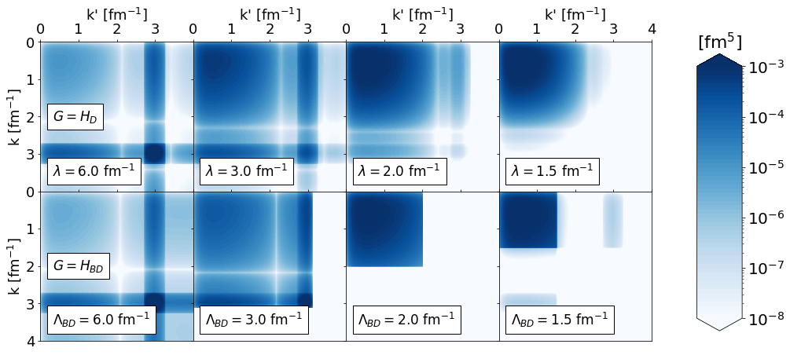
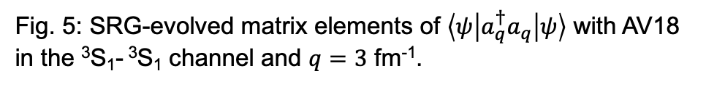
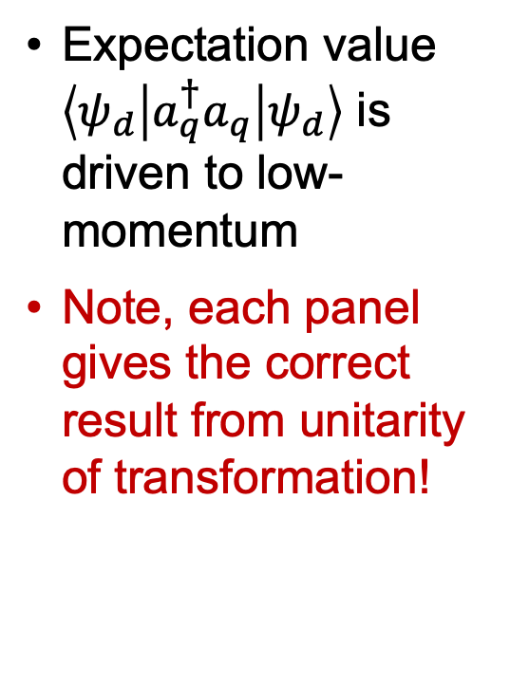
Deuteron momentum distribution
Expectation value $\left\langle ψ_{d} | a_{q}^{†}a_{q} | ψ_{d}\right\rangle$ is driven to low-momentum
Note, each panel gives the correct result from unitarity of transformation!
Scale
Scheme
Fig. 5: SRG-evolved matrix elements of $\left\langle ψ | a_{q}^{†}a_{q} | ψ\right\rangle$ with AV18 in the ³S₁- ³S₁ channel and $q=3$ fm⁻¹.

Slide 17
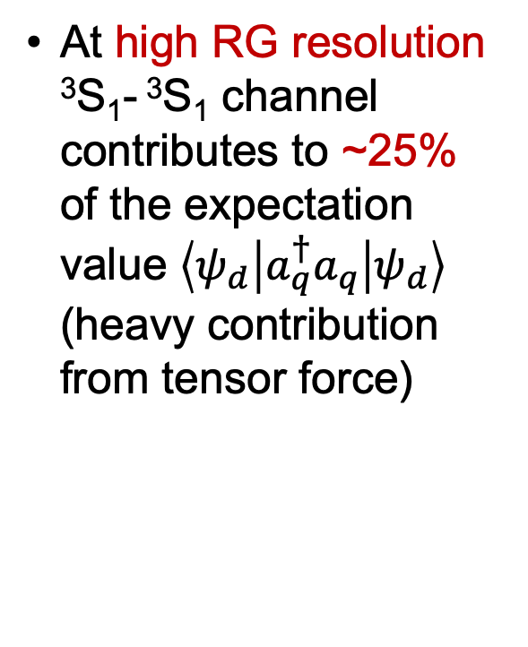
Deuteron momentum distribution
At high RG resolution ³S₁- ³S₁ channel contributes to ~25% of the expectation value $\left\langle ψ_{d} | a_{q}^{†}a_{q} | ψ_{d}\right\rangle$ (heavy contribution from tensor force)
Fig. 5: SRG-evolved matrix elements of $\left\langle ψ | a_{q}^{†}a_{q} | ψ\right\rangle$ with AV18 in the ³S₁- ³S₁ channel and $q=3$ fm⁻¹.

Slide 18
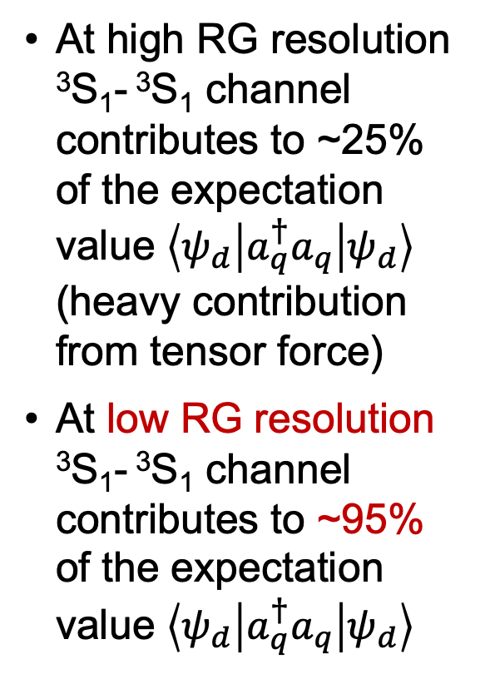
Deuteron momentum distribution
At high RG resolution ³S₁- ³S₁ channel contributes to ~25% of the expectation value $\left\langle ψ_{d} | a_{q}^{†}a_{q} | ψ_{d}\right\rangle$ (heavy contribution from tensor force)
At low RG resolution ³S₁- ³S₁ channel contributes to ~95% of the expectation value $\left\langle ψ_{d} | a_{q}^{†}a_{q} | ψ_{d}\right\rangle$
Fig. 5: SRG-evolved matrix elements of $\left\langle ψ | a_{q}^{†}a_{q} | ψ\right\rangle$ with AV18 in the ³S₁- ³S₁ channel and $q=3$ fm⁻¹.
Notes:
Transition to next slide: so what happens in interpreting experimental results which are typically explained with the heavy contribution from the tensor force?

Slide 19
NN pair ratios
np includes ¹S₀ and ³S₁-³D₁
Scalar limit
At high RG resolution, the tensor force and the repulsive core of the NN interaction kicks nucleon pairs into SRCs
Seen in the ratio of pairs produced where np dominates because the tensor force requires spin triplet pairs (pp are spin singlets)
Node in ¹S₀
Fig. 6: (a) Ratio of two-nucleon to single-nucleon electron-scattering cross sections for carbon as a function of missing momentum. (b) Fraction of np to p and pp to p pairs versus the relative momentum. Figure from CLAS collaboration publication¹.
¹I. Korover et al. (CLAS), arXiv:2004.07304 (2014)
Notes:
Transition to next slide: so what happens in interpreting experimental results? Explain figures. np/p cross section compared to pp/p for electron-carbon scattering. At high RG resolution, tensor force of NN interaction is used to explain dominance of np over pp pairs, because the tensor force requires spin triplet pairs and proton-proton are always spin singlets. But in low RG resolution, tensor force is suppressed. So the SRC physics must be moved to the operator! Leads into “consider the ratio 3S1 over 1S0 momentum projection operators.”

Slide 20
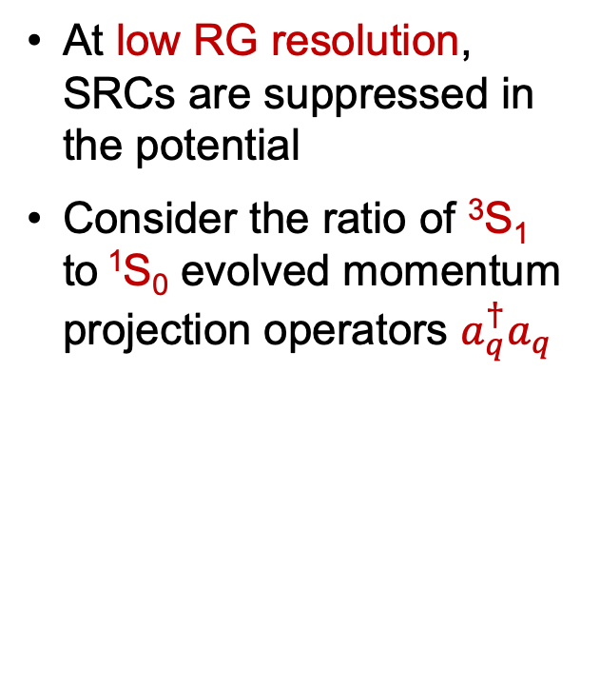

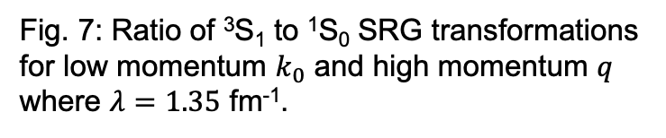
NN pair ratios
np includes ¹S₀ and ³S₁-³D₁
Scalar limit
At low RG resolution, SRCs are suppressed in the potential
Consider the ratio of ³S₁ to ¹S₀ evolved momentum projection operators $a_{q}^{†}a_{q}$
$$\frac{ {{a_{q}^{†}a_{q}(}^{3}S_{1})}_{λ}}{{{a_{q}^{†}a_{q}(}^{1}S_{0})}_{λ}}$$
Node in ¹S₀
Fig. 7: Ratio of ³S₁ to ¹S₀ SRG transformations for low momentum $k_{0}$ and high momentum $q$ where $λ=1.35$ fm⁻¹.
Notes:
Transition to next slide: so what happens in interpreting experimental results? Explain figures. np/p cross section compared to pp/p for electron-carbon scattering. At high RG resolution, tensor force of NN interaction is used to explain dominance of np over pp pairs, because the tensor force requires spin triplet pairs and proton-proton are always spin singlets. But in low RG resolution, tensor force is suppressed. So the SRC physics must be moved to the operator! Leads into “consider the ratio 3S1 over 1S0 momentum projection operators.”

Slide 21
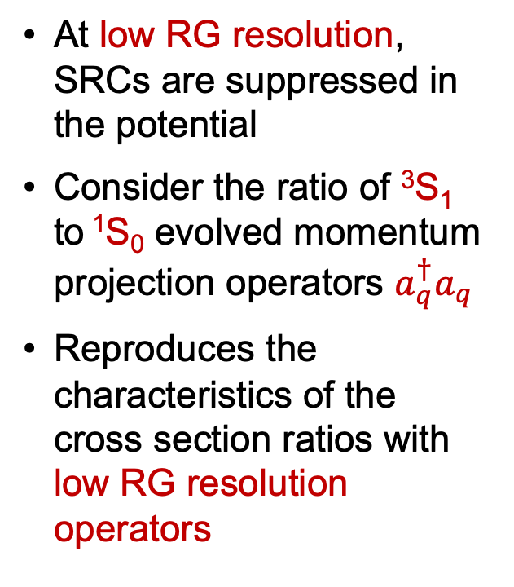
NN pair ratios
Node in ¹S₀
np includes ¹S₀ and ³S₁-³D₁
Scalar limit
At low RG resolution, SRCs are suppressed in the potential
Consider the ratio of ³S₁ to ¹S₀ evolved momentum projection operators $a_{q}^{†}a_{q}$
Reproduces the characteristics of the cross section ratios with low RG resolution operators
$$\frac{ {{a_{q}^{†}a_{q}(}^{3}S_{1})}_{λ}}{{{a_{q}^{†}a_{q}(}^{1}S_{0})}_{λ}}$$
Scalar limit
Node in ¹S₀
Fig. 7: Ratio of ³S₁ to ¹S₀ SRG transformations for low momentum $k_{0}$ and high momentum $q$ where $λ=1.35$ fm⁻¹.

Slide 22
Summary and outlook
Results suggest that we can analyze high-energy nuclear reactions with low RG resolution structure (e.g., shell model) and evolved operator (and correct initial operator)
Matching resolution scale between structure and reactions is crucial!

Slide 23
Summary and outlook
Results suggest that we can analyze high-energy nuclear reactions with low RG resolution structure (e.g., shell model) and evolved operator (and correct initial operator)
Matching resolution scale between structure and reactions is crucial!
Ongoing work:
Calculate pair distributions in nuclei (N=Z, N>Z) using local density approximation
Relate to quenching in knock-out reactions by applying to different processes with factorization

Slide 24
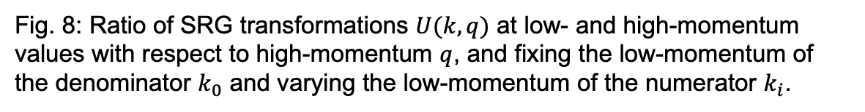
Back up slides
Add factorization figure
Fig. 8: Ratio of SRG transformations $U(k,q)$ at low- and high-momentum values with respect to high-momentum $q$, and fixing the low-momentum of the denominator $k_{0}$ and varying the low-momentum of the numerator $k_{i}$.

