Slide 1




Analyzing scale and scheme dependence in NN operators with the SRG
Anthony Tropiano¹, Dick Furnstahl¹, Scott Bogner²
¹Ohio State University, ²Michigan State University
NUCLEI Annual Meeting
June 9, 2020

Slide 2
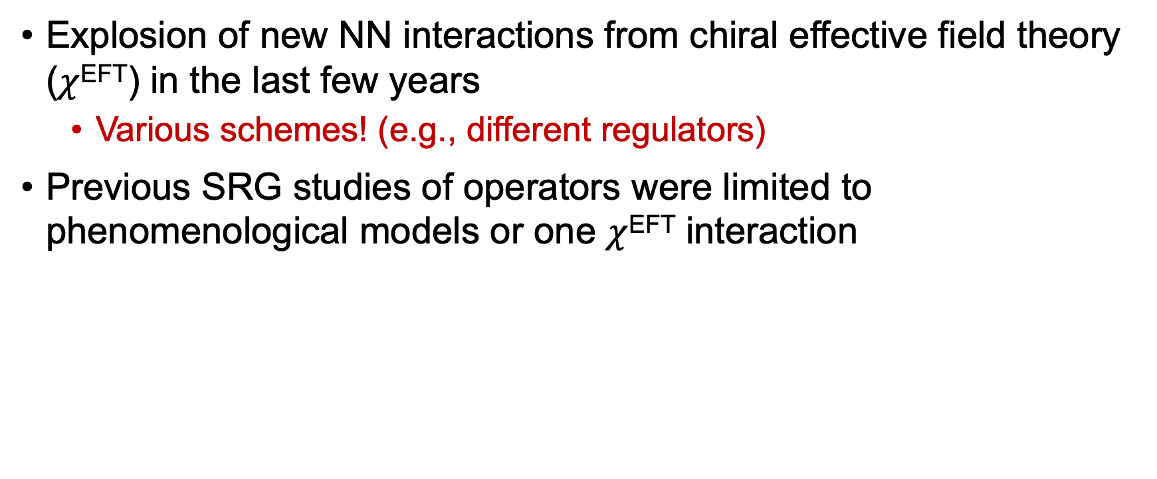
Motivation
Explosion of new NN interactions from chiral effective field theory ($χ$^{EFT}) in the last few years
Various schemes! (e.g., different regulators)
Previous SRG studies of operators were limited to phenomenological models or one $χ$^{EFT} interaction

Slide 3
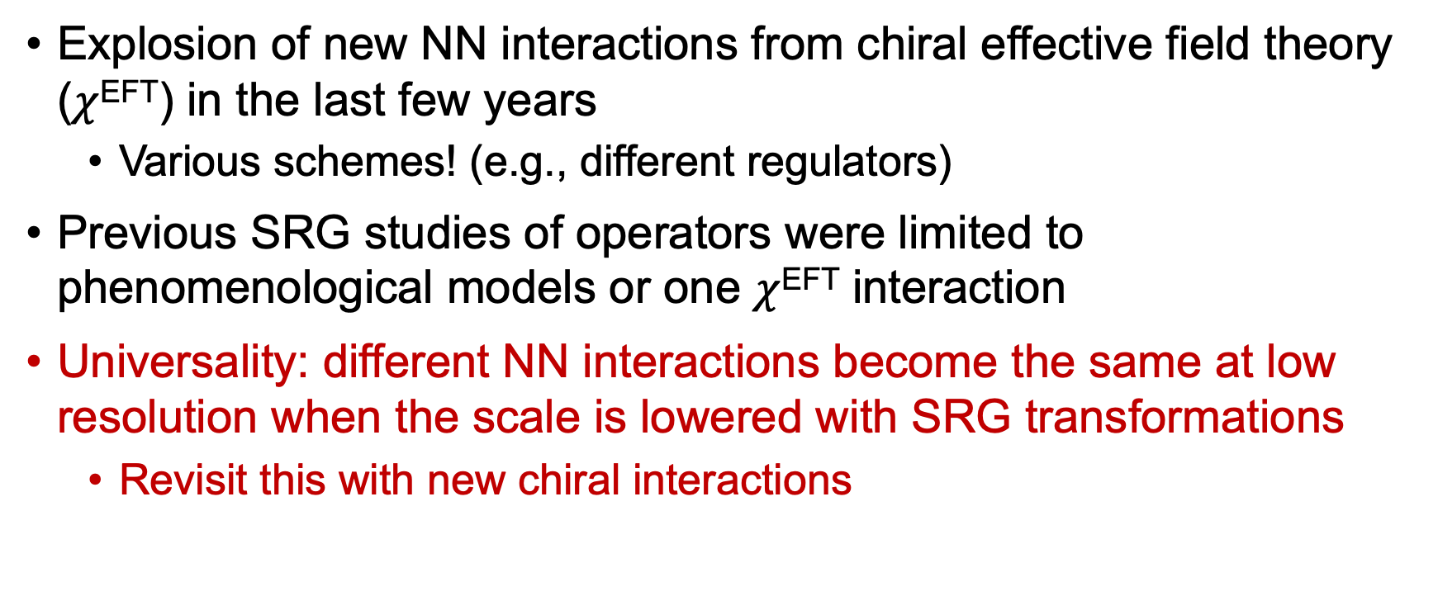
Motivation
Explosion of new NN interactions from chiral effective field theory ($χ$^{EFT}) in the last few years
Various schemes! (e.g., different regulators)
Previous SRG studies of operators were limited to phenomenological models or one $χ$^{EFT} interaction
Universality: different NN interactions become the same at low resolution when the scale is lowered with SRG transformations
Revisit this with new chiral interactions

Slide 4
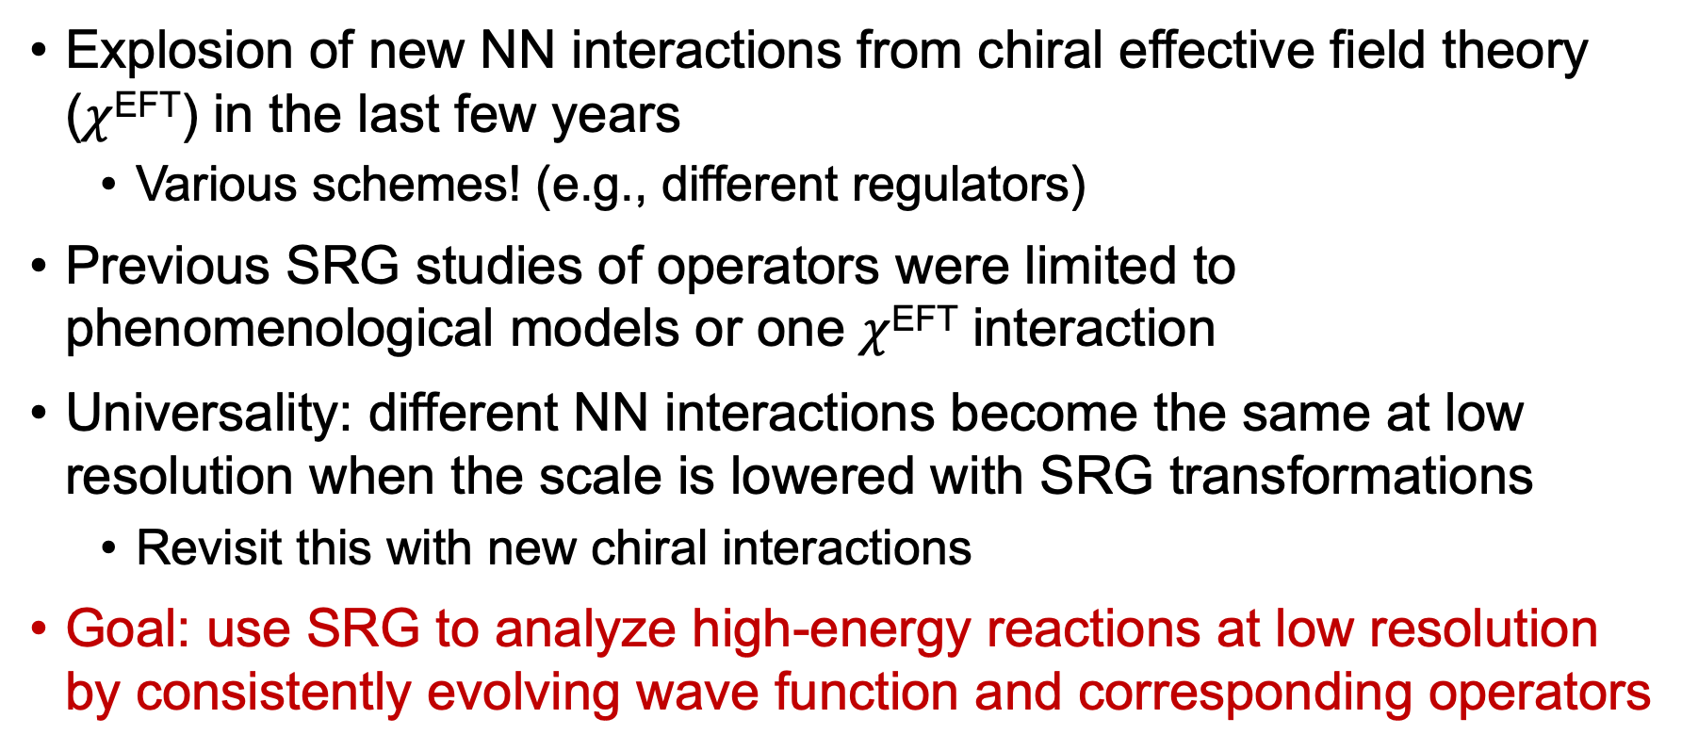
Motivation
Explosion of new NN interactions from chiral effective field theory ($χ$^{EFT}) in the last few years
Various schemes! (e.g., different regulators)
Previous SRG studies of operators were limited to phenomenological models or one $χ$^{EFT} interaction
Universality: different NN interactions become the same at low resolution when the scale is lowered with SRG transformations
Revisit this with new chiral interactions
Goal: use SRG to analyze high-energy reactions at low resolution by consistently evolving wave function and corresponding operators

Slide 5
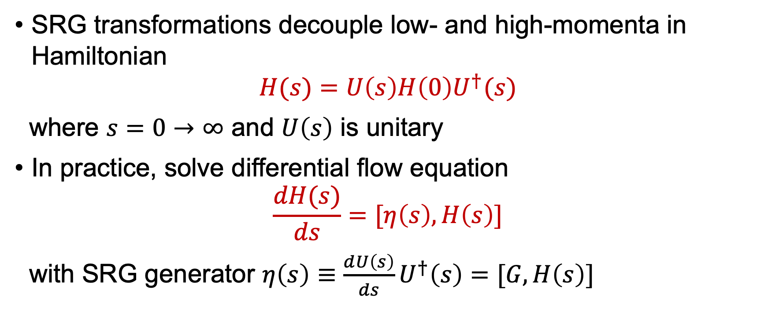
SRG formalism
SRG transformations decouple low- and high-momenta in Hamiltonian
$$H(s)=U\left(s\right)H\left(0\right)U^{†}(s)$$
where $s=0→∞$ and $U\left(s\right)$ is unitary
In practice, solve differential flow equation
$$\frac{dH(s)}{ds}=[η\left(s\right),H\left(s\right)]$$
with SRG generator $η\left(s\right)≡\frac{dU\left(s\right)}{ds}U^{†}\left(s\right)=[G,H\left(s\right)]$

Slide 6
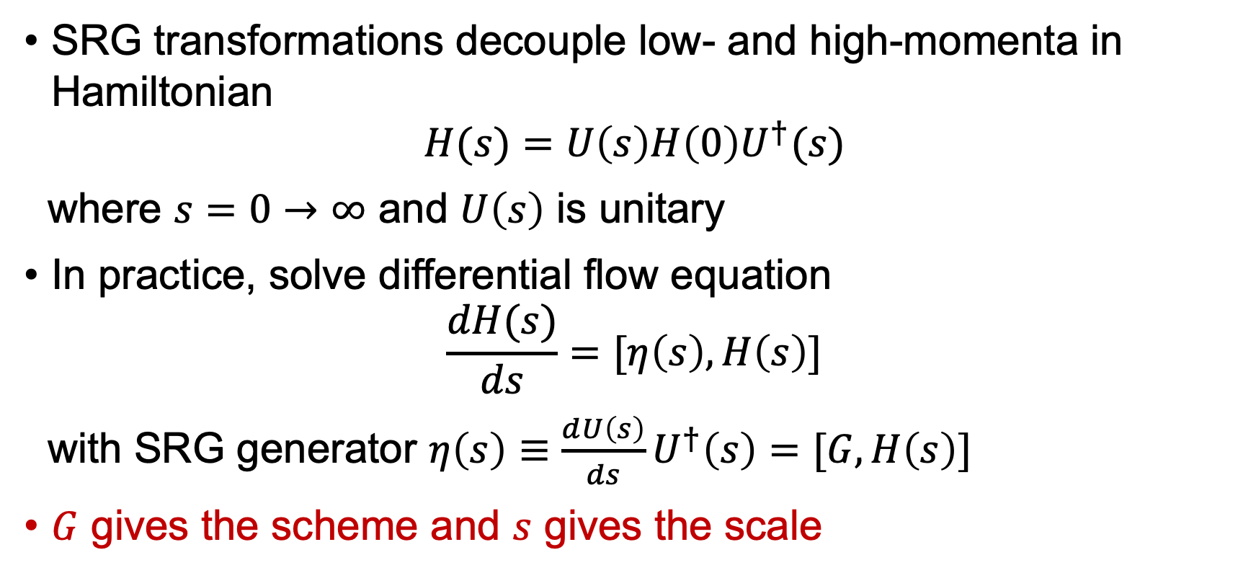
SRG formalism
SRG transformations decouple low- and high-momenta in Hamiltonian
$$H(s)=U\left(s\right)H\left(0\right)U^{†}(s)$$
where $s=0→∞$ and $U\left(s\right)$ is unitary
In practice, solve differential flow equation
$$\frac{dH(s)}{ds}=[η\left(s\right),H\left(s\right)]$$
with SRG generator $η\left(s\right)≡\frac{dU\left(s\right)}{ds}U^{†}\left(s\right)=[G,H\left(s\right)]$
$G$ gives the scheme and $s$ gives the scale

Slide 7
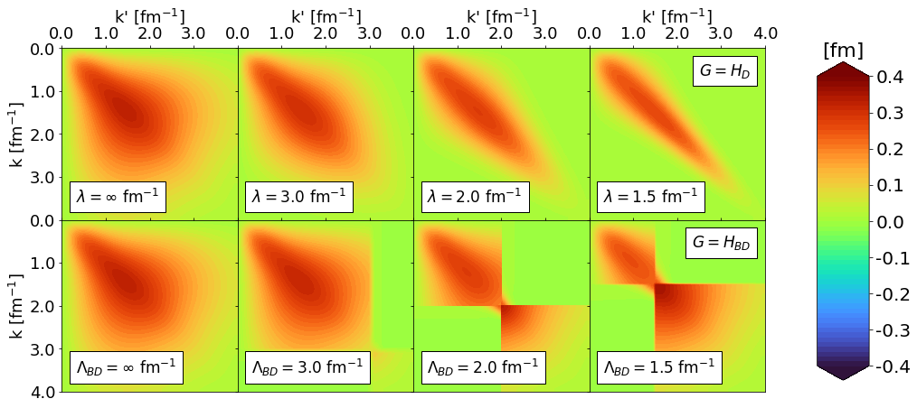


SRG formalism
RKE N⁴LO $Λ=450$ MeV
$G=H_{D}(s)$ for band-diagonal decoupling and $G=H_{BD}(s)$ for block-diagonal decoupling scheme
Fig. 1: SRG evolution of $V_{λ}(k,k^{′})$ for several values of $λ$ and $Λ$ in the ¹P₁ channel. Potentials from P. Reinert et al., Eur. Phys. J. A 54, 86 (2018) which will be referred to as the RKE potentials.

Slide 8
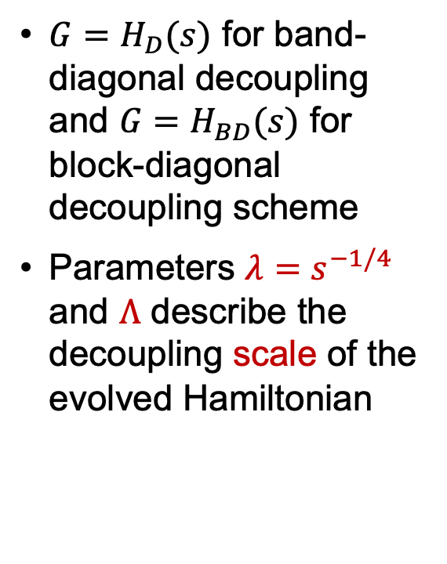
SRG formalism
RKE N⁴LO $Λ=450$ MeV
$G=H_{D}(s)$ for band-diagonal decoupling and $G=H_{BD}(s)$ for block-diagonal decoupling scheme
Parameters $λ=s^{−1/4}$ and $Λ$ describe the decoupling scale of the evolved Hamiltonian
Fig. 1: SRG evolution of $V_{λ}(k,k^{′})$ for several values of $λ$ and $Λ$ in the ¹P₁ channel. Potentials from P. Reinert et al., Eur. Phys. J. A 54, 86 (2018) which will be referred to as the RKE potentials.

Slide 9
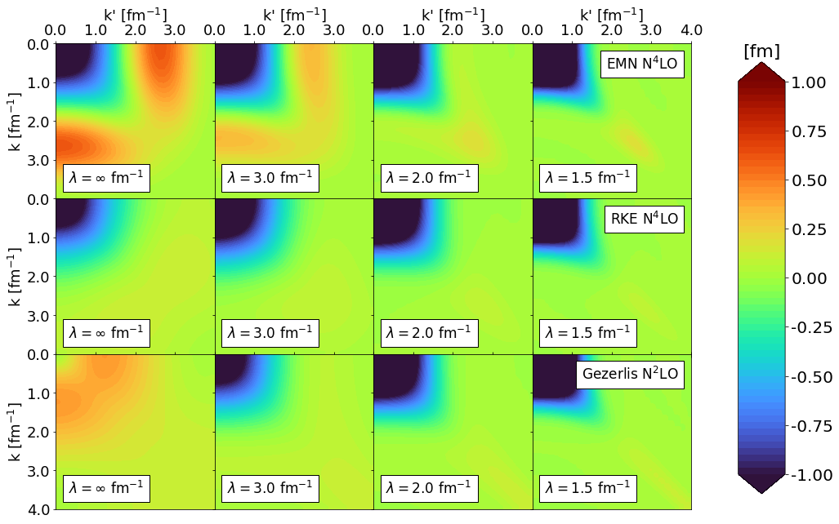
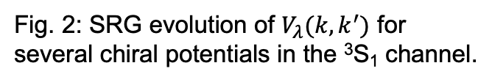
SRG evolution of modern chiral potentials
Variety of NN interactions with different schemes: non-local EMN¹ (500 MeV), semi-local RKE² (450 MeV), and local Gezerlis et al.³ (1 fm) potentials as examples
¹D.R. Entem, R. Machleidt, and Y. Nosyk, Phys. Rev. C 96, 024004 (2017)
²P. Reinert, H. Krebs, and E. Epelbaum, Eur. Phys. J. A 54, 86 (2018)
³A. Gezerlis, et al., Phys. Rev. C 90, 054323 (2014)
Fig. 2: SRG evolution of $V_{λ}(k,k^{′})$ for several chiral potentials in the ³S₁ channel.

Slide 10
SRG evolution of modern chiral potentials
Change the scale to lower resolution
Different potentials are approximately the same at low resolution!
Fig. 2: SRG evolution of $V_{λ}(k,k^{′})$ for several chiral potentials in the ³S₁ channel.

Slide 11

Universality: NN potentials
Equivalent low-energy phase shifts $⟹$ equivalent low-momentum matrix elements $V_{λ}\left(k,k^{′}\right)$¹
¹B. Dainton et al., Phys. Rev. C 89, 014001 (2014)

Slide 12
Universality: Wave functions
What happens to the wave functions from different NN interactions?
Look at deuteron wave function in coordinate space as example
S-state
D-state
Fig. 3: SRG evolution of deuteron wave function in coordinate space for several interactions.

Slide 13
Universality: Wave functions
Natural consequence: the low-energy states between drastically different potentials also exhibit universality
S-state
S-state
D-state
D-state
Fig. 3: SRG evolution of deuteron wave function in coordinate space for several interactions.

Slide 14
Universality: Wave functions
SRC in AV18
No SRC
Natural consequence: the low-energy states between drastically different potentials also exhibit universality
SRC physics in AV18 (scheme dependent) is gone from wave function at low resolution
S-state
S-state
D-state
D-state
Fig. 3: SRG evolution of deuteron wave function in coordinate space for several interactions.

Slide 15
Universality: Wave functions
SRC in AV18
No SRC
Natural consequence: the low-energy states between drastically different potentials also exhibit universality
SRC physics in AV18 (scheme dependent) is gone from wave function at low resolution
All deuteron wave functions become soft and D-state probability goes down
Observables such as asymptotic D-S ratio the same
S-state
S-state
D-state
D-state
Fig. 3: SRG evolution of deuteron wave function in coordinate space for several interactions.

Slide 16

Connection to experiments
In analyzing scattering observables, there is scale and scheme dependence in factorization of structure and reaction
General problem for any matrix element $\left\langle ψ_{f} | O | ψ_{i}\right\rangle$

Slide 17
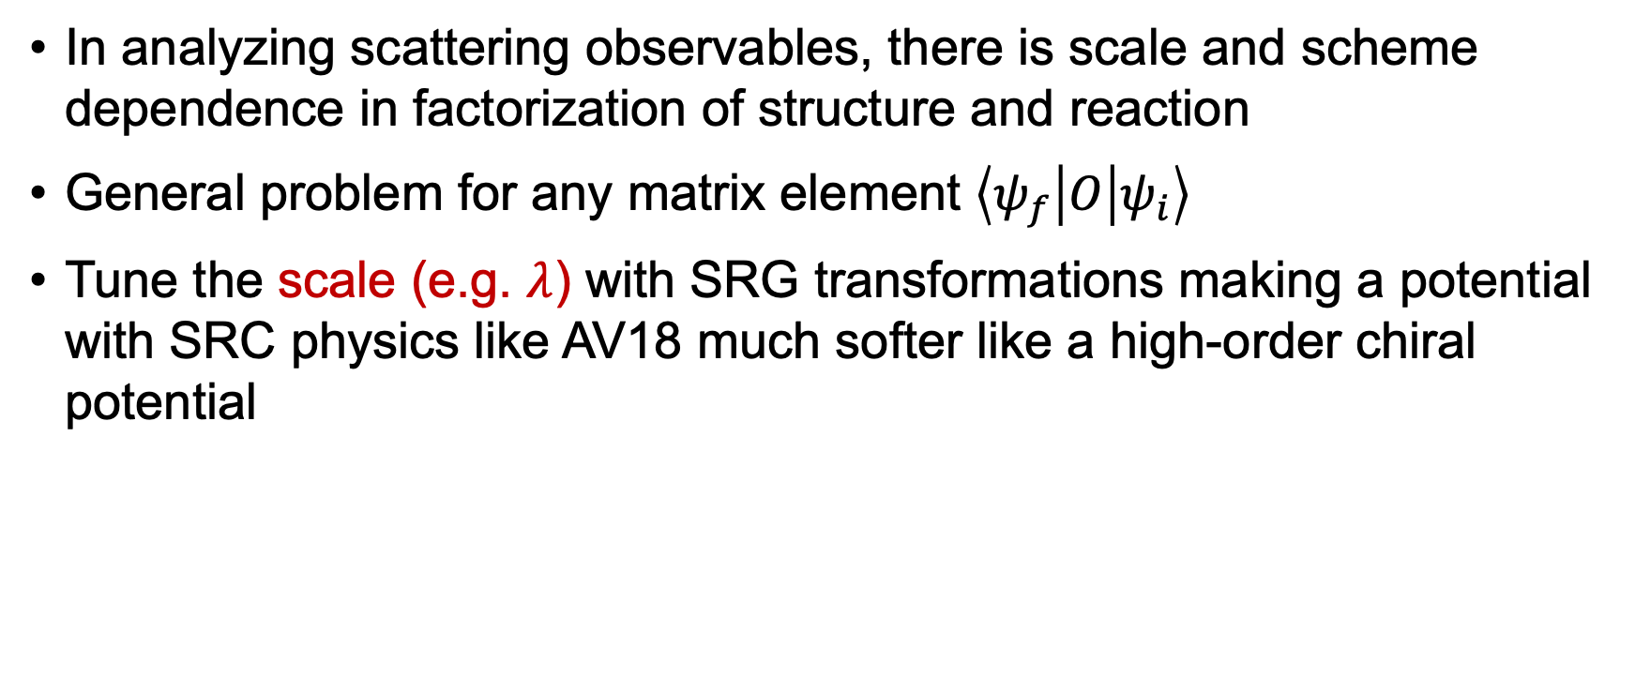
Connection to experiments
In analyzing scattering observables, there is scale and scheme dependence in factorization of structure and reaction
General problem for any matrix element $\left\langle ψ_{f} | O | ψ_{i}\right\rangle$
Tune the scale (e.g. $λ$) with SRG transformations making a potential with SRC physics like AV18 much softer like a high-order chiral potential

Slide 18
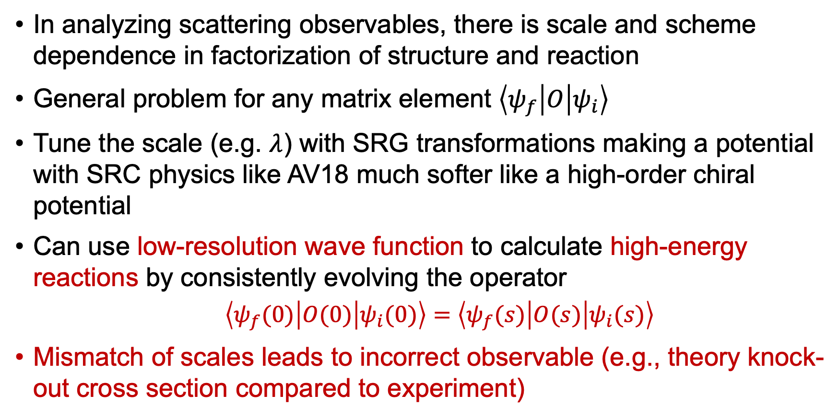
Connection to experiments
In analyzing scattering observables, there is scale and scheme dependence in factorization of structure and reaction
General problem for any matrix element $\left\langle ψ_{f} | O | ψ_{i}\right\rangle$
Tune the scale (e.g. $λ$) with SRG transformations making a potential with SRC physics like AV18 much softer like a high-order chiral potential
Can use low-resolution wave function to calculate high-energy reactions by consistently evolving the operator
$\left\langle ψ_{f}(0) | O(0) | ψ_{i}(0)\right\rangle =$ $\left\langle ψ_{f}(s) | O(s) | ψ_{i}(s)\right\rangle$
Mismatch of scales leads to incorrect observable (e.g., theory knock-out cross section compared to experiment)

Slide 19
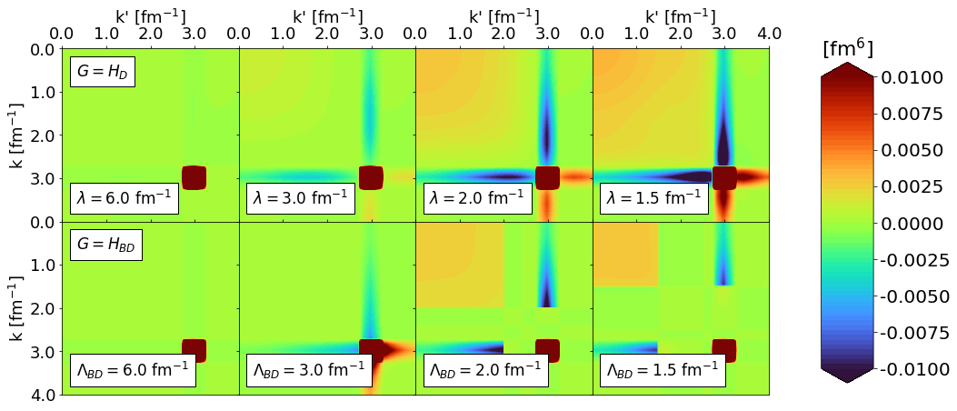

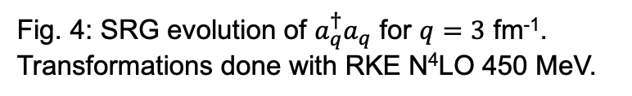
Where does the short-distance physics go?
Use simple operator $a_{q}^{†}a_{q}$ where $q$ is the relative momentum
$$a_{q}^{†}a_{q}\sim δ(k−q)δ(k^{′}−q)$$
Scale
Scheme
Fig. 4: SRG evolution of $a_{q}^{†}a_{q}$ for $q=3$ fm⁻¹. Transformations done with RKE N⁴LO 450 MeV.

Slide 20
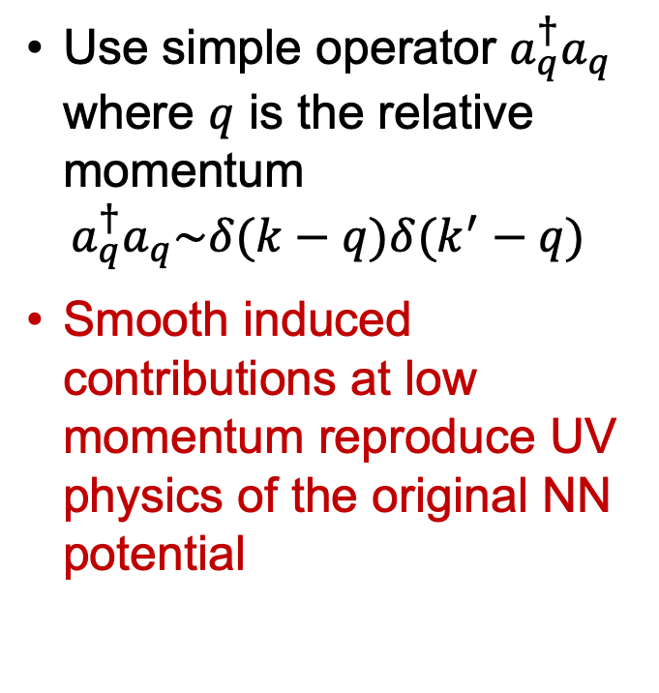
Where does the short-distance physics go?
Use simple operator $a_{q}^{†}a_{q}$ where $q$ is the relative momentum
$$a_{q}^{†}a_{q}\sim δ(k−q)δ(k^{′}−q)$$
Smooth induced contributions at low momentum reproduce UV physics of the original NN potential
Fig. 4: SRG evolution of $a_{q}^{†}a_{q}$ for $q=3$ fm⁻¹. Transformations done with RKE N⁴LO 450 MeV.

Slide 21


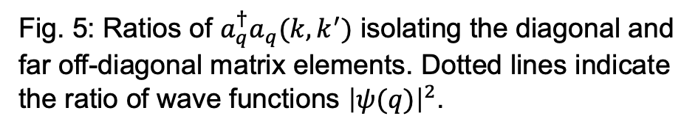
Scheme dependence in evolved $a_{q}^{†}a_{q}$
SRG induced terms in $a_{q}^{†}a_{q}$reflects difference in UV physics (scheme dependence from NN interaction)
Fig. 5: Ratios of $a_{q}^{†}a_{q}(k,k^{′})$ isolating the diagonal and far off-diagonal matrix elements. Dotted lines indicate the ratio of wave functions ${\left|ψ(q)\right|}^{2}$.

Slide 22
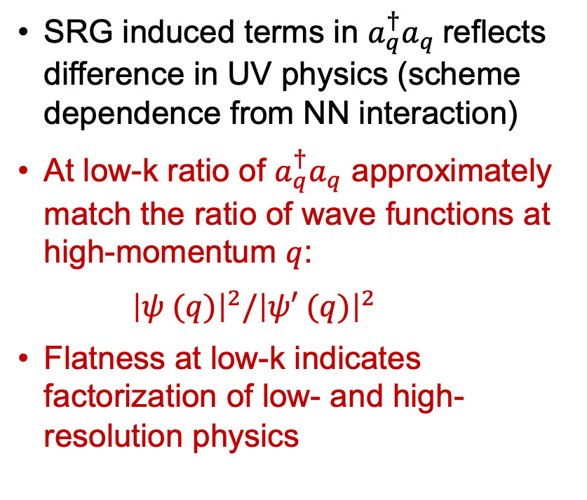
Scheme dependence in evolved $a_{q}^{†}a_{q}$
SRG induced terms in $a_{q}^{†}a_{q}$reflects difference in UV physics (scheme dependence from NN interaction)
At low-k ratio of $a_{q}^{†}a_{q}$ approximately match the ratio of wave functions at high-momentum $q$:
${\left|ψ (q)\right|}^{2}/{\left|ψ′ (q)\right|}^{2}$
Flatness at low-k indicates factorization of low- and high-resolution physics
Fig. 5: Ratios of $a_{q}^{†}a_{q}(k,k^{′})$ isolating the diagonal and far off-diagonal matrix elements. Dotted lines indicate the ratio of wave functions ${\left|ψ(q)\right|}^{2}$.

Slide 23


Where does the short-distance physics go?
Consistently evolve the wave functions!
Strength of wave function shifted to low-momentum
$\left\langle ψ(0) | O(0) | ψ(0)\right\rangle =$ $\left\langle ψ(s) | O(s) | ψ(s)\right\rangle$
$⟹$ Transformations on the operator must induce low-momentum contributions!
Fig. 6: SRG evolution of $ψ_{d}^{2}(k)$.
Fig. 4: SRG evolution of $a_{q}^{†}a_{q}$ for $q=3$ fm⁻¹. Transformations done with RKE N⁴LO 450 MeV.

Slide 24
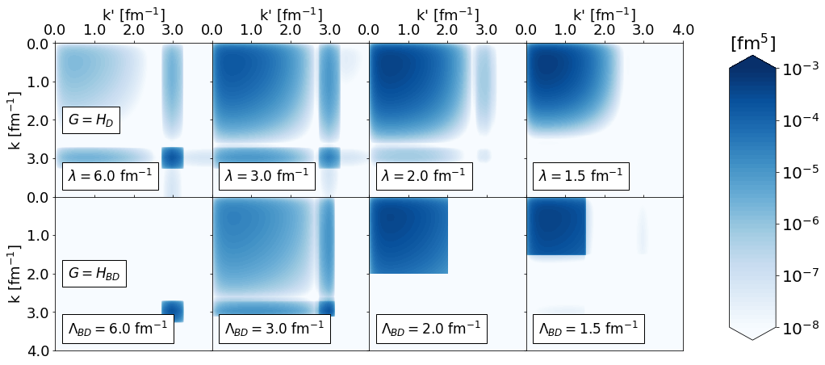
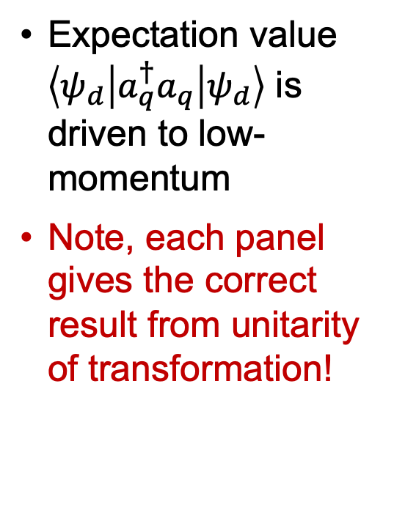
High-momentum operator at low resolution
Expectation value $\left\langle ψ_{d} | a_{q}^{†}a_{q} | ψ_{d}\right\rangle$ is driven to low-momentum
Note, each panel gives the correct result from unitarity of transformation!
Scale
Scheme
Fig. 7: SRG-evolved matrix elements of $\left\langle ψ | a_{q}^{†}a_{q} | ψ\right\rangle$ with RKE N⁴LO .

Slide 25
Summary and outlook
Universality holds in drastically different chiral potentials
At low resolution, different interactions are the same
Universality shows in low-energy states
Evolved (non-Hamiltonian) operators reflect scheme dependence from different potentials
Results suggest one can analyze high-energy nuclear reactions with low-resolution structure (e.g., shell model) if evolved operator used (and correct initial operator)

Slide 26
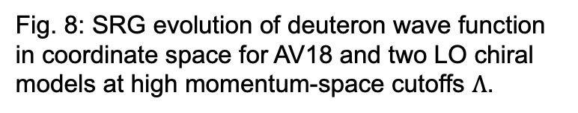
Back up slides
Fig. 8: SRG evolution of deuteron wave function in coordinate space for AV18 and two LO chiral models at high momentum-space cutoffs $Λ$.

Slide 27
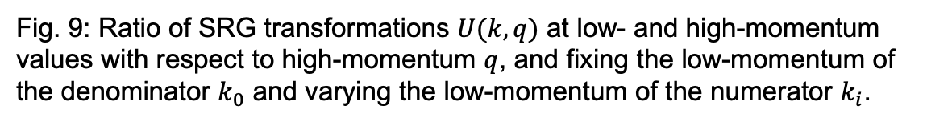
Back up slides
Add factorization figure
Fig. 9: Ratio of SRG transformations $U(k,q)$ at low- and high-momentum values with respect to high-momentum $q$, and fixing the low-momentum of the denominator $k_{0}$ and varying the low-momentum of the numerator $k_{i}$.

