Slide 1




Short-range correlation physics from operator evolution
Anthony Tropiano¹, Dick Furnstahl¹, Scott Bogner²
¹Ohio State University, ²Michigan State University
APS DNP Meeting – Virtual Meeting
October 30, 2020

Slide 2
Motivation
Bullet

Slide 3
Motivation
Bullet

Slide 4
Motivation
Bullet

Slide 5
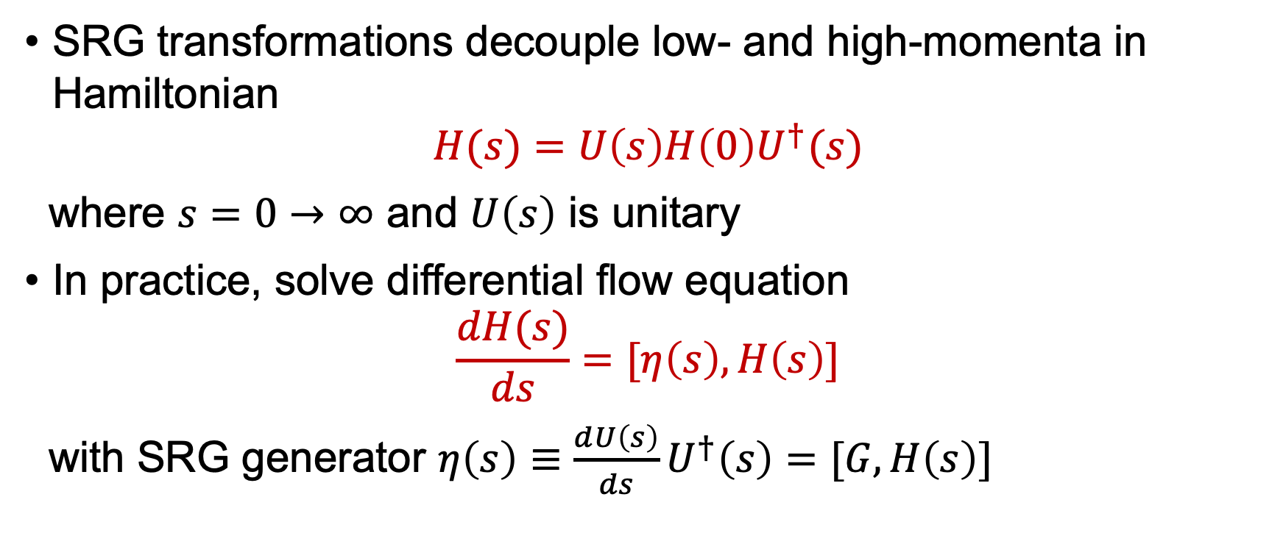
SRG formalism
SRG transformations decouple low- and high-momenta in Hamiltonian
$$H(s)=U\left(s\right)H\left(0\right)U^{†}(s)$$
where $s=0→∞$ and $U\left(s\right)$ is unitary
In practice, solve differential flow equation
$$\frac{dH(s)}{ds}=[η\left(s\right),H\left(s\right)]$$
with SRG generator $η\left(s\right)≡\frac{dU\left(s\right)}{ds}U^{†}\left(s\right)=[G,H\left(s\right)]$

Slide 6
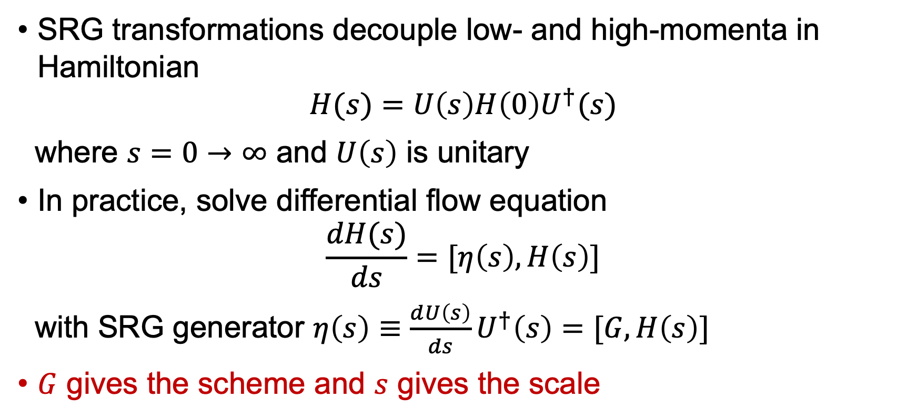
SRG formalism
SRG transformations decouple low- and high-momenta in Hamiltonian
$$H(s)=U\left(s\right)H\left(0\right)U^{†}(s)$$
where $s=0→∞$ and $U\left(s\right)$ is unitary
In practice, solve differential flow equation
$$\frac{dH(s)}{ds}=[η\left(s\right),H\left(s\right)]$$
with SRG generator $η\left(s\right)≡\frac{dU\left(s\right)}{ds}U^{†}\left(s\right)=[G,H\left(s\right)]$
$G$ gives the scheme and $s$ gives the scale

Slide 7
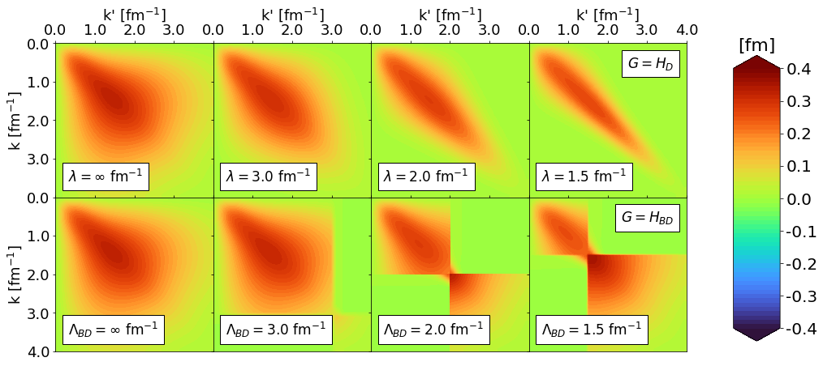


SRG formalism
RKE N⁴LO $Λ=450$ MeV
$G=H_{D}(s)$ for band-diagonal decoupling and $G=H_{BD}(s)$ for block-diagonal decoupling scheme
Fig. 1: SRG evolution of $V_{λ}(k,k^{′})$ for several values of $λ$ and $Λ$ in the ¹P₁ channel. Potentials from P. Reinert et al., Eur. Phys. J. A 54, 86 (2018) which will be referred to as the RKE potentials.

Slide 8
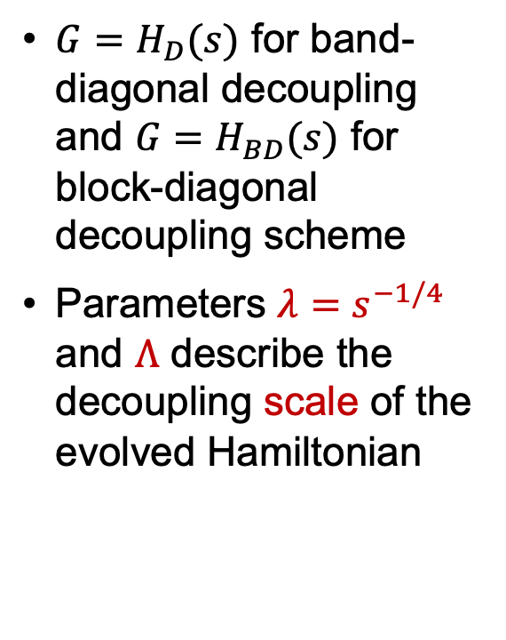
SRG formalism
RKE N⁴LO $Λ=450$ MeV
$G=H_{D}(s)$ for band-diagonal decoupling and $G=H_{BD}(s)$ for block-diagonal decoupling scheme
Parameters $λ=s^{−1/4}$ and $Λ$ describe the decoupling scale of the evolved Hamiltonian
Fig. 1: SRG evolution of $V_{λ}(k,k^{′})$ for several values of $λ$ and $Λ$ in the ¹P₁ channel. Potentials from P. Reinert et al., Eur. Phys. J. A 54, 86 (2018) which will be referred to as the RKE potentials.

Slide 9
Deuteron wave function
Bullet

Slide 10
Deuteron wave function
Bullet

Slide 11
Deuteron wave function
Bullet

Slide 12

Connection to experiments
In analyzing scattering observables, there is scale and scheme dependence in factorization of structure and reaction
General problem for any matrix element $\left\langle ψ_{f} | O | ψ_{i}\right\rangle$

Slide 13
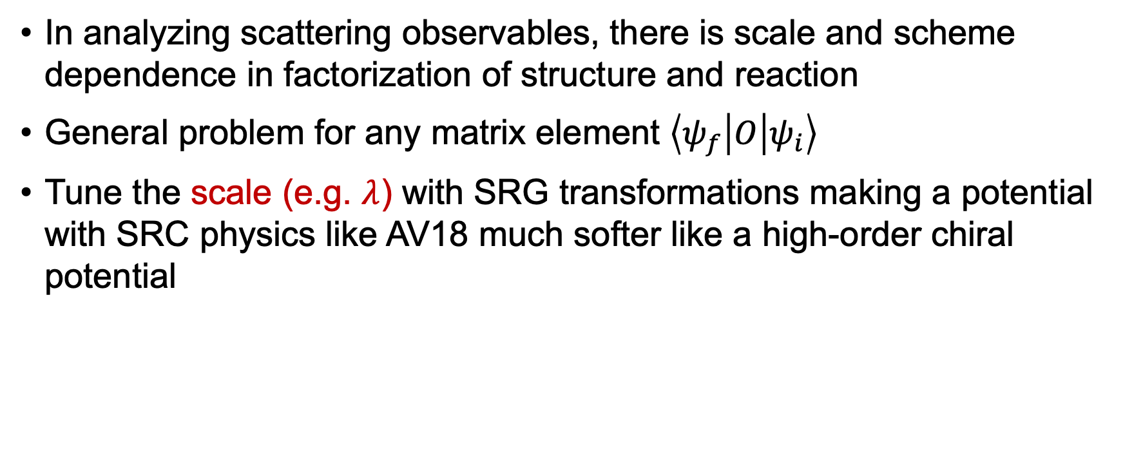
Connection to experiments
In analyzing scattering observables, there is scale and scheme dependence in factorization of structure and reaction
General problem for any matrix element $\left\langle ψ_{f} | O | ψ_{i}\right\rangle$
Tune the scale (e.g. $λ$) with SRG transformations making a potential with SRC physics like AV18 much softer like a high-order chiral potential

Slide 14
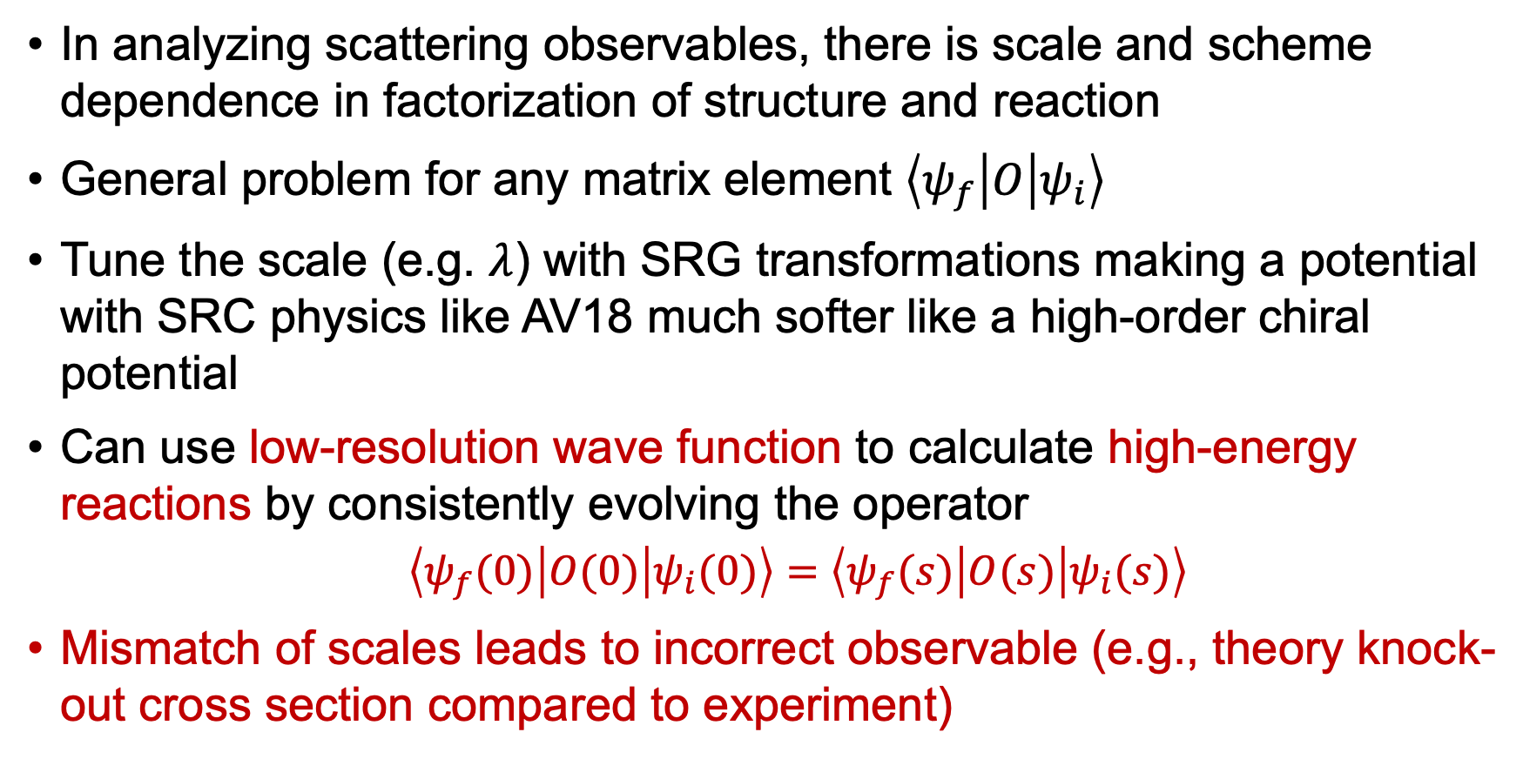
Connection to experiments
In analyzing scattering observables, there is scale and scheme dependence in factorization of structure and reaction
General problem for any matrix element $\left\langle ψ_{f} | O | ψ_{i}\right\rangle$
Tune the scale (e.g. $λ$) with SRG transformations making a potential with SRC physics like AV18 much softer like a high-order chiral potential
Can use low-resolution wave function to calculate high-energy reactions by consistently evolving the operator
$\left\langle ψ_{f}(0) | O(0) | ψ_{i}(0)\right\rangle =$ $\left\langle ψ_{f}(s) | O(s) | ψ_{i}(s)\right\rangle$
Mismatch of scales leads to incorrect observable (e.g., theory knock-out cross section compared to experiment)

Slide 15
Momentum distribution of the deuteron
Bullet

Slide 16
Momentum distribution of the deuteron
Bullet

Slide 17
Momentum distribution of the deuteron
Bullet

Slide 18
Momentum distribution of the deuteron
Bullet

Slide 19
Factorization
Bullet

Slide 20
Factorization
Bullet

Slide 21
Factorization
Bullet

Slide 22
Nucleon-nucleon pairs in nuclei
Bullet

Slide 23
Nucleon-nucleon pairs in nuclei
Bullet

Slide 24
Nucleon-nucleon pairs in nuclei
Bullet

Slide 25
Summary and outlook
Bullet

Slide 26
Summary and outlook
Bullet

Slide 27
Summary and outlook
Bullet

