Slide 1
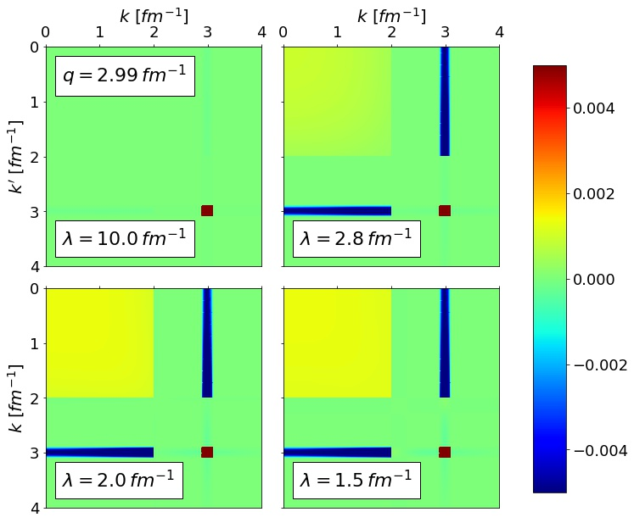
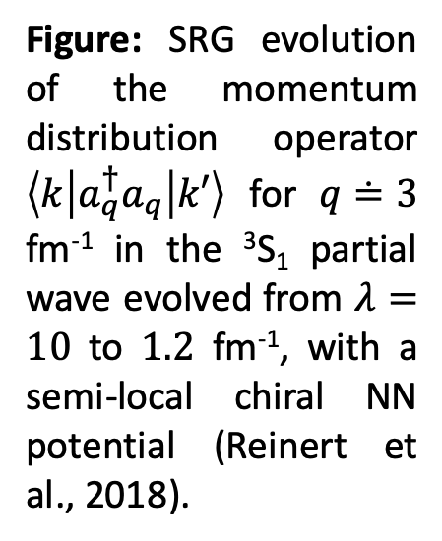
Operator evolution
Figure: SRG evolution of the momentum distribution operator $\left\langle k | a_{q}^{†}a_{q} | k′\right\rangle$ for $q≐3$ fm⁻¹ in the ³S₁ partial wave evolved from $λ=10$ to $1.2$ fm⁻¹, with a semi-local chiral NN potential (Reinert et al., 2018).

