Slide 1




Analyzing scale and scheme dependence in NN operators with the SRG
Anthony Tropiano¹, Dick Furnstahl¹, Scott Bogner²
¹Ohio State University, ²Michigan State University
NUCLEI Meeting
June 9, 2020

Slide 2
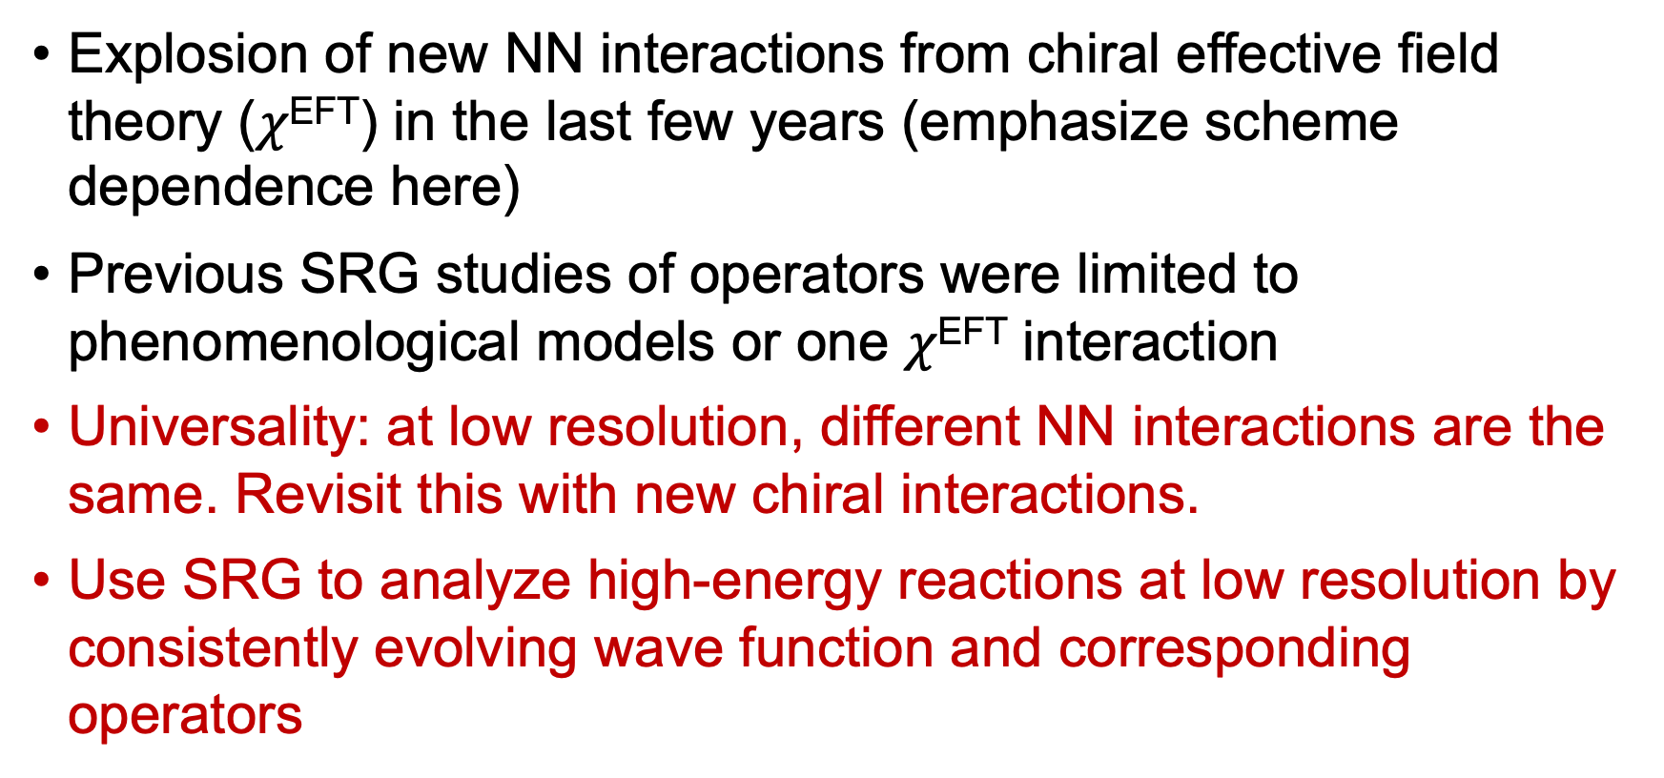
Motivation
Explosion of new NN interactions from chiral effective field theory ($χ$^{EFT}) in the last few years (emphasize scheme dependence here)
Previous SRG studies of operators were limited to phenomenological models or one $χ$^{EFT} interaction
Universality: at low resolution, different NN interactions are the same. Revisit this with new chiral interactions.
Use SRG to analyze high-energy reactions at low resolution by consistently evolving wave function and corresponding operators

Slide 3
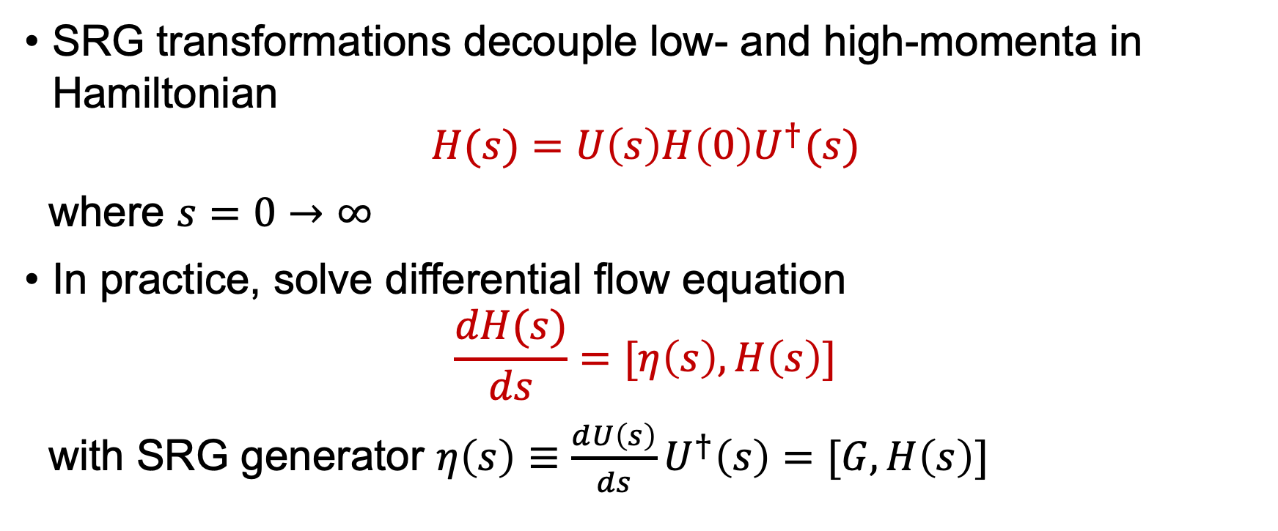
SRG Formalism
SRG transformations decouple low- and high-momenta in Hamiltonian
$$H(s)=U\left(s\right)H\left(0\right)U^{†}(s)$$
where $s=0→∞$
In practice, solve differential flow equation
$$\frac{dH(s)}{ds}=[η\left(s\right),H\left(s\right)]$$
with SRG generator $η\left(s\right)≡\frac{dU\left(s\right)}{ds}U^{†}\left(s\right)=[G,H\left(s\right)]$

Slide 4
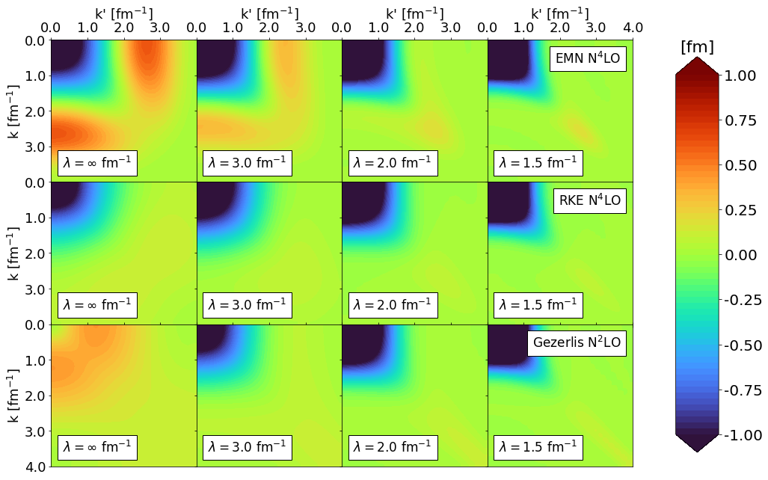
Universality of potentials
¹D.R. Entem and R. Machleidt, Phys. Rev. C 68, 041001 (2003)
²P. Reinert, H. Krebs, and E. Epelbaum, Eur. Phys. J. A 54, 86 (2018)
³A. Gezerlis, et al., Phys. Rev. C 90, 054323 (2014)
Variety of NN interactions - at low-resolution they are the same thing
Cite papers
Define \lambda
Explanation of universality: phase equivalence
Emphasize where we have scheme dependence

Slide 5
Universality of potentials
Variety of NN interactions - at low-resolution they are the same thing
Cite papers
Define \lambda
Explanation of universality: phase equivalence

Slide 6
Universality of potentials
Variety of NN interactions - at low-resolution they are the same thing
Cite papers
Define \lambda
Explanation of universality: phase equivalence (maybe add 3S1 phase shifts on top)

Slide 7
SRG-evolved wave functions
Natural consequence: the low-energy states between drastically different potentials also exhibit universality
SRC physics in AV18 is gone (scheme dependence)
All deuteron wave functions become soft and D-state probability goes down
Observables such as asymptotic D/S ratio the same
(add Gezerlis to this plot, S- and D-state arrows)

Slide 8
SRG-evolved wave functions
Natural consequence: the low-energy states between drastically different potentials also exhibit universality
SRC physics in AV18 is gone
All deuteron wave functions become soft and D-state probability goes down
Observables such as asymptotic D/S ratio the same

Slide 9
SRG-evolved wave functions
Natural consequence: the low-energy states between drastically different potentials also exhibit universality
SRC physics in AV18 is gone
All deuteron wave functions become soft and D-state probability goes down
Observables such as asymptotic D/S ratio the same

Slide 10
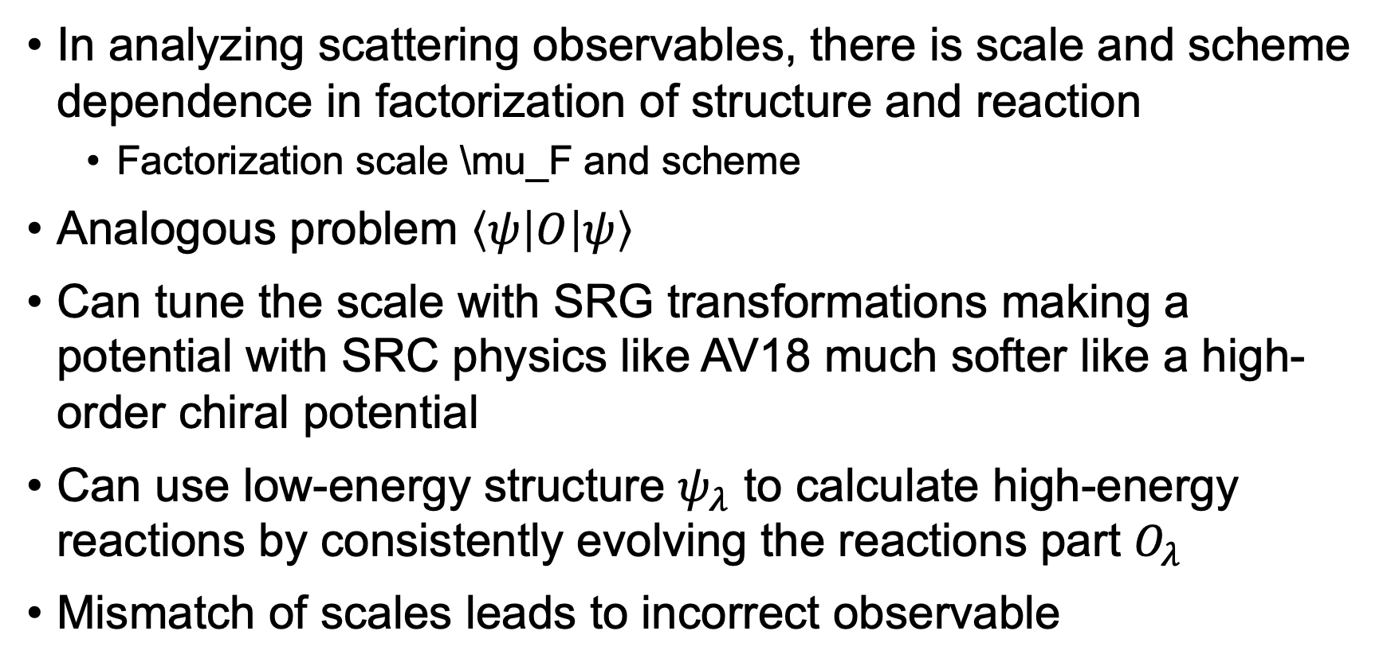
Connection to experiments
In analyzing scattering observables, there is scale and scheme dependence in factorization of structure and reaction
Factorization scale \mu_F and scheme
Analogous problem $\left\langle ψ | O | ψ\right\rangle$
Can tune the scale with SRG transformations making a potential with SRC physics like AV18 much softer like a high-order chiral potential
Can use low-energy structure $ψ_{λ}$ to calculate high-energy reactions by consistently evolving the reactions part $O_{λ}$
Mismatch of scales leads to incorrect observable

Slide 11
Connection to experiments
In analyzing scattering observables, there is scale and scheme dependence in factorization of structure and reaction
Factorization scale \mu_F and scheme
Analogous problem $\left\langle ψ | O | ψ\right\rangle$
Can tune the scale with SRG transformations making a potential with SRC physics like AV18 much softer like a high-order chiral potential
Can use low-energy structure $ψ_{λ}$ to calculate high-energy reactions by consistently evolving the reactions part $O_{λ}$
Mismatch of scales leads to incorrect observable

Slide 12
Connection to experiments
In analyzing scattering observables, there is scale and scheme dependence in factorization of structure and reaction
Factorization scale \mu_F and scheme
Analogous problem $\left\langle ψ | O | ψ\right\rangle$
Can tune the scale with SRG transformations making a potential with SRC physics like AV18 much softer like a high-order chiral potential
Can use low-energy structure $ψ_{λ}$ to calculate high-energy reactions by consistently evolving the reactions part $O_{λ}$
Mismatch of scales leads to incorrect observable

Slide 13
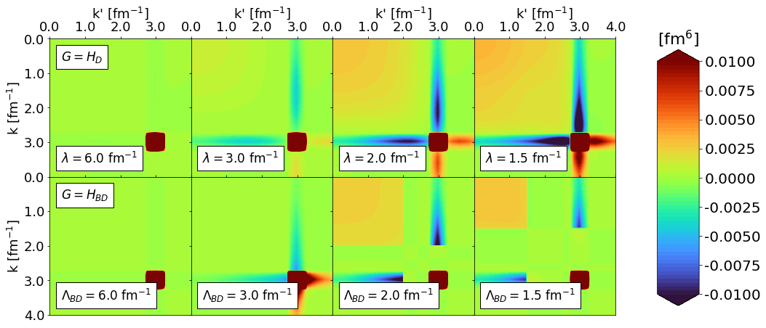
Where does the short-distance physics go?
Use ataq as an example, depending on time can provide further detail (just do band-diagonal decoupling) (add relative momentum q)
Induced low-momentum contributions reflecting UV physics of the NN potential

Slide 14



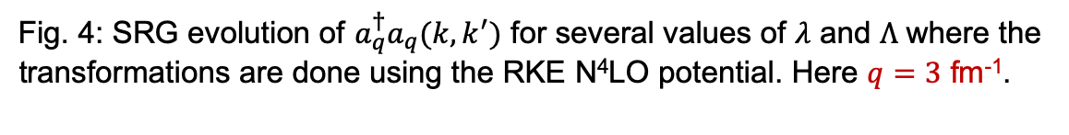
Momentum projection operator
RKE N⁴LO $Λ=450$ MeV
We use the momentum projection operator $a_{q}^{†}a_{q}$as a test case
$$a_{q}^{†}a_{q}ψ\left(k\right)=ψ(q)$$
Initially starts out as a $δ$-function
SRG transformations induce low-momentum contributions
Strength of wave function shifted to low-momentum
$\left\langle ψ(0) | O(0) | ψ(0)\right\rangle =$ $\left\langle ψ(s) | O(s) | ψ(s)\right\rangle$
$⟹$ Transformations on the operator must induce low-momentum contributions!
Fig. 4: SRG evolution of $a_{q}^{†}a_{q}(k,k^{′})$ for several values of $λ$ and $Λ$ where the transformations are done using the RKE N⁴LO potential. Here $q=3$ fm⁻¹.

Slide 15
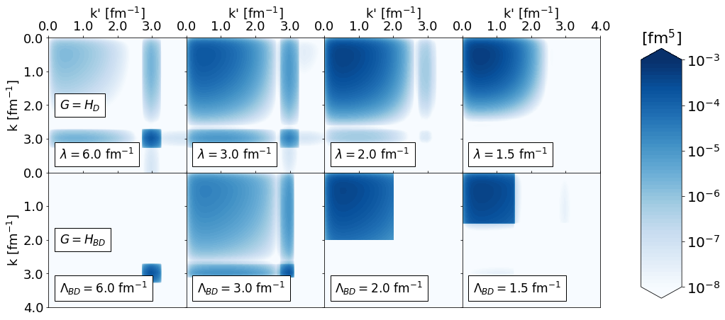
Expectation value under SRG
Walk through the <\psi_d|ataq|\psi> changes connecting back to point that we can utilize high-order chiral potentials
Expectation value is shifted to low resolution
Maybe do just band-diagonal decoupling
Arrows to indicate scale dependence (left to right) and scheme dependence (up to down)

Slide 16
Ratios of different potentials
SRG induced terms in the operator reflects difference in UV physics, maybe show ataq(k,k) ratios
Transition into ratios of A/d ~ low-energy structure components

Slide 17
Ratios of different potentials
SRG induced terms in the operator reflects difference in UV physics, maybe show ataq(k,k) ratios
Transition into ratios of A/d ~ low-energy structure components

Slide 18
Ratios of different potentials
SRG induced terms in the operator reflects difference in UV physics, maybe show ataq(k,k) ratios
Transition into ratios of A/d ~ low-energy structure components
Add in momentum distributions

Slide 19
Summary
Universality in drastically different chiral potentials
Universality shows in low-energy states as well
Soft wave functions, consistently evolved operators with SRG induced terms from UV: decouples calculation from high-energy for low-energy states

Slide 20
Outlook

Slide 21
Back up slides
Add high cutoffs psi(r) figure

