Slide 1


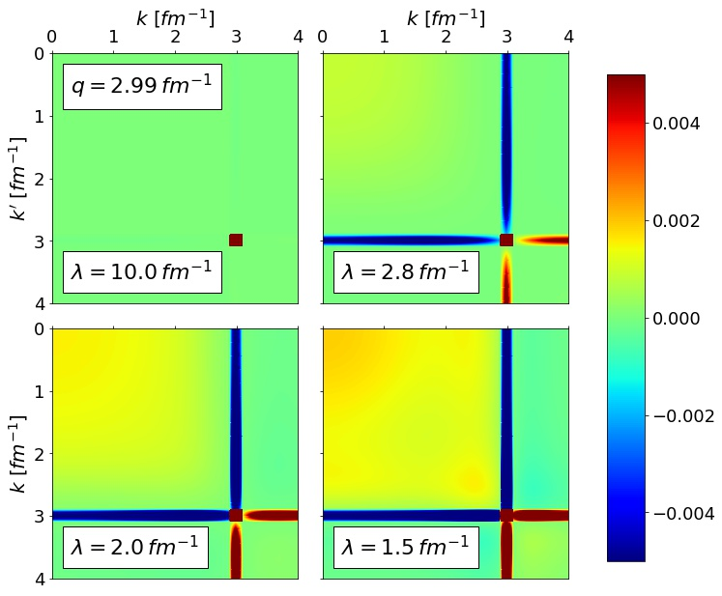
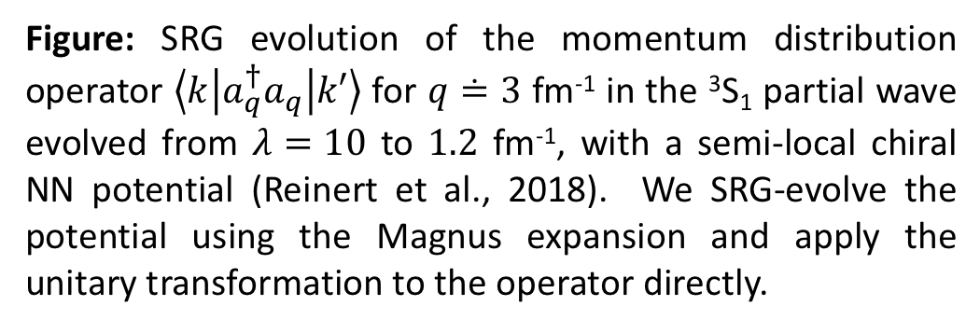
Using the Magnus expansion to
SRG-evolve operators
Objectives
Compare similarity renormalization group (SRG) operator evolution using Magnus expansion to standard approach.
The Magnus expansion drastically reduces the memory needed to evolve operators besides the Hamiltonian, which is otherwise prohibitive for medium-mass nuclei. Test its numerical precision and stability.
Investigate operator evolution with new chiral potentials.
Impact
The SRG transformation shifts the strength of operators to low-energy in the form of smeared contact operators.
Calculations of deuteron observables with evolved wave functions and operators show very small error relative to the unevolved value due to exact unitarity in Magnus transformations.
Enables re-examination of SRG calculations with new chiral potentials and consistently evolved wave functions and operators. Applications to observables such as radii, electromagnetic moments and transitions, etc.
Validated the Magnus expansion as an avenue for in-medium (IM)-SRG evolution of A-body operators.
Accomplishments
A. J. Tropiano, work in progress.
Figure: SRG evolution of the momentum distribution operator $\left\langle k | a_{q}^{†}a_{q} | k′\right\rangle$ for $q≐3$ fm⁻¹ in the ³S₁ partial wave evolved from $λ=10$ to $1.2$ fm⁻¹, with a semi-local chiral NN potential (Reinert et al., 2018). We SRG-evolve the potential using the Magnus expansion and apply the unitary transformation to the operator directly.

