Slide 1




Short-range correlation physics at low RG resolution
Anthony Tropiano¹, Dick Furnstahl¹, Scott Bogner²
¹Ohio State University, ²Michigan State University
APS April Meeting – Virtual Meeting
April 19, 2021
ajt, S.K. Bogner, and R.J. Furnstahl, arXiv:2006.11186
Phys. Rev. C 102, 034005 (2020)
ajt, S.K. Bogner, and R.J. Furnstahl, in progress

Slide 2
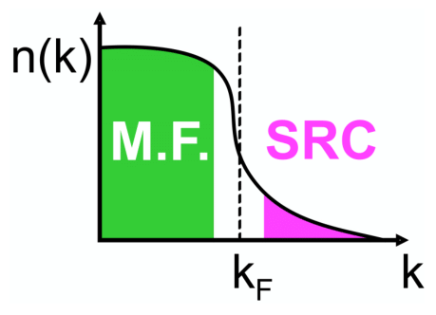
Motivation
knock-out 2 high-k nucleons
Recent experiments have been able to isolate processes where short-range correlation (SRC) physics is dominant and well accounted for by SRC phenomenology
High RG resolution description of SRC physics
SRC pairs are components in the nuclear wave function with relative momenta above the Fermi momentum
excite SRC pair
same expt. resolution
low-k initial pair

Slide 3
Motivation
knock-out 2 high-k nucleons
Recent experiments have been able to isolate processes where short-range correlation (SRC) physics is dominant and well accounted for by SRC phenomenology
Alternative viewpoint
Using renormalization group (RG) methods we can tune the scale to low RG resolution
The SRC physics is shifted into the reaction operators from the nuclear wave function (which becomes soft)
excite SRC pair
same expt. resolution
low-k initial pair

Slide 4
Motivation
knock-out 2 high-k nucleons
Recent experiments have been able to isolate processes where short-range correlation (SRC) physics is dominant and well accounted for by SRC phenomenology
Alternative viewpoint
Using renormalization group (RG) methods we can tune the scale to low RG resolution
The SRC physics is shifted into the reaction operators from the nuclear wave function (which becomes soft)
Experimental resolution (set by momentum of probe) is the same in both pictures
Same observables but different physical interpretation!
excite SRC pair
same expt. resolution
low-k initial pair

Slide 5
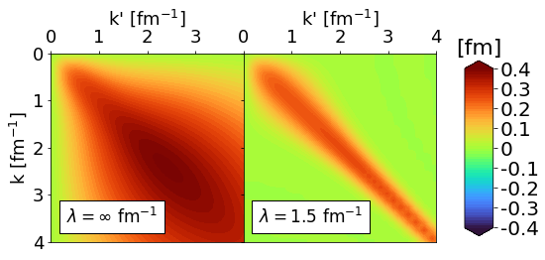
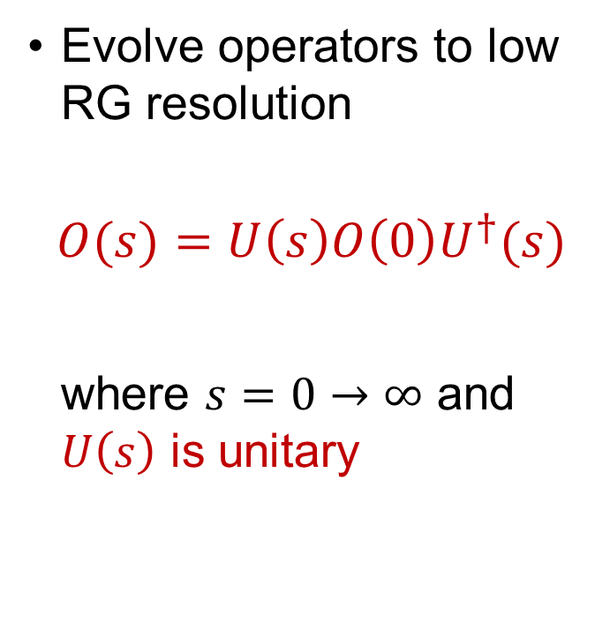
Similarity Renormalization Group (SRG)
Evolve operators to low RG resolution
$$O(s)=U\left(s\right)O\left(0\right)U^{†}(s)$$
where $s=0→∞$ and $U\left(s\right)$ is unitary
Fig. 1: Momentum space matrix elements of Argonne v18 (AV18) under SRG evolution in ¹P₁ channel.
Notes:
\lambda bullet point and add arrows to plot.

Slide 6
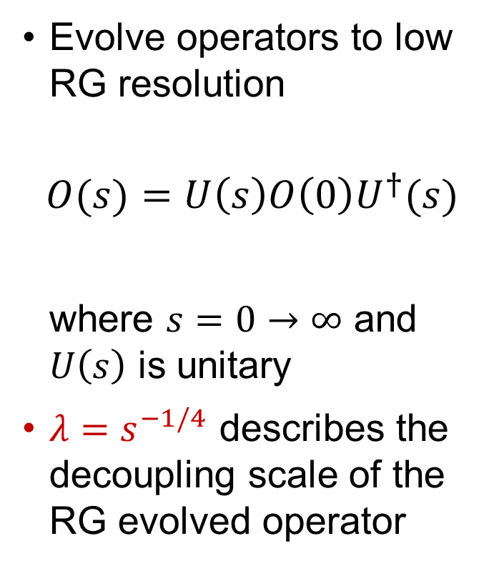
Similarity Renormalization Group (SRG)
Evolve operators to low RG resolution
$$O(s)=U\left(s\right)O\left(0\right)U^{†}(s)$$
where $s=0→∞$ and $U\left(s\right)$ is unitary
$λ=s^{−1/4}$ describes the decoupling scale of the RG evolved operator
Fig. 1: Momentum space matrix elements of Argonne v18 (AV18) under SRG evolution in ¹P₁ channel.
Notes:
\lambda bullet point and add arrows to plot.

Slide 7
Deuteron wave function at low RG resolution
AV18 wave function has significant SRC
What happens to the wave function at low RG resolution?
SRC in AV18
S-state
D-state
Fig. 2: SRG evolution of deuteron wave function in coordinate space for AV18 and Gezerlis N2LO¹.
¹A. Gezerlis et al., Phys. Rev. C 90, 054323 (2014)

Slide 8
Deuteron wave function at low RG resolution
SRC physics in AV18 is gone from wave function at low RG resolution
Deuteron wave functions become soft and D-state probability goes down
Observables such as asymptotic D-S ratio are the same
SRC in AV18
No SRC
S-state
S-state
D-state
D-state
Fig. 2: SRG evolution of deuteron wave function in coordinate space for AV18 and Gezerlis N2LO¹.
¹A. Gezerlis et al., Phys. Rev. C 90, 054323 (2014)
Notes:
Also make sure you say AV18 lies on top of Gezerlis. Where does the SRC physics go? Use this as transition into next slide.

Slide 9
Momentum distributions at low RG resolution
Soft wave functions at low RG resolution
Where does the SRC physics go?

Slide 10
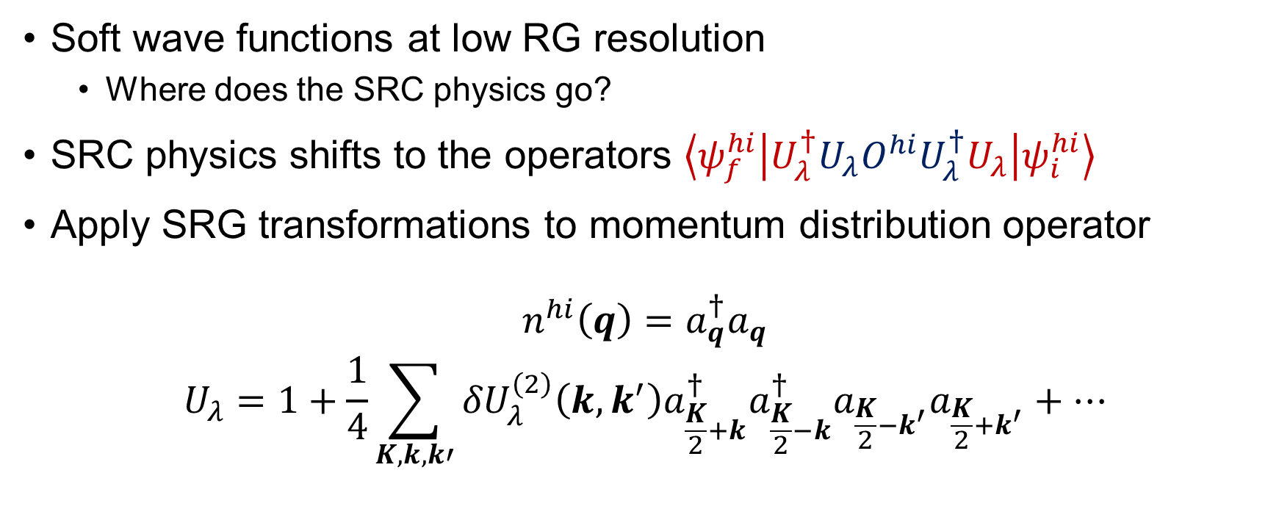
Momentum distributions at low RG resolution
Soft wave functions at low RG resolution
Where does the SRC physics go?
SRC physics shifts to the operators $\left\langle ψ_{f}^{hi} | U_{λ}^{†}U_{λ}O^{hi}U_{λ}^{†}U_{λ} | ψ_{i}^{hi}\right\rangle$
Apply SRG transformations to momentum distribution operator
$$n^{hi}\left(q\right)=a_{q}^{†}a_{q}$$
$$U_{λ}=1+\frac{1}{4}\sum_{K,k,k′}{{δU}_{λ}^{\left(2\right)}\left(k,k^{′}\right)a_{\frac{K}{2}+k}^{†}a_{\frac{K}{2}−k}^{†}a_{\frac{K}{2}−k^{′}}a_{\frac{K}{2}+k^{′}}+⋯}$$

Slide 11
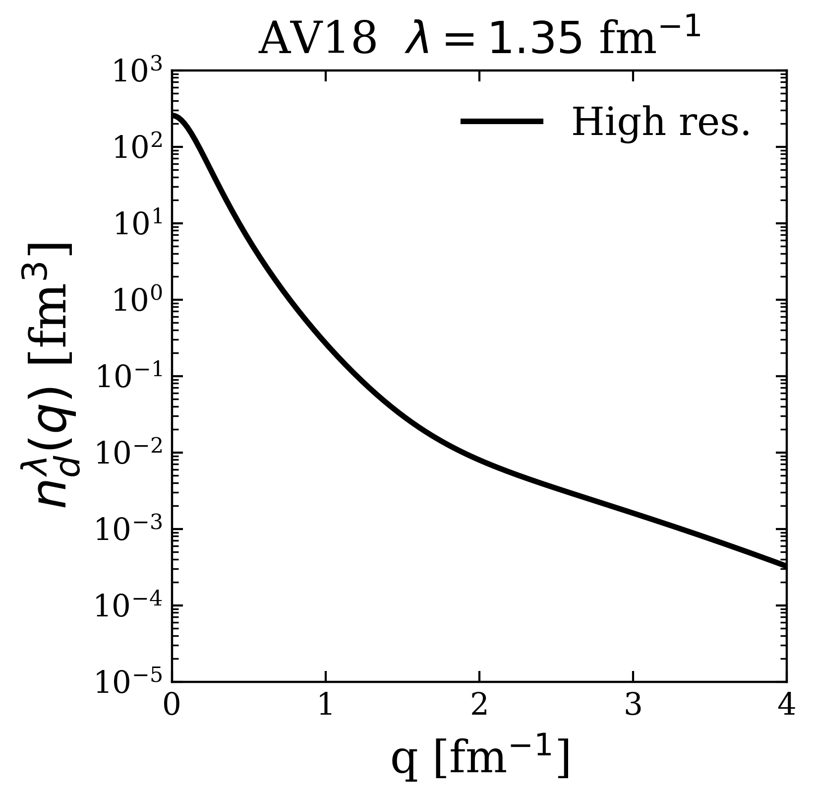

Momentum distributions at low RG resolution
Deuteron example
$$n^{lo}\left(q\right)=(1+δU)a_{q}^{†}a_{q}(1+δU^{†})$$
$$\left\langle ψ_{d}^{hi} | a_{q}^{†}a_{q} | ψ_{d}^{hi}\right\rangle$$

Slide 12
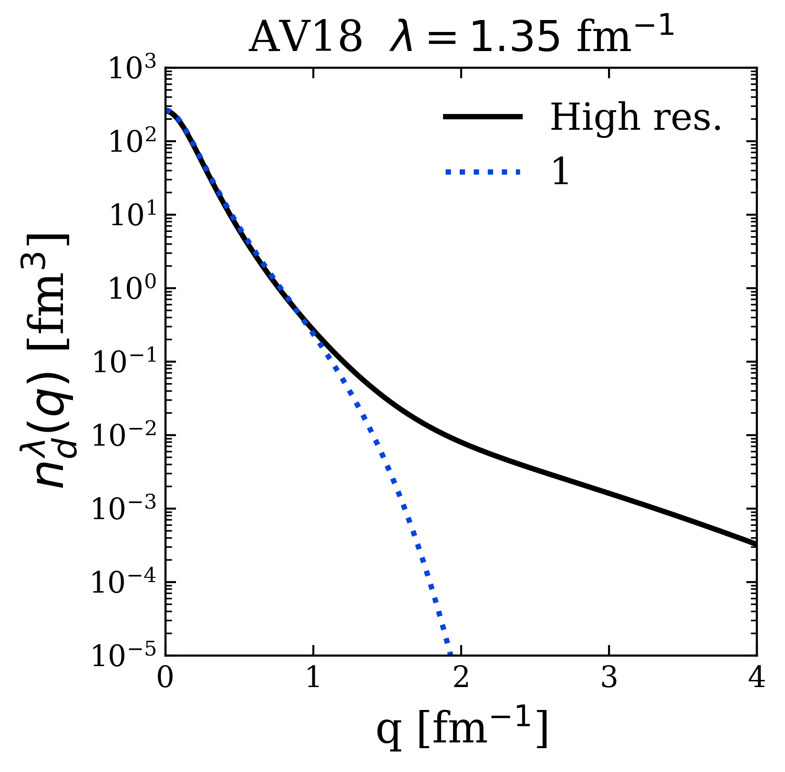
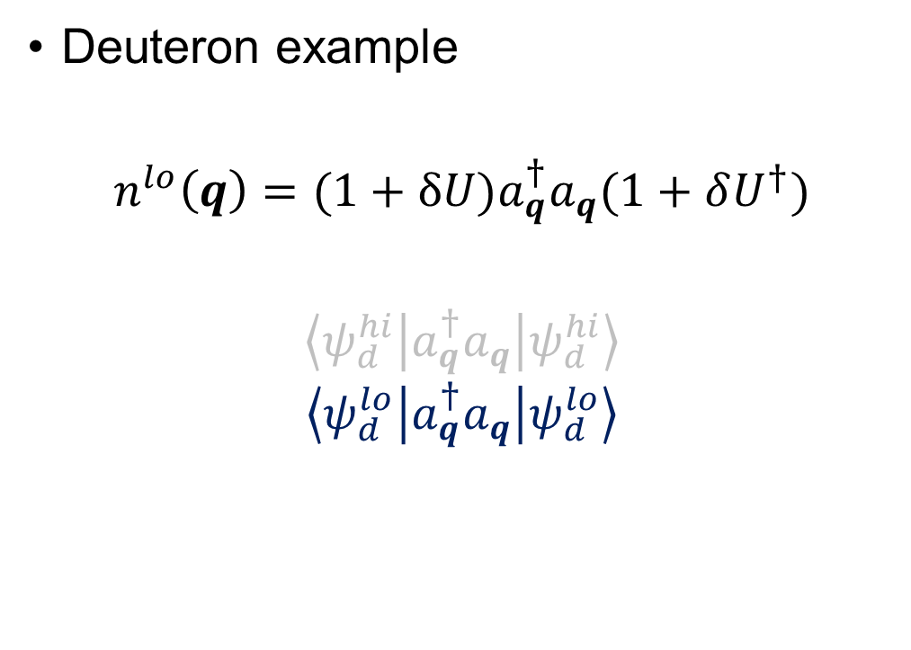
Momentum distributions at low RG resolution
Deuteron example
$$n^{lo}\left(q\right)=(1+δU)a_{q}^{†}a_{q}(1+δU^{†})$$
$$\left\langle ψ_{d}^{hi} | a_{q}^{†}a_{q} | ψ_{d}^{hi}\right\rangle$$
$$\left\langle ψ_{d}^{lo} | a_{q}^{†}a_{q} | ψ_{d}^{lo}\right\rangle$$

Slide 13
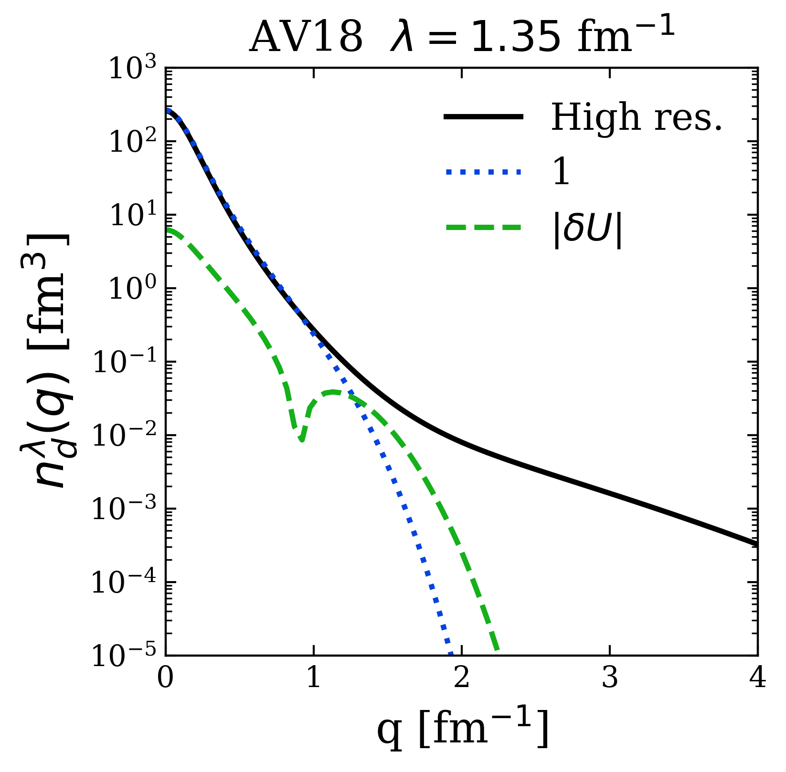
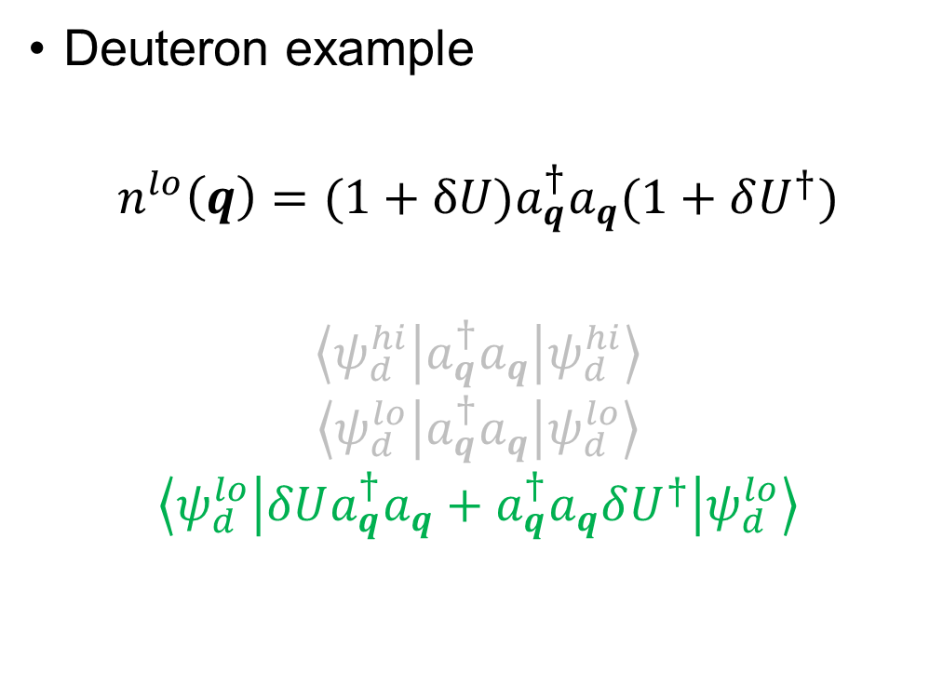
Momentum distributions at low RG resolution
Deuteron example
$$n^{lo}\left(q\right)=(1+δU)a_{q}^{†}a_{q}(1+δU^{†})$$
$$\left\langle ψ_{d}^{hi} | a_{q}^{†}a_{q} | ψ_{d}^{hi}\right\rangle$$
$$\left\langle ψ_{d}^{lo} | a_{q}^{†}a_{q} | ψ_{d}^{lo}\right\rangle$$
$$\left\langle ψ_{d}^{lo} | δUa_{q}^{†}a_{q}+a_{q}^{†}a_{q}δU^{†} | ψ_{d}^{lo}\right\rangle$$

Slide 14
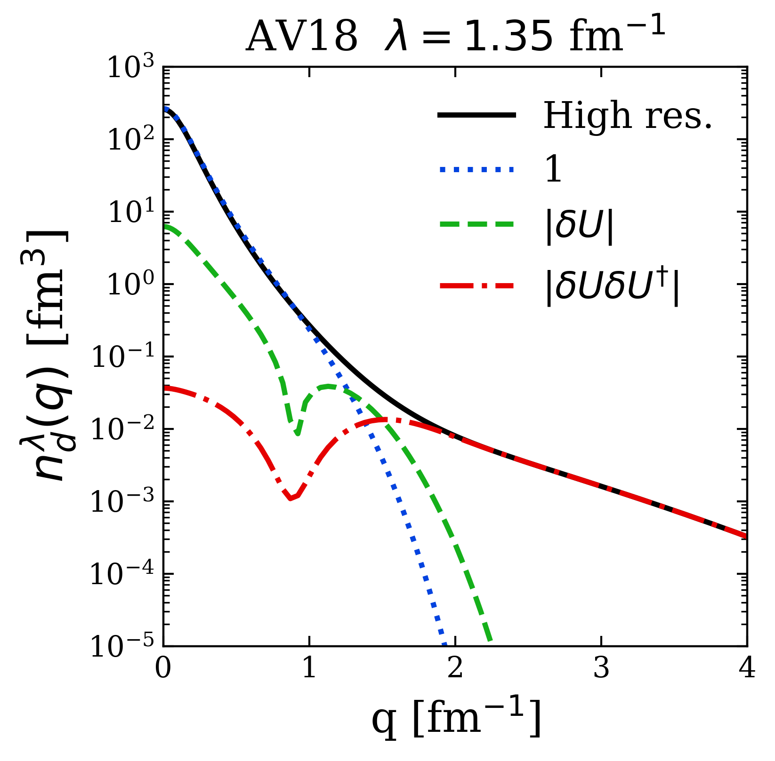
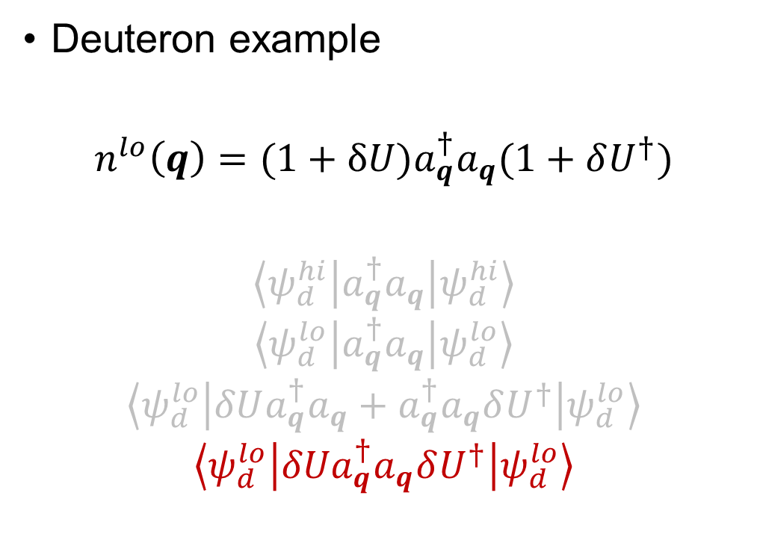
Momentum distributions at low RG resolution
Deuteron example
$$n^{lo}\left(q\right)=(1+δU)a_{q}^{†}a_{q}(1+δU^{†})$$
$$\left\langle ψ_{d}^{hi} | a_{q}^{†}a_{q} | ψ_{d}^{hi}\right\rangle$$
$$\left\langle ψ_{d}^{lo} | a_{q}^{†}a_{q} | ψ_{d}^{lo}\right\rangle$$
$$\left\langle ψ_{d}^{lo} | δUa_{q}^{†}a_{q}+a_{q}^{†}a_{q}δU^{†} | ψ_{d}^{lo}\right\rangle$$
$$\left\langle ψ_{d}^{lo} | {δUa}_{q}^{†}a_{q}δU^{†} | ψ_{d}^{lo}\right\rangle$$

Slide 15

Momentum distributions at low RG resolution
For high-$q$, the ${δU}_{λ}{δU}_{λ}^{†}$ term dominates
$$≈\sum_{K,k,k′}{{δU}_{λ}\left(k,q\right){{δU}_{λ}^{†}(q,k′)a}_{\frac{K}{2}+k}^{†}a_{\frac{K}{2}−k}^{†}a_{\frac{K}{2}−k^{′}}a_{\frac{K}{2}+k^{′}}}$$

Slide 16
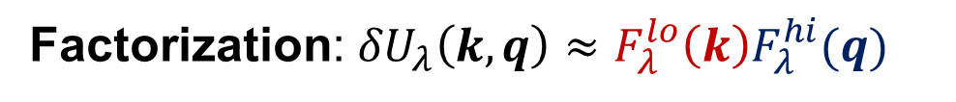
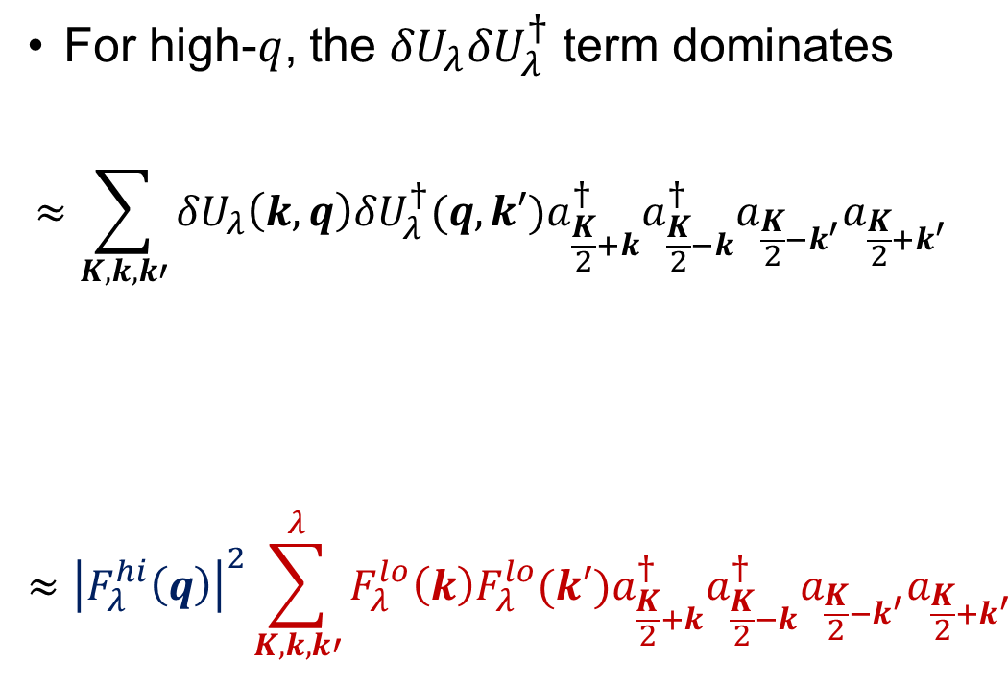
Momentum distributions at low RG resolution
For high-$q$, the ${δU}_{λ}{δU}_{λ}^{†}$ term dominates
$$≈\sum_{K,k,k′}{{δU}_{λ}\left(k,q\right){{δU}_{λ}^{†}(q,k′)a}_{\frac{K}{2}+k}^{†}a_{\frac{K}{2}−k}^{†}a_{\frac{K}{2}−k^{′}}a_{\frac{K}{2}+k^{′}}}$$
$$≈{\left|F_{λ}^{hi}\left(q\right)\right|}^{2}\sum_{K,k,k′}^{λ}{F_{λ}^{lo}\left(k\right){F_{λ}^{lo}(k′)a}_{\frac{K}{2}+k}^{†}a_{\frac{K}{2}−k}^{†}a_{\frac{K}{2}−k^{′}}a_{\frac{K}{2}+k^{′}}}$$
Factorization: ${δU}_{λ}\left(k,q\right)≈F_{λ}^{lo}{\left(k\right)F}_{λ}^{hi}(q)$

Slide 17

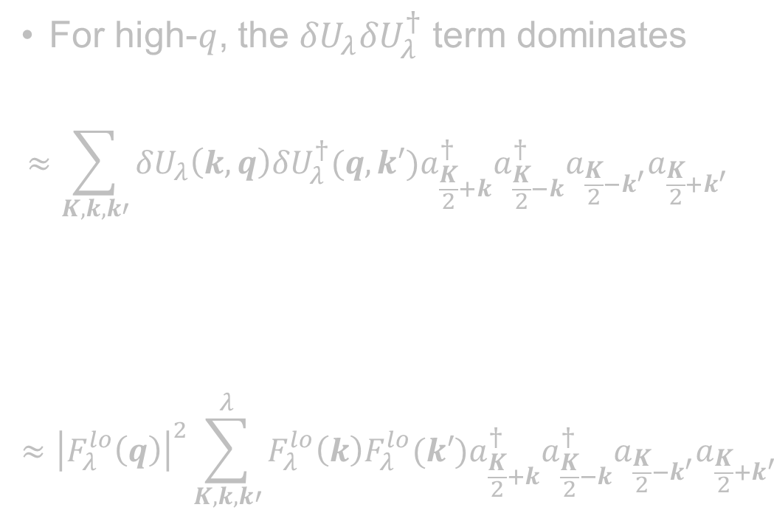
Momentum distributions at low RG resolution
For high-$q$, the ${δU}_{λ}{δU}_{λ}^{†}$ term dominates
$$≈\sum_{K,k,k′}{{δU}_{λ}\left(k,q\right){{δU}_{λ}^{†}(q,k′)a}_{\frac{K}{2}+k}^{†}a_{\frac{K}{2}−k}^{†}a_{\frac{K}{2}−k^{′}}a_{\frac{K}{2}+k^{′}}}$$
$$≈{\left|F_{λ}^{lo}\left(q\right)\right|}^{2}\sum_{K,k,k′}^{λ}{F_{λ}^{lo}\left(k\right){F_{λ}^{lo}(k′)a}_{\frac{K}{2}+k}^{†}a_{\frac{K}{2}−k}^{†}a_{\frac{K}{2}−k^{′}}a_{\frac{K}{2}+k^{′}}}$$
Apply this strategy to nuclear momentum distributions using local density approximation (LDA)!
Factorization: ${δU}_{λ}\left(k,q\right)≈F_{λ}^{lo}{\left(k\right)F}_{λ}^{hi}(q)$

Slide 18
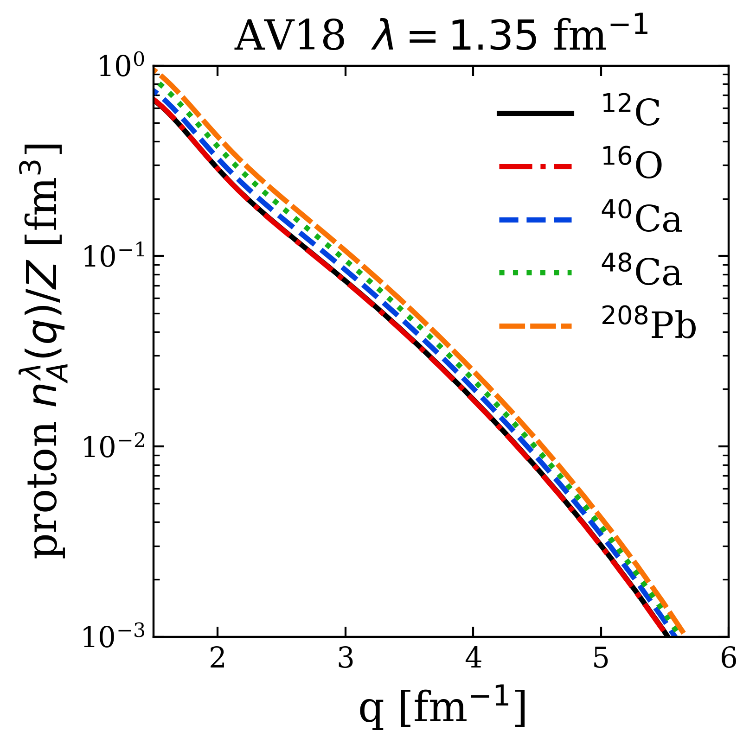

Preliminary LDA results
Universality
High-$q$ tail collapses to universal function $≈{\left|F_{λ}^{hi}\left(q\right)\right|}^{2}$ fixed by 2-body

Slide 19
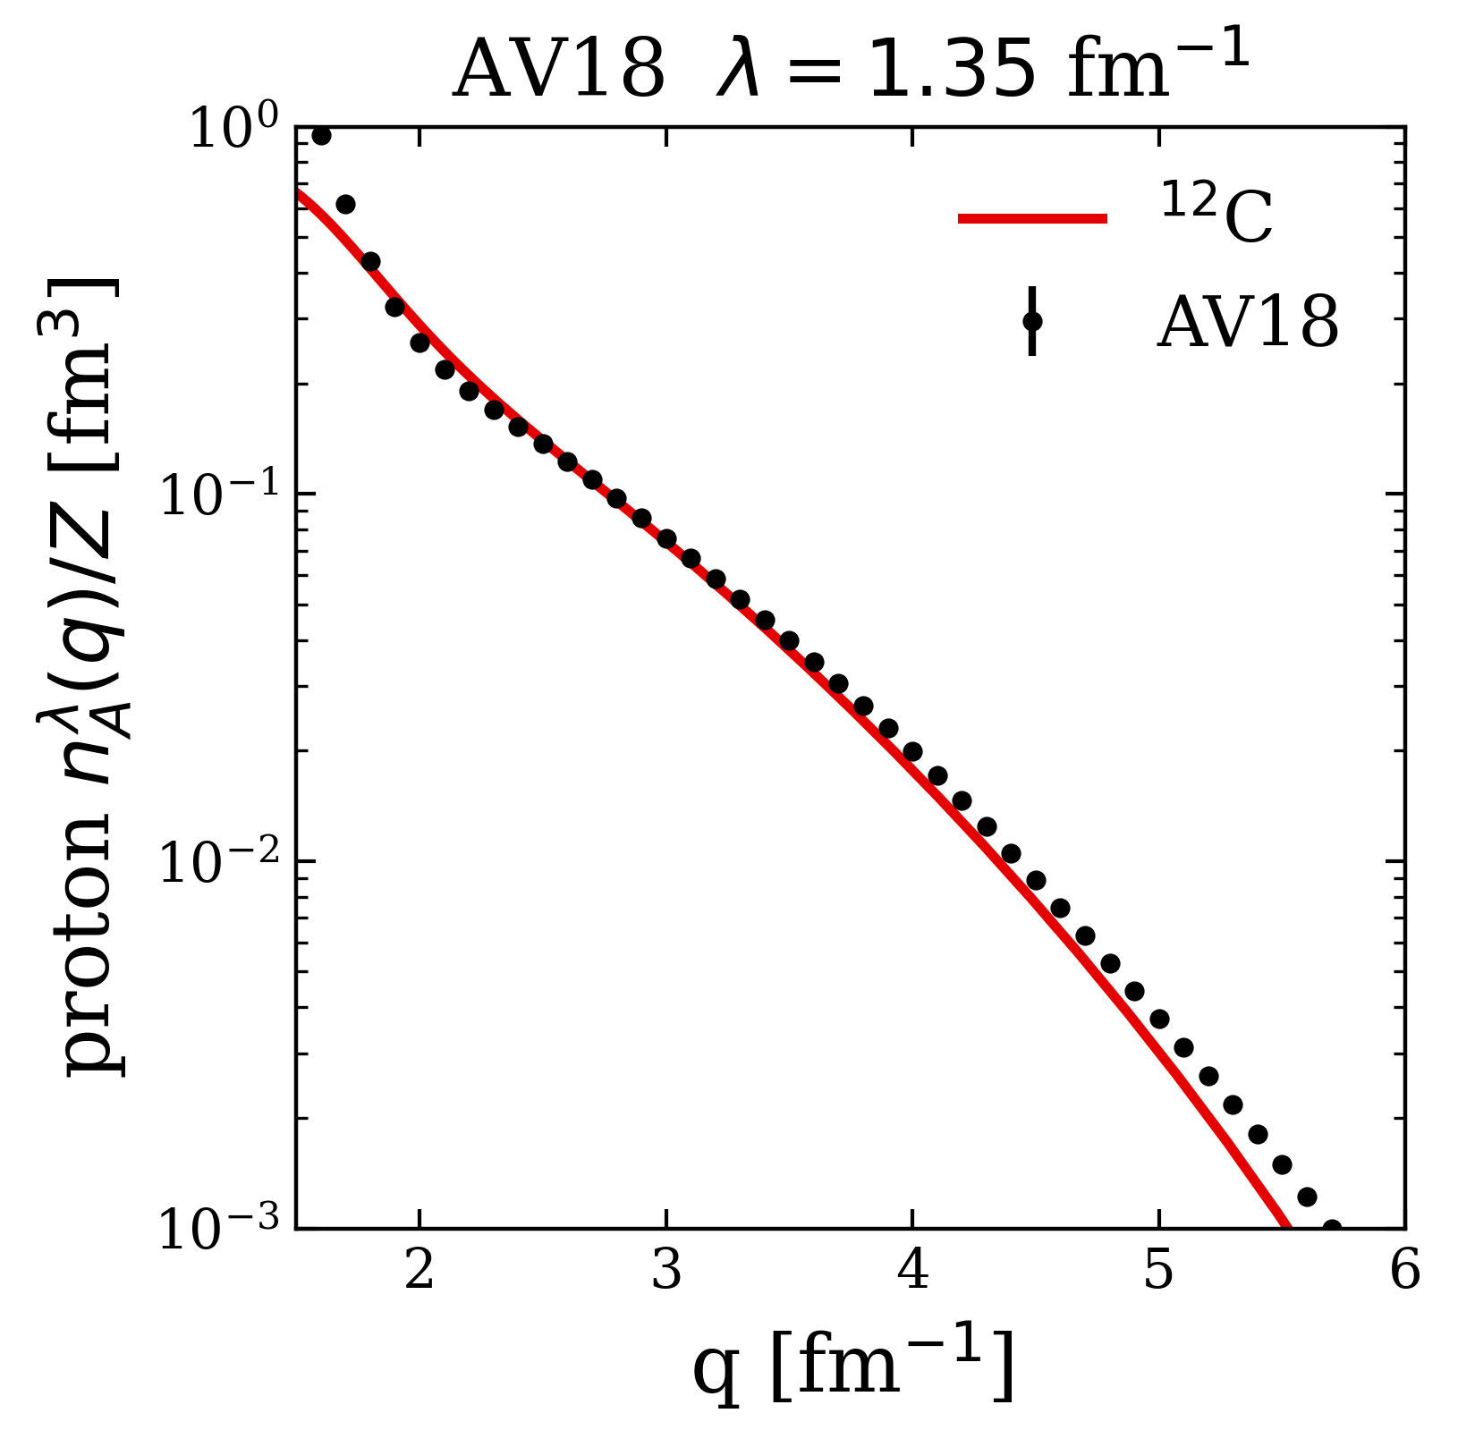
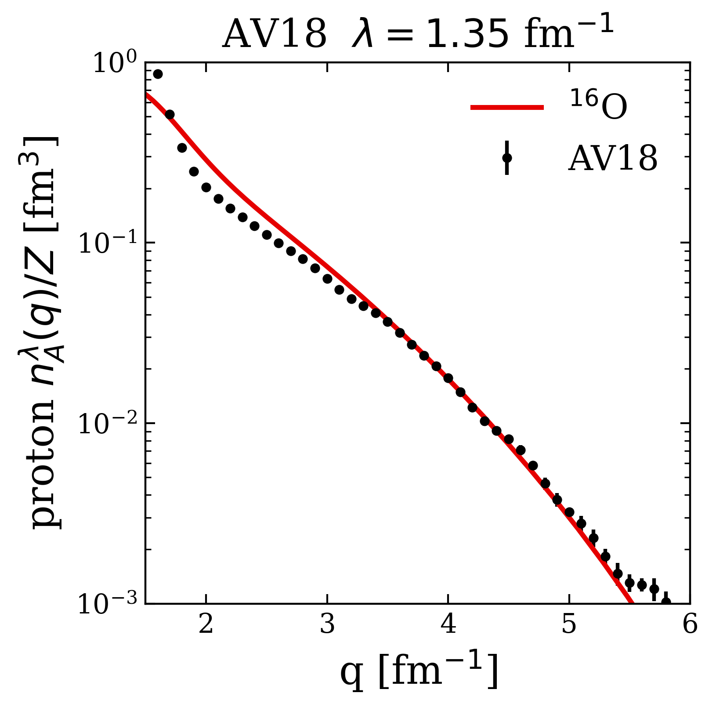
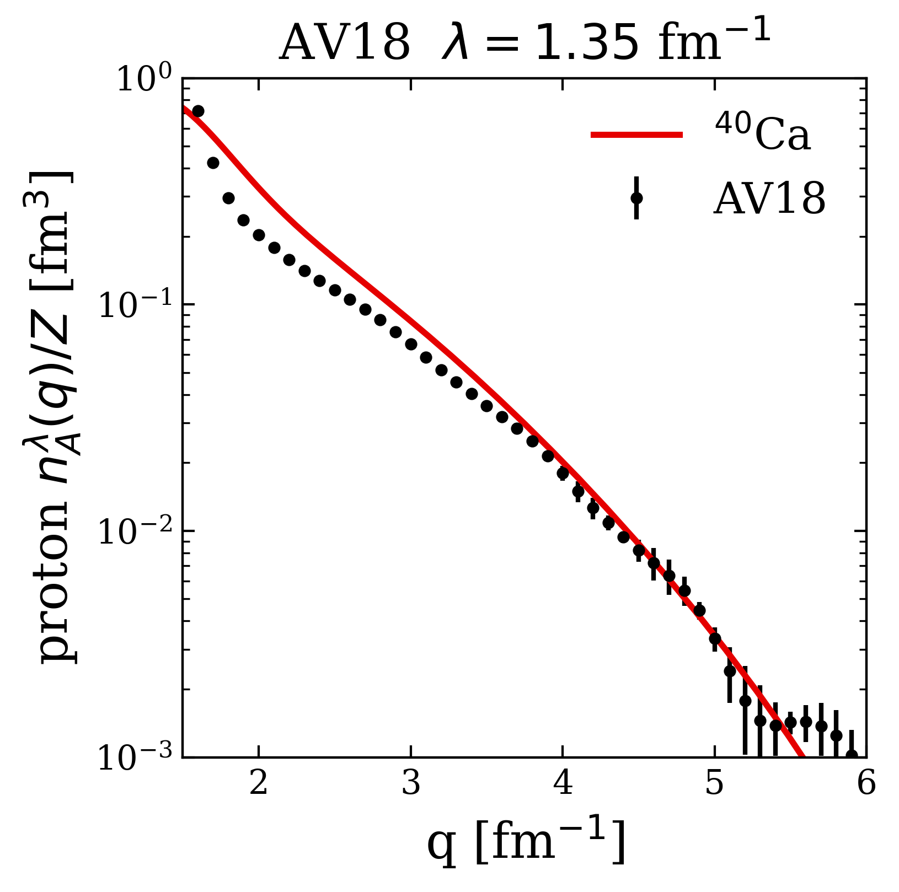
Preliminary LDA results
Low RG resolution calculations reproduce momentum distributions of AV18 data (high RG resolution calculation)
Absolute normalization still a work in progress (scaled up by one overall factor)

Slide 20
Preliminary LDA results
np includes ¹S₀ and ³S₁-³D₁
Scalar limit
At high RG resolution, the tensor force and the repulsive core of the NN interaction kicks nucleon pairs into SRCs
np dominates because the tensor force requires spin triplet pairs (pp are spin singlets)
Fig.: (a) Ratio of two-nucleon to single-nucleon electron-scattering cross sections for carbon as a function of missing momentum. (b) Fraction of np to p and pp to p pairs versus the relative momentum. Figure from CLAS collaboration publication¹. (add ref)

Slide 21
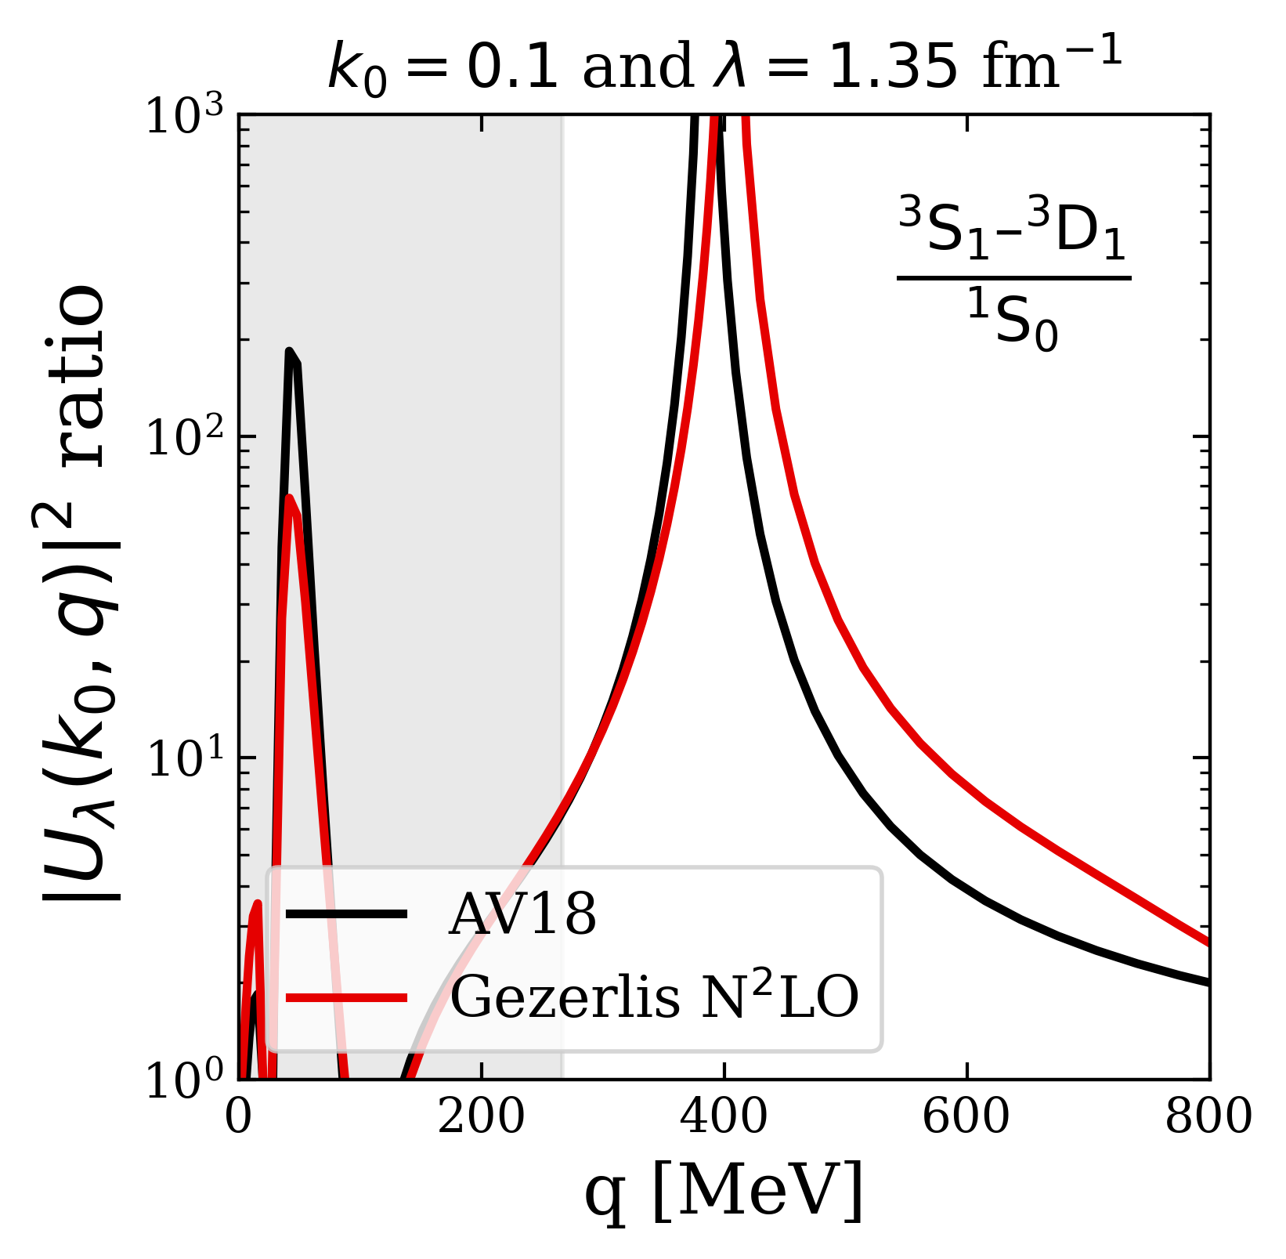
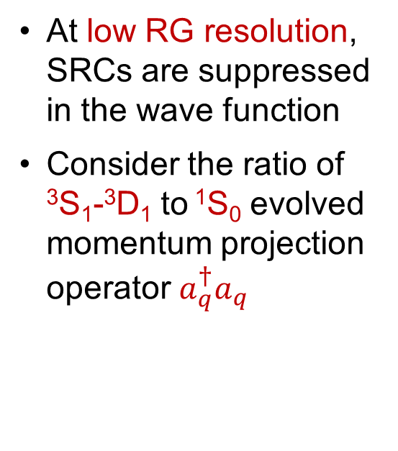
Preliminary LDA results
np includes ¹S₀ and ³S₁-³D₁
Scalar limit
At low RG resolution, SRCs are suppressed in the wave function
Consider the ratio of ³S₁-³D₁ to ¹S₀ evolved momentum projection operator $a_{q}^{†}a_{q}$
pn dominance
Scalar limit

Slide 22
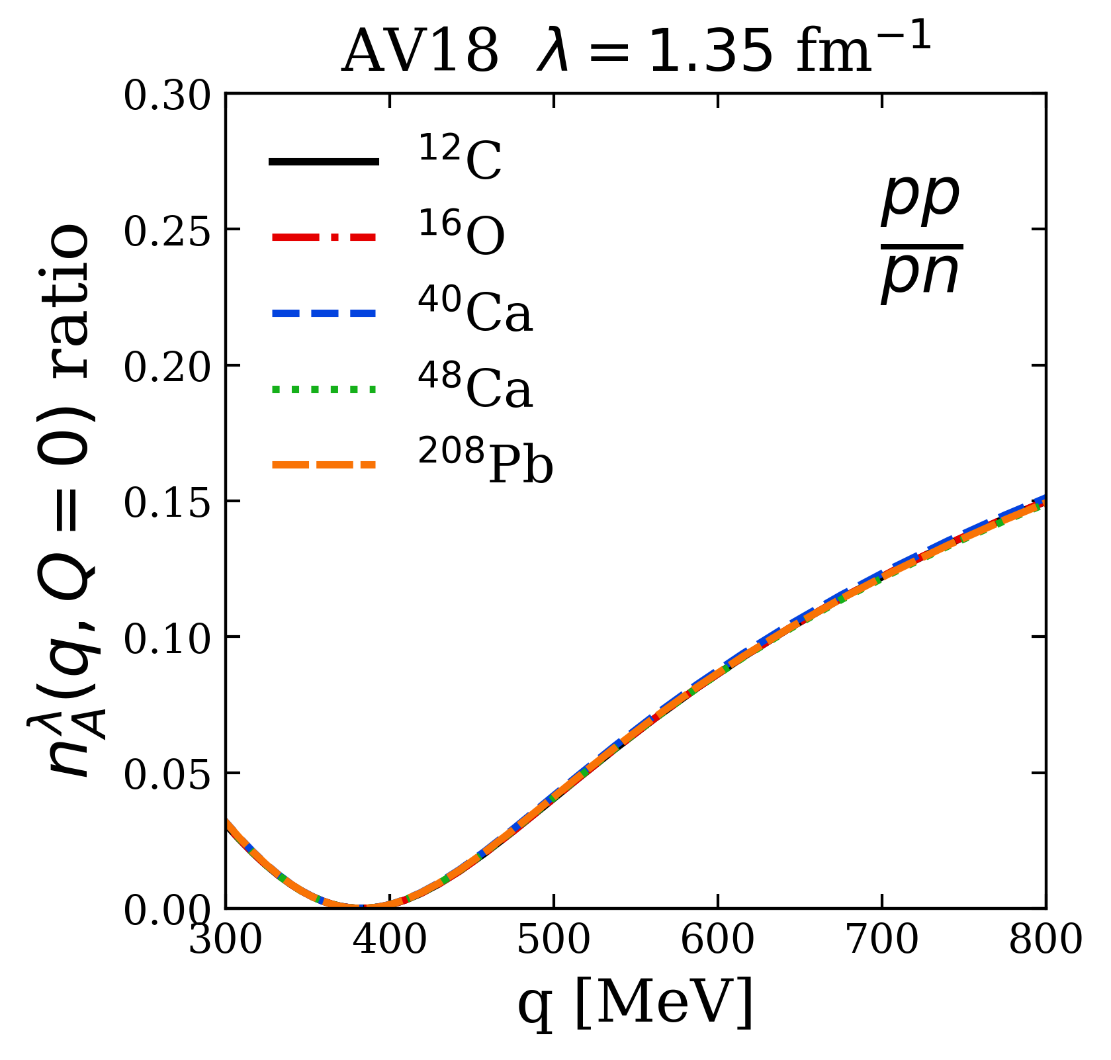
Preliminary LDA results
np includes ¹S₀ and ³S₁-³D₁
Scalar limit
Reproduces the characteristics of cross section ratios using low RG resolution operator
pn dominance
Scalar limit
Notes:
Connect to SRC phenomenology: np dominance from tensor force.
Highlight weak nuclear dependence from factorization (and LDA).
Add pp/p np/p pictures?

Slide 23
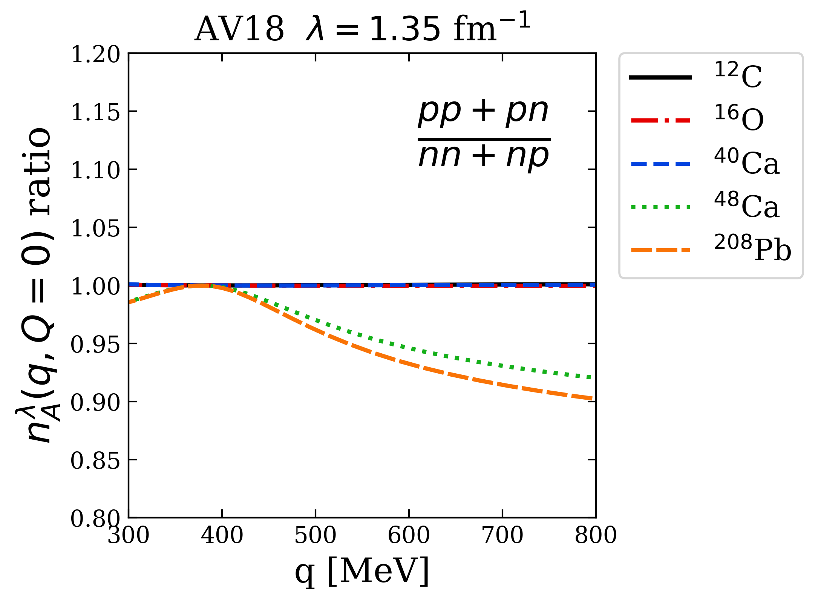

Preliminary LDA results
Ratio $\sim 1$ independent of N/Z in pn dominant region
pn dominance
Notes:
Add pp/p np/p pictures?
Node in 1S0. Tensor dominance at 400 MeV -> np dominance.

Slide 24
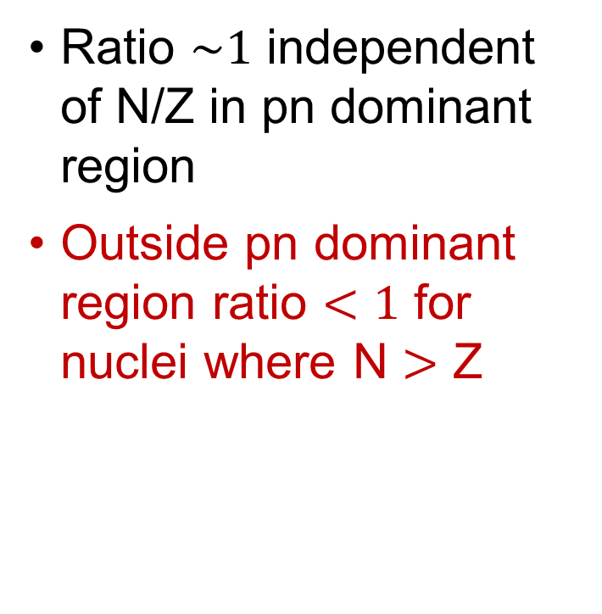
Preliminary LDA results
Ratio $\sim 1$ independent of N/Z in pn dominant region
Outside pn dominant region ratio $<1$ for nuclei where N $>$ Z
pn dominance
Notes:
Add pp/p np/p pictures?
Node in 1S0. Tensor dominance at 400 MeV -> np dominance.

Slide 25
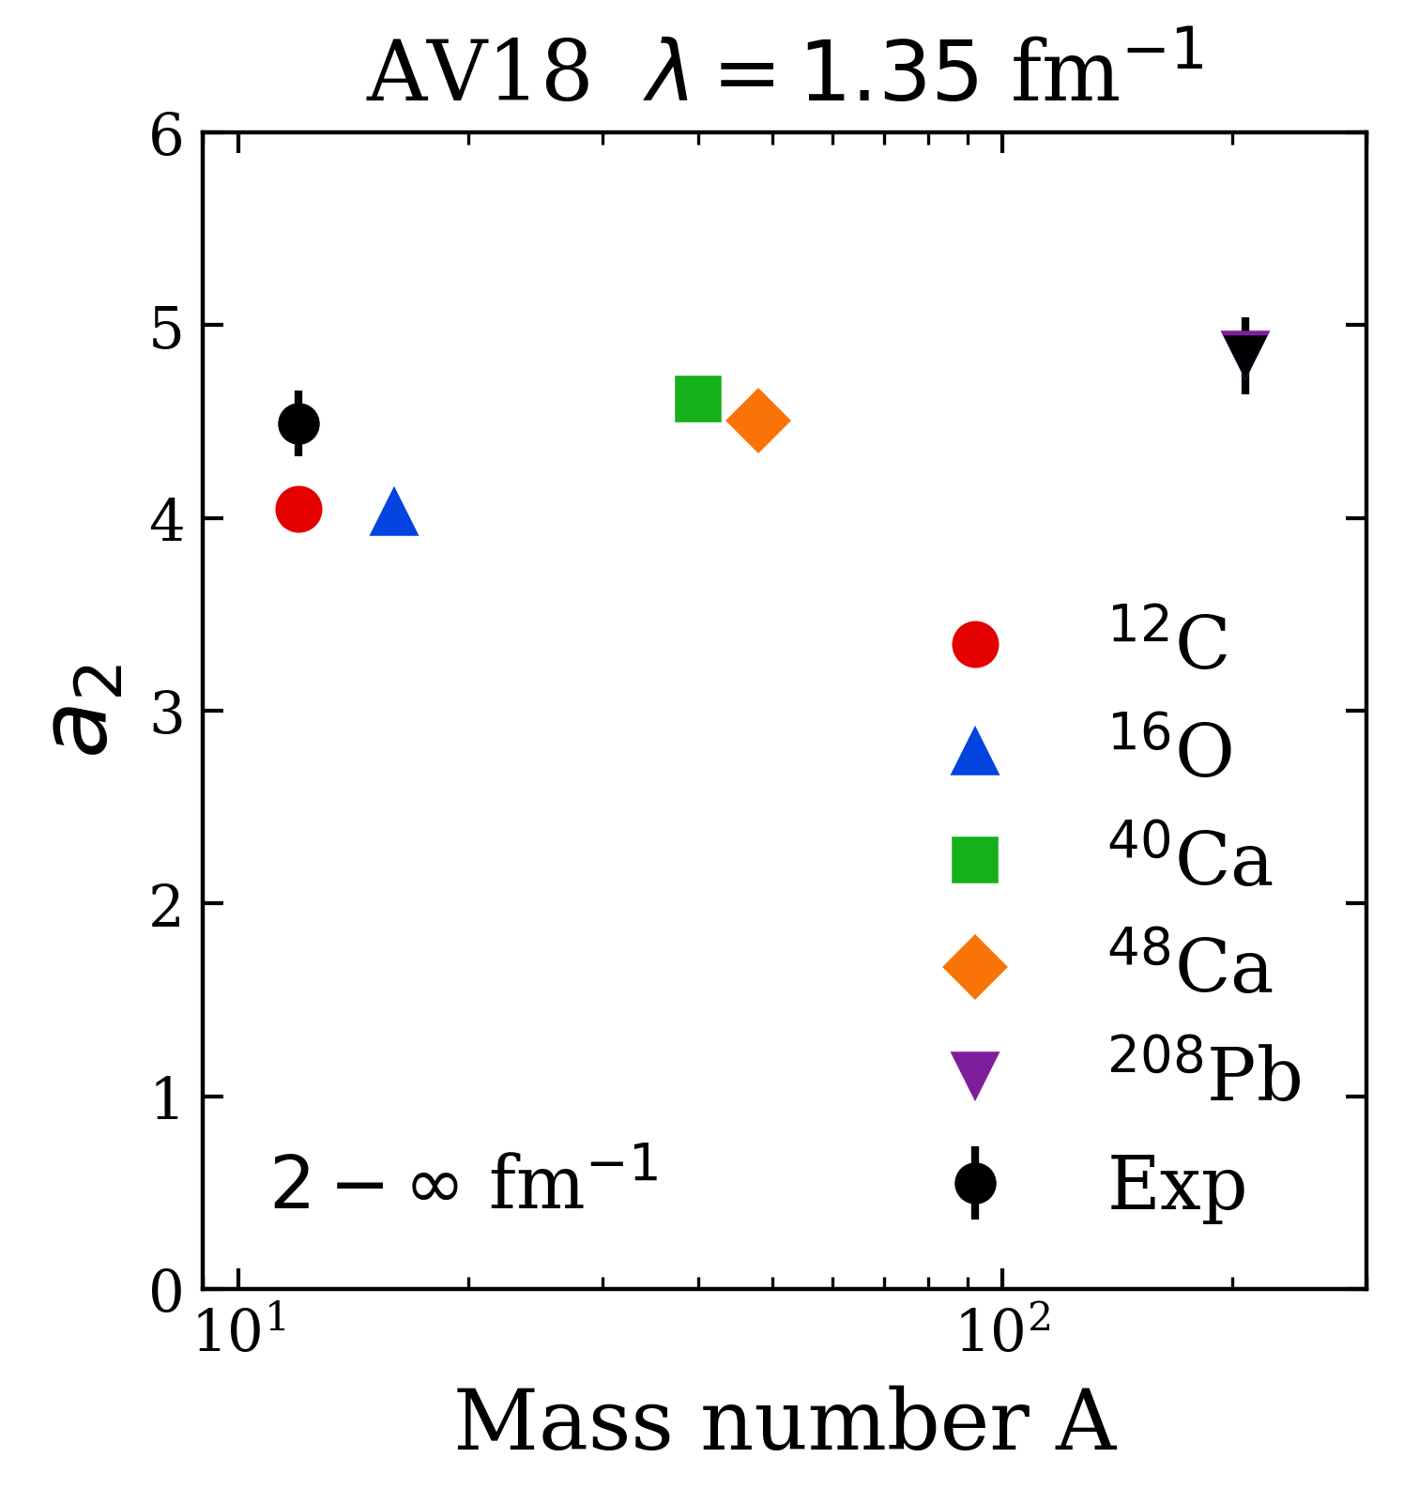
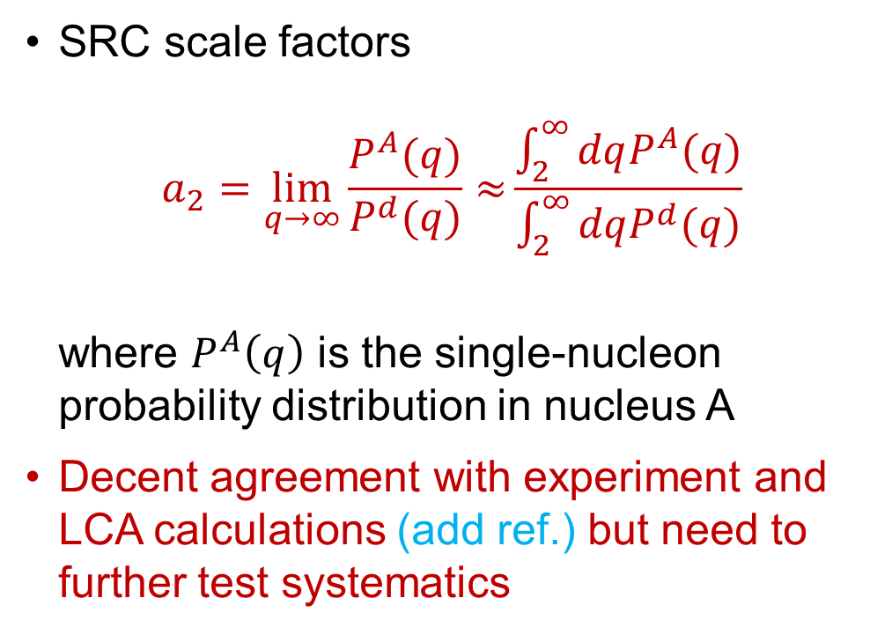
Preliminary LDA results
SRC scale factors
$$a_{2}=\lim_{q→∞}{\frac{P^{A}(q)}{P^{d}(q)}≈}\frac{\int_{2}^{∞}{dqP^{A}(q)}}{\int_{2}^{∞}{dqP^{d}(q)}}$$
where $P^{A}\left(q\right)$ is the single-nucleon probability distribution in nucleus A
Decent agreement with experiment and LCA calculations (add ref.) but need to further test systematics
Notes:
Add in experimental results.

Slide 26
Summary and outlook
Results suggest that we can analyze high-energy nuclear reactions using low RG resolution structure (e.g., shell model) and consistently evolved operators
Matching resolution scale between structure and reactions is crucial!
Ongoing work:
Extend to cross sections and test scale/scheme dependence of extracted properties
Further investigate how final state interactions (FSI’s) and physical interpretations depend on the RG scale
Apply to knock-out reactions (optical potentials) – see Mostofa Hisham’s talk (add time/session)

Slide 27
Extras
Notes:
Factorization figure…

