Slide 1
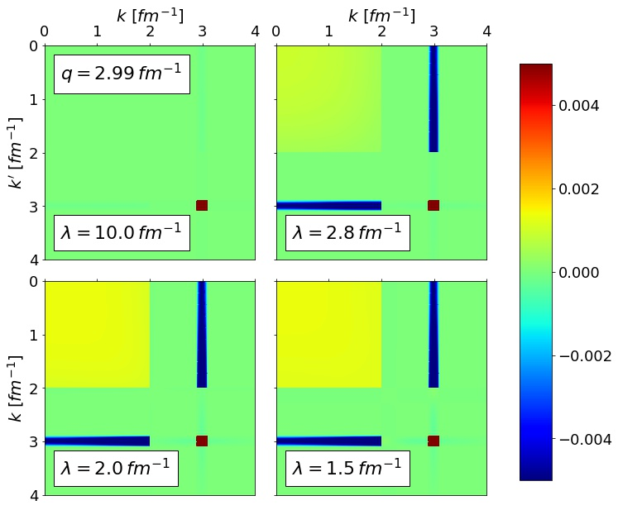
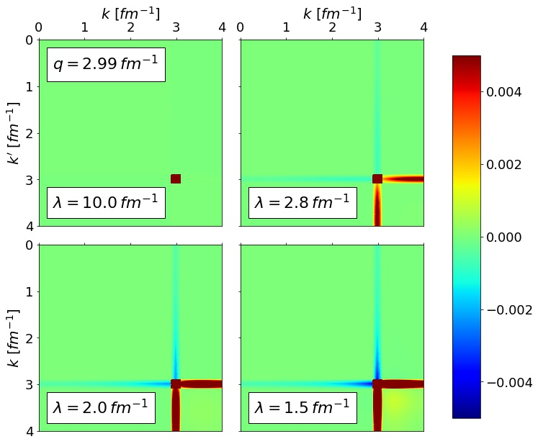
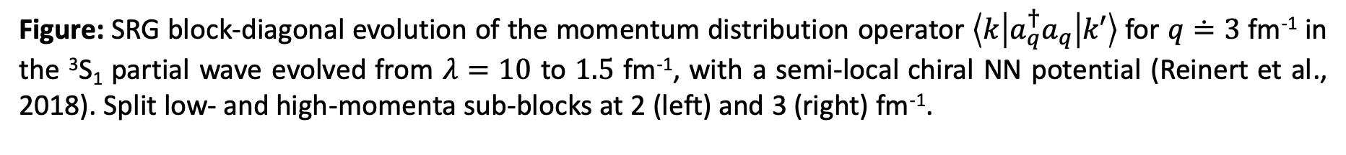
SRG-evolved momentum distributions
Figure: SRG block-diagonal evolution of the momentum distribution operator $\left\langle k | a_{q}^{†}a_{q} | k′\right\rangle$ for $q≐3$ fm⁻¹ in the ³S₁ partial wave evolved from $λ=10$ to $1.5$ fm⁻¹, with a semi-local chiral NN potential (Reinert et al., 2018). Split low- and high-momenta sub-blocks at 2 (left) and 3 (right) fm⁻¹.

Slide 2
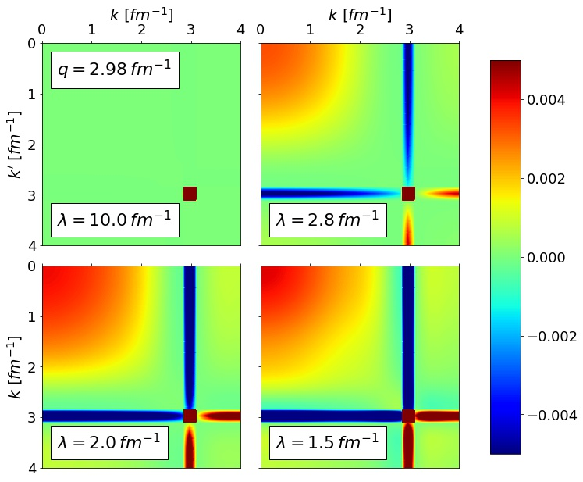
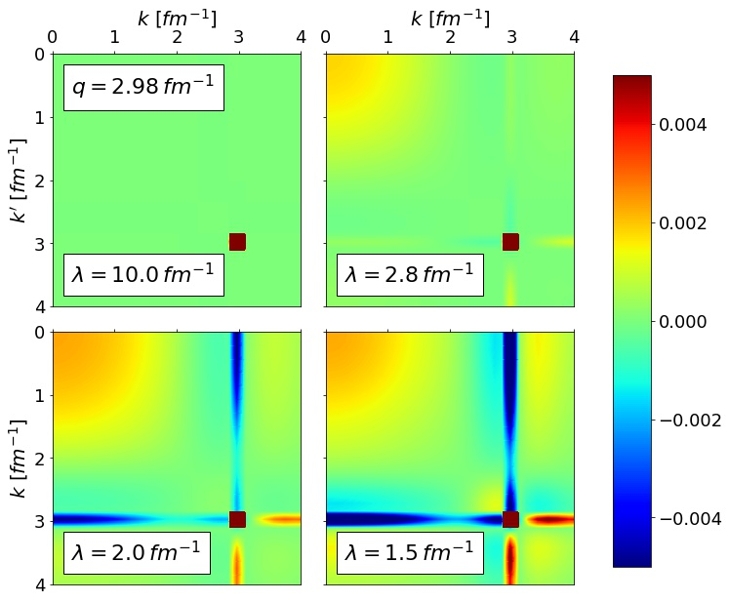
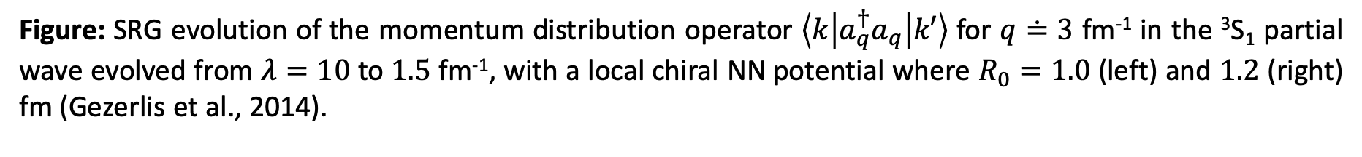
SRG-evolved momentum distributions
Figure: SRG evolution of the momentum distribution operator $\left\langle k | a_{q}^{†}a_{q} | k′\right\rangle$ for $q≐3$ fm⁻¹ in the ³S₁ partial wave evolved from $λ=10$ to $1.5$ fm⁻¹, with a local chiral NN potential where $R_{0}=1.0$ (left) and $1.2$ (right) fm (Gezerlis et al., 2014).

