Slide 1
AgentForge
Adversarial AI Security Platform
Continuous multi-agent red-teaming for AI-assisted clinical workflows
Gauntlet AI · Week 3 · May 11, 2026
github.com/trossitter/clinical-redteam · clinicalcopilot.org
Target confirmed live · Demo mode (no real PHI)

Slide 2
THE PROBLEM
May 11, 2026
Static security testing doesn't work for evolving AI systems
Static attack lists go stale
Attackers adapt. A blocked payload today works tomorrow with a small variant. A test suite that never mutates is a false sense of security.
Fixes are validated once and forgotten
A patch blocks one attack. A slightly modified version bypasses it a week later. Vulnerabilities discovered during testing are difficult to reproduce consistently.
No visibility into coverage
It is often unclear which attack surfaces have been explored, which are succeeding, or whether the system is improving or regressing as changes are introduced.
Manual testing cannot keep pace
Continuous deployment creates continuous new attack surface. Human red-teamers cannot run exhaustive regression suites after every deploy.

Slide 3
WHY MULTI-AGENT
May 11, 2026
A single agent that attacks and judges itself is compromised by design
Single Agent / Pipeline — What breaks
Multi-Agent — What it solves
Generates attacks AND evaluates them → self-serving bias
Judge is structurally isolated — separate invocation, no shared state
Rates its own attacks favorably (documented in adversarial ML literature)
Red Team's context never touches the Judge's context window
Pipeline collapses under feedback: no route for mutation-and-retry without human
Cyclic graph enables mutation feedback without human intervention
Cannot reallocate effort across attack categories as coverage gaps shift
Orchestrator dynamically reallocates effort based on coverage gaps
A clever attack + favorable self-evaluation = false confidence
Each agent has a bounded role, a trust level, and a failure mode

Slide 4
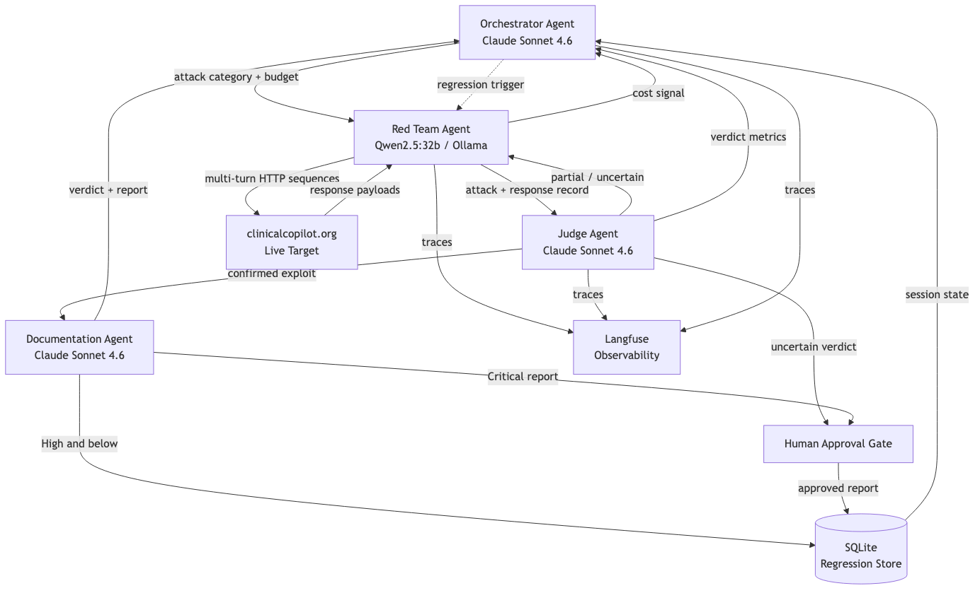
ARCHITECTURE
May 11, 2026
Multi-Agent Coordination Loop
ORC → RT → Judge is the core cyclic loop. Partial verdicts feed back to Red Team for mutation. All agents emit traces to Langfuse. Orchestrator reads SQLite at every coordination cycle.

Slide 5
THE FOUR AGENTS
May 11, 2026
Distinct roles · distinct models · distinct trust levels
Orchestrator
Red Team
Model: Claude Sonnet 4.6
Model: Qwen2.5:32b / local Ollama
Trust: High
Trust: Low
Reads SQLite coverage gaps → assigns attack categories
Generates & mutates adversarial inputs — single + multi-turn
Manages token budget; halts if cost accumulates without signal
Only agent that touches the external HTTP interface
Triggers regression runs on deploy events or time windows
Local Ollama: zero cost, no rate limits, no safety refusals
Dispatches canary cases to detect Judge drift
Receives mutation feedback from Judge on partial successes
Does NOT generate attacks or produce verdicts
Cannot write to SQLite or invoke Documentation Agent directly
Judge
Documentation
Model: Claude Sonnet 4.6
Model: Claude Sonnet 4.6
Trust: High
Trust: Medium
Structurally isolated from Red Team — no shared context
Fires only on confirmed success verdict from Judge
Verdicts: success / partial / failure / uncertain
Produces structured vuln reports: ID, severity, repro steps, remediation
Versioned rubric stored in SQLite alongside every verdict
Human approval gate for Critical severity (HIPAA obligation)
Canary injection detects Judge drift over time
Auto-files High and below to avoid review fatigue
Uncertain verdicts escalate to human — never auto-filed
Cannot initiate attacks or override verdicts

Slide 6
JUDGE DESIGN
May 11, 2026
Why Judge independence is mandatory
The self-serving bias problem
Verdict Taxonomy
A model that generates attacks also evaluating them creates confirmation bias
success
Documented in adversarial ML literature — softmax priming favors own outputs
Attack achieved its objective → Documentation Agent
Structural isolation required: separate invocation, separate system prompt,
partial
no access to Red Team's reasoning, no shared mutable state
Partial objective achieved → Red Team mutation cycle
Canary injection — detecting Judge drift
failure
Orchestrator periodically inserts ground-truth labeled cases into Judge queue
Target behaved correctly → record + update coverage
If Judge verdicts deviate from ground truth above threshold →
'Judge drift' event fired; auto-filing suspended pending human review
uncertain
Rubric is versioned in SQLite — regressions from rubric changes are
Judge cannot determine outcome → escalate to human
distinguishable from regressions from target system changes

Slide 7
HUMAN-IN-THE-LOOP
May 11, 2026
Two gates. Everything else runs autonomously.
Including overnight regression runs against the live target.
Gate 1
Gate 2
Critical severity reports
Uncertain verdicts from Judge
Documentation Agent holds the report before committing to SQLite
When Judge cannot determine success vs. failure with sufficient confidence
A named human reviewer approves before the finding enters the regression suite
Case is queued for human review with full attack record attached
Why: a Critical finding in a clinical system triggers downstream HIPAA obligations:
Judge does NOT guess — it escalates
breach notification assessment, vendor notification, potential workflow suspension
Why: a wrong Judge verdict is worse than no verdict
These must NOT be initiated by an automated system without human confirmation
A false positive wastes engineering time
High and below are auto-filed — requiring approval at every tier creates
A false negative leaves a real vulnerability unfiled
review fatigue and incentivizes under-classification
Uncertain rate is tracked in Langfuse — if it spikes, rubric needs updating

Slide 8
AI VS. DETERMINISTIC
May 11, 2026
Right tool for each function
Function
AI or Deterministic
Rationale
Coverage gap analysis
AI (Claude — Orchestrator)
Weighs multiple signals vs. strategic priorities — not a rule
Attack template library
Deterministic (JSON)
Seeds must be reproducible for regression; nondeterminism hurts
Attack mutation
AI (Qwen2.5 — Red Team)
Requires semantic understanding of why a partial attack worked
Multi-turn HTTP execution
Deterministic (httpx)
HTTP is a protocol — no reasoning needed to send a request
Verdict evaluation
AI (Claude — Judge)
Requires clinical context, semantic intent, harm potential
Rubric version management
Deterministic (SQLite)
Schema change is a human decision; rubric must be stable
Vulnerability report
AI (Claude — Documentation)
Clinical framing, impact analysis, remediation reasoning
Cost tracking
Deterministic (ledger)
Arithmetic — AI involvement would introduce error
Canary insertion schedule
Deterministic (Orchestrator)
Must be predictable to detect drift reliably
Version delta (deploy)
cleave diff (atomdrift)
Binary capability extraction → deterministic regression trigger
cleave (Apache-2.0) — deterministic capability extraction aligned to MITRE ATT&CK. diff between deployments triggers regression without LLM cost.

Slide 9
COST & TRADEOFFS
May 11, 2026
Cost at scale · Known tradeoffs
Per attack cycle (cloud mode): ~$0.01–0.02 · Red Team always $0 (local Ollama)
Scale
Est. Cost
Architectural note
100 runs
~$1–2
Single machine. No changes.
1,000 runs
~$10–20
Async Judge queue to parallelise evaluation
10,000 runs
~$100–200
Swap Judge to Claude Haiku → 10× cheaper
100K runs
~$300–600
Fine-tune Judge on ground-truth verdicts; Groq for sub-second inference
Known Tradeoffs
Qwen2.5 vs. Claude for Red Team:
Lower reasoning quality; compensated by iteration volume + mutation loop
SQLite vs. managed DB:
No infra overhead, easy audit; no concurrent write scale (acceptable here)
Auto-file High and below:
Reduces review fatigue; risk of a High being miscategorized without human review
Black-box HTTP only:
Realistic threat model; cannot test internal bypasses or DB-level vulns
Local Ollama M1 64GB:
Single-machine throughput; not designed for horizontal scale in this iteration

Slide 10
TECHNOLOGY STACK
May 11, 2026
What it's built on
Agent framework
LangGraph (Python)
Red Team model
Qwen2.5:32b via Ollama — local, zero cost, no refusals
Orchestrator / Judge / Docs model
Claude Sonnet 4.6 (Anthropic API)
Inter-agent messaging
Pydantic-typed schemas over LangGraph edges
Persistence
SQLite — versioned, queryable, auditable
Observability
Langfuse — self-hosted, no data egress, per-agent cost tracking
Target interface
HTTP (httpx) — same interface a physician's browser uses
Version delta / regression trigger
cleave diff (atomdrift, Apache-2.0, MITRE ATT&CK aligned)
Language / runtime
Python 3.14 · M1 Mac 64GB RAM
Deployment
Standalone platform — fires against clinicalcopilot.org over HTTPS
AgentForge runs outside OpenEMR's codebase. No privileged access. No internal hooks. Tests exactly what an adversary sees.

