Slide 1
VM Workshop 2023 Securing z/VM and Linux using Tor Hidden Services
Rick Troth, CISSP, BAE Systems
<rmt@casita.net>

Slide 2

Audience: Linux admins, z/VM admins, z/VSE admins, cybersec aficionados, curious workshop attendees
Today’s goal: understand basic Tor concepts, see how to use Tor with z/VM, conclude “we gotta have that!”, use it, tell friends, stay out of trouble (IT dept, NSA)
Tor can’t help you if you don’t use it right.

Slide 3

disclaimer …
The content of this presentation is informational only. The reader or attendee is responsible for his/her own use of the concepts and examples presented herein.
In other words: Your mileage may vary. “It Depends.” Results not typical. Actual mileage will probably be less. Use only as directed. Do not fold, spindle, or mutilate. Not to be taken on an empty stomach. Refrigerate after opening.
Notes:
Some graphics courtesy of istockphoto.com.

Slide 4

special disclaimer …
Many enterprises frown on this, even the presentation. They consider Tor not suitable for corporate use. We will show some examples. The Workshop organizers do not want to give the idea that they sanction using something as fringe as Tor.
Notes:
When I gave a similar talk at for Cedarville University’s cybersec students, I warned them to not get sideways with the school’s IT department. Same goes here.

Slide 6








about:rick
Unix for 35+ years, Linux since 0.99
VM/SP (et al) since 1981, VMware, Xen, KVM
Passionate about open-source systems
Previous jobs: SSL stack, z/VM, Unix/Linux
Data security: Voltage 2015-2022, now at BAE
Notes:
“It’s all about trust” is one of my slogans.
Trust is a recurring theme: trust is one reason for using open source.
But even with source code, consider Thompson 1984.
https://www.cs.cmu.edu/~rdriley/487/papers/Thompson_1984_ReflectionsonTrustingTrust.pdf

Slide 7

Notes:
BAE Systems: no cool logo, just cool stuff

Slide 8

Tunneling into Tor
What exactly is Tor?
Some History, a little How-To, and stories
Tor client proxy, tor “server”, and hidden services
What can Tor do for z/VM?
Look outside the box (or maybe “think outside the box”)
Leverage Tor “Hidden Services” (HS) for z/VM TCP/IP
Notes:
HS = hidden service throughout this presentation
We will not specifically cover *building* Tor from source, but slides discussing that are at the end of the presentation deck.
We will not discuss Tor startup (INIT or SystemD), but sample files are available at the web site.

Slide 10


about:tor
The Onion Router
http://www.torproject.org/
Originally a US Navy project, first release 2002-September-20
Other sponsors (e.g., EFF), now 501(c)(3)
“making the web safe for whistleblowers”
Notes:
Tor provides two functions: encryption and routing.
Tor is essentially a distributed VPN.
1995: David Goldschlag, Mike Reed, Paul Syverson, at U.S. Naval Research Lab (NRL) ... a way to create internet connections that don't reveal who is talking to whom ... protect Navy operatives … the first research designs and prototypes of onion routing.
Early 2000s, Roger Dingledine ... NRL onion routing project with Syverson. Roger called it Tor, which stood for The Onion Routing.
Nick Mathewson joined soon after.

Slide 11

about:tor
News Flash …
July 2016 the whole Tor Project board resigned
New board members: Matt Blaze, Cindy Cohn, Gabriella Coleman, Linus Nordberg, Megan Price, and Bruce Schneier
So what’s up with that??
Can we trust the new board??
Notes:
It’s all about trust, folks.
Interestingly, we are at the ten-year mark after Snowden met with Greenwald, MacAskill, Poitras. Is it related that the Tor board swizzle happened *after* the Snowden thing?

Slide 12
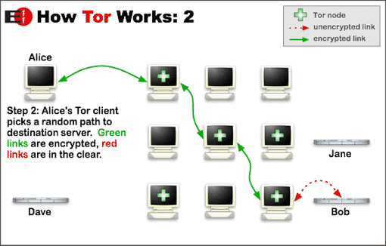
about:tor
Exit node
Your Tor
Notes:
The entry point is local.
Your local ‘tor’ program connects with the fabric and provides a SOCKS proxy into that.
The last part, after the “exit node” is visible to others. That part of your surfing can be profiled. But the exit node will vary, is used by others, and does not map back to you.

Slide 13
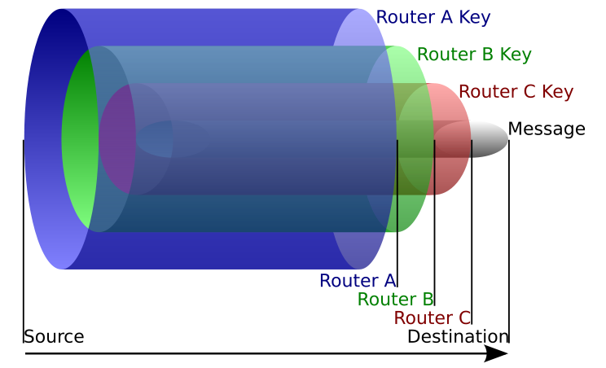
about:tor
onion routing
Notes:
“Layers … ogres have layers.”

Slide 15
Using Tor
“But Rick, how do we use it?”
Just run it
Don't run it as root
Use an RC file, perhaps /etc/tor/torrc else “not present, using reasonable defaults”
State directory $HOME/.tor will be created
Point at it as a SOCKS proxy
Notes:
I use /etc/tor. It holds more than just the RC file.
I run ‘tor’ under a service account. That ID owns the “state” content.
Note: this mode of operation does not make you a target
The daemon can be started manually, via traditional Unix ‘init’ or via SystemD, or run as a co-process (e.g., to support the Tor Browser)

Slide 16

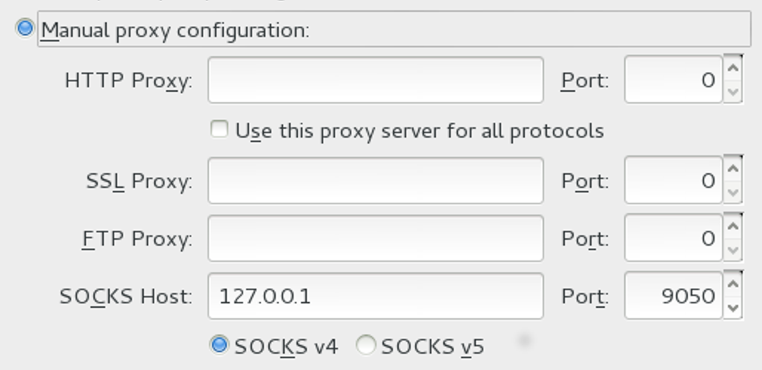
Using Tor – SOCKS4a proxy
Notes:
Uses “socks4” at local TCP port 9050.

Slide 17
Using Tor – avoid DNS leakage
Force hostname resolution through the proxy
See Firefox about:config panel
Notes:
Make sure that DNS requests are handled by Tor. Running DNS through the proxy is not always the default, so you have to check it manually.

Slide 18


Using Tor – OpenSSH and Netcat
ssh -o \
ProxyCommand=\
'netcat -x 127.0.0.1:9050 %h %p' \
xxxxxxxx.onion
Probably obvious, but it’s not all about web surfing.
Notes:
Important: Tor is not limited to web pages. ANY TCP traffic can be relayed through Tor.
OpenSSH does not have built-in proxy support, but ‘netcat’ does and SSH can punt to ‘netcat’.
This extends to Linux "console server" too.

Slide 19

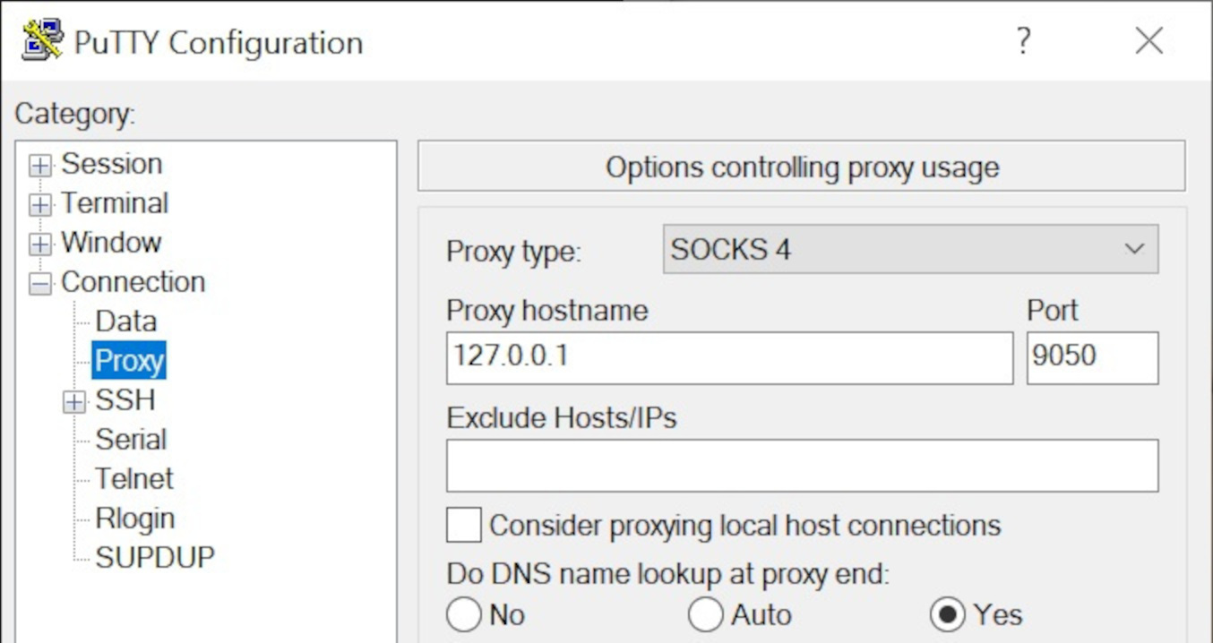
Using Tor – PuTTY
Notes:
Again, force DNS through the proxy.

Slide 20
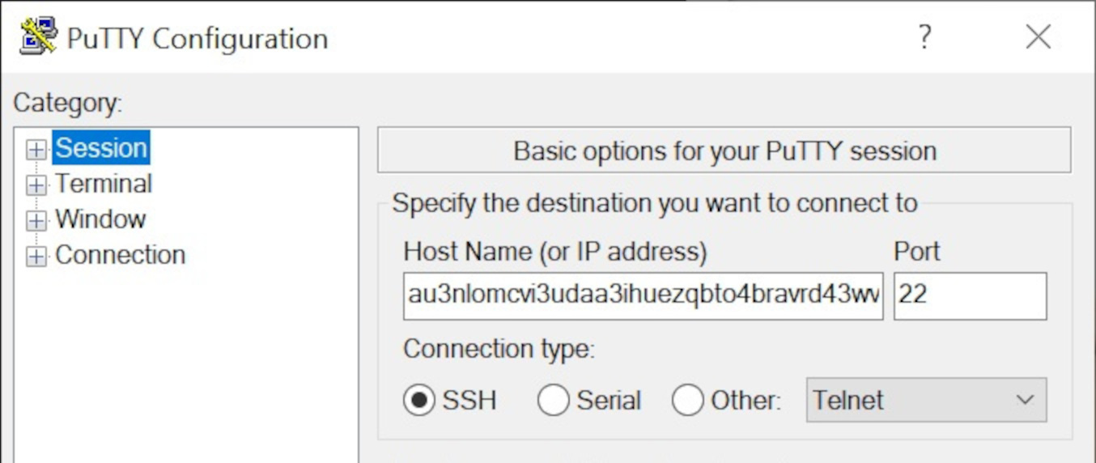
Using Tor – PuTTY
Notes:
The filled-in hostname is a “.onion” hostname.
More on that in following slides.

Slide 21

Using Tor – X3270
x3270 \
-proxy socks4:127.0.0.1:9050 \
xxxxxxxx.onion
Notes:
X3270 has built-in proxy support. Yay!

Slide 23
What’s with the “dot onion”?
Introducing … hidden services [the crowd cheers]
Traffic past an “exit node” is visible outside
Traffic handled by a “hidden service” is not visible
Hidden services are known by “.onion” hostnames
Notes:
Hidden services are thus named because they are not visible (indeed, not even reachable) from the public internet.

Slide 24
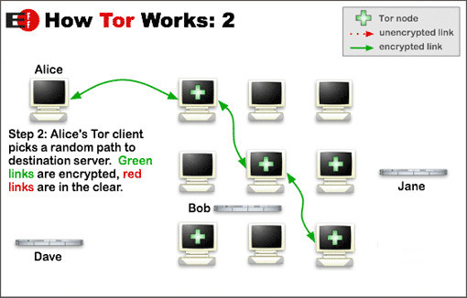
Where’s Bob?
Your Tor
Notes:
No red links here! (Nothing outside Tor network.)
Bob is not accessed via an exit node.
Bob is hiding somewhere in the fabric.
There’s a private key (automatically generated) and a .onion hostname (derived from the key), but Bob’s location is unknown.
Whoever maintains Bob can relocate him (the key and related state files) to another physical host should the need arise.
https://2019.www.torproject.org/docs/onion-services

Slide 25

Does It Work?
Yup, some say so.
“Not Even the NSA Can Crack
the State Dept's Favorite Anonymous Network”
[Wikipedia, Foreign Policy, “The Cable”, wayback]
Notes:
I got this from footnotes in the Wikipedia page about Tor.
How is it that people trust SELinux from the NSA and yet they don't trust Tor from the US Navy?

Slide 26

Isn’t It Illegal?
Not at all, though it does get bad press.
In its filing against Ross William Ulbricht (Dread Pirate Roberts) of Silk Road, the FBI acknowledged that Tor has “known legitimate uses”.
[Wikipedia, UC Berkeley, wayback]
Notes:
I got this from footnotes in the Wikipedia page about Tor.
Tor is attacked by good guys to stop the bad guys.
Tor is attacked by bad guys to stop the good guys.
Tor itself is just a tool.
Tor is also a potential threat to people and organizations which need (or just want) ultimate control over end-user networking.

Slide 28
Using Tor with z/VM
“But Rick, what’s this got to do with VM?”
nuthin!
Except VM (and VSE, MVS, TPF) is in the same DC
Use “remote” (w/r/t the Tor host) hidden services
Use it where PKI won’t suffice; no conflict with PKI
No changes needed to VM (nor VSE, TPF, MVS)
Notes:
VM is a near neighbor (same DC) to the Linux Tor host
Define hidden services from Linux directed at VM
You can define HS to *any* near neighbors, thus VSE, MVS, TPF, other Linux, … anything
No changes needed to CP, CMS, MVS, TSO, etc.
There is no conflict between PKI (SSL/TLS) and Tor. You can run Tor without losing SSL service. The trust models between the two are the biggest operational difference. Tor is also stronger w/r/t privacy. (HS are very very very difficult to trace and re-identify.)

Slide 29

Using Tor with z/VM
z/VM
port 22
port 23
port 80
Linux
z/VSE
Define a hidden service, some ports local, others remote
z/OS
Notes:
This slide shows arbitrary TCP port choices.
You can assign an incoming Tor HS port to any address:port pair you need.

Slide 30
Using Tor with all Z
z/VM
port 22
port 23
port 80
Linux
z/VSE
HS2 port 23
Define a hidden service, some ports local, others remote
Define a second hidden service, same box
Define a third hidden service, same box
HS3 port 23
z/OS
HS3 port 50000
Notes:
You can define any number of Tor hidden services.
Consider one for VM and Linux, another for VSE, another for MVS (here with DB2).

Slide 32

Getting Tor
Get the source and compile it
https://www.torproject.org/dist/tor-0.4.7.13.tar.gz
https://www.torproject.org/dist/tor-0.4.7.13.tar.gz.asc
Get it from your software package repository
SUSE, Debian, RedHat and derivatives, BSD
Notes:
More details on compiling Tor yourself at end of this presentation.

Slide 33
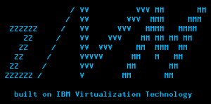
Example RC file for Tor
Nickname myzvmsystem
ContactInfo zVM Master <maint AT vm dot dom>
…
Notes:
When supporting z/VM, Tor would actually run on a Linux guest.

Slide 34
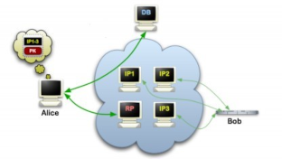
Example RC file with Hidden Service
…
HiddenServiceDir /var/tor/hidden_service/
HiddenServicePort 22 192.168.29.111:22
HiddenServicePort 23 192.168.29.222:23
HiddenServicePort 80 192.168.29.222:80
Notes:
Here we define a hidden service.
A key pair will be generated by Tor, if such does not exist already. A .onion hostname will be derived. The files will be placed into the indicated directory.
There can be any number of hidden services (HS) defined, a separate directory for each.
The address side of the address:port pair can be any reachable address, not just the local host (where Tor is running).

Slide 35
Demo Time

Slide 36
.onion addresses (.onion hostnames)
The long and the short of it …
Originally: 2hiyjpes6xu5ds7l.onion
Currently: au3nlomcvi3udaa3 ihuezqbto4bravrd 43wvehyhq24ricqk kwy2csyd.onion
Notes:
Hidden service addresses originally had 16 characters to the left of “.onion”.
Current hidden service addresses have 56 characters to the left of “.onion”. This is presumably to make them more secure.
These are actually “v2” and “v3”, so there was presumably a “v1” back in the day, before my time.
These hostnames, and their counterpart keys, are derived by Tor when the given hidden service is first instantiated.

Slide 37




Popular .onion Sites
Protonmail
Keybase
Debian
DuckDuckGo
Facebook
If the site also has a public address, does it need HS?
Notes:
For Debian, install the “apt-transport-tor” package.
A list of long .onion hostnames is in a file alongside the download of this presentation.
Q: Why use a hidden service if the site itself is public?
A: Hides that “last hop” from tracking. It doesn’t help hide the site, but may help the users.
https://en.wikipedia.org/wiki/List_of_Tor_onion_services

Slide 39

The Pain of Certificate Management
Generate a private key
Generate a certificate request
Submit the request
… wait …
Install the certificate, install intermediates?
Next year, do it all over again
Notes:
Tor is not better than PKI, but for some things it is easier. Tor has the objective advantage of obscuring traffic patters (visible when using plain SSL/TLS).

Slide 40
The Pain of Certificate Management
Which CA to use?
In-house CA needed?
Costs of certificates justified?
There is no Easy Button
SSH, PGP, Tor, different trust models each with their own issues
Notes:
GitHub.com changed their SSH server key.
I heard about it on IBM-MAIN or would have been caught quite by surprise and likely panicked.
That was not a PKI matter, but illustrates the general issue of certificate management.

Slide 41
The Pain of Certificate Management
Comparing Tor with PKI
No CA to trust (but must trust the Tor network)
No certificate to manage (hidden service key is automatic)
Full anonymization (connections are not easily tracked)
Notes:
There must always be a trust anchor.
Hidden service “certs” (keys) are created automatically.
Unlike SSL/TLS, the traffic (connections) is hidden too.
For some things, Tor is easier than TLS/SSL PKI.
In some ways, it’s just different.
With respect to traffic analysis, it’s better.

Slide 42
The Pain of Certificate Management
One of the inherent problems of standard HTTPS is that trust put in a website is defined by certificate authorities: a hierarchical and closed set of companies and governmental institutions approved by your web browser vendor. This model of trust has long been criticized and proven … to be vulnerable to attacks …
Notes:
Who ya gonna trust?

Slide 43
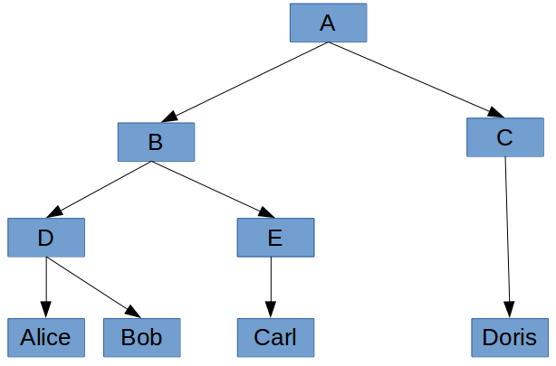
Trust Models
Root CA
Intermediate CA
Issuing CA
Issuing CA
Notes:
This is the PKI model.

Slide 44
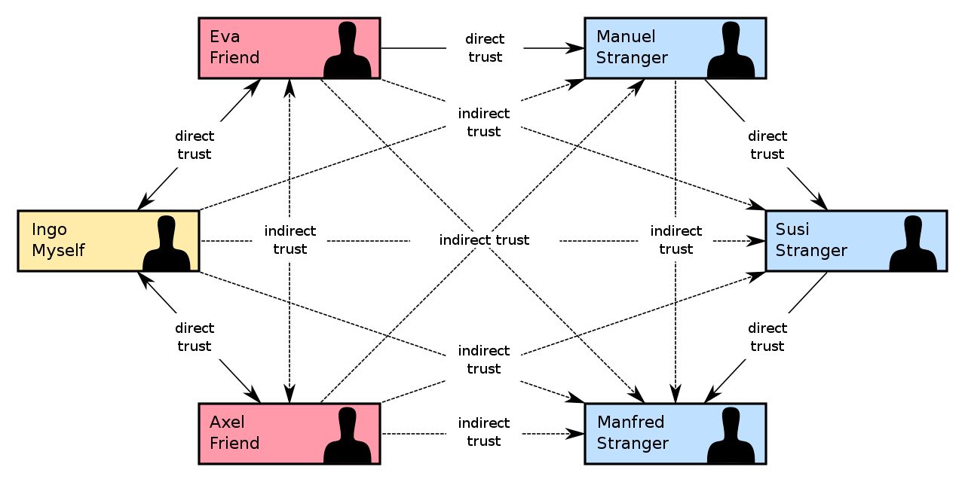
Trust Models
Notes:
This is the PGP model.

Slide 46

Exit Node Extras
Three kinds of Tor nodes
Exit Node (or “exit relay”, seen above)
Relay Node (“guard” or “middle”, generally safe from worry)
Bridge Node (unpublished exit)
Notes:
Relay nodes, or “normal” nodes, are not directly visible as Tor network participants.
Exit nodes are visible as clients to those sites which Tor users want to access anonymously. They are also listed publicly.
Bridge nodes are similar but unlisted.

Slide 47
Exit Node Extras
To run an exit node, in your “torrc” file:
ORPort 9001
DirPort 9030
2020, doing research for a Tor talk, I left an exit node running … at home
Notes:
Running the exit node was intentional.
LEAVING it up was not.

Slide 48

Exit Node Extras
Home residential IP address suddenly blocked by …
Key Bank,
Capital One credit card issuer,
Verizon Wireless cellular provider,
Norwegian Cruise Line,
Zoom conferencing
Notes:
But none of them told me why!
Mostly stuff “just didn’t work”.
We protect the wrong things.
Sad that running an exit node might put a target on your back.

Slide 49
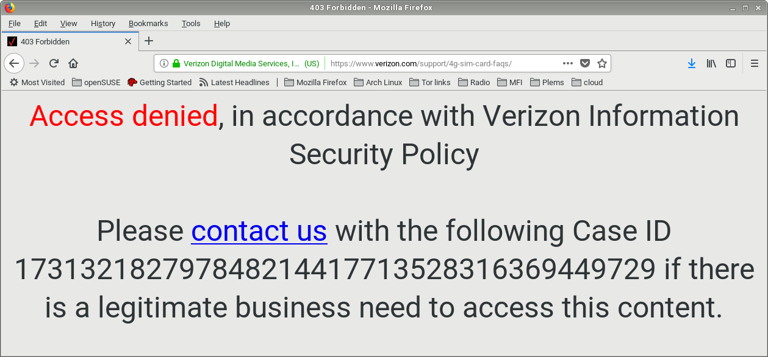
Exit Node Extras
Notes:
Verizon at least gave a clue to the problem.
I was then able to contact them and get more info.

Slide 50
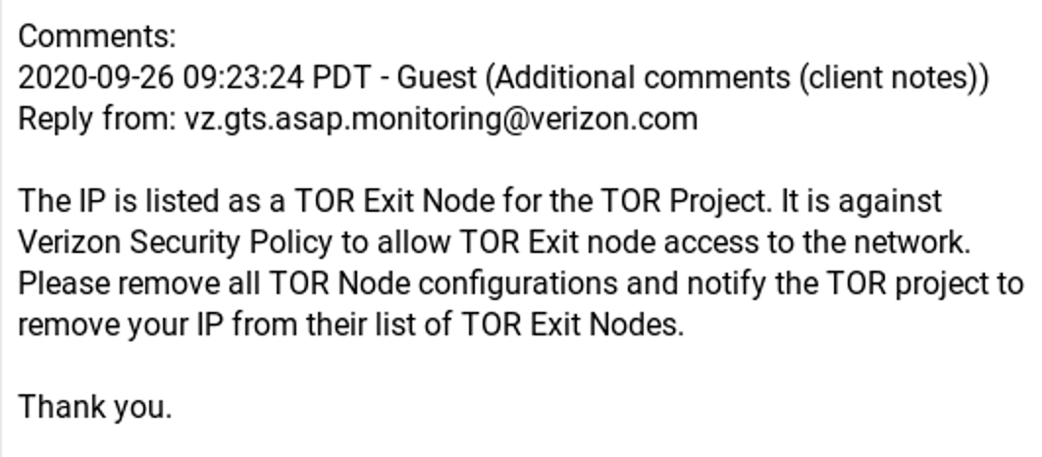
Exit Node Extras
Notes:
Again … NOT an issue for ordinary relay nodes, so not a risk for hidden service hosting.
You don’t have to worry about this kind of block just for running a Tor hidden service.

Slide 51

Exit Node Extras
Further response …
“Although some users of the TOR project are using it for good intentions and so forth,
it is also a place where nefarious users can also perform anonymous malicious attacks
and attempt fraudulent activities. Thus, Verizon deems the project's network as risky
and restricts communications from their TOR Exit Nodes. As a security specialist,
we hope you can understand this position. We apologize for the inconvenience.
However, it is for the security of all our Verizon clients.”
Notes:
I asked Verizon to comment for the cybersec presentation, but crickets.

Slide 52
“this slide intentionally left blank”

Slide 53
Conclusion … maybe you should use Tor
Tor is a tool providing anonymity (privacy)
Tor Hidden Services provide strong end-to-end encryption
do not interfere with other security protocols (e.g., TLS)
do not require changes to VM or sibling systems
Tor is easy to run and configure and relatively easy to use

Slide 54
Thank you!
http://www.casita.net/vmworkshop/2023/torforzvm.ppt
http://www.casita.net/vmworkshop/2023/torforzvm/

Slide 55
Thank you!
Or when you’re “on” Tor …
[]=au3nlomcvi3udaa3ihuezqbto4bravrd43wvehyhq24ricqkkwy2csyd.onion
http://[]/vmworkshop/2023/torforzvm.ppt
http://[]/vmworkshop/2023/torforzvm/
Notes:
Put that 62-character address in place of the square brackets. Works if you’re “on” Tor.

Slide 57
Building Tor from Source
“If you’re not using the source code, then ‘open source’ might not really be part of your supply chain.”
package-version.tar.zz
package-version.tar.zz.asc (or .sig, .sign)
https://www.torproject.org/dist/tor-0.4.7.13.tar.gz

Slide 58

Getting and Vetting the Source
gpg --verify package-version.tar.zz.asc
Extract the key ID (check the sig, it will fail)
Find that key in the Web-of-Trust
Walk the trust chain; if trusted then add key
Check the signature again (for real)

Slide 59
Getting and Vetting the Source
Get files, extract key, find in WOT, follow the chain
Do you trust it? If so then add key and re-check src sig
Signing key: 0x42e86a2a11f48d36
https://the.earth.li/~noodles/pathfind.html
Tor project sometimes signs a hash and not the tarball.

Slide 60
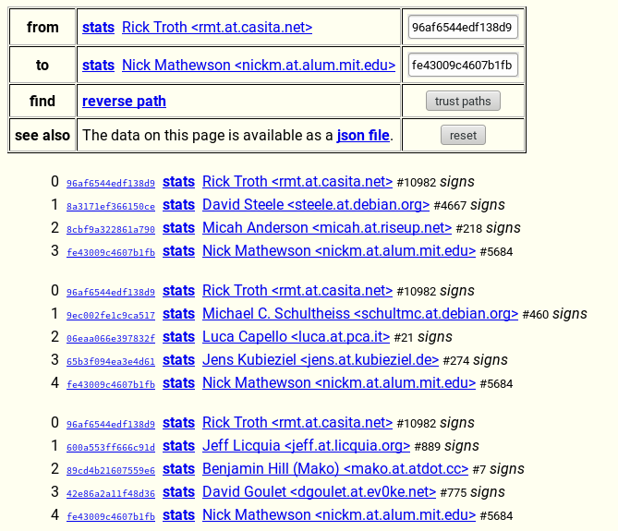
Getting and Vetting the Source
Multiple “paths” between the keys provide more assurance.

Slide 61


Explode, Config, “just make”
tar xzf tor-0.4.7.13.tar.gz (then ‘cd’)
./configure optional --prefix=
make
make install
make clean or make distclean
(or use Chicory)

